Slide 1
CMNS 210: Media history
Searching for primary sources
(news, popular press)
Sylvia Roberts sroberts@sfu.ca

Slide 2
Assignment outcome
You will choose one historical newspaper or magazine article (published before 1996) about a communication technology that was new at the time of the article’s publication.
You will write a 1,000-word paper (must be 950-1050 words, firm) that summarizes and critiques how that one article portrays the relationship between that new technology and society.

Slide 3
Workshop outcomes
Increased awareness of databases that provide full text access to articles in historical newspapers and popular magazines
Be able to identify suitable databases by scope (content, date coverage, geography)
Learn effective full-text search techniques
Learn how to find the full text of an article when not available online

Slide 4
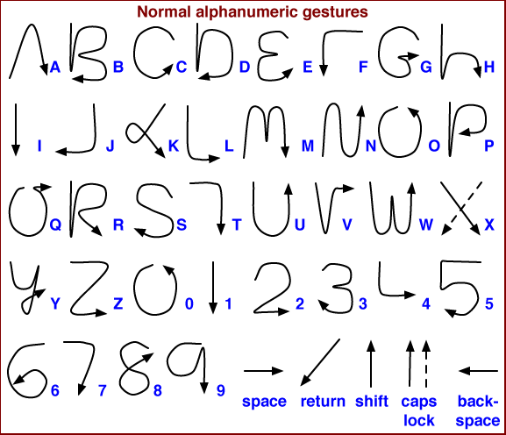
Palm Pilot

Slide 5
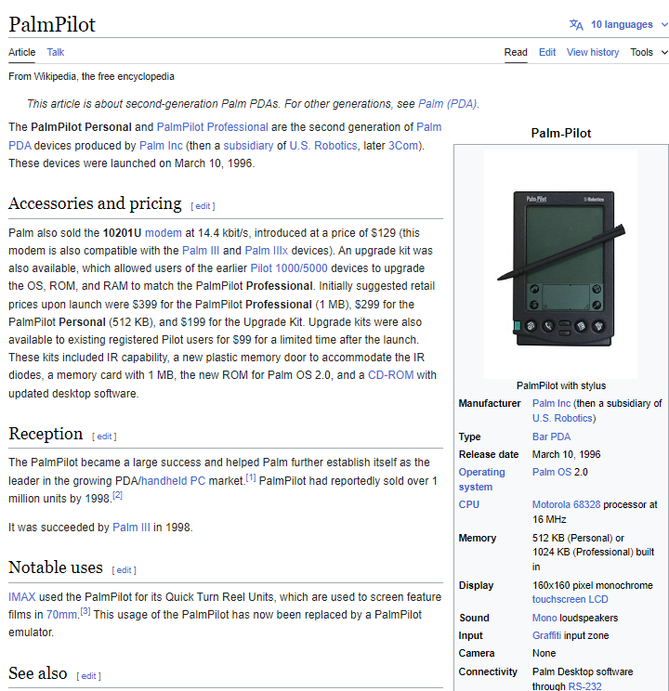
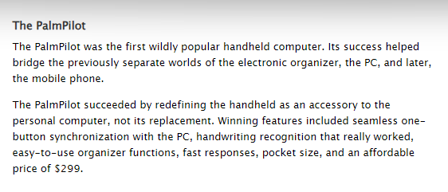
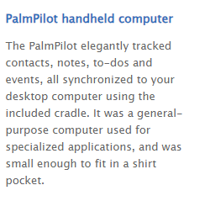
<https://www.computerhistory.org/revolution/mobile-computing/18/321>

Slide 6
<https://www.computerhistory.org/revolution/mobile-computing/18/321>

Slide 7
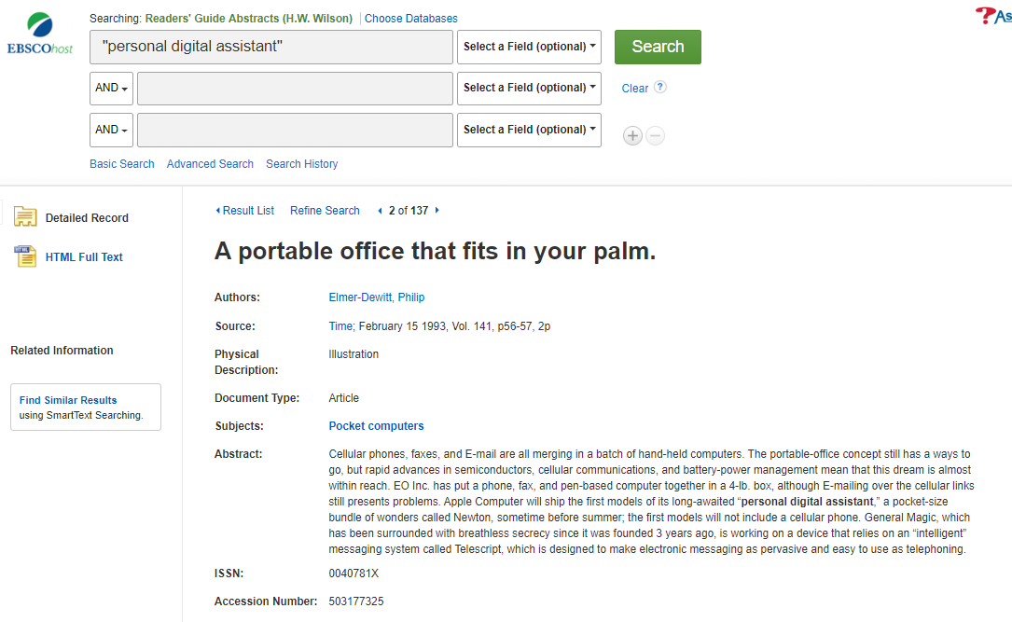
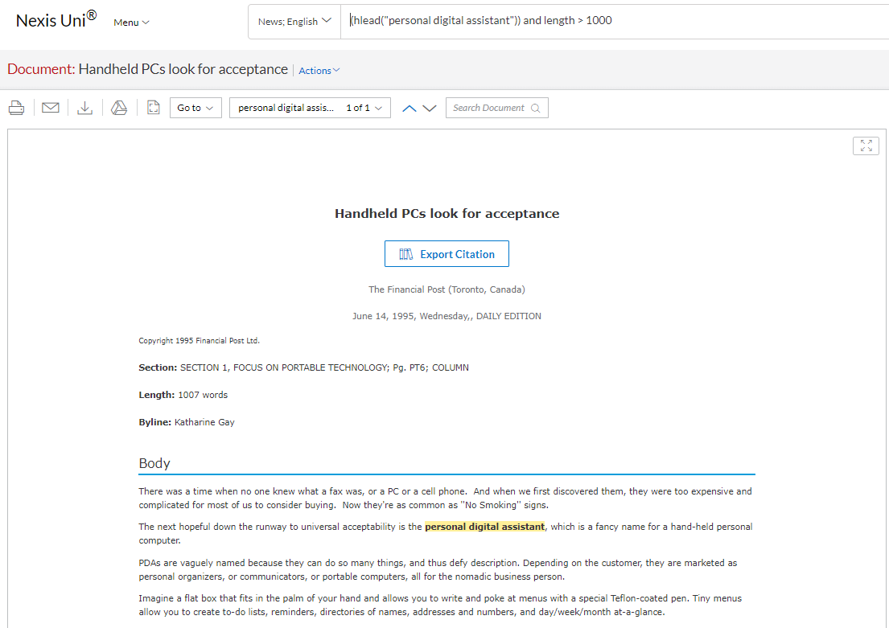
Index databases versus Full text searching
Notes:
Semantic search denotes search with meaning, as distinguished from lexical search where the search engine looks for literal matches of the query words or variants of them, without understanding the overall meaning of the query.^{[1]} Semantic search seeks to improve search accuracy by understanding the searcher's intent and the contextual meaning of terms as they appear in the searchable dataspace, whether on the Web or within a closed system, to generate more relevant results. Semantic search systems consider various points including context of search, location, intent, variation of words, synonyms, generalized and specialized queries, concept matching and natural language queries to provide relevant search results.

Slide 8
Full text news database records are structured like newspaper articles. The fields are labelled accordingly:
“author” is byline
“title” is headline
“lead” is first paragraph

Slide 9
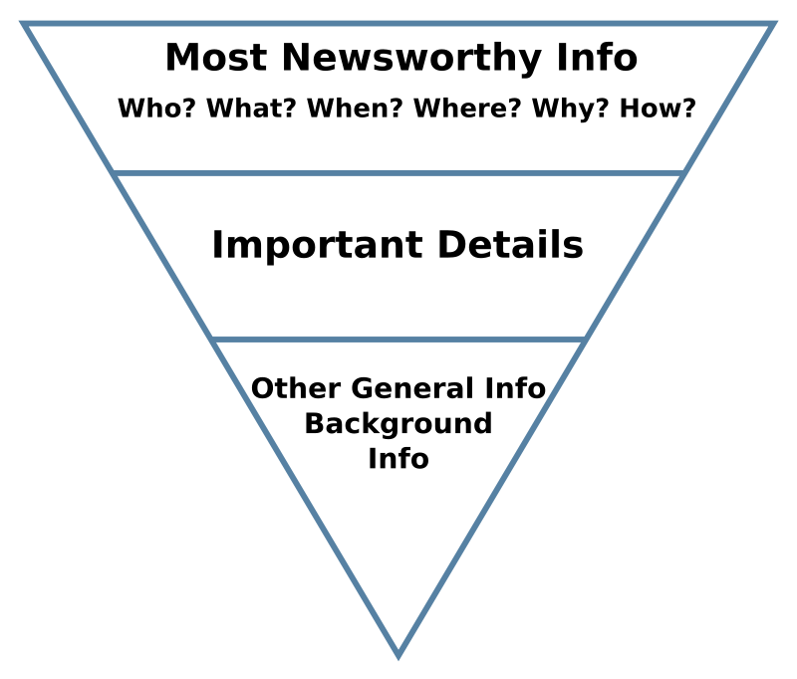
The inverted pyramid is a metaphor used by journalists to illustrate how information should be prioritized and structured in prose (e.g. a news report).
Searching for your terms in the headline and lead paragraph helps you find news stories that focus on your topic.

Slide 10
Notes:
Additional fields enhance searching by adding information about companies or subjects that are the focus of the article

Slide 11
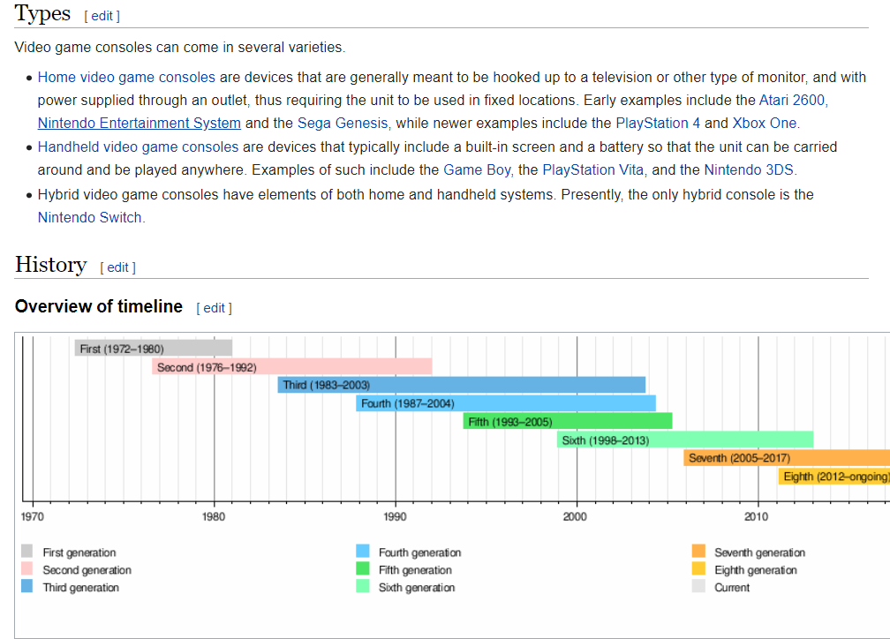
PREPARING TO SEARCH
SCOPE OF DATABASE:
Date range covered
New? Popular? Change in use?
Geography
Uptake / availability of technology may vary
Nature of publications
Newspapers Popular magazines (lifestyle, sport, technology)
SEARCH TERMS:
Generic variations
radio OR wireless
Brand names
Terminology may change over time or geography
mobile OR cell
Wikipedia contributors. (2020, February 9). Video game console. In Wikipedia, The Free Encyclopedia. Retrieved February 10, 2020, from https://en.wikipedia.org/w/index.php?title=Video_game_console&oldid=939970186

Slide 12
Search options for full text news sources
Natural language
Term & connectors
Boolean (and, or, not)
Proximity (same, w/5)
Wildcards (! *, ?)
Limiters
By source
By date
Words within specific fields / segments
Headline
Headline & lead paragraph
Byline
Section (editorial, opinion)
Filter after searching

Slide 16
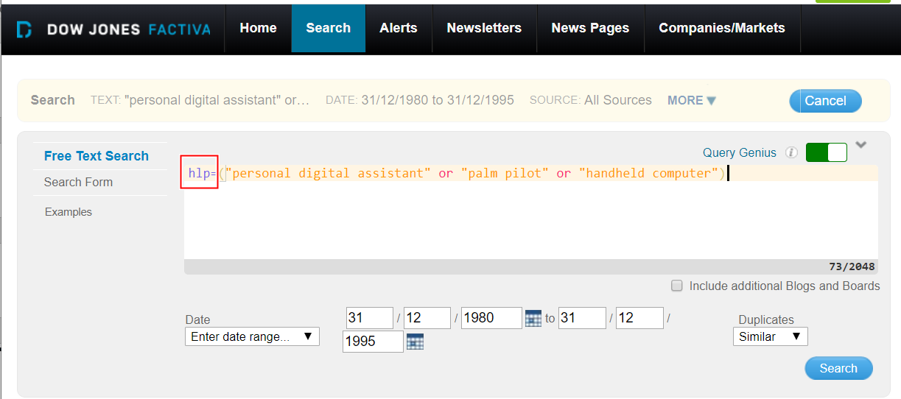
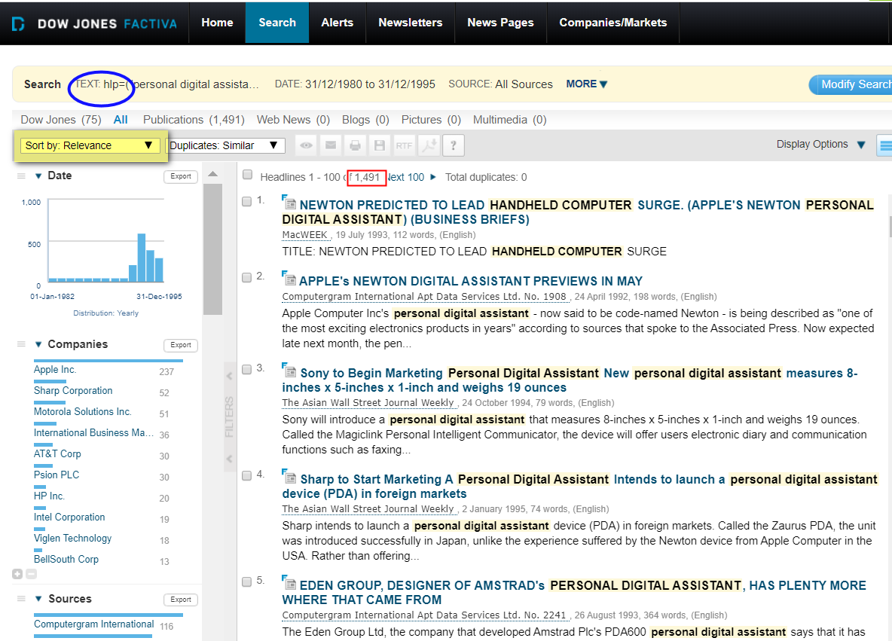
Factiva database

Slide 17
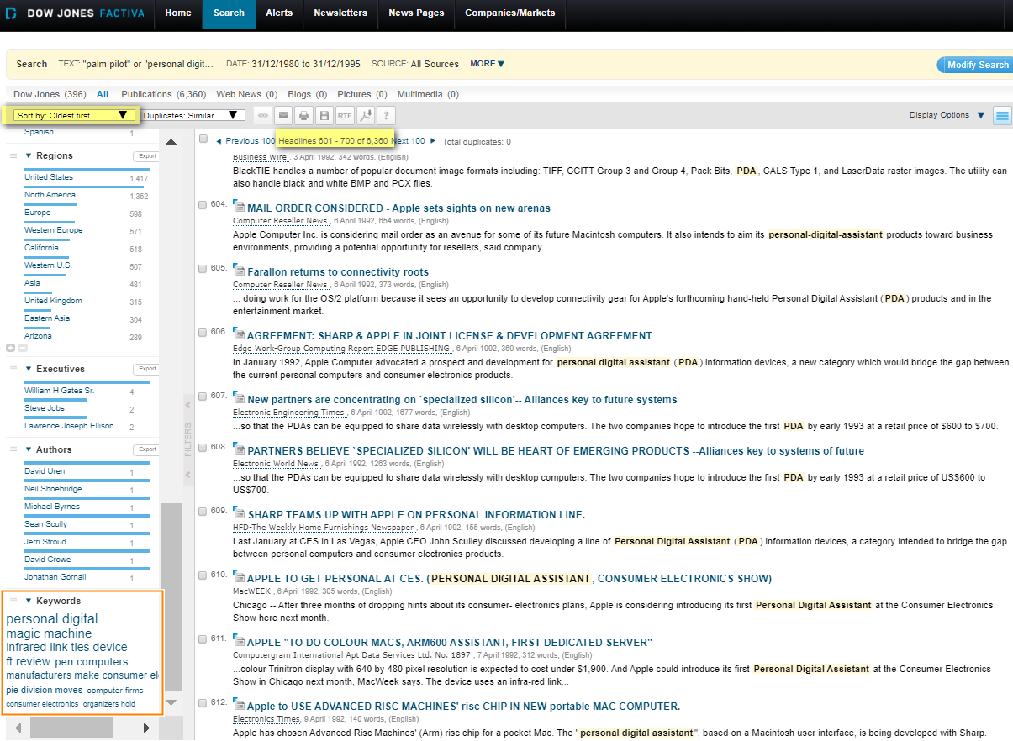
New search terms:
“hand-held computer”
“pen computer”

Slide 18
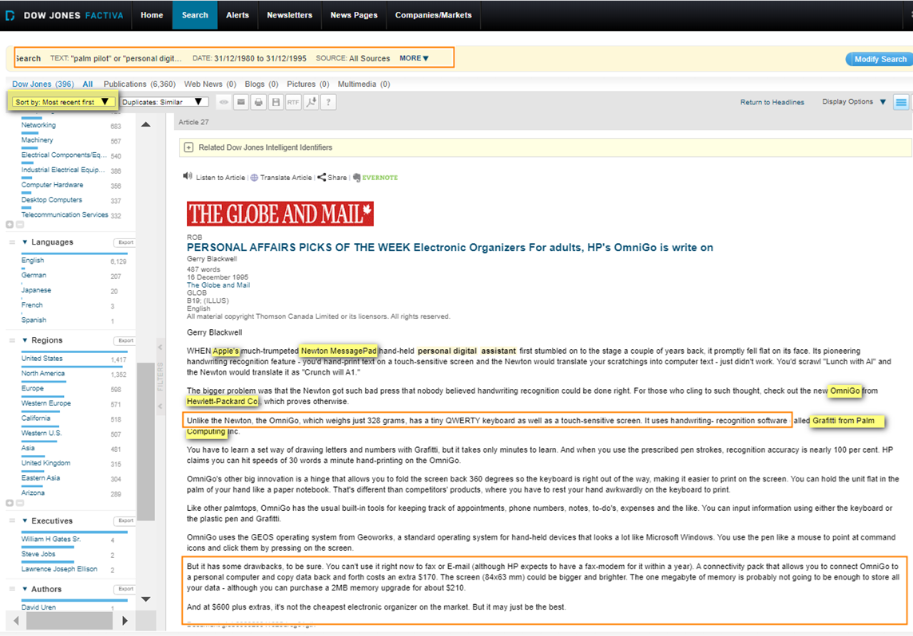
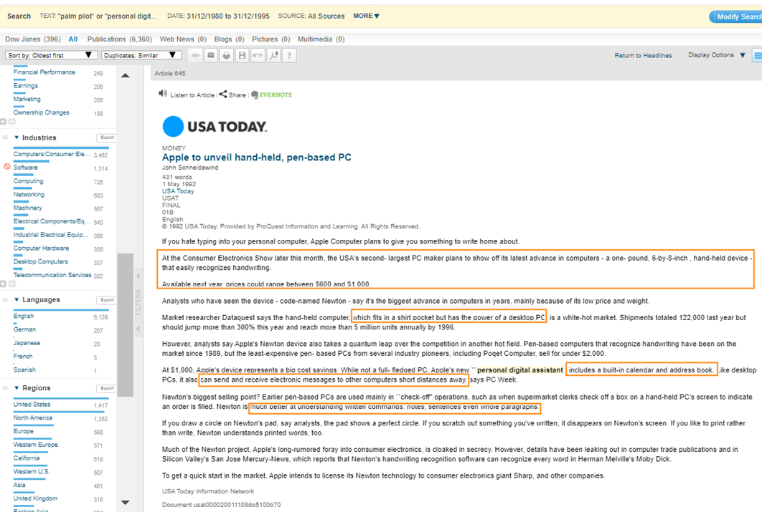

Slide 19
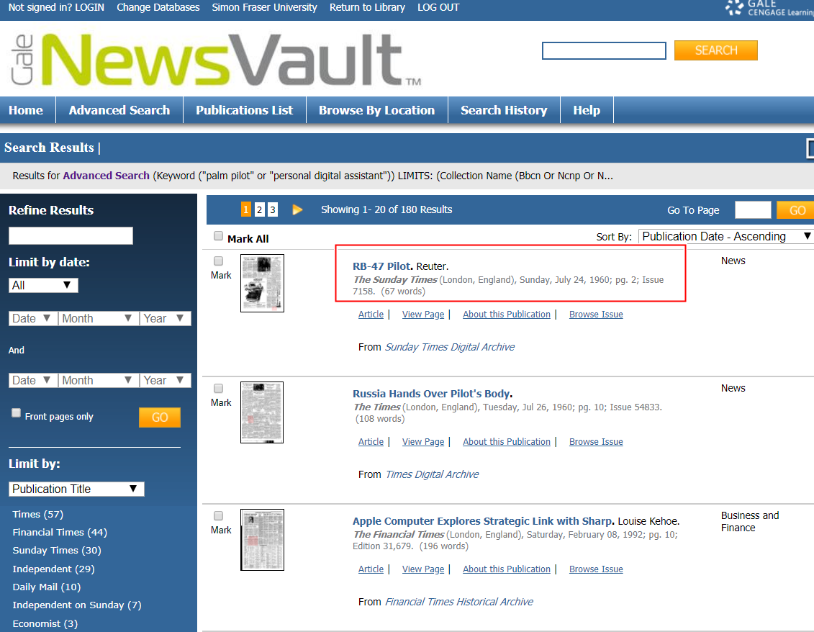
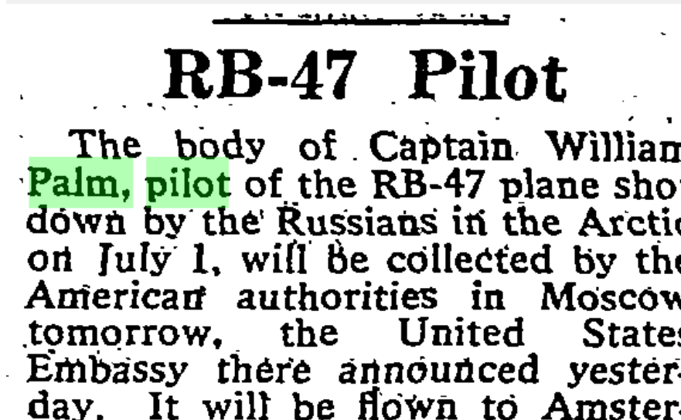

Slide 20
Search options for index/abstract databases
Database record is a surrogate for the document, sometimes with full text
Search terms not natural language
Boolean operators connect search terms: “palm pilot” OR “personal digital assistant” OR PDA OR “hand-held computers” “palm pilot” AND productivity
Limit prior to search
By type of source or source title
By date
Search within fields:
Author
Subject
Title
Filter results after searching

Slide 22
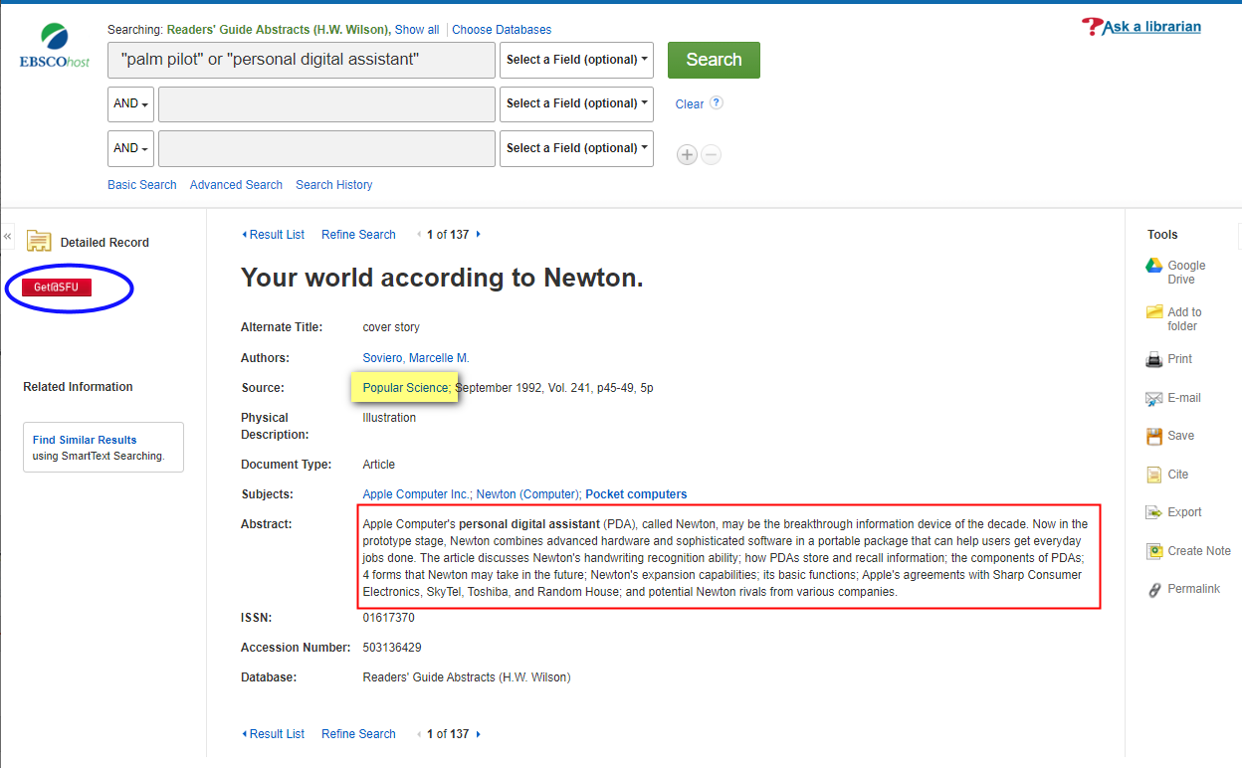
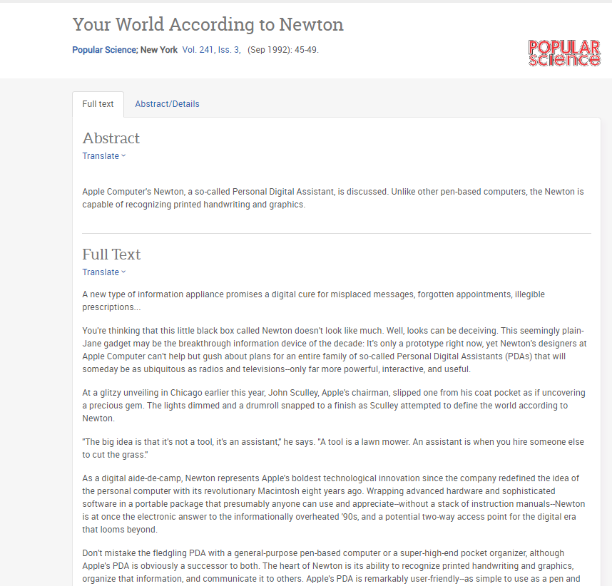
FINDING THE FULL TEXT OF THE ARTICLE

Slide 23
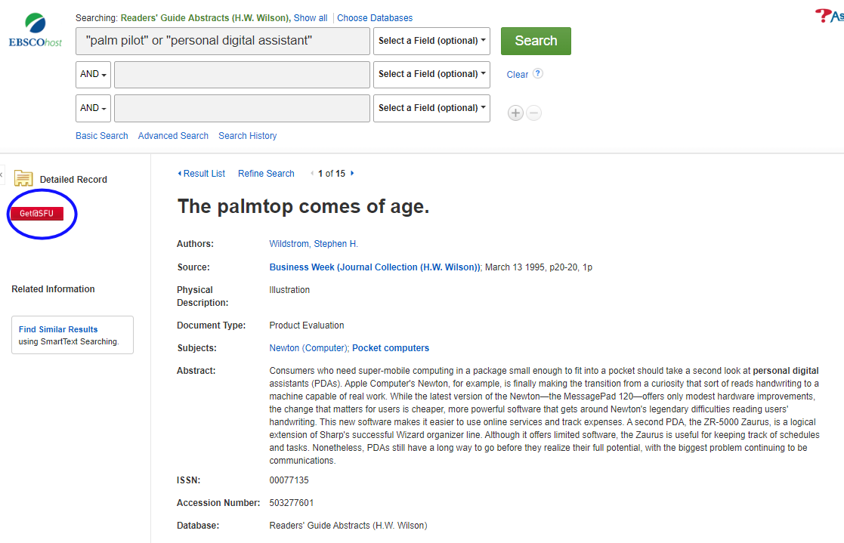
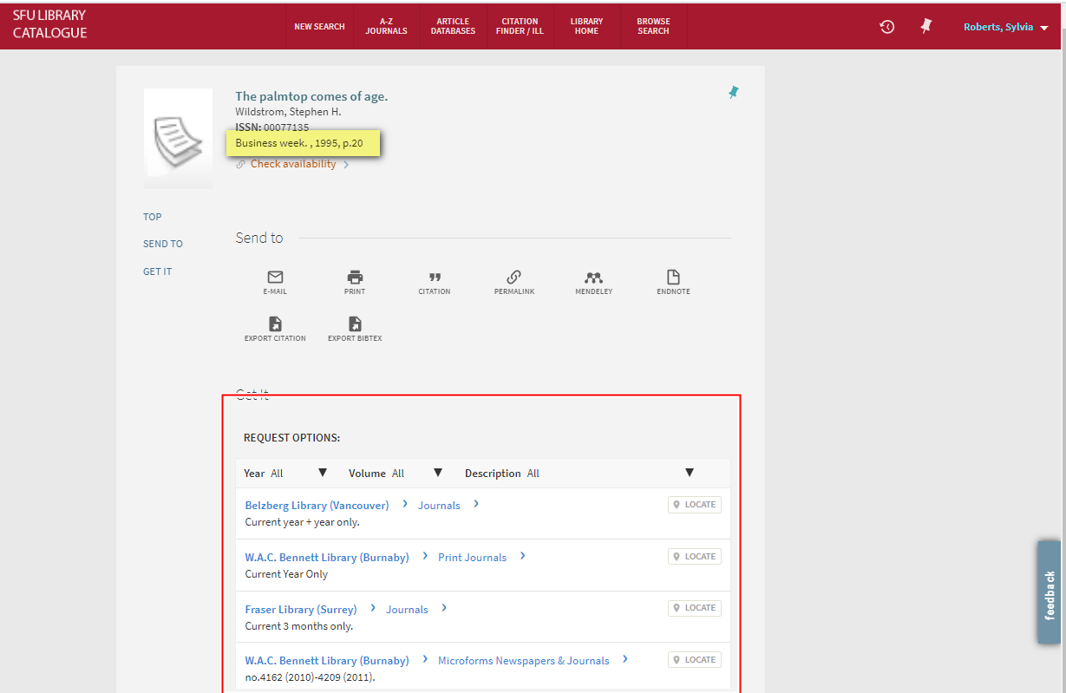
FINDING THE FULL TEXT OF THE ARTICLE

Slide 24
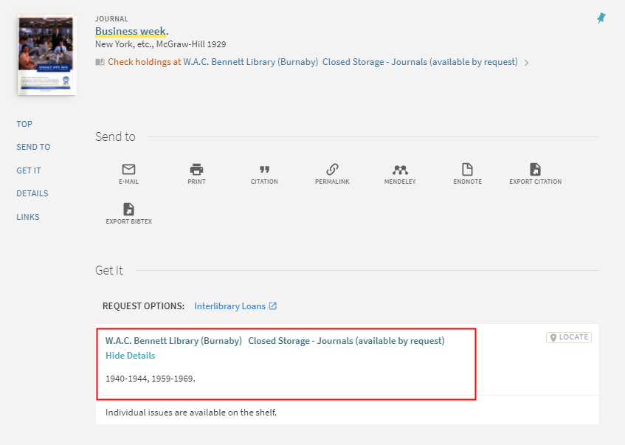
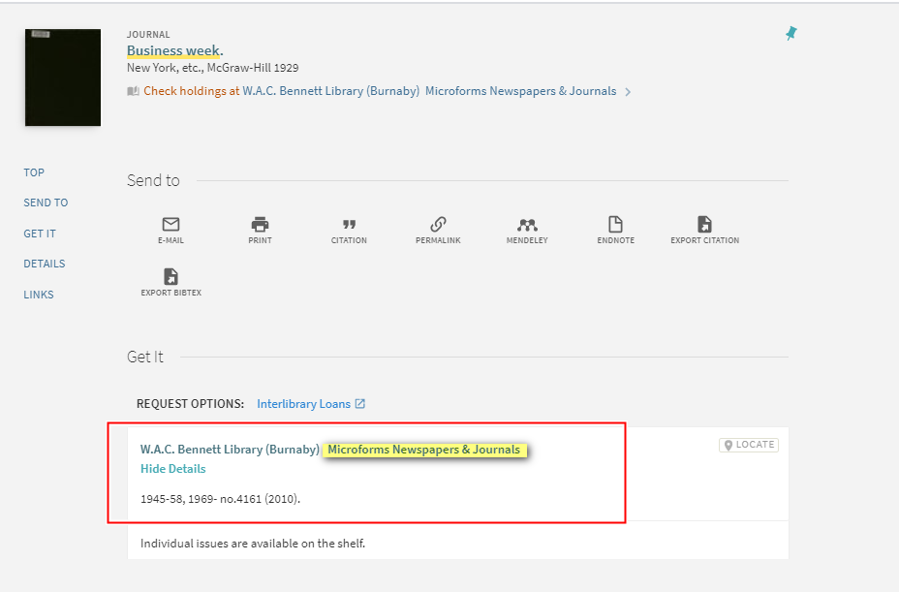
Other archival formats:
Print (bound journals)
Microform
Both can be scanned to digital files, using the photocopiers or the microfilm readers on the 6th floor of the Bennett Library.

Slide 25
Public library print archives of popular magazines

Slide 26
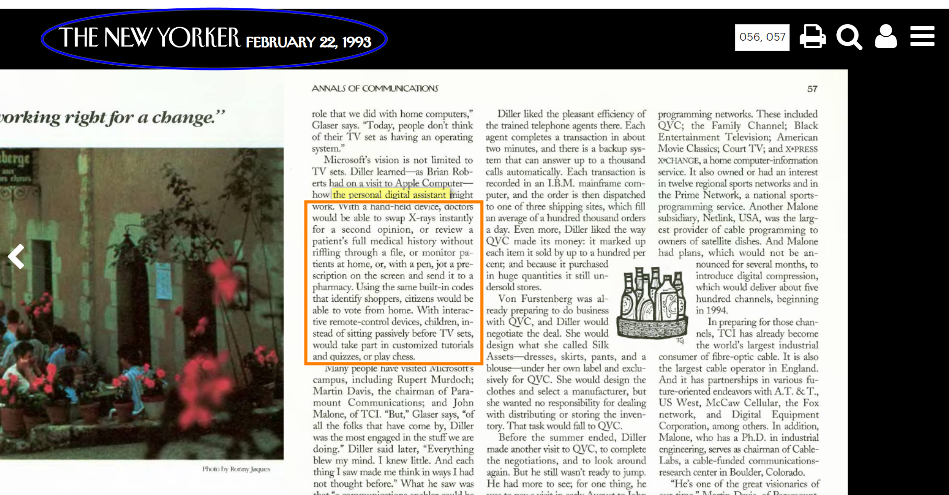

Slide 27
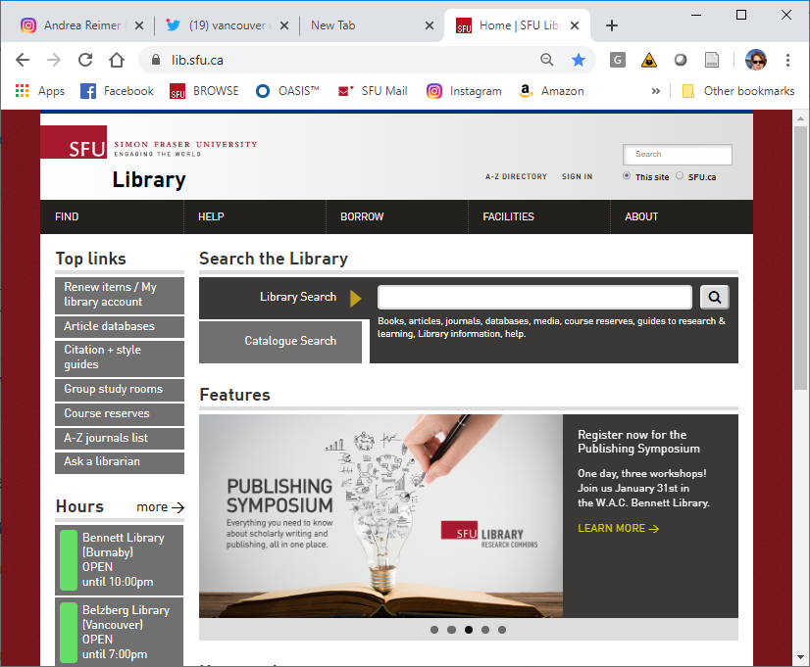
Finding news databases at SFU Library

