Slide 1
CA 304: Researching arts organizations & people
SYLVIA ROBERTS
Liaison Librarian for Communication sroberts@sfu.ca / 778-558-3681
Notes:
HELLO, This is Sylvia Roberts, Liaison Librarian for the SFU School of Communication. This slide show is going to focus on finding essential source materials for your organizational profile.
I’m going to provide an overview but each type of organization may present unique research challenges. If you have questions about finding information about your selected organization, contact me or use our Ask a Librarian services.
I have also created a research guide with links to sources and explanation of how these might be useful to you. Search CA 304on the SFU Library search box to find this guide.

Slide 2
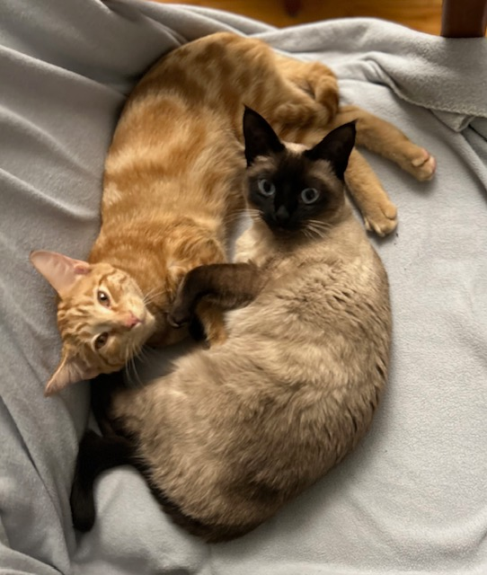
Who is Sylvia and why is she here?
Liaison Librarian for Contemporary Arts
Family and friends work in theatre, film, dance and the visual arts
Organizational research core skills, in order to:
To profile a local arts organization (assignment)
To support your work as an arts professional, working in arts organizations or in support of your own arts practice
Notes:
I want to acknowledge that you may not have met with a librarian at SFU before. You may be part of the cohort of students who came to SFU during pandemic
Librarian with a specialty in the ways that information about the arts and arts practice is created, distributed and used. I support the research and teaching at the SCA with workshops on how to do different kinds of research. Often that is finding academic sources but today, the focus is on finding information about organizations that helps you prepare job applications, interviews, proposals for funding or projects, communicate with potential partners / venues
In all cases, it’s useful to equip yourself in preparation for working with an organizational
How might you use the information that you find to support your professional activities?

Slide 3
Why organizational research?
Background for proposal, funding or job applications
Demonstrate your professionalism
Shows initiative and preparedness
Displays enthusiasm for the organization
Enables you to highlight appropriate skills and knowledge
Asking good questions shows respect for others’ time
Understanding the organization and the industry helps you demonstrate insight and strategic thinking about their goals and challenges
Helps you develop a strong answer to the question of why you want to work with the organization
Notes:
You don’t want to waste the interviewer’s time asking questions that could easily be answered with a small amount of research. Instead, you should have a list of thoughtful questions to ask the interviewer.

Slide 4
Workshop outcomes
Introduction to types of arts organizations and how that affects the information available
Learn how to find key documents for non-profit organizations
Understand the role of industry information
Critically assess information sources to ensure the quality meets your intended use
Assess the authority and potential biases of information providers
Will help with preparation for organizational profile assignment and for life working in the arts

Slide 5
If time, can discuss sources about:
Taxes, budgets, time management
Strategic plans and business startup plans
Vocational guidance sources

Slide 6
What do you want to know?
History, mission, notable accomplishments
Details on operations, activities, programs, productions
Plans for the future
How are organizational decisions made
Sources and nature of funding
Other resources (staffing, infrastructure, technology, partners)
Stakeholders
Similar organizations in local, regional, national, international scene (as appropriate)
Industry / sector challenges & opportunities (SWOT)
Notes:
org decisions: board of directors high-level strategic planning, workers execute the plans but also supply BoD with details about operations

Slide 7
Quality assurance considerations
Who produced the information?
For what purpose?
Who is the intended audience?
How might that affect the information?
Scope / detail / currency?
Research supported finding or opinion?
Why might it be hard to find a good source?
When might you use an imperfect source?
Notes:
Audience: donors, members, volunteers, public, funding bodies?

Slide 8
How might the content in IG differ from this news article?

Slide 9
“CORPORATE PERSONHOOD”
Ongoing collective entity
Prevents personal liability
Formal reporting requirements depend on the type of organization
Organizations also share news of their activities via press releases, social media, interviews
Notes:
Key concept when searching for information about organizations
Corporations / Associations are legal entities formed to fulfill a particular aim, with laws dictating how how decisions are made and to whom they are accountable.
The nature of the organization dictates how they report on their finances, where the income comes from, how it’s spent, whether they’re doing better or worse than the previous year.
Organizations also often share news about their plans, the outcomes of these plans, as well as other corporate activities that relate to their mission
This is true for for-profit corporations as well as not for profit cultural organizations, for advocacy organizations and for policy bodies / agencies

Slide 10
What kind of organization is it?
Jurisdiction?
For-profit?
Public company?
Private company?
Not for profit?
Charitable status?
Government agency
Notes:
Knowing more about the nature of your organization will help you determine where to look for in-depth information. Each of the three types of organizations in the assignment provide formal records of their activities to their stakeholders.
Start by making notes about what you already know about your organization. What is the full formal name of your organization? Are there alternative names that it’s known by? Did it used to be called something else? Where are they based? Are they motivated by seeking profit? Or by advocating on behalf of stakeholders? Are there people or other organizations that have a significant relationship with yours, such as a partnership for a specific project or a shared venue
When students ask me for information about an organization, I ask a set of questions to help me know where to start looking.
My first question is where is this organization located? Is it Canada? Or another country? This provides us with information about the legal and political framework in which the company operate. If it’s a Western democracy, there are often laws that require that corporate or organizational information be made available to the public.
This also tells me about how to scope my searches by selecting databases with coverage of that region. If it’s an English speaking country, reports will be in English.
Next, I would ask whether the organization was a for-profit or not-for-profit organization.
If it is a for-profit organization, is it a public company or a private company?
Public companies invite investment by members of the public by sharing shares in the company through stock exchanges. Public companies are required to publish reports that share details about their activities, governance and financial status, in order to inform investors, business partners, customers and other stakeholders.
Private companies are owned by one or more individuals. This can be small companies, like Mint Records in Vancouver, or large companies like Cirque de Soleil. Because they do not trade shares in their company on a public stock exchange, there is no requirement for these companies to produce public facing reports. You may find enough information in the business press to produce a good case study.
Many arts organizations in Canada are not-for-profit, meaning all the money earned by or donated to the organization is used in pursuing the organization’s objectives, rather than being distributed to the owners or shareholders.
Not for profit organizations may be registered charities (as approved by Revenue Canada) able to issue receipts to donors for income tax purposes. Cultural organizations often use their charitable status as a means to generate revenue. As such, they are required to provide publically accessible reports on their finances and activities.
Examples of government agencies in the arts are the BC Arts Council and the Canada Council (grant funding)

Slide 11
Sources for in-depth investigation of org.s
ORGANIZATION AS AUTHOR
Organizational web site
Formal reports (accountability) annual, financial, planning
Promotion of programs: press releases, social media, interviews, excerpts
Fundraising: newsletters, interviews, partners
NEWS MEDIA
reviews, staff change announcements, interviews, advertising
ARTS MEDIA
podcasts, interviews (CBC local, national, Georgia Straight, Instant coffee), program announcements, discussions
INDUSTRY SOURCES
Shared interests: issues (policy, technology, economic), employment, advocacy
Industry associations: web site, social media, email lists, postings, industry journals
Notes:
Start your research with information produced by the company, through their web site, annual report and social media postings.
Social and news media media will give you information by your organization and the response to postings can help demonstrate how it is seen by clients and other stakeholders.
Industry sources discuss events or factors that will affect all the organizations in a cultural sector, like the COVID pandemic. Could also be a technological, economic, or policy change.

Slide 12
Organizational web site
Investigate your organization’s web site
Find the About page
Find the Annual report
Find Media Releases (press releases, news about the company intended for distribution to a wider audience)
Expect answers to questions like:
What is the nature of their operations?
How do they fund their operations?
How are decisions made?
How are they accountable?
Notes:
Funding: donations, govt grants, tickets, membership dues, workshops
Accountability is often to members of the org, funders like donors or granting agencies

Slide 13
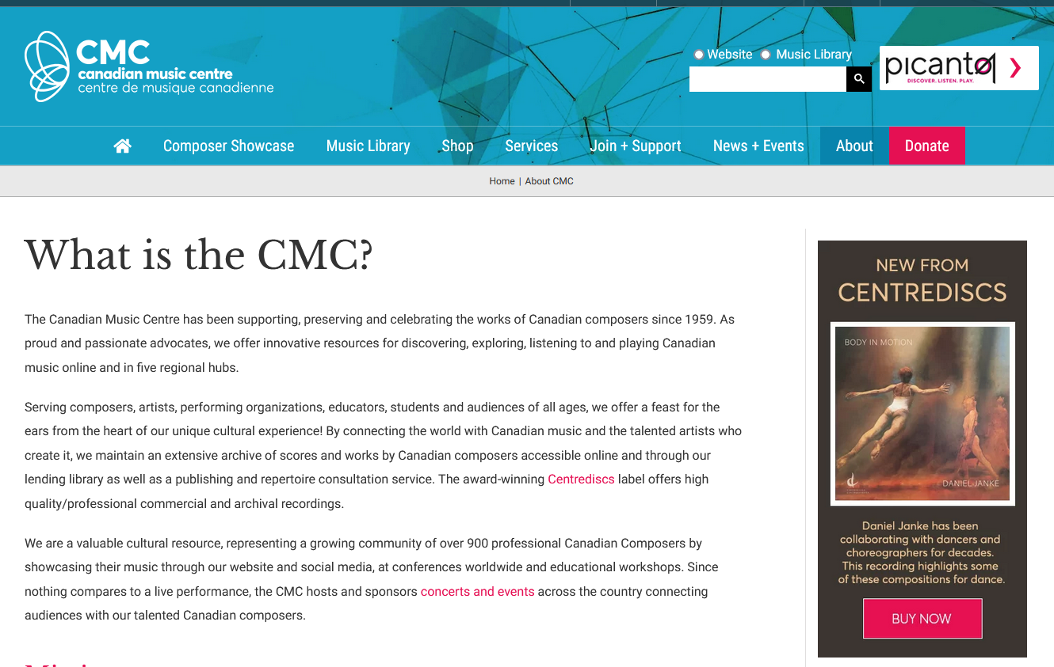

Slide 14
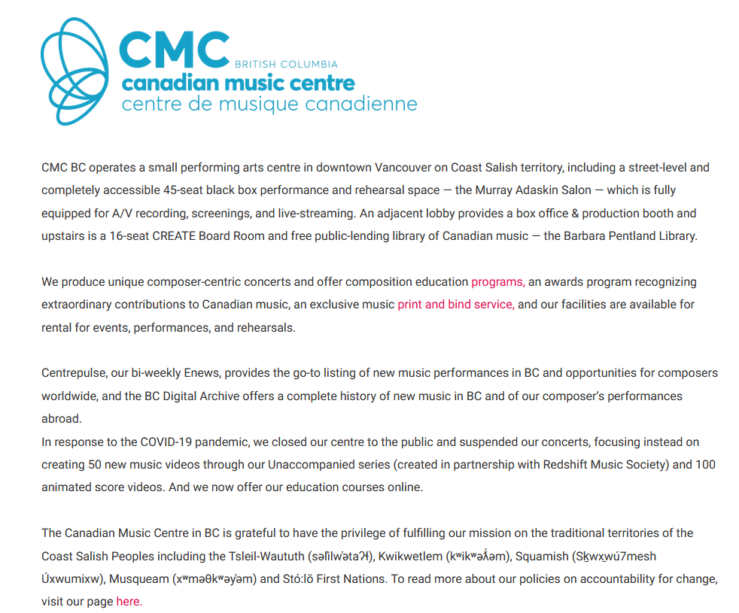

Slide 15
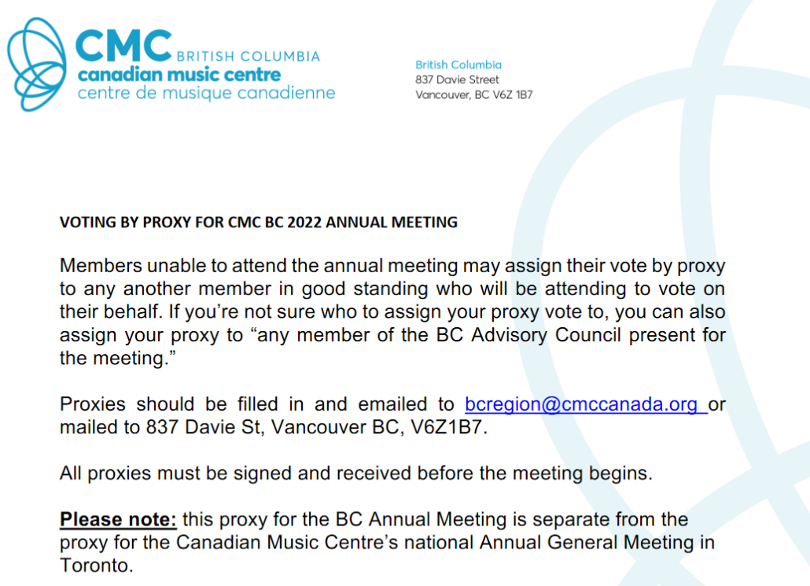
Notes:
BC is a subsidiary of Canadian music Centre in Toronto

Slide 16
Notes:
Funding partners' logos

Slide 17
Annual reports
A comprehensive report on a company's activities throughout the preceding year…intended to give shareholders and other interested people information about the company's activities and financial performance
A publication sent to a nonprofit’s donor base letting them know how the organization has grown and changed over the past year
May not be posted publicly but only go to members
Information about the annual report / AGM may be found in social media
EXCEPTIONS: No annual reports from private companies, individual practitioners or partnerships, subsidiaries, new organizations
Different countries handles this type of accountability reporting differently
Notes:
Published every year; provides a summary of the previous year’s operations/activities and plans for the future, depending on the organization’s goals
Just as we take pains to present ourselves in the best possible light, corporate authors tend to show their best selves in their own documents
Definitely start with the web site for your organization but don’t stop there – continue to find additional sources to add depth and balance to your analysis

Slide 18
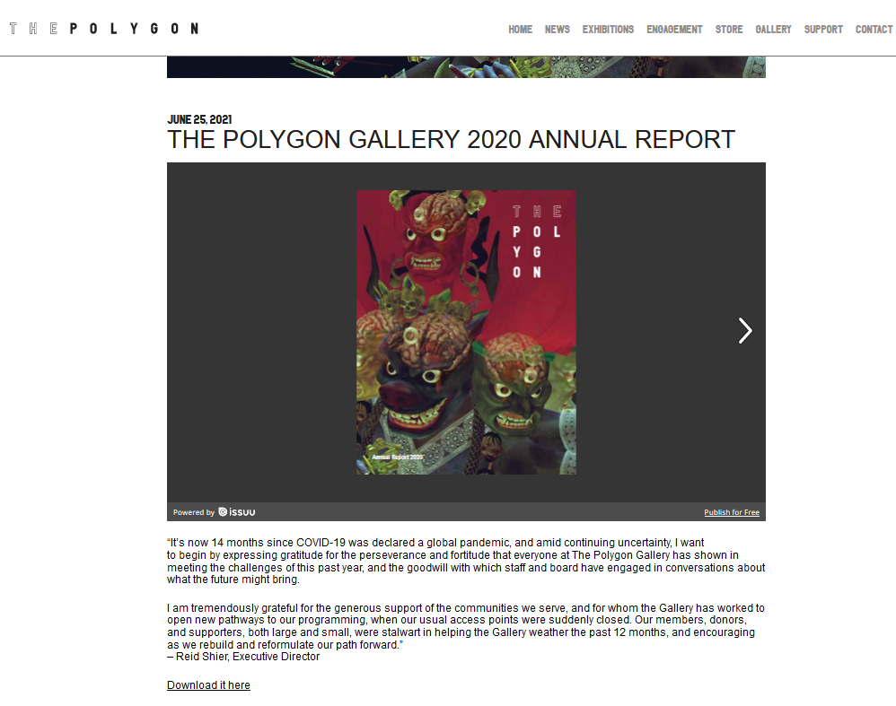

Slide 19
In the annual report
What is the full legal name of your organization?
Where are they located?
Who makes the decisions for the company?
Are they doing better or worse financially than the previous year?
What are their chief operations?
What’s a significant change that happened during that year?
What did they do in response?
What are they planning for the future?

Slide 20
Registered charities
Many (but not all) non-profit arts organizations gets some of their funding from donations
Canadian tax-payers who donate to registered charities get an income tax deduction in return
Charitable organizations must file an annual report with Revenue Canada
Report provides financial, staffing, activities for each year

Slide 21
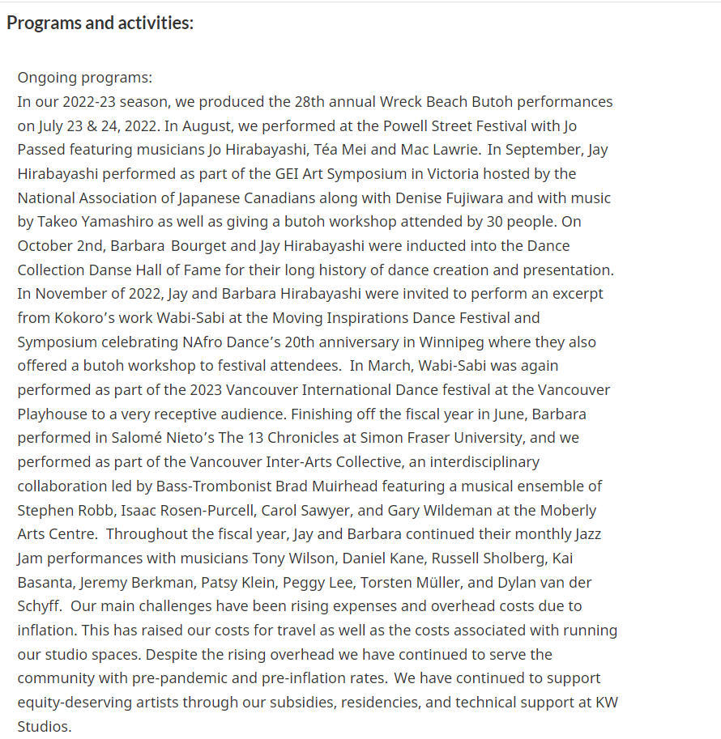
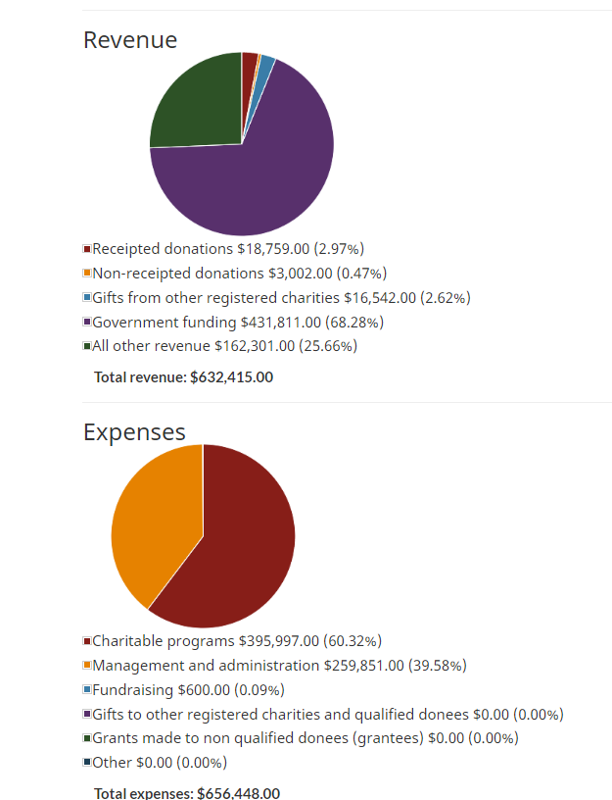
Kokoro Dance Theatre Society charitable status report

Slide 22
Press releases and news
“An official statement delivered to members of the news media for the purpose of providing information, an official statement, or making an announcement”
May or may not result in a news media story
Increasingly social media used as a direct route of communication with stakeholders
How might the source of the information affect the content?

Slide 23
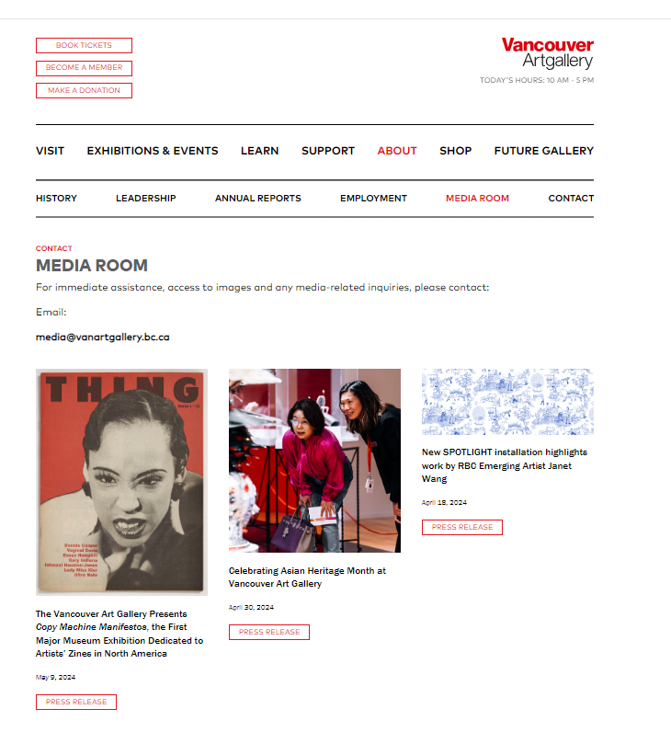
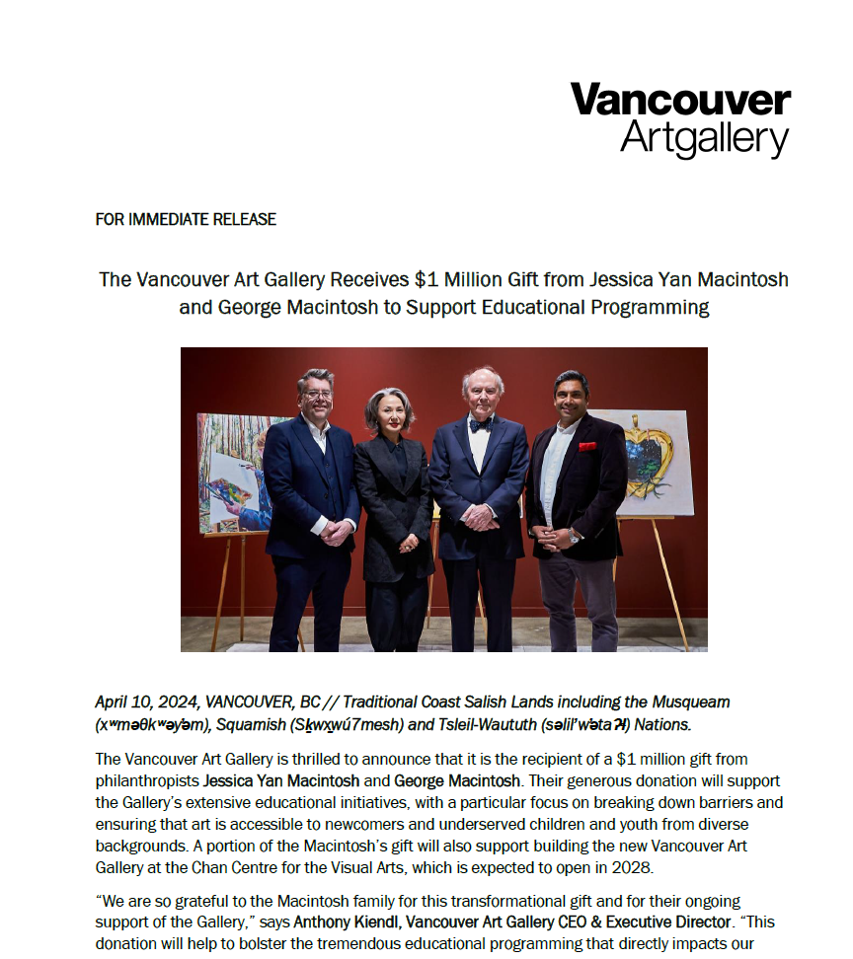
Notes:
Sometimes press releases result in an news media piece sometime they don’t ; sometimes the news release gets reprinted without change

Slide 24
Trade journals
“A trade magazine, also called a trade or industry journal, is a magazine or newspaper whose target audience is people who work in a particular trade or industry. “
News & articles on topics of interest to this audience:
Impact of change on the sector (economic, policy, technology)
Trends and developments in the industry
Included in business and news databases
Also in databases for specific cultural sectors: dance, film, theatre design, music composition, performance
Use CA 304 guide to see lists of current trade journals and database that let you search for stories within your cultural sector

Slide 25
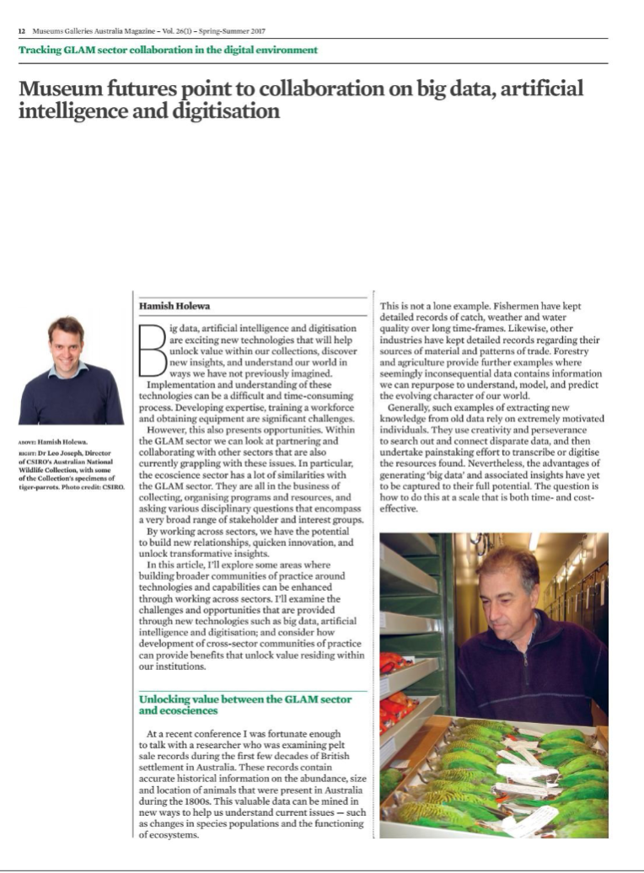
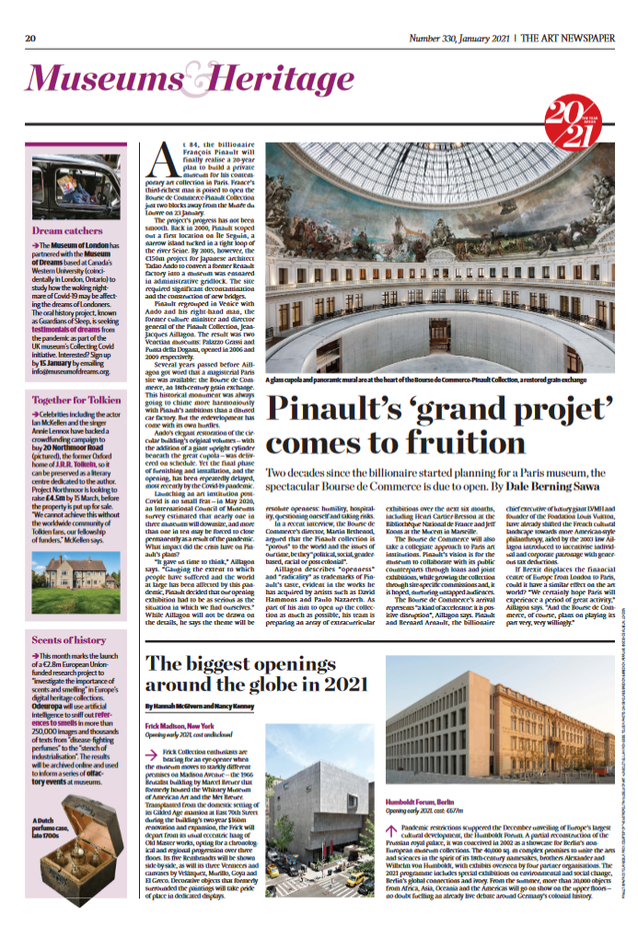

Slide 26
News sources
Full text of newspaper stories, transcripts of news media programs
Industry or geographically centred sources – list on research guide
Search for your organization’s name, for names of individuals involved in the organization, productions/exhibitions, related news
Search for your industry genre, to get a sense of the environment

Slide 27
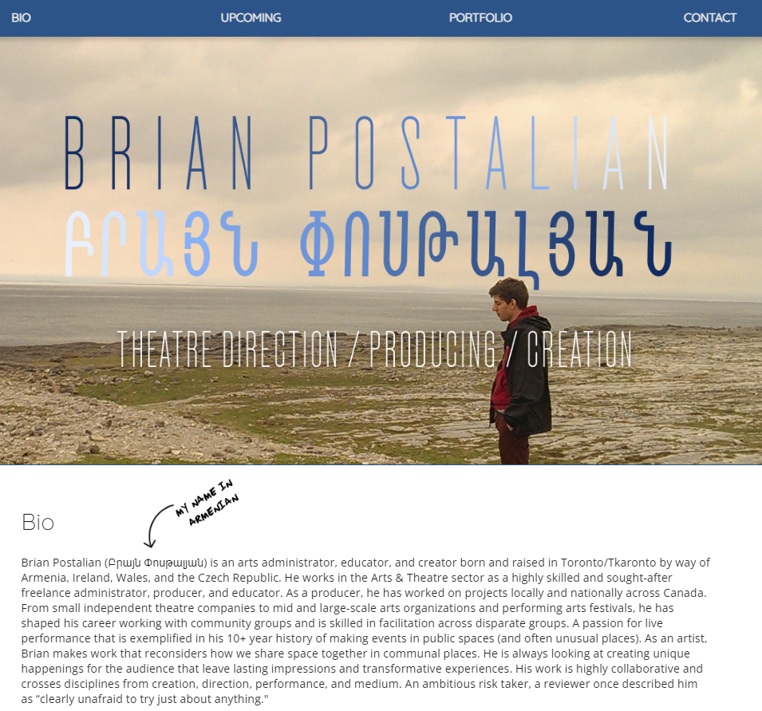
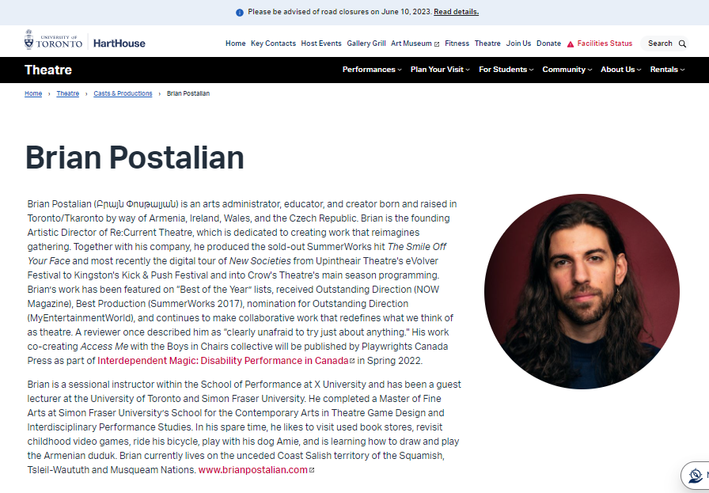

Slide 28
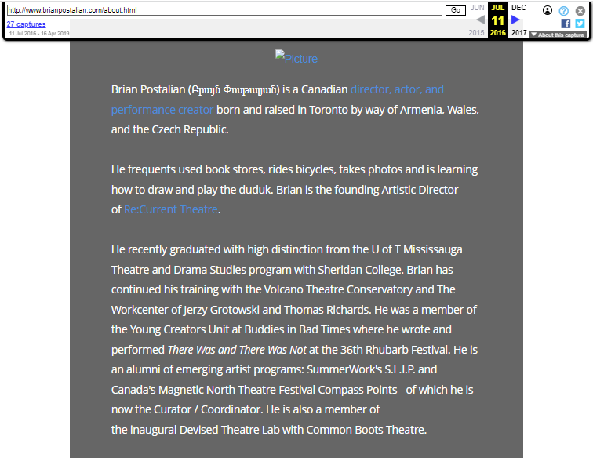
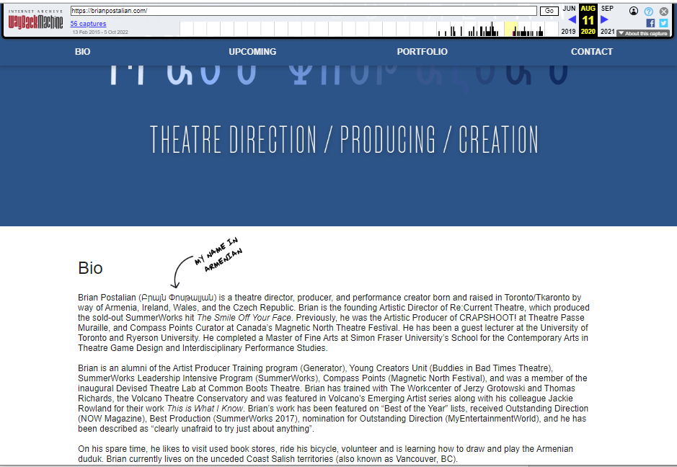

Slide 29
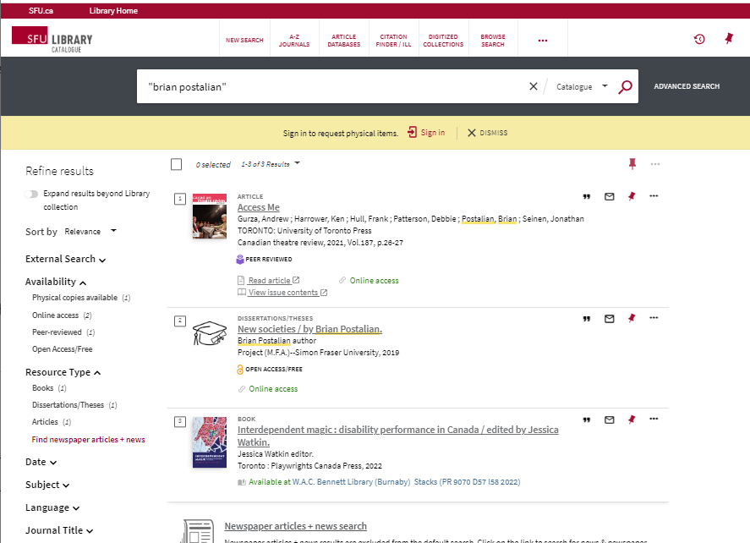
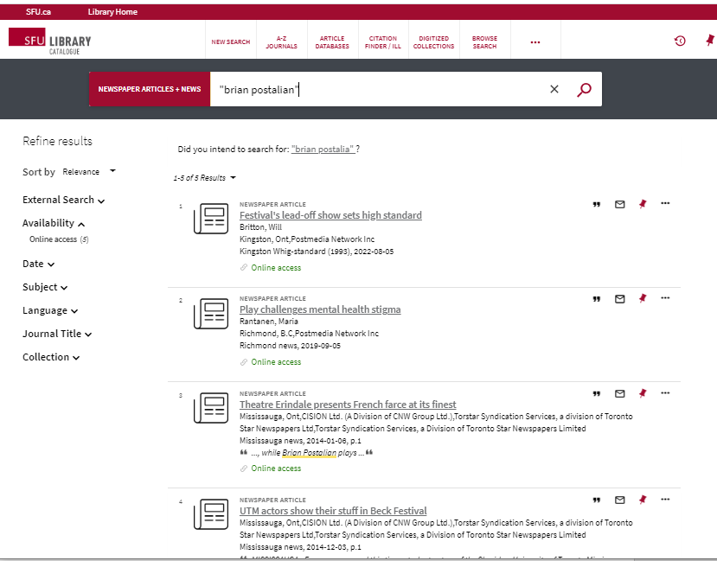

Slide 30
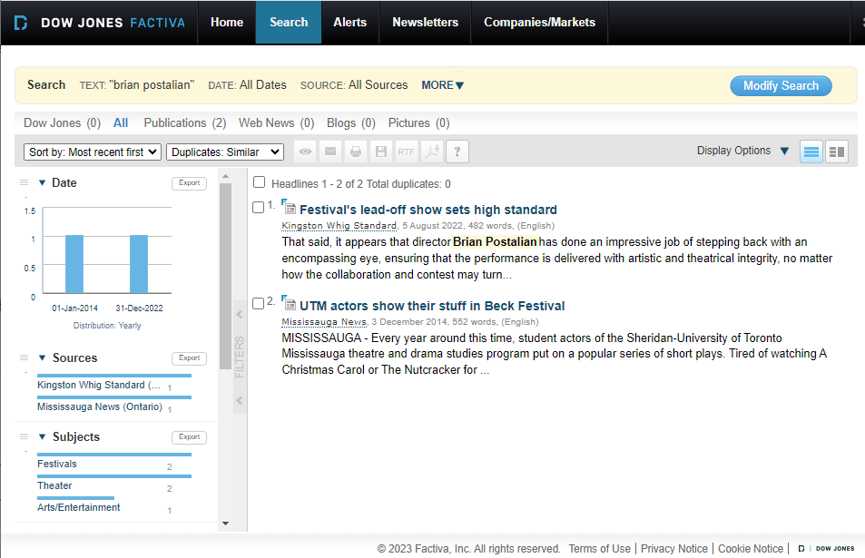

Slide 31
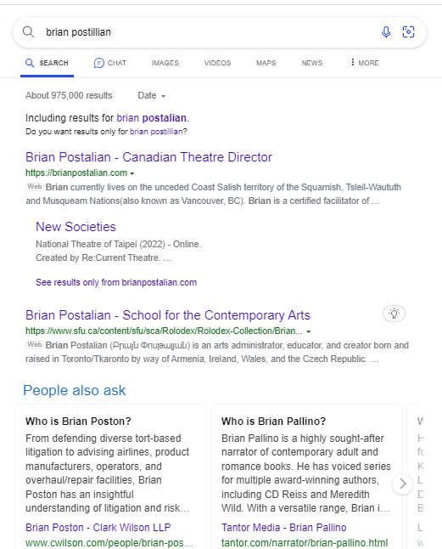
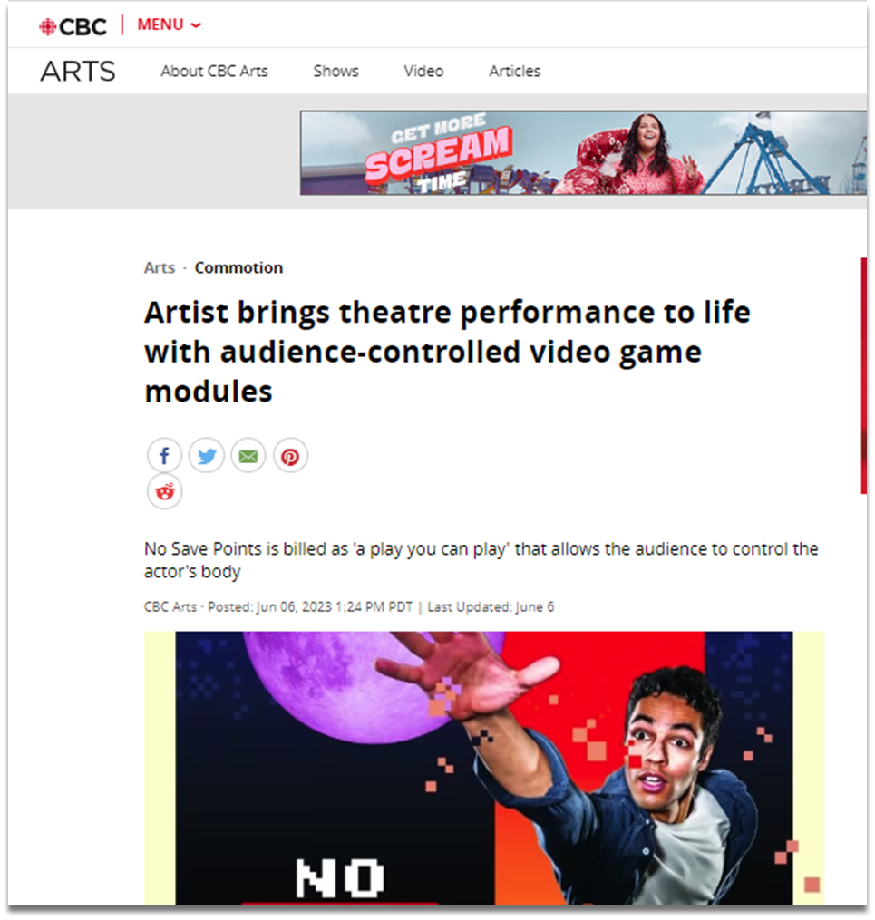
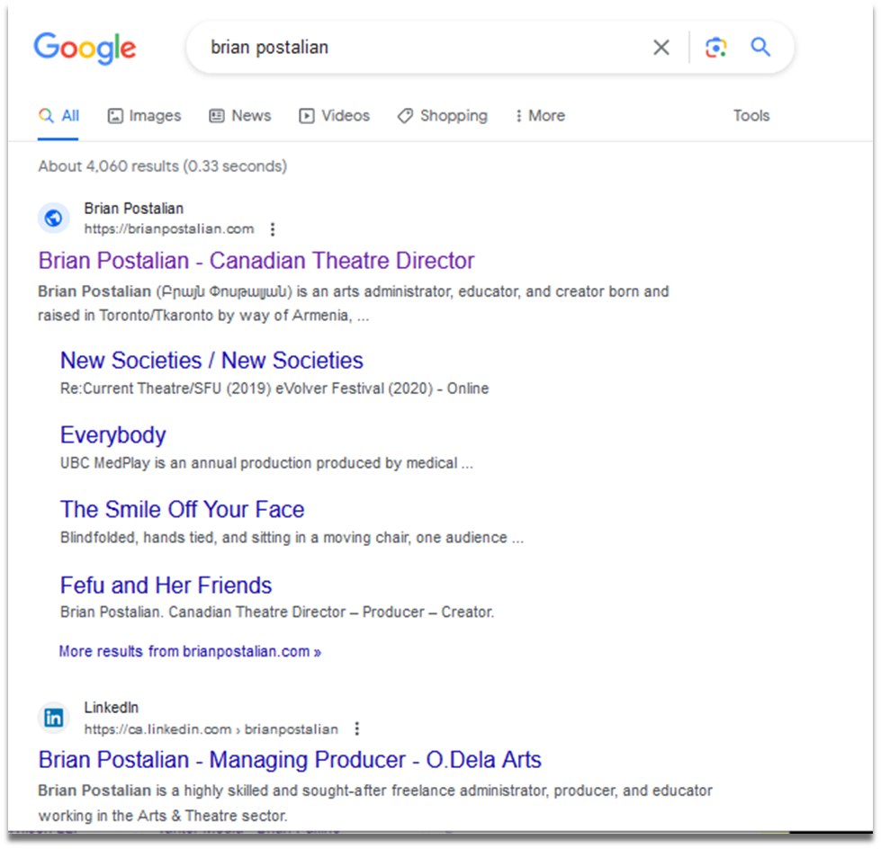

Slide 32
Industry / trade associations
Trade associations represent members, usually organizations or individuals working in a specific sector
Act as a collective to lobby for positive policy environment, conduct research, monitor trends
Produce press releases, reports, social media postings
Search for a trade association that your organization might join or follow for developments in their specific cultural sector

Slide 33
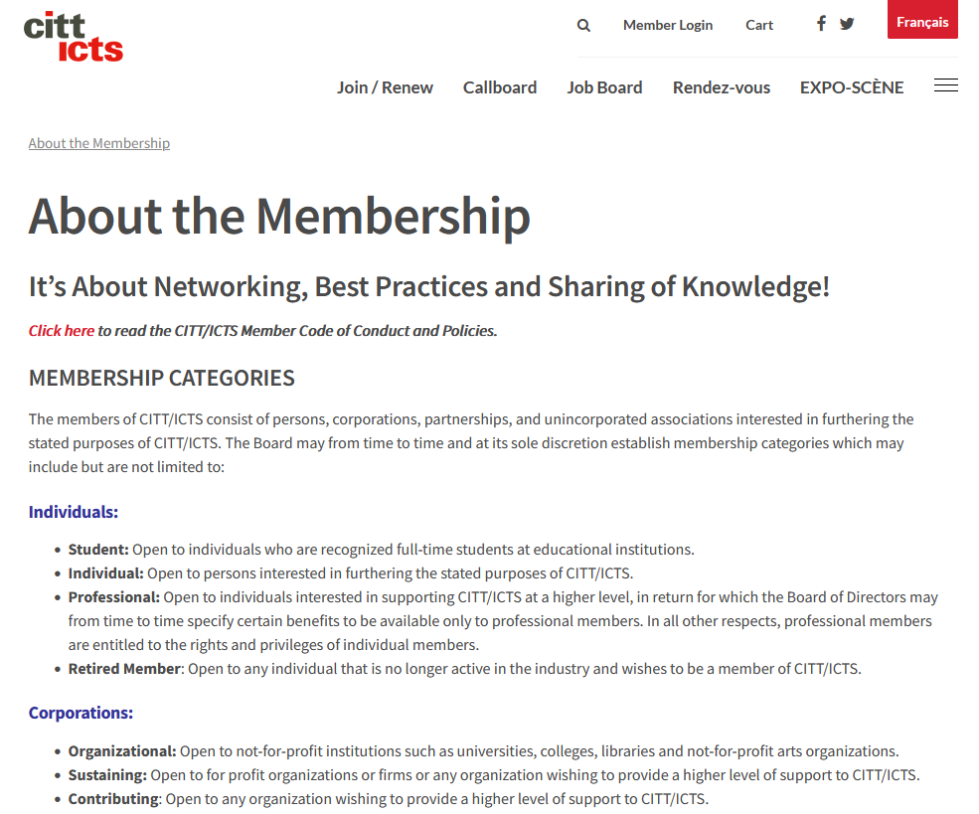
Notes:
Canadian Institute for Theatre Technology

Slide 34
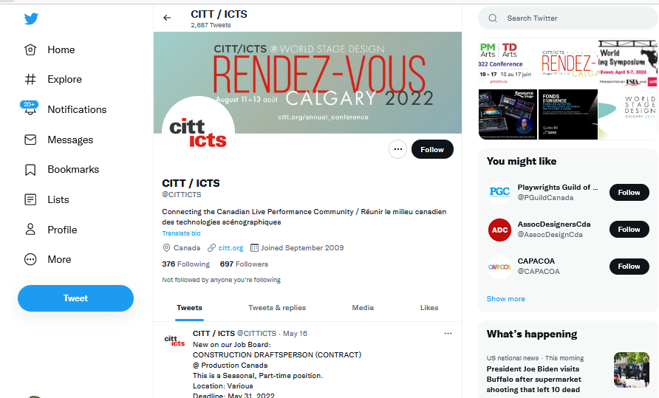

Slide 36
Select your organization wisely
Do some preliminary searching before deciding on a topic, to ensure you can find enough appropriate sources
Potential problematic organizations:
Private, for-profit companies
Subsidiaries of for-profit companies
Entities that do not have a formal, incorporated organization
Based in a country where English is not dominant (unless you have fluency in that country’s language)
Very new organizations
Notes:
If you choose an organization that falls into one of these categories, you may have difficulties finding sufficient credible information sources to support your case study analysis. Check with Sylvia if you want a second opinion about this
The size, age and nature of your organization will influence how much information has been produced about them. Newer or smaller organizations may not have a large body of background information about them so you may need to consider whether to select a different agency for your focus.

Slide 37
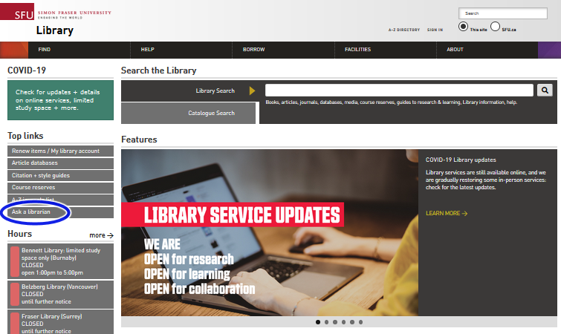
Sylvia Roberts: sroberts@sfu.ca
Notes:
This is the end of the slide show. Please contact me by email or in the discussion area on Canvas if you’re having difficult with your research or need other assistance. Good luck with your case study!

