Slide 1
Delineating Grassland in British Columbia
GIS Day Lightning Talk
Jackie Ng
Master of Geomatics and Environmental Management Student
Faculty of Forestry
University of British Columbia

Slide 2
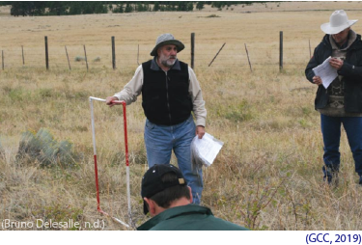
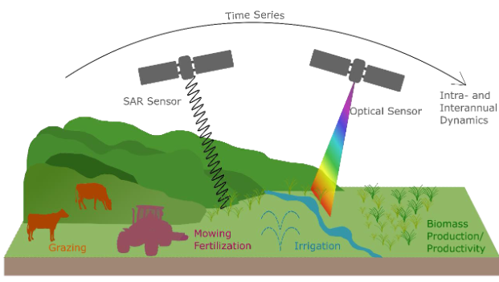
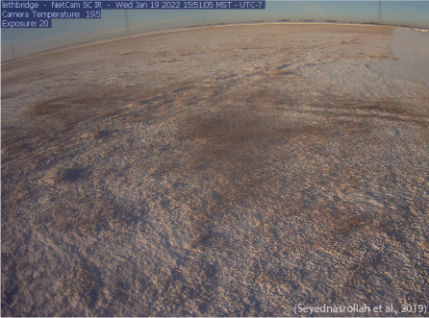
Introduction: Current approaches for grassland inventory
REMOTE SENSING
FIELD STUDIES
PHENOCAMS
(Reinermann et al., 2020)

Slide 3
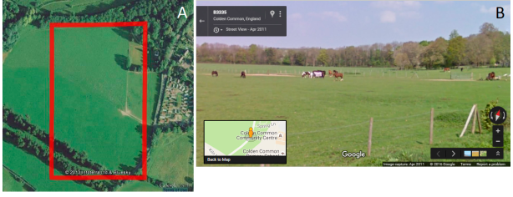
Introduction: Grassland inventory in BC is limited
INCOMPLETE AND FRAGMENTED INVENTORY IN BC
SIMILAR
SPECTRAL SIGNATURE
(Spectral Characteristics Viewer | Landsat Missions, n.d.)
LACK OF
VALIDATION DATA
(Salk et al., 2016)
Notes:
An ecosystem management specialist, Don Gayton, described the grassland inventory as “a few isolated fragments of damaged footage”
because we don’t have an automated tools to collect local data to study annual grassland condition.
Even though making use of satellite images to monitor grassland becomes popular lately, we are still striving in classifying land covers accurately. Challenges lay in differentiating land features that shares similar spectral signature. For example, the spectral signatures of lawn grass and maple leaf would be challenging for a classifier.
It is also difficult to gather enough ground truth point to train and validate a classifier for each cover class. Although it is common to use high-resolution imagery from open-source platform to gather training data, it is not easy to interpret the image. For example, many mistakenly thought the image on the left was a cropland. Actually, it is a pasture.

Slide 4
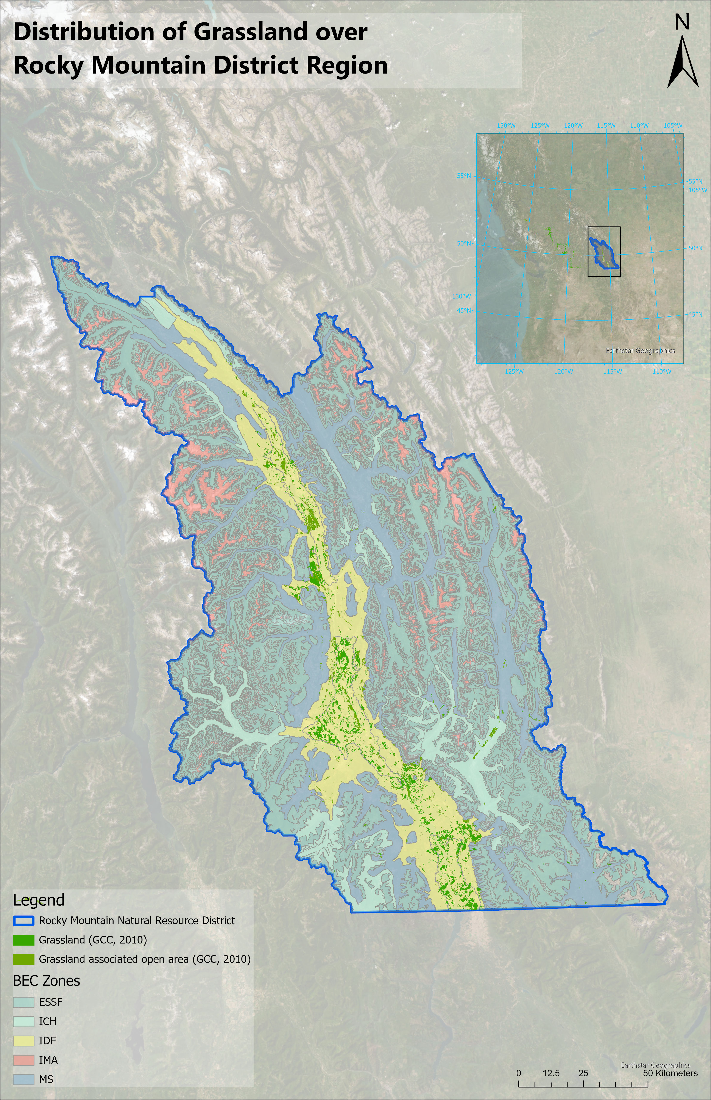
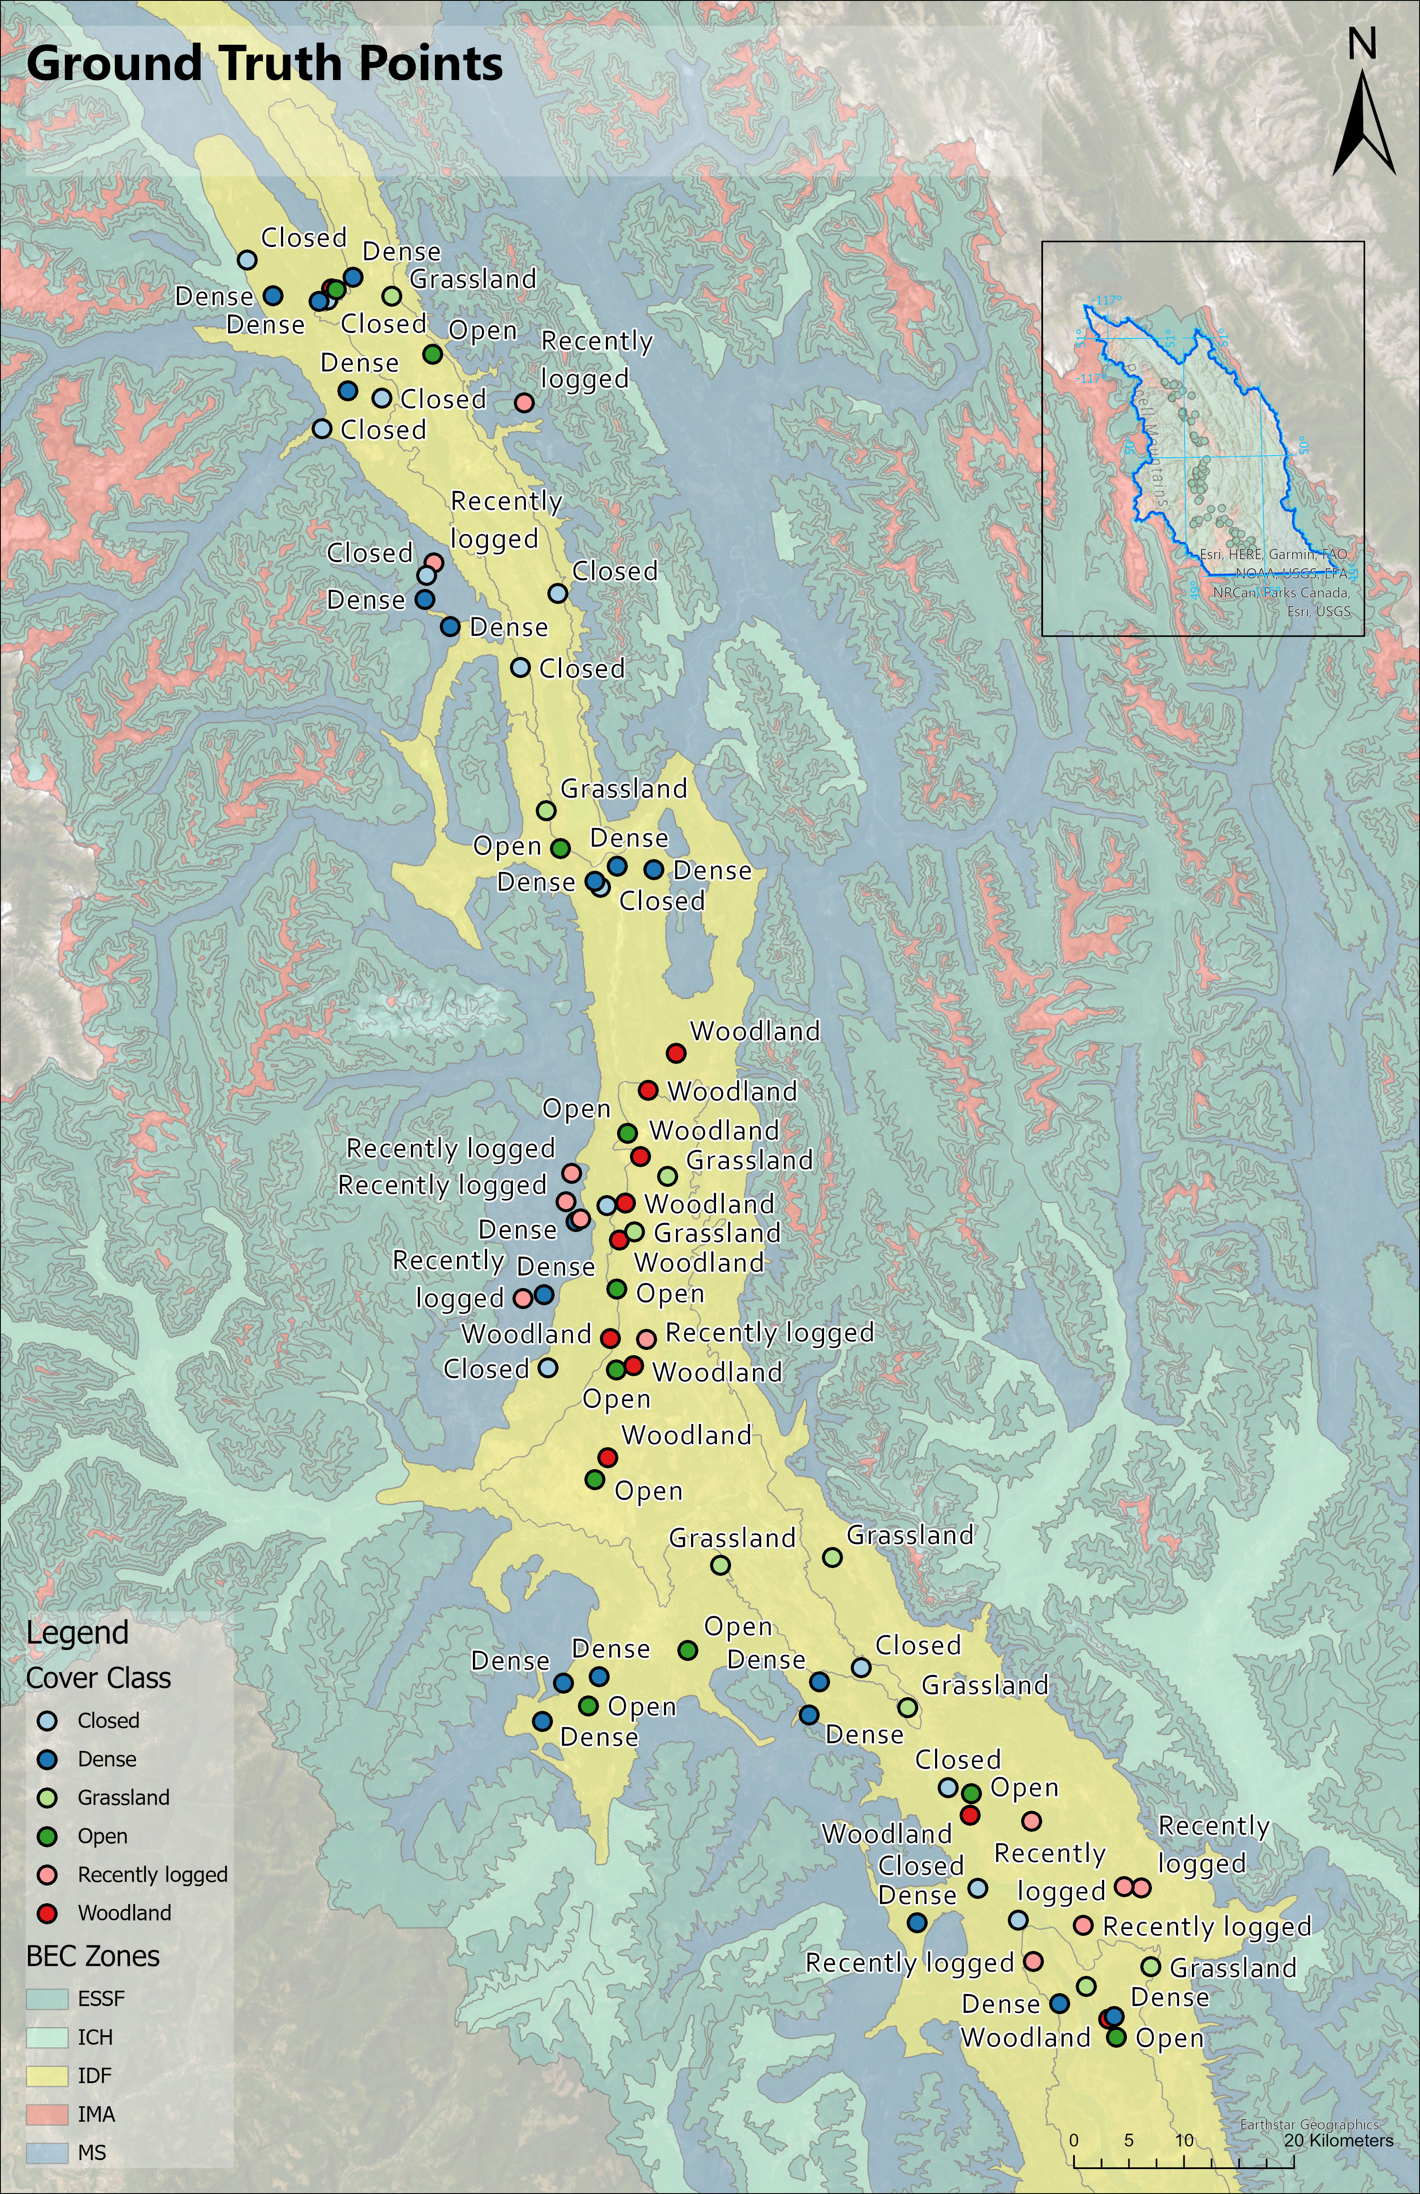
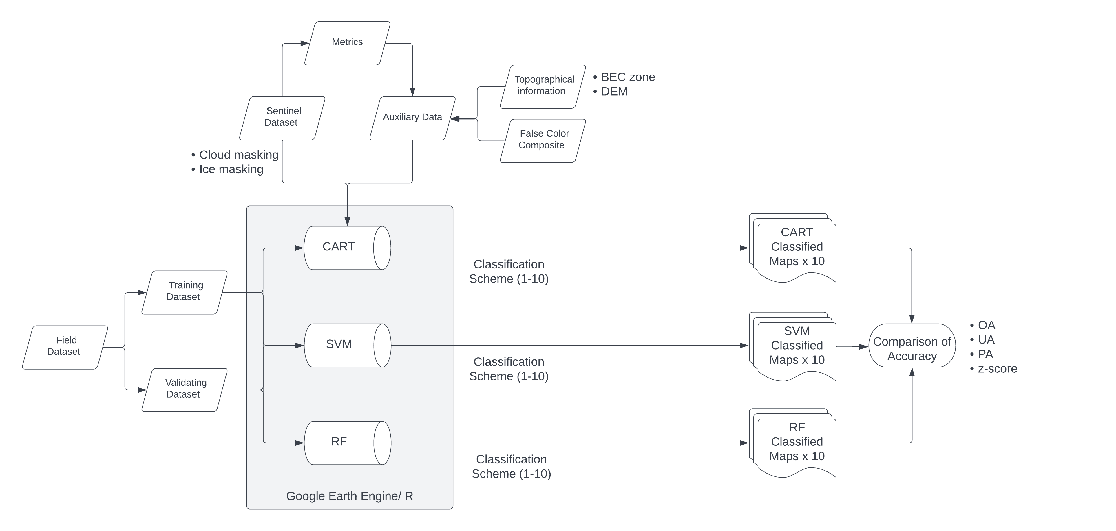
Methods: Machine learning to delineate grasslands
Notes:
A pilot study is conducted over Rocky Mountain District Region in East Kootenay where field data is available. The field data will be used to create training dataset and validation dataset for the three classifiers.
The classifiers will digest Copernicus Sentinel-2 (S2) data and auxiliary data on Google Earth Engine or R to create 3 sets of classified maps. The auxiliary data includes vegetation indices, false color composite, Digital Elevation Model and BEC zones.
Accuracy between the classifiers will be determined by confusion matrix statistically. Overall accuracy, user accuracy and producer accuracy will be computed from the confusion matrix.
14 cover classes are adopted in the study. I’ve designed 10 different schemes of cover class. Land features that share similar spectral signatures are grouped under the same category in the early experimental stage.
If the classifiers’ performances are acceptable, I would challenge the classifier to create maps with finer landscape details and test the limitation of the classifier without scarifying the accuracy.

Slide 5
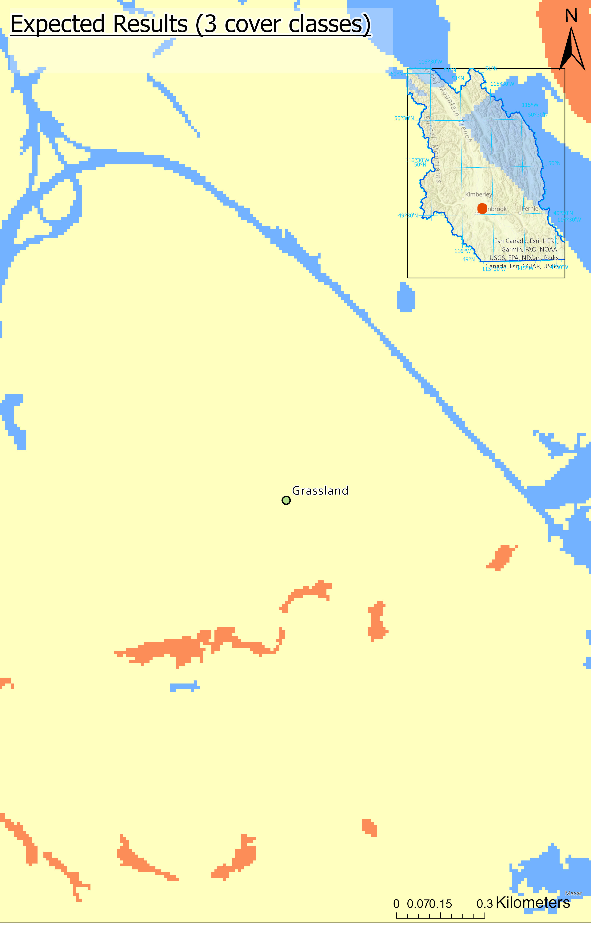
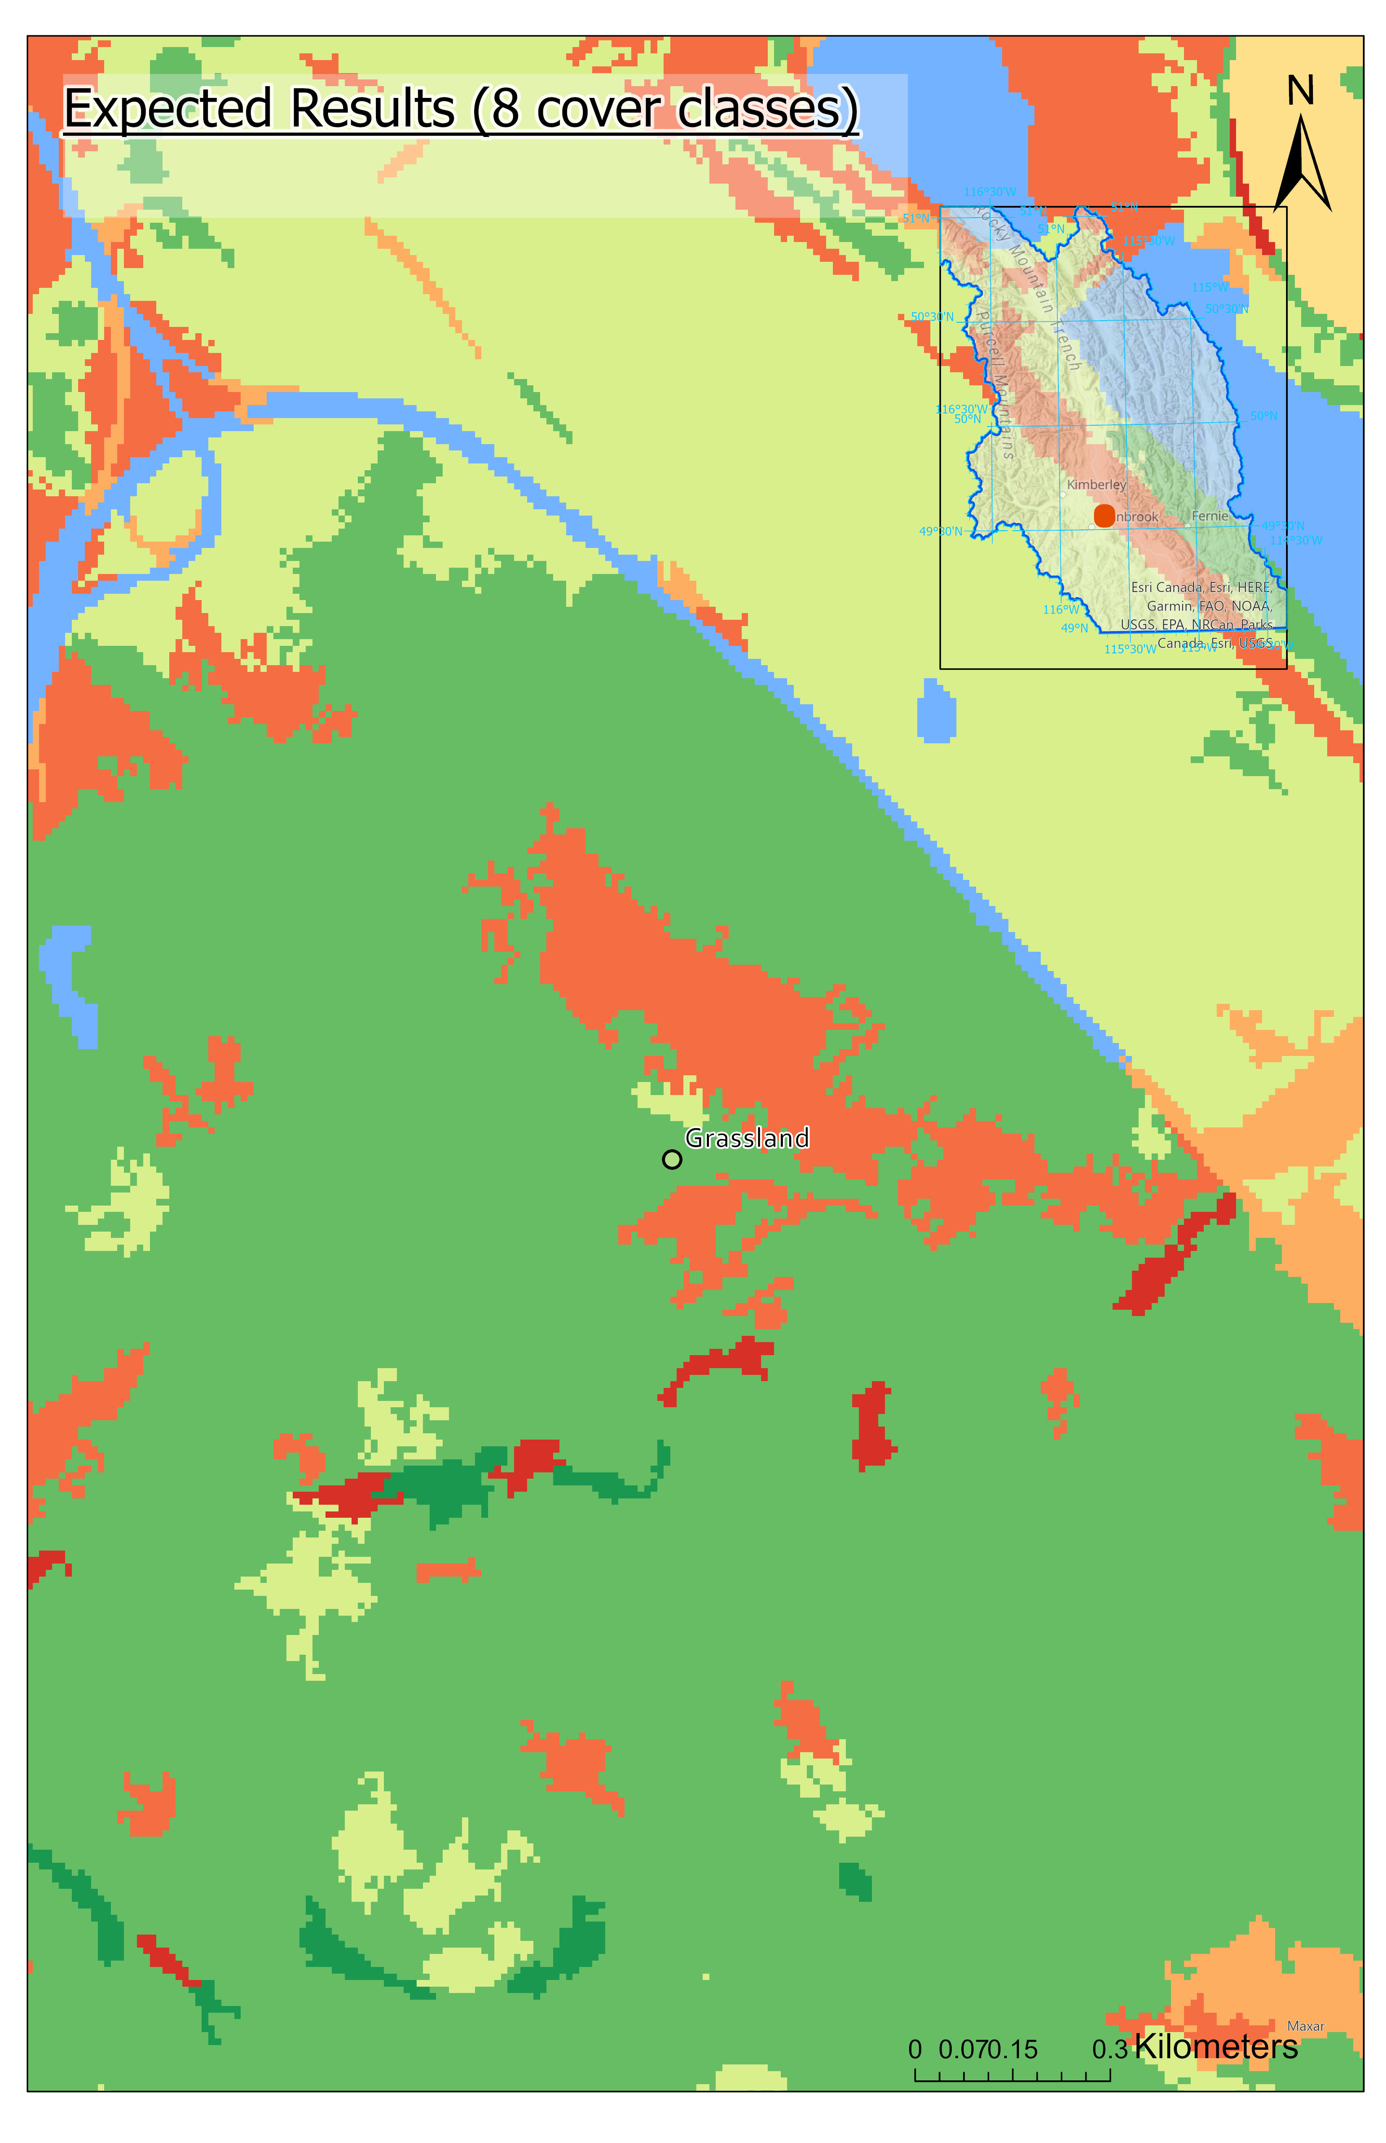
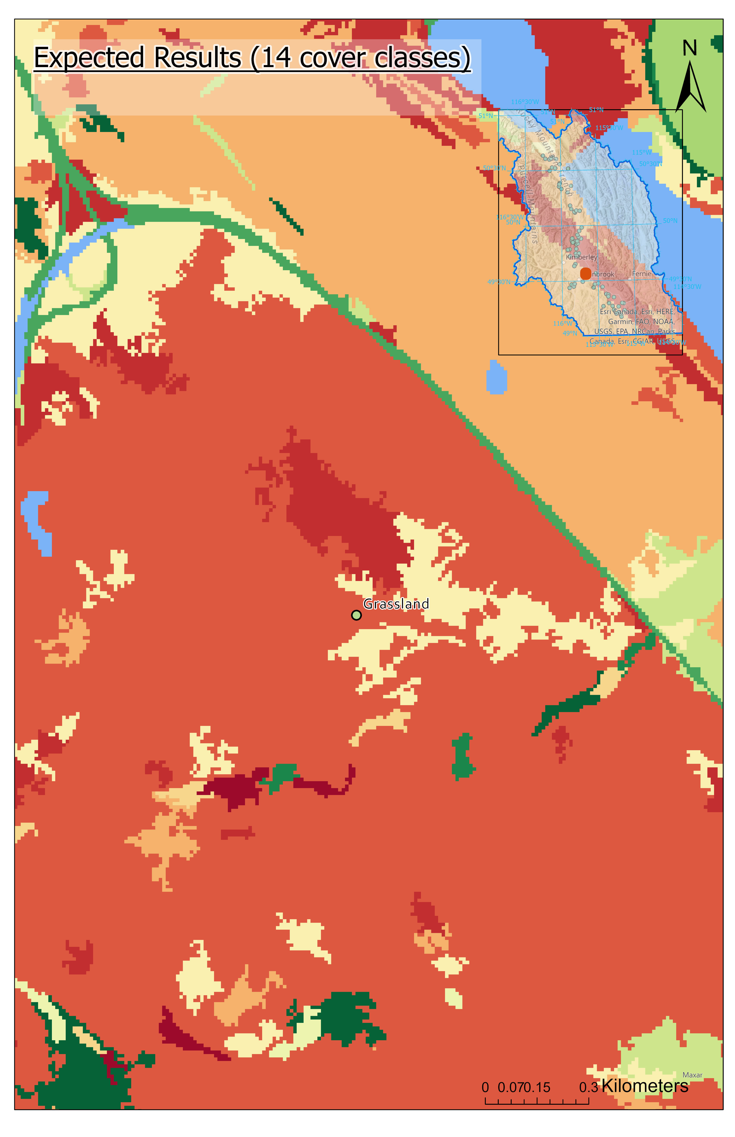
Expected Results: Challenges in identifying grassland classes
- HIGH ACCURACY
- UNHELPFUL
- OPTIMAL ACCURACY
- HELPFUL
- LOW ACCURACY
- UNHELPFUL
Notes:
These are simulations of the classified maps showing 3, 8 and 14 cover classes.
If the spectral signature of 2 features are not significantly different, say hay field and agricultural land, the classifier might mistakenly consider patches that belong to the same class (as indicated by the dash line) into different classes.
In this case, we would rather stick to the classifier that produce accurate map instead of producing a map classify land features in fine details with low accuracy.

Slide 6
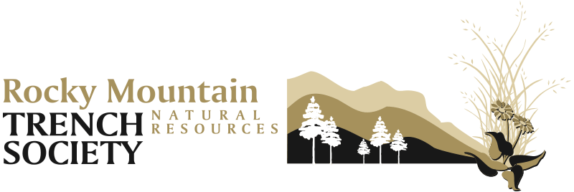
Conclusions
OBJECTIVE
Improve BC grassland inventory
using remote sensing
CHALLENGES
Distinguishing grassland landcover
with similar spectral signatures
Improve BC grassland inventory
using remote sensing
MY APPROACH
Machine learning classifier:
False color composite + site context + field data
Notes:
I expected that the most important variables for the classifier would be the data that describe sites’ context , composite images that are useful in highlighting barren ground and cropland and several common vegetation indices (e.g. MASVI, NDWI, SAVI, NDVI).

Slide 7
Reference
Baron, J. N. (2022). 2022 Field Work Summary.pdf. Faculty of Foresty, Department of Forest and Conservation Sciences, UBC.
Bardgett, R. D., Bullock, J. M., Lavorel, S., Manning, P., Schaffner, U., Ostle, N., Chomel, M., Durigan, G., L. Fry, E., Johnson, D., Lavallee, J. M., Le Provost, G., Luo, S., Png, K., Sankaran, M., Hou, X., Zhou, H., Ma, L., Ren, W., … Shi, H. (2021). Combatting global grassland degradation. Nature Reviews Earth & Environment, 2(10), 720–735. https://doi.org/10.1038/s43017-021-00207-2
British Columbia Forest Service. (2006). Protection Program Strategy. https://www.google.com/url?sa=t&rct=j&q=&esrc=s&source=web&cd=&ved=2ahUKEwjbyYXjvaf7AhX0AzQIHdVkCsIQFnoECBcQAQ&url=https%3A%2F%2Fwww.for.gov.bc.ca%2Fhfd%2Flibrary%2Fdocuments%2Fbib96763.pdf&usg=AOvVaw3IskQXECQG_hhCpv674bu1
Frank, T., Smith, A., Houston, B., Lindsay, E., & Guo, X. (2022). Differentiation of Six Grassland/Forage Types in Three Canadian Ecoregions Based on Spectral Characteristics. Remote Sensing, 14(9), 2121. https://doi.org/10.3390/rs14092121
Gayton, D. (2022). Grasslands: Durable, Resilient, and Connected.
Gibbs, H. K., & Salmon, J. M. (2015). Mapping the world’s degraded lands. Applied Geography, 57, 12–21. https://doi.org/10.1016/j.apgeog.2014.11.024
Krzic, M. (2016). APBI402 Rangeland. http://lfs-sw.sites.olt.ubc.ca/files/2015/12/Case_Range_Physical_Sep0214.pdf
Phillips, P. B., Szkorupa, T., Crowley, S., & Division, E. S. (2012). Rocky Mountain Trench Rangeland Assessment Project. 20.
Reinermann, S., Asam, S., & Kuenzer, C. (2020). Remote Sensing of Grassland Production and Management—A Review. Remote Sensing, 12(12), 1949. https://doi.org/10.3390/rs12121949
Royal BritishColumbia Museum and Archives. (1925). Lumbering in British Columbia. https://royalbcmuseum.bc.ca/collections/object/nptac-bca-08
Salk, C., Sturn, T., See, L., & Fritz, S. (2016). Local Knowledge and Professional Background Have a Minimal Impact on Volunteer Citizen Science Performance in a Land-Cover Classification Task. Remote Sensing, 8(9), 774. https://doi.org/10.3390/rs8090774
Seyednasrollah, B., Young, A. M., Hufkens, K., Milliman, T., Friedl, M. A., Frolking, S., Richardson, A. D., Abraha, M., Allen, D. W., Apple, M., Arain, M. A., Baker, J., Baker, J. M., Baldocchi, D., Bernacchi, C. J., Bhattacharjee, J., Blanken, P., Bosch, D. D., Boughton, R., … Zona, D. (2019). PhenoCam Dataset v2.0: Vegetation Phenology from Digital Camera Imagery, 2000-2018. ORNL Distributed Active Archive Center. https://doi.org/10.3334/ORNLDAAC/1674
Soubry, I., & Guo, X. (2022). Quantifying Woody Plant Encroachment in Grasslands: A Review on Remote Sensing Approaches. Canadian Journal of Remote Sensing, 48(3), 337–378. https://doi.org/10.1080/07038992.2022.2039060
Spectral Characteristics Viewer | Landsat Missions. (n.d.). Retrieved November 11, 2022, from https://landsat.usgs.gov/spectral-characteristics-viewer
The Grassland Conservation Council of British Columbia. (2022). Grasslands: Resilience Champion in a Changing Climate. https://bcgrasslands.org/wp-content/uploads/2022/09/bc-grasslands-2022_final.pdf
Wikeem, B. M., Newman, R. F., & Ross, T. J. (2012). Long-term effects of cattle and wildlife grazing on grassland plant community recovery in the East Kootenay Region of British Columbia. British Columbia Ministry of Forests, Lands and Natural Resource Operations.

