Slide 1
Student-led design and development of GIS labs for teaching Forestry
Honghong Li, UBC MGEM student
Han Yan, UBC BUF student
Marcellus Wang, UBC BSc Forestry student
Kailey Chelswick, UBC BSc ES + MM student
An Hoang, UBC BUF student
Paul Pickell, UBC Asst. Prof. Teaching

Slide 2
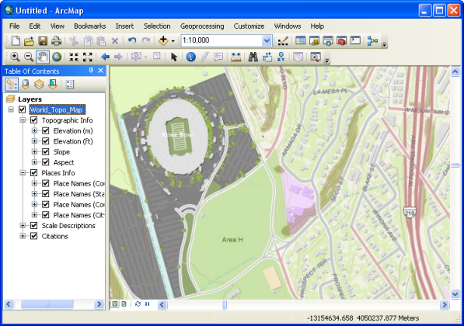
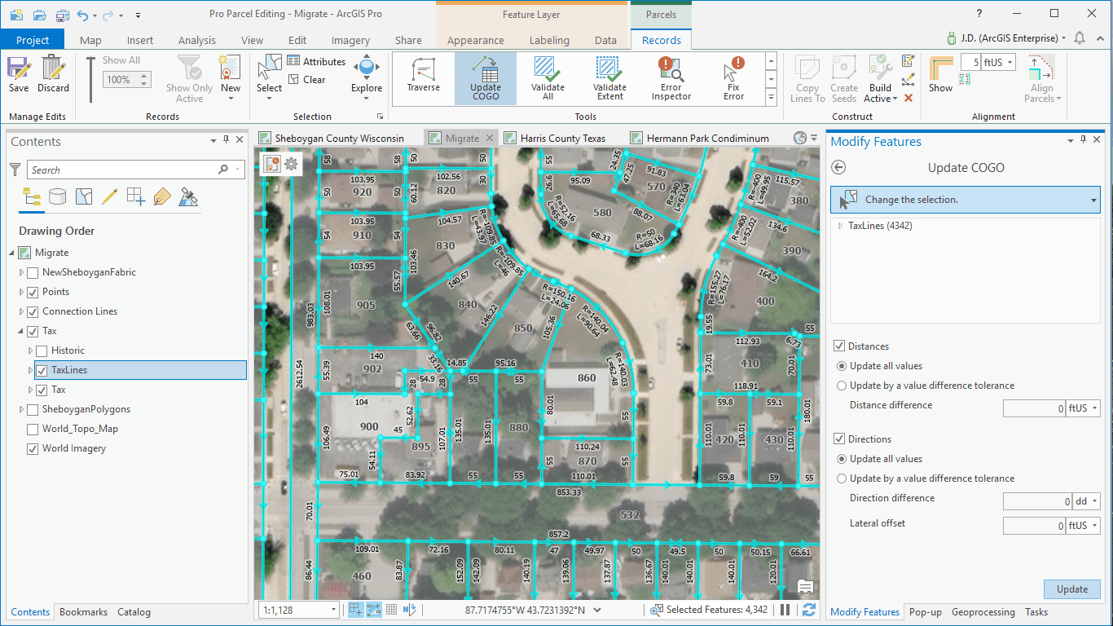
Motivations
Env. Sci. + MM student
ESRI

Slide 3
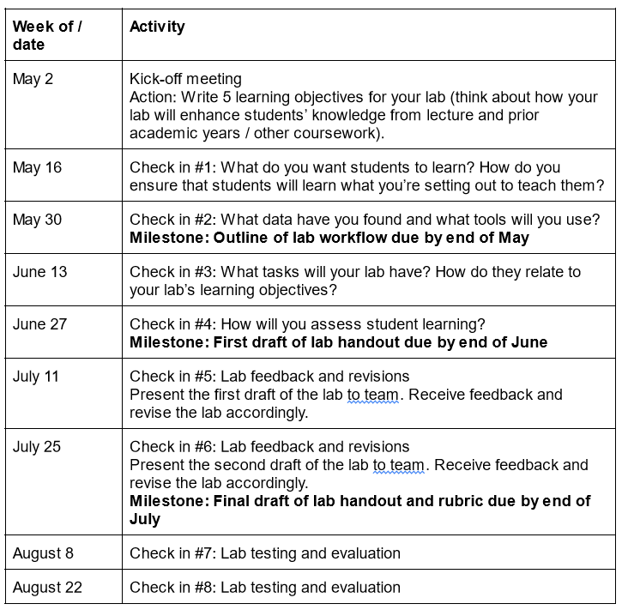
Process
Recognize students as co-creators of knowledge
Write a grant together as co-applicants
Hold “Content Creators” competition for students to submit lab ideas
Review submissions and select students to hire

Slide 4
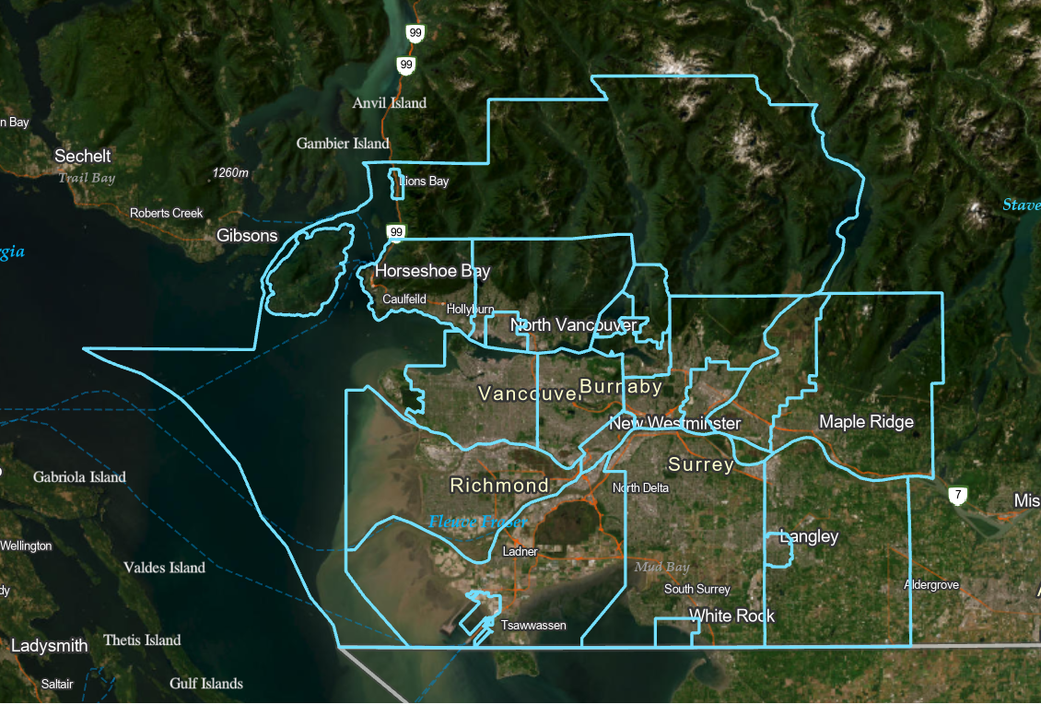
Green Equity Lab
Urban green equity is broadly defined as fair access to urban forests regardless of differentiating factors, such as socioeconomic status, racialization, cultural background, or demographics (Nesbitt et al., 2018).
Learning Objectives:
understand the greenery status in the Metro Vancouver area
Develop open data search and collection skills
Get familiar with the Proximity toolset
present analytical findings
Figure 1. The boundary of Metro Vancouver Area

Slide 5
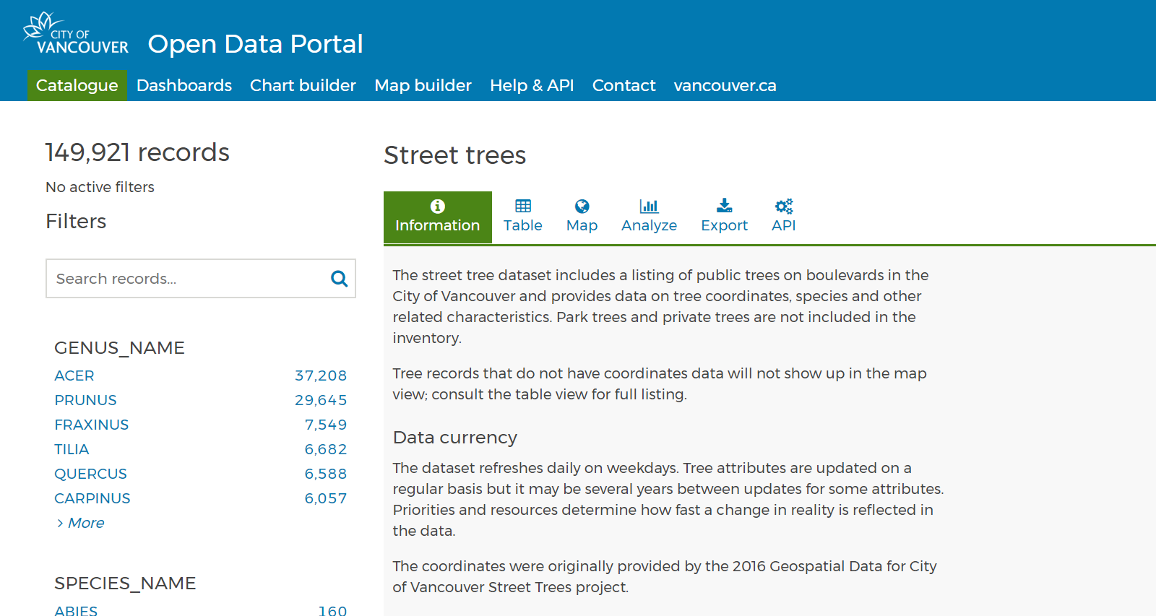
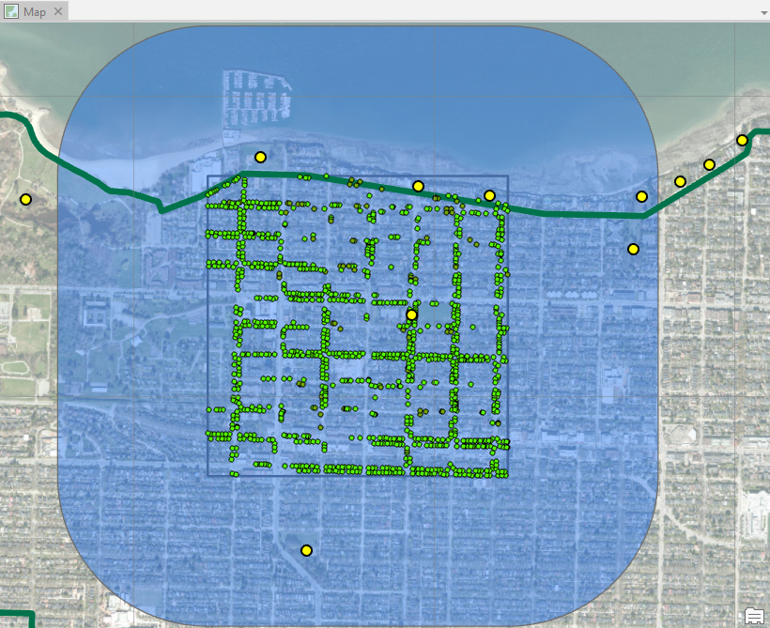
Green Equity Lab
Lab Tasks:
Finding & Accessing Data
Creating Urban Forest Map
Creating Buffer Zones
Classifying Forest Types
Figure 2. Vancouver Open Data Portal
Deliverables:
Urban Forests Map
Short Paragraph explaining whether you think urban green equity issue exists in the Metro Vancouver area or not based on students’ findings
Figure 3. Example urban forest map at a neighbourhood scale

Slide 6
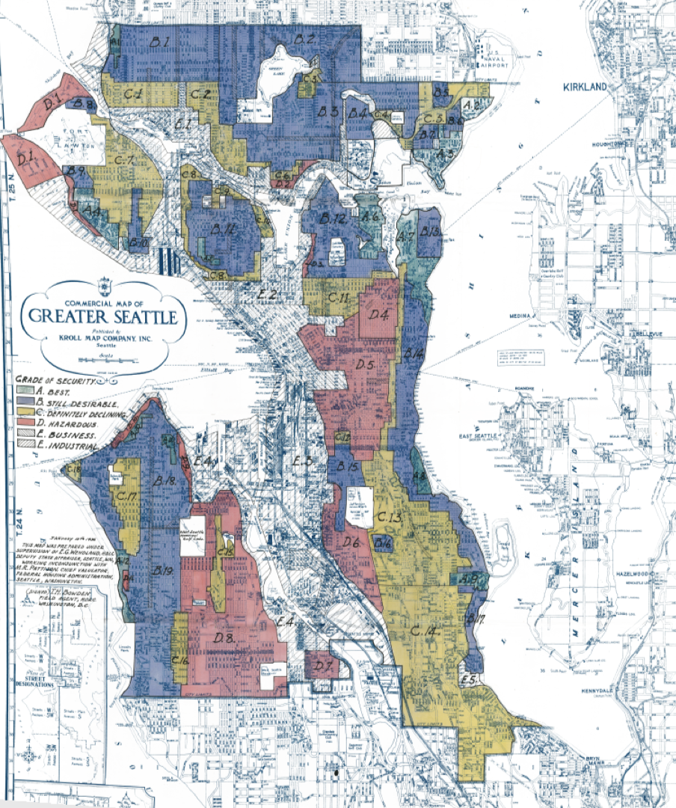
Visualizing Historical Redlining Legacies
Redlining emerged as a discriminative classification practice
to refuse to provide mortgages, insurance, loans and other
financial services to specific racial-discriminated customers.
Learning Objectives:
Understand the workflow of ArcGIS
Land cover/use differentiation
Structured Query Language (SQL)
Data analysis tools (e.g., clip)
Visualize legacies & understand the Luxury Effect.
Figure 4. Seattle Redlining Districts Classification in 20th century

Slide 7
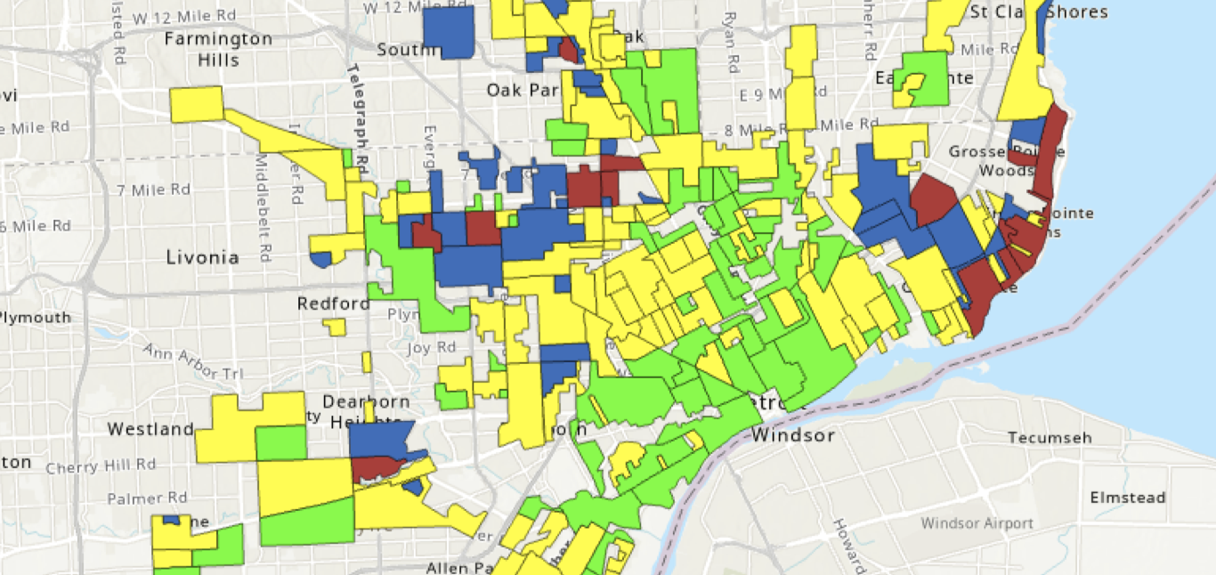
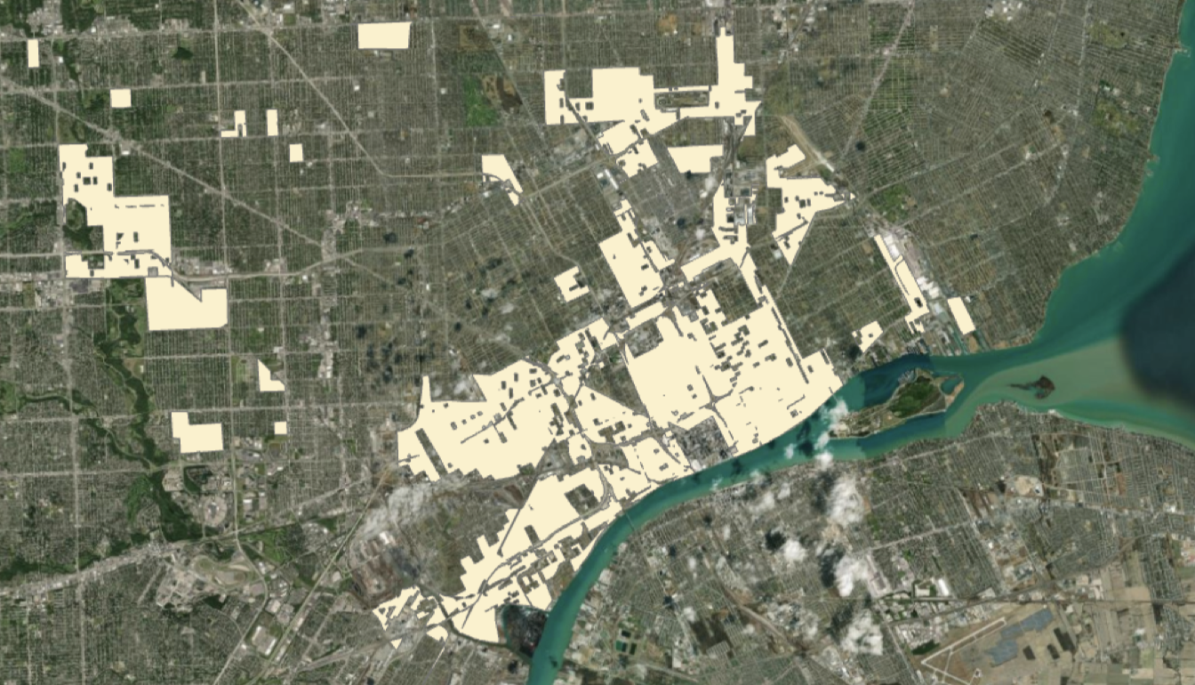
Visualizing Historical Redlining Legacies
Abilities:
Lecture Knowledge
Critical Thinking
Problem-solving
Figure 6. Processing Map
Env. Sci. + MM student
Figure 5. Ideal Classification Example
Tasks:
Canvas Questions List
PDF Maps
Canvas Discussions

Slide 8
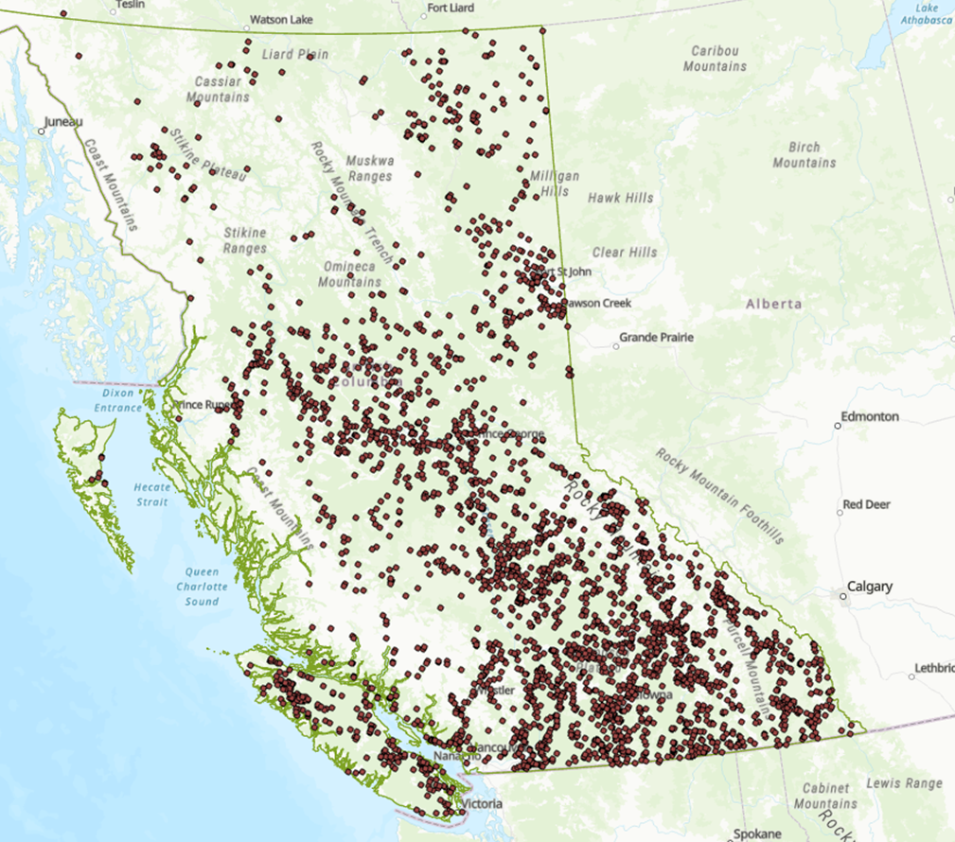
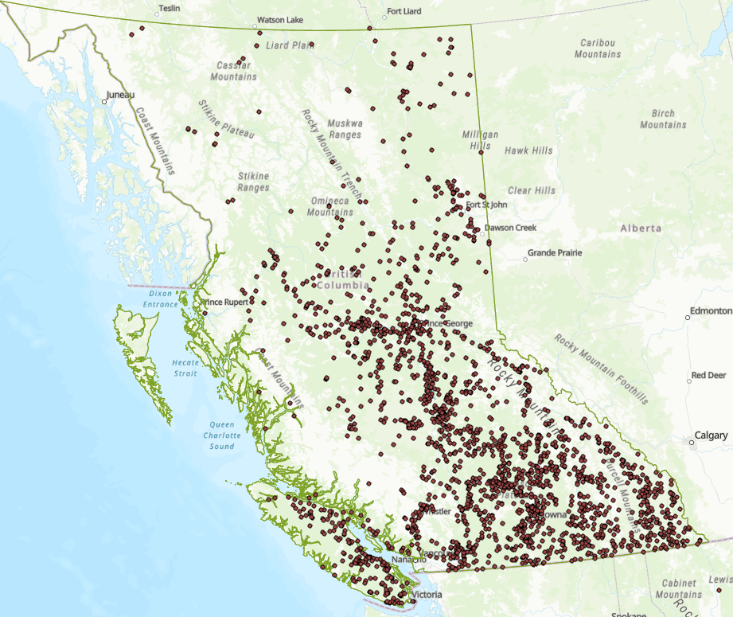
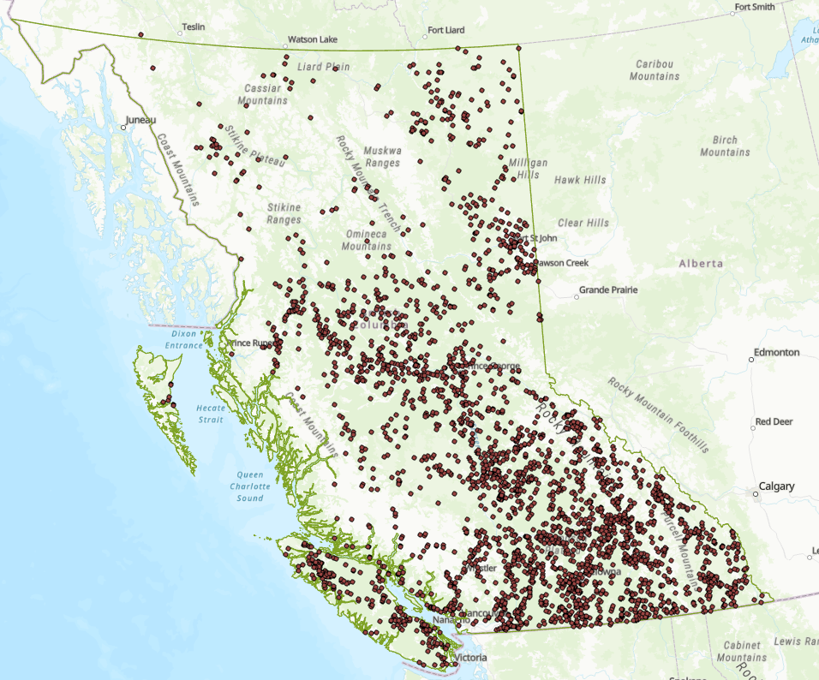
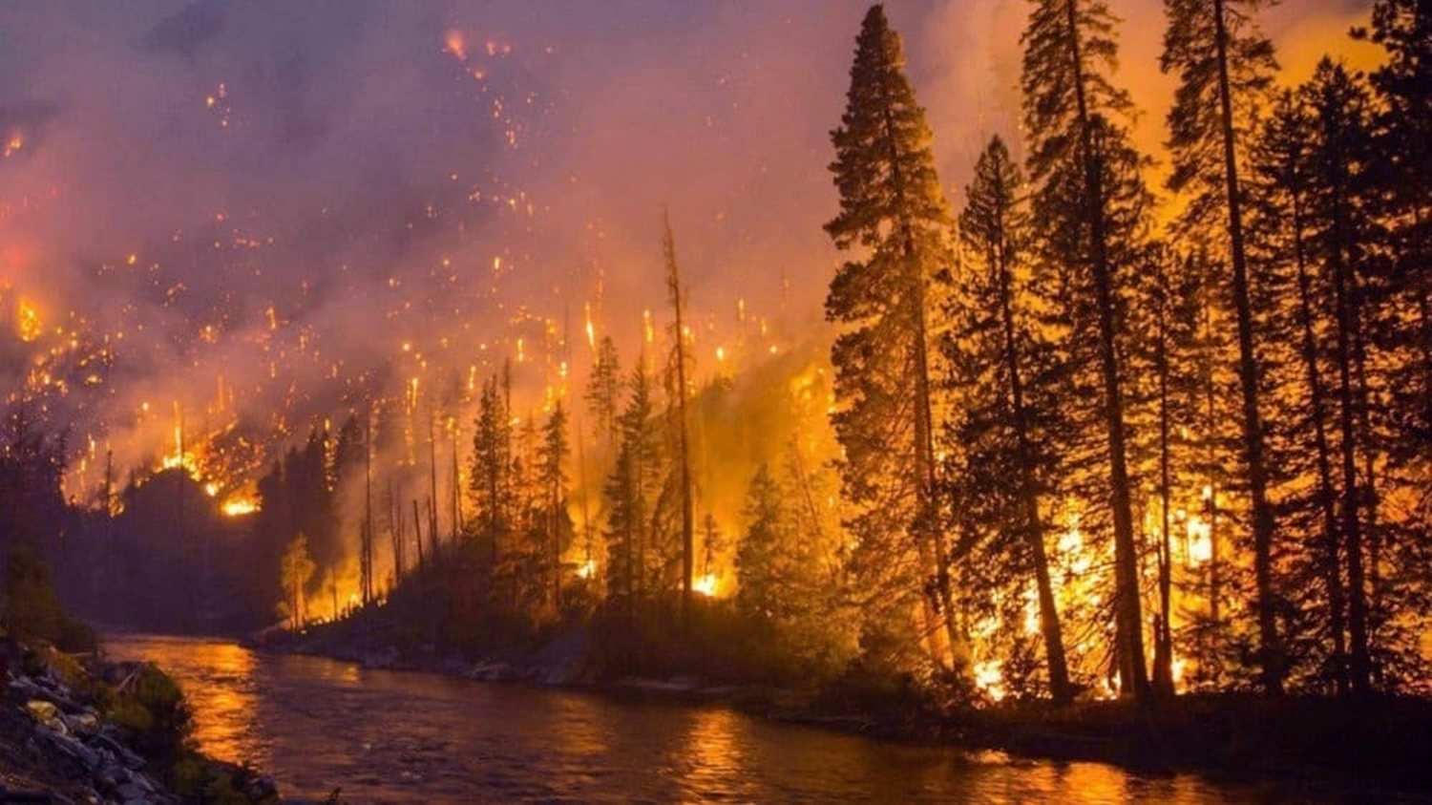
Wildfire
2021
More than 1,600 fires
869,279 hectares
2017
1.2 million hectares
2018
More than 2,000 fires
1,354,284 hectares

Slide 9
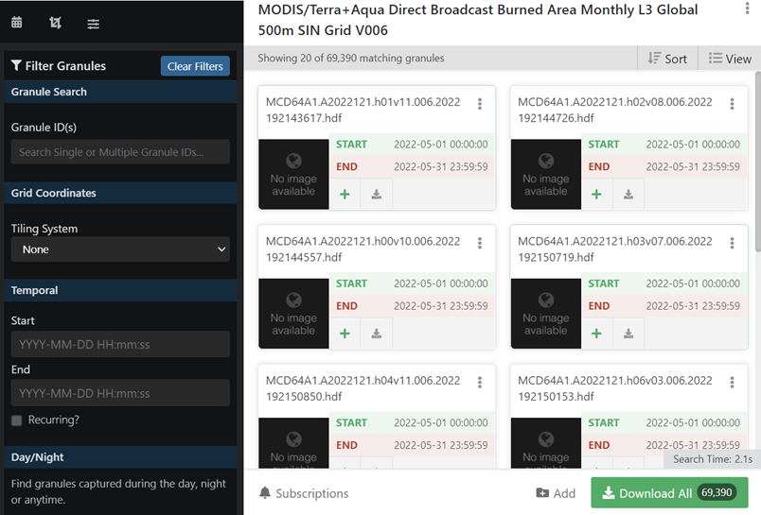
Learning outcomes and workflow
Primary learning outcomes: Students will learn about the frequency of wildfires in BC in recent years and how to search, download, and manage public geospatial data sources.
•Design database
•Process given vector data
•Search and download data from public data sources
•Process downloaded raster data
Env. Sci. + MM student

Slide 10
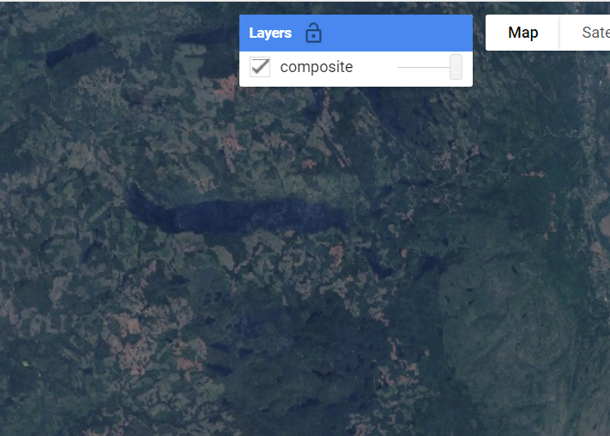
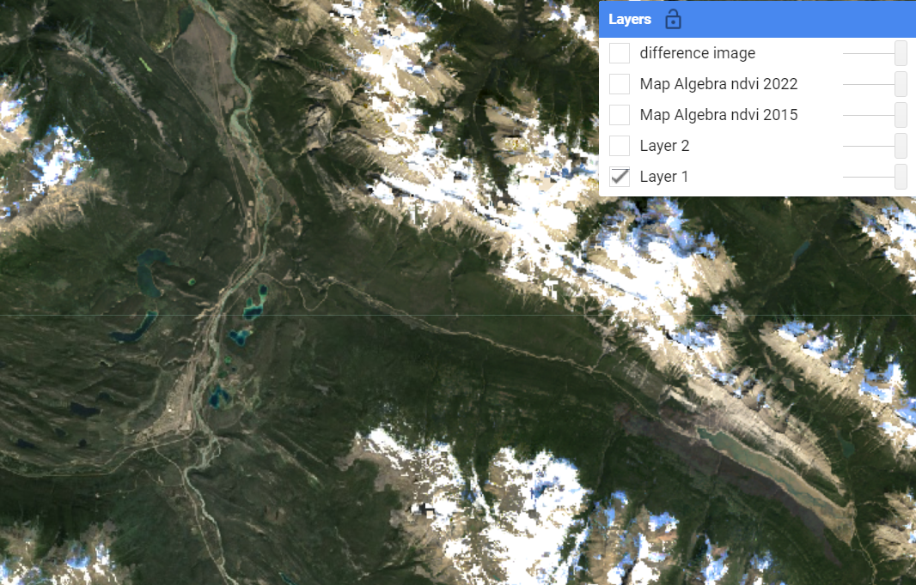
Cloud Computing
Using JavaScript in Google Earth Engine
explain code examples in plain English.
Understand the Google Earth Engine Interface.
Understanding and completing an NDVI analysis
Use NDVI change maps and be able to describe results

Slide 11
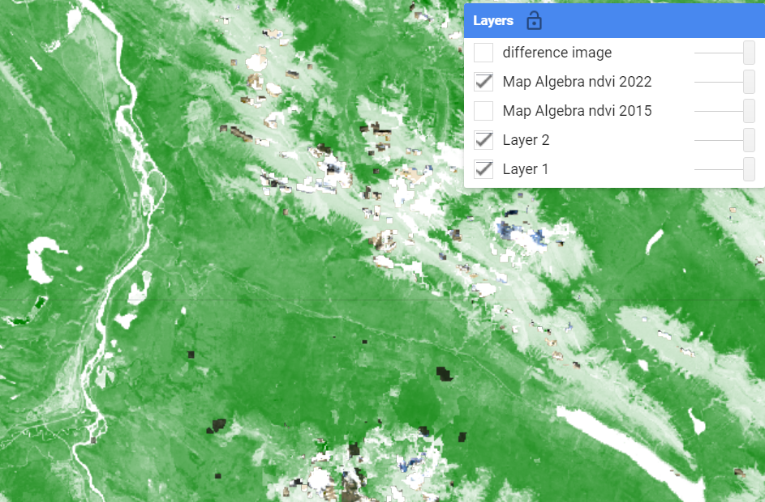
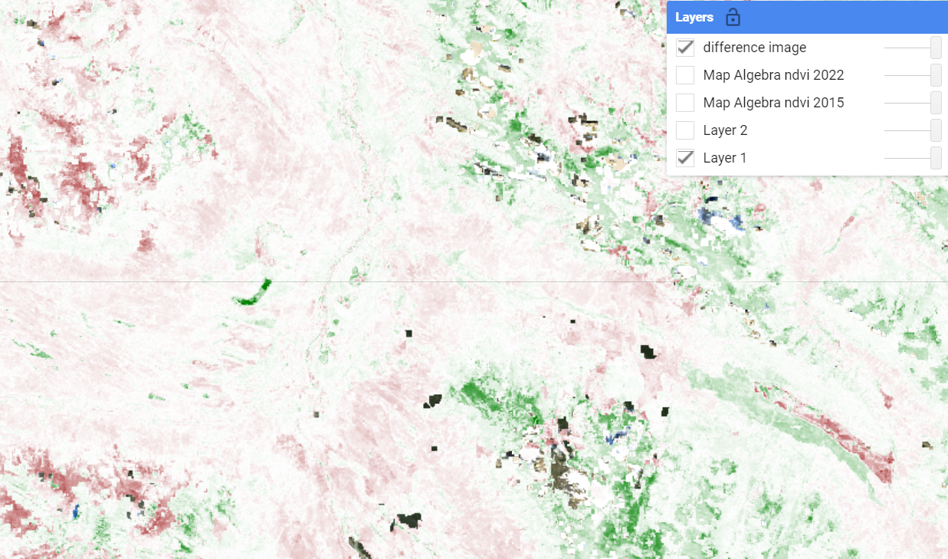
Cloud Computing
FOCUS: Changing the way we look at “Coding Labs”
puts emphasis on code comprehension and analysis rather than following specific instructions.
DELIVERABLES:
Discussion Post
NDVI Maps
NDVI Change Maps
False Colour Maps
Code Interpretation Short Answers

