Slide 1
CA 374 - Stage Lighting Finding images & reviews
Sylvia Roberts, Contemporary Arts Librarian sroberts@sfu.ca 778-662-3681

Slide 2
Outline
Finding images – contemporary and historical
Finding performance reviews
How to cite images and performances

Slide 3
Image searching experiences
What are you looking for?
Where have you looked?
What were the difficulties in finding the right image?

Slide 4
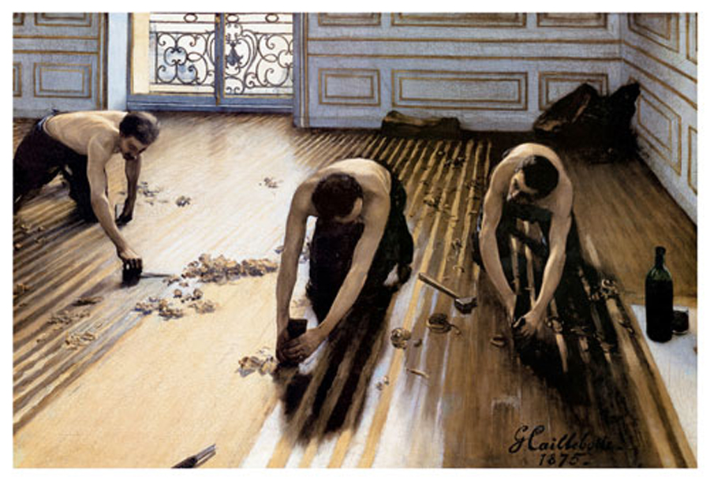
Finding inspiration in art works
The Floor Planers(1875) Gustave Caillebotte
Notes:
artists have always used light effects in their paintings and photography
Wood Floor Planers Giclee by Gustave Caillebotte How would you look for similar images
Topic / time of day / time in history / emotional dimensions “affect” / people?
My husband said homoerotic but he’s an art historian – naked male bodies,, workers in part an excuse to show – sort of a legitimate erotica
Other impressionists, the female nude was prominent content
Also a matter of class as manual labourers shown in form of classical statuary of antiquity
Talk about the light –suggesting differences in material (wood floor in dif stages), comes through window from outside, suggesting the street, daytime, and it’s not strong sunlight because it’s Paris which is frequently cloudy

Slide 5
Finding inspiration in art works
Nighthawks (1942) Edward Hopper
Coruscating Cinnamon Granules (1996) Rodney Graham
Notes:
Nighthawks (1942) Edward Hopper – what time is it? What year is it? What are these people doing? Thinking? What’s the feeling
Art Institute of Chicago “About Nighthawks Edward Hopper recollected, “unconsciously, probably, I was painting the loneliness of a large city.” In an all-night diner, three customers sit at the counter opposite a server, each appear to be lost in thought and disengaged from one another. The composition is tightly organized and spare in details: there is no entrance to the establishment, no debris on the streets. Through harmonious geometric forms and the glow of the diner’s electric lighting, Hopper created a serene, beautiful, yet enigmatic scene. Although inspired by a restaurant Hopper had seen on Greenwich Avenue in New York, the painting is not a realistic transcription of an actual place. As viewers, we are left to wonder about the figures, their relationships, and this imagined world.”
, Hopper had mastered the suggestive possibilities of narrative clues like these, fragments of plot that offer innuendos of deeper stirrings without revealing their exact nature. The light in the painting is crucial. Take a moment to look at the shape of the lighted areas. The bold geometry of the yellow interior, with its dagger-like point that extends sharply to the left, is focused and precise, adding a tone of edginess to the work. Its shape is roughly mirrored by the light that extends across the street floor. In many respects, Hopper was a painter of light. So many of his works utilise natural sunlight, often shown streaming in through a window or doorway, lighting up faces and casting shadows across walls. In Nighthawks the light is artificial, fluorescent lighting that in the 1940s was still a fairly new invention.
Rodney Graham Coruscating Cinnamon Granules 1996
documents sparks that Graham created by sprinkling cinnamon on the surface of an electric cooking element before turning it on in darkness. The artist describes it as “a glittering mini-spectacle that resembles a constellation of stars that appears before one’s eyes after a mild blow to the head.” Graham explains that the “film is intended to be projected in a cinema bearing the dimensions of [his] own modest kitchen.”
Coruscating Cinnamon Granules, 1996, a work that inserts a domestic space into the gallery—a projection booth whose dimensions correspond to those of Graham’s kitchen—and then expands it to cosmic proportions. A black and white film loop shows an electric hot plate heating up and then cooling while cinnamon is sprinkled onto it. As the spice burns, one can see pricks of scintillation all over the screen, both while the ring’s elliptical spiral is glowing and when it has been switched off, but is still hot. The scale of what one sees is at once clear and ungraspable, its limits indeterminate.

Slide 6
Finding inspiration
Other Contemporary artists using light as a medium:
Dan Flavin
James Turrell
Yayoi Kusama
Jenny Holzer
Rafael Lozano-Hemmer
Daan Roosegaarde
Kevin Schmidt
And many more
Film/video artists’ use of film
Notes:
Artists have long used light to create mood in their paintings, as well as trying to represent light as it occurs in nature or construction
What are some of the strategies that these artists have used with their light? Reflection, mirrors, contrast (chiarascuro – highlights, lowlights), intensity / strength, shape, source / direction, combinations of colour (complementary or contrast), hue, value, saturation
Joseph Albers “interaction of colour” theory says that there is “visually energetic reaction” in viewers of 2 contrasting colours with similar intensity causes predictable physiological response in viewers
Psychological effects of light and colour, both through nature (physiology – red/orange is stimulating) and nuture (cultural associations with colour/light)

Slide 7
Abbott & Cordova, 7 August 1971 (2008) Stan Douglas.
Notes:
‘Abbott & Cordova, 7 August 1971’ by Stan Douglas.
How would you look for similar images
Topic / time of day / time in history / emotional dimensions “affect” / people?
Talk about the light – where does your eye go?
Stan Douglas’s career-long investigation of the history of Vancouver. Douglas chose to commemorate the 1971 Gastown riot during which a peaceful “smoke-in” against the city’s use of undercover agents and in favor of the legalization of marijuana erupted into a conflict with the police, fueled by anger over the neighborhood’s gentrification. The photograph is the product of exacting historical reconstruction involving an elaborate life-size stage set, lighting, and paid actors. To ensure historical accuracy, he also conducted extensive research, collected archival photographs, and interviewed witnesses and participants

Slide 8
‘Helen Lawrence’’directed by Stan Douglas, 2014
Notes:
Stan Douglas does videos that evoke other times, Helen Lawrence was a theatre work, written by Chris Haddock, presented at the Stanley
Film Noir influence but also incorporating historical content, projecting images of the old Vancouver Hotel found in archival sources, extensive research to get the right look
Have both Dance and Theatre in Video as examples , YouTube, Vimeo BUT you know how to find these once you’ve identified

Slide 9
Bill Viola trailer (2019). Illuminations media.
Notes:
The raft (2004) “video like electronic water, it’s flowing, electrical currents fluid” same might be said of light, waves

Slide 10
Sources of images
SFU books & articles
By topic: advanced catalogue search, “illustrations” in description / format
By subject: “in art”, “pictorial works”, “juvenile literature”, “social life and customs”, “popular culture”
“illustrated history” example – use back of the book index to find specifics
SFU Library databases with images
ARTstor
Primary sources
Open digital image collection, examples:
Digital collections in archives e.g. BC Historical Collections Online directory
Museums e.g. UBC Museum of Anthropology collections online
SFU digitized collections: Images and photographs
NYPL Digital Gallery
Notes:
Eg “fancy dress” what does this mean? Costume or evening wear? Ball? Ballroom, masquerade – look at topic words to see if there’s a standard way to describe what you want

Slide 11
Considerations when using images
Inspiration versus reproduction
Fair dealing provision of Canada’s Copyright Act for school projects
Creative commons licenses
Public Domain
Otherwise require permission from the copyright holder
Representation
Consider what is missing, selected, altered
Verify assumptions through research
Notes:
Canadian public domain 50 years after death of creator, end of calendar year
“Photography is not benign” romanticized views of Indigenous peoples by Edward Curtis funded y JP Morgan to document a so-called vanishing race, carried props to enhance photos, not always accurately applied
Everyone knows the photographs of Edward S. Curtis–they are the “iconic” Indian pictures you see in coffee table books, on postcards, even on wall hangings at Ikea. They’re the images people most often associate with Natives: Indians on horses, Indians in headdresses, Indians riding off into the sunset never to be seen again… At the time he was working, Curtis was convinced that the Native population was about to disappear forever, so he took it upon himself to photograph as much of this “vanishing race” as he could. He amassed an amazing body of work, but he definitely had an idea of what he thought “real” Indians looked like.
Walter McClintock selected only camp scenes and traditional dress, despite being surrounded by Blackfeet nation living contemporary life
‘Western photographers often refrained from taking pictures of Anishinabeg in ‘Western’ clothing because these images were not aligned with the salvage paradigm that focused on preserving what was left of authentic ‘native’ cultures.’ ‘Our Pictures Are Good Medicine’ Celeste Pedri-Spade

Slide 12
Finding support from experts
Library catalogue finds 95% of information resources in all disciplines, based on words in the description
Library databases focus on the published research of a discipline, providing records that describe each article’s finding information (authors, title, journal) and what it is about (topic words, abstract)
Arts databases include research articles, reviews of performances, discussions of trends, images, sounds and videos
Let’s try a search for an artist that focuses on light as a medium

Slide 13
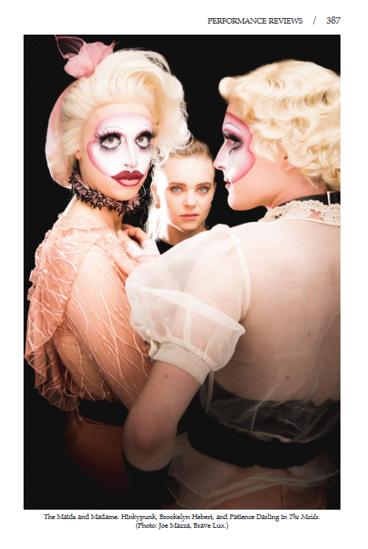
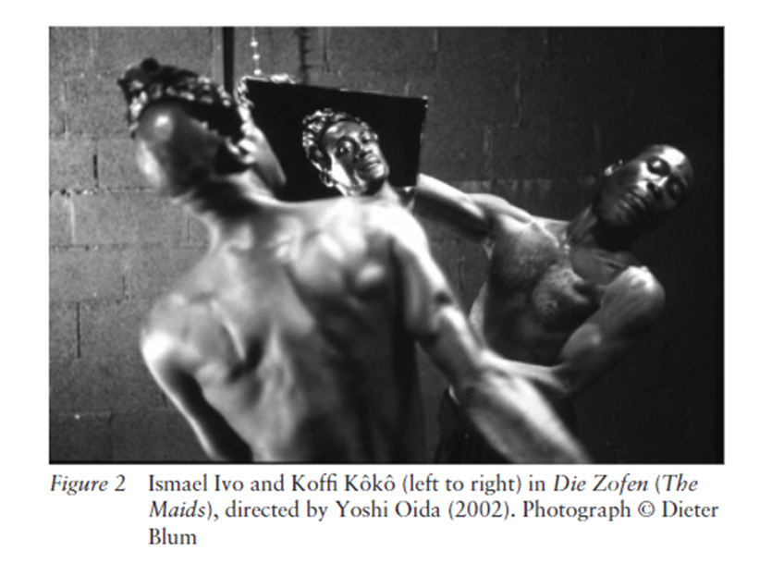
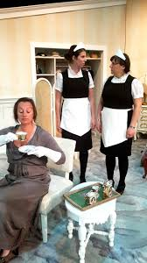
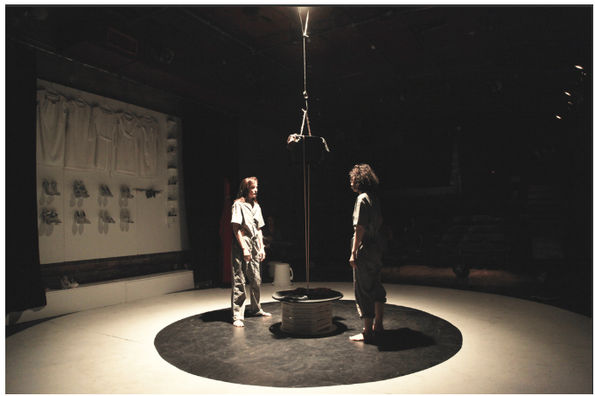
Notes:
Images of 3 dif productions of Jean Genet’s The Maids
Bradby, Finburgh, & Finburgh, Clare. (2012). Jean Genet / David Bradby and Clare Finburgh. Routledge.
.
Theatre Journal; Baltimore reviw of 2018 Chicago IL production Japanese production 2002
La MaMa 2017 NYC
production 2016 touring production opened in Armstrong bc 2016
Theatre mania NYC 2012

Slide 14
Finding production reviews
WHY NOT just use the Internet and social media?
Theatre databases especially the Performing Arts Periodicals database
Drama indexes in print (historical)
New York theatre critics' reviews (historical)
Excerpted in books about playwrights’ works: Search name and “dramatic production”, “stage history”, “criticism and interpretation”
News sources
Consider geography, date, scale of production when searching
Canadian: Canadian Newsstream
Global: Factiva, NexisUni, Press Reader
Online: The Guardian, Entertainment Weekly, Globe & Mail, New York Times
Notes:
Search “the maids” AND genet AND review
Dance and lighting and review
QUESTION: Are reviews of film productions useful???

Slide 15
Citing images and reviews
MLA or Chicago citation styles typically used in theatre
You can incorporate images into your text and use a caption to identify the work:
Use Library citation guides to find format and examples
Notes:
In general, researchers in theatre and drama use the citation style in the Modern Language Association (MLA) Style Guide or the Notes-Bibliography version of the Chicago Manual of Style.

