Slide 1
CA 357 Research strategies
Sylvia Roberts
January 28, 2022

Slide 2
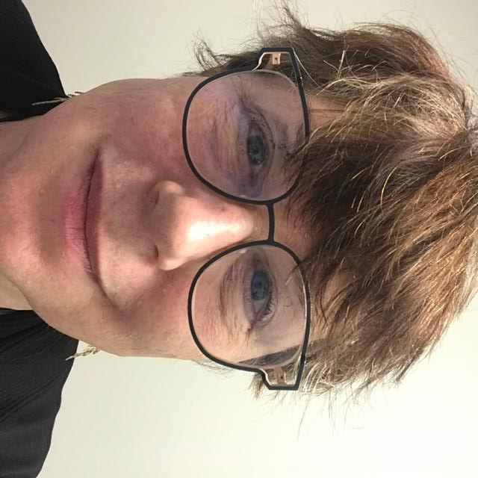
Who I am
Sylvia Roberts, Liaison Librarian for Communication and Contemporary Arts
Provide specialized and discipline-specific research support
Friends and family working in theatre, film, dance and visual arts
Enthusiastic consumer of the arts
Endlessly curious and widely read
Notes:
Been a librarian since before the internet, at SFU since 1997

Slide 3
Purpose of the SFU Library
To support the curriculum (teaching and learning)
To support research by faculty and students
To encourage critical use of information in all of life’s pursuits
Collect materials in all formats and make them accessible to SFU researchers
Study space for groups and individuals

Slide 4
CA357 Assignment
A piece of critical writing in which a show/exhibition/performance are present but peripheral.
You need to go and see a show in a theatre/gallery/museum and consider what supports the work that you are there to see.
A 2500 word essay with a minimum of 5 academic sources.
Research for the annotated bibliography and final essay

Slide 5
Your research journey
“Information searching is a contextualized, complex experience that affects, and is affected by, the cognitive, affective, and social dimensions of the searcher.”
(ACRL 2015)

Slide 6
Research starts with a question*
What are you planning to see?
What do you already know about the venue?
What interests you about these?
* At least one!
Notes:
Can do some research prior to seeing the show or the exhibition. Where’s it being held? Have you been there before? Can you get pictures of the interior online? Is there a history of the organization or of the performance company? What do you know about the performance? If nothing, can you read reviews? Or discussions of the company or artist? Newspapers and general searching can help you prepare your mind to take advantage of what you see and how that experience is framed by the nature of the institution.

Slide 7
SUGGESTIONS (as appropriate)
Washrooms and water fountains,
The lobby, coat check, gift shop, bar
Seating/viewing (assigned or not)
Getting there, entering, the lineup and leaving
The site, its history, past occupants of the building
Name or corporation on the building
Speeches beforehand or at an opening
The donors, the board, power structures that uphold the institution.
How the content relates to the container (the show in relation to the theatre or gallery)
The relationships to industry standards and conventions
Time in between the matinee and the evening show
The starting time of the show or the time in which you saw it.
Notes:
When I saw this list, I wasn’t sure about how this might work but … suggested some students were planning to see Hamilton at the Queen Elizabeth Theatre. I spent 5 minutes brainstorming some possibilities: a successful commercial musical road production coming to a civic theatre in a time when it’s been difficult for local theaters to open for performances; also what I know of Hamiliton is it’s about the formation of the American nation whereas the Queen Elizabeth Theatre is named in tribute to Canada’s colonial history

Slide 8
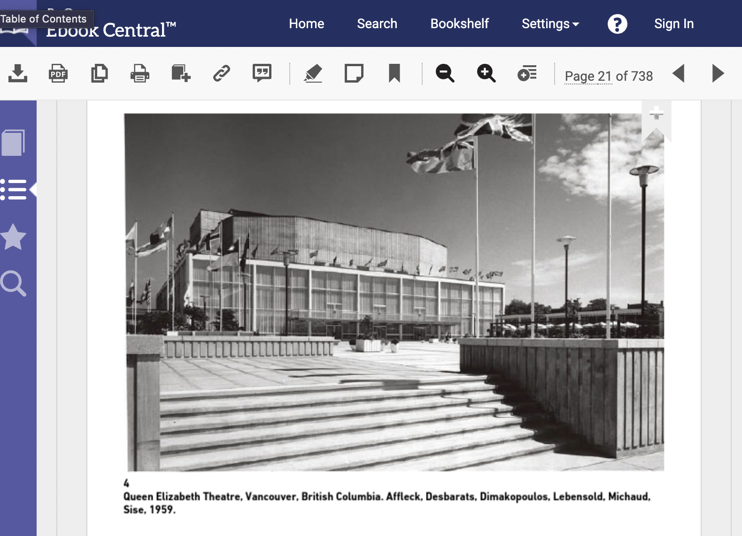
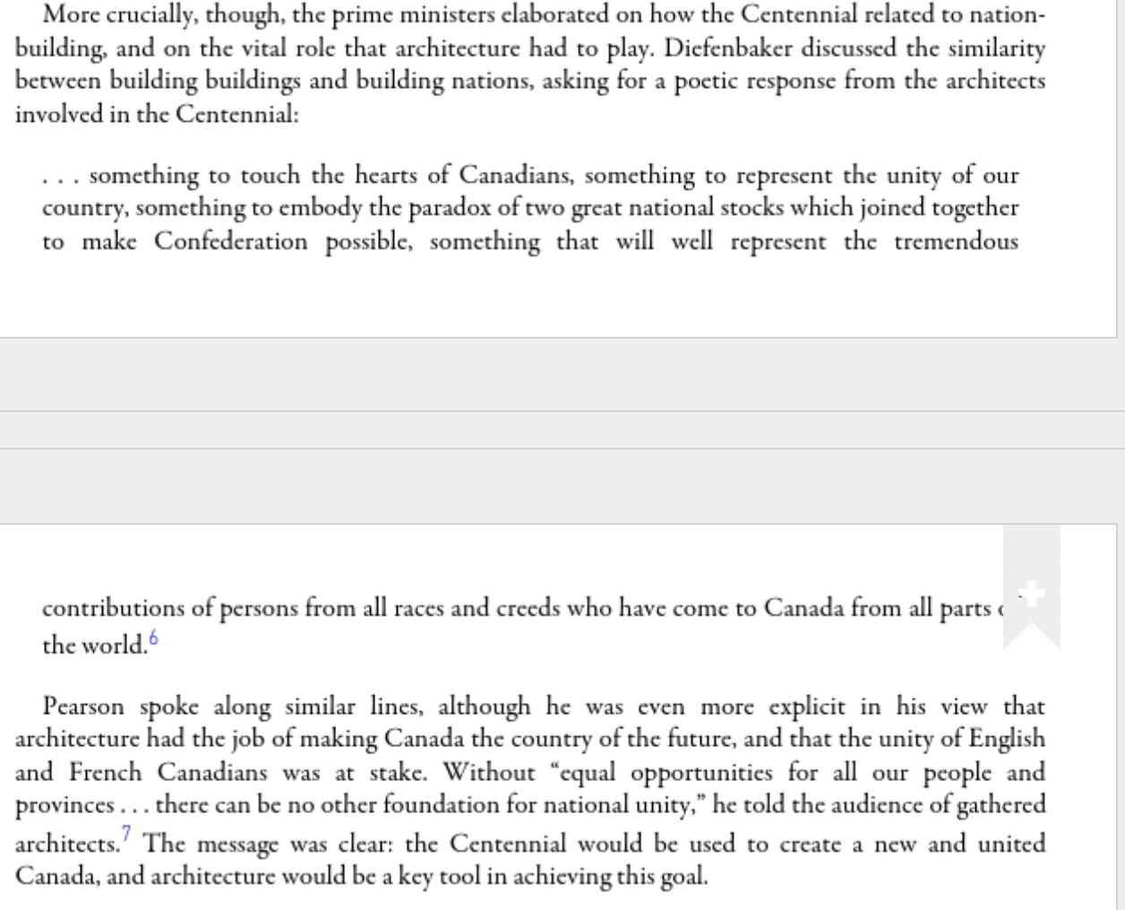
Lam, Elsa, et al. Canadian Modern Architecture : 1967 to the Present / Edited by Elsa Lam and Graham Livesey. Princeton Architectural Press, 2019.

Slide 9
BRAINSTORMING (generating ideas) BACKGROUND READING (clarify and focus) MINDMAPPING (imposing order on ideas) RESEARCH PLANNING (mindful, intentional)

Slide 10
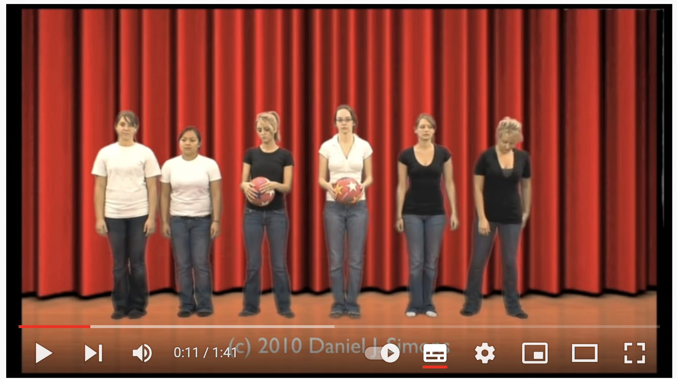
Plan your research
BUT be open to…
SERENDIPITY
LATERAL THINKING
LEADS (to related information)
DIFFERENT PERSPECTIVES
Notes:
Serendipity - the occurrence and development of events by chance in a happy or beneficial way.
Lateral thinking - the occurrence and development of events by chance in a happy or beneficial way.
Leads – mentions of other performances / persons in sources, mining the reference list for related sources, related phenomenon
Dif perspectives – have anthropologists, sociologists, psychologists discussed a phenomenon, other cultural thinkers

Slide 11
Background reading
Informs research planning
Understanding the relevant terminology, key concepts, context of topic
Often include bibliography or list of related reading
Specialized encyclopedias, handbooks, textbooks

Slide 12
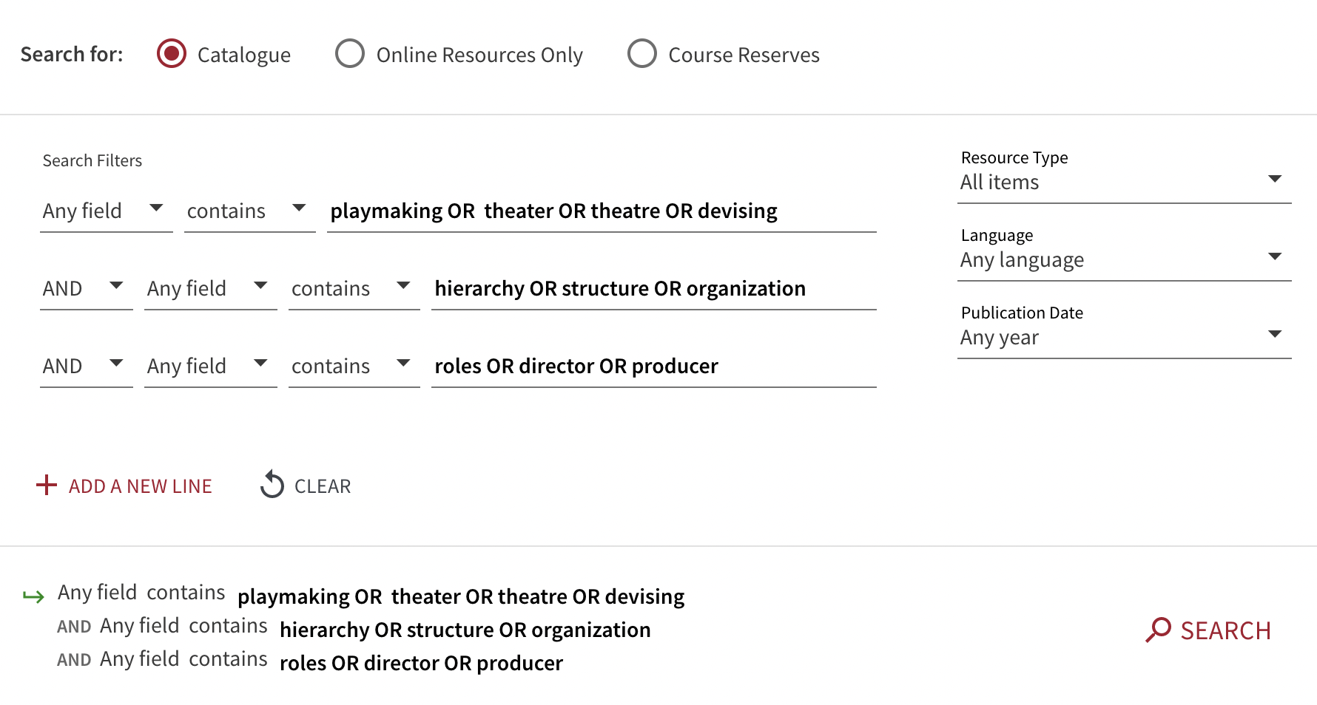
Notes:
Lauren Han

Slide 13
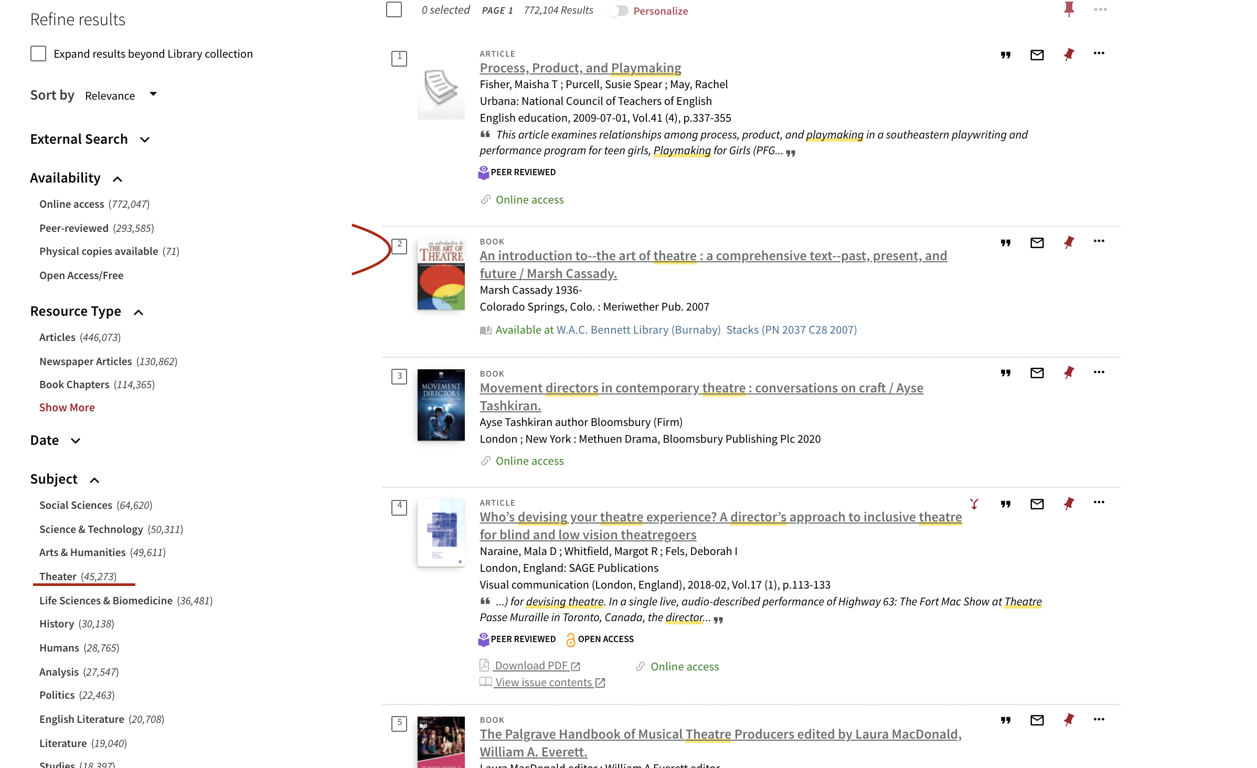

Slide 14
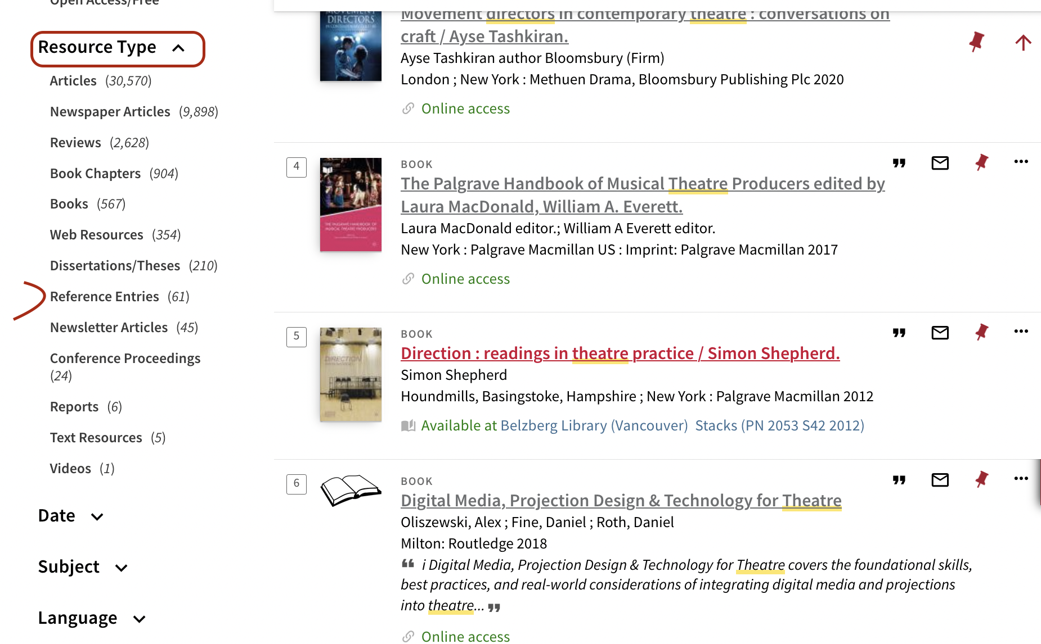

Slide 15
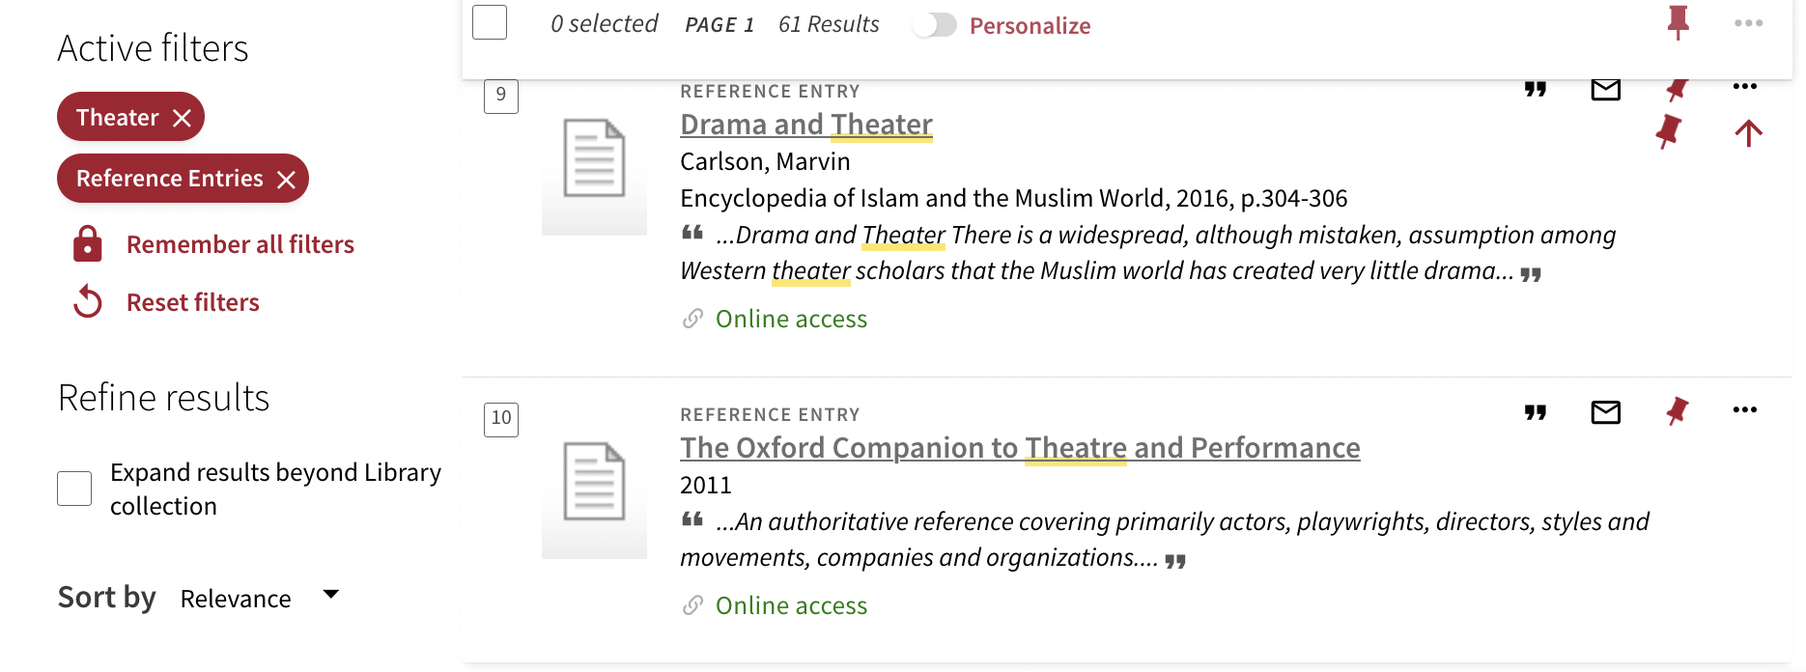

Slide 16
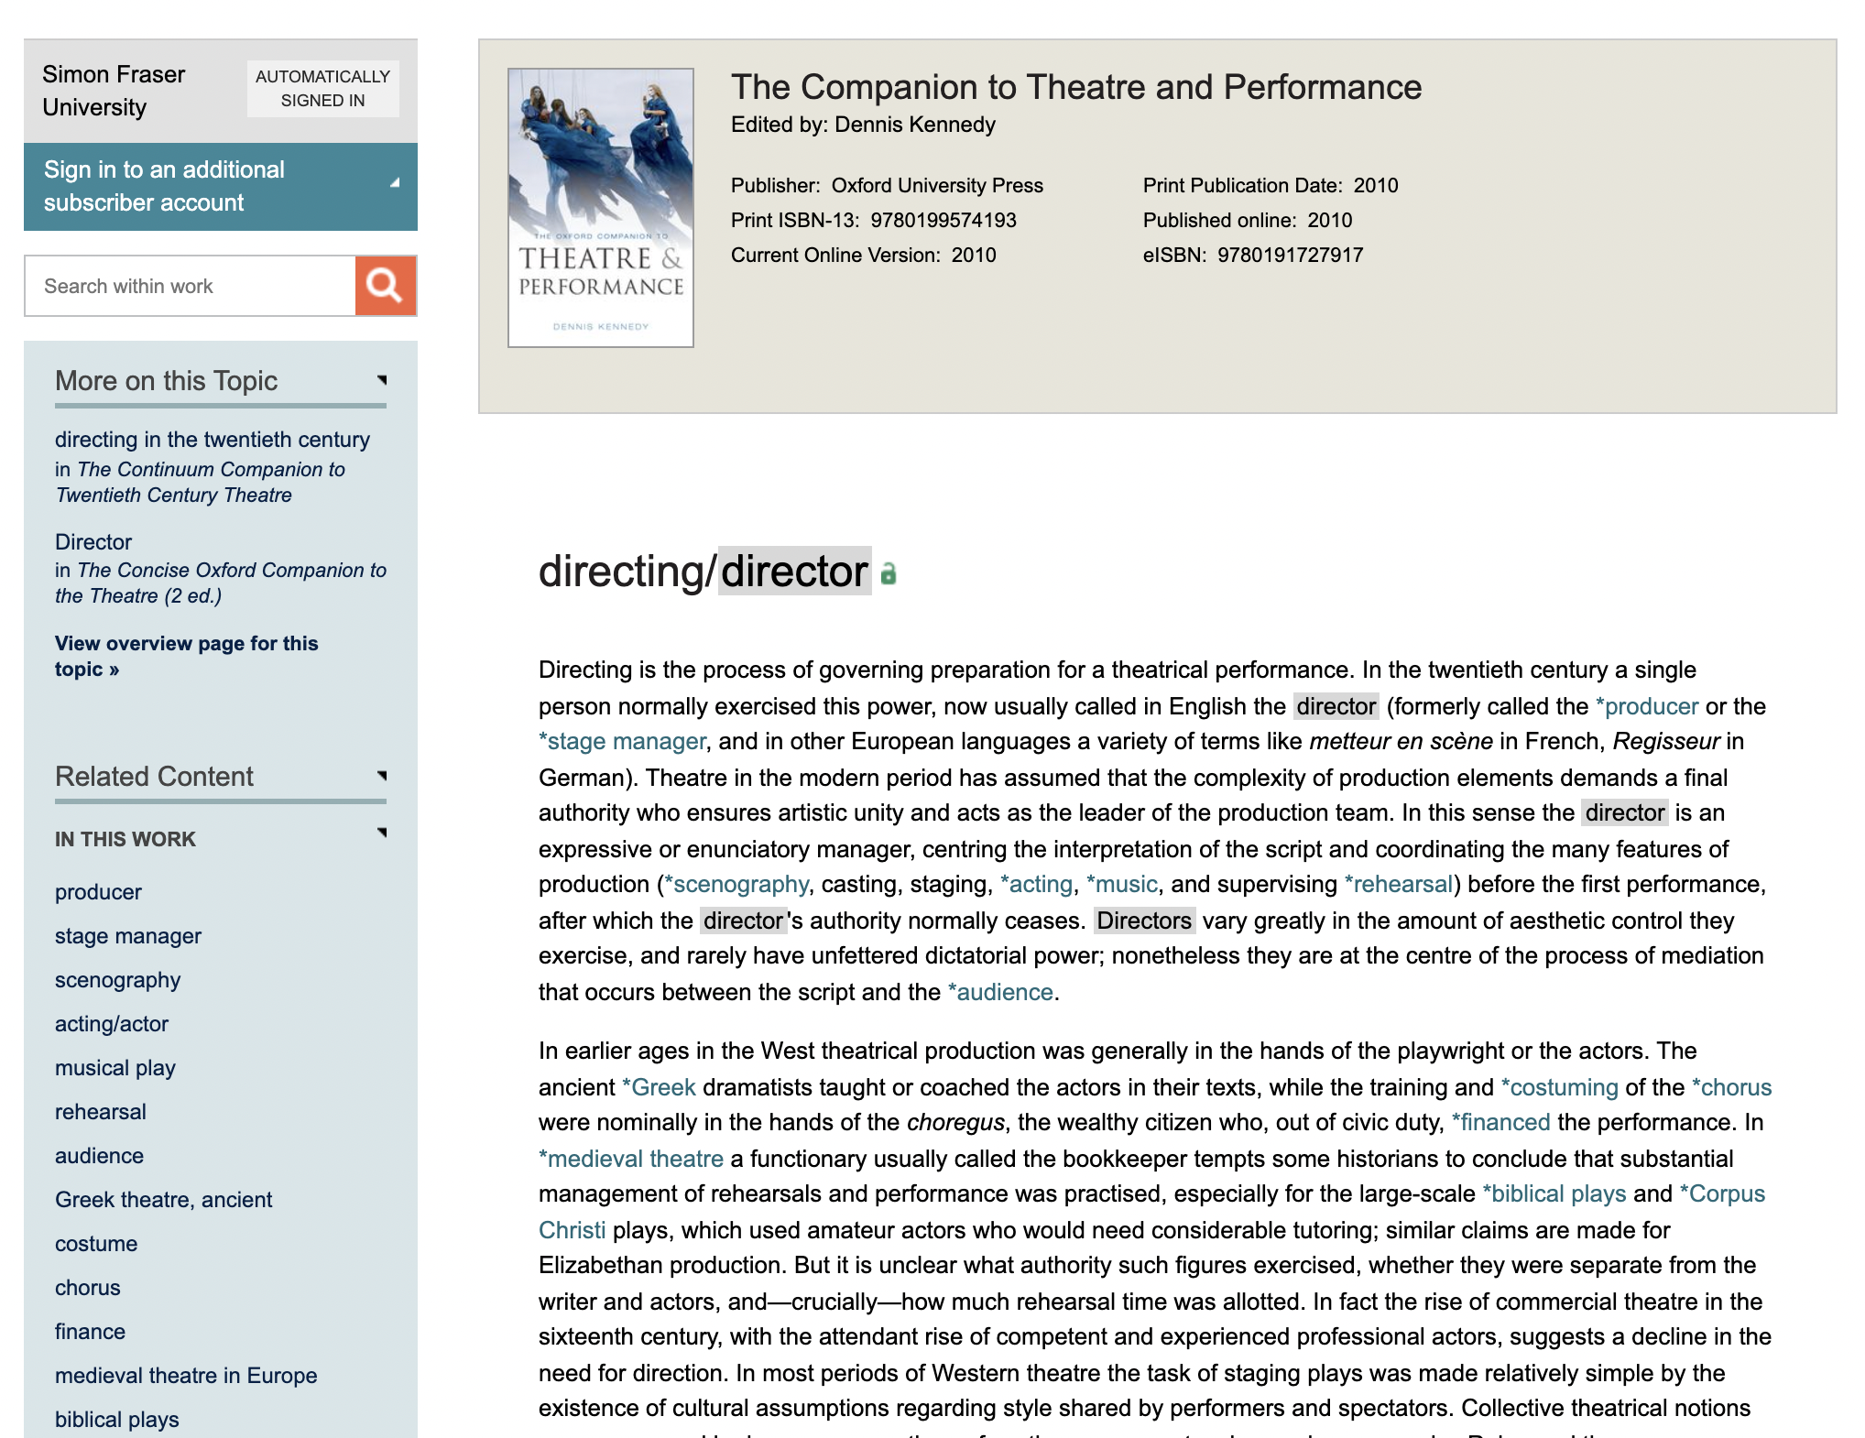

Slide 18
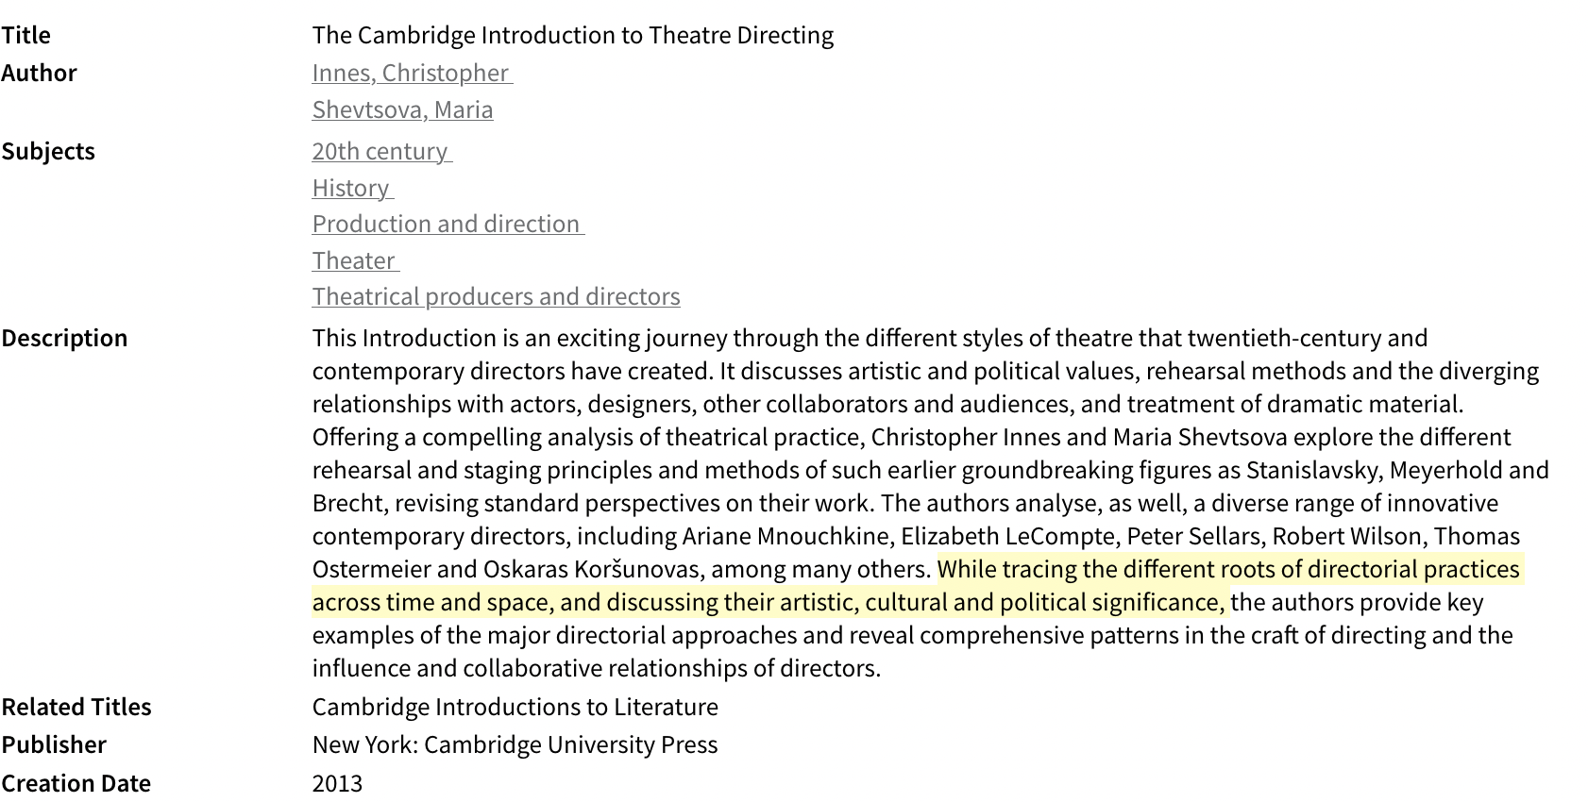

Slide 19
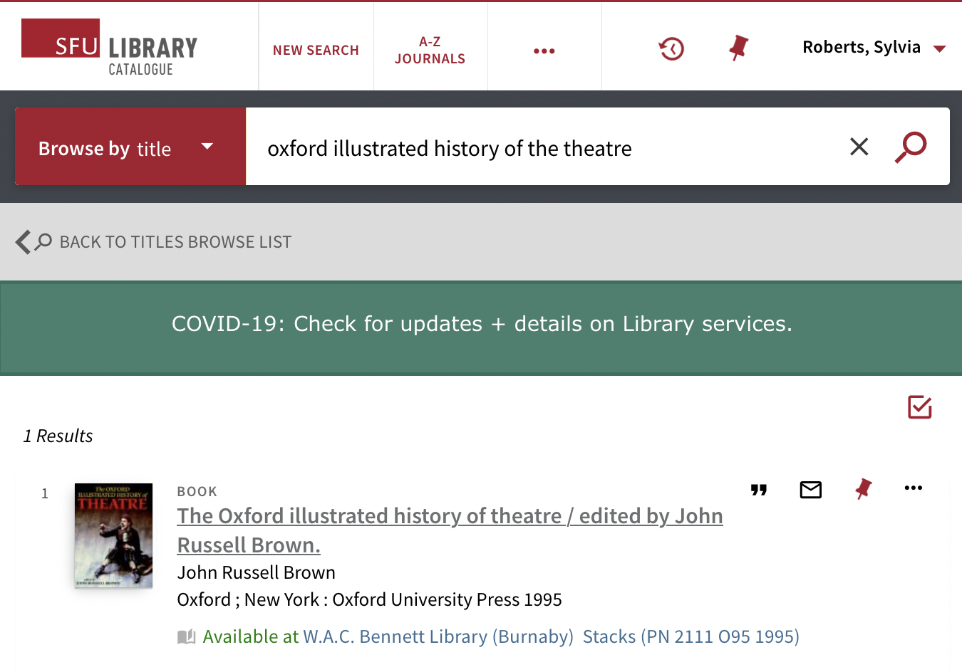
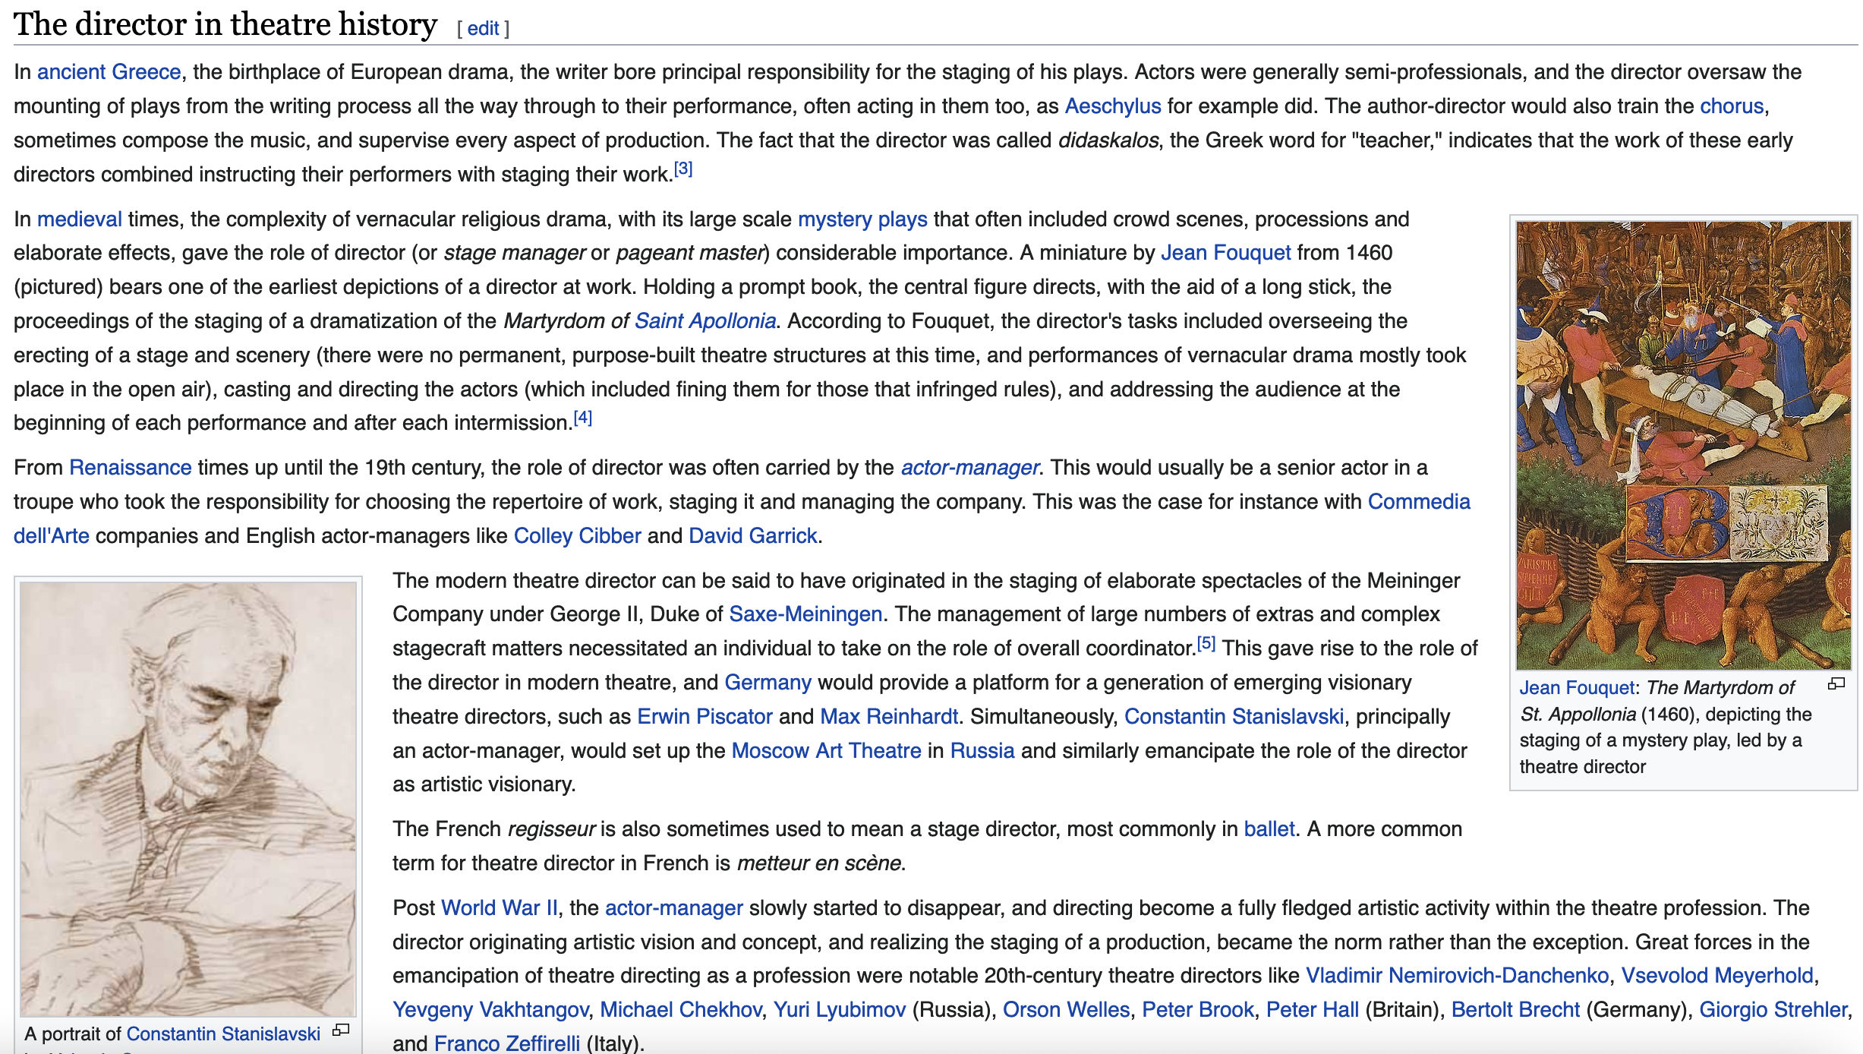
Notes:
Wikipedia

Slide 20
Background for topics beyond theatre…
International encyclopedia of the social and behavioral sciences (2nd ed.)
Oxford Reference Online
Oxford Very Short Introductions

Slide 21
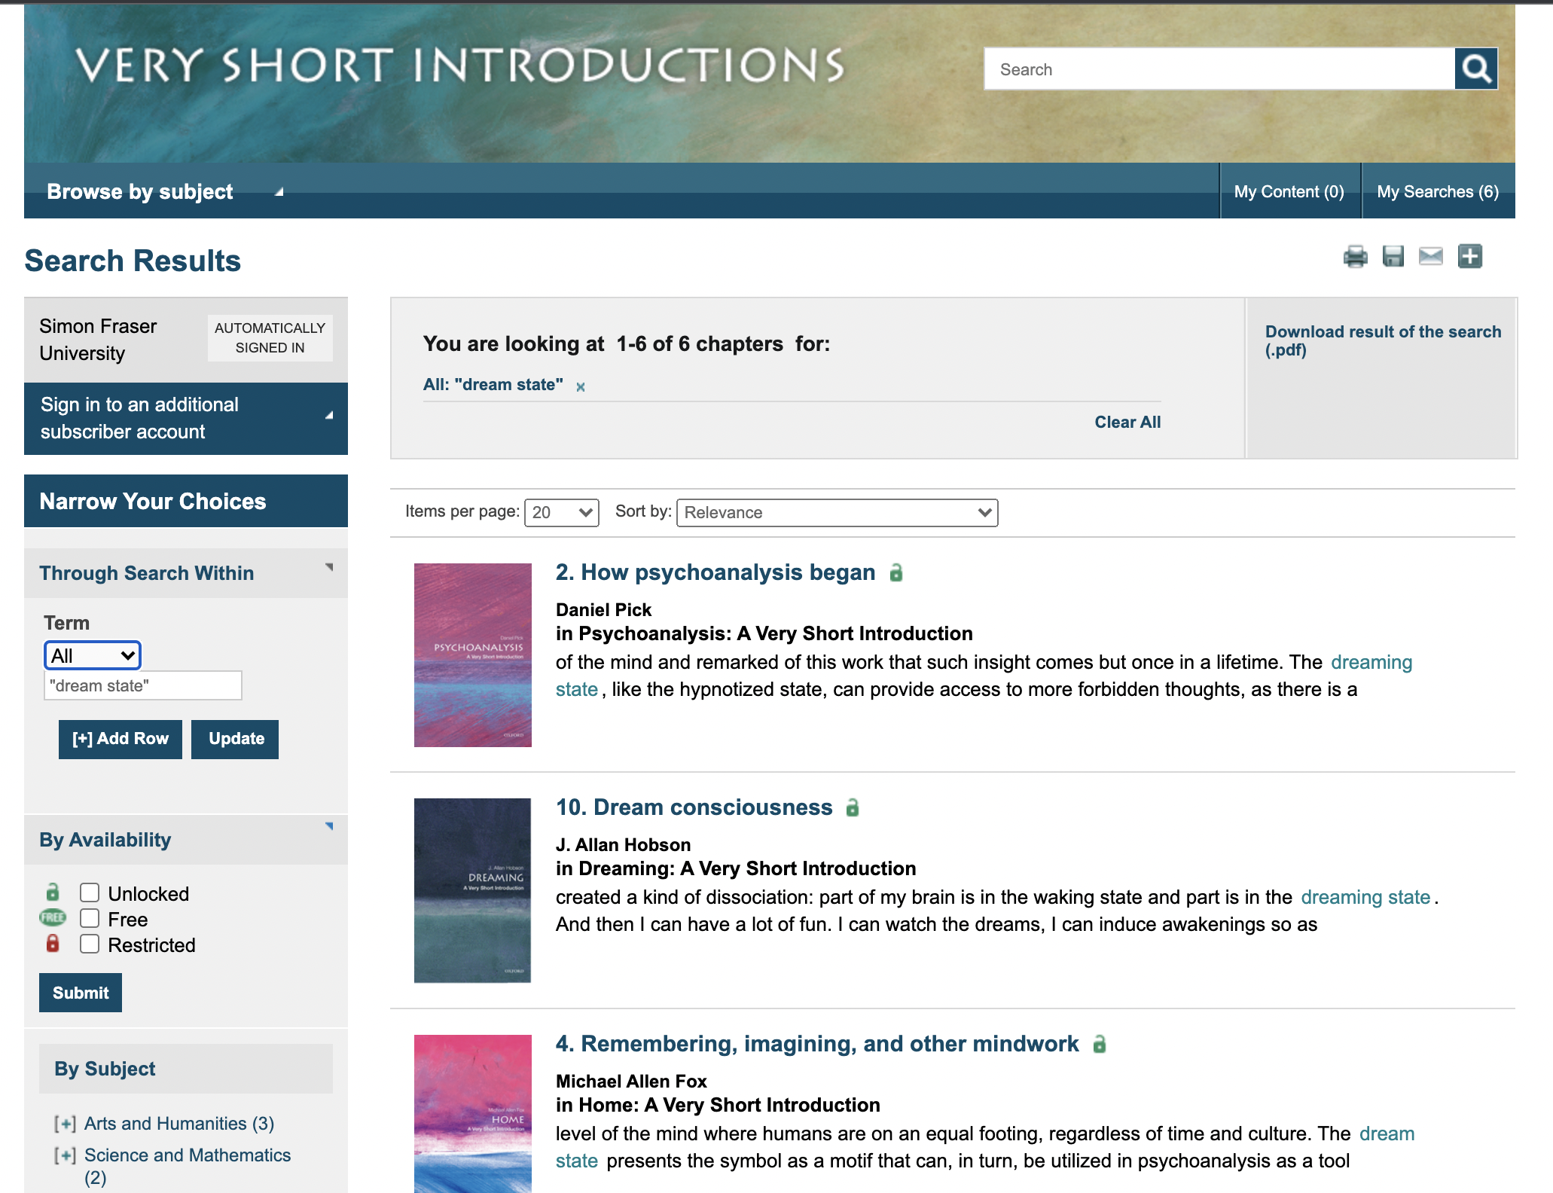

Slide 22
In-depth discussions
Books, chapters in books, articles, interviews
Search Library catalogue and then use the limiters to focus your results
Search specialized subject indexes to find articles
Full-text sources (Project Muse, JSTOR, Google Scholar) work best with unique terminology searching
Have a focused search plan

Slide 23
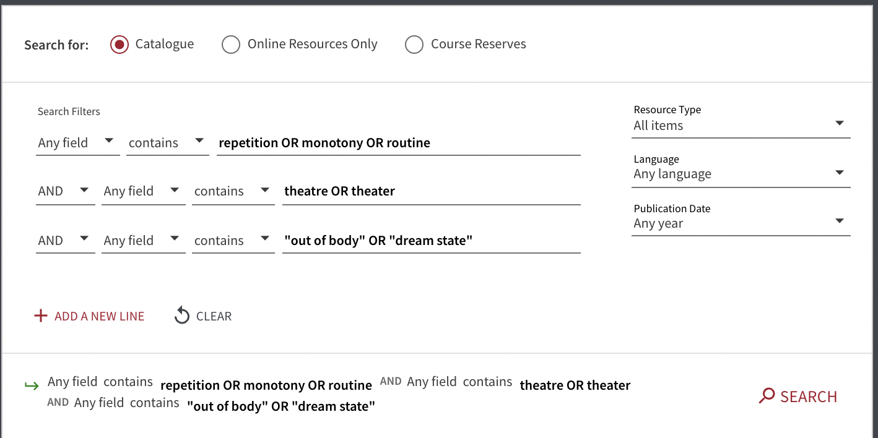
Notes:
Brianna Bernard – need to clarify what’s key to your interest – is it useful to look at psychological literature? Or dance literature?

Slide 24
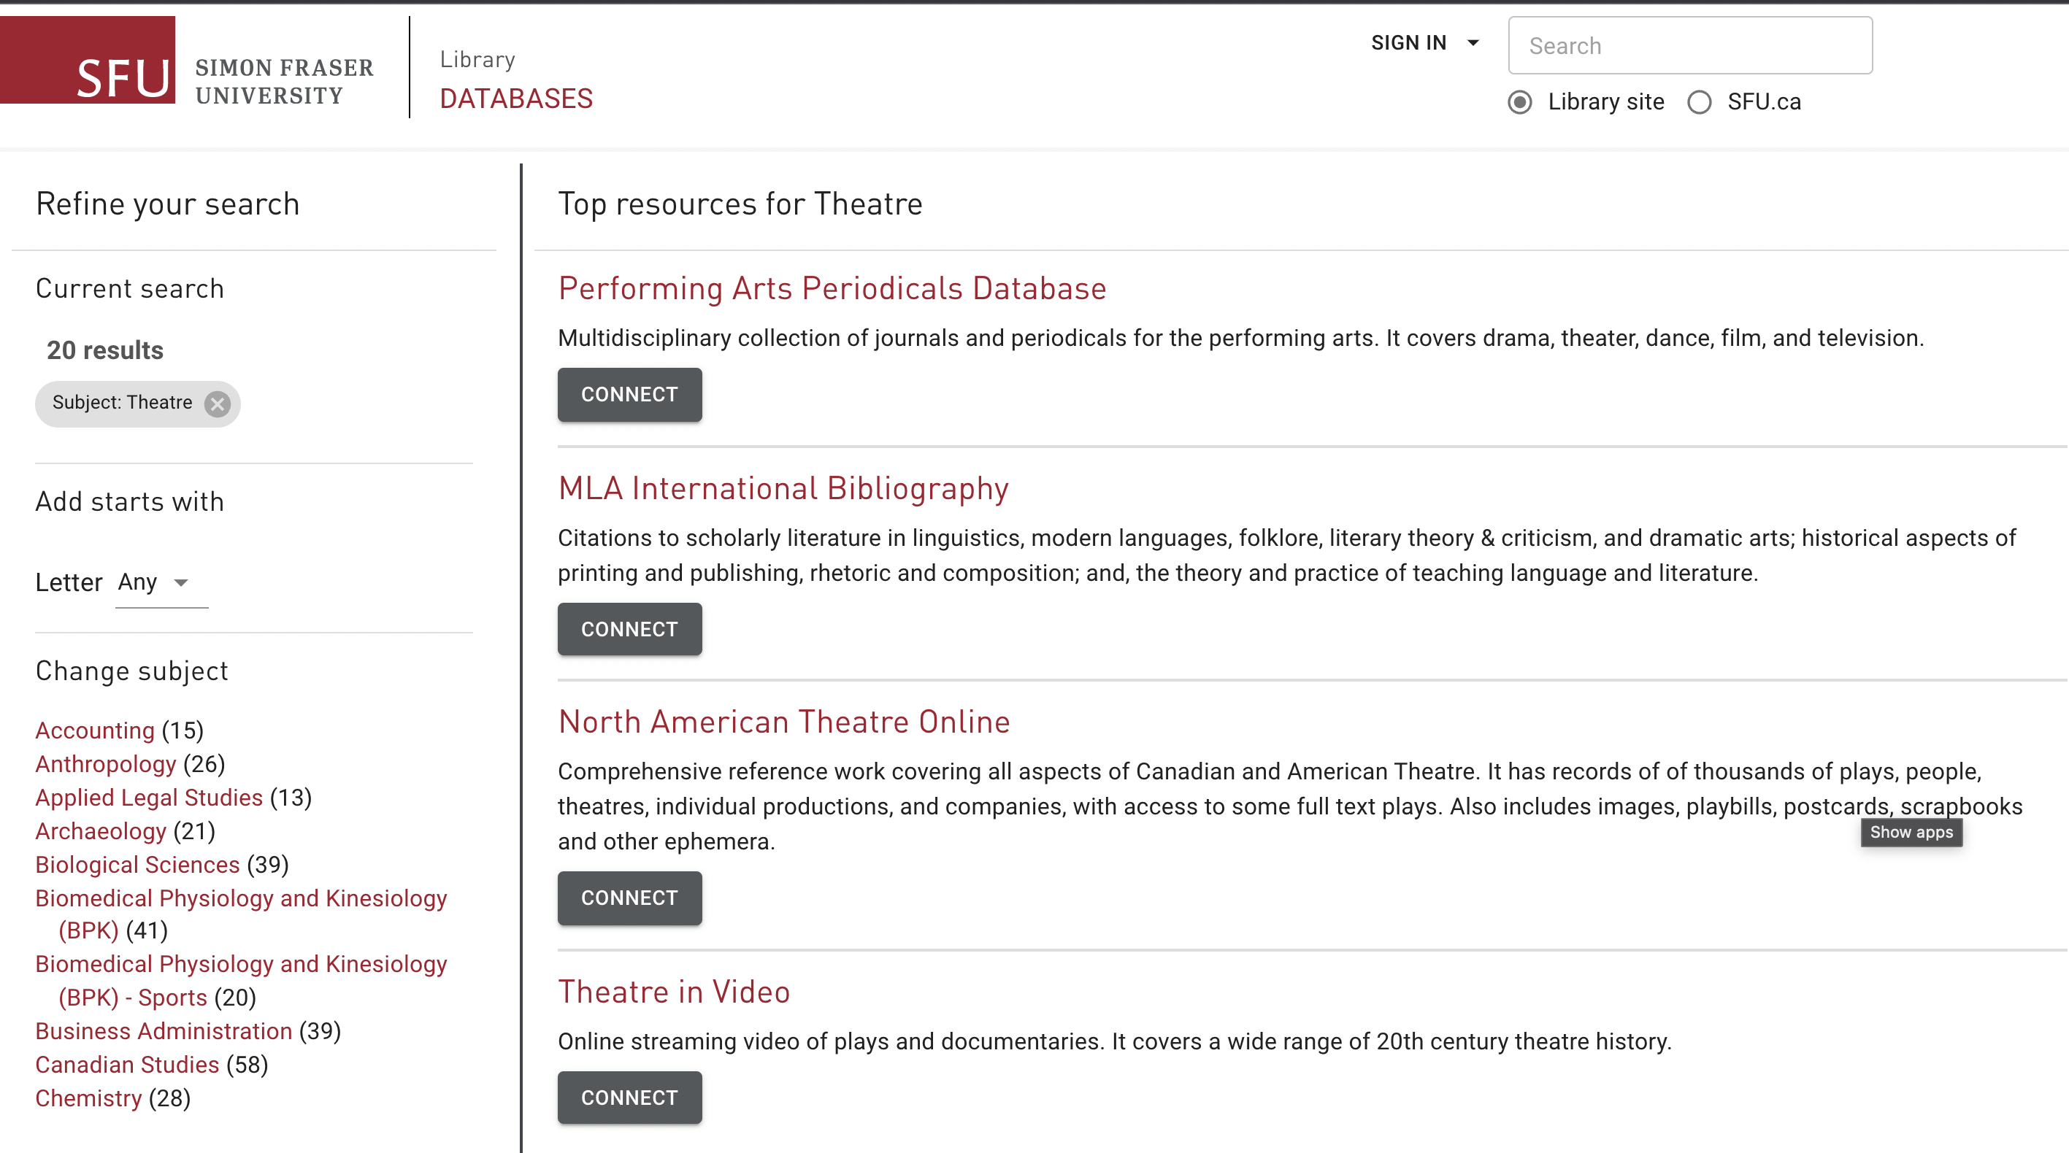

Slide 25
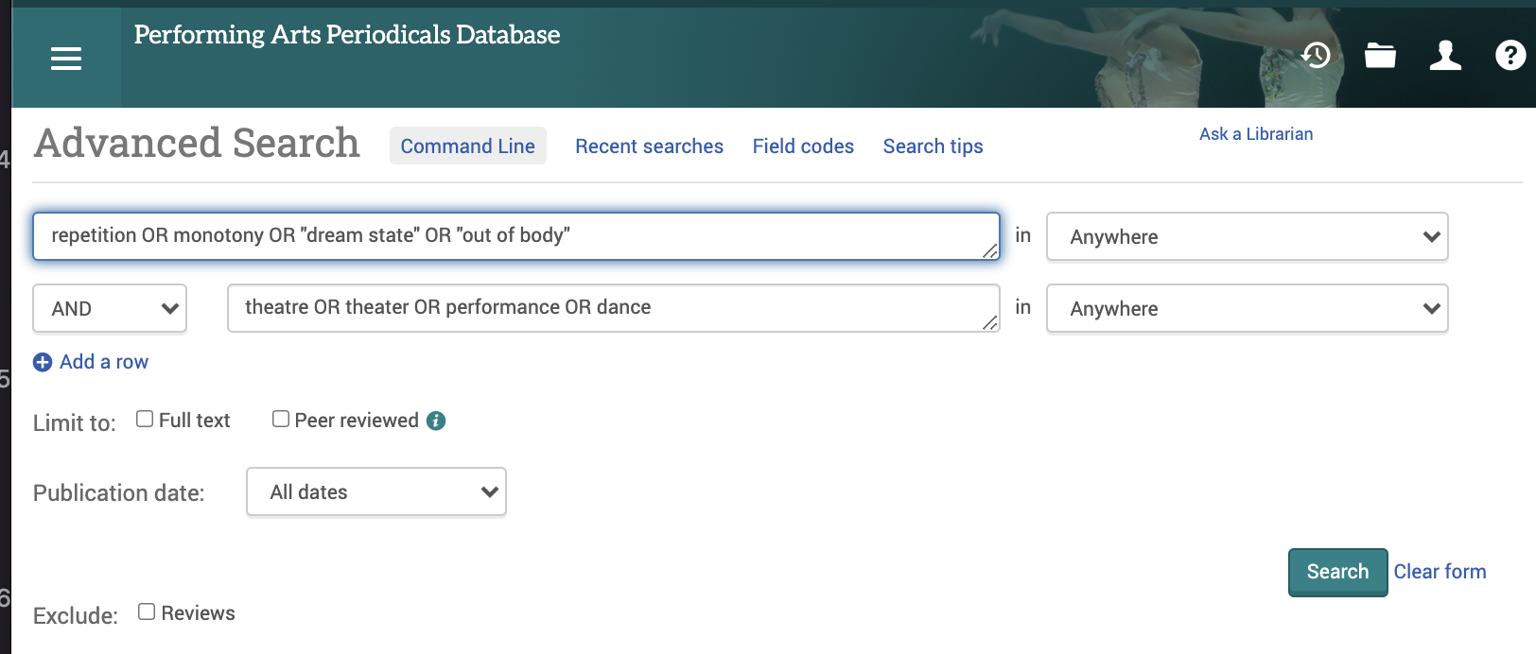

Slide 26
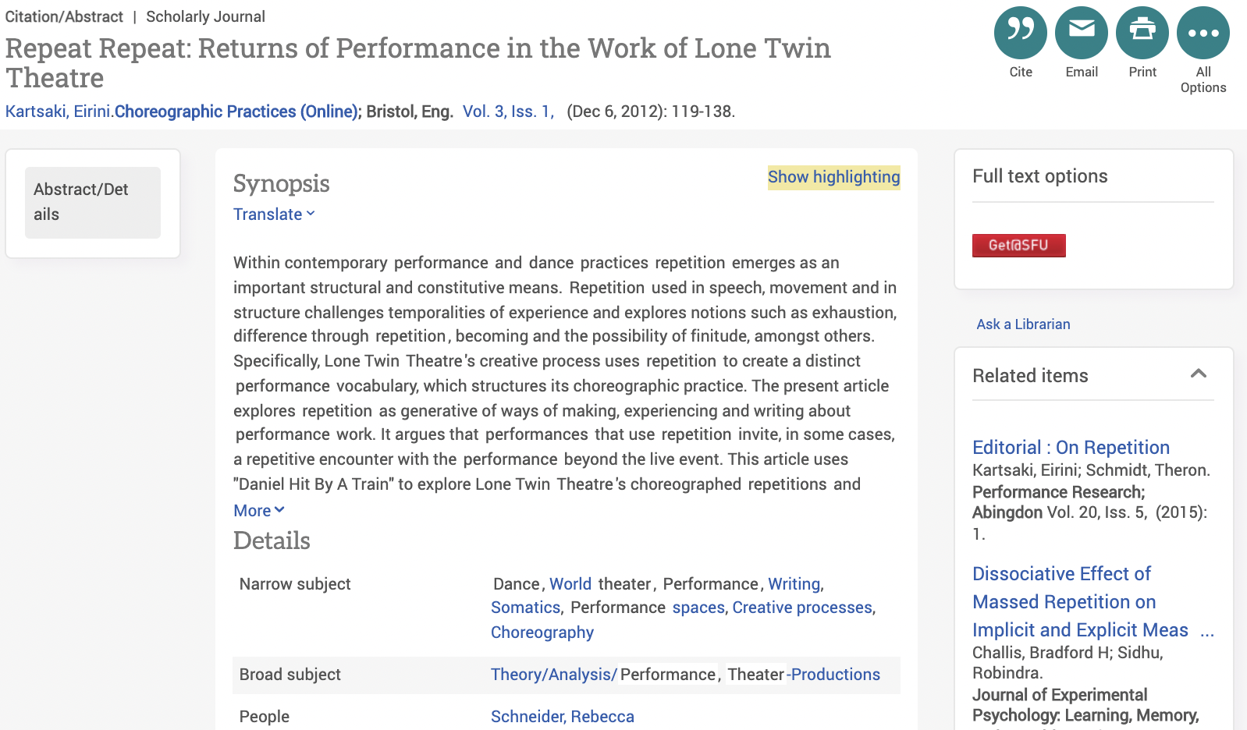

Slide 27
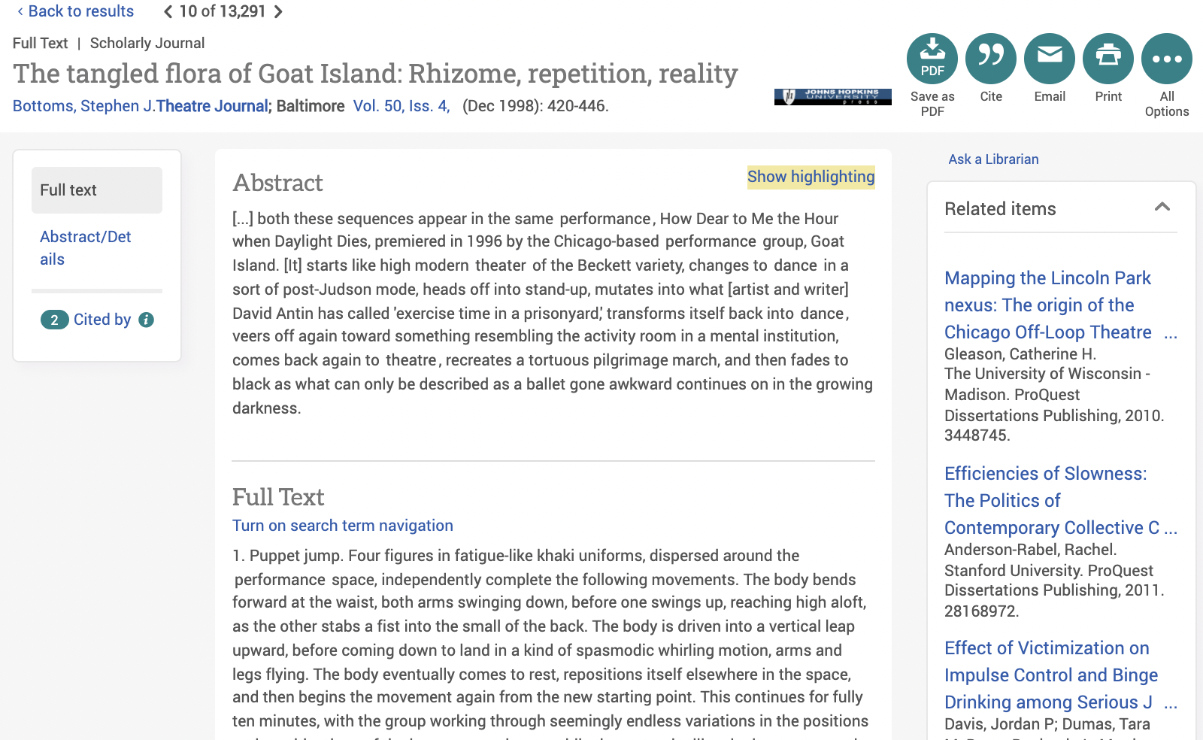

Slide 28
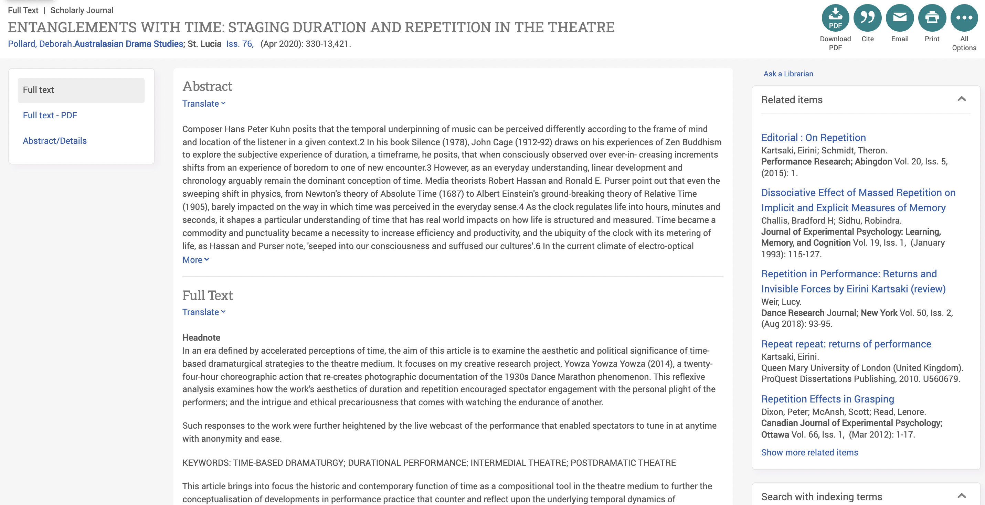

Slide 29
DEMONSTRATION
OF HOW LIBRARIANS HELP RESEARCHERS FIND USEFUL SOURCES

Slide 30
Recently I've been feeling myself honing in on the aspect of the audience and their effects on myself as a performer when creating or analyzing work. I have a huge desire for connection and trust when it comes to the audience. In my personal opinion, I find relatable and provocative philosophies very engaging and a strong jumping-off point when cultivating a relationship with the audience. Because who wants to be told what to do, or how things should be done? Versus how things are going and what it's like to be amongst life. The aspect of asking very forward and ambitious questions rather than providing solutions is another big temptation for me. Brutal honesty is such a force within a friendship and when balanced right, it can enrich a performative experience. With this in mind, I have found myself returning to Michel Foucault often, a very forward and provocative french philosopher from the 20th century. I've been coming across a lot of his written work in various film theory and context-like classes. Here's a good video (Links to an external site.) on him for anyone interested. My research thus far is otherwise quite open with mostly texts on collaboration, defamiliarization, the effect of performative scores such as the Fluxus workbook. I'm still looking for an interesting show to check out in Vancouver related to this (other than the Yoko Ono exhibition).
Notes:
Emma savic Kallesoe

Slide 31
Recently I've been feeling myself honing in on the aspect of the audience and their effects on myself as a performer when creating or analyzing work. I have a huge desire for connection and trust when it comes to the audience. In my personal opinion, I find relatable and provocative philosophies very engaging and a strong jumping-off point when cultivating a relationship with the audience. Because who wants to be told what to do, or how things should be done? Versus how things are going and what it's like to be amongst life. The aspect of asking very forward and ambitious questions rather than providing solutions is another big temptation for me. Brutal honesty is such a force within a friendship and when balanced right, it can enrich a performative experience. With this in mind, I have found myself returning to Michel Foucault often, a very forward and provocative french philosopher from the 20th century. I've been coming across a lot of his written work in various film theory and context-like classes. Here's a good video (Links to an external site.) on him for anyone interested. My research thus far is otherwise quite open with mostly texts on collaboration, defamiliarization, the effect of performative scores such as the Fluxus workbook. I'm still looking for an interesting show to check out in Vancouver related to this (other than the Yoko Ono exhibition).
EXAMPLE?

Slide 32
Venue
Foucault: Power?
History as a storehouse of good ideas?
Medicalization of madness & sex
performer
Relationship
Trust
Brutal honesty
Performance / exhibition
audience
Collatoration
Defamiliarization
Performative scores

Slide 33
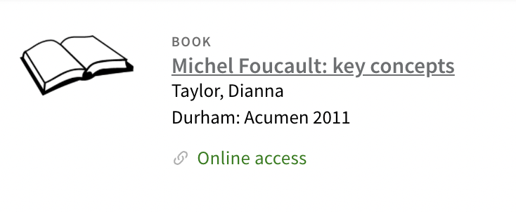
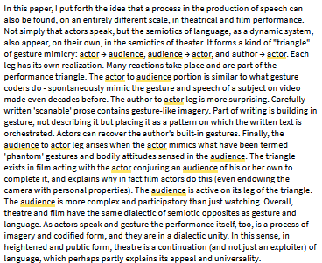
RESEARCH PLANNING - background
McNeill, David. “Speech-Gesture Mimicry in Performance: An Actor → Audience, Author → Actor, Audience → Actor Triangle.” Journal for Cultural Research, vol. 19, no. 1, Routledge, 2015, pp. 15–29, https://doi.org/10.1080/14797585.2014.920184.

Slide 34
SEARCH TERMS
actor AND audience AND (trust OR relationship)

Slide 35
Scholarly works provide abstracts / summaries and reference lists
“Of Other Spaces: Michel Foucault.” Theatre and Performance Design, Routledge, 2010, pp. 97–104, https://doi.org/10.4324/9780203124291-19.

Slide 36
Research strategy
“Searching for information is often nonlinear and iterative, requiring the evaluation of a range of information sources and the mental flexibility to pursue alternative avenues as new understanding develops”
(ACRL 2015)

Slide 37
”Chance favours the prepared mind”*
”Genius is 10% inspiration and 90% perspiration”**
*Louis Pasteur
**Kate Sanborn (attributed to Thomas Edison)
Notes:
Louis Pasteur “sudden flashes of insight don’t just happen but are the product of preparation”

Slide 38
Personalized research support
Ask a Librarian
In person, drop-in or by appointment
Phone / email
Sylvia Roberts
Email question to sroberts@sfu.ca
Meet by Zoom, phone, in-person, by appointment

Slide 39
Reading & writing (SLC)
Workshops and one-on-one consultations
Virtual and in-person sessions at all 3 campuses
Self-directed learning resources also available on the web site

