Slide 1
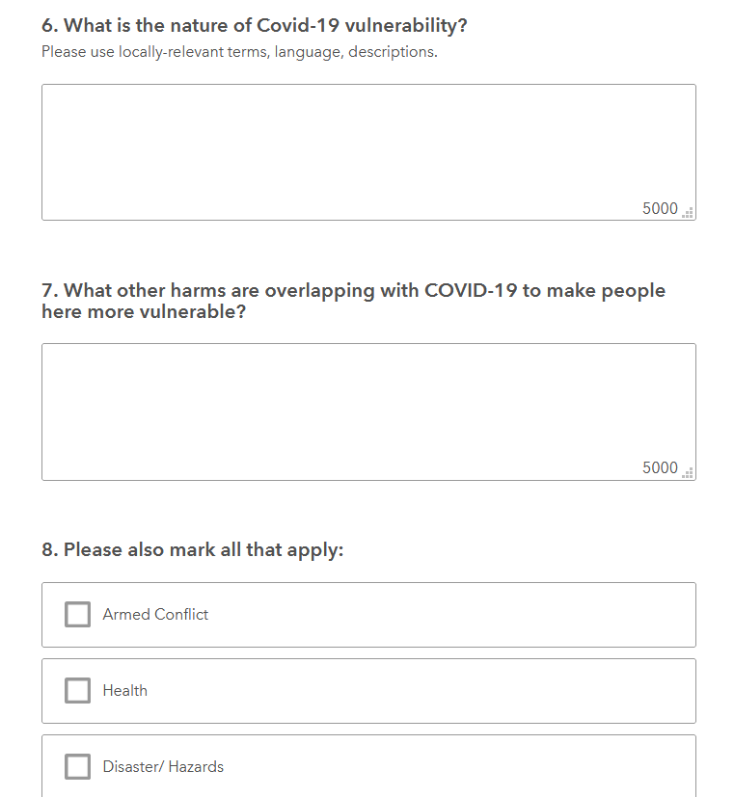
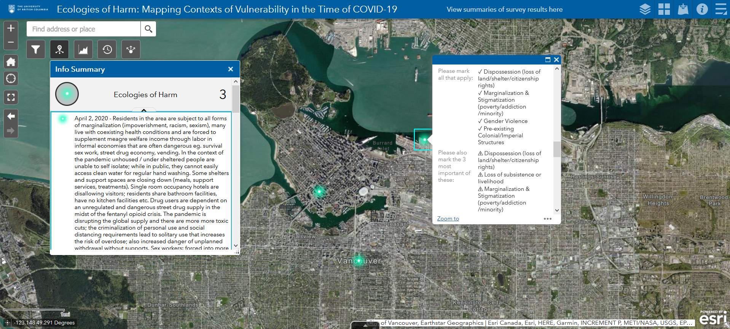
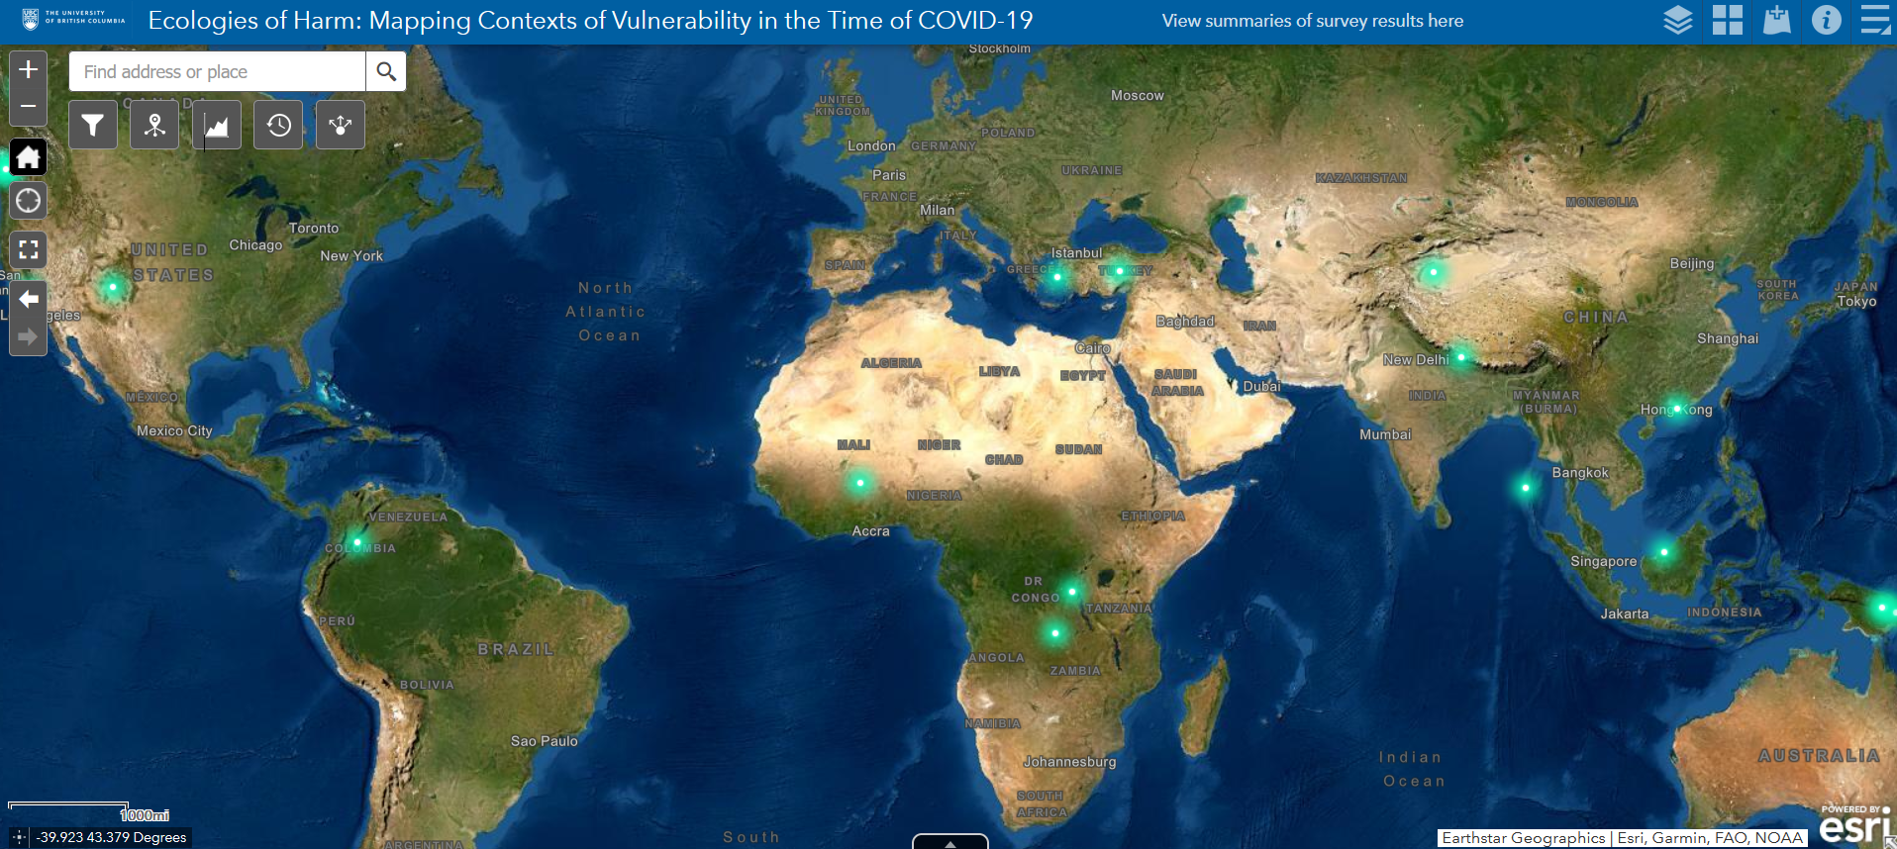
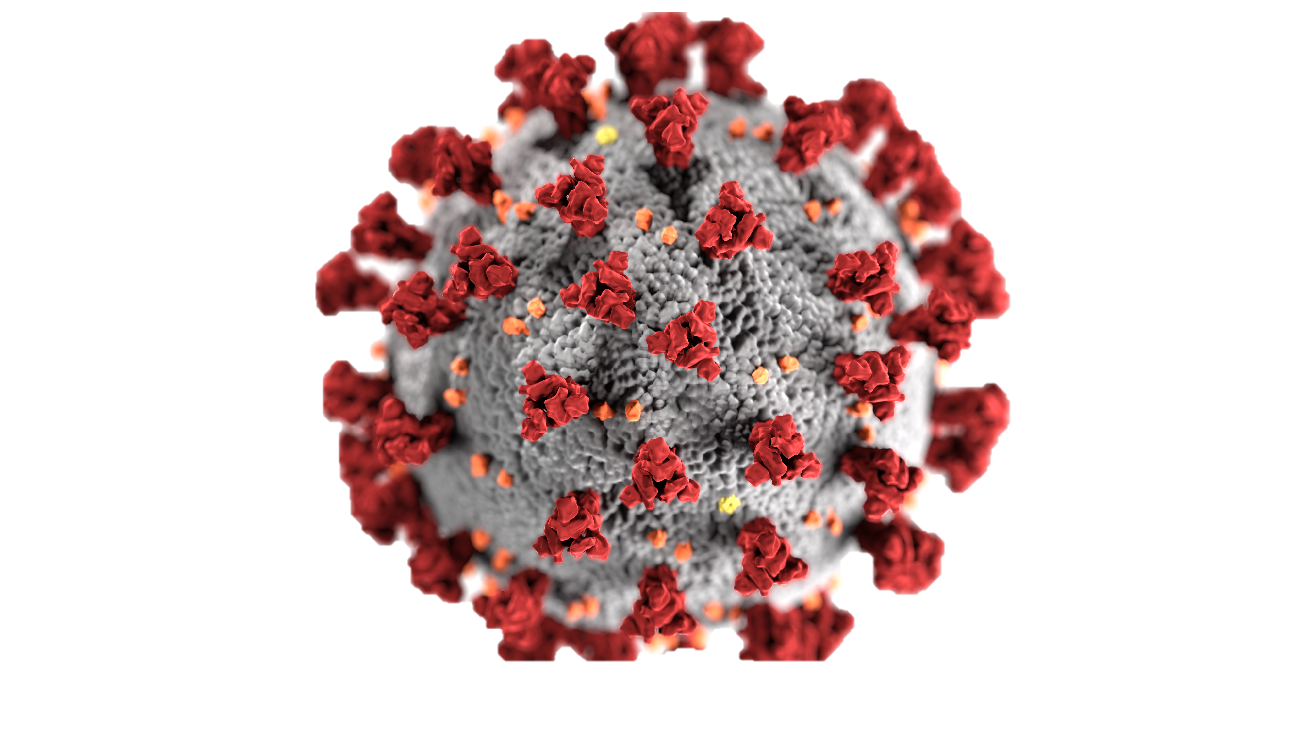
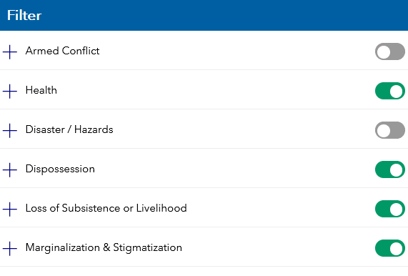
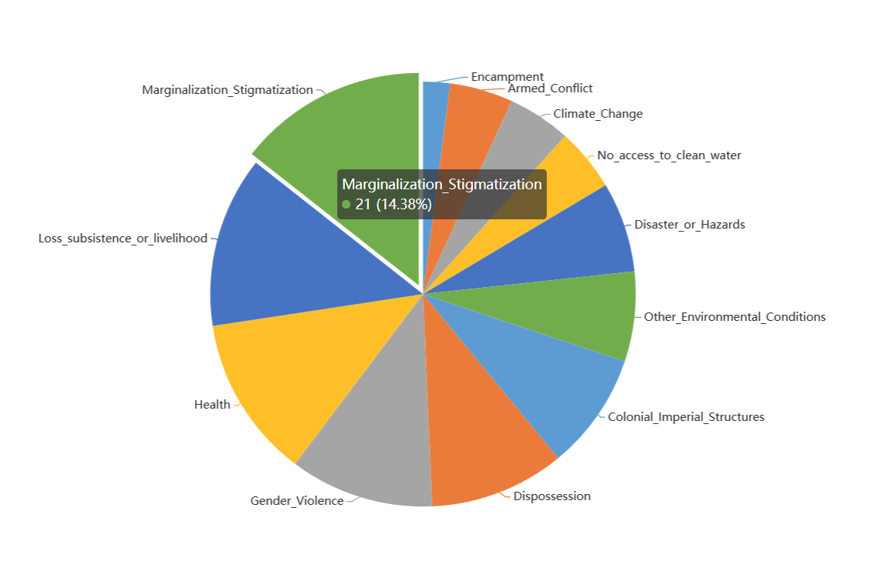
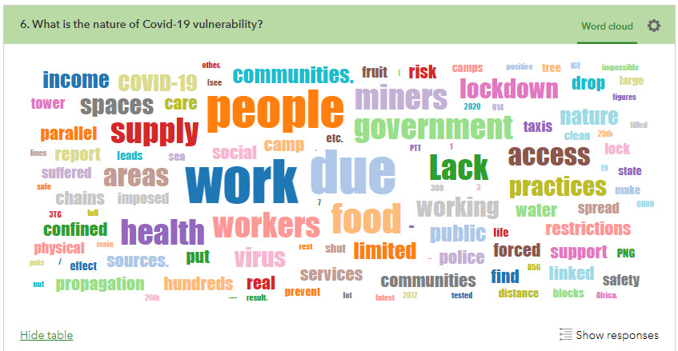
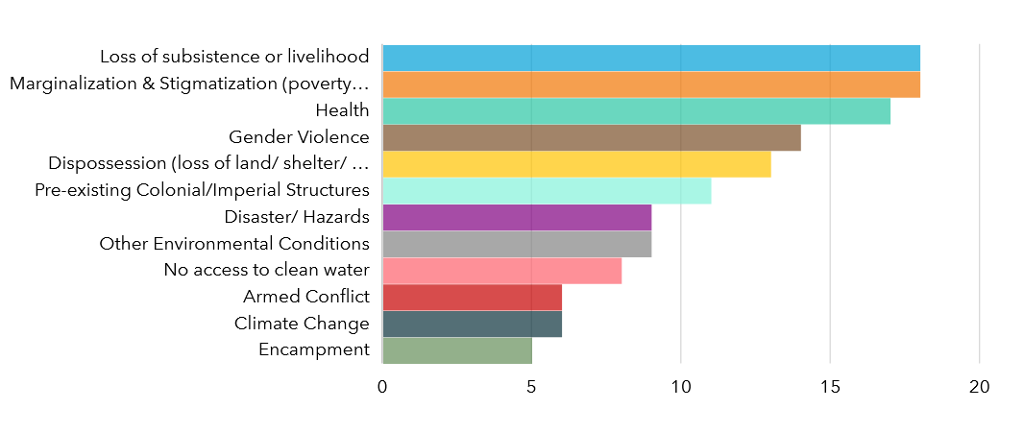
Ecologies of Harm: Mapping Contexts of Vulnerability in the Time of COVID-19
Maya Daurio¹, Stephen Chignell², Dr. Leslie Robertson, Principal Investigator¹
¹ Department of Anthropology, University of British Columbia
² Institute for Resources, Environment and Sustainability, University of British Columbia
Background
Project Design
Many are by now familiar with the John Hopkins COVID-19 Dashboard, a powerful visual illustration of COVID-19 cases and deaths across the globe. This dashboard is typical of how most of us interact with information about COVID-19, through quantitative representations of harm. While critically important, consistent exposure to such statistics can create what researcher Paul Slovic calls “psychic numbing”, an emotional disconnect that impacts our actions and decision making (see NPR’s “Why 500,000 COVID-19 Deaths May Not Feel Any Different”).
Our project, Ecologies of Harm: Mapping Contexts of Vulnerability in the Time of COVID-19, acts as a complement to statistical renderings of COVID-19, encouraging us to reflect on the lives beneath the numbers. In line with principles of counter-mapping, our research illustrates how harms caused by the pandemic intersect with other injustices and with specific geographies to exacerbate vulnerabilities of marginalized populations.
Drawing on survey responses submitted by community-based researchers or local witnesses, Ecologies of Harm is creating a collaborative spatial archive to document locally defined conditions of vulnerability in order to generate opportunities for knowledge-sharing, dialogues, and solutions-based engagements.
Using Survey123 Connect, we created a highly customized survey comprising questions eliciting text responses, multiple choice selections, and a map of the world where respondents could plot their location.
Survey123 links to a hosted feature layer of the survey responses in ArcGIS Online, and the location information is used to plot point locations of survey responses on a web map. When a new survey is submitted, the map is automatically updated.
Data Visualization & Exploration
Using the Arcade language to create our own expressions, we configured customized pop-ups for the survey responses in a web map in ArcGIS Online. Some of the pop-ups contain user-uploaded images or links to websites. We used this web map to create a web application using the ArcGIS Web AppBuilder.
Although our research project collects primarily qualitative data, we were able to configure several widgets to allow map users to interact with the survey responses in multiple ways. The Filter widget filters the data by 12 overlapping harms, while the Query widget enables users to filter, select, and download features which intersect with a user-defined shape on the map. Users can also view summaries of survey results via a link, which include word clouds, column charts, and photos submitted by respondents. The Time Slider widget interactively shows a chronology of survey submissions from April 2020 to the present. The Information Summary widget offers a way for the user to view the main narrative summarizing harms, with the ability to click on the text to generate a pop-up for that entry at the corresponding location on the map.
Filter the data by specific harms.
Chart proportions over an area.
Visualize Word Clouds of survey responses.
Insights
With contributions from 14 countries and six continents, this project has mobilized knowledge about vulnerabilities ranging from lack of access to adequate housing and sanitation among residents of Vancouver’s Downtown Eastside, to overcrowding and lack of mobility among refugees in a camp in Chios, Greece. The narratives collected also highlight positive solidarities which have formed during the pandemic, such as the creation of local fishing cooperatives in the Andaman and Nicobar Islands.
To date, our Web App shows that the greatest markers of intersecting harms due to the pandemic are stigmatization and loss of subsistence. The Filter widget shows that armed conflict is reported as an overlapping harm in five different locations spanning four continents, while gender violence is pervasive across all continents.
Are there positive solidarities that have formed during the pandemic?
“Local fishing cooperatives have been mobilized to provide aid to vulnerable sections of the fishing population.”
“Some NGOs and individuals have taken it upon themselves to provide food parcels to people that are desperately in need of food.”
Collaborators
Dr. Sally Babidge, Anthropology, University of Queensland, Queensland, Australia
Dr. Anita Lacey, Political Science, University of Melbourne, Victoria, Australia
The At-Risk Youth Study Youth Advisory Council, British Columbia Centre on Substance Use
Notes:
Esri’s suite of web-based tools are typically used for collecting and analyzing highly structured, quantitative geographic data. We effectively adapted these tools to compile and visualize qualitative data about the complexities of intersecting inequities exposed and made worse by the ongoing COVID-19 crisis.

