Slide 1
Demystifying Academic Jargon: GIS and Accessibility Katherine Yuko Fry University of British Columbia MA Educational Studies

Slide 2
The Purpose of This Presentation
Recognize the inaccessibility of academic language (lectures, texts).
Thinking about how to incorporate GIS and digital cartography in teaching, in classrooms and communities.
Increasing exposure and utilization of GIS outside of academia.

Slide 3
My Story – Why GIS and Education?
Chief Sealth International High School, Seattle, Washington, USA
Seattle Public School District
International Baccalaureate Diploma Program
Western Washington University, Bellingham, Washington, USA
BA Geography, Certificate in Geographic Information Sciences
Minor in Education and Social Justice (ESJ)
The University of British Columbia, Vancouver, British Columbia, Canada
MA Educational Studies – Society, Culture, and Politics in Education (SCPE)

Slide 4
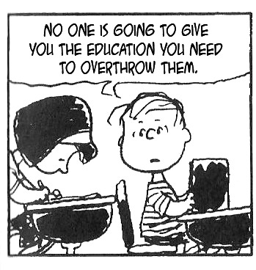
“No one is going to give you the education you need to overthrow them. Nobody is going to teach you your true history, teach you your true heroes if they know that that knowledge will help set you free.” - Assata Shakur

Slide 5
The Inaccessibility of Academic Language
Academic Concepts:
Neoliberalism, Social Stratification, Critical Race Theory, Distributive Justice, Abolition, Political Discourse, Globalization, Decolonization, Commodification, Racialization, Marxism, etc.

Slide 7
"Telling our Stories In Our Own Words" Drawing Upon Chicanx Feminisms
"A theory in the flesh means one where the physical realities of our lives – our skin color, the land or concrete we grew up on, our sexual longings – all fuse to create a politic born out of necessity. Here, we attempt to bridge the contradictions in our experience. We do this bridging by naming ourselves and by telling our stories in our own words."
- Cherríe Moraga and Gloria Anzaldúa, 1983

Slide 8
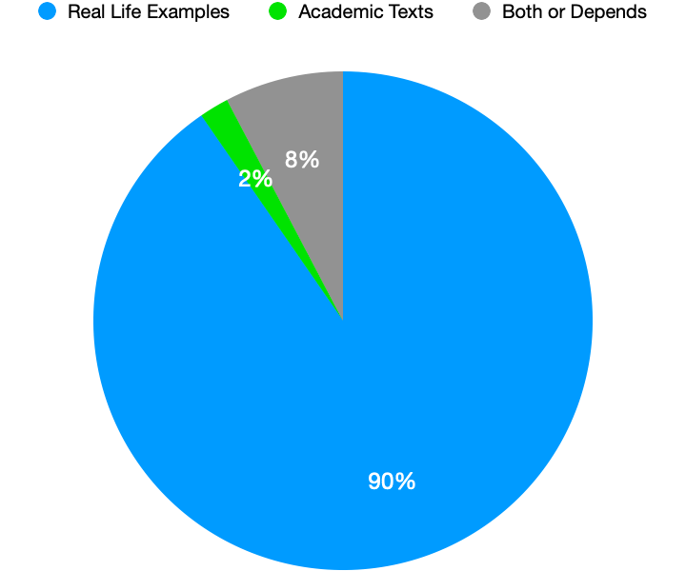
Modes of Academic Delivery
Over 90% of responses stated that Real Life Examples with Images are the easiest mode of learning new academic concepts.
How do we utilize GIS as an alternative form of media to communicate complex topics?

Slide 9
Engaging Community Experiences using GIS and Digital Cartography
Visualizing Home
•Neighborhoods
•Institutions (School, Jobs, Religion, Recreation)
•Social, Political, and Economic Demographics
Memories and Questions
•“Wow, you experienced ______ so differently but we we’re both from ____”
•“Hey, remember __________ , wasn’t that messed up?”

Slide 10
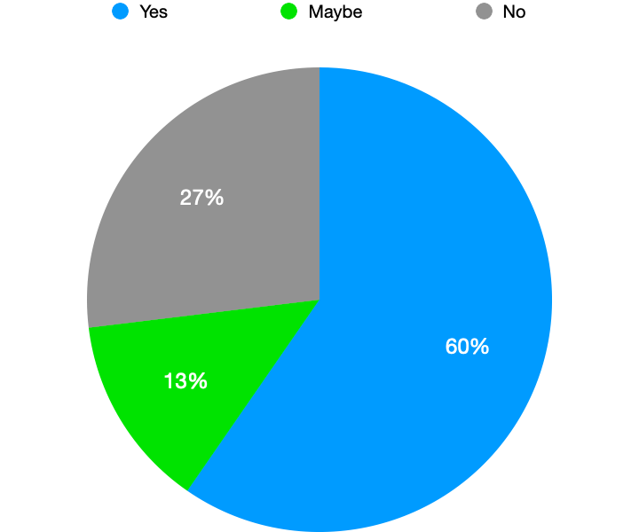
Do You Know What GIS Is?
Some guesses of what GIS is included:
Geo Something Software
Geographical Internet Software
Global Imaging Software
Those who responded yes were predominantly exposed to GIS through classes or jobs.

Slide 11
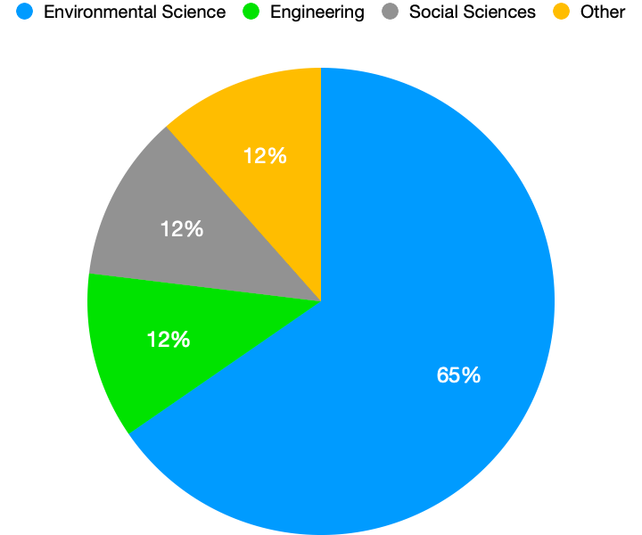
Perceptions of Usage
Other Fields
Recreation Management and Leadership
Consumer Marketing, Website Design
Travel
Health

Slide 12
My Current Project

Slide 13
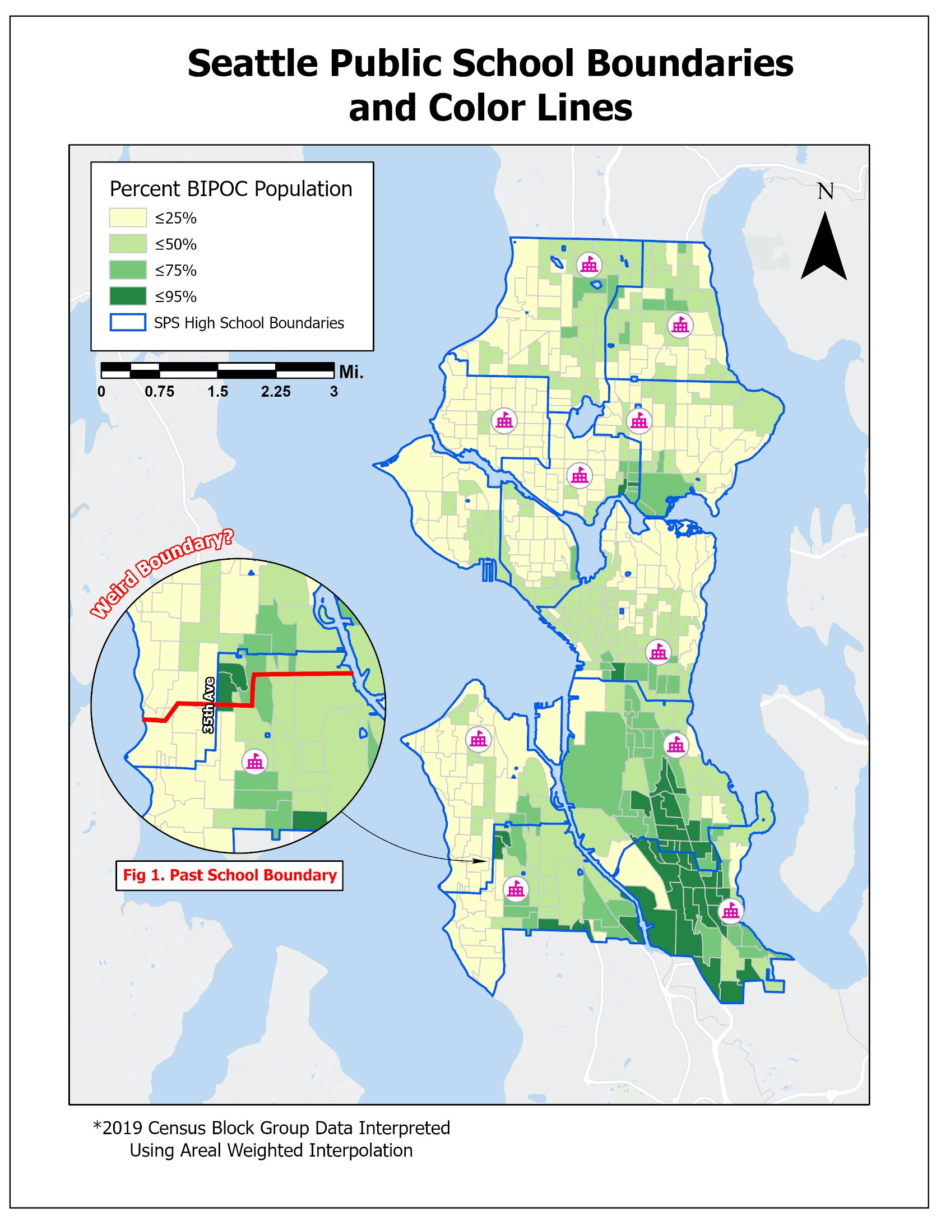
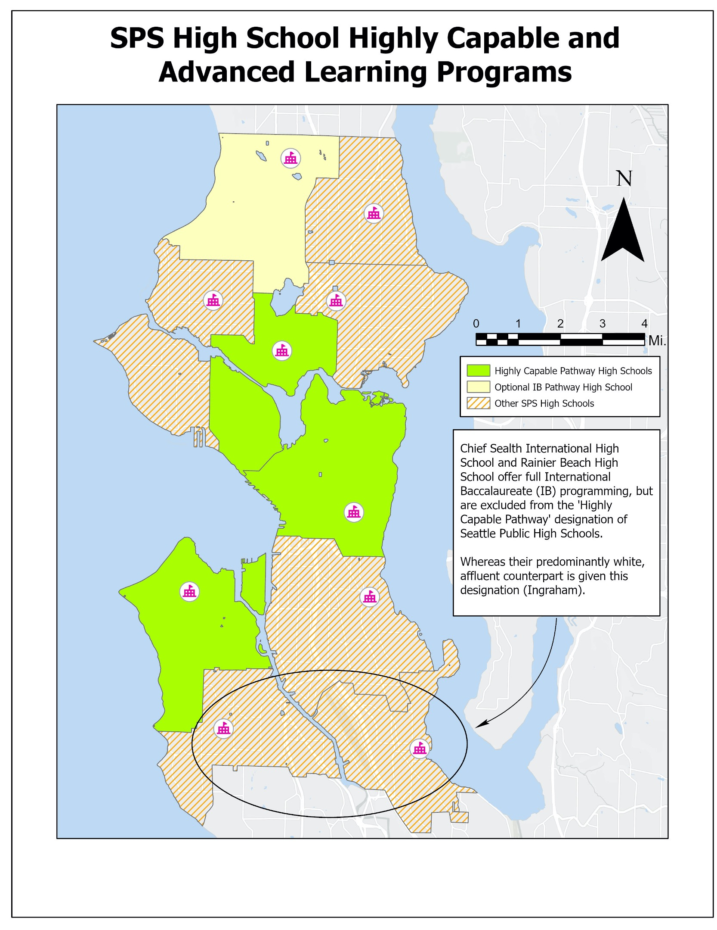

Slide 14
Questions to Consider
How can you incorporate technology and media into your teachings?
Why is STEM left out of conservations surrounding intersectionality?
How do we increase the number of departments that are involved in GIS?

