Slide 1
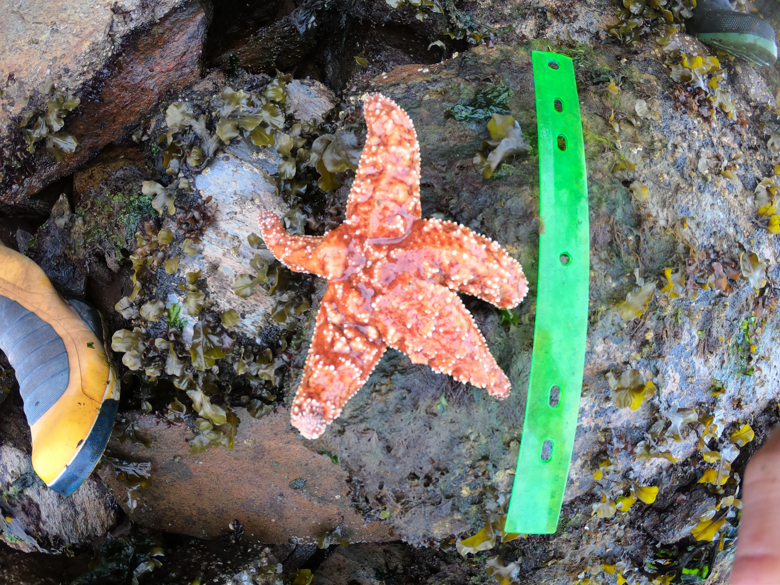
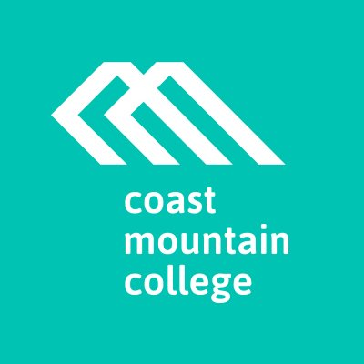
Using GIS tools to enhance post-secondary student engagement: ArcGIS collector and sick sea stars
Kirk Hart
Coast Mountain College
Prince Rupert
Notes:
For the past 3 years I’ve gotten my students involved in a citizen science project which monitors the health of sea star species affected by a phenomenon called sea star wasting. This past year, I thought it would be a great thing to incorporate into my GIS class. In doing so, I tested ESRI’s collector app to streamline data collection and compiling

Slide 2
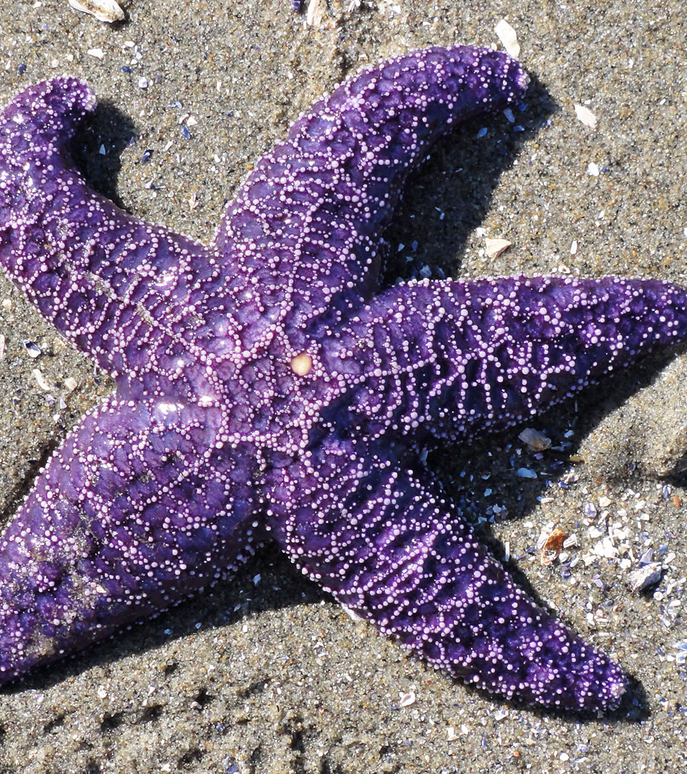
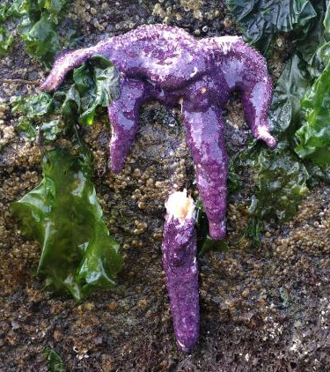
Sea Star Wasting
Notes:
First off, what exactly is this?
Sources not completely understood yet
Relatively new phenomenon – first really looked at in 2011ish
Affects pacific sea stars from California to Alaska

Slide 3
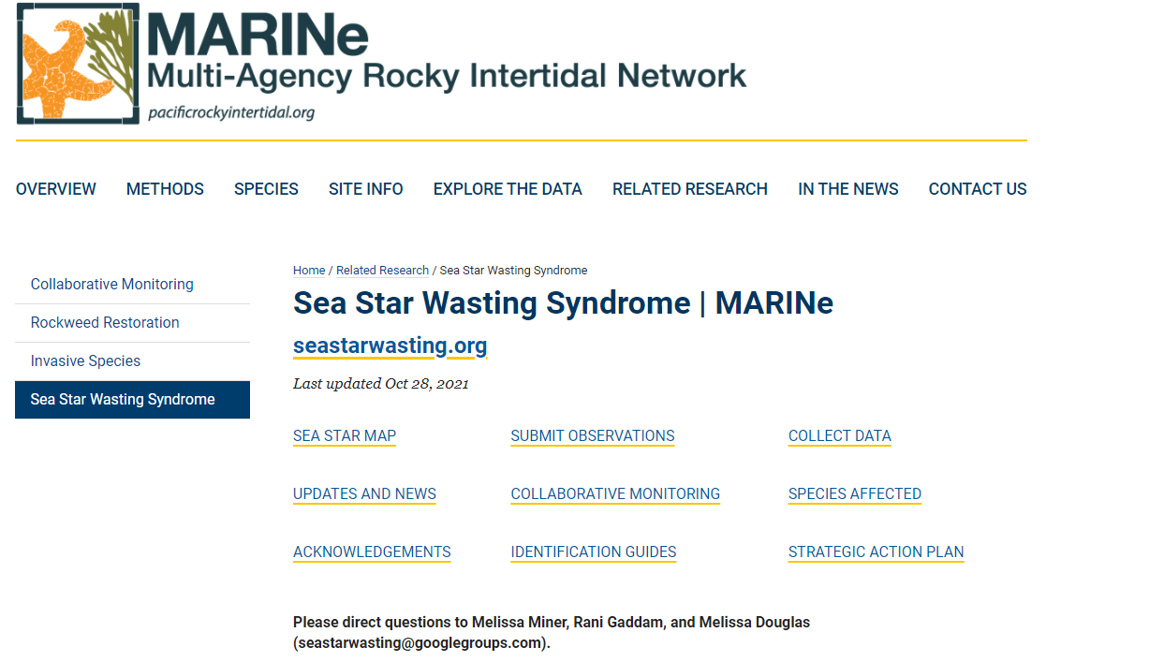
Citizen Science – Get students involved
Show SSWD project site
Notes:
This project asks for the help of the community to monitor sites in their areas and to submit observations here
My class has been doing this for the past 3 years
I think it is a win-win to get students involved in these types of projects.
Valuable experience for the students and valuable data for projects

Slide 4
Data collection in 3 easy steps:

Slide 5
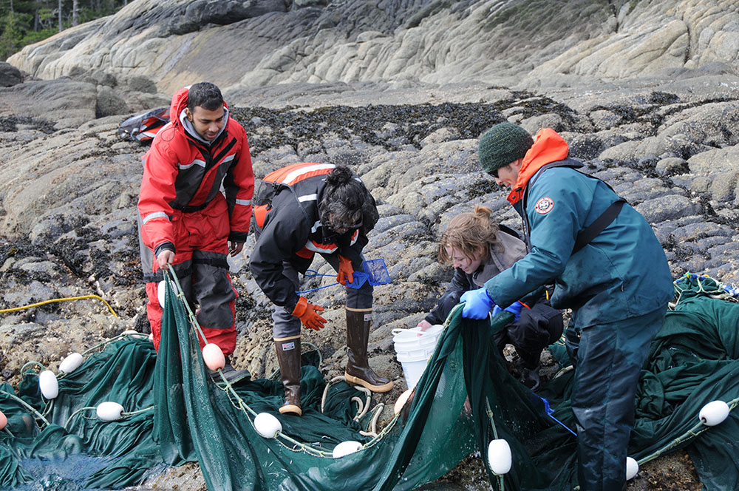
Step 1: Go out in the field

Slide 6
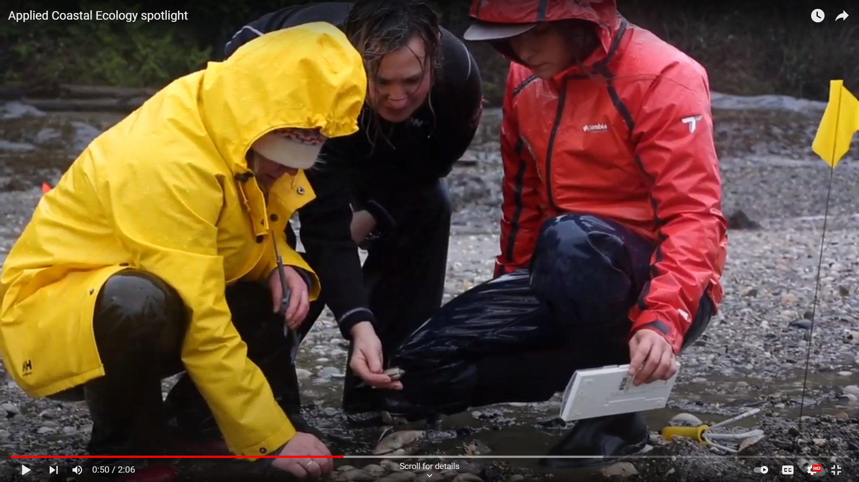
Step 2: Get rained on

Slide 7
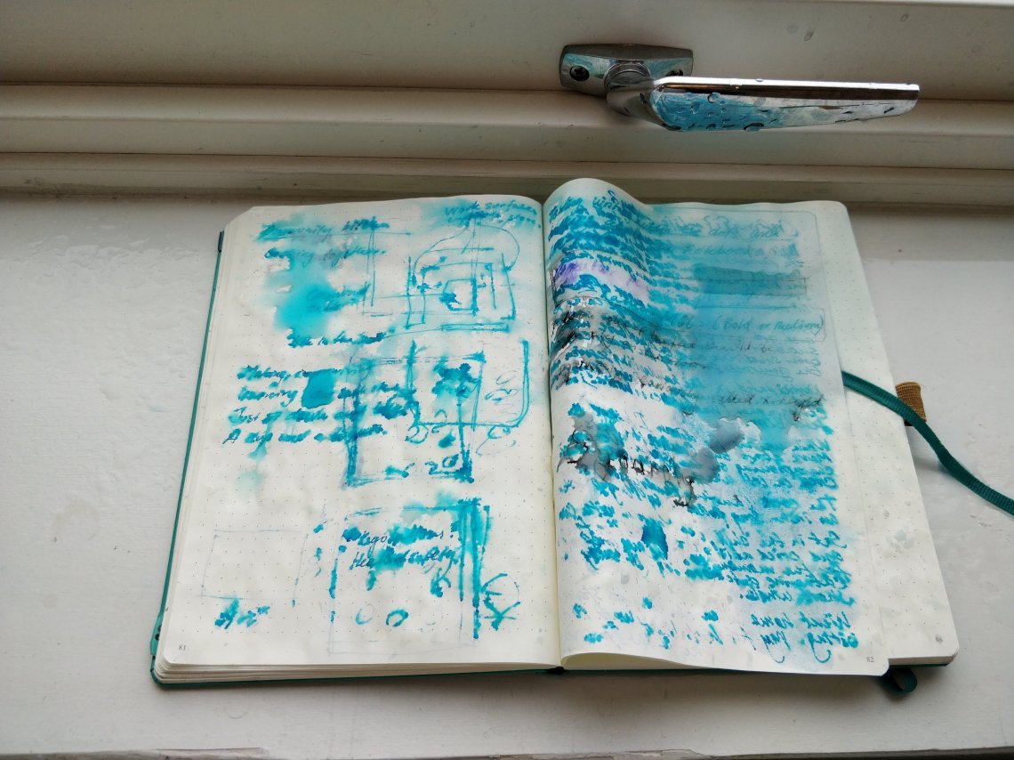
Step 3: Return with soaked data sheet (if anything)

Slide 8
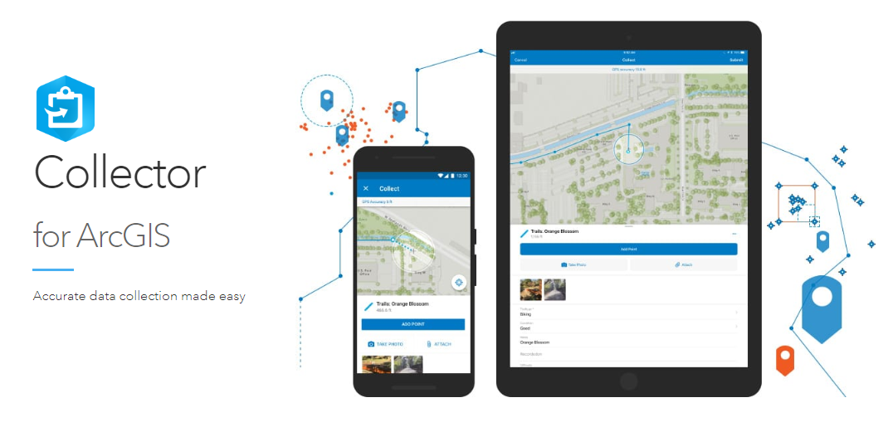
Why not streamline?
Notes:
Students downloaded collector on their devices and set up an account.

Slide 10
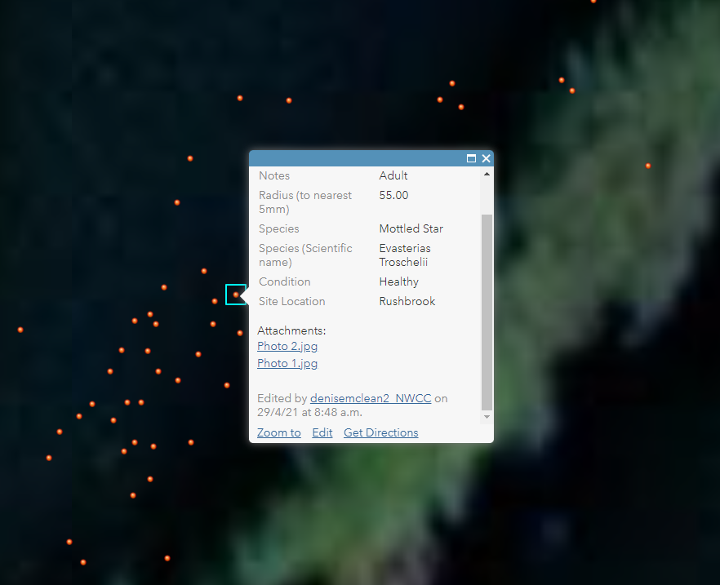

Slide 11
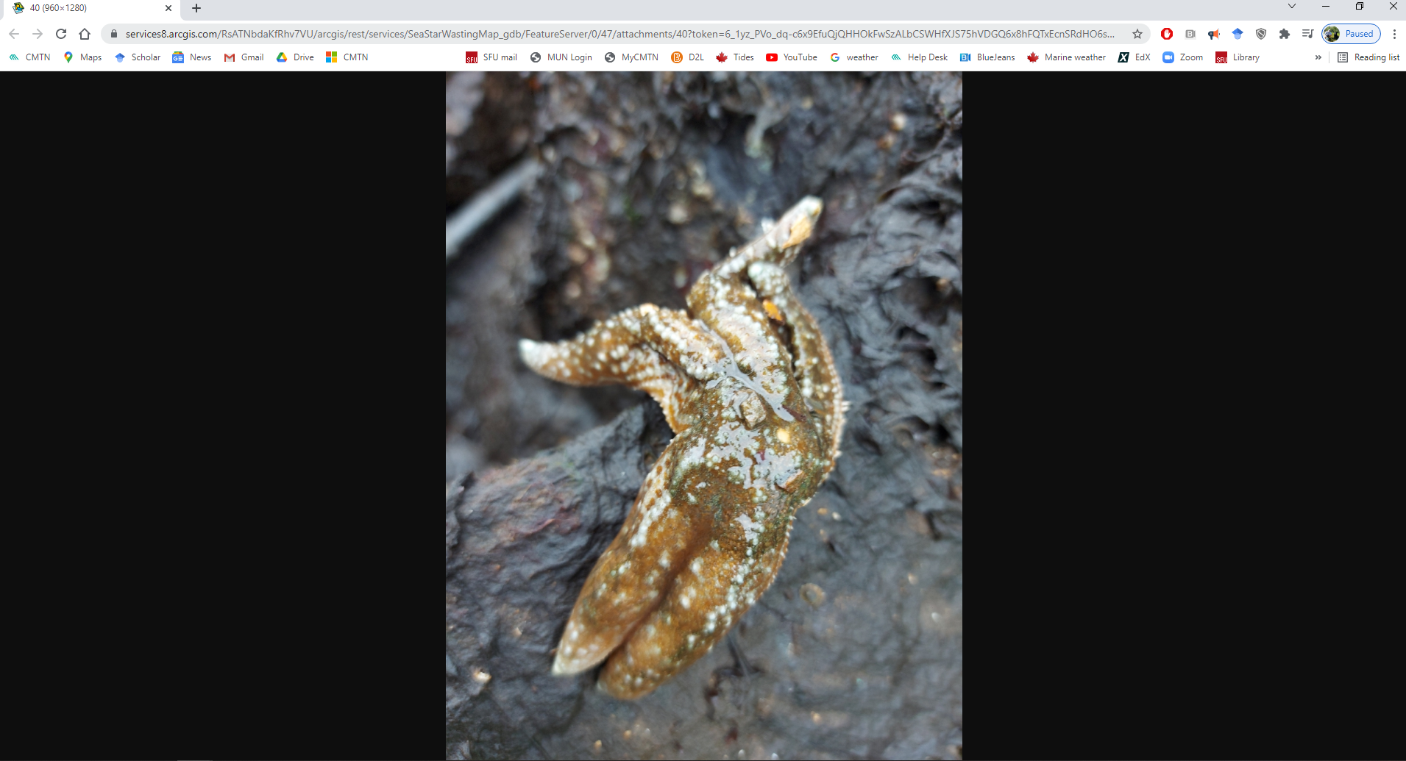

Slide 12
Benefits of Collector in a class setting
Real time data upload
No loss of data
Instantly shared with class
User friendly
Robust data
Location
Many fields (can be from pre-set list)
Multimedia

Slide 13
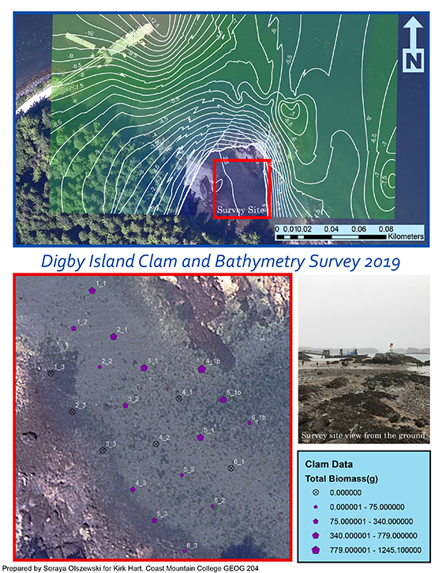
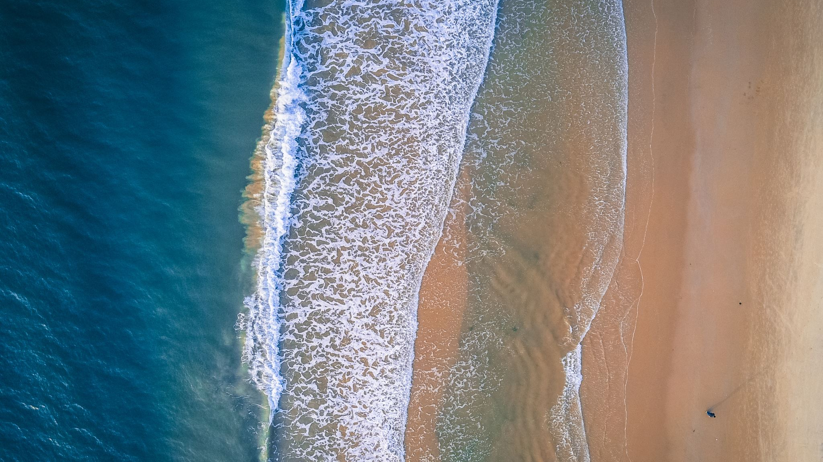
Future uses:
Shoreline Bathymetry
Clam morphometrics and species diversity
My own research

Slide 14
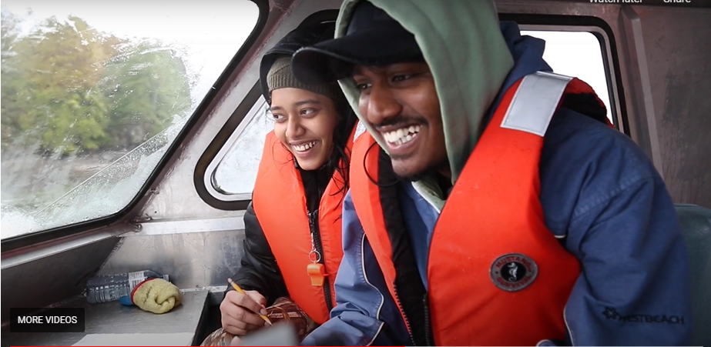
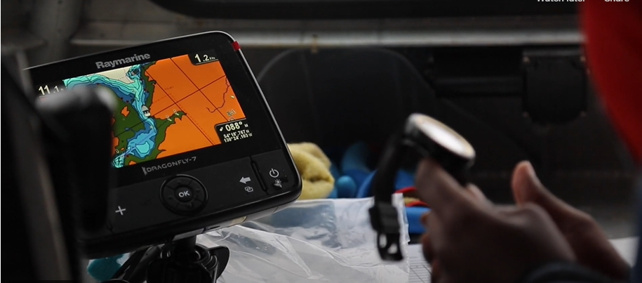

Slide 15
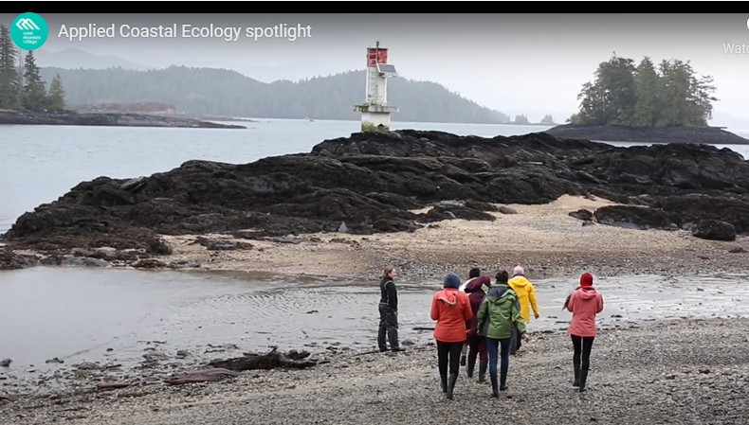

Slide 16
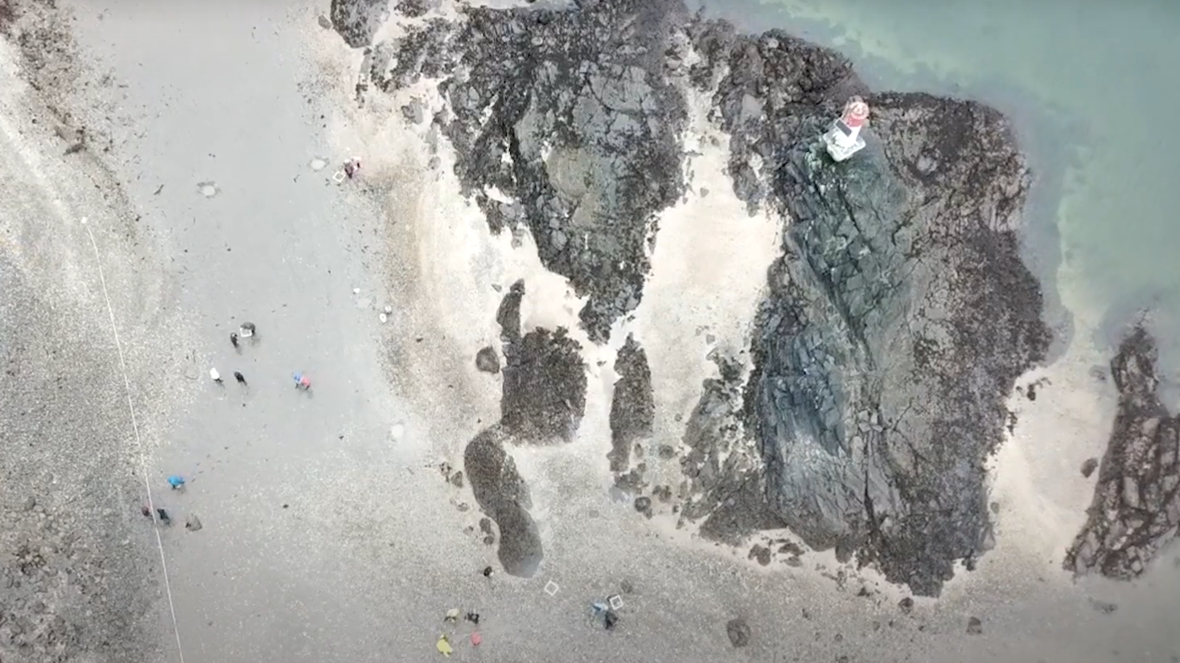

Slide 17
Thank you!

