Slide 1
USING ZOTERO TO SAVE, CITE, AND SHARE RESEARCH WITH YOUR TEAM
In advance of this workshop, you should have
Registered for a Zotero account
Downloaded and installed Zotero 5.0
https://www.zotero.org/download/
Slides & Handout Available
Kate Shuttleworth | Community Scholars Librarian; Librarian, Digital Publishing
kshuttle@sfu.ca
July 28 | Presenters: Kate Shuttleworth, Jess Yao
Notes:
Welcome/intro from Kate
Jess’ intro
Workshop goals: today we’ll be covering the basics of Zotero, which is a citation management tool; we’ll go over what this means later. The goal of this workshop is to introduce basics of Zotero to use within your teams to manage and cite sources, such as when you’re writing grant applications
The good thing is that even though there’s a lot of features, you really only need to grasp a few of them to see its value.
A couple things to note.
You should have received these slides and a handout in an email that Kate sent. They’ll also be available on the Community Scholars webpage
You don’t have to download them for this workshop, but you can if it makes following along easier.
They’re meant so you can refer back to them after this workshop.
Workshop:
Interactive: We tried to make this workshop have a bit of balance between “instruction” and time to try things out
If you have any issues, questions, or comments any time throughout this workshop feel free to write in chat/speak up and Kate (and I) can help; can also make use of things like breakout rooms if anyone has a very specific or technical problem

Slide 2
SFU’s campuses are located on the unceded, traditional, and current territories of the xʷməθkwəy̓əm, Sḵwx̱wú7mesh Úxwumixw, Səl̓ílwətaɬ, q̓íc̓əy̓, and kʷikʷəƛə̓ m Nations.
http://www.criticalethnicstudiesjournal.org/citation-practices
Notes:
Before we begin, I would like to acknowledge that SFU’s campuses are located on the unceded, traditional, and current territories of the Musqueam, Squamish, Tsleil-Waututh(slay-wah-tooth), Katzie (kut-zee) and Kwikwitlem (kway-kwit-lem) First Nations. Personally, I am on the traditional, ancestral, and unceded territory of the Musqueam, Squamish, and Tsleil-Waututh People.
Since we’re all spread out at the moment, if anyone would like to make their own land acknowledgement, I’ll pause a for a few seconds right now so that you can. [7 second rule!]
I want to address why recognizing the land we are on is important when we’re talking about citation and using citation software. As you may know, scholarship & research doesn’t have the best track record in terms of inclusivity. So we need to be mindful when gathering citations, look at the intent + diversity of who we’re citing and make sure it’s not the same circle of people again and again.
If you’re interested in this topic, I recommend taking a look at the link, which we’ll leave in the chat: http://www.criticalethnicstudiesjournal.org/citation-practices
[Optional reading for facilitator: Justice, Daniel Heath. (2018). “Bibliographic essay: Citational relations.” Why Indigenous literatures matter. Waterloo, Ontario: Wilfrid Laurier University Press.]

Slide 3
Need help with Zotero after today?
Contact your Community Scholars Librarian:
comschol@sfu.ca
Contact us by email, or set up a phone or in-person appointment.
Notes:
After today, if you have any questions, about Zotero, about the community scholars portal, or anything else please reach out to your Community Scholars Librarian by email, and you can also set up appointments as well (which will be virtual for the time being).

Slide 4
Why should I use Zotero?
Free, open source citation management tool
Easily collect and organize citations and resources
Quickly create citations and bibliographies in most citation styles
Use group libraries to share resources in organizations/teams
Notes:
There are lots of great reasons to get started with Zotero.
But first, what even is Zotero? And what is a citation management tool?
Basically, it’s a piece of software that collects your sources, organizes them, and then lets you quickly create reliable citations and bibliographies. You can also create a group library for your team or organization, which means that if you have multiple people working on something, you have a library that updates and syncs.
Zotero, compared to the other ones, is free and also has a lot of support as people are constantly working on improving it.
But it’s also important to mention that Zotero (this is true of most of the major citation management options) stores data on US servers, which means the account information is subject to US privacy laws. This usually isn’t an issue because normally you’re collecting articles that are already published and should have gone through anonymization, etc. but if you’re citing personal emails, for instance, you can also use Zotero offline which eliminates that problem as long as you don’t sync to an online account.
Other options are listed on the Citation Management page: https://www.lib.sfu.ca/find/research-tools/citation-software#comparing-citation-management-tools
Storage: 300mb for free (you can pay for additional storage). This is approx. 500-600 PDFs.
There are third party apps for iOS and Android. https://www.zotero.org/support/mobile

Slide 5
Today’s agenda
Add sources to your library
Organize your library
Create citations & bibliographies
Learn about group libraries and other features
Setup (check that these are done):
Register for a Zotero account
Download & install Zotero 5.0 + install Zotero Connector
Sync account
Practice adding sources
Practice creating citations/references
Notes:
Go over agenda
Ask if everyone has Zotero downloaded and registered for an account (should we make this a poll? If it turns out a ton of people haven’t finished this process, it might make sense to go over it together.)
Collect any other questions before moving on
[You don’t have to register for an account to use the downloaded software. But having an account lets you use the browser version from anywhere, and it also syncs any changes you or a team member makes to the library.]

Slide 6
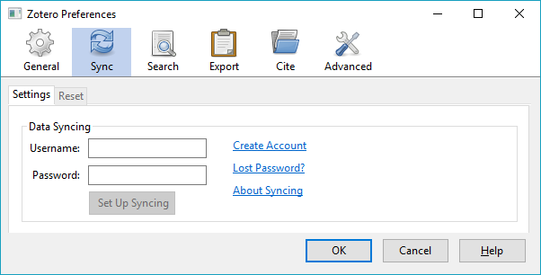
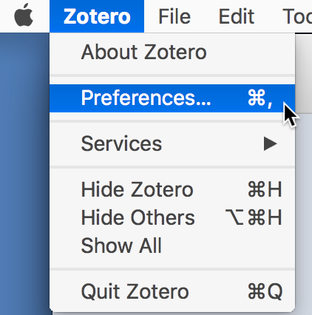
Setting Up & Syncing
Open Zotero
Go to Preferences
Windows Mac
Go to the Sync tab and log in
Notes:
Now that we all have a Zotero account and also installed Zotero…Let’s get the sync up and running. Syncing will link your online & desktop version regularly.
Go through this
Wait for a bit, but not too long, as they can do this step by themselves afterwards too (isn’t required for adding sources to library or creating citations)

Slide 7
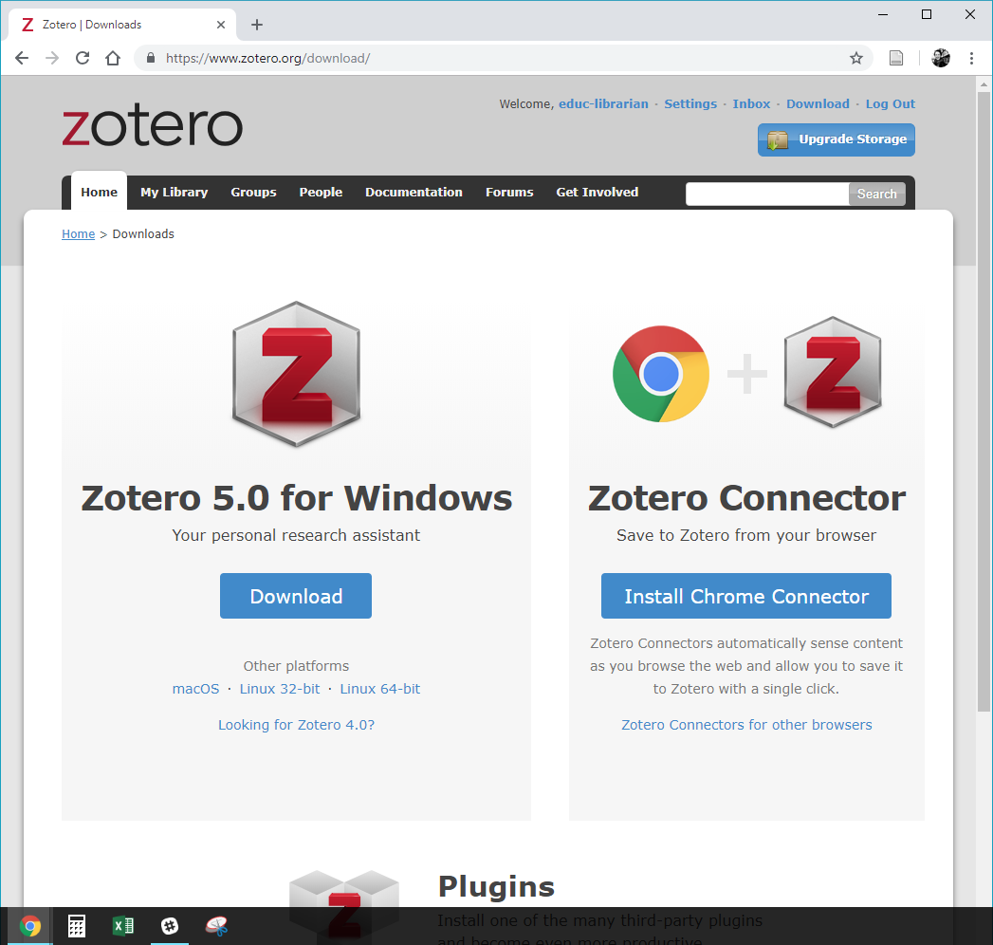
Install Zotero Connector
Go to zotero.org/download
Download + install Zotero 5.0
Install Zotero Connector
Zotero Connector doesn’t work with .Internet Explorer or Microsoft Edge or Safari 13 . If one of these is your preferred browser, ask me about your options!
Notes:
Another thing to have installed before we move on:
Zotero Connector is an add-on in your browser that will allow you to quickly and easily add resources to your library while you’re browsing the web, or using the Community Scholars Portal.
Some of you may have already installed this when you were installing Zotero. If you haven’t, and would like to practice with it during this workshop, please head over to zotero.org/download to do so.
In this screenshot of the Zotero downloads page, you can see on the right that Zotero has recognized I’m in the Chrome browser and prompts me to install the add-on in Chrome.
Zotero does not work with Microsoft Explorer or Microsoft Edge, and is being discontinued for Safari 12. If you are using one of those browsers, please let me know and we can discuss your options.
For facilitator: the options are:
Use the Zotero bookmarklet for any browser (IE, Edge, Opera): https://www.zotero.org/downloadbookmarklet
Safari 13+ is not currently (Sept 2019) operable with Zotero Connector or the bookmarklet. Info and options for Safari 13: https://www.zotero.org/support/kb/safari_compatibility
Other options for getting sources into Zotero (drag & drop, magic wand, etc.)

Slide 8
Build your Zotero library
Add sources to your library in a variety of ways:
From your web browser (Zotero Connector)
From the Community Scholars Portal (Zotero Connector)
Drag + drop PDFs
By unique identifier (e.g., ISBN, DOI)
Manual entry
Notes:
Check-in questions/poll ideas:
Have you used the portal recently?
Which types of resources do you work with (articles, books, other materials, etc.)?
Today we’ll mainly be focusing on using the Zotero Connector -- it’s the most common and also one of the most useful ways to add sources to your Zotero library. As we’ll see, the Zotero Connector works through your web browser. This means you can use it for a wide variety of content you access using your browser (articles, ebooks, citations for physical books, websites, news articles, and so on). However, we’ll try to stick to examples from the Community Scholars portal, as these are probably the type of scholarly articles you’ll be citing the most.
There are also other ways to add sources. We’ll quickly go over these, but as these aren’t as common, we won’t spend too much time on them. These ways are: drag and dropping PDFs, using unique identifiers, and entering citations manually. Remember that Zotero’s usefulness comes from NOT having to enter information manually, so this last one is for those items that can’t be automatically added to Zotero.
For any slides we skip, you also have the slides to refer back to.
What we’ll do is go over the Zotero Connector, as well as adding sources using the Community Scholars Portal. Then I’ll pause for a few minutes to give you time to try it. That way everyone will have at least one item in their library before we move on. The other methods I’ll quickly demo. If there’s time at the end, we can come back and you can try the other methods out too.

Slide 9
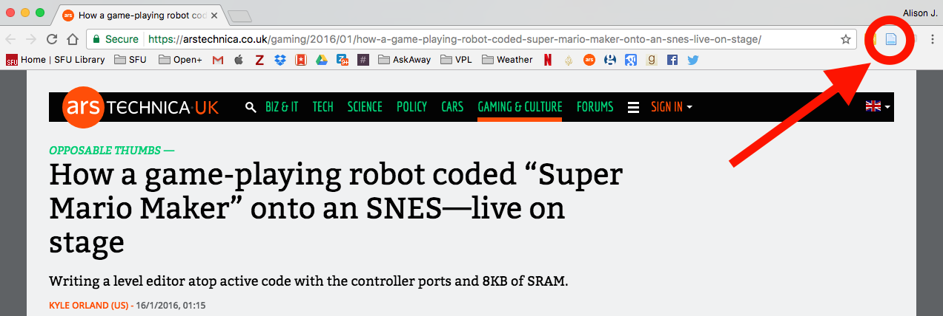
Add sources using Zotero Connector
Find the Zotero icon in your browser.
Notes:
Go over where to find the Zotero icon in different browsers (right hand side for Chrome and Firefox; for Safari, it’s just to the left of the address bar.)
To add an item to your library, simply click on the Zotero icon. The item and all its accompanying metadata will be added to your library, including a link back to the page it was retrieved from, and a PDF, if applicable.

Slide 10
Notes:
The Zotero icon may change, depending on the type of item you’re looking at (book, magazine article, journal article)

Slide 11
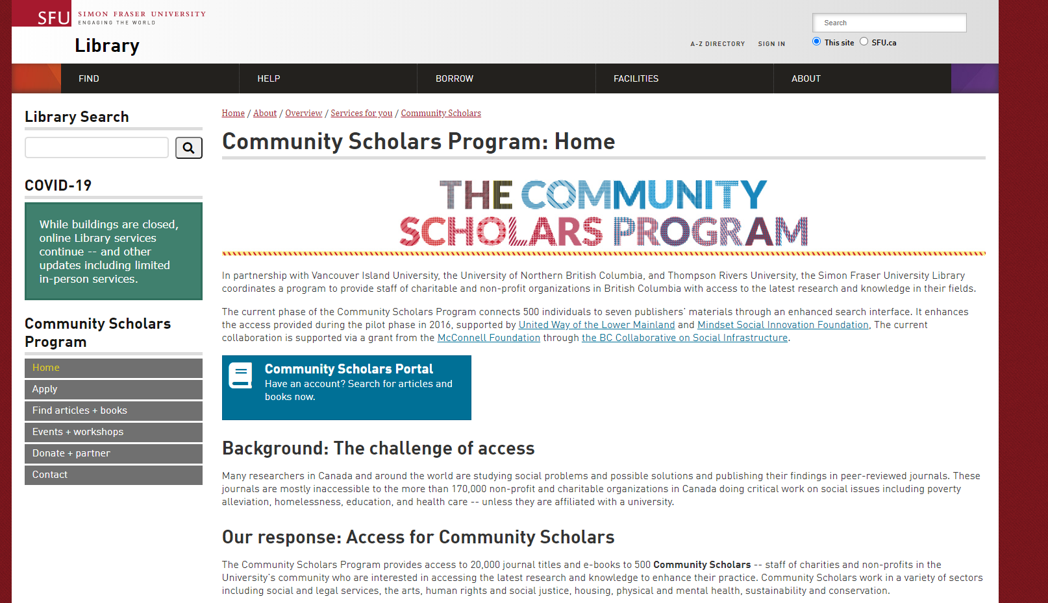
Add sources from the Community Scholars Portal
Use the CSP homepage, a direct link to the Portal, or your bookmarked page
www.communityscholars.ca
Notes:
Here is where you might use the Zotero Connector the most. This is the Community Scholars Portal which you may be familiar with – it’s the portal for all the electronic resources, articles, ebooks, and so on, that you can access as part of the community scholars program. You can find it on the Community Scholars Program page or you may have a bookmarked page or received a direct link in your email to the portal.
I recommend bookmarking or saving the Community Scholars home page. This way, you’ll have easy access to both the portal AND tips and advice on the left hand side. We’ll paste the link in the chat: www.communityscholars.ca
Make sure that everyone is able to get to this step.
Check for questions about login, barcode issues

Slide 12
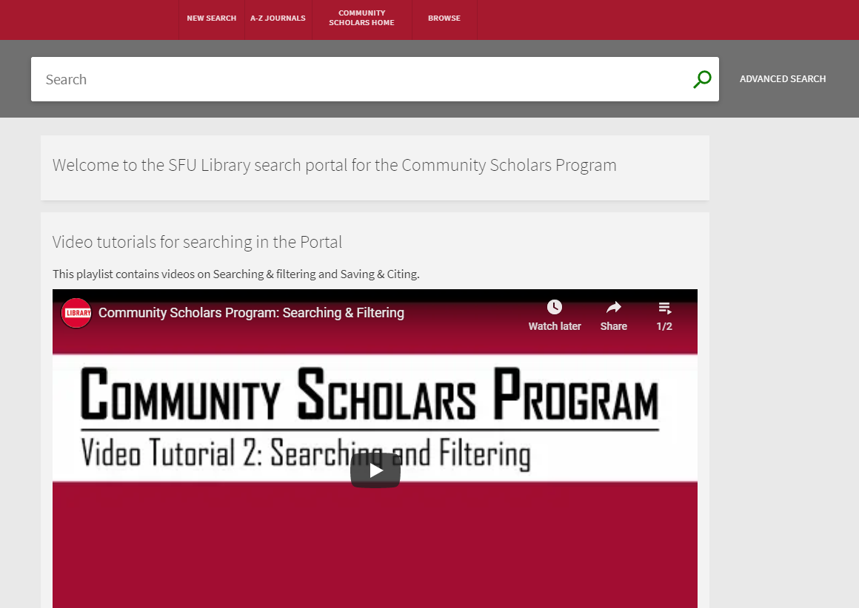
Add sources from the Community Scholars Portal
www.communityscholars.ca
Notes:
So hopefully you all can now see this page. This is the portal. We won’t be covering the features of the portal in this workshop, such as how to search or use filters, but there are many helpful tutorials and videos. You can also get to the search tips page through the home page that we just sent (www.communityscholars.ca)
Now I’ll show a GIF (animation) demonstrating how to add sources using this portal. I’ll let it play a couple of times.
[I’ve found that one should not talk during GIFs!]

Slide 13
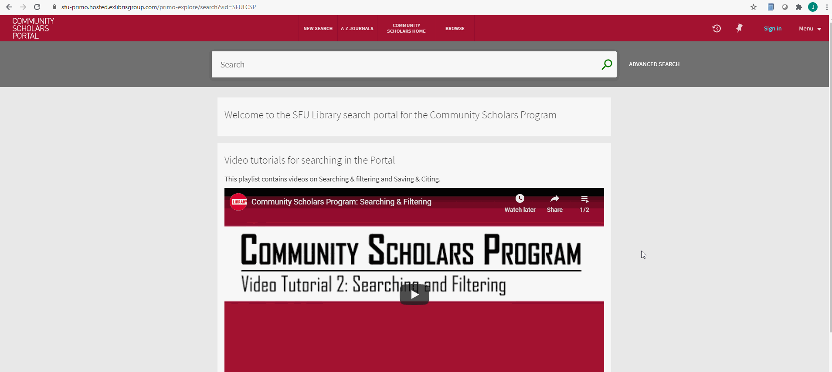
Community Scholars Portal
Notes:
Things to note:
You need to navigate to the article first before using the connector
You need to have Zotero open, or else you’ll see a prompt asking you to open Zotero
We’ll talk about folders/collections later, but the connector will automatically add the item to the library or folder you have highlighted in Zotero
Any questions about this method?
[Possibly pause here to allow them to try, then just quickly go over the other 3 methods]

Slide 14
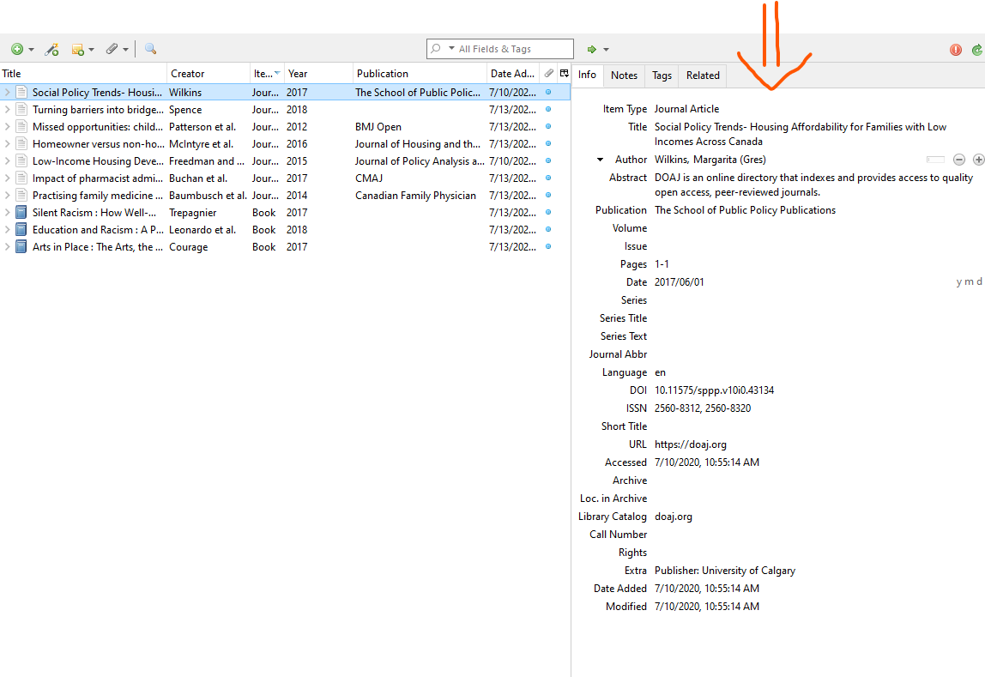
Start building your library!
Use the Zotero Connector to add a source to your Zotero library
Go to the Community Scholars Portal to find a resource and add it using Zotero Connector
Check back in once you have 1+ items in your library, or if you have issues
Notes:
PAUSE for 5 minutes to allow them to try; check back in (another 2-3 minutes).
Check in when you’ve got an item in your library (please enter a ‘done’ message in the chat when you’ve done this). If you have any issues while you’re trying it out, let us know!
On the left is a screenshot showing the kind of information you should be seeing once you’ve added an item

Slide 15
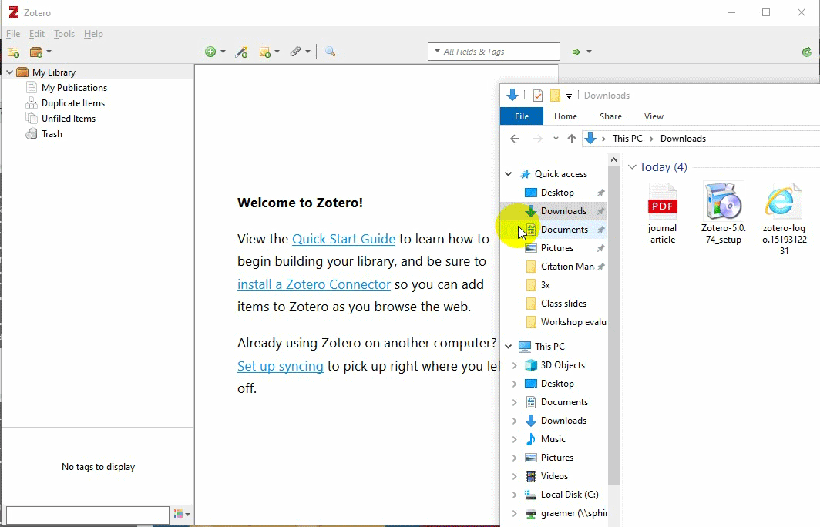
Add sources by drag + drop
Drag + drop a PDF from your computer into Zotero
If it doesn’t automatically get the full citation information:
Right click + select “Retrieve Metadata for PDF”
Notes:
*Skippable
If you have a PDF saved on your computer, it’s very easy to add it to your Zotero library. Simply drag and drop the item into “My Library.”
If the item has been identified by Zotero before, or, the item has a DOI, Zotero should be able to locate all of the relevant bibliographic information, it should do this automatically. You don’t have to worry about how it does this, but you should double check that it worked.
Also, this will only work with PDFs that have the information embedded into the file (eg articles from publishers). This will not work with photocopied book chapters, or PDFs that don’t have this information embedded. If you check and the information isn’t there, I recommend going back to the source of the article, depending on where you retrieved it from, and trying the Zotero Connector to see if that works.
If it doesn’t do this automatically, right-click on the item and select “retrieve metadata for PDF.” [This option often comes with a host of issues, so might be worth not even mentioning.]
https://www.zotero.org/support/retrieve_pdf_metadata

Slide 16
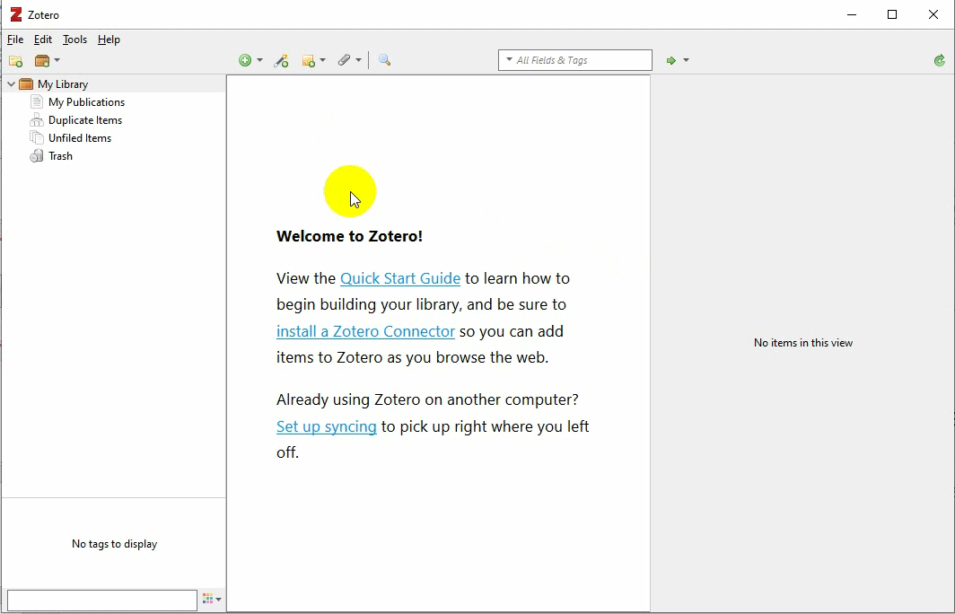
Add an item by identifier (ISBN or DOI)
Zotero’s “Magic Wand” tool.
Enter a unique identifier for your source & Zotero will search for it.
ISBN (International Standard Book Number): unique identifier for books
DOI (Digital Object Identifier): unique identifier for online articles
Notes:
*Skippable
An ISBN you will usually find on top of the barcode of a book
A DOI you can either find in an article’s description and sometimes in the URL

Slide 17
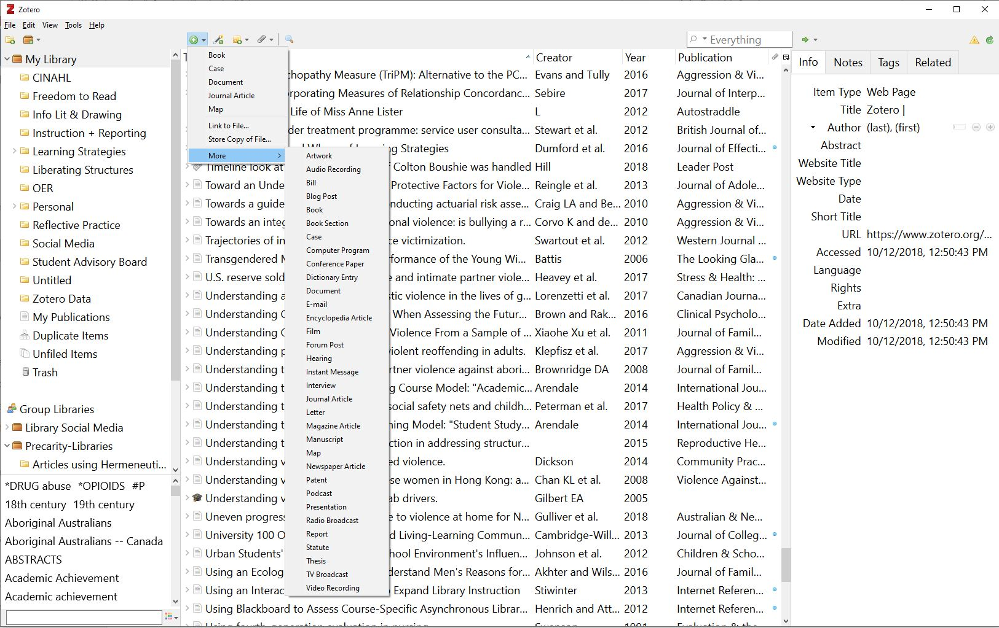
You can also add items manually!
Click on the round green plus icon to add an item manually
Why might this be useful?
Emails
Episodes of a podcast
TV show
Radio broadcast
Etc.
Notes:
Sometimes you may need to add sources that Zotero can’t add automatically, like emails, podcasts, and so on. Or rarely, Zotero Connector might have issues. But you still want to have all your sources in your library, so you might want to add it manually. The arrow points to the icon you will need to click for adding items manually.
Check-in questions:
Which method did you try?
Which one do you think or predict would be most useful?
Are there any you’d like to go back over?

Slide 18
Organize Your Zotero Library
Keep your references organized with these features:
Save sources to folders (called Collections)
Add notes or tags
Notes:
The following features listed here will help keep your library organized.
Saving sources to folders. Note that folders are called collections in Zotero. They mean the same thing.
Adding or browsing tags
Searching collections

Slide 19
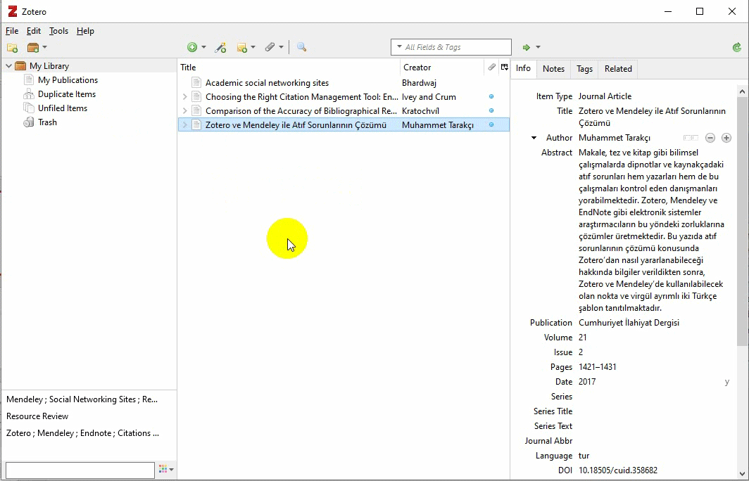
Save sources to folders
Click on the folder icon to create a collection.
Drag sources into the created collection.
Notes:
You can add items to multiple collections. This won’t duplicate your item. It’s like creating an iTunes playlist...All of your sources are in your Library. When you create a folder and add sources to the folder, your source is still in your library, the folder contents are kind of “on top” of the library or like a shortcut. So in this way it’s different from creating a folder for files on your computer.
If you have a specific folder/collection highlighted when you go to add a source using the connector, it will add the item to your library AND create that shortcut in the folder/collection.
When we get to group libraries, this works the same way.

Slide 20
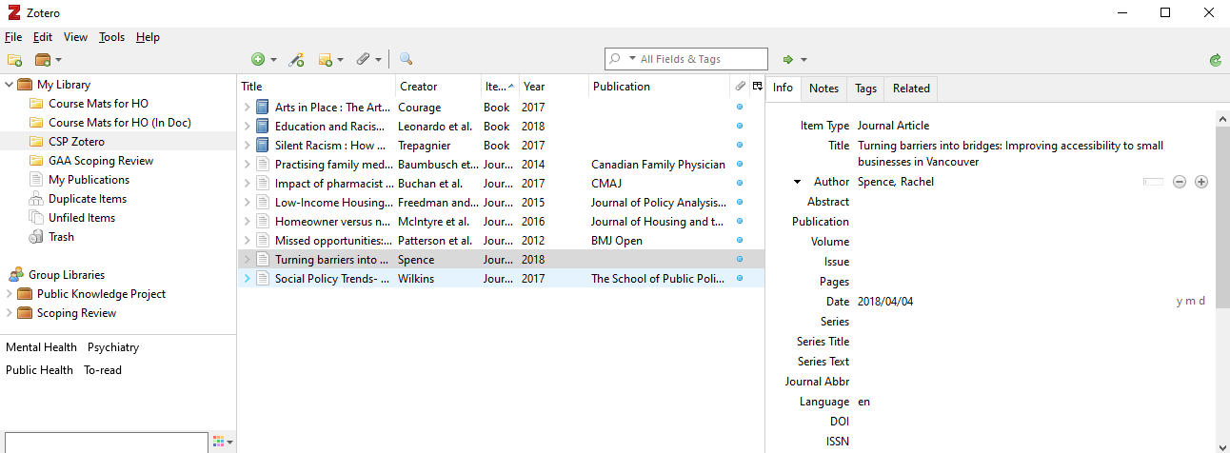
Create tags for your sources
Add tags and notes to a source
Browse your tag cluster
Notes:
Another way to organize your sources is by adding tags and notes. In this example, you can see that tags can be anything - they can be about the content or subjects of the article, or you can use them to keep track of which articles are “to-read.”
You do already have folders/collections, but one reason you might want to use tags as well is when, for instance, you’ve already used folders to organize your sources for different areas or projects. But you still want another way to show which articles are “to-read” you would use tags.
The next slide shows another GIF (animation) on adding tags.
You can also add longer notes to your sources.

Slide 21
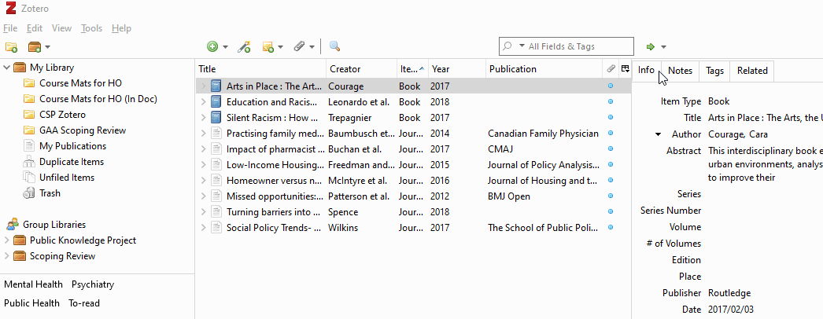
Creating tags for sources

Slide 22
Create Citations & Bibliographies
Two useful ways to do this:
By drag + drop (in-text citations, references)
Using the word processor plug-in for Word, GoogleDocs, or Libre Office (integrated in-text citations and references)
Notes:
This is one of the most important and useful tools that Zotero provides. There are two ways you can quickly create citations and add bibliographies. You can just drag and drop - this is really simple, but it’s “static” which means that it won’t automatically update. Also, if you’re creating a bibliography, you have to make sure it’s complete and final before you drag and drop, otherwise you’ll have to do it again if you make any changes to it.
Option 2 is more popular and shows where the full power of Zotero and its word processor plugin becomes apparent. This one just has to be set up, but then it’s easy to use. We’ll go over both now.

Slide 23
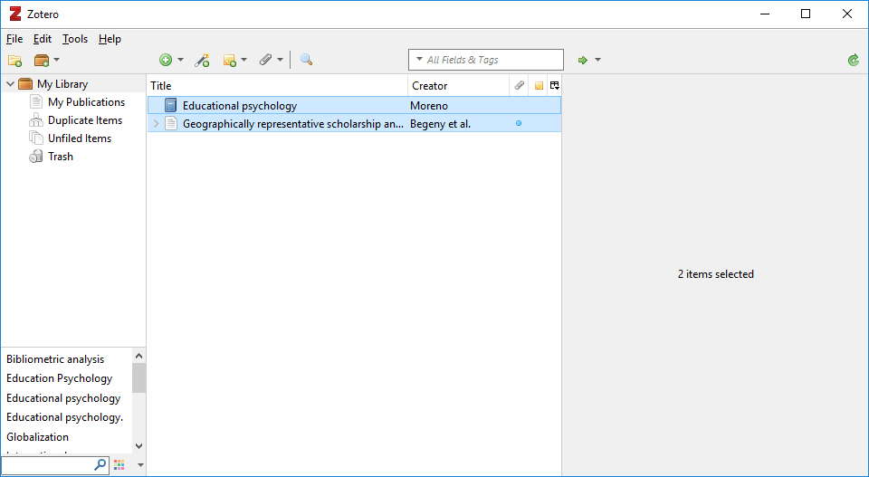
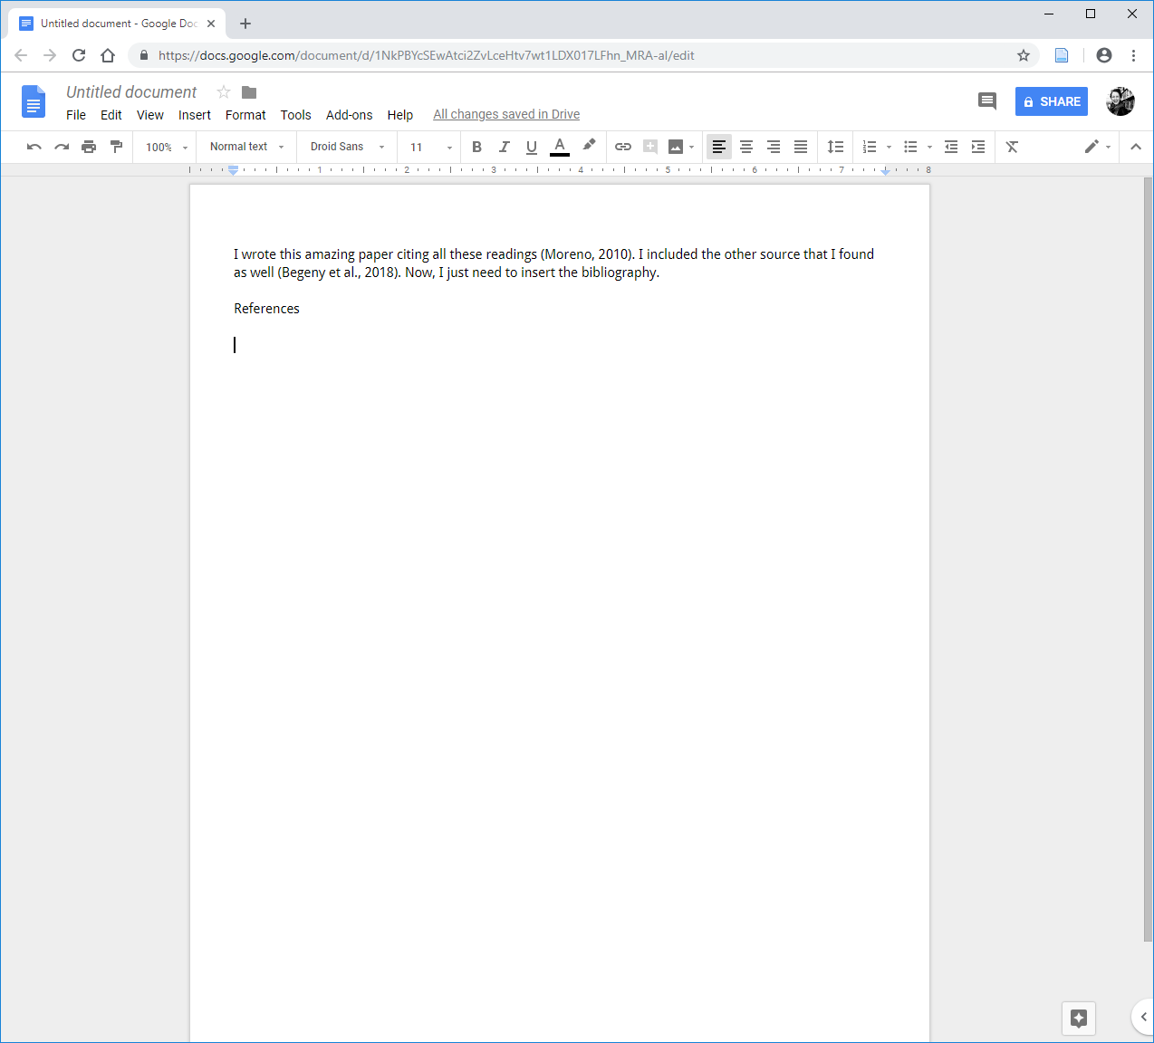
Add references by drag + drop
Open a word document (e.g. MS Word, Google Docs).
Drag source(s) from your Zotero library into the document.
Hold SHIFT and drag a source to create in-text citations.
Notes:
To add references by drag n’ drop, open a document either on word or google docs and drag the source from your Zotero library into the document. Then click shift and drag a source to create in-text citations.

Slide 24
Zotero Word Add-In
Word 2016
For older versions of Mac (e.g. Word 2011), look for the script icon
Notes:
Word add-in/plug-in
NOTE: There is a common issue that usually comes up every workshop, where some participants will not be able to find the Zotero tab in their version of Word. If online, consider asking participants to let you know when they see it (via chat, poll, thumbs-up). You can move to the next slide for the troubleshooting steps that fixes the issue 90% of the time.
Troubleshooting? See next slide.

Slide 25
Notes:
Let’s go through some Troubleshooting. Something that might happen to you is finding that the Zotero tab is not appearing. Here are the most common steps for getting the Zotero Word plugin to show up.
First steps to try, from the Zotero forums: (this most often works)
If the Zotero tab or toolbar (or Zotero scripts menu for Word 2008/2011 for Mac) does not appear, follow these steps:
Close and quit Word or LibreOffice. This means not just closing the documents you have open, but actually right clicking the word icon to completely close it.
In Zotero, go to Tools → Add-ons → Extensions.
If “Zotero Word for Mac/Windows Integration” or “Zotero LibreOffice Integration” are disabled, click the “Enable” button to re-enable the extension.
If the “Enable” button for “Zotero Word for Mac/Windows Integration” is grayed out, and you are unable to click it, click the “Remove” button and restart Zotero.
If you don't see “Zotero Word for Mac/Windows Integration” or “Zotero LibreOffice Integration” in the Extensions window at all, then you should re-download and re-install Zotero. It’s not necessary to uninstall Zotero before re-installing; simply install Zotero on top of the existing installation. Please note that re-installing Zotero rarely fixes problems though and should not be used as a general troubleshooting step. This is one of the few instances where re-installation is helpful.)
In Zotero, go to Preferences Cite pane, and open the “Word Processors” tab.
Click “Reinstall LibreOffice/Microsoft Word Add-in” and then restart your word processor.
A second set of (similar) steps in case the above does not work:
Quit Word.
Uninstall Zotero 5.0 from your computer. (You will not lose access to the references in your Zotero library, as you will be able to re-log-in once you reinstall.)
Reinstall Zotero 5.0: https://www.zotero.org/support/installation
Log in to Zotero 5.0 (under Preferences - Sync)
Check to make sure Word Plugin is enabled in Zotero 5.0 (under Tools - Add-ons).
Open Word, and look for the Zotero tab.
For other troubleshooting solutions, you can visit Zotero.org/support and search for word processor plugin troubleshooting.
Beyond that, there are more complex troubleshooting that you likely won't have time to get into during the workshop, but can follow up with them afterwards: https://www.zotero.org/support/word_processor_plugin_troubleshooting

Slide 26
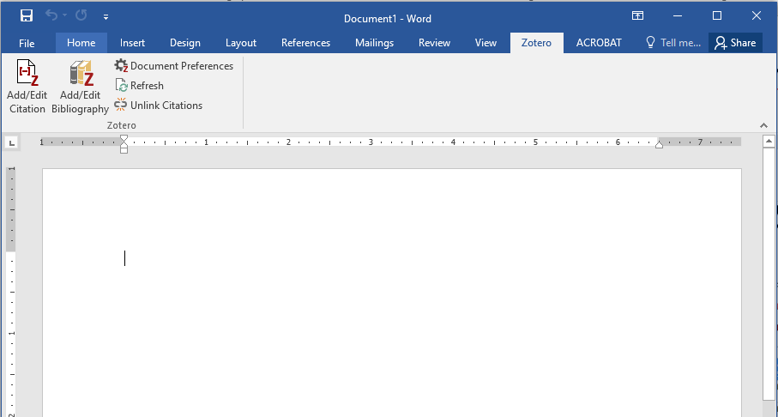
Finding citation & bibliography options in Word
Add/Edit Citation inserts in-text citations.
Add/Edit Bibliography creates a list of references.
Notes:
This slide is just to illustrate where you would click to add in-text citations + bibliography. These can be referenced again in the handout.

Slide 27
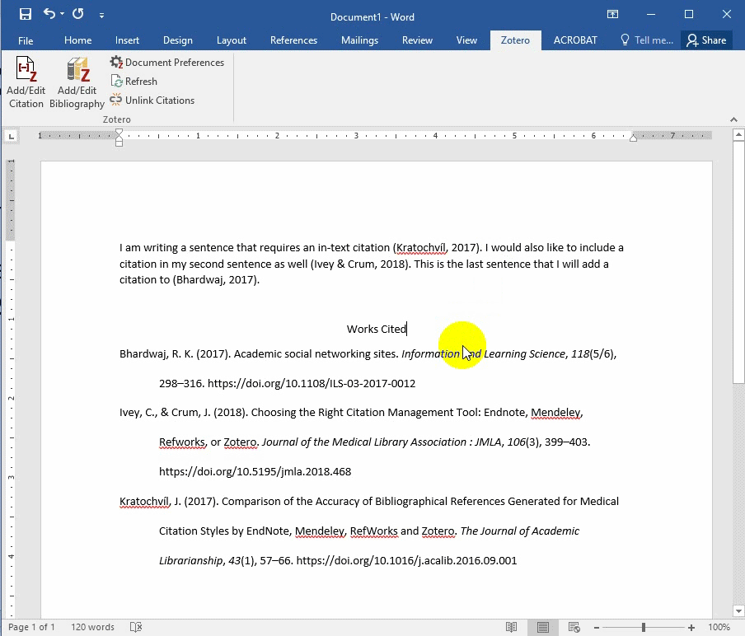
Changing the citation style with Zotero in Word
Click on the Document Preferences button.
Select the citation style you wish to use.
Click OK.
(If the style does not change, click the Refresh button in the Zotero toolbar.)

Slide 28
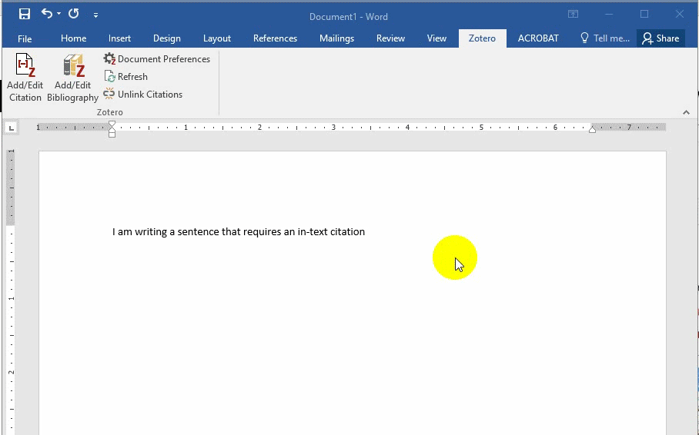
Insert in-text citations in Word from Zotero
Place your cursor where you wish to insert your citation.
Click on the Add/Edit Citation button.
Search for the source via author name or keyword.
Push enter to insert the citation.
Notes:
(Alternatively, you can live demo this instead of showing the GIF!)

Slide 29
Citing more than one author
In Word, choose Add/Edit Citation, & search for the source you want to cite in the Zotero search ribbon.
Before you press Enter, you can search & add other sources using the same Zotero search ribbon.
Notes:
This slide is just to illustrate what it would look like if you wanted to cite more than one author.

Slide 30
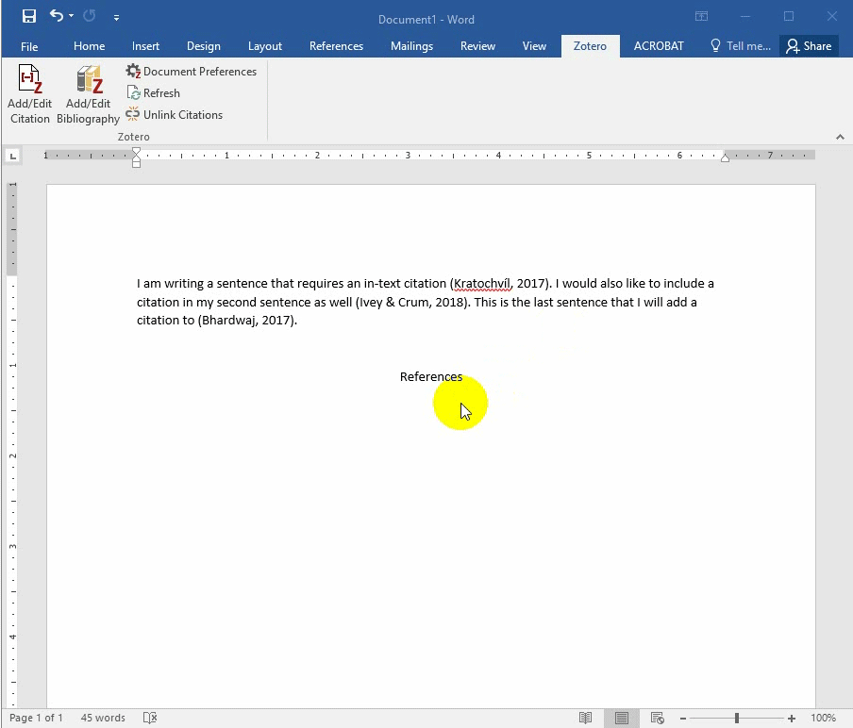
Insert a Bibliography from Zotero
Place cursor where you wish to insert your list of references.
Click on the Add/Edit Bibliography button.
Notes:
PAUSE here for 5 minutes to let people try adding in-text citations and bibliographies

Slide 31
Other Features
Group libraries
Additional features
Notes:
Just going over a couple of other features...

Slide 32
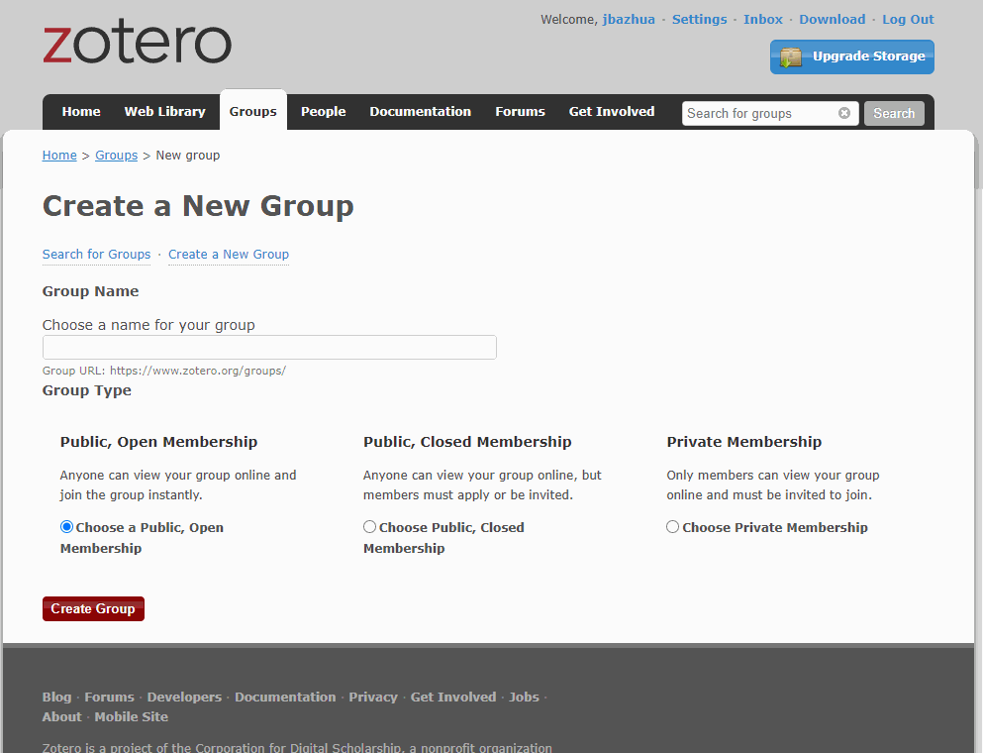
Create groups to share libraries
Click on New Library icon in application
OR
https://www.zotero.org/groups/
Register with an email
Select public or private membership
Invite team/organization members
Notes:
You are welcome to share the resources you find in the Community Scholars Portal with your immediate work team. Zotero groups can be one way of sharing a collection of articles, by asking your team members to set up their own Zotero account and log in to see the shared library. We do ask that you not share the licensed resources from the portal publicly or with clients outside of your work team. However, if you are interested in finding resources that you can share with outside clients, we have another workshop next week on this topic. We'll share more info at the end.
You can add items to group libraries, create folders/collections, in the same way that you do for your own initial library. After creating your group library, wait a bit or click on “sync” in Zotero if the group library doesn’t appear automatically.

Slide 33
What else can you do with Zotero?
Mobile: no official app, but install the bookmarklet tool into your browser to add and sync items with your Zotero library
Social features: create a profile, send messages, follow users’ feeds & libraries
Notes:
*Skippable
Depending on time: do they have questions about any of these features?
Mobile options: https://www.zotero.org/support/mobile

Slide 34
Questions?
After this workshop:
Contact your Community Scholars Librarian:
comschol@sfu.ca
Contact us by email, or set up a phone or in-person appointment.
Thank you for attending!
Feedback survey:
https://www.surveymonkey.ca/r/CommunityScholarsZotero
Notes:
If you have a minute, please fill out our survey - we’d love to get your feedback on how to improve workshops in the future (https://www.surveymonkey.ca/r/CommunityScholarsZotero)
On August 4th, Kate will be giving a different workshop - this one is on called Sharing research beyond your team: How to find openly licensed research to share with clients. This is a great opportunity to learn about how to share research articles you’ve found using the Portal with external clients that you’re working with. The focus is on ways to tell which articles are openly licensed
You will also be discussing ways to cite works to give credit to the author, so you can improve knowledge sharing while respecting intellectual property.

