Slide 1
SEE 101, Fall 2019
Chloe Riley | Research Commons Librarian | car11@sfu.ca

Slide 2
Need help with Zotero after today?
Contact the citation management experts email list for remote support:
citation-managers@sfu.ca.
Contact us by email, or set up a phone or in-person appointment.

Slide 3
How are you managing your references right now?

Slide 4
Why should I use Zotero?
A free, open source citation management tool.
Helps you import, organize, share, and manage your citations and documents.
Helps you create correctly formatted in-text citations and bibliographies in almost any style.
Easily finds & formats relevant citation information from almost any website.

Slide 5
Today’s agenda
Register for a Zotero account
Download & install Zotero 5.0 + install Zotero Connector
Add citations (3 different ways)
Organize your sources (folders, tags, de-duplication)
Create a bibliography (3 different ways)
Explore additional features (groups, adding citation styles)

Slide 6
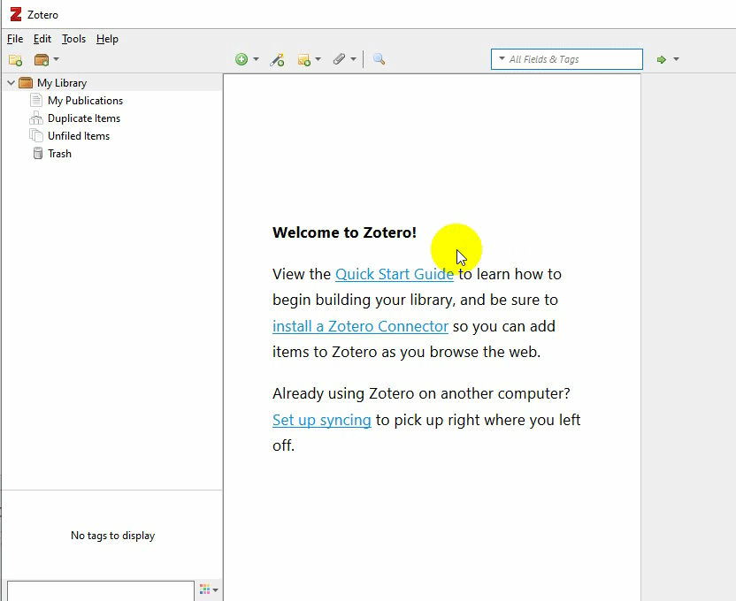
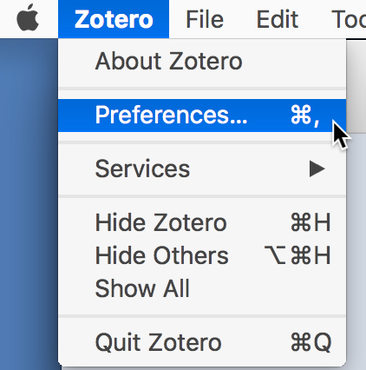
Log in to Zotero
Preferences > Sync
Login with account
Preferences on Mac

Slide 7
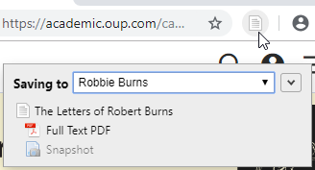
The 3 Fastest Ways to Add Sources to Zotero
From your Web Browser (using Zotero Connector)
Drag and drop PDFs
By identifier (e.g., ISBN, DOI)

Slide 8
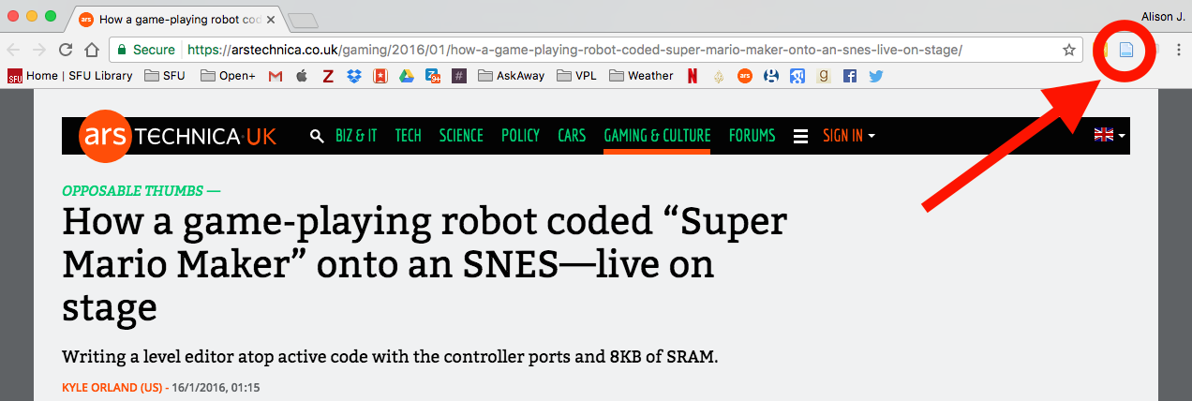
1. Add sources from your browser using Zotero Connector
Find the Zotero icon in your browser.

Slide 9
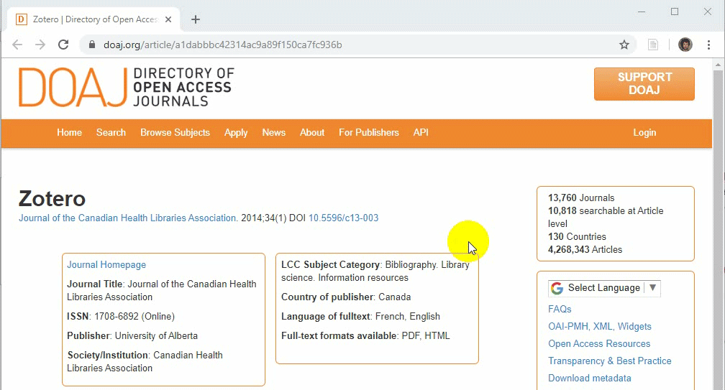
1. Add sources from your browser using Zotero Connector

Slide 10
1. Add sources from your browser using Zotero Connector
Click on the Zotero icon to add a source to your library.
Your new source will show up in your Zotero library.
(If it doesn’t show up immediately, click “Sync.”)

Slide 11
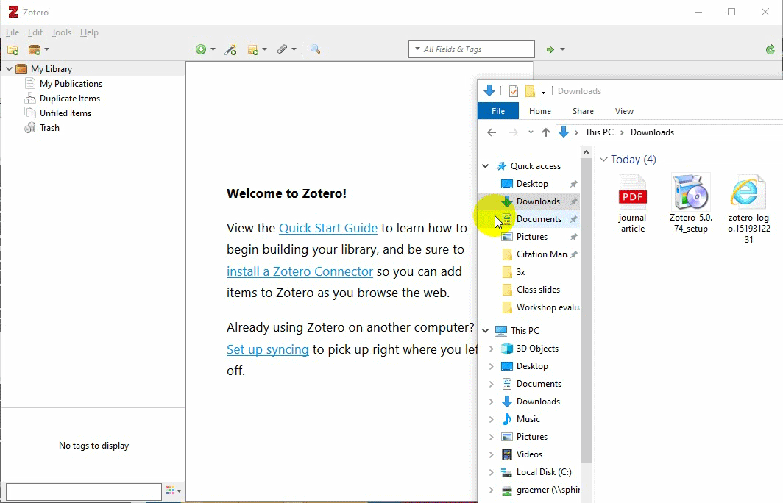
2. Add sources by drag & drop
Drag + drop a PDF from your computer into Zotero
To get the full citation information: Right click + select “Retrieve Metadata for PDF”

Slide 12
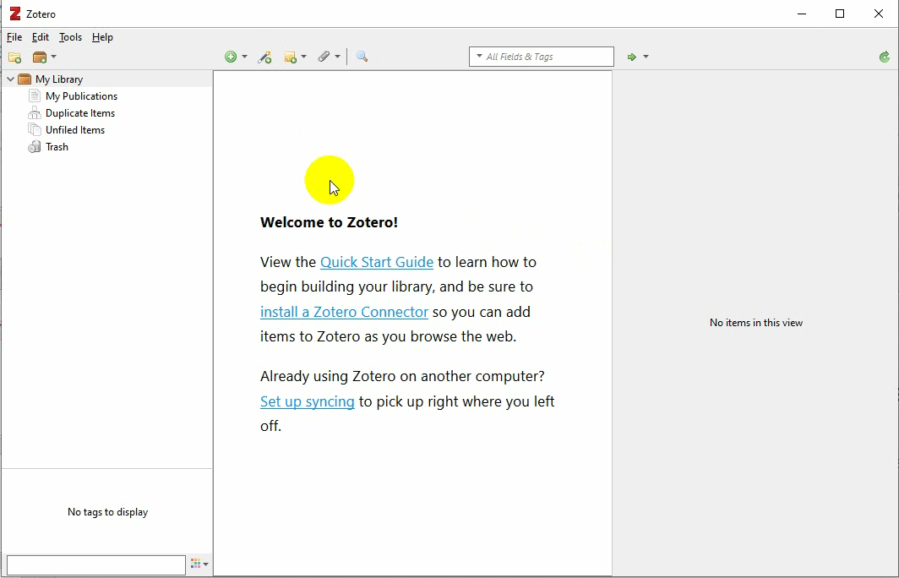
3. Add an item by identifier (ISBN or DOI)
Zotero’s “Magic Wand” tool
Enter a unique identifier for your source (ISBN or DOI) and Zotero will search for it

Slide 13
Organize your sources
Save sources to folders (called Collections in Zotero)
Add or browse tags
De-duplicate your library

Slide 14
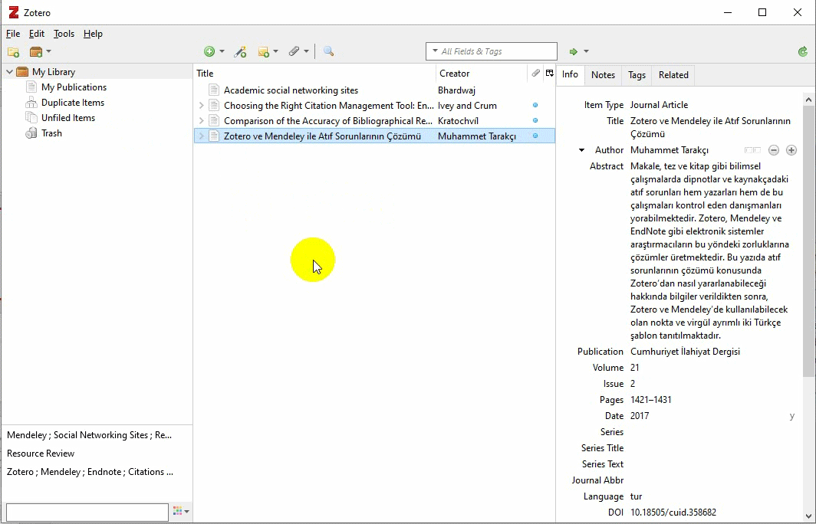
1. Save Sources to Folders
Click on the folder icon to create a collection.
Drag sources into the created collection.

Slide 15
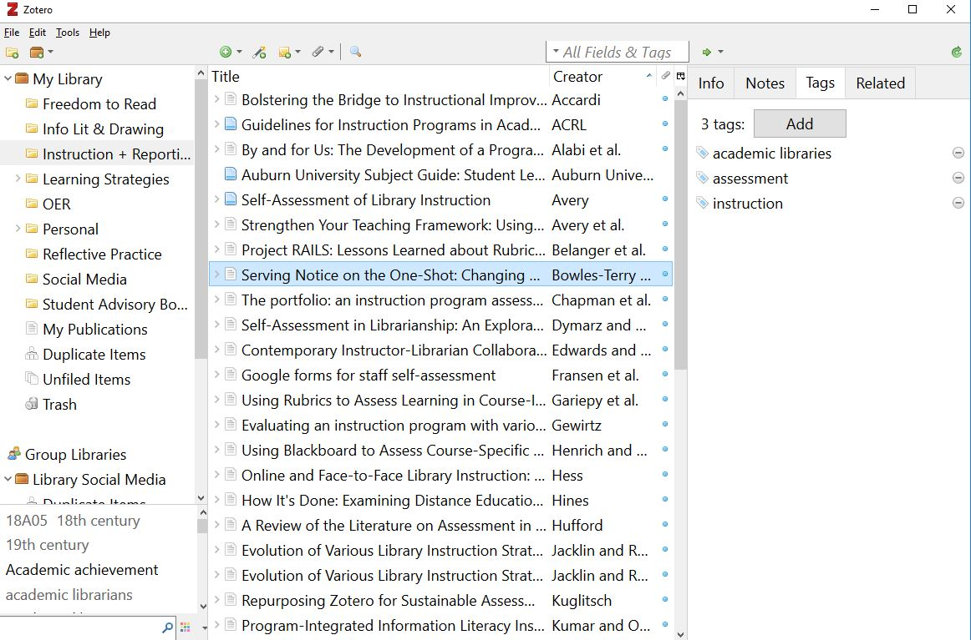
2. Create Tags for your sources
Add tags to a source
Browse your tag cluster

Slide 16
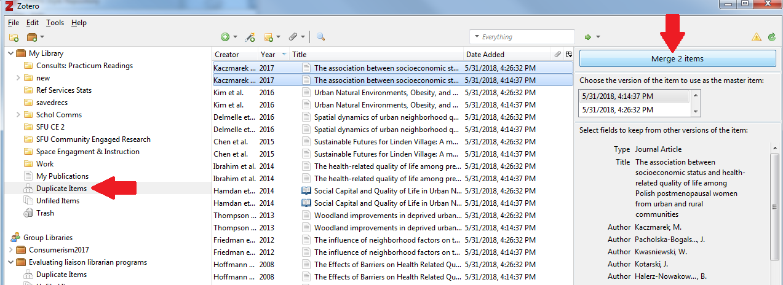
3. De-duplicate your Library

Slide 17
3 ways to create references in Zotero
By drag and drop (references only)
Right-click to create a bibliography from items in Zotero (references only)
Using the Word or Google Docs plug-in (in-text citations and references)

Slide 18
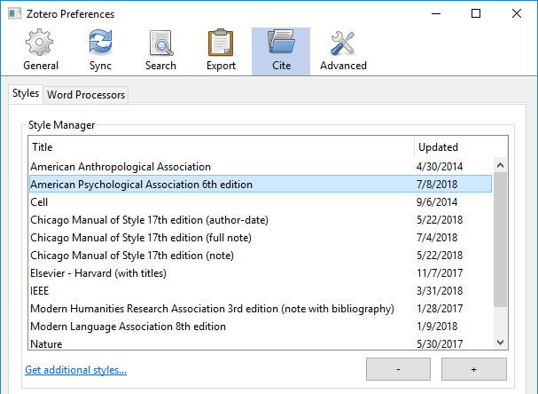
Select citation style in Zotero
Go to Preferences.
Windows: Mac:
Go to the Cite tab to select a citation style.

Slide 19
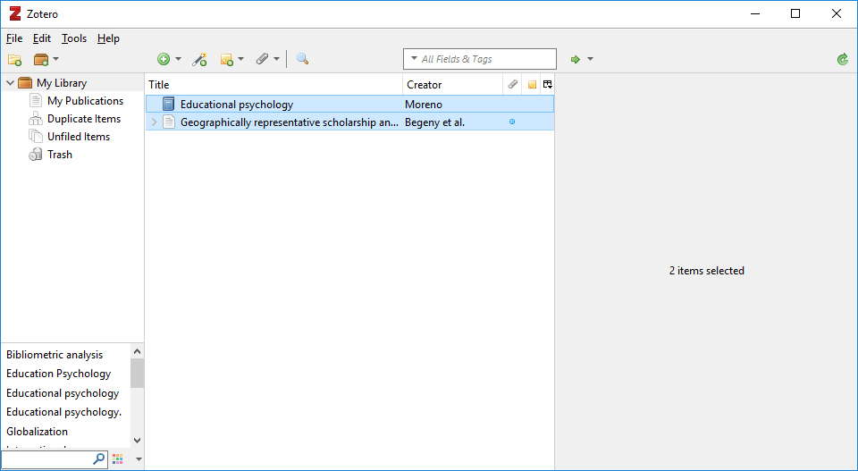
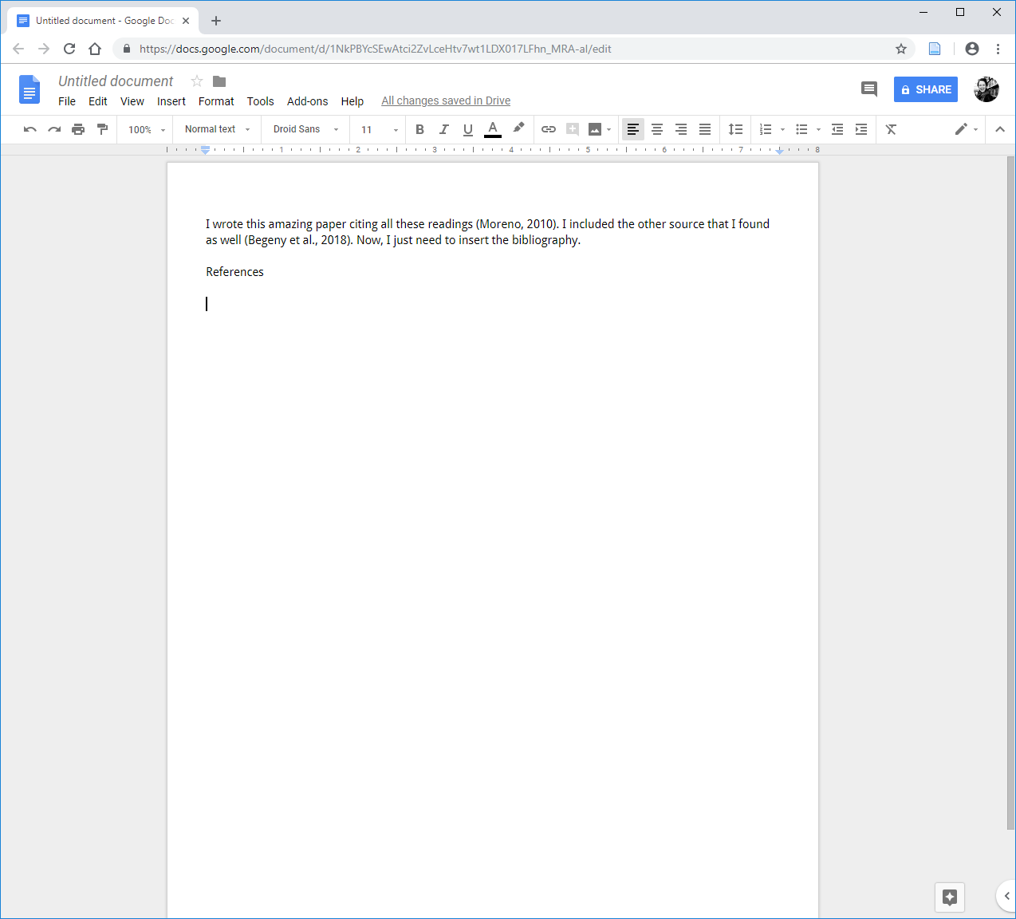
Add References by Drag & Drop
Open a word document (e.g. MS Word, Google Docs).
Drag source(s) from your Zotero library into the document.
Click SHIFT and drag a source to create in-text citations.
Not appearing in the right style? Change your default export style:
Preferences – Export – Default Format

Slide 20
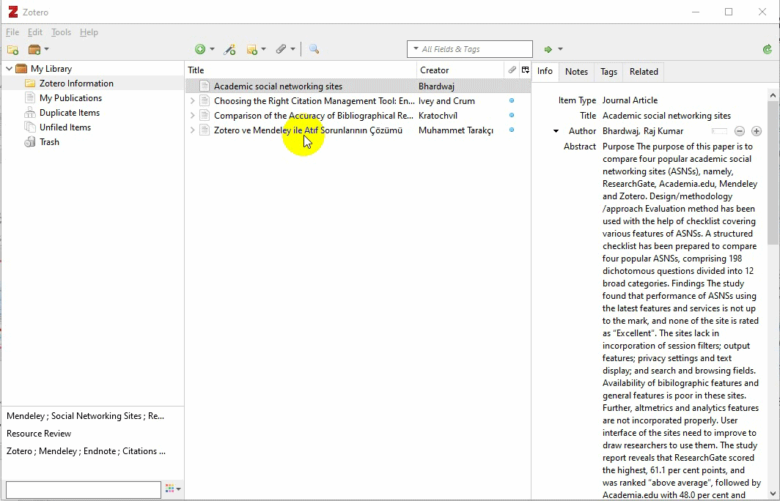
Export References by Right-Clicking in Zotero
Control-click to select items for your bibliography.
Right-click and select “Create Bibliography from Items.”

Slide 21
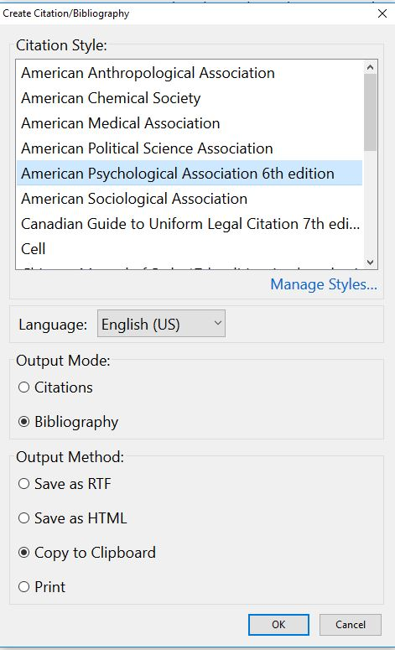
Export References by Right-Clicking in Zotero
Choose citation style
Output Mode: select “Bibliography”
Output Method: select “Copy to Clipboard” to copy the bibliography
Click OK
Paste into a word document (MS Word, GoogleDocs, etc.)

Slide 22
Finding the Zotero Word Add-In
Word 2016
For older versions of Mac (e.g. Word 2011), look for the script icon

Slide 23
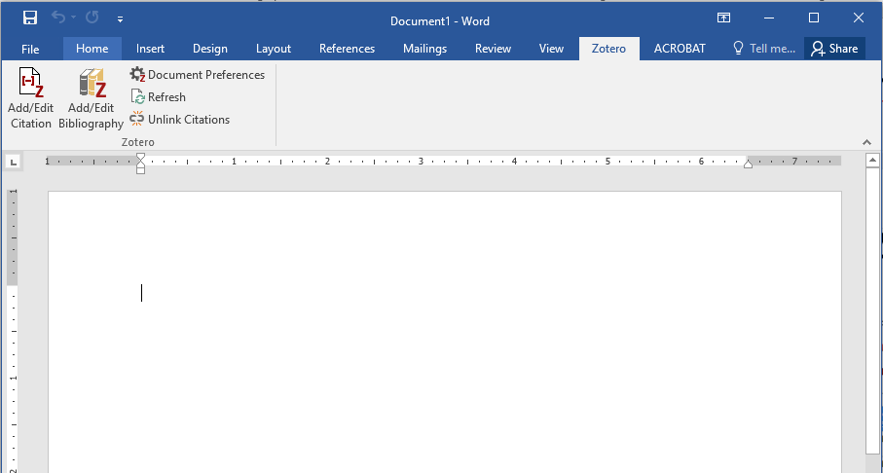
Insert In-Text Citations in Word from Zotero
Add/Edit Citation inserts in-text citations.
Add/Edit Bibliography creates a list of references.

Slide 24
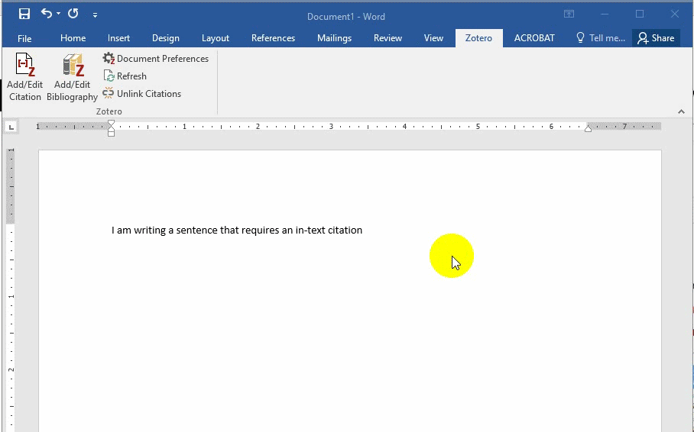
Insert In-Text Citations in Word from Zotero
Place your cursor where you wish to insert your citation.
Click on the Add/Edit Citation button.
Search for the source via author name or keyword.
Push enter to insert the citation.

Slide 25
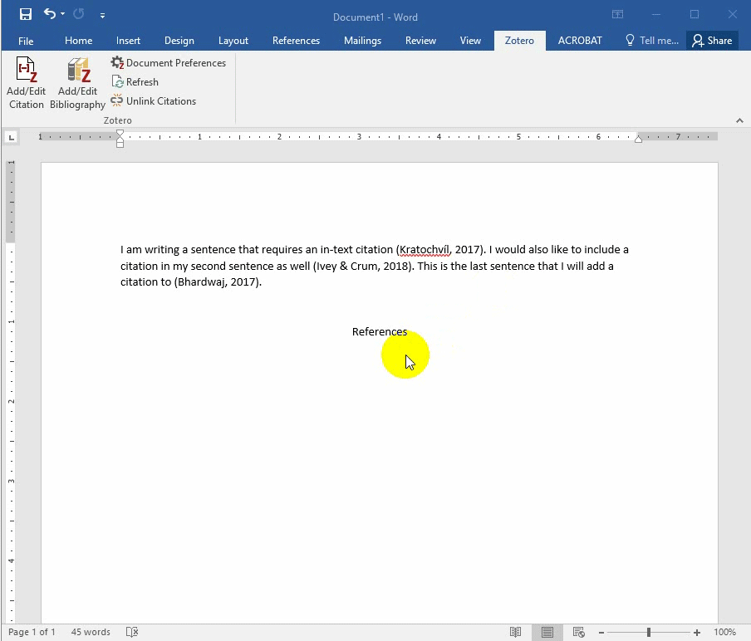
Insert a Bibliography from Zotero
Place cursor where you wish to insert your list of references.
Click on the Add/Edit Bibliography button.

Slide 26
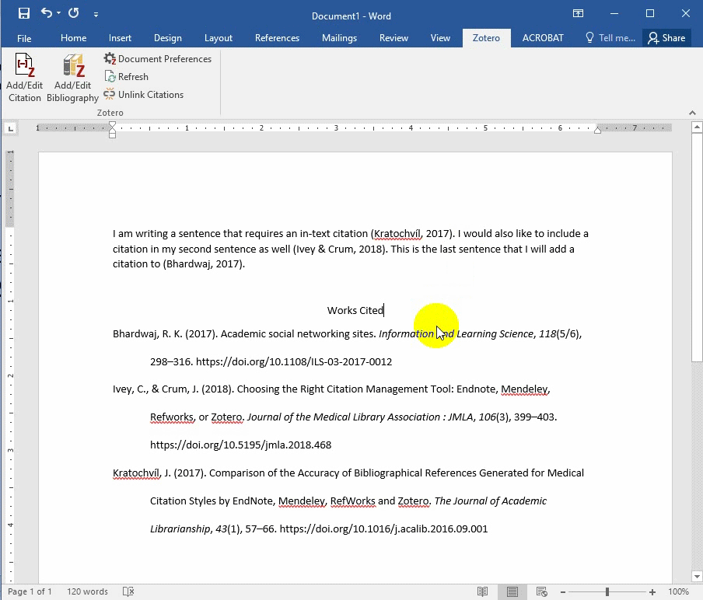
Changing the citation style with Zotero in Word
Click on the Document Preferences button.
Select the citation style you wish to use.
Click OK.
(If the style does not change, click the Refresh button in the Zotero toolbar.)

Slide 27
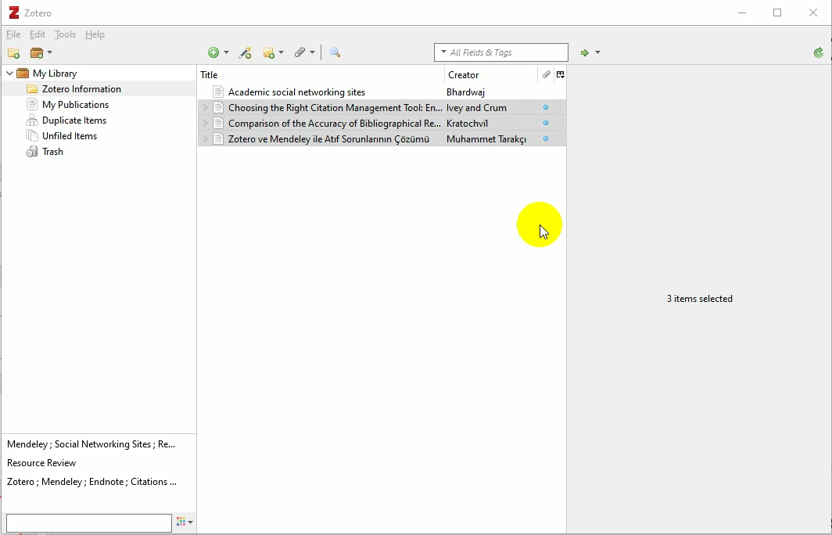
Add additional citation styles to Zotero
Go to Preferences and then Cite.
Click on the Get additional styles link.
Search for the style you wish to add.
Click on the style, then click OK.

Slide 28
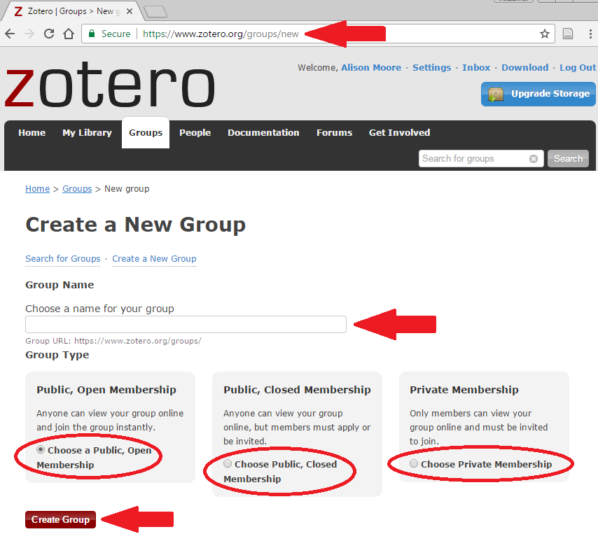
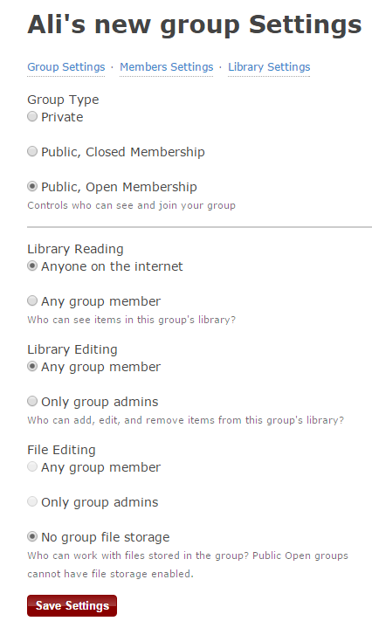
Create a group

Slide 29
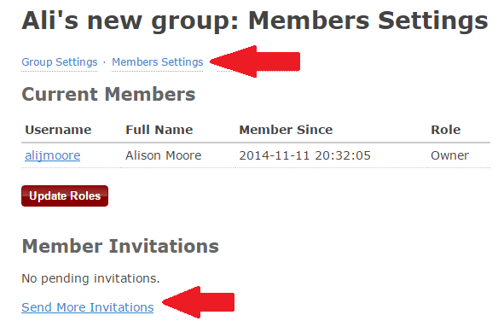
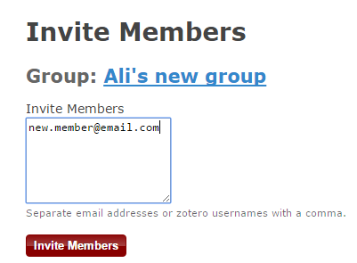
Invite your colleagues

Slide 30
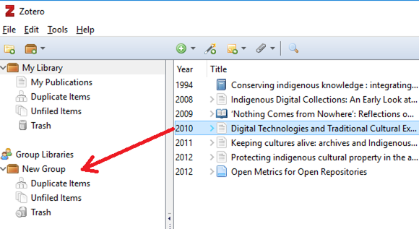
Share sources with your group

Slide 31
Need help with Zotero after today?
Contact the citation management experts email list for remote support:
citation-managers@sfu.ca.
Contact us by email, or set up a phone or in-person appointment.
Chloe Riley | car11@sfu.ca | 778-782-5594

