Slide 1
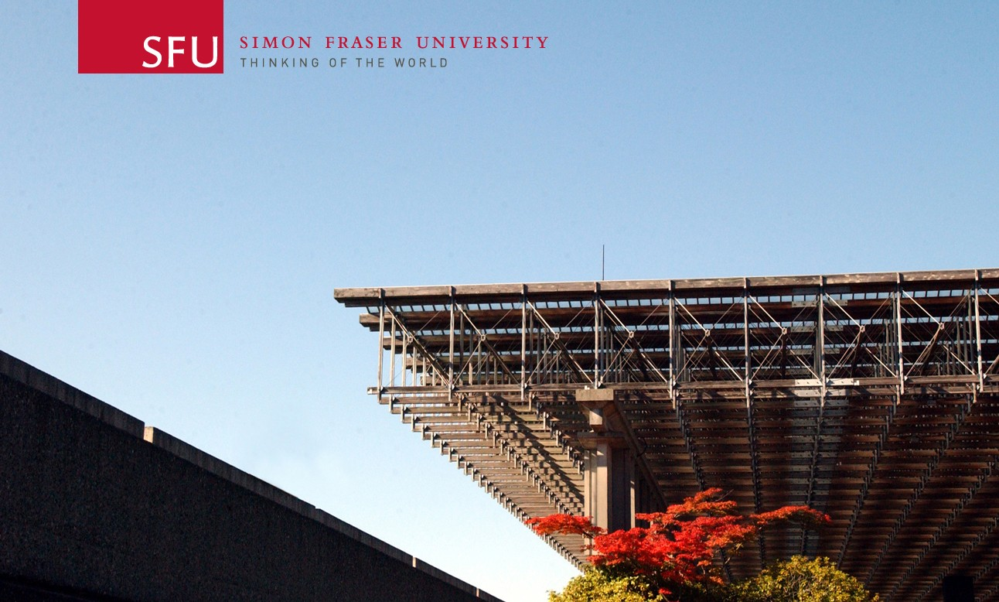
Lighting:
Operation & Safety
Spring 2016

Slide 2
Before Borrowing Lighting Kits
Complete the online quiz
Score 100% based on the material in this workshop
Show the library technicians
Get a sticker for your student card
Lighting Kits
https://www.lib.sfu.ca/about/branches-depts/fraser/fraser-equipment/siat-equipment

Slide 3
Quartz Halogen vs. Incandescent Lighting
Both operate on the same principle:
Electric current passes through a thin tungsten metal filament causing it to heat white hot and emit light
However, quartz halogen lamps encase the filament in a quartz casing filled with halogen gas. This allows these bulbs to run hotter, brighter and whiter
Lighting Kits
https://www.lib.sfu.ca/about/branches-depts/fraser/fraser-equipment/siat-equipment

Slide 4
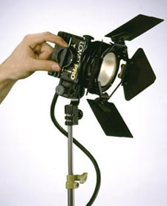
Lighting Kits For Loan:
Small Lighting Kit
3 x Lowel Prolight 150W tungsten balanced lights
Low-level key or accent light, fill light (with diffusion) or back-light for interviews & other small shooting-areas
3 x stands
3 x barn doors
Colour correction and diffusion gels
Lighting Kits
https://www.lib.sfu.ca/about/branches-depts/fraser/fraser-equipment/siat-equipment

Slide 5
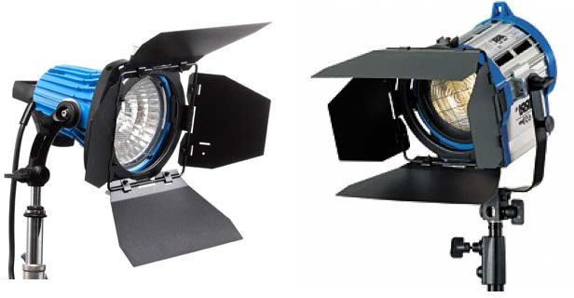
Lighting Kits For Loan:
Large Lighting Kit
Contains one 750W ARRILite open face lamp and two 300W ARRI fresnel lamps
Ideal for lighting standing or multiple subjects or from a farther distance
3 x stands
Soft-box
3 x barn doors
Scrims
Lighting Kits
https://www.lib.sfu.ca/about/branches-depts/fraser/fraser-equipment/siat-equipment

Slide 6
Safety
Check all equipment for damage before use
Tape down all cables with Gaffer tape or duct tape (the library can provide duct tape)
Use in dry conditions
Always open the barn doors before turning a lamp on
Use at least 14 gauge extension cords
Never look directly at the lamps (call “Spark!”)
Lighting Kits
https://www.lib.sfu.ca/about/branches-depts/fraser/fraser-equipment/siat-equipment

Slide 7
Safety
Never pick up and move a lamp stand while the lamp is on
Do not operate the lamps pointing up or down at a very steep angle
Do not operate lamps upside down; they could overheat
If smoke appears around the lamp or cables turn off the lamp and return it to the library
Lighting Kits
https://www.lib.sfu.ca/about/branches-depts/fraser/fraser-equipment/siat-equipment

Slide 8
Hot Lamps
These lights can get very hot!
Use only approved accessories and gels that are specifically designed for use with hot lights.
When placed on or very near the lights, any other materials such as paper, plastic or cellophane will melt and possibly ignite.
If you have a problem with a bulb, DO NOT attempt to change it, return it to the library for assistance
Subjects will be affected by the lights; consider their comfort
Lighting Kits
https://www.lib.sfu.ca/about/branches-depts/fraser/fraser-equipment/siat-equipment

Slide 9
Hot Lamps
Keep all subjects/objects minimum 2 meters away
Keep all lamps and cables at least 6 meters away from all flammable materials such as gas and oily rags
Do not touch the lamps without gloves for at least 5 minutes after turning them off
Lighting Kits
https://www.lib.sfu.ca/about/branches-depts/fraser/fraser-equipment/siat-equipment

Slide 10
Electric Safety
How to find the draw on a circuit
Draw (amperage) = total light wattage (watts) / voltage
– e.g. draw = 1000 watts / 120 volts = 8.3 amps
In North America, 120V is the standard
Most households have 15amp circuits
Using this formula do not load a circuit more than 80% of its maximum
- e.g. most household circuits are rated at 15 amps:
» 15 amps x 80% safety factor = 12 amps
» (do not use more than 12 amps)
Lighting Kits
https://www.lib.sfu.ca/about/branches-depts/fraser/fraser-equipment/siat-equipment

Slide 11
W
W
12amps=
A= _{V}
120volts
Lighting Kits
https://www.lib.sfu.ca/about/branches-depts/fraser/fraser-equipment/siat-equipment

Slide 12
W=AV
x 120volts =1440watts
W=12amps
approx. 1440w of lights may be loaded on a standard household circuit
Lighting Kits
https://www.lib.sfu.ca/about/branches-depts/fraser/fraser-equipment/siat-equipment

Slide 13
Activity: Inventory Check
What is in the Kit:
A set of 3 lamps
3 sets of barn doors
3 light stands
Operation and safety guide
Gaffer’s tape or duct tape
Leather gloves
Gels and clothes pegs are in the Small Lighting Kit only
Soft-box and scrims are in the Large Lighting Kit only
Lighting Kits
https://www.lib.sfu.ca/about/branches-depts/fraser/fraser-equipment/siat-equipment

Slide 14
Activity: Inventory Check
Additional items you should borrow from the library
Gels (not in the Large Lighting Kit)
Sandbags
Umbrellas, reflectors, bounce boards, gobos
14 gauge power extension cables
Duct tape
Ask the library techs for accessories!
Lighting Kits
https://www.lib.sfu.ca/about/branches-depts/fraser/fraser-equipment/siat-equipment

Slide 15
Extras You Can Supply:
Wooden clothes pegs for fastening gels, foils, etc.
Practical lighting from hardware stores:
Utility lights:
– Aluminum reflectors, ceramic sockets, etc.
Windshield sunscreen as a reflector
Foam core whiteboard
Leather gloves for handling bulbs
Lighting Kits
http://www.libsfu.ca/surrey/equipment
https://www.lib.sfu.ca/about/branches-depts/fraser/fraser-equipment/siat-equipment

Slide 16
Activity:
– Setup and Assembly
Lighting Kits
https://www.lib.sfu.ca/about/branches-depts/fraser/fraser-equipment/siat-equipment

Slide 17
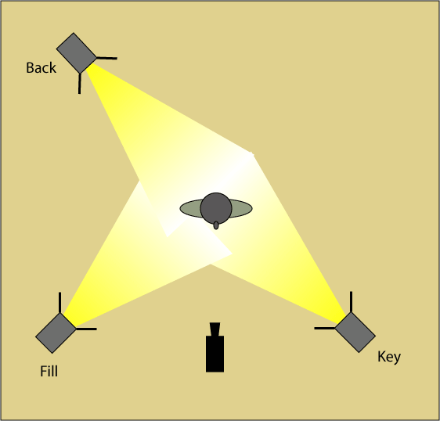
Assembly and Setup
Procedure:
Assemble your lighting kits according to the instructions
Recall what you learned about safety and…
Set the lights according to the 3-point lighting diagram
After your setup is checked by your instructor, disassemble
and return the kits
Lighting Kits
https://www.lib.sfu.ca/about/branches-depts/fraser/fraser-equipment/siat-equipment

Slide 18
Online Quiz:
https://www.lib.sfu.ca/about/branches-depts/fraser/fraser-equipment/siat-equipment
Lighting kit workshop and quiz
Lighting Kits
https://www.lib.sfu.ca/about/branches-depts/fraser/fraser-equipment/siat-equipment

Slide 19
Questions:
Contact the Library Media Technicians
fraser_library@sfu.ca
778-782-7411
Lighting Kits
https://www.lib.sfu.ca/about/branches-depts/fraser/fraser-equipment/siat-equipment

