Slide 1
SIAT equipment at Fraser Library
How to request, borrow, and use.

Slide 2
Content
How to book, borrow, and return equipment
Responsibilities and policies
Basic camera operation
SIAT equipment at Fraser Library | Spring 2022

Slide 3
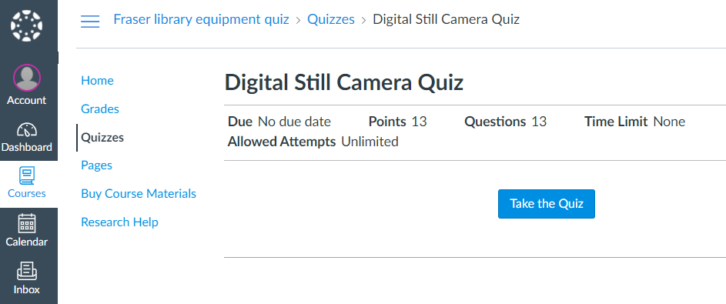
SIAT equipment collection
The intended use of SIAT equipment is in class or in production of course assignments.
Unless noted, equipment is only available to students currently enrolled in IAT courses.
Before borrowing, students must complete a library and camera quiz, which covers the content of this presentation (https://canvas.sfu.ca/enroll/G8GAE7).
The SIAT Digital Camera quiz page in Canvas
SIAT equipment at Fraser Library | Spring 2022

Slide 4
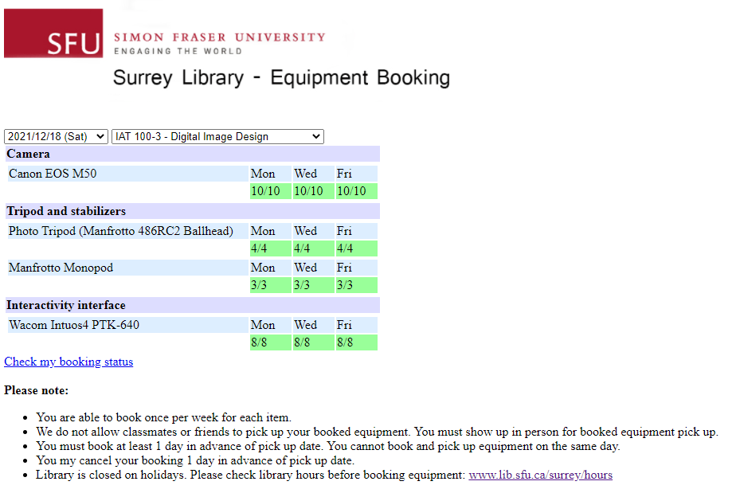
Booking and borrowing
Equipment must be booked online, in advance.
Booking tool: http://libequipbooking.surrey.sfu.ca
Or visit lib.sfu.ca and search SIAT equipment
SIAT equipment at Fraser Library | Spring 2022

Slide 5
Booking and borrowing
Pick up booked equipment between 1 and 3 p.m. on day of booking.
Borrower must pick up their own booked equipment and bring SFU ID. No other form of ID will be accepted.
After 3 p.m., all booked equipment will be released and available to other borrowers.
Check that all components are included and in working order before leaving the library.
IAT 100 camera loan period: overnight (one day), due the next day at noon.
Check your email for loans receipt to confirm the correct due date and time.
SIAT equipment at Fraser Library | Spring 2022

Slide 6
Renewal
Renewal requests may be granted according to equipment availability and the discretion of library staff.
Renewals can be requested by speaking to staff in person or on phone (778-782-7411).
Please note that renewal requests made by email or left on voice mail cannot be accepted.
Renewal requests can be made prior to the equipment becoming due.
Maximum of three renewal requests can be made on per lending session and item.
SIAT equipment at Fraser Library | Spring 2022

Slide 7
Returning
Borrower is expected to return equipment.
Ensure all components are in the kit when returned.
Return directly to a library staff member. Do not leave equipment unattended at the loans counter.
Receive confirmation from library staff that all items are checked in.
Notify staff of any missing, damaged, or non-working parts.
Reminder: Late fine is $3 per hour, up to a maximum of $200 in total. Fine begins to accrue at 12:01 pm. If you’re on your way to return equipment but know you might be late please call to let us know.
SIAT equipment at Fraser Library | Spring 2022

Slide 8
Responsibilities and policies
The borrower agrees to all posted policies, fines and fees https://www.lib.sfu.ca/borrow/borrow-materials/laptops-equipment/borrow-laptop
Borrowers are responsible for late, lost, stolen, or damaged equipment and will be charged applicable fines, fees, and/or replacement and repair costs.
Be informed on how to operate equipment correctly; realize you are using the equipment at your own risk.
Do your best to minimize equipment wear and tear.
Contact the library as soon as possible if equipment malfunctions or becomes damaged or lost.
SIAT equipment at Fraser Library | Spring 2022

Slide 9
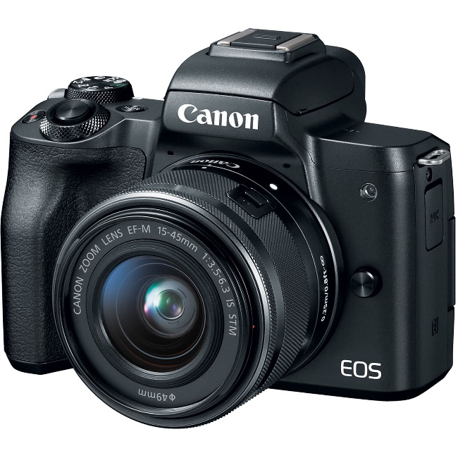
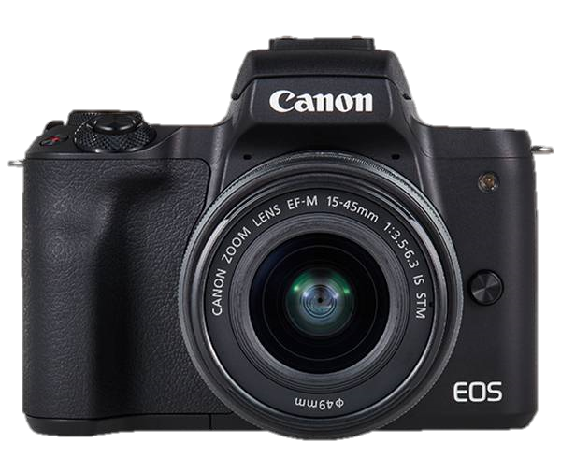
The Camera
Canon EOS M50 (15)
2019 Model
SIAT equipment at Fraser Library | Spring 2022

Slide 10
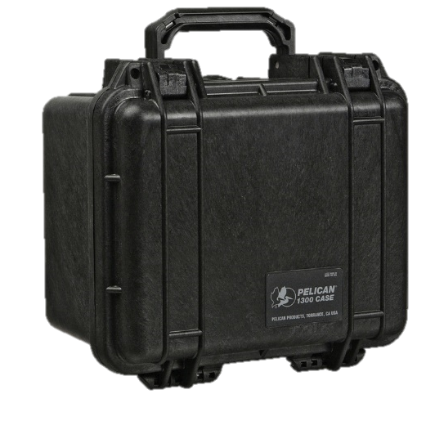
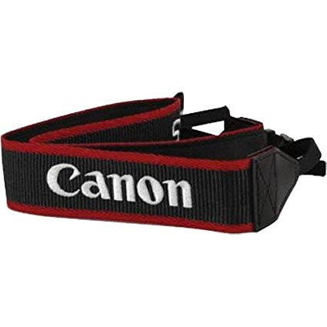
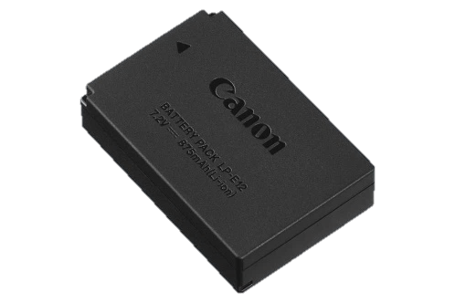
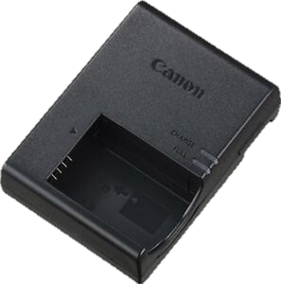
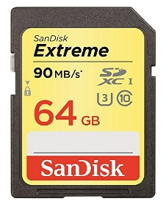
Camera Kit Components
The Camera + Accessories
Hard or Soft Camera Case
Battery + Charger
Memory Card
SIAT equipment at Fraser Library | Spring 2022

Slide 11
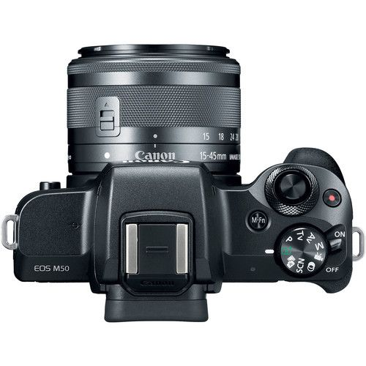
Camera Operation - Layout
2
2.
On/off Switch
Manual Focus Ring
Zoom Ring
Zoom Lock*
Shutter Wheel
Manual Function (ISO)
Mode Select
And Many More…
4.
3.
1
3
Panasonic FZ-18
5.
6.
7.
1.
2
SIAT equipment at Fraser Library | Spring 2022

Slide 12
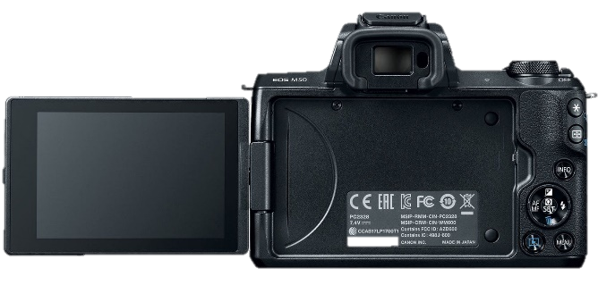
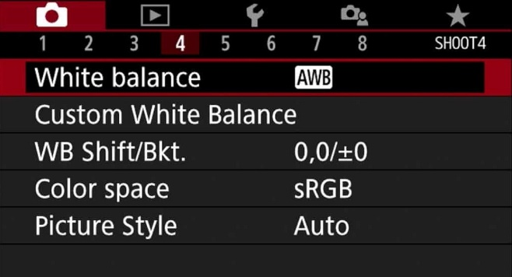
Camera Operation – White Balance
Changing White balance
Set camera to M – Manual mode
Press Menu to access camera settings, then scroll to White Balance
Press WB Shift/Bkt to adjust the levels
SIAT equipment at Fraser Library | Spring 2022

Slide 13
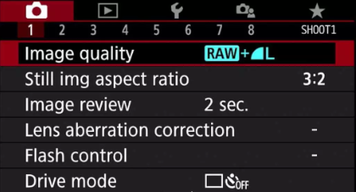
Camera Operation – Image Size
Changing Image Size
Set camera to M – Manual mode
Press Menu to access camera settings, then press Image Quality
Choose your preference for image quality and size
You can also adjust the aspect ratio from by pressing “Still img aspect ratio”
SIAT equipment at Fraser Library | Spring 2022

Slide 14
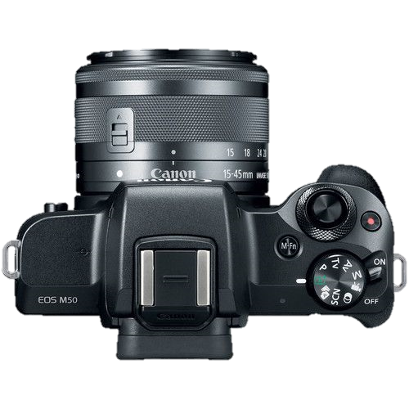
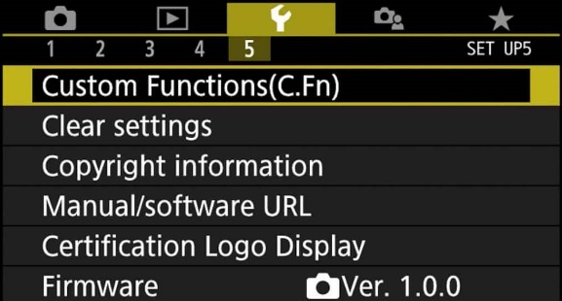
Resetting the Camera to Default Settings
Formatting the Memory Card
Move the mode dial to M (Manual)
Press the menu button
Scroll to Format Card
Resetting all camera settings
Move the mode dial to M (Manual)
Press the menu button
Scroll to Clear Settings
SIAT equipment at Fraser Library | Spring 2022

Slide 15
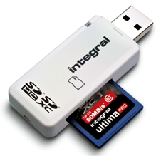
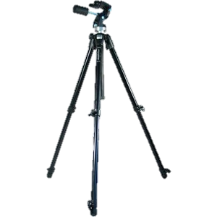
Upload to Computer
Take SD memory card out of the camera
Use memory card reader (available at library)
Insert SD memory card to the reader and connect the memory card to computer
Memory card reader
Tripods (also available at library)
SIAT equipment at Fraser Library | Spring 2022

Slide 16
Questions?
SIAT equipment at Fraser Library | Spring 2022

Slide 17
Resources
Visit the library website for:
policies, procedures, and equipment inventory
https://www.lib.sfu.ca/about/branches-depts/fraser/fraser-equipment/fraser- library-equipment-policy
SIAT-specific information, including workshop slides, quizzes, and suggested equipment tutorials
https://www.lib.sfu.ca/about/branches-depts/fraser/fraser-equipment/siat- equipment
SIAT equipment at Fraser Library | Spring 2022

Slide 18
Contact
Library hours:
lib.sfu.ca/about/branches-depts/fraser/hours
Email:
fraser_library@sfu.ca
Phone:
778-782-7417
SIAT equipment at Fraser Library | Spring 2022

