Slide 1
CMNS 800:
Scope, nature and discoverability of CMNS research literature
Sylvia Roberts
Liaison Librarian for Communication
sroberts@sfu.ca

Slide 2
Advanced knowledge practices
Information searching is a contextualized, complex experience that affects, and is affected by, the cognitive, affective and social dimensions of the researcher
Searching for information is often nonlinear and iterative, requiring the evaluation of a range of information sources and the mental flexibility to pursue alternate avenues as new understanding develops
Research is a conversation, a discursive practice in which ideas are formulated, debated, and weighed against one another over extended periods of time
Experts understand that a given issue may be characterized by several competing perspectives as part of an ongoing conversation in which information users and creators come together and negotiate meaning.
ACRL Framework (2015)
Notes:
Communities of scholars, researchers, or professionals engage in sustained discourse with new insights and discoveries occurring over time as a result of varied perspectives and interpretations.

Slide 3
CMNS – Disciplinary influences
CMNS

Slide 4
Which are CMNS theses?
Power and the newsprint media’s framing of the Downtown Eastside
The concert hall as a medium of musical culture: the technical mediation of listening in the 19th century
New media, new policies: the ambiguous role of popular online media in British Columbian classrooms
Delving into drones: secret war drone strikes, mass media’s role, and the need for better data
Vancouver and the quotidian: exploring everyday urbanity through film
Gendered Images in Oral History Documentary: A Case Study of Wode Kangzhan
Cinematic photography, theatricality, spectacle: The art of Jeff Wall
Post-modemism: the role of user adoption of teletext, videotex & bulletin board systems in the history of the Internet
Chinese media in Canada: An exploratory study of Orient Star Media’s cross-media publishing
From arterial integration to segregated lanes: A 1988-2011 case study of cycling routes in Vancouver, British Columbia
Inventing Havana in Thin Air: Sound, Space, and the Making of Sonic Citizenship

Slide 5
Finding grad student research
Summit Research Repository
  Search “School of Communication” AND topic word
  Search for your supervisor’s name (or another CMNS faculty member)
ARTICLE DATABASES – Search “theses”
  Select Proquest Dissertations and Theses OR Open Access Theses
  Search for your topic word

Slide 6
Characteristics of CMNS literature
Geopolitical
Chronological
Demographic
Economic
Usual mechanisms for sharing research outputs
Scholarly communication trends
Discovery tools

Slide 7
WHICH SUBJECT DATABASES ARE YOU FAMILIAR WITH?

Slide 8
Discovery tools
SFU Library catalogue search
  Finds 95% collection
  Books, articles, chapters, proceedings, films, recordings, data, statistics, reports, etc.
  Print, digital, media
KEY journal index: Communication & Mass Media Complete
  Databases for related fields
  Multidisciplinary databases - Google Scholar
Lexical versus semantic searching
Boolean operators

Slide 9
Boolean search techniques
Narrow/decrease | Expand/increase
Using AND to include another concept, e.g. youth AND Instagram AND review Using quotation marks to search for a phrase, e.g. “early adolescence” or “Vitamin C” Using limiters to refine your search, e.g. limit to “Dissertations” or limit by “Publication Years” Field searching, e.g. searching only within the “Title” field Using NOT to filter out irrelevant concepts (use carefully!), e.g. antibiotic NOT antibiotic-resistant | Using OR to include another related terms, e.g. youth OR teenager Using an asterisk (truncation), e.g. adolescen* for adolescence, adolescent, adolescents, etc. Using broader keywords, e.g. social media instead of Instagram Looking at cited and citing articles, related articles, bibliography (see next slide)
Notes:
Besides for Boolean operators, there are other techniques you can use to adjust your search results and exert control over what the database gives you.
Narrow/decrease:
Adding in new concepts with AND
Using quotation marks, e.g. “Vitamin C” instead of Vitamin C
Using limiters to refine your search
Sorting by relevance or times cited
Using NOT to filter out irrelevant concepts, e.g. antibiotic NOT antibiotic-resistant
Expand/increase:
Adding more related terms with OR
Using an asterisk, e.g.
Using broader keywords, e.g. citrus fruits instead of oranges
Looking at cited and citing articles, related articles, bibliography
Add MeSH terms (see handout)
* Productivity tools: search alerts, table of contents alerts
Pitfalls: not taking advantage of your liaison librarian!
DEMO: in PsycINfo
Adolescent AND Instagram AND self-perception
(Adolescent OR youth OR teenager) And Instagram AND self-perception
(Adolescent OR youth OR teenager) And (Instagram OR social media) AND self-perception

Slide 10
Looking for KEY works
Is there a canon of CMNS literature?
How do you identify influential works?
How do you reconcile differences between sources?

Slide 11
Identifying key CMNS literature
Oxford Bibliography Online
International encyclopedia of communication (ICA)
The concise encyclopedia of communication (browse)
Encyclopedia of media and communication (timelines)
Encyclopedia of communication theory
The handbook of media and mass communication theory
International history of communication study
Handbook of communication history
Canonic texts in media research : are there any? should there be? how about these?
Notes:
Many of us have our own canonic texts - the kind that won't go away. We tell them that their time has passed, that it's embarrassing they're still around, but they turn up repeatedly on our reading lists and in our bibliographies. They inspire us, haunt us, argue with us - but they won't leave. Typically, we keep them to ourselves. There's no reason to hide them. Canons (and saints) should be shared, because they define fields and communities. These texts are not simply monuments, however. They are alive and breathing, standing the test of time by shedding old meanings and assuming new ones. The minimal care they need - occasional brushing off and bulb-changing - is well worth the trouble. The field of media studies is now more than 50 years old, and the contributors to this volume offer their own candidates for canonization. Each of the 13 essays in the book presents a critical reading of one of these classics and debates its candidacy. The texts are summarized, analysed and re-examined for their contemporary relevance.

Slide 12
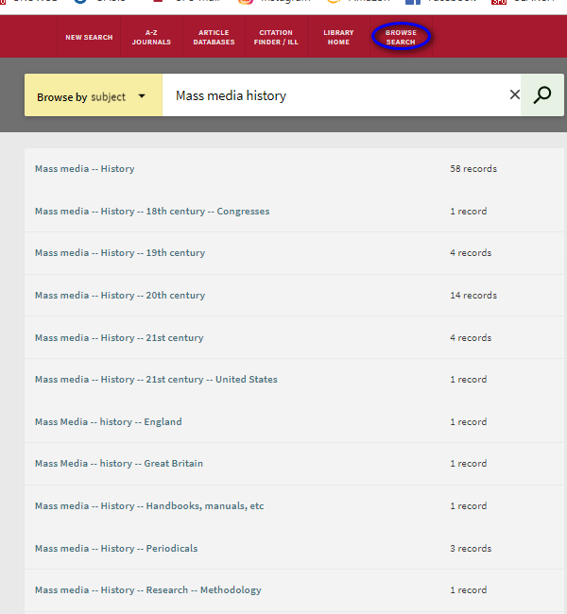
Browsing for background texts
Mass media / Communication
  Philosophy
  Research – methodology
  History
  Social aspects
  Political aspects

Slide 13
Backgrounders:
Key Thinkers in Critical Communication Scholarship
Communication, cultural and media studies : the key concepts
Theories of communication: A short introduction
Theorizing communication : a history
Sage Research Methods Online

Slide 14
WHICH JOURNALS ARE KEY?
WHAT ABOUT ARTICLES?
How do you know?

Slide 15
CMNS journal rankings
Journal Citation Reports (JCR) from Web of Science
Scimago Journal & Country rank
Google Scholar Metrics
National Communication Association (2013)
Notes:
SCImago Journal & Country Rank is a publicly available portal that includes the journals and country scientific indicators developed from the information contained in the Scopus® database (Elsevier B.V.) SJR “average number of weighted citations received in the selected year by the documents published in the selected journal in the three previous years” http://www.scimagojr.com/help.php#rank_journals

Slide 16
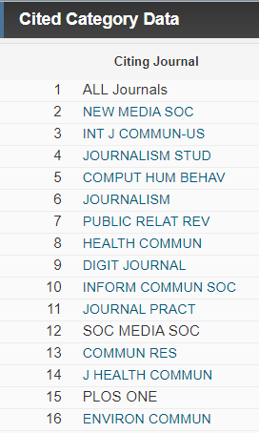
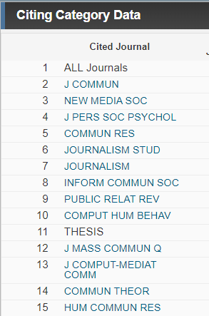
JCR for Communication Journals
Journals that are citing articles from journals within a category, showing which journals are most active within that category and also outside that category.
Cited journals are sorted in descending order, from most cited to least cited.

Slide 17
Selected key CMNS journals
Journal of Computer Mediated Communication
New Media and Society
Journal of Communication
Information Communication & Society
Communication Research
European Journal of Communication
International Journal of Communication
Communication Theory
Communication Monographs
Public Opinion Quarterly
Human Communication Research
Canadian Journal of Communication

Slide 18
Tracking influence through citation searching
Web of Science
  Indexes only journal literature
  Takes information from research literature reference lists
  Searching only metadata (title, author keywords, abstracts)
  Advanced searching
Google Scholar
  Indexes journal literature, books, reports, other materials on academic web sites
  Searches full text
  Advanced searching, limit by year

Slide 19
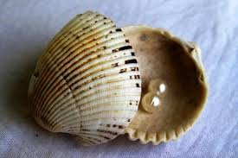
Pearl-growing
Track search terms, both effective and not
Mine reference lists
Note journal names, conferences, authors, affiliations
CVs of CMNS scholars –
Where do they publish?
Where have they presented?
Journal alerts: subject, ToC
Citation alerts
Notes:
Pearl Growing is in this context the process of using one information item (like a subject term or citation) to find more information.

Slide 20
Individual research consultations
Sylvia Roberts
sroberts@sfu.ca
778-782-3681
SFU Vancouver (most Tuesdays & Thursdays)
SFU Bennett (most Mondays & Wednesdays)

