Slide 1
Imperfect Foundations
Secondary Market Research
Perspectives & Resources
Radius - Slingshot
Mark Bodnar
mbodnar@sfu.ca

Slide 2
Context
vs.

Slide 3
Context
vs.

Slide 4
Context
vs.

Slide 5
Secondary research

Slide 6
Secondary research
Therefore…
Don’t expect perfection (but seek it!)
Ask good questions
Evaluate everything
Build the best foundation you can, and…
be ready to defend it

Slide 7
Secondary research
Why?
Why research at all? Isn’t your “gut feeling” enough?
Why do secondary research instead of primary if secondary is flawed by definition?

Slide 8
Good questions
Mark’s SalmAppleTM
Customers
Competitors
Environment

Slide 9
Good questions
Your
turn
List some secondary research questions about your initiative. If it helps, try to think in terms of the categories below.
Customers
Competitors
Environment

Slide 10
Good questions
Your
turn
If answers to those questions aren’t available, how flexible can you be?
Can you make use of older information on similar topics and from similar regions?
Geography
Topic
Time

Slide 11
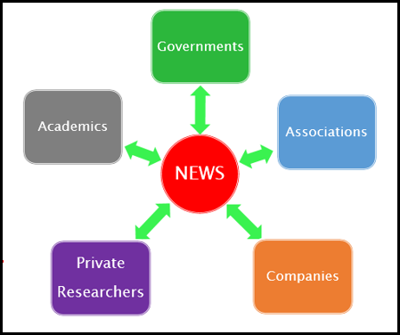
Publishers

Slide 12
Publishers
Mark’s SalmAppleTM
Which publisher types might have statistics on…
fish consumption in Canada?
Why?

Slide 13
Publishers
Your
turn
Which publisher types seem most likely to have the answers to the questions you listed earlier?
Do your questions seem…
newsworthy?

Slide 14
Layers
Big name
analysis
Below
+ analysis
Dispersed and incomplete information
Aggregated information
+ gaps filled with primary research
Aggregated and incomplete information
Euromonitor: 128M wearables will be sold in 2017
(Oct. 5, 2017)
Gartner:
310M wearables will be sold in 2017
(Aug. 24, 2017)

Slide 15
Sources - free
Small Business Accelerators
via UBC
sba.ubc.ca
Vancouver Public Library
Business & Careers Resources
Link via: www.vpl.ca/digitallibrary
Private research firms: Social media
Blog post via:

Slide 16
Sources – SFU Library
Guest access
in any SFU Library branch:
bit.ly/sfu-guest
Statista:
Vividata:

Slide 17
Sources – SFU Library
IBISWorld:
Factiva:
Business Source Complete:

Slide 18
Sources – SFU Library
SimplyAnalytics:
Frost & Sullivan:
More?
bit.ly/sfubuslib-guides

Slide 19
Recap
Secondary research
Brainstorm questions
then add flexibility and brainstorm some more
Predict publishers
“Who cares?” & “Why?”
Be open to the value of imperfect information
Build a foundation for your estimates

Slide 20
Next steps
Discussion of individual needs?
Deeper exploration of resources?
More time on your Question-Publisher worksheets?
Go home for a nap?

Slide 21
Questions?
Radius - Slingshot
Mark Bodnar
mbodnar@sfu.ca

