Slide 1
International Market Research Skills & Resources
Mark Bodnar
mbodnar@sfu.ca

Slide 2
Trendspotting
Making new connections with seemingly unconnected information
Rising disposable incomes
+ Declining mobile phone manufacturing costs
+ Existing infrastructure problems
= Leapfrogging to mobile phones in India
See also: In India, a push for acceptance when the grandparents move out (G&M)

Slide 3
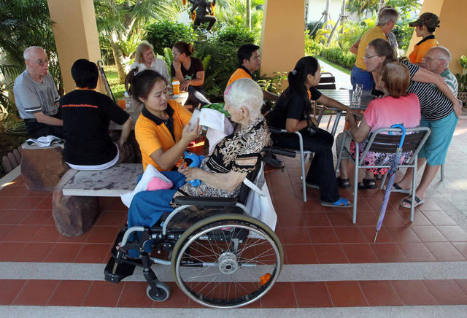
Trendspotting
Baan Khamlangchay Care Centre
Chiang Mai, Thailand
What
trends & factors led to the success of this organization?
Image credit: Desert News:
http://m.deseretnews.com/photo/765644521?nm=1

Slide 4
Convergence
New!
Skype
60+
Alzheimers
Medical tourism
Thai culture & reputation
Cost/patient
Academic opinions
Multiculturalism

Slide 5
Information sources
Regulations, Trade Data, Industry Overviews, and more...
NEWS
Academics
Associations
Private
Researchers
Governments
Companies
Directories. Industry Overviews, News…
How and Why Questions
Pyramid peak!
(more about that later...)
Key financials? News about actions taken?

Slide 6
Information sources
Baan Khamlangchay Care Centre
Chiang Mai, Thailand
What types of
information sources
provided evidence
of the trends?
Image credit: Desert News:
http://m.deseretnews.com/photo/765644521?nm=1

Slide 7
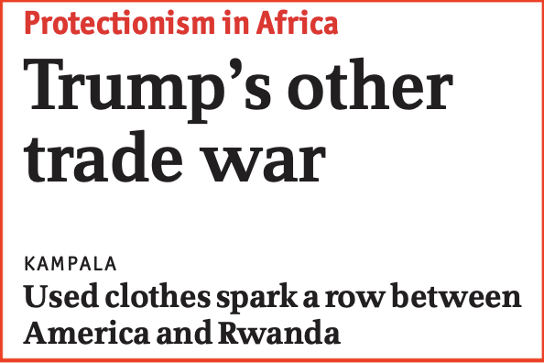
Reading for Context
Trump's other trade war. (2018, Apr 07). The Economist, 427, 43.

Slide 8
Key Message
Read everything about...
producing & consuming countries;
relevant industries (globally);
cultural issues and trends...

Slide 9
Business Information
$$$
Big name
analysis
Below
+ analysis
Dispersed and incomplete information
Aggregated information
+ gaps filled with primary research
Aggregated and incomplete information

Slide 10
Business Info - Issues
$$$ analysis
+ analysis
+ primary research
Aggregated
Dispersed
Issues below (again)
Issues below, plus…
Expertise
Experience
Track record
Issues below, plus…
Methodology
Varying definitions
Varying quality
Gaps

Slide 11
Resources
International Market Research web guide
Books and eBooks! Samples…
Doing business in Korea
Japan : Market entry handbook [food & beverage]
Navigating commerce in Latin America : options and obstacles
International retailers’ performance in host countries: The roles of strategies, consumer perceptions and the local environment
Emerging issues in global marketing: A shifting paradigm
Chinese consumers: Exploring the world's largest demographic
Social marketing in action: Cases from around the world
Social entrepreneurship for development : a business model
Scaling up business solutions to social problems : a practical guide for social and corporate entrepreneurs

Slide 12
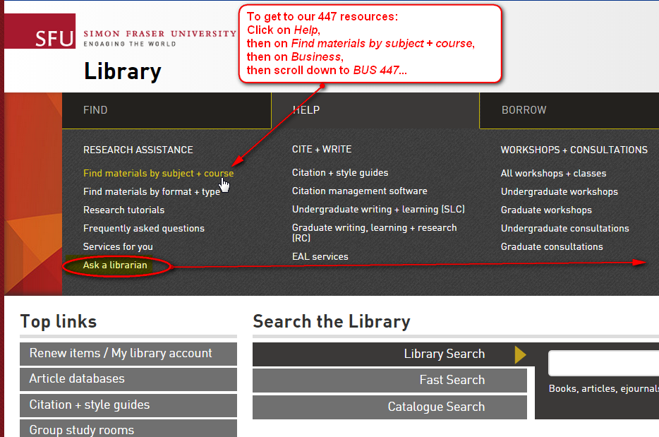
Questions?
Chat
Email
Phone
In person

