Slide 1
Beyond
“Fake vs. Real” & “True vs. False”
Evaluating imperfect information
BUS 217W
Critical Thinking in Business
BUS 217W
Mark Bodnar
mbodnar@sfu.ca

Slide 2
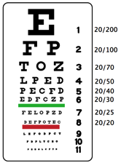
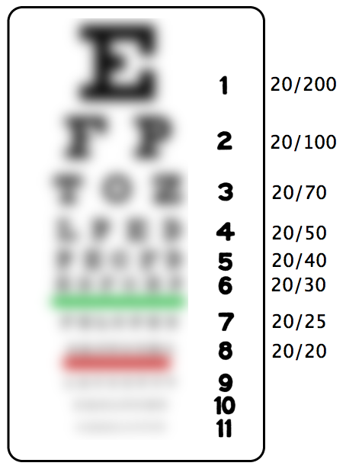
Eye test
1
2
BUS 217W
Mark Bodnar
mbodnar@sfu.ca

Slide 3
Which one is probably better?
Decision: Banning vaping in BC
“Electronic Cigarettes
Are Not Addictive”
from…
Journal of Addiction Research
“Electronic Cigarettes
Are Not Addictive”
from…
Joe Smith’s blog: Everything Vaping!
1
2
Note: The examples used in this session not real – they are intended for instruction only.
BUS 217W
Mark Bodnar
mbodnar@sfu.ca

Slide 4
Which one is probably better?
Decision: Banning vaping in BC
“Vaping produces cancer-causing chemicals”
by... Prof. Jane Chan,
cancer researcher in the Faculty of Medicine,
Harvard University
“Vaping produces cancer-causing chemicals”
by…
Jane Chan,
my mother’s
cousin’s
friend
1
2
BUS 217W
Mark Bodnar
mbodnar@sfu.ca

Slide 5
Which one is probably better?
Decision: Banning vaping in BC
“E-cigs are an effective tool for quitting smoking”
by…
the Electronic Cigarette Industry Association
“E-cigs are an effective tool for quitting smoking”
by…
Health Canada (federal government agency)
1
2
BUS 217W
Mark Bodnar
mbodnar@sfu.ca

Slide 6
Which one is probably better?
Decision: Banning vaping in BC
“Second-hand smoke from electronic cigarettes was proven to be dangerous”
study completed in… 2017
“Second-hand smoke from electronic cigarettes was proven to be dangerous”
study completed in… 2007
1
2
BUS 217W
Mark Bodnar
mbodnar@sfu.ca

Slide 7
Which one is probably better?
Decision: Banning vaping in BC
“E-cigarette sales are increasing, but so are cigarette sales”
based on a study
conducted in…
Egypt
“E-cigarette sales are increasing, but so are cigarette sales”
based on a study
conducted in…
Alberta
1
2
BUS 217W
Mark Bodnar
mbodnar@sfu.ca

Slide 8
Which one is probably better?
Decision: Banning vaping in BC
“Vaping decreases anxiety”
based on a study
of… 10,000 vapers
“Vaping decreases anxiety”
based on a study
of… 100 vapers
1
2
BUS 217W
Mark Bodnar
mbodnar@sfu.ca

Slide 9
Next steps
Group discussions
Step 1 (by topic)
Step 2 (regroup & report)
Incredibly hard quiz
Final thoughts: big picture
BUS 217W
Mark Bodnar
mbodnar@sfu.ca

Slide 10
The 3 Rs of evaluation
Reliability
Recency
Relevance
BUS 217W
Mark Bodnar
mbodnar@sfu.ca

Slide 11
Incredibly hard quiz
Facts found in academic journal articles…
tend to be more reliable because of the peer review process.
often have recency and relevance issues.
can be thought of as bits of gum on the world’s largest chewed-gum ball.
all of the above.
BUS 217W
Mark Bodnar
mbodnar@sfu.ca

Slide 12
Incredibly hard quiz
Online comments about news articles are…
useless – ignore them all!
full of amazing and reliable information!
sometimes a way to learn about perspectives & issues you hadn’t thought of.
BUS 217W
Mark Bodnar
mbodnar@sfu.ca

Slide 13
Incredibly hard quiz
To be sure the authority behind a fact is good enough, you should…
look for evidence of their experience and expertise.
use a lie detector.
call their mother.
BUS 217W
Mark Bodnar
mbodnar@sfu.ca

Slide 14
Incredibly hard quiz
Facts from a biased authority may still be okay if…
you just ignore the bias.
you acknowledge and counter the bias with other perspectives.
you examine the methodology to ensure objectivity.
numbers 2 and 3 above.
BUS 217W
Mark Bodnar
mbodnar@sfu.ca

Slide 15
Incredibly hard quiz
When judging the recency of a fact, you are most interested in…
the date it was published.
the date it was gathered (when the study was conducted).
the date your cousin Vinnie mentioned it on Facebook.
BUS 217W
Mark Bodnar
mbodnar@sfu.ca

Slide 16
Incredibly hard quiz
All facts automatically become useless when they are 2 years old.
True
False
Umm… idk
All of the above
BUS 217W
Mark Bodnar
mbodnar@sfu.ca

Slide 17
Incredibly hard quiz
Proving the relevance of a fact to a decision you are trying to make…
is impossible.
involves thinking about the industry, geography, topic, and scale of the study and of your situation, considering similarities, then attempting to build the data into a reasonable estimate.
ummm…. what he said
BUS 217W
Mark Bodnar
mbodnar@sfu.ca

Slide 18
3 Rs: Reliability
Source
Author/Authority
Expertise & experience
Methodology
Reliable enough because …?
BUS 217W
Mark Bodnar
mbodnar@sfu.ca

Slide 19
3 Rs: Recency
Which date?
Facts, not containers
Floors & ceilings for estimates
Recent enough because …?
BUS 217W
Mark Bodnar
mbodnar@sfu.ca

Slide 20
3 Rs: Relevance
Geography
Industry
Scale
Topic
Relevant enough because …?
BUS 217W
Mark Bodnar
mbodnar@sfu.ca

Slide 21
Last words
Context matters:
Decision?
Audience?
Good enough because …?
How to spot fake news
The 3 Rs
BUS 217W
Mark Bodnar
mbodnar@sfu.ca

Slide 22
Questions?
BUS 217W
Mark Bodnar
mbodnar@sfu.ca

Slide 23
Images
Snellen Chart (eye exam). Public Domain, https://commons.wikimedia.org/w/index.php?curid=1486501
Other images (line drawings) are all from The Noun Project: https://thenounproject.com/ (paid subscription)
BUS 217W
Mark Bodnar
mbodnar@sfu.ca

