Slide 1
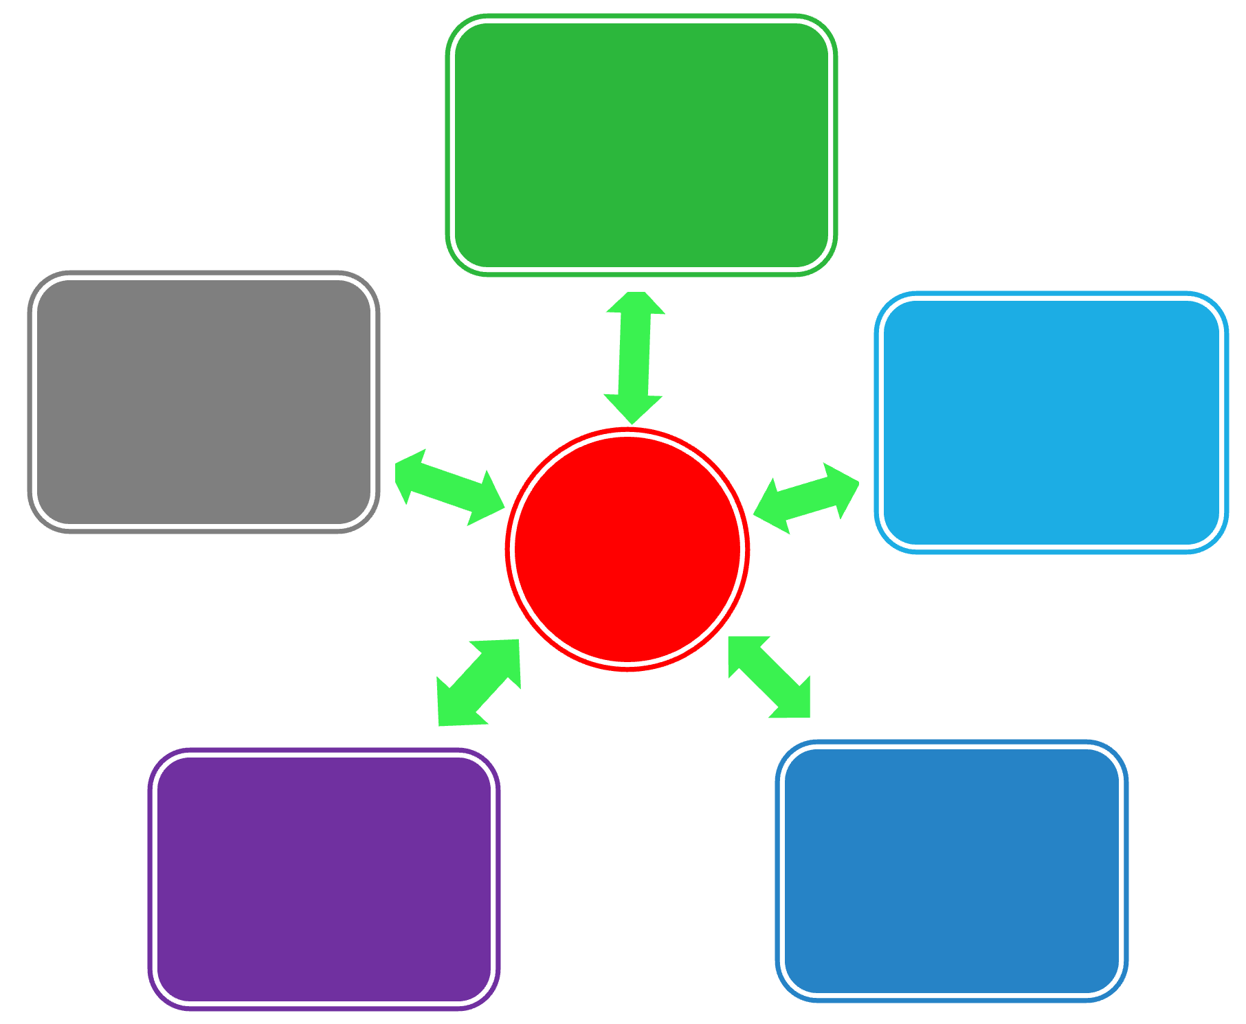
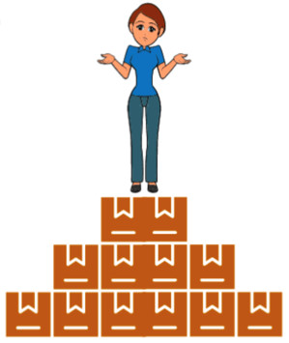
Beedie Case Competition Training Program
Speedy & Structured Research

Slide 2
On Expectations…
Do you agree or disagree with the following statements?
1. Perfect answers to case questions are probably published. I just need to find them.
2. The judges are interested in my creativity and strategic thinking, so I only need to think of an imaginative solution to their problem; research isn’t necessary.

Slide 3
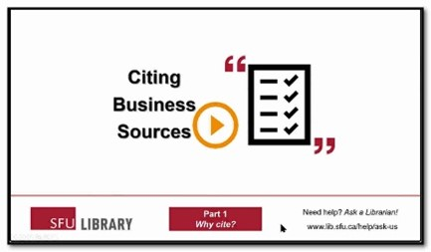
Answers vs Guesses vs Well-Founded Estimates…
Build a good foundation by asking many related questions and searching widely
Imperfection requires
evaluation
communication
citation
Click the image above to link out to the video.

Slide 4
Discuss…
Business research is often difficult,
especially when it involves marketing & strategy topics.
What is it about business needs & sources that leads to frustration?

Slide 5
Pyramid Peak Problems
Why do you think the following two market size estimates are so different?
a. Euromonitor International: 232,667,700 units of wearables estimated to be sold worldwide in 2026.
Retrieved Jan. 31, 2023 from Euromonitor’s Passport database at SFU Library
2.7x
b. IDC Inc.: 628.3 million units of wearables forecast to be shipped annually by the end of 2026.
Press release: Dec. 21, 2022. Online: https://www.idc.com/getdoc.jsp?containerId=prUS49980022

Slide 6
Business Information
$$$
Big name
analysis
Below
+ analysis
Dispersed and incomplete information
Aggregated information
+ gaps filled with primary research
Aggregated and incomplete information

Slide 7
Business Info - Issues
$$$ analysis
+ analysis
+ primary research
Aggregated
Dispersed
Issues below (again!)
Issues below, plus…
Expertise
Experience
Track record
Issues below, plus…
Methodology
Varying definitions
Varying quality
Gaps

Slide 8
Information Sources
Regulations, Trade Data, Industry Overviews, and more...
Information Sources
NEWS
Academics
Associations
Private
Researchers
Governments
Companies
Directories. Industry Overviews, News…
How and Why Questions
Read my Trampoline series of posts to see the “wheel” in action
Pyramid peak!
Key financials? News about actions taken?

Slide 9
Craft Spirits Company
Sustainable Craft Spirits Initiative
Industry magazines: just-drinks – sample 1 & sample 2
Passport: FMCG data + analysis
Spirits in Canada
Craft Spirits: Spirit of the Times
Consumer Lifestyles in Canada
Is Coronavirus the End for Craft Beer and Spirits?
Vivintel: Canadian consumer opinions + purchases
Associations: Distilled Spirits Council of the U.S. + Artisan Distillers Canada + more via Small Business Accelerator
MarketLine report via BSC: Spirits Industry in Canada

Slide 10
ERP Markets for a Fintech Firm
Exploring ERP Trends for
Strategic Market Entry
Factiva: iStart, Accounting Technology, Insight Partners, CIO…
Plunkett Research Online: Fintech Industry Almanac 2024
Business Source Complete: rough search/trade & industry
Industry news + more news
Statista: AI & Financial Services → Nvidia & ERP search
Google Scholar: ERP trends (since 2023)

Slide 11
Gold Mining Firm
Capital Allocation Analysis
S&P Capital IQ: peers, industry surveys, key ratios…
Mergent Intellect: D&B Key Business Ratios
Mergent Archives: CRB Commodity Yearbooks
Industry Surveys (guide): IBISWorld + BMI
Business Source: article(s) in Canadian Mining Journal + more
Assoc report & PwC re: IFRS+mining & WoodMac & NRC & book & chapter from conference & dissertation (last 2 via Google Scholar)

Slide 12
Airport Infrastructure Planning
Optimizing Value Framework Governance for Implementation of Asset Management Planning System
Ebooks!
Managing Airport Corporate Performance: Leveraging Business Intelligence and Sustainable Transition (2024-OA)
Strategic Airport Planning (2022)
Foundations of airport economics and finance (2022)
Associations: IATA: Airport Infrastructure Investment + IATA2 Airports Council International reports (not all free)
Articles: Journal of Air Transport Management + other (??)

Slide 13
Agri-tech
Identify New International Markets for an Early-Stage Agritech Company (Automated Fertigation)
Search for associations/news: indoor farming association
News w/leads: BBC + WP + ??
Agriculture Canada: Start + Sectors/Markets
Passport: products/cost/yield of tomatoes: all countries
Agricola: article + Sustainability journal: article
Statista: Indoor farming- statistics & facts

Slide 14
Record Label
Market Research & Strategic Analysis for the Rock Artists Under Agency Management
Public opinion firms: Kantar + Pew + Marist + YouGov + ??
Google Scholar: articles (very rough search)
Book: Bloomsbury handbook of popular music & youth culture
Statista: Target audience: Rock / alternative / indie music fans in the United States
Vividata: demographics of freq. rock concert attendees (CDN)

Slide 15
Local Café Chain
Launching in New Markets
Small Business Accelerator: Coffee Shops Guide
Research guide on Starbucks & innovation (Fall 2024)
Sage Business Cases: case studies on similar topics
SimplyAnalytics + ArcGIS Online: Business Analyst

