Slide 1
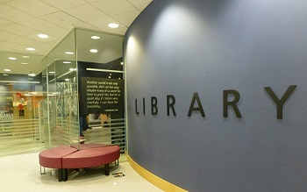
Library Resources & Services
for MBA students
Mark Bodnar – mbodnar@sfu.ca

Slide 2
Agenda
Details
Potential
Advice

Slide 3
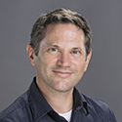
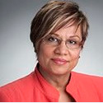
Your Business Librarian Team
Mark Bodnar
Burnaby + Surrey
Moninder Lalli
Vancouver

Slide 4
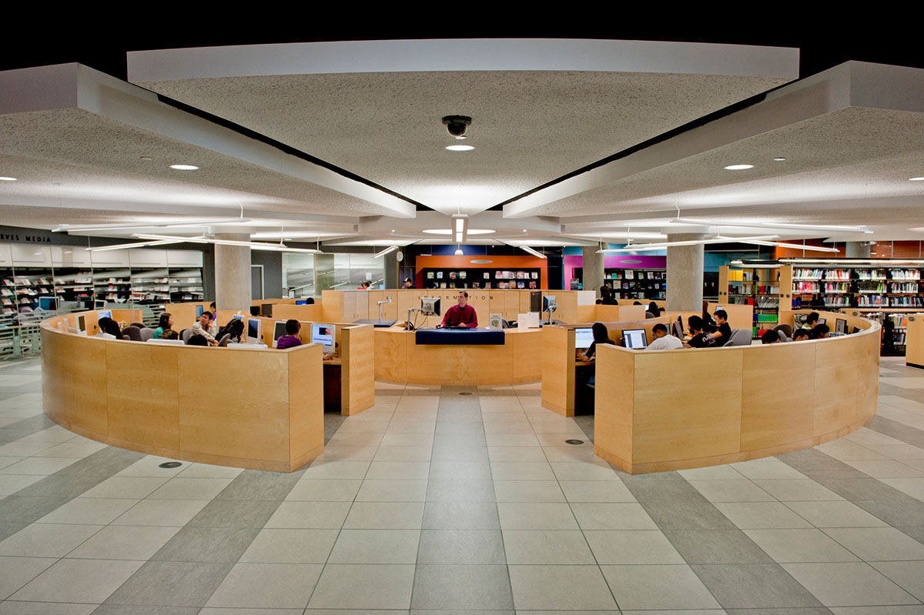
Fraser Library
Print/Online Collection and Intercampus Delivery

Slide 5
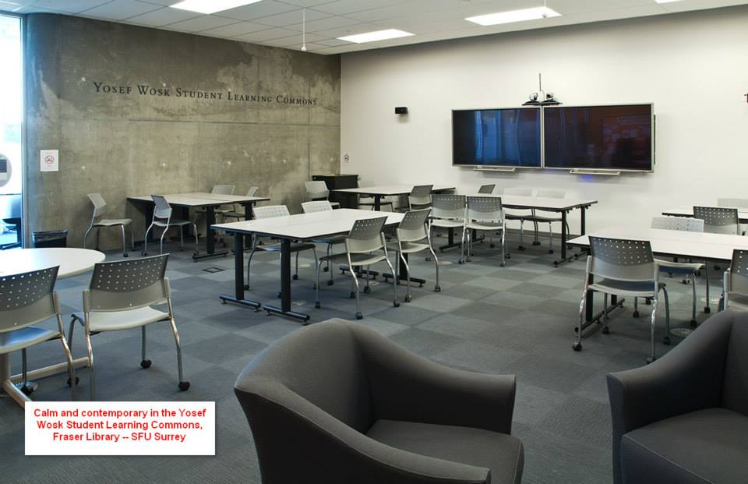
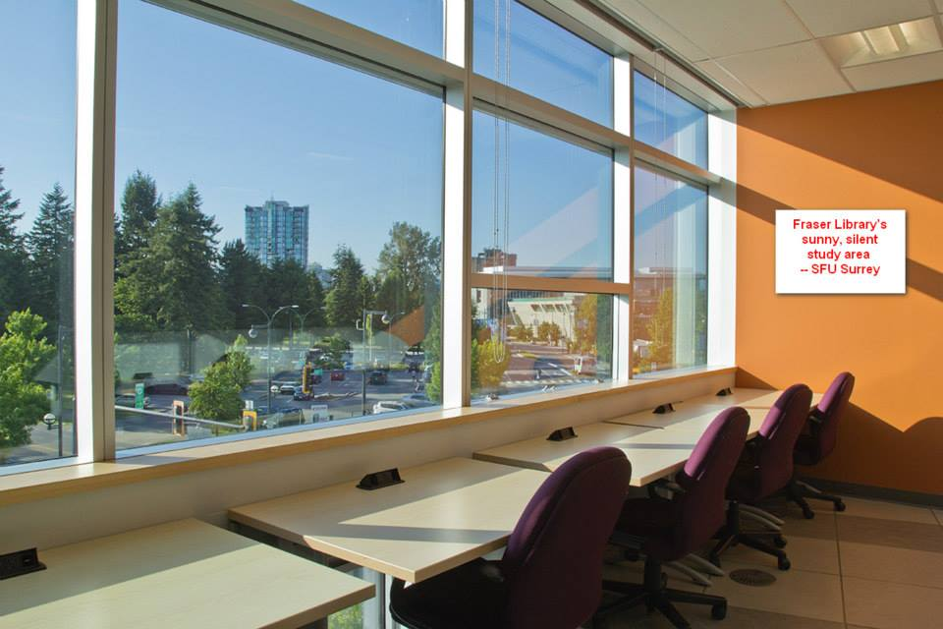
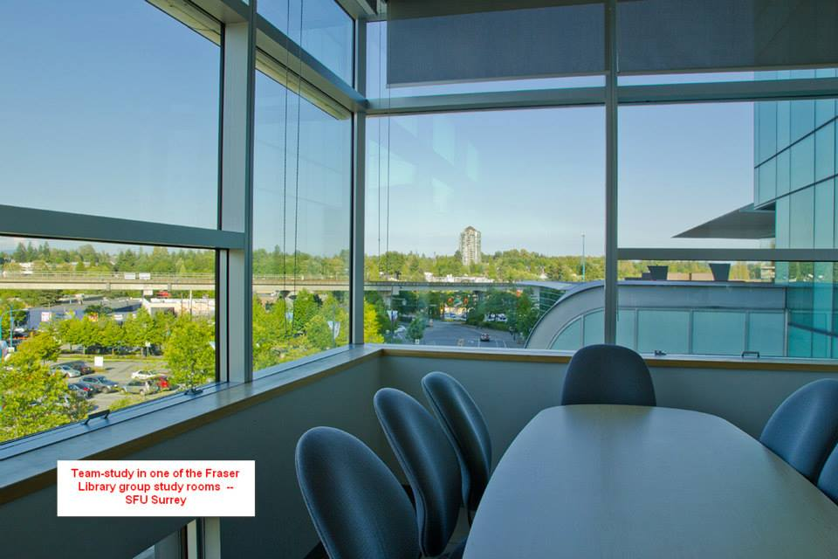
Fraser Library
Collaborative &
Silent Study Spaces

Slide 6
Story #1
Carly Fryer
2014 PT-MBA Cohort member
“The assistance I received from SFU's librarians was professional and incredibly useful for all of my course projects. They helped access relevant, appropriate information that I would have never known was available.
This helped me save time and effort in the research process for projects. I highly recommend meeting with an SFU librarian early on in your program to help you gain a competitive advantage in your research.”

Slide 7
Story #2
Help?!?
I’m researching the industry strategy for car repair shops in Vancouver.

Slide 8
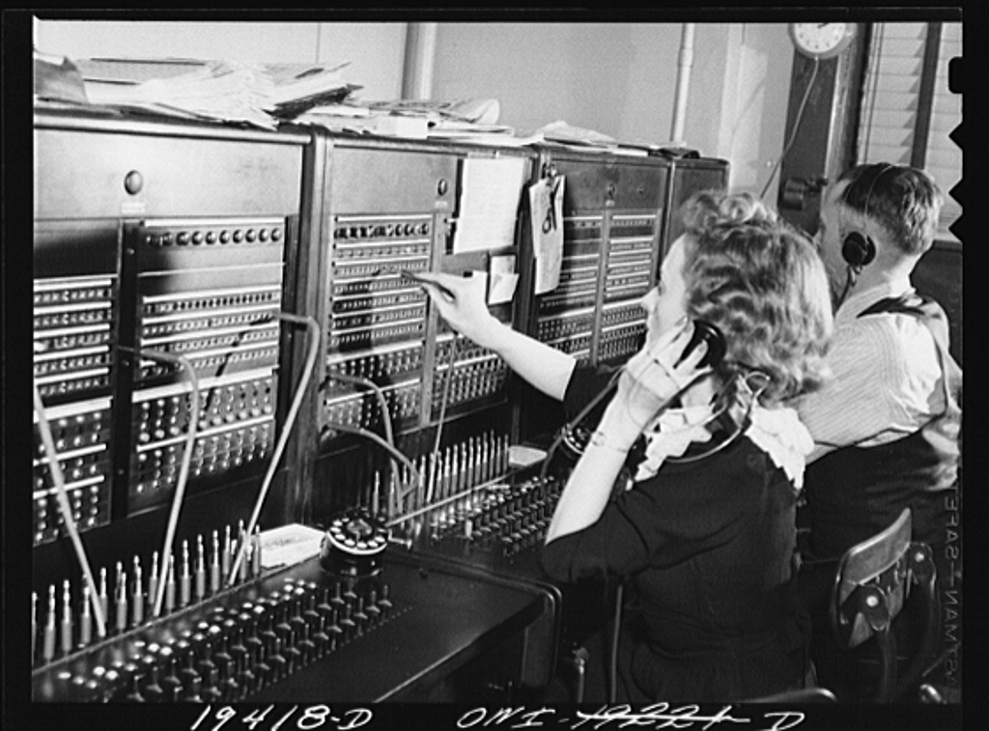
Contact the library
Notes:
https://www.flickr.com/photos/dcwalkabout/6891314429

Slide 9
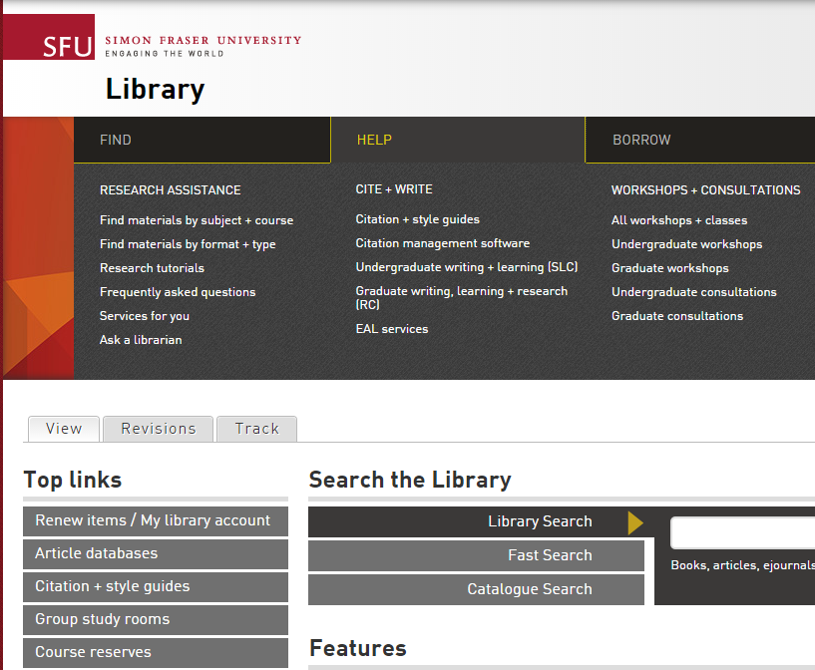
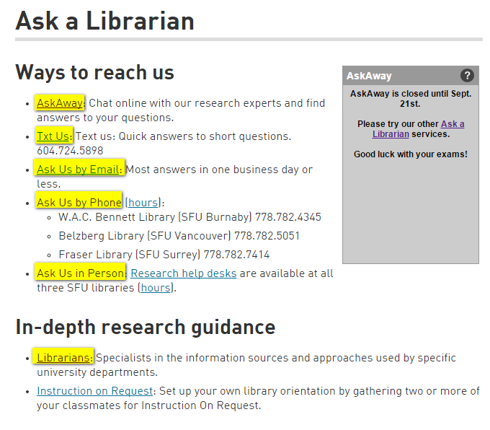
Contact the library
“Ask a Librarian” link
Chat, Phone, Email, Text, In-person…

Slide 10
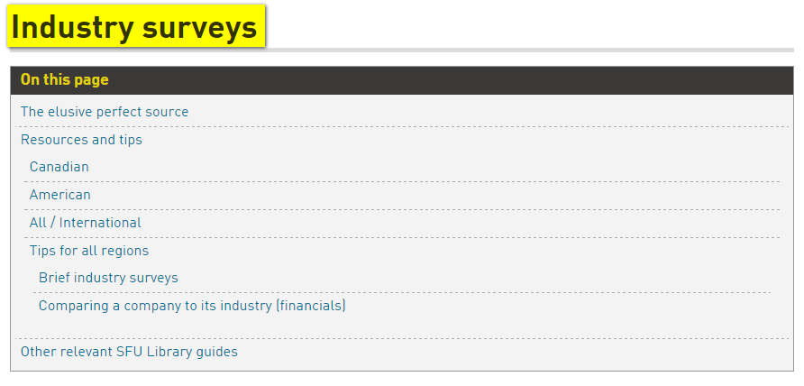
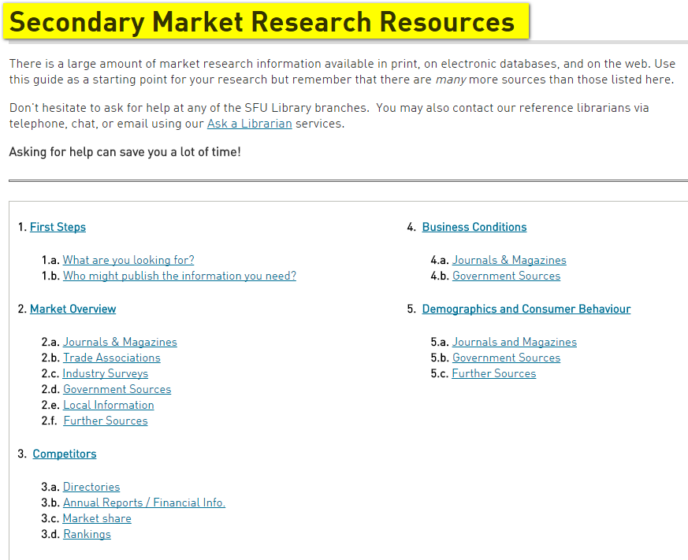
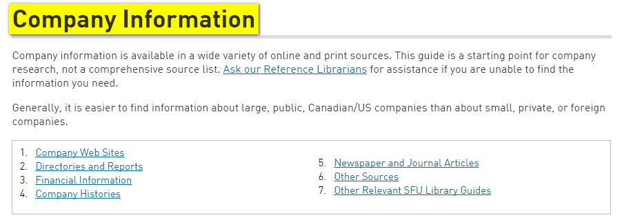
First…

Slide 11
Discussion
Brainstorming specific needs/questions
Economic & business environment?
Competitors & suppliers?
Customers?

Slide 12
Nature of business information…
Discussion
$$$
Big name
analysis
Below
+ analysis
Dispersed and incomplete information
Aggregated information
+ gaps filled with primary research
Aggregated and incomplete information

Slide 13
Discussion
Adjusting expectations…
Why would this info be published?
Why might it not be published?
Might someone have estimated it?
Can we bend the constraints a bit?
Can we look for disaggregated info instead?

Slide 14
Wine industry in BC!
Notes:
https://www.flickr.com/photos/mendozaeconomico/8639436187

Slide 15
Exploration
Identify likely publishers…
NEWS
ACAD
ASSOC
PRIV
GOV
COMP

Slide 16
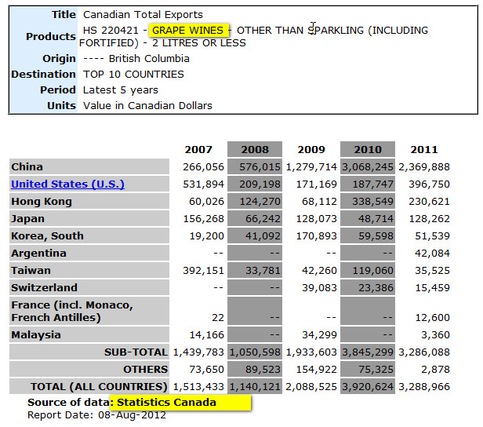
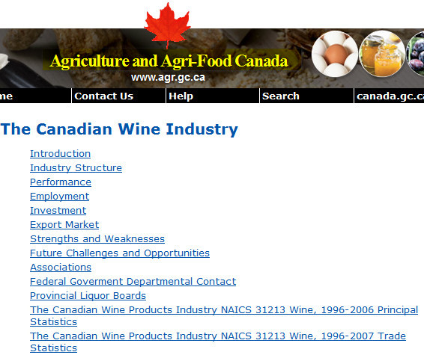
Exploration
Government depts

Slide 17
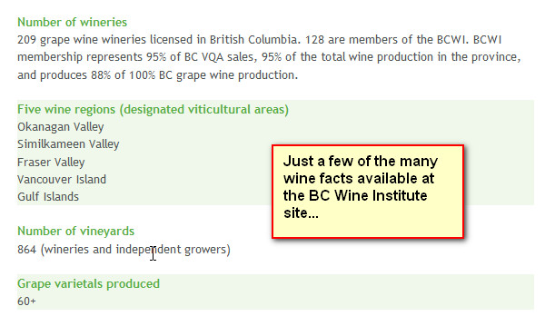
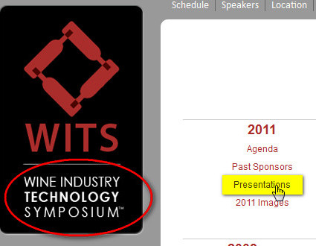
Exploration
Associations

Slide 18
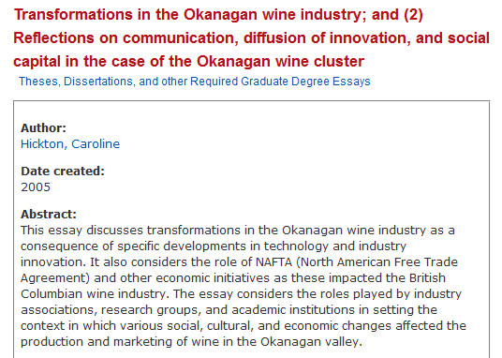
Exploration
Academic researchers

Slide 19
Exploration
Private research firms

Slide 20
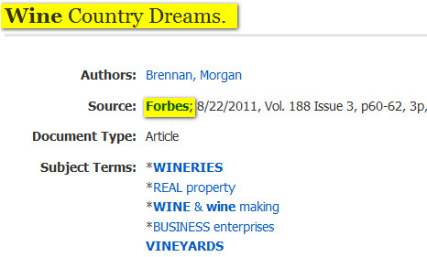
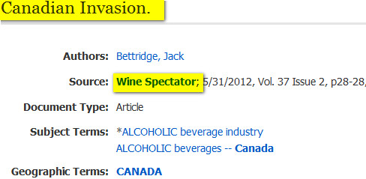
Exploration
News sources

Slide 21
“Thanks again for all your help - all these databases can be overwhelming!”

Slide 22
Bottom Line(s)
You’re not alone!
There are Business Information experts available to help.
Give yourself time…
to explore, learn, change your topic…
Learn the basics early.
Start exploring our guides and resources before you are facing a deadline.

Slide 23
And finally…
A few tips to get you started
Specific article: Peer Coaching: A Relational Process for Accelerating Career Learning
Articles on a topic: Teamwork among business school students
(E)books
Research guides:
Business + Surrey + …

Slide 24
Questions?
Good luck!
Mark Bodnar – mbodnar@sfu.ca
Notes:
https://www.flickr.com/photos/msiebuhr/987572658

