Slide 1
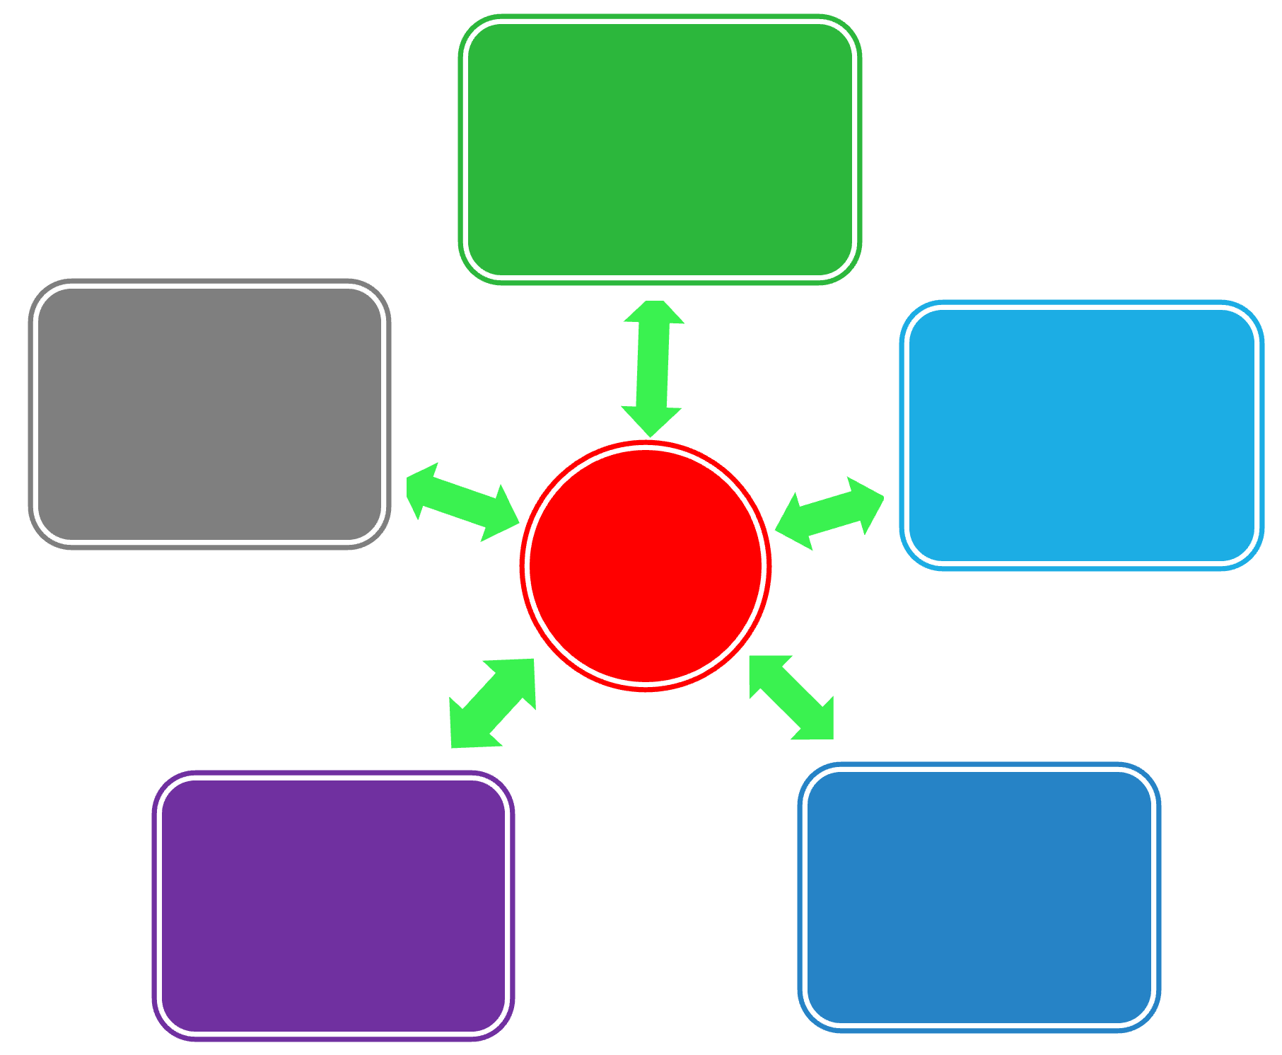
Pyramids, Wheels, and Shooting Stars
Effective ways to think about the structure of business information in BUS 784

Slide 2
Business Information
$$$
Big name
analysis
Below
+ analysis
Dispersed and incomplete information
Aggregated information
+ gaps filled with primary research
Aggregated and incomplete information

Slide 3
Pyramid Peak
Why do you think the following two market size estimates are so different?
a. Euromonitor International: 232,667,700 units of wearables estimated to be sold worldwide in 2026.
Retrieved Jan. 31, 2023 from Euromonitor’s Passport database at SFU Library
b. IDC Inc.: 628.3 million units of wearables forecast to be shipped annually by the end of 2026.
Press release: Dec. 21, 2022. Online: https://www.idc.com/getdoc.jsp?containerId=prUS49980022

Slide 4
Business Info - Issues
$$$ analysis
+ analysis
+ primary research
Aggregated
Dispersed
Issues below (again)
Issues below, plus…
Expertise
Experience
Track record
Issues below, plus…
Methodology
Bonus:
Scam research
Varying definitions
Varying quality
Gaps

Slide 5
Information Sources
Regulations, Trade Data, Industry Overviews, and more...
NEWS
Academics
Associations
Private
Researchers
Governments
Companies
Directories, Industry Overviews, News…
How & Why Questions
WHY might any of these source types gather info on your topic and make it public?
E.g.: Fish consumption in Canada
Key financials? News about actions taken?
Pyramid peak!

Slide 6
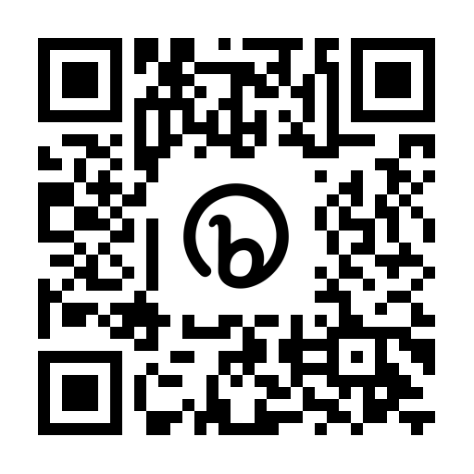
Converging Trends
Thai care homes
for European
Alzheimer’s
patients <news>
Read this news article:
What trends converged to create the market described in the article?
bit.ly/447-preread
(Alternative)

Slide 7
Converging Trends
Thai care homes
for European
Alzheimer’s
patients <news>
Bonus:
Retirement homes in India
Skype
60+
Alzheimers
Thai culture & reputation
Medical tourism
Cost/patient
Academic opinions
Multiculturalism

