Slide 1
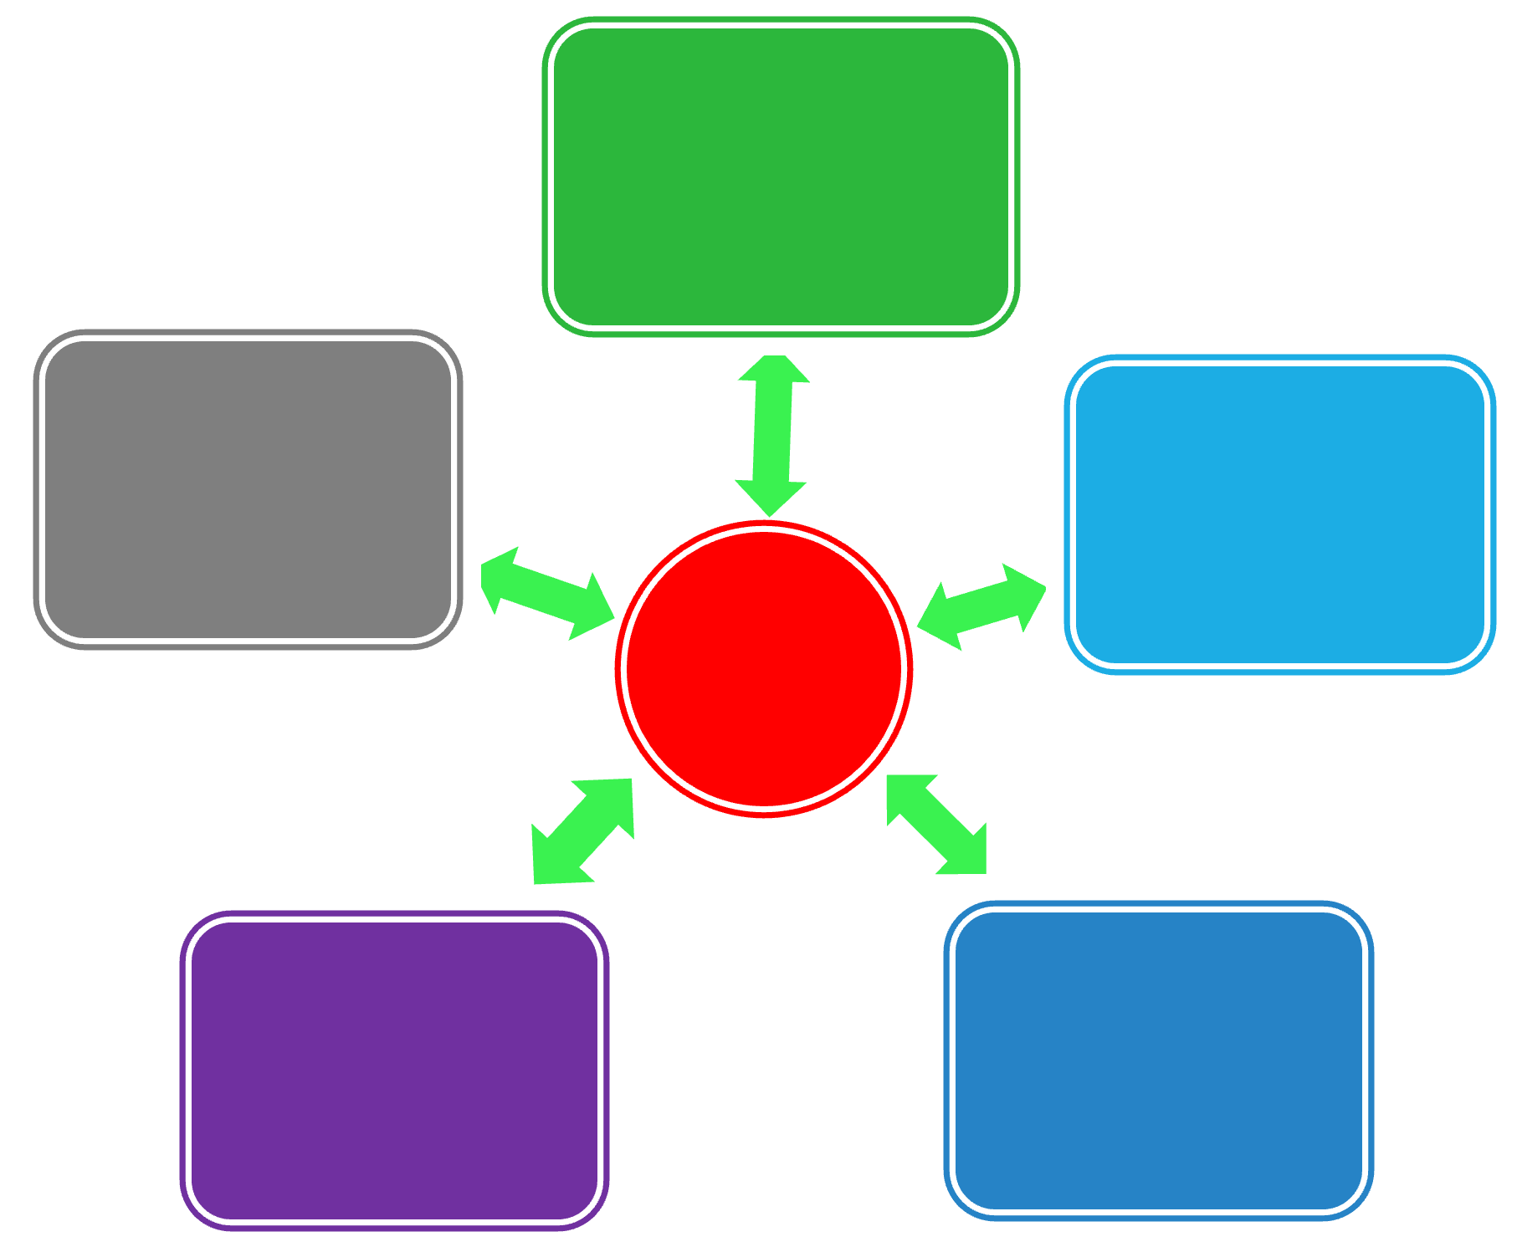
Pyramids,
Wheels, and Shooting Stars
Effective ways to think about the structure of business information
Research perspectives & samples for BUS 720 – Fall 2023

Slide 2
Business Information
$$$
Big name
analysis
Below
+ analysis
Dispersed and incomplete information
Aggregated information
+ gaps filled with primary research
Aggregated and incomplete information

Slide 3
Business Info - Issues
$$$ analysis
+ analysis
+ primary research
Aggregated
Dispersed
Issues below (again)
Issues below, plus…
Expertise
Experience
Track record
Issues below, plus…
Methodology
Varying definitions
Varying quality
Gaps

Slide 4
Converging Trends
Thai care homes
for European
Alzheimer’s
patients
<news>
Skype
60+
Alzheimers
Thai culture & reputation
Medical tourism
Cost/patient
Academic opinions
Multiculturalism

Slide 5

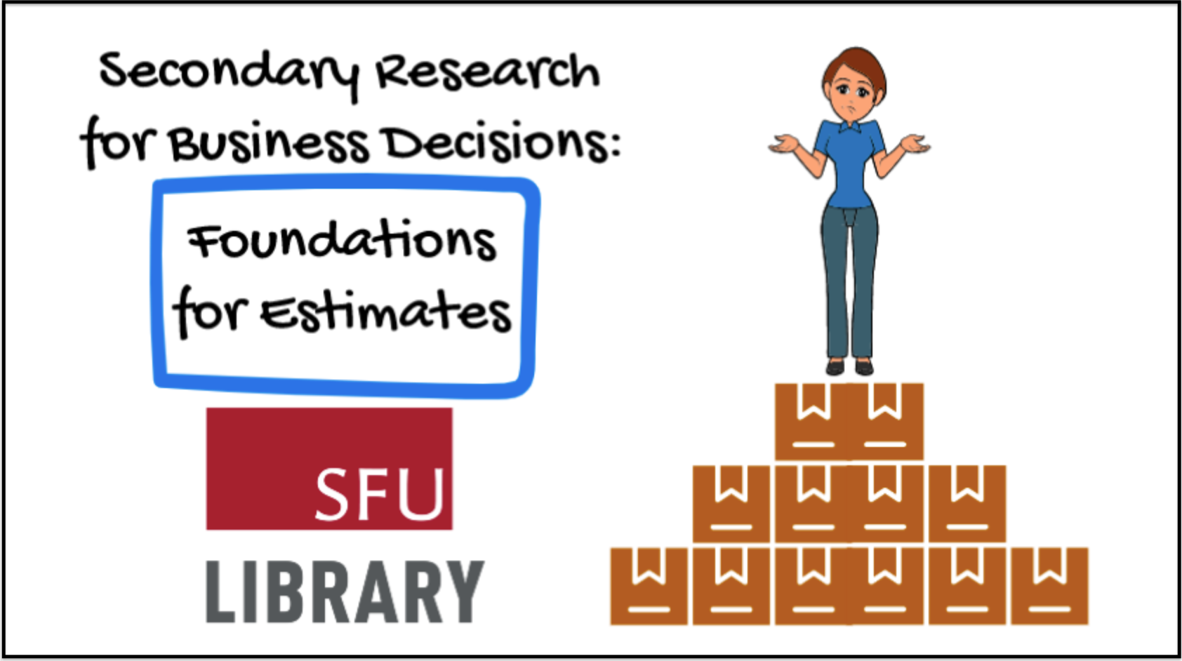
Answers vs Estimates
Click the image above to link out to the video.

Slide 6
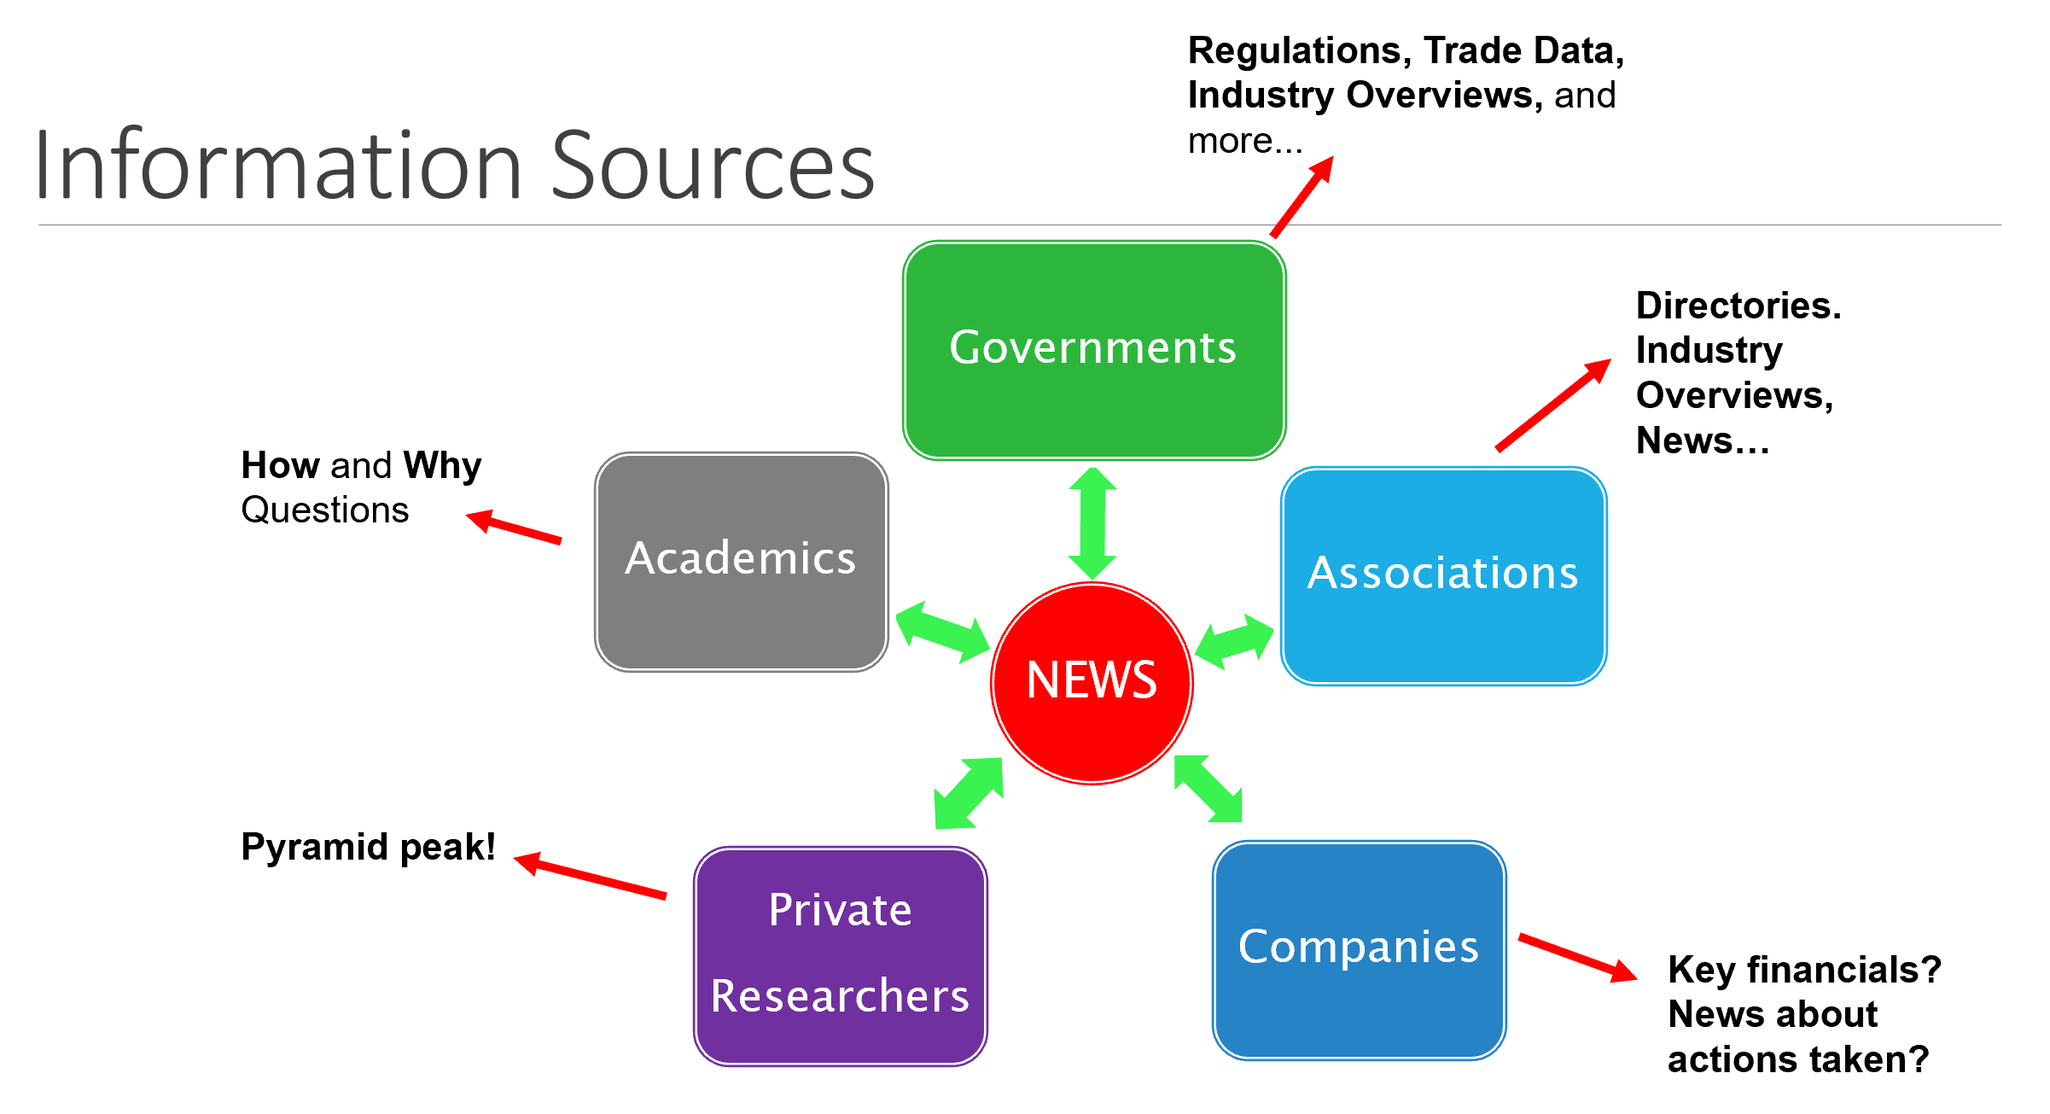
Information Sources
Regulations, Trade Data, Industry Overviews, and more...
Information Sources
NEWS
Academics
Associations
Private
Researchers
Governments
Companies
Directories. Industry Overviews, News…
How and Why Questions
Read my Trampoline series of posts to see the “wheel” in action
Pyramid peak!
Key financials? News about actions taken?

Slide 7
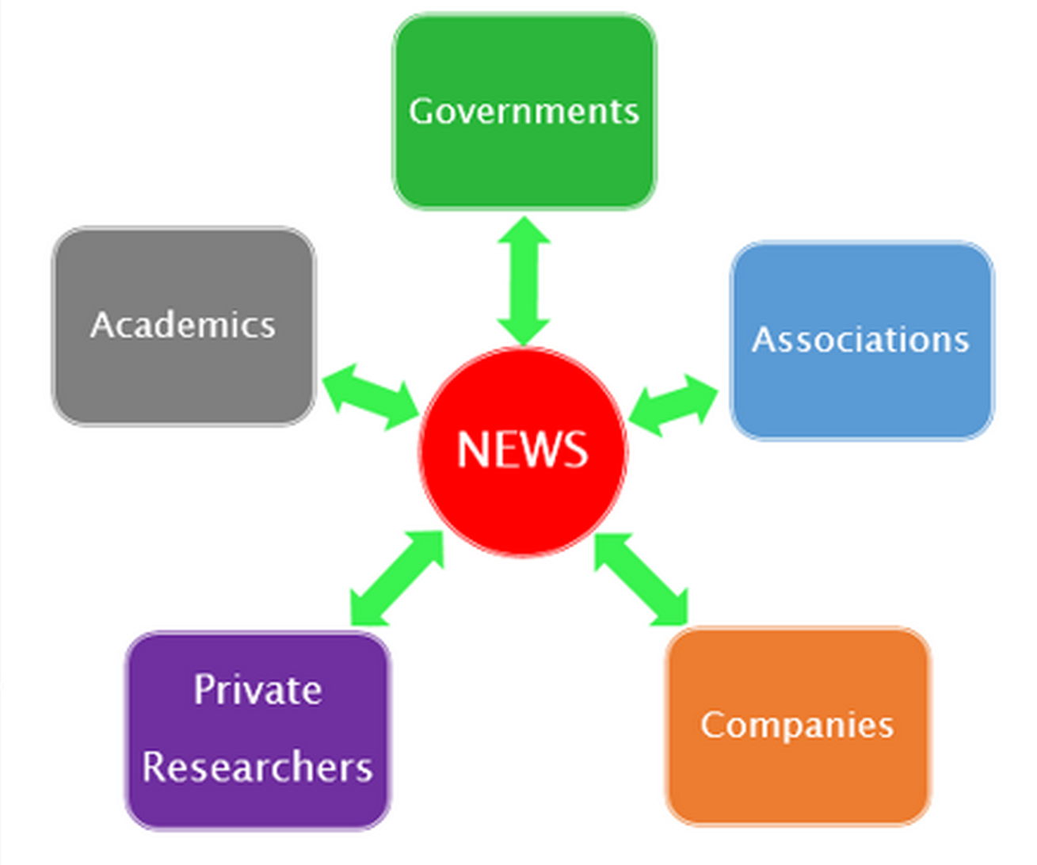
AdvisorFlow
map AF’s key features & benefits for enterprise clients
identify best practices in product positioning
identify the pain points of financial advisors
develop a strategy to communicate the benefits
What FA problems does this tool solve, and does it solve them better than the competitors? How can we best get such messages to potential FA customers?

Slide 8
AdvisorFlow
Mark’s rough searches: A + B + C + D
Associations: Search + Advocis + IAA
Industry News: Search + Sample from FA Mag + mentioned JD Power research
Statista: Market share of CRM technology vendor in 2022
(mentioned by Morningstar)
Business Source: product positioning AND strategy
ACM: broader search for market positioning

Slide 9
Nourish Labs
Develop go-to-market sales & marketing strategy, incl. how to resource and staff the plan.
Develop a partnership strategy : identify potential partners with resources & relationships that can be leveraged.
Develop a budget & compensation plan…
Develop a technology partnership & integration strategy.
Which market has the greatest need and the least competition? On which indoor crops should they focus first?

Slide 10
Nourish Labs
Frost & Sullivan: fertigation!
Search #1 for associations/news: indoor farming association
Search #2 for CDN gov docs: inurl:gc.ca "indoor farming"
Focus on Agriculture Canada: Start + Sectors/Markets
Passport: tomatoes Canada

Slide 11
Sage (for Accountants)
A bunch of stuff about understanding Sage…
Create a model to rank the importance of a practice to Sage based on opportunity size
Quantify the potential value to Sage of our existing base and prospects
Consider other attributes to define the value to Sage and how you prioritize accounts
Understand the (CDN?) accounting practice market. Do they value what we offer? What else do they need? Which practices should we target first, and why?

Slide 12
Sage (for Accountants)
Mergent Intellect: SIC: 8721… / NAICS: 5412…
vs. CPA Association Directory (BC)
see also: First Research reports via Mergent Intellect
Canadian government summary data
IBISWorld: Accounting Services in Canada
Business Source Complete:
Accounting AND Workflow (as subjects)

