Slide 1
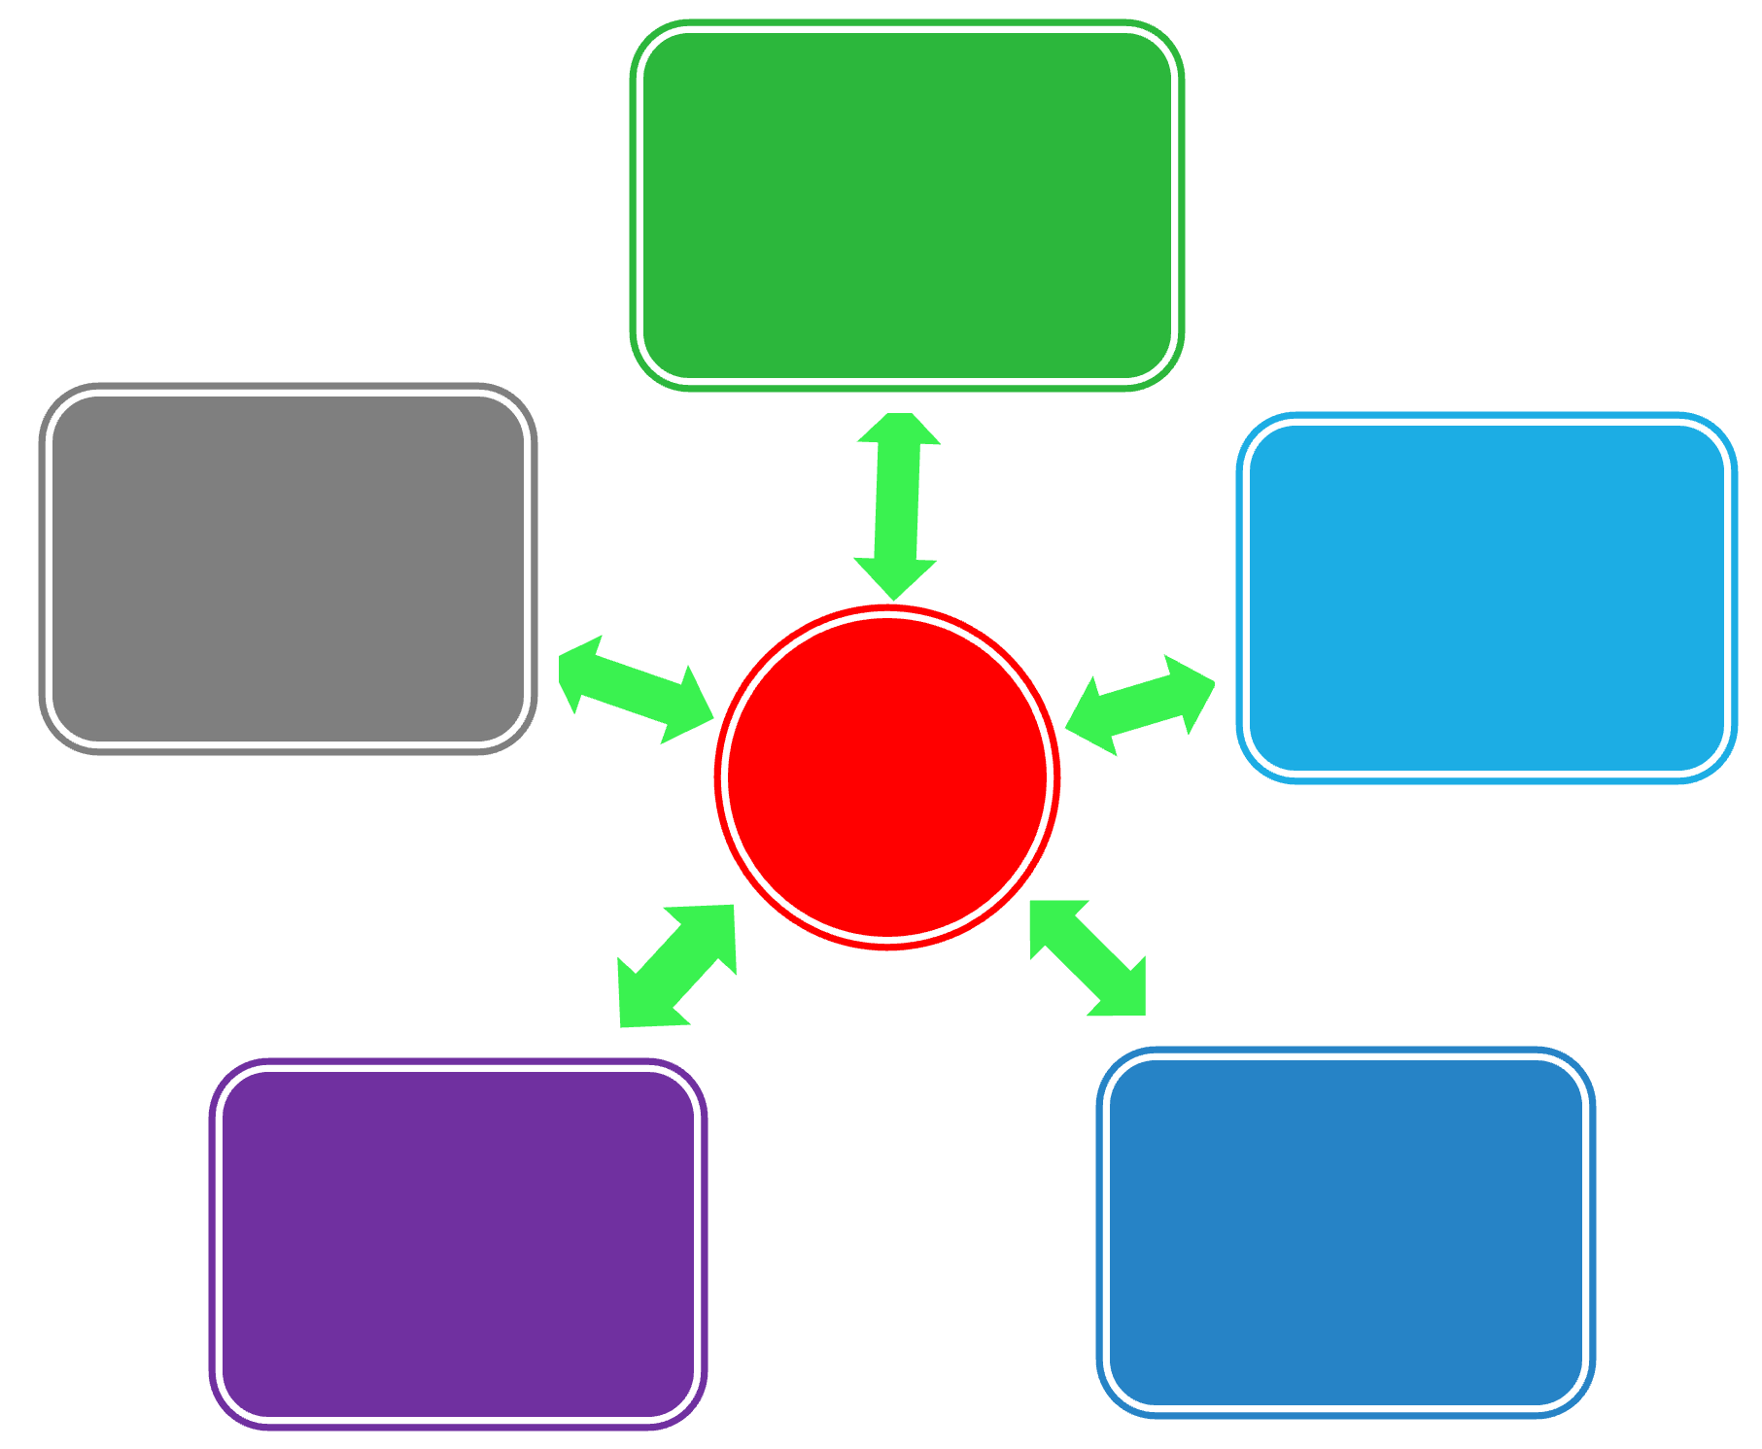
Pyramids, Wheels, and Shooting Stars
Effective ways to think about the structure of business information
Research perspectives & samples for BUS 655 – Spring 2025

Slide 2
On Expectations…
Do you agree or disagree with the following statements?
1. A perfect answer to my project sponsor’s needs is probably published. I just need to find it.
2. My project sponsor is interested in my MBA-level knowledge & skills, so I only need to think of a creative solution to their problem; research isn’t necessary.
3. Research is easy.
* negotiation/ongoing conversations *

Slide 3
Answers vs Estimates
Click the image above to link out to the video.

Slide 4
Pyramid Peak Problems
Why do you think the following two market size estimates are so different?
a. Euromonitor International: 232,667,700 units of wearables estimated to be sold worldwide in 2026.
Retrieved Jan. 31, 2023 from Euromonitor’s Passport database at SFU Library
b. IDC Inc.: 628.3 million units of wearables forecast to be shipped annually by the end of 2026.
Press release: Dec. 21, 2022. Online: https://www.idc.com/getdoc.jsp?containerId=prUS49980022

Slide 5
Business Information
$$$
Big name
analysis
Below
+ analysis
Dispersed and incomplete information
Aggregated information
+ gaps filled with primary research
Aggregated and incomplete information

Slide 6
Business Info - Issues
$$$ analysis
+ analysis
+ primary research
Aggregated
Dispersed
Issues below (again!)
Issues below, plus…
Expertise
Experience
Track record
Issues below, plus…
Methodology
Varying definitions
Varying quality
Gaps

Slide 7
Converging Trends
Thai care homes
for European
Alzheimer’s
patients <news>
Also see: G&M article re: India’s retirement homes
Skype
60+
Alzheimers
Thai culture & reputation
Medical tourism
Cost/patient
Academic opinions
Multiculturalism

Slide 8
Information Sources
Regulations, Trade Data, Industry Overviews, and more...
Information Sources
NEWS
Academics
Associations
Private
Researchers
Governments
Companies
Directories. Industry Overviews, News…
How and Why Questions
Pyramid peak!
Key financials? News about actions taken?

Slide 9
BC Parks
contractors offering services in parks
The Trampoline blog post series:
the “likely publishers” wheel in action!
A union perspective on contracting out government services
Public opinion polling… with data:
Trails and Outdoor Recreation in BC
Policy Commons database:
A toolkit for insourcing in Wales

Slide 10
SFU Dining
increasing foot traffic + revenue
Academic research via Google Scholar: university dining student preferences
then cycle via “cited by” + journal + subtopic + ??
Association: NACUFS
Campus Dining: 2030 and Beyond
Campus Dining Today

Slide 11
SFU Galleries
launching a new museum & making it “inviting”
Ebooks & books: Marketing the Arts (2023) & Museum Branding (2016)
& Marketing Strategy for Museums (2024)
Associations: AAM + MA1 + MA2
International Journal of the Inclusive Museum
(via our Art Fulltext database)

Slide 12
IITTI World Civility Index
soft skills certification
Faculty perspective: 2022 journal article:
Direct instruction of inter- and intrapersonal skills for business education
Business perspective: 2024 PhD dissertation:
A post-pandemic measurement of the required soft employability skills for business school graduates
Student perspective: 2023 journal article:
Understanding accounting students’ intentions to use
digital badges to showcase employability skills
** Sage Business Skills!

Slide 13
eMission
carbon emissions metrics
Factiva for news articles: sample 1 green buildings in Bangladesh
sample 2 carbon emissions accounting
sample 3 patent application – NFT carbon credit tracking
Policy Commons for research institute, think tank, and government/intergovernmental reports:
sample 1 Carbon Capture and Release - Oversight Failures
sample 2 What makes a high-quality carbon credit?

Slide 14
J-Healthcare Initiative
person-centred substance use healthcare
BC Government: Adult Substance Use System of Care Framework
BC211 (Red Book Online)
Other programs across Canada (Canadian government funding announcement)
SFU: Homelessness, addiction & mental illness: A call to action for British Columbia
CIHI for data?

Slide 15
Polymuse
market?: 3D product models for ecommerce
Passport database (FMCG focus):
Digital Consumer (E-Commerce Goods and Services) in the US
Mastering E-Commerce: Leveraging Category Nuances to Unlock Growth
Retail E-Commerce in Canada (+ “in World,” “in China,” etc.)
Statista:
Interest in augmented reality shopping experiences among global consumers as of Feb. 2022, by generation - always check the source in Statista!

