Slide 1
SFU Library – Assignment Support
Psychology 250: Introduction to Developmental Psychology
January 18, 2023
Ebenezer Kakra Acheampong
Student Librarian
libask@sfu.ca

Slide 2
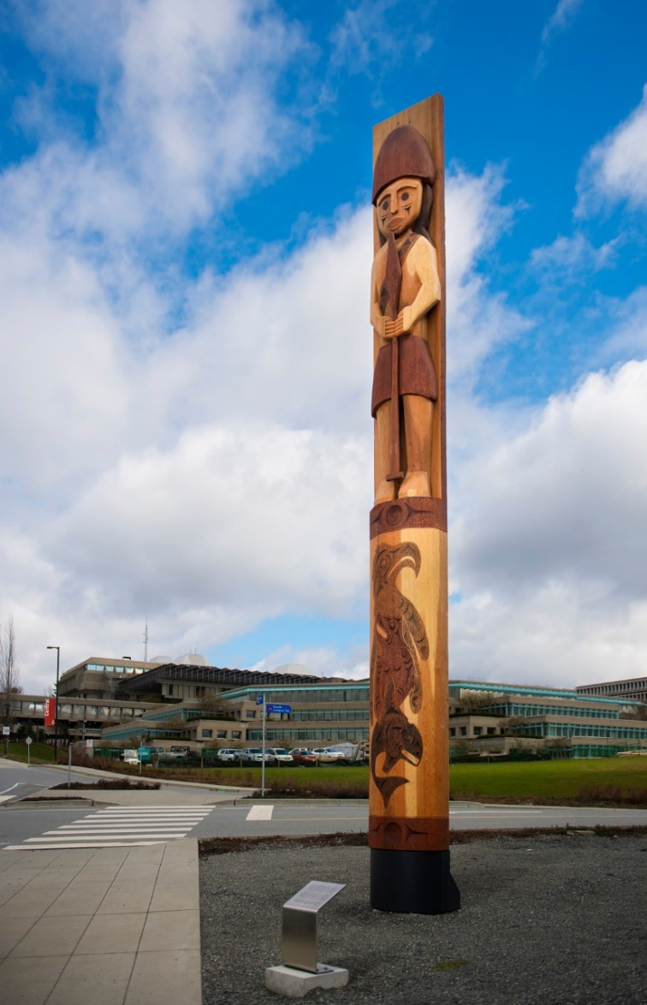
Land Acknowledgement
I acknowledge the xʷməθkʷəy̓əm (Musqueam), Sḵwx̱wú7mesh (Squamish), Səl̓ílwətaɬ (Tsleil-Waututh), q̓íc̓əy̓ (Katzie), and kʷikʷəƛ̓əm (Kwikwetlem) Nations and peoples on whose ancestral, unceded, and rightful lands the three SFU campuses are located.

Slide 3
Agenda
1. Gain an overview of SFU Library Resources
2. Find peer-reviewed journal articles
3. Cite your sources & avoid plagiarism
4. Get Help
https://i.pinimg.com/originals/de/32/89/de32896d6903b303071c14c42c09e2a8

Slide 4
SFU Library Info

Slide 5
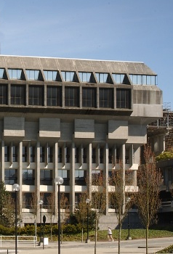
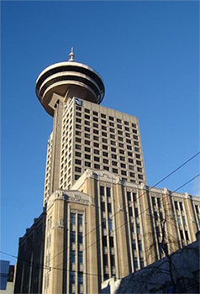
SFU Library Info
A few quick facts about us …
SFU Burnaby
SFU Vancouver
SFU Surrey
Online
three campus libraries
2.5 million+ books & e-books
98,000+ subscriptions to journals, magazines & newspapers
700+ research databases
Use the library remotely: https://www.lib.sfu.ca/
Notes:
Virtual and Physical Library Presence
Very large amount of broad and specialized sources
Want to help you understand all the library has to offer at all stages of your education and career

Slide 6
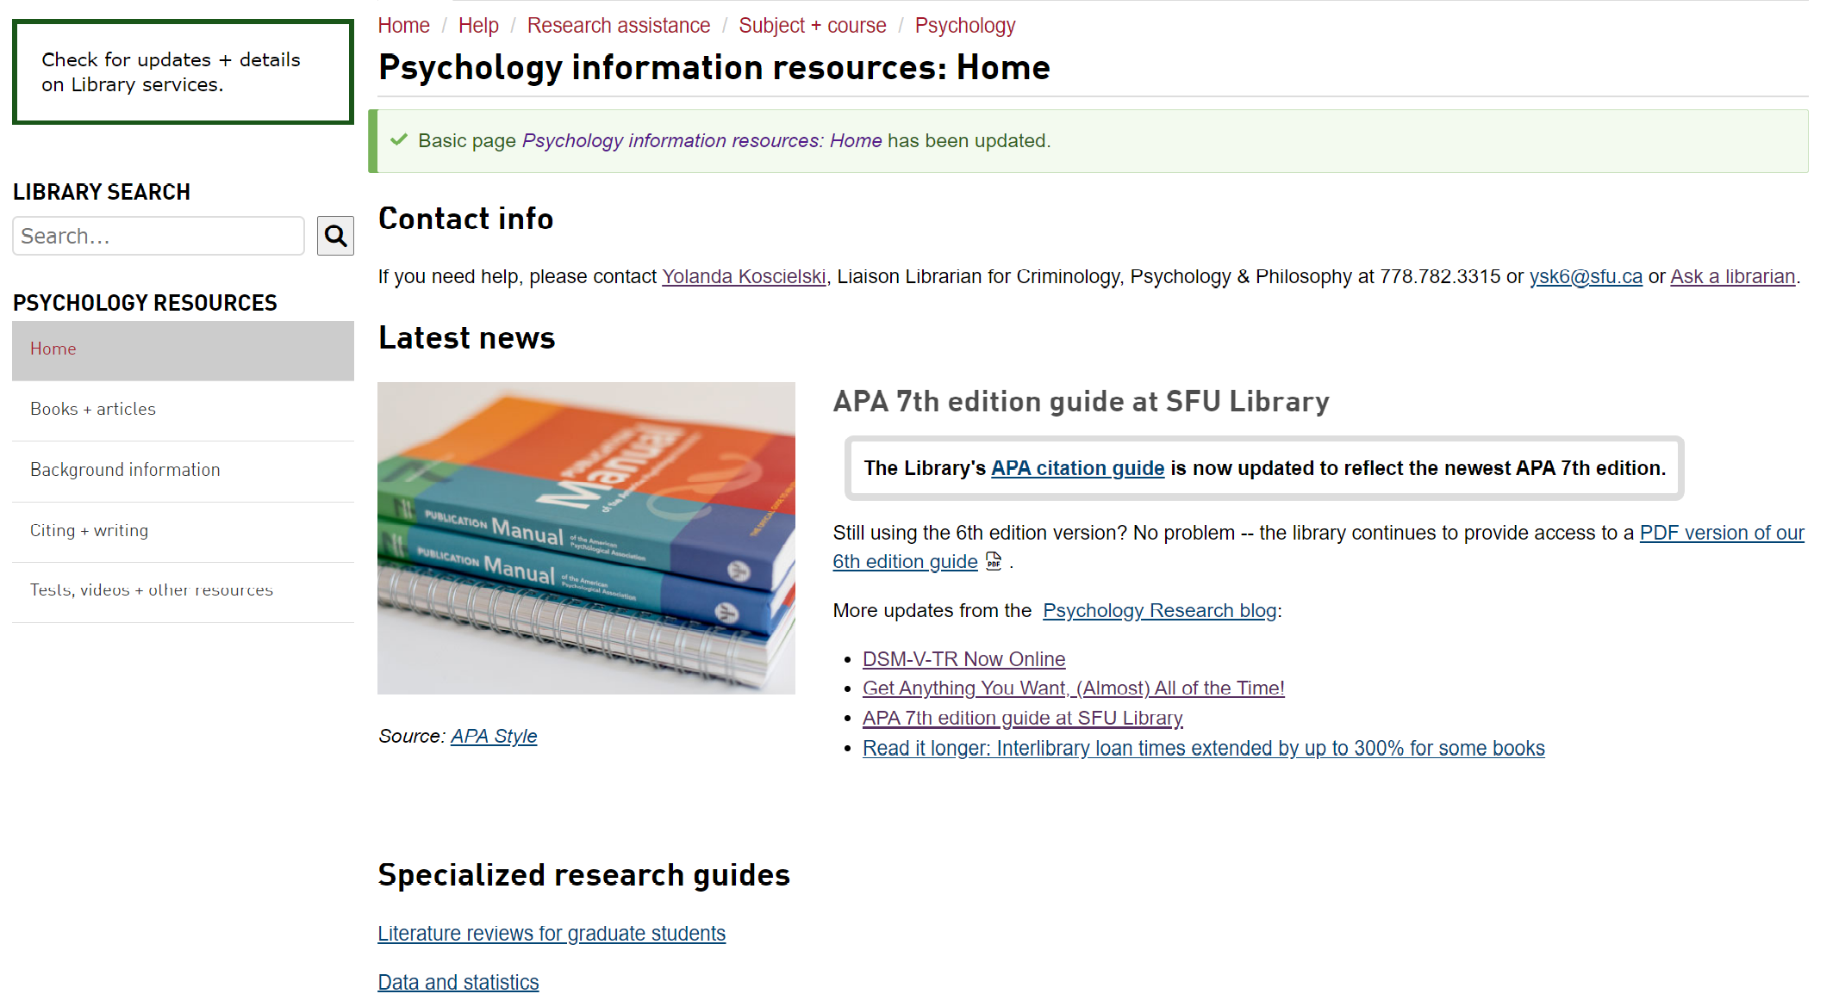
Psychology at SFU Library: Home Base
Today’s PP +
handout
Course guides
Notes:
Highlight:
Psychology Research Guide
Today’s PP is here

Slide 7
Finding academic sources

Slide 8
Articles: Popular vs. Scholarly

Slide 9
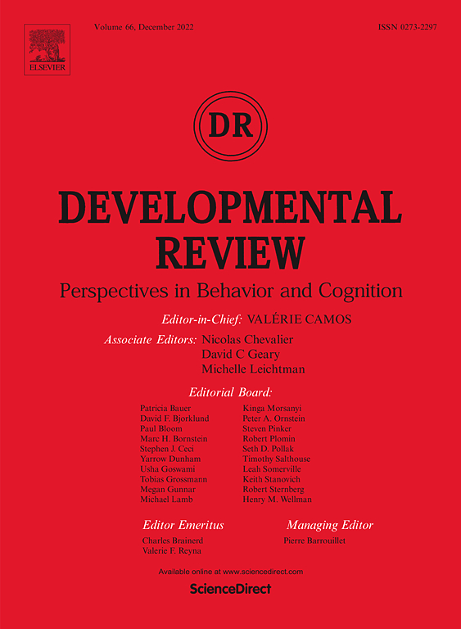
Popular vs. Scholarly
Popular Magazine
Example: Psychology Today
Scholarly Journal
Example: Developmental
Review

Slide 10
Popular vs. Scholarly
Popular Magazine articles Example: Psychology Today
Audience: general public
Writers: paid reporters, non-specialist writers
Design: colourful, graphics, advertisements
Features: no abstracts, citations, or bibliographies
Focus: on a popular topic of interest to the general public
Use: good for broad overviews and popular perspectives
Language: plain, accessible

Slide 11
Popular vs. Scholarly
Scholarly Journal articles
Example: Developmental Review
Audience: academics
Writers: unpaid scholars and researchers
Design: often visually boring with mostly text, some tables and charts
Features: abstracts, citations, bibliographies
Focus: on a specific topic of interest to specialists
Use: good for historical, current, scholarly, in-depth perspectives
Language: subject-specific, jargon-filled
Key criterion: peer-reviewed
Notes:
Peer-review = group of academics and researchers of the topic review the article and evaluate the quality of the article before publishing

Slide 12
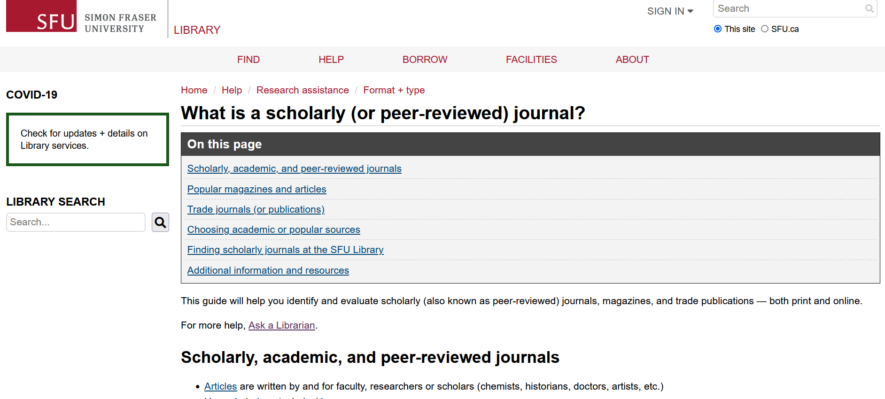
Popular vs. Scholarly
SFU Library’s Scholarly Journal Guide offers a lot more info about scholarly journals and popular magazines.
Feel free to browse through it!

Slide 13
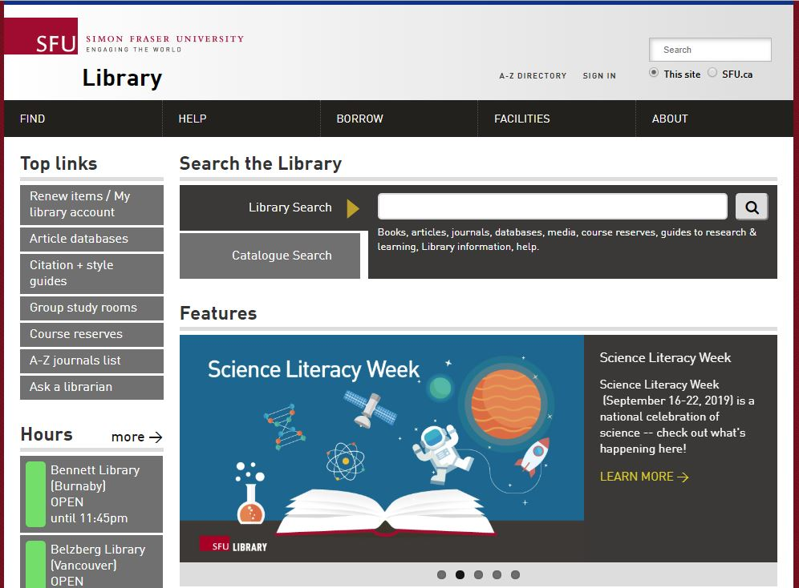
Finding Articles Online
Library Search
Broad/preliminary searches
Includes books, articles, databases, media, course reserves
ALSO includes research guides, learning guides, library info, help
Searches many (but not all) databases
Notes:
Disambiguate the home page of the library
--First search searches (almost) everything – the names of our databases, Psychology guide, FAQs, individual journal articles

Slide 14
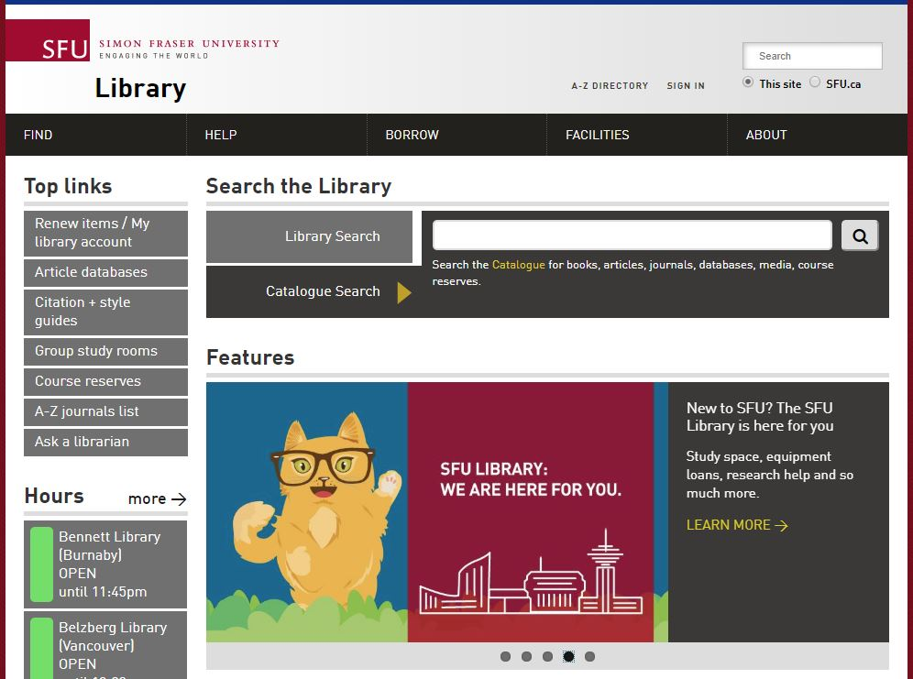
Finding Articles Online
Catalogue Search
Broad/preliminary searches
Includes books, articles, databases, media, course reserves
Searches many (but not all) databases
Notes:
--Narrower, but still quite broad
--searching articles and books and other resources, without all the extra stuff like research guides, FAQs and library policies

Slide 15
Finding Known Articles DEMO
Warning! When using Google, you may be prompted for payment to access an article. Instead, search through the Library’s website: you will be able to access our subscription content.
Lou, N. M., Masuda, T., & Li, L. M. W. (2017). Decremental mindsets and prevention-focused motivation: An extended framework of implicit theories of intelligence. Learning and Individual Differences, 59, 96-106. https://doi.org/10.1016/j.lindif.2017.08.007
Notes:
DEMO search for an article. Start by putting journal title in catalogue search.
Note: this is an example taken from your reading list.

Slide 16
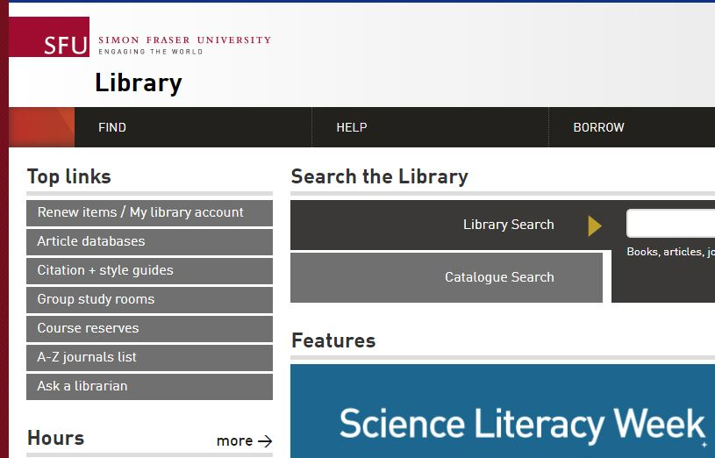
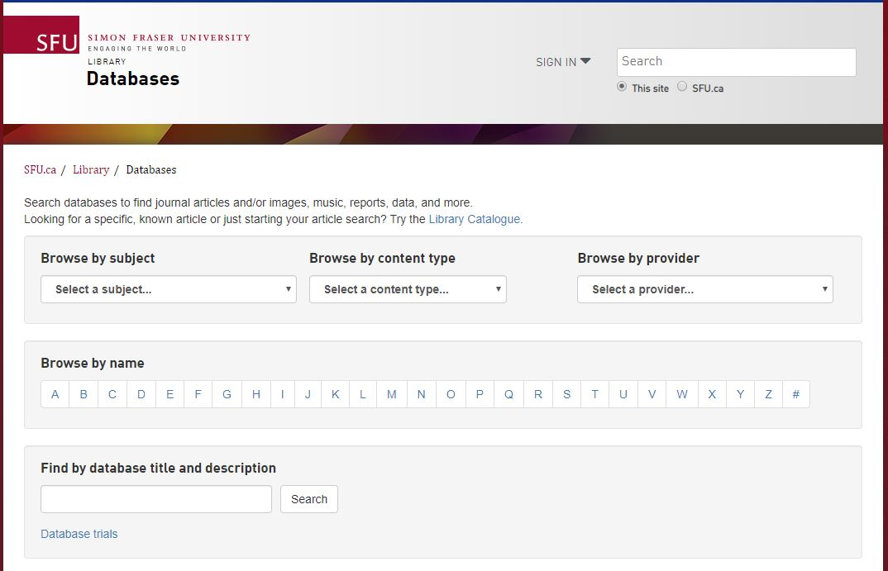
Finding Articles Online
Article databases
More targeted & in-depth searches
Subject-specific or multidisciplinary
Notes:
Finally, you can go to individual database for more targeted searches – subject-specific or multidisciplinary.

Slide 17
Recommended Databases
DEMO: Databases by Subject Area
Psychology database
PsycINFO
academic articles, books, dissertations …
Other discipline-based databases
Sociological Abstracts
academic articles, books, dissertations…
EducationSource
A comprehensive Education database
Notes:
Four specific databases that might be useful for your assignment include PsycINFO, PsycBOOKS, Sociological Abstracts, and EducationSource.
DEMO: databases by subject area, databases by resource type
Find → databases → browse by subject OR browse by content type →news sources

Slide 18
PsycINFO
A discipline–specific database
Main database for Psychology
High-quality, detailed metadata allows for effective use of limiter and subject collocation related to your topic
Virtually all articles in PsycINFO are peer-reviewed (exceptions: book reviews, articles published before that concept introduced, etc.)
Notes:
If you’ve taken Psyc 100 or Psyc 102 at SFU, you are likely already familiar with PsycINFO
Peer-review publications started - 1731

Slide 19
Working with your topic – Exercise
Developing keywords
Topic: How does social media exposure impact adolescents’ identity formation
Identify key concepts
Brainstorm keywords (search terms) for each key concept
Research Concepts Worksheet
Key Concept? | Key Concept? | Key Concept?
? ? ? ? ?.. | ? ? ? ? ?... | ? ? ? ? ?...
Notes:
To develop your search terms, one thing that is important to do is to think about synonyms.
For instance, with the topic, there are three key concepts.
You can brainstorm keywords for each.
Exercise: take a couple of minutes to 1) identify key concepts, and 2) brainstorm search terms for each

Slide 20
Working with your topic – Exercise
Developing keywords
Revised topic: How does social media exposure impact adolescents’ identity formation
Identify key concepts
Brainstorm keywords (search terms) for each key concept
Research Concepts Worksheet
Social Media | Adolescents | Identity Formation
Social Networking Influencers Online social networks TikTok Twitter Instagram … | Youth Teenagers Young adult Teens | Identity development Personality development Self-concept Body image Social identity Ethnic identity …
Notes:
Social media: could include more general terms for social media, or more specific terms for types of social media. Exposure is somewhat of an implied concept.
Adolescents – multiple ways to describe this demographic
Identity formation – a broad concept with many related terms. This would be an area to consider narrowing to a sub-topic if you are getting too many results.

Slide 21
IPsycINFO
Notes:
Once you’ve generated your synonyms, one way to search is by putting your each concept’s synonyms into a dedicated search line, separated by OR.

Slide 22
Boolean searching: AND/OR Exercise
QUIZ:
Which search will typically bring you the most search results?
Cats AND dogs
Cats OR dogs
It doesn’t make a difference
Notes:
Search Strategies

Slide 23
Boolean searching: AND/OR
CATS AND DOGS
CATS
DOGS
CATS OR DOGS
Notes:
Answer: CATS or DOGS
AND brings less results. You are creating more restrictions for your search.

Slide 24
Boolean searching: and/or
A AND B
A
B
A OR B
Notes:
OR means the criteria is one, the other, or both → three different possibilities

Slide 25
SEARCH STRATEGIES
Use AND between keywords to narrow your search
For example: personality AND youth
Use OR between keywords to broaden your search
For example: “Twitter” or “TikTok” or “Instagram”
Use quotation marks around an exact phrase
For example: “identity formation”
Use an asterisk (*) to find related terms
For example: Canad* will get results for: Canada, Canadian, Canadians …

Slide 26
Citation, Plagiarism, and APA Style
Notes:
For your assignment, you will be using APA Style

Slide 27
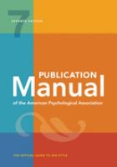
Citing is the practice of acknowledging in your paper the sources from which you obtained information. You cite your sources by providing information about the author’s name, publication date, and so on.
The Publication Manual of the American Psychological Association, 7th ed, provides the standard style for citing in Psychology
SFU Library’s guide to APA citation provides selected citation examples for common types of sources.
Notes:
***Plagiarism Tutorial in general***

Slide 28
Plagiarism means using the words or ideas of another person as if they were your own and without giving proper credit to the sources you have used. Plagiarism is often unintentional because students are not aware of all the ways they can accidentally plagiarize.
SFU Library’s Understanding and Avoiding Plagiarism tutorial will help you:
learn to recognize what plagiarism is
learn several techniques for avoiding plagiarism
Notes:
--Plagiarism tutorial should be part of your course blackboard
--Takes about 30 minutes to complete
--Is interactive

Slide 29
Almost done!

Slide 30
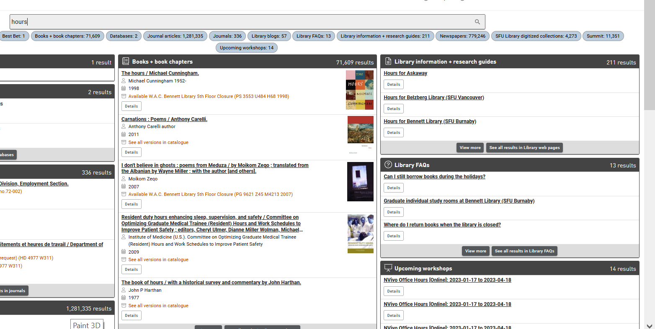
Library FAQs
Library FAQs on homepage
Search FAQs in LibrarySearch, or directly in FAQs.
Notes:
Search any question on library website and answers will appear in the FAQ section
DEMO (if time): hours

Slide 31
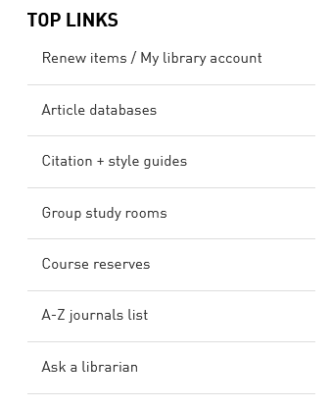
Where to go for help
Contact us:
Research help desk (drop-in & by appointment)
Zoom consultations
Phone: 778.782.4345
Email us at: libask@sfu.ca
AskAway (online chat)
Citation Guides: APA, MLA, Chicago …
Student Learning Commons
Academic writing, study skills, EAL/ESL support
Notes:
The library is here to help you with research at all stages of your career, in person or online through our many resources
Please do not hesitate to contact us
If we are not the right person to answer your question, we will do our best to direct you to someone who is

