Slide 1
Psychology 201 – Library Research May 16, 2019
Yolanda Koscielski, Liaison Librarian for Psychology, Criminology, and Philosophy

Slide 2
Where to Start?
2.5 million+ books & ebooks
98,000+ subscriptions to journals, magazines & newspapers
500+ research databases
PsycINFO
PsycTESTS
Three campus libraries
May 16th, 2019 – Psyc 201 – Library Research

Slide 3
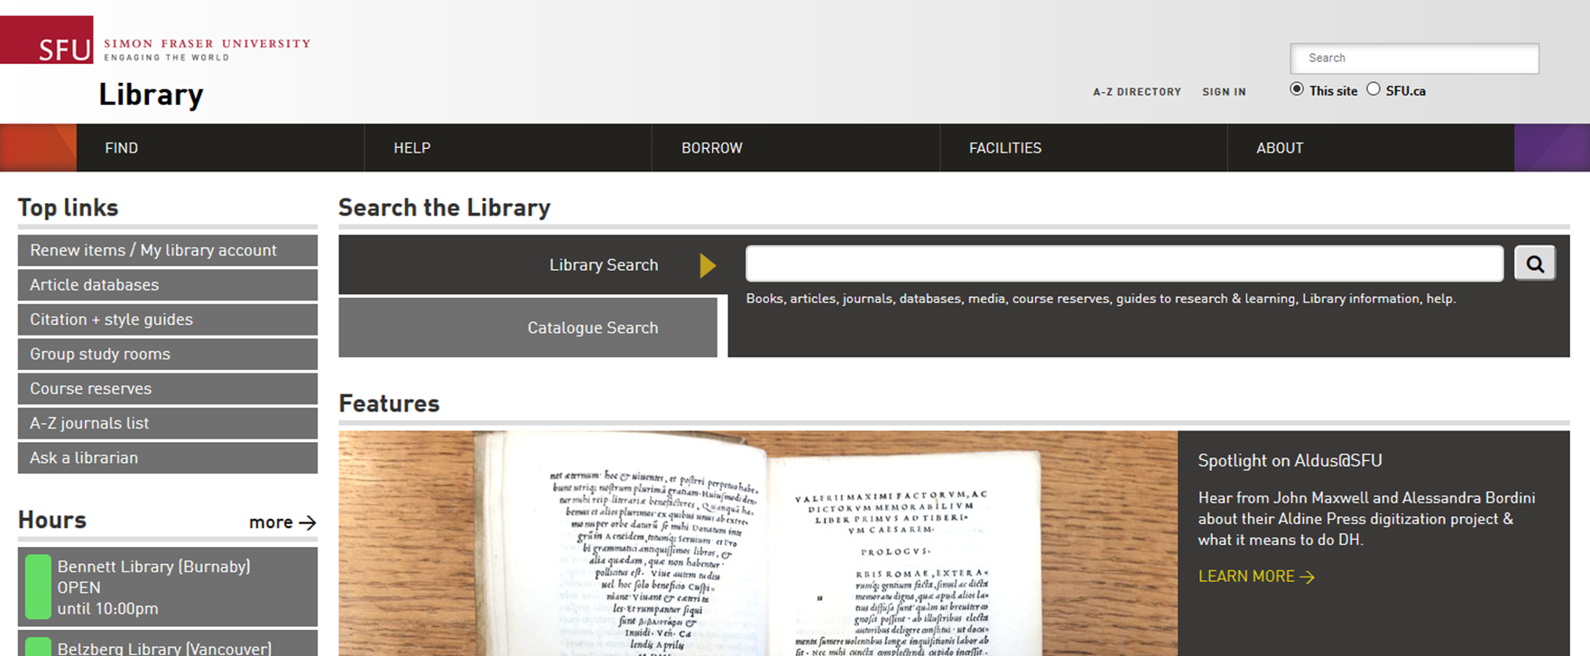
Where to start?
Search from very broadly to more specifically
Broadest: Library Search
More broad: Library Catalogue
Less broad: Specific databases such as PsycINFO
May 16th, 2019 – Psyc 201 – Library Research
Notes:
DEMO:
Quantity versus quality
-google of library site
--not 100%
--focus in on your subject, 500 databases, lots of overlap

Slide 4
Google (vs. subject-specific databases) - Pros
Casts a wider net
Reveals the most popular articles
High volume of articles retrieved (millions of records searched)
Google’s algorithm compensates for search weaknesses (rare to get no results)
Full-text indexing is now part of Google Scholar (working with publishers)
Known-item searching
Long-tail searching (when search terms are low-occurring)
Times cited tool (context-specific)
Books – out-of-copyright full-text access, locating a quote
US case law, grey literature, academic websites, Institutional Repositories
May 16th, 2019 – Psyc 201 – Library Research
Notes:
Same reason as you would use library search

Slide 5
Google (vs. subject-specific databases) - Cons
Casts a wider net
Low level of subject + author collocation
Not mapped to a specific discipline (Challenging to run searches that combine common words (e.g. Art + Time)
Less search sophistication & manipulation (e.g. search limiters specific to Psychology, such as population groups)
Pseudo-boolean operators
Missing deep data (e.g., statistics)
Not usually free (search via library)
Mysterious algorithms (Coverage? Publishers? Opposite of transparent sources such as PsycINFO).
New articles might not be pushed up (popularity over currency)
Indexes articles from “predatory publishers”, perhaps harder to identify if working outside of your field
May 16th, 2019 – Psyc 201 – Library Research

Slide 6
PsycINFO
A disciplinary–specific database. Another example: Criminal Justice Abstracts
Main database for Psychology
Mapped to a disciplinary perspective
High-quality, detailed metadata allows for effective use of limiter and subject collocation related to your topic
Access to specialized material (e.g., tests, dissertations, data)
Virtually all articles in PsycINFO are peer-reviewed (exceptions: book reviews, articles published before that concept introduced, etc.)
May 16th, 2019 – Psyc 201 – Library Research
Notes:
Use Limits with confidence
Extensive – index from outside of Psyc journals (as long as it is psyc related)
Does curatrion for you

Slide 7
PsycTESTS
Indexes 18,000+ Psychology tests, measures, assessments
Mostly unpublished, non-commercial tests
Scoring key usually not included (65 tests only with key)
Descriptive test information – construct being measured, purpose, test description, etc.
Helpful for seeing how Psychologists have developed their experiments and brainstorming ideas for designing your own experiment
May 16th, 2019 – Psyc 201 – Library Research

Slide 8
Search Strategies
May 16th, 2019 – Psyc 201 – Library Research

Slide 9
Search Terms
Assess the impact of the media on the body image of young women.
Identify key concepts
Brainstorm synonyms and related words for each concept
Take a minute and fill out part one of the activity sheet.
May 16th, 2019 – Psyc 201 – Library Research

Slide 10
Search Terms
Assess the impact of the media on the body image of young women.
Identify key concepts
Brainstorm synonyms and related words for each concept
Can often leave out relationship words like “impact”, “effect of”, etc.
May 16th, 2019 – Psyc 201 – Library Research

Slide 11
Search Terms
Media: television, magazines, movies, films, celebrities, music, fashion, Facebook, Twitter, YouTube, Instagram…
Body Image: self esteem, self concept, body conscious, identity…
Young Women: teenage, teenager, teen, youth, adolescent, adolescence, women, woman, female…
Tip: consider narrowing of your focus (i.e. Media is a big topic, “Facebook” might be a more manageable topic)
Tip: keep in mind your inclusion/exclusion research criteria and the rationale for it
May 16th, 2019 – Psyc 201 – Library Research

Slide 12
Boolean Operators
Connect concepts
(magazine AND body image)
Search for related terms
(teen OR youth OR adolescent)
Exclude irrelevant terms
(woman NOT man)
Notes:
Common research pitfall – too many keywords with “AND” separating them

Slide 13
AND / OR
Magazines AND body image
Magazines
Body image
Magazines OR body image

Slide 14
Topic Scope
Do you have a subject area, topic, or thesis?
Subject is very broad: freedom of information, Charter of Rights and mental illness
Topic adds a second concept, explores a relationship or question between the two concepts: testosterone levels in sex offenders, effect of art therapy on recidivism
Thesis: you are making an assertion and providing supportive evidence: Art therapy decreases recidivism in young offenders
If you are getting too few or too many results, it may be helpful to think about what level you are searching for and adjust.
May 16th, 2019 – Psyc 201 – Library Research
.

Slide 15
Subject Headings
Not necessary, but an added tool that might be useful
DEMO
Subject headings: a systematic, hierarchical, and finite language used for describing subjects/concepts.
Articles and books will usually have 3-8 subject headings assigned to their citation or bibliographic record. This is human indexing.
Keyword searching based on computer indexing
SH particularly useful for increasing relevancy with high volume searches and disambiguation
May 16th, 2019 – Psyc 201 – Library Research

Slide 16
Subject Headings
Not necessary, but an added tool that might be useful
Not as useful for newer concepts, e.g. “internet shaming”
Subject headings/descriptors are a standard field in most databases
Subject Headings are unique to each database (PsycINFO subject headings for PsycINFO only)
Sometimes keywords = subject headings
May 16th, 2019 – Psyc 201 – Library Research

Slide 17
Practice!
"Social Media" OR Facebook OR Internet
AND
“body image” OR
AND
Adolescents OR “young women”
May 16th, 2019 – Psyc 201 – Library Research

Slide 18
APA
Resources
APA Style Blog
SFU Guide to APA
OWL – Purdue APA Guide
AskAway (particularly helpful for citation questions)
May 16th, 2019 – Psyc 201 – Library Research
.

Slide 19
Library Research Help
Contact us:
Phone: 778.782.4345
Email us at: libask@sfu.ca
AskAway (online chat)
Research help desk (drop-in & by appointment)
Liaison Librarian for Psychology: ysk6@sfu.ca
May 16th, 2019 – Psyc 201 – Library Research

