Slide 1
Welcome to the SFU Library!
Social Psychology Area Seminar
January 26, 2024
Yolanda Koscielski,
Librarian for Psychology, Criminology and Philosophy
ysk6@sfu.ca

Slide 2
Liaison Librarian for Psychology
Based at Burnaby campus
Manage print and electronic collections for Psychology
Provide individual and group consultations on library research, including for evidence synthesis projects
Author instructional web guides
Help you locate hard to find resources
Full list of Liaison Librarians

Slide 3
Workshop Agenda
Feedback:
Databases: indicated you were "somewhat comfortable" to "comfortable"
Getting SFU access to articles from Google
Finding very specific information in searches
Finding papers on measures or specific methodologies
Learning more about qualitative research
Using some of the psychology tailored resources such as PsycTESTS
Finding measures/scales/inventories are hard
Is there a quick way to find how to score known measures
Searching for statistical resources

Slide 4
Workshop Agenda
Getting SFU access to articles from Google (and other sources)
PsycINFO – tips and tricks
Finding papers by methodology
Tests and measures
Statistical sources
Exercises, Q&A

Slide 5
Access Library Resources - LibKey Nomad
Running into paywalls and multi-step workarounds?
LibKey Nomad provides instant access to journal articles and e-books.
Add the Libkey Nomad browser extension to your computer's internet browser (Safari, Chrome, Firefox, or Microsoft Edge) to be connected to the library's holdings when navigating the internet.
thirdiron.com/downloadnomad

Slide 6
How to install LibKey Nomad
Go to thirdiron.com/downloadnomad
Choose your browser and follow the prompts to install the LibKey Nomad browser extension
Search for and choose Simon Fraser University as your organization
You’re all set!
Look for LibKey Nomad icons on scholarly webpages.
Notes:
* Google Scholar

Slide 7
Access Library Resources
Send requests for important books to purchase directly to me: ysk6@sfu.ca
Make use of (free!) Interlibrary Loan System for books and journal articles
Overjoyed cats.

Slide 8
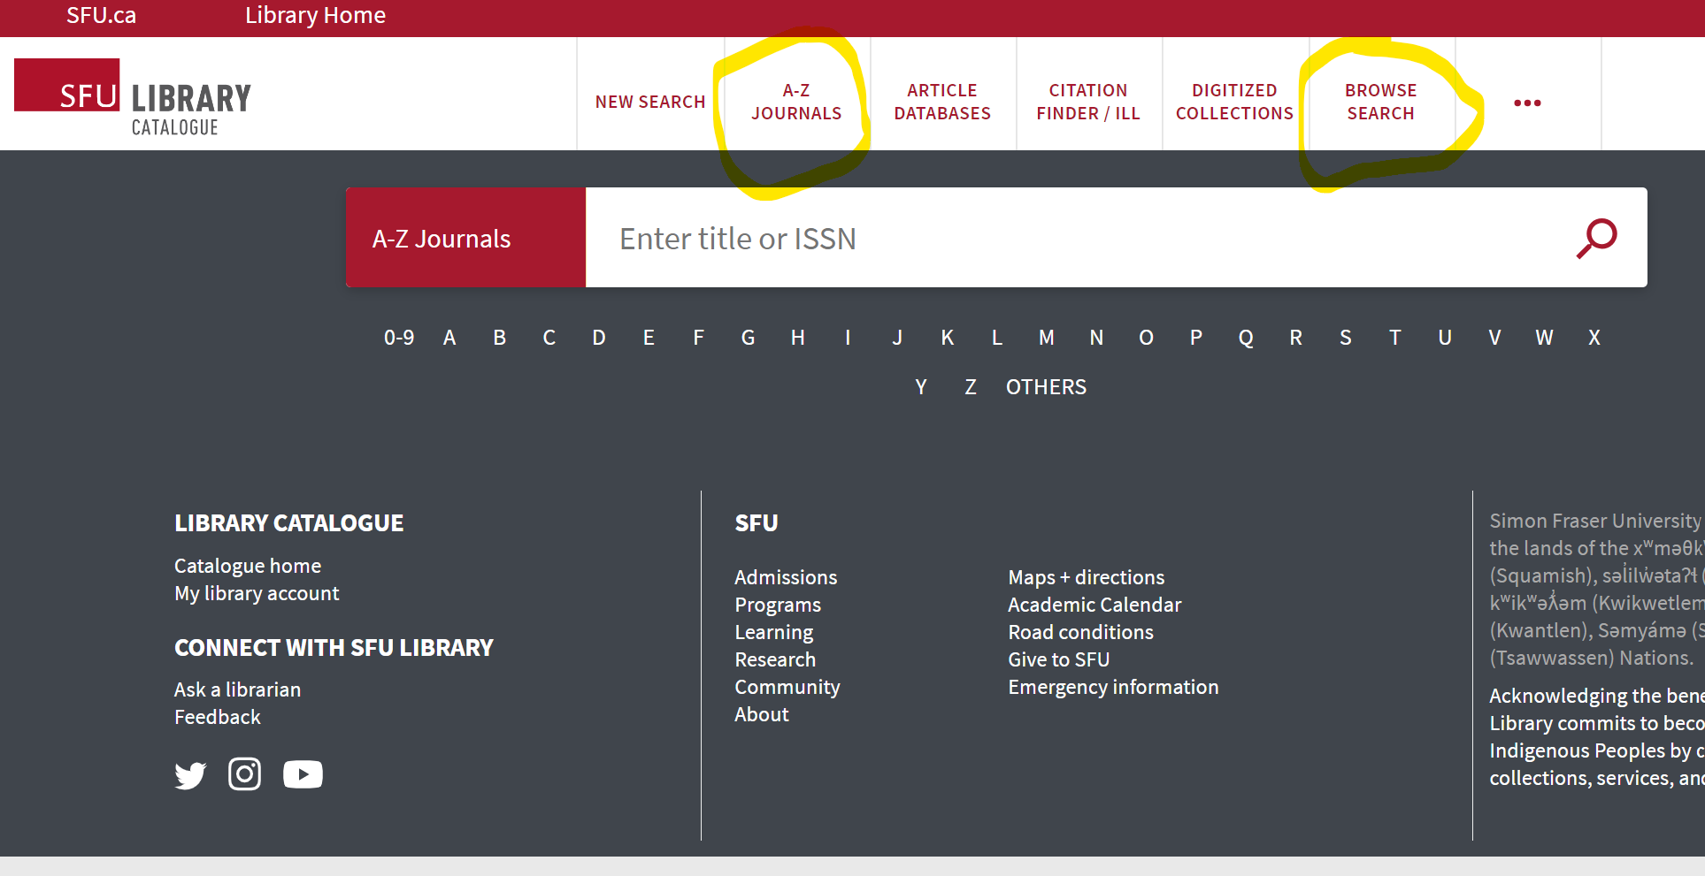
Searching for known items
Journal: Social issues and policy review
Book: Handbook of Personality and Social Psychology

Slide 9
PsycINFO
Features:
High quality metadata, particularly subject headings
Limiters unique to discipline, e.g., methodology
Search history + sets to keep track of your research over time
Complex citation records allow for complex search manipulation. Maximize your use of the tool!

Slide 10
PSYCINFO Subject Headings
Subject Headings provide a standardized vocabulary for describing key concepts
APA Thesaurus of Psychological Terms is >10,100 terms
Human-assigned
Found within a hierarchy of broader, narrower, and related terms. Also “used for” terms.
APA: “With the wide variety of concepts and vocabulary used in the psychological literature, search and retrieval of records about specific concepts is virtually impossible without the controlled vocabulary of a thesaurus”.

Slide 11
PSYCINFO Subject Headings
Keyword searches = machine indexing
Subject headings = human indexing
MeSH = Medical Subject Headings (PubMed)
PsycINFO’s MeSH headings link out to PubMed database
MeSH included if article indexed in PubMed (about 35%)
30,000-ish MeSH terms
DEMO: Sample Record, Type A; Anxiety
Notes:
--keyword field???

Slide 12
Boolean review
Poll Everywhere
Notes:
PollEv.com​/yolandak214
*present view + instructions

Slide 13
Boolean searching: and/or
A AND B
A
B
A OR B
Notes:
Search Strategies

Slide 14
Boolean searching: and/or
CATS AND DOGS
CATS
DOGS
CATS OR DOGS
Notes:
Search Strategies

Slide 15
Boolean review

Slide 16
Boolean searching: and/or
PsycINFO
(pandemic OR epidemic OR coronavirus) AND (dogs OR cats OR animals) AND (depression OR anxiety OR stress) (147 results)
Dogs pandemic depression (312 results)
Dogs OR pandemic OR depression (403,498 results)
Dogs AND pandemic AND depression (7 results)
Notes:
In psycINFO
Dogs pandemic depression (312)
Dogs or pandemic or depression (403,498)
Dogs AND pandemic AND depression (7)
(pandemic OR epidemic OR coronavirus) AND (dogs OR cats OR animals) AND (depression OR anxiety OR stress) (147)

Slide 17
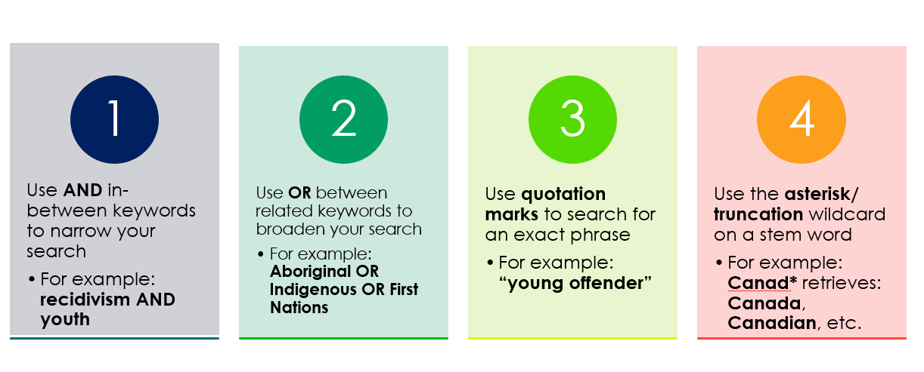
Database Toolkit
Notes:
-Broad review without details

Slide 18
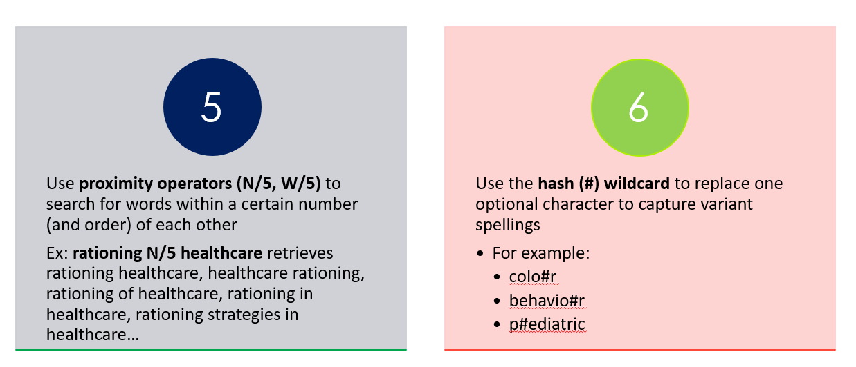
Database Toolkit
[PubMed example]
Notes:
-Broad review without details

Slide 19
PSYCINFO Exercise
In PsycINFO, access the APA Thesaurus. Search for the subject heading (SH), Prosocial Behavior. Add the SH to your search. How many results do you received?
Next, look up your research topic of interest in the Thesaurus. Are there subject headings that describe it well? Does the entry include broader terms, narrower terms, or related terms?
Run a search in the regular database for “Psychotic Depressive Reaction” (with quotation marks intact). What do you notice about the results?
Next, look up “Psychotic Depressive Reaction” in the Thesaurus. What happens?
Run a search for the subject heading, Major Depression. How many results do you have?
Click on “search history” (mid-page). Here you will see a list of the searches you have done this session. Combine your past searches for “major depression” OR “Psychotic Depressive Reaction”. What do you notice about the number of your results?
Bonus question: how is the subject heading “major depression” structured in in MeSH headings? (Medical Subject Headings)

Slide 20
Finding Research Methodology Info

Slide 21
A portal about research methodology: books, dictionaries, encyclopedias, ca, etc.
Little Blue Books series focus on qualitative research
How to find… Research Methodology info
Sage Research Methods Online (SRMO)

Slide 22
How to find… Research Methodology info
Example resource: SAGE Encyclopedia of Qualitative Research Methods

Slide 23
How to find… Research Methodology info
Interactive Methods Map (Sage)

Slide 24
Finding articles by methodology
Notes:
“Finding papers on measures or specific methodologies “

Slide 25
Two main methods for searching by methodology Example: qualitative articles
Locating Qualitative Articles
Dedicated search limiters in databases
Adding related keywords
Citation chaining, curated resources

Slide 26
Search limiters
PsycINFO
APA Databases Methodology Field Values
Qualitative Study: “A type of research methodology that produces descriptive data, with little emphasis given to numerical quantitative measures”. – APA
Notes:
--won’t capture those articles that haven’t been indexed

Slide 27
Adding methodology keywords
Possibilities:
Qualitative
Ethnography
Interviews
Life-course
Narrative inquiry
Content analysis
Case study
Focus group
…
Useful for databases without a qualitative study limiter.

Slide 28
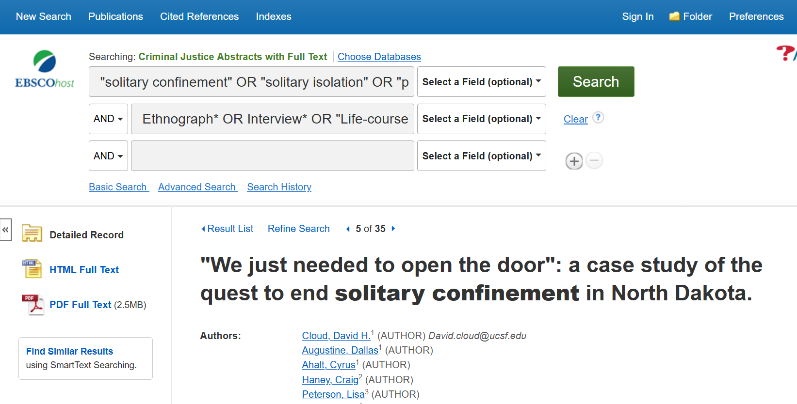
Adding methodology keywords
DEMO
Notes:
Demo in CJA
First line – our topic
Second line – these qualitative keywords
Quotation marks so it is searching terms as a phrase
First line: "solitary confinement" OR "solitary isolation" OR "prison confinement" OR "administrative segregation"
Second line: Ethnograph* OR Interview* OR "Life-course" OR "Narrative inquiry" OR "Content analysis" OR qualitative
Highlighted terms will show you why the article is coming up. Some will be irrelevant.
Go to article #5- case study, may be relevant
“Methods: We conducted an embedded case study, analyzing changes in policies and procedures, administrative data, and focus groups and interviews with incarcerated persons and staff, ”

Slide 29
PsycTESTS and Scales/Measures/Inventories
SFU Library Guide: Psychological Tests and Measures
PsycTESTS: “Focused primarily on unpublished tests, this database was designed to save your researchers time from having to reproduce tests when conducting research on previously measured constructs.”
Mental Measurements Yearbook with Tests in Print (TIP) Tests In Print "serves as a comprehensive bibliography to all known commercially available tests that are currently in print in the English language".
Notes:
-Broad review without details

Slide 30
Scoring Measures
Is there a quick way to find how to score known measures
Psychometric Software?
Support for some software offered via the Library’s Research Commons
List of Software for SFU Researchers
SPSS, R, Tableau, SMP, Nvivo…
Research Commons provides consultations and other support for selected
Notes:
-Broad review without details

Slide 31
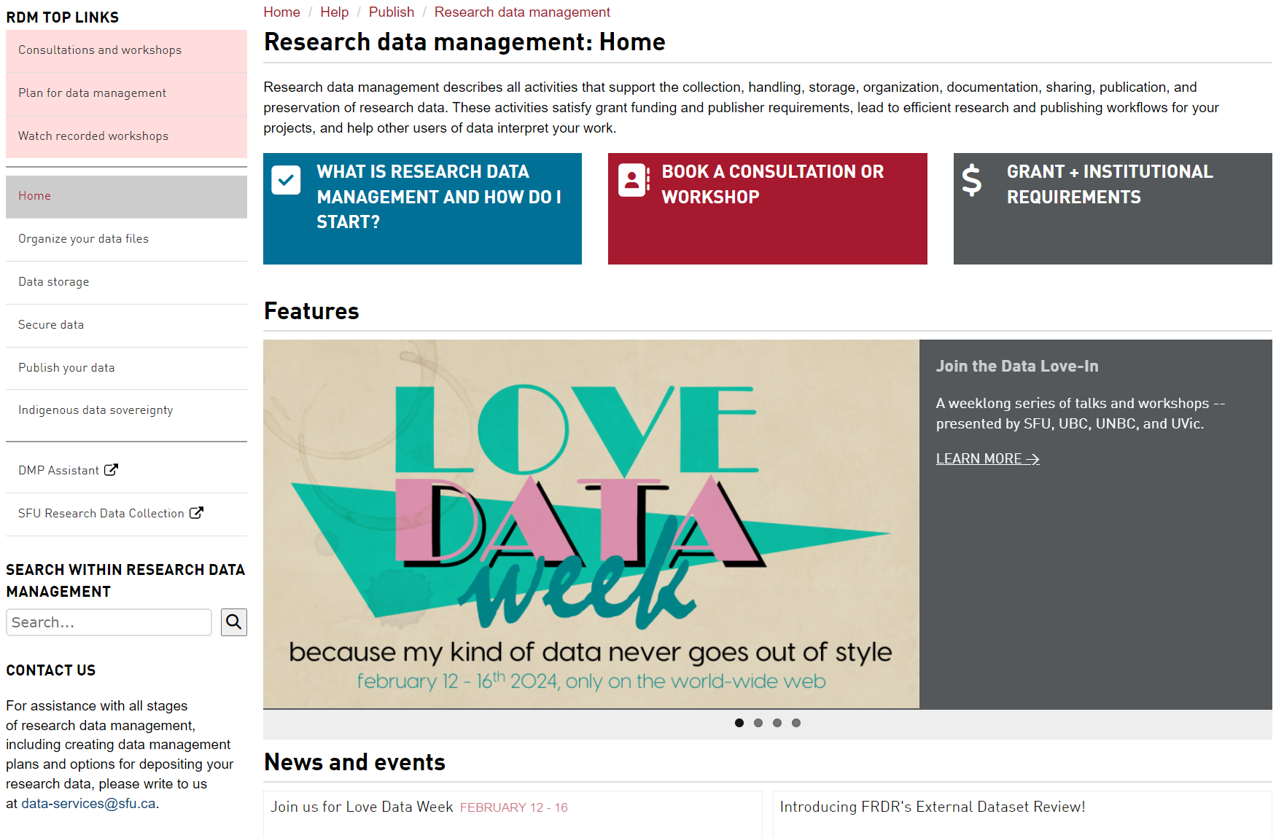
Statistical Sources
Cursory overview – dedicated librarian
Statistics or Data?
Statistics – pre-curated data snapshots
Data – can be machine readable, used to draw your own analysis

Slide 32
Statistical Sources
SFU Library’s Research Data Management Centre
Statistics (pre-curated data snapshots) and data (can be machine readable, used to draw your own analysis)
SFU Library Guide: Statistical resources: Data & statistics information
PsycINFO – Supplemental Materials – Data Sets – 8,483 results (DEMO)
May be hosted on journal platform sites (requiring a proxy), or link to an open access source (OSF)
Google to find data/statistics citations, then track down source
The Daily (Statistics Canada)
Notes:
-Sample topic: what percentage of Canadians have been Institutionalized for mental health reasons?
https://www150.statcan.gc.ca/n1/pub/11-627-m/11-627-m2023053-eng.htm
https://www150.statcan.gc.ca/n1/pub/75-006-x/2023001/article/00011-eng.htm
https://www150.statcan.gc.ca/n1/en/surveys/3204
https://www.cihi.ca/en/topics/mental-health-and-substance-use/data-tables

Slide 33
Statistical Sources
Business sources: Secondary Market Research Data
Psychographics, public opinion polling, etc.
Example: Vividata provides “Detailed Canadian consumer data covering product/service purchases, leisure activities, opinions, and demographics”
Example: Vividata provides a generational breakdown of people in Canada who agreed with the statement: "Global warming is not man-made -- it's a natural occurrence."
“Gen Z was 29% more likely to agree that global warming isn't man-made than you'd expect given the proportion of 14+ Gen Zers in Canada's population. Boomers, in comparison, were 20% under-represented: they make up about 32% of the 14+ population, but only 25% of the people who think global warming is natural.” – SFU Librarian Colleague

Slide 34
PsycTESTS and Scales/Measures/Inventories
From the SFU Library Website, access PsycINFO.
In the first search box, enter a keyword for a topic you are interested in
In the second search box, type "appended" and select Tests & Measures from the drop-down menu to the right. This will narrow your search to articles with tests appended.
What is the name of the scale/measure/test appended to the article? Is there a scoring key?
From the SFU Library Website, access Tests in Print with Mental Measurements Yearbook.
Run a keyword search for “prosocial”. How many tests are retrieved?
For the first test listed, how many reviews of this test are included?
Start a new search. Select “indexes” in the upper left. From the drop-down menu, choose the index “test category” and select browse. How many tests are found under the category, “Family and Relationships”?

Slide 35
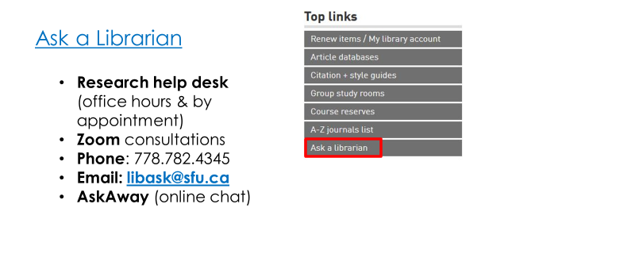
Help
Yolanda Koscielski
ysk6@sfu.ca

