Slide 1
Welcome to the SFU Library!
Incoming Graduate Students’ Orientation
September 8, 2023
Yolanda Koscielski,
Librarian for Psychology
ysk6@sfu.ca
https://i.pinimg.com/originals/de/32/89/de32896d6903b303071c14c42c09e2a8
Notes:
-PowerPoint online

Slide 2
Top 7 things to know about SFU Library
Liaison Librarian for Psychology
Key resources
Support for evidence synthesis
Access resources (for free)
Research Commons
Support for open access publishing
Research Data Management
Notes:
-Broad review without details

Slide 3
Liaison Librarian for Psychology
Based at Burnaby campus
Manage print and electronic collections for Psychology
Provide individual and group consultations on library research
Author instructional web guides
Help you locate hard to find resources
Full list of Liaison Librarians

Slide 4
Key Resources – Beyond Journal Databases
About 700 databases, such as:
Covidence
Primal Pictures Interactive Anatomy
WestLaw Next Canada
Oxford Bibliographies Online
Sage Research Methods Online
Notes:
-Specializes resources for statistics and data, GIS, etc.
*Covidence: Systematic Review support software: helps with all stages of a review: importing citations, screening articles by title and abstract, and by full text, populating risk of bias tables, extracting data and exporting
*Primal Pictures: Interactive 3D - human anatomy and physiology models – brain, hormones, gut, etc.
*OBO: Lists key books, articles, and other sources on a wide variety of subjects via annotated and curated bibliographies. An excellent starting point for locating important literature and scholarly sources on a topic. Psychology module.
*Search or browse a wide variety of sources on research methods, including ebooks, articles, reference sources, and videos

Slide 5
Key Resources – Psychology Web Guide
Ask a Librarian
Course guides
Notes:
-Student support: course guides, specialized guides (e.g., finding tests and measurements), psyc databases, etc.
-Ask a Librarian contact points – for undergraduates, quick answers, AskAway open evenings and weekends
-Psyc 102 guide

Slide 6
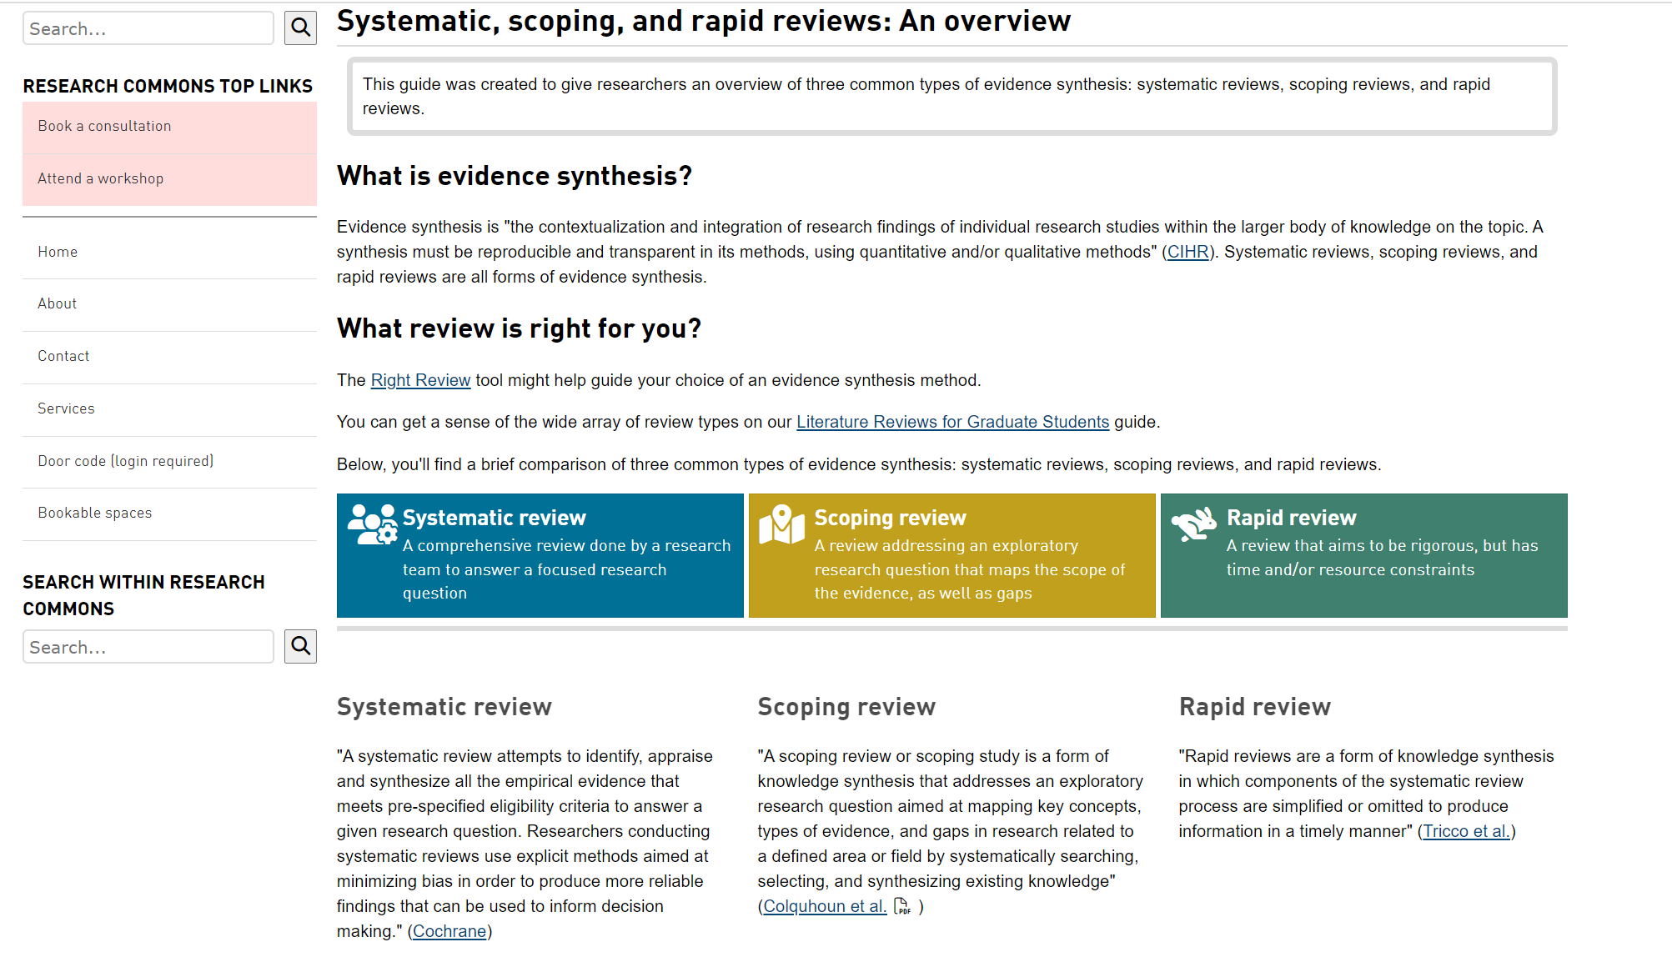
Support for Evidence Synthesis
Guide: Systematic, scoping and rapid reviews: An overview
Notes:
-Rapidly growing area, where I spend most of my time working with Psyc Graduate students
-Evidence synthesis or knowledge synthesis is an umbrella term for the range of synthesizing literature reviews with a specific methodology, designed to create reproducibility and transparency

Slide 7
Support for Evidence Synthesis
Individual or group consultations; one-time or iterative; lead time required
Some areas for support:
Deciding on a review type
Identifying appropriate protocols, frameworks/mnemonics, and reporting and conducting guidelines for your search
Selecting the appropriate databases to search
Using advanced database features
Reviewing your search strategy
Translating your search strategy across databases
Co-investigating tricky questions
Notes:
Protocols: Registered blueprint for your search, e.g., PROSPERO protocol
Reporting Guidelines: “List of reporting items for researchers to use when documenting study details from IMRAD (Intro, Methods, Results, & Discussion) and beyond.”, e.g., PRISMA, ROSES
Conducting Guidelines: how to conduct the search, e.g., exclusion and inclusion criteria. Ex: JBI
Frameworks/Mnemonics: “Frameworks are used to break up the research topic into key concepts and in the developing of research question”, Ex: PICO

Slide 8
Access Library Resources
Send requests for important books to purchase directly to me: ysk6@sfu.ca
Make use of (free!) Interlibrary Loan System for books and journal articles
Overjoyed cats.

Slide 9
Access Library Resources - LibKey Nomad
Running into paywalls and multi-step workarounds?
LibKey Nomad provides instant access to articles.
thirdiron.com/downloadnomad
Notes:
The Libkey Nomad browser extension can now link to e-books in addition to journal articles.
Add the Libkey Nomad browser extension to your computer's internet browser (Safari, Chrome, Firefox, or Microsoft Edge) to be connected to articles and e-books from the library's holdings when navigating the internet.

Slide 10
How to install LibKey Nomad
Go to thirdiron.com/downloadnomad
Choose your browser and follow the prompts to install the LibKey Nomad browser extension
Search for and choose Simon Fraser University as your organization
You’re all set!
Look for LibKey Nomad icons on scholarly webpages.
Notes:
* Google Scholar

Slide 11
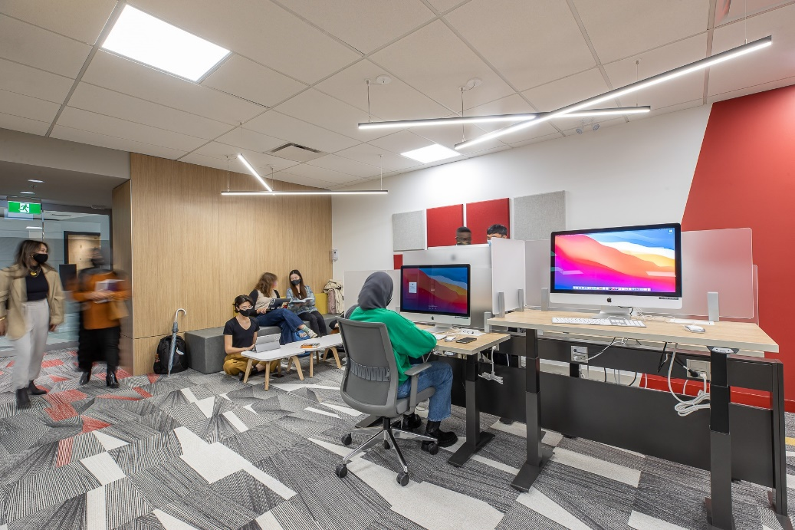
Research Commons
Free services for graduate students and postdocs in all disciplines.
Spaces to work, including private, bookable rooms for individuals and groups
Specialized workshops
Access to research software
Consultations with specialists
Graduate Writing Services
Thesis template and formatting help
Data services and Digital Humanities support
Learn more: https://www.lib.sfu.ca/about/branches-depts/rc

Slide 12
Research Commons
Workshops and consultations are available to graduate students and postdocs in a variety of areas, including:
Academic publishing and impact metrics
Citation management with Zotero
Digital Humanities approaches and tools
Qualitative data analysis with NVivo
R & Python programming
ArcGIS & QGIS
Thesis and academic writing
Thesis template and submission help
Research Data Management

Slide 13
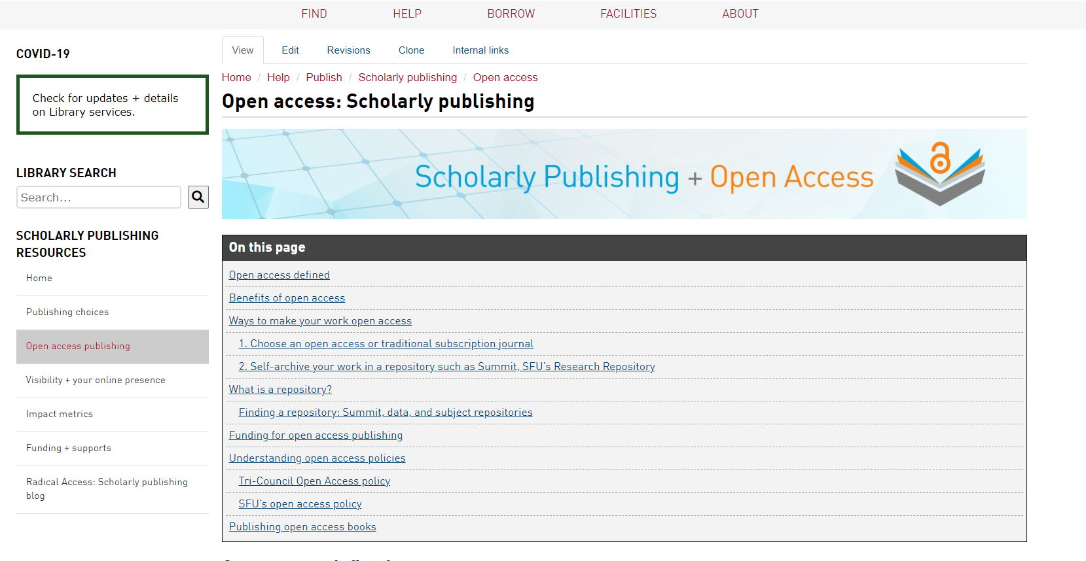
Support for Open Access Publishing
Support for one article per calendar year, up to $2500 (CDN)*
Library has memberships or direct invoicing arrangements with some of the most prominent open access publishers
Notes:
-Change from last year (2 articles)
-Check eligibility first

Slide 14
Research Data Management
www.lib.sfu.ca/data
Notes:
Area on library website dedicated to RDM
Note upcoming 3-session workshops in early November

Slide 15
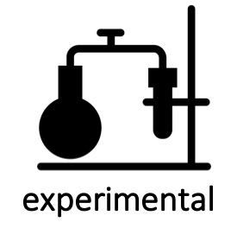
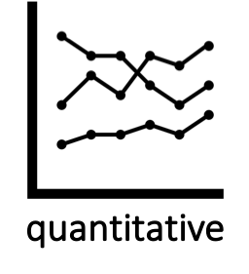
What is Research Data Management?
Research Data: materials created, generated, or collected as evidence in support of scholarly publications, presentations, etc.
Research Data Management: steps taken to ensure your data remains safe, persists, and is accessible in the long-term.

Slide 16
Research Data Management
data-services@sfu.ca www.lib.sfu.ca/data
Consider early on in your research
Increase your visibility and impact: data can be cited, too!
Retention of data enables both verification of results and new insights
Good practice to manage your data, especially if working with human participants
Required by granting agencies, publishers, research institutions.
.

