Slide 1
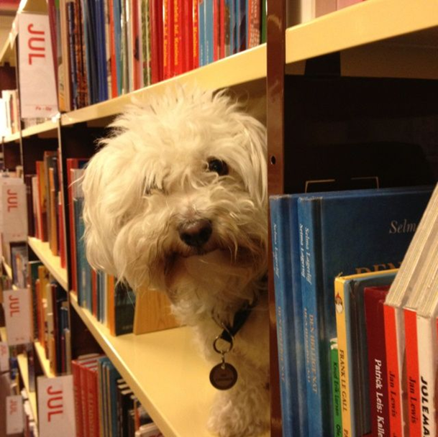
Welcome to SFU Library!
Yolanda Koscielski,
Librarian for Psychology
ysk6@sfu.ca
September 8, 2022
INCOMING STUDENTS’ ORIENTATION 2022
https://i.pinimg.com/originals/de/32/89/de32896d6903b303071c14c42c09e2a8
Notes:
-Bird’s eye view / fly-over of the broad landscape of library services
-PowerPoint online

Slide 2
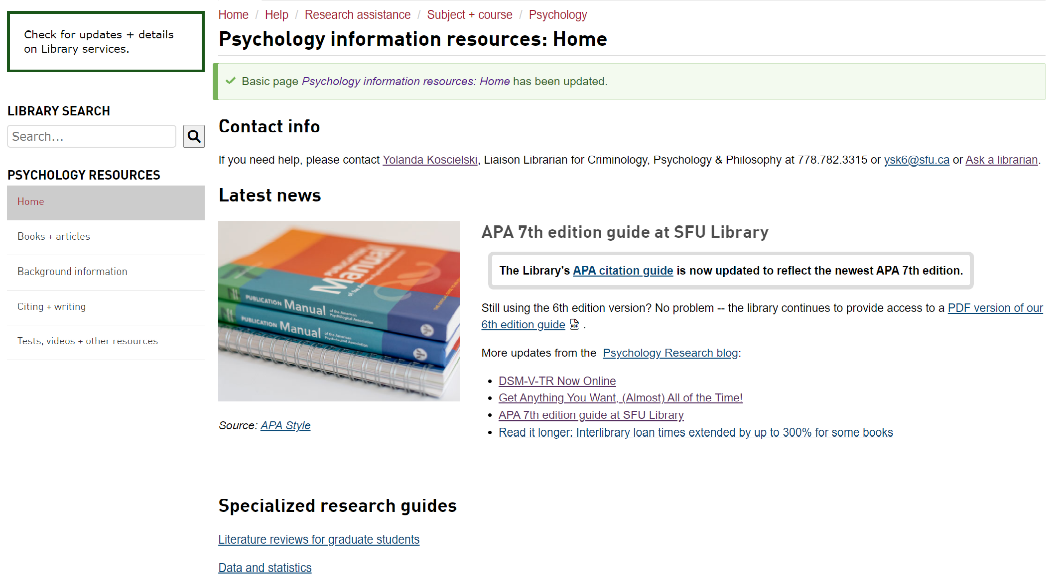
Psychology at SFU Library: Home Base
Today’s PP +
handout
Course guides
Notes:
Demo on how to get to the library slide

Slide 3
Resources – Beyond Journal Article Databases
Covidence
Primal Pictures Interactive Anatomy
WestLaw Next Canada
Oxford Bibliographies Online
Sage Research Methods Online
NEW
Notes:
*Interactive 3D animated human anatomy and physiology models, narrated animations and illustrations, dissection slides, clinical case studies – brain, hormones, gut, other biological intersections
*Lists key books, articles, and other sources on a wide variety of subjects via annotated and curated bibliographies. An excellent starting point for locating important literature and scholarly sources on a topic. Psychology module.
*Search or browse a wide variety of sources on research methods, including ebooks, articles, reference sources, and videos

Slide 4
Research Help
Yolanda Koscielski, Psychology Librarian:
778-782-3315 / ysk6@sfu.ca
* Based at Burnaby campus, also work from home
Full list of Liaison Librarians
Develop and manage print and electronic collections for our subject areas
Provide one-to-one and group consultations on library research
Advise on strategies for conducting a literature review
Help you locate hard to find resources

Slide 5
Interlibrary Loan & Book Requests
Can send book requests for important titles to purchase directly to me: ysk6@sfu.ca
Make use of (free!) Interlibrary Loan System for books and journal articles
Overjoyed cats.

Slide 6
Research Commons
Research Commons for Graduate Students:
The Research Commons provides graduate student support at all stages of research and study. One-on-one online/remote consultations are available, as well as online workshops. Areas of support, include, for instance:
Citation management software (Mendeley, Zotero)
Knowledge mobilization
Read Ahead service for writing consultations
Preparing to publish
Software support (GIS, Python, R, NVivo, etc.)
Thesis format and submission support
NEW(ISH)!: The Research Commons at Vancouver is located in room HC 7050 on the 7th floor of SFU Harbour Centre.
Notes:
Research Commons downtown just opened up!

Slide 7
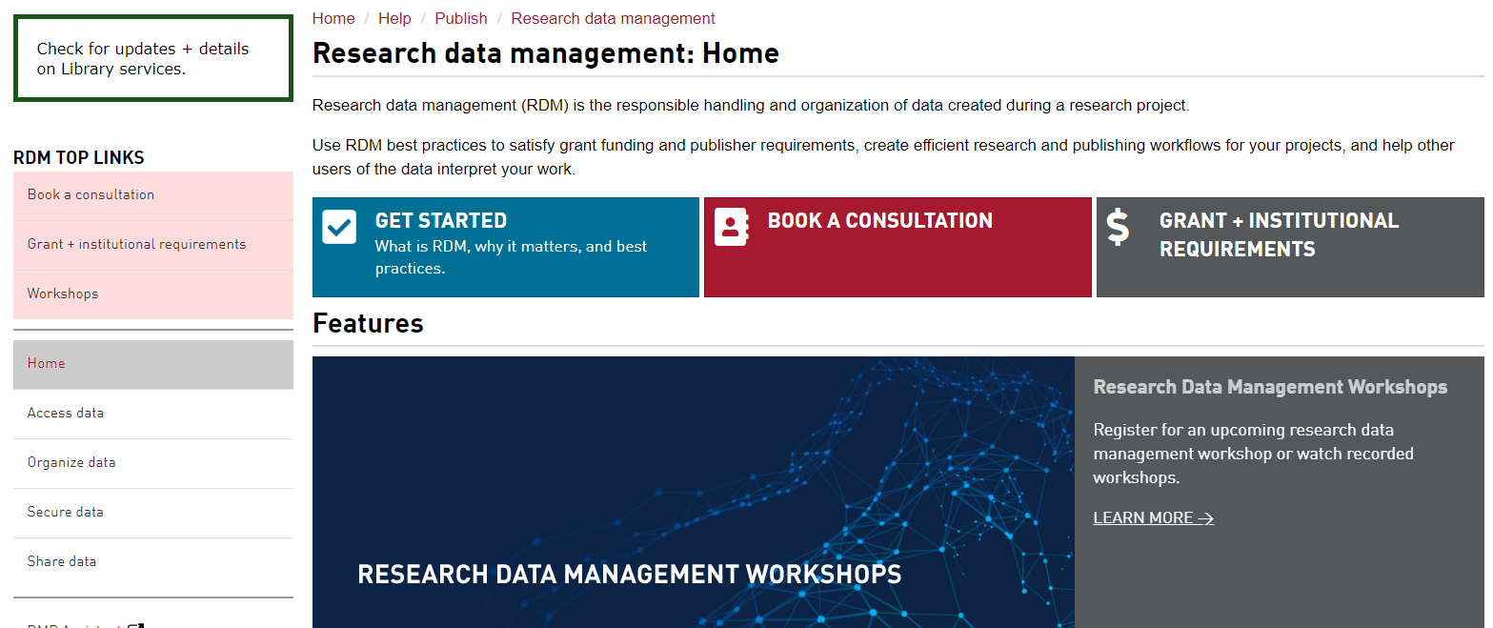
Research Data Management
It’s good practice to think about this proactively, early on in your research.

Slide 8
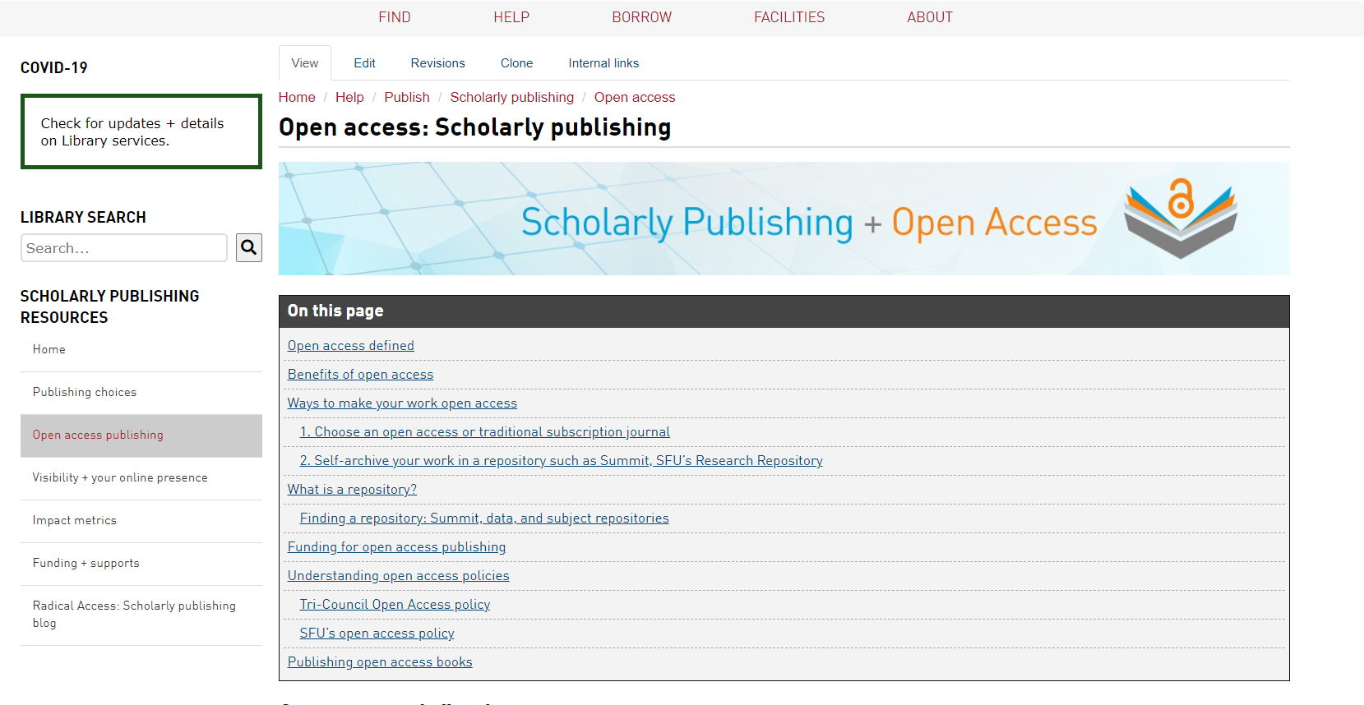
Support for Open Access Publishing
Graduate Students eligible to apply for open access publishing funding*
* = please review conditions to ensure eligibility
Support for up to two articles per calendar year
Support of up to $2500 (CDN) per article.
Date and description here.

Slide 9
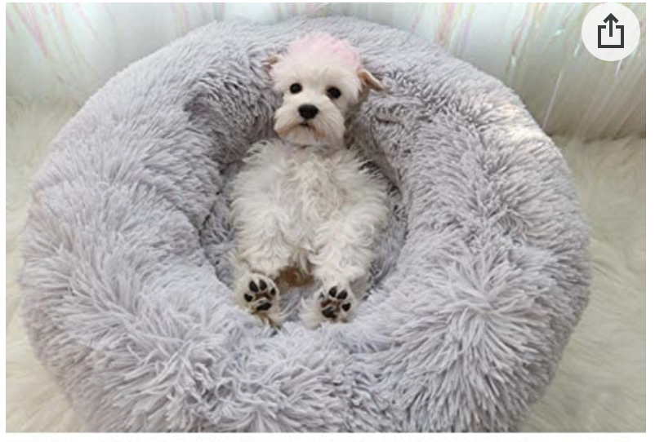
Thank you!
SharepointHome warm dog bed, photo from Amazon.com
Photo of cute puppy

