Slide 1
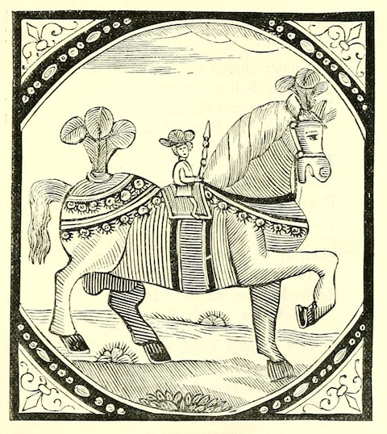
PHIL 451W / 854: New Narratives in the History of Philosophy: Learning to Be a Thinking Thing in the 17th century
Library Research Workshop
Yolanda Koscielski
Liaison Librarian for Philosophy, Criminology, Psychology
Summer 2022
Notes:
--Powerpoint Online, Philosophy guide
----Links to resources intact

Slide 2
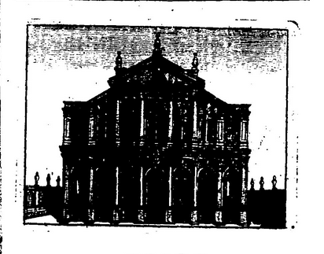
Liaison Librarians
Collections
Develop collection
Book requests
EBA (Evidence-based aqusitions
Research support
Liaise with departments
Internal projects

Slide 3
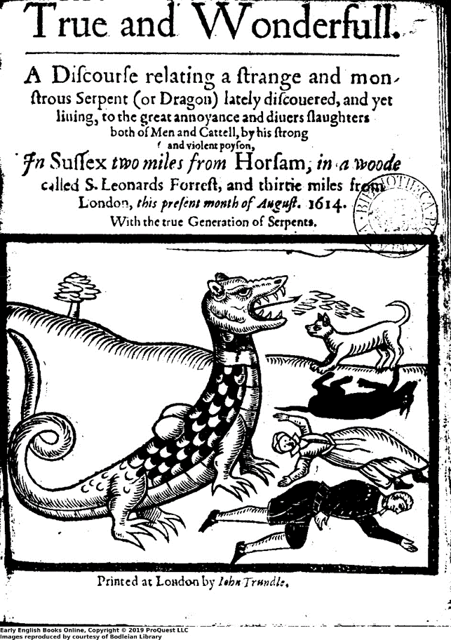
We will cover:
How to find primary sources
Early English Books Online (EEBO)
Eighteenth Century Collections Online (ECCO)
Other 17th century sources
How to find secondary sources
Library Resources for You
Citation management software
Interlibrary Loans
Help
Notes:
Format: Talk –Exercise – Debrief
Note: Image search

Slide 4
Primary sources - Where to find them?
Primary sources: works written by the Philosopher
On the Web – online collections/archives, institutional repositories, etc.
Subscription databases, such as EEBO & ECCO
Library catalogue
Include keywords, such as correspondence, diaries, sources, letters, speeches, etc.
Interlibrary Loan
SFU guide: Primary sources for the Humanities
http://www.lib.sfu.ca/help/research-assistance/format-type/primary-sources
SFU database: Primary sources
https://databases.lib.sfu.ca/browse?contentTypes=Primary+sources
Notes:
--In general, where to find primary sources.
--Re: assignment
DEMO: Primary sources guide for the Humanities

Slide 5
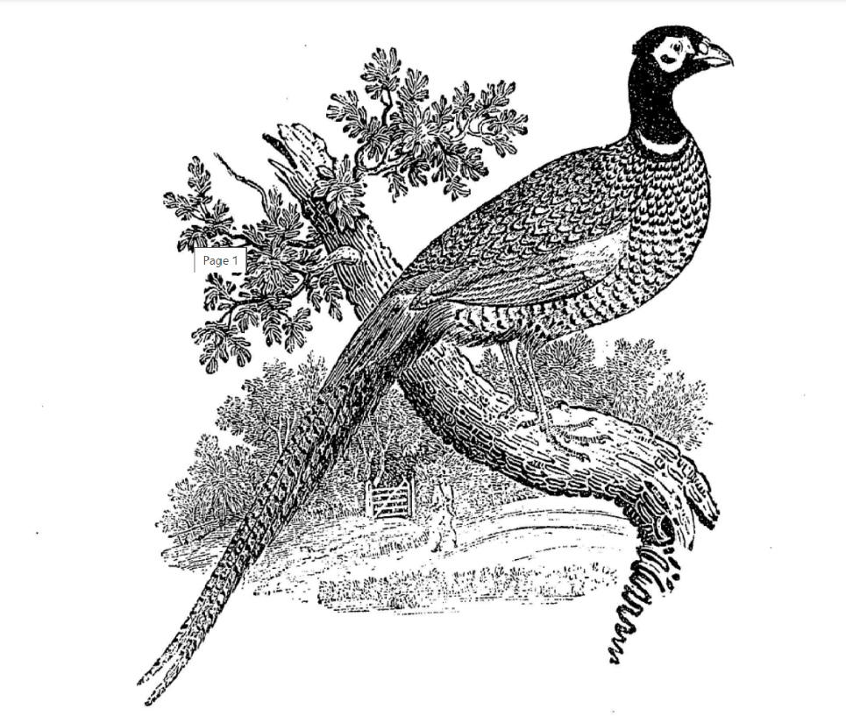
Early English Books Online (EEBO)
“Early English Books Online (EEBO) features page images of almost every work printed in the British Isles and North America, as well as works in English printed elsewhere from 1470-1700. Over 200 libraries worldwide have contributed to EEBO. From the first book printed in English through to the ages of Spenser, Shakespeare and of the English Civil War…”
Makes rare books more accessible, collocated
Notes:
Bird’s Eye View of 1of 2 features databases

Slide 6
Early English Books Online (EEBO)
Facsimiles of 125,000+ English works printed between 1473 and 1700
22 million scanned pages
Items can be:
Digital facsimile pages (document images, not searchable)
In a text-readable form, with keyed full text. Look for the ‘TCP Full text’ link
Titles are listed in the SFU Library catalogue*
Notes:
In more detail

Slide 7
Early English Books Online (EEBO)
DEMO: “Queen Christina of Sweden”
(Many) word variants automatically included in search to reflect early materials
e.g. ‘Julius Caesar’ finds ‘Iulius Caesar’ and ‘Ivlivs Caesar’
Multiple editions of works may be available
Book = manuscript, circulars, pamphlets, etc., in this context
Long titles
Useful options: “details”, “cite”, “TCP Full Text”
Notes:
Demo:
Search for “Queen Christina of Sweden”
Note spelling variants automatically reproduced for Queen and Sweden
3. Note 1) details, 2) cite, 3) TCP full text

Slide 8
EEBO - Tips
Truncation:
asterisk (*) at the end of a word root
wildcard (?) to replace a single character
Proximity searching operators:
NEAR/N, e.g. liberties NEAR/3 people
PRE/N (=preceding), e.g. young PRE/5 love
Phrase search: use quotation marks (note: doesn’t work well for including spelling variants).
Be mindful of name variants

Slide 9
General search tips
Catalogue: log in & use the Advanced Search for best results
Boolean operators:
AND - connects concepts (&, ^)
(communism AND america)
OR - searches for related terms & synonyms (V, inclusive OR)
(america OR “united states”)
Quotation marks for a phrase
“glorious revolution”
Asterisk after the root of the word for alternative endings
child* picks up child, children, childhood, childish

Slide 10
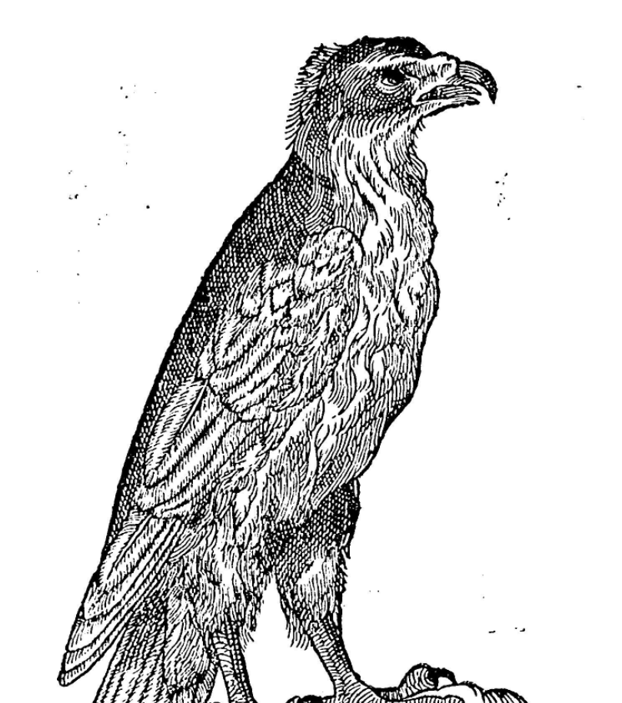
Eighteenth Century Collections Online (ECCO)
Fully searchable texts of books, pamphlets, broadsides and essays printed in the UK and Ireland from 1701 through 1800, along with thousands of important works from the Americas
Subject coverage: history, literature, religion, law, fine arts, science, and more
32 million+ searchable pages & 180,000+ titles, sourced from national libraries
Titles are listed in the catalogue*
Notes:
--Similar resource, different time frame, similar interface
--Bird’s eye view #2

Slide 11
ECCO - Tips
‘Allow variations’ box: matches imperfect or old spellings and variants, e.g. missus, missis
DEMO: Margaret Fell Fox
Authors search (leaf icon) – pick letter first
“Explore” = Search within text
“Full citation” = Item details
Topic Finder search: visualization
“This tool takes the titles, subjects, and approximately the first 100 words from a subset of your top results and feeds them into an algorithm. Keywords shown in the graphics are those found most often in the text with your search term.”
Notes:
DEMO for author’s search:
1. Margaret Fell Fox (under F – Fell, Margaret)
2. Select view OCR Text – 86%
3. title search in catalogue – cut and pace
4. second version in 19th Century collections online much more readable, Gale Primary Sources
DEMO for topic finder search: women, evil

Slide 12
Other 18th century resources – just FYI
Primary Sources
Electronic Enlightenment
British and Irish Women’s Letters and Diaries

Slide 13
Electronic Enlightenment
Correspondence among writers, scientists, philosophers, politicians and political thinkers; from the early 17th to mid 19th century.
Browse by Letters, Lives (by last name, nationality, occupation) or Location. Lives are connected to letters and correspondents.
E.g., Cavendish, Margaret
Includes editorial notes.
Notes:
-Peripherally interesting primary sources database
DEMO:
--Browse
--Lives
--C
--Scroll to Cavendish
---Biographical Entry
---Letters
----Link to Oxford National Biography larger entry

Slide 14
British and Irish Women's Letters and Diaries
Full text of letters and diaries from nearly 500 women (1500-1950) and biographical information
Browse by: People, Subjects, Historical events, Publishers, Type of content (‘letters’, ‘diaries’, etc.)
Advanced Search – offers detailed options
Notes:
DEMO:
--advanced search
--next to author/creator field, select “select terms”. This will bring up an index of sorts

Slide 15
Finding secondary sources
Stanford Encylopedia of Philosophy (Open Access)
Internet Encyclopedia of Philosophy (Open Access)
Routledge Encyclopedia of Philosophy
Oxford Bibliographies Online – Philosophy and other modules
E.g., Renaissance and Reformation module: Women and Learning
Entries on philosophical topics, pointing you to key readings
Some entries on individual Philosophers, e.g. Margaret Cavendish, Anna Maria van Schurman
Notes:
Stanford DEMO: Lady Anne Conway
DEMO of OBO
1. Entries on possible philosophical topics
--Bibliography may not point you to your philosopher, but does provide a broad categorization of a topic, e.g., causation
2. Some Philosopher entries.
DEMO: Causation – points you to oxford handbook of causation
DEMO: Some entries on individual Philosophers, e.g., Anna Maria van Schurman
--also try get at SFU

Slide 16
Finding secondary sources
Catalogue Search (limit to 'articles’)
Philosophy databases
Some recommended journal article databases:
Philosopher’s Index & PhilPapers
Historical Abstracts (European history)
Humanities Source
Arts & Humanities Citation Index
Academic Search Premier
MLA International Bibliography (Literature)
Art & Architecture Source
JSTOR (Note: it doesn't contain current material)
Notes:
Some of these can be searched together if on the same platform.

Slide 17
Interlibrary Loan
Interlibrary Loans (access: Catalogue/Citation Finder-ILL tab)
Free!
Articles usually arrive in 1-3 days. Books usually arrive between 3-8 days. Items coming from outside Canada may take up to 14 days or longer to arrive.
Books are picked up from whichever SFU campus library you designated as your pick-up location.
Articles and other copies are delivered via email
Can request items the library already owns under some circumstances: missing copies, already checked out and/or multiple holds, print preference

Slide 18
Citation management software
Allows you to create and format your bibliography
SFU Library supports Zotero
For help, workshops or one-on-one appointments, contact
citation-managers@sfu.ca
Citation management software and tools
https://www.lib.sfu.ca/find/research-tools/citation-software
Citation & style library guides
https://www.lib.sfu.ca/help/cite-write/citation-style-guides
Notes:
Comparison Chart

Slide 19
Help is available
Yolanda Koscielski, Liaison Librarian for Philosophy
ysk6@sfu.ca (*away June 2-20)
Ask a Librarian http://www.lib.sfu.ca/help/ask-us
Student Learning Commons
https://www.lib.sfu.ca/about/branches-depts/slc/
Special Collections & Rare Books
http://www.lib.sfu.ca/about/branches-depts/special-collections

