Slide 1
SFU Library
LaBour STudies 313: Library research
Yolanda Koscielski
Liaison Librarian for Criminology, Philosophy & Psychology
ysk6@sfu.ca
September 23, 2019

Slide 2
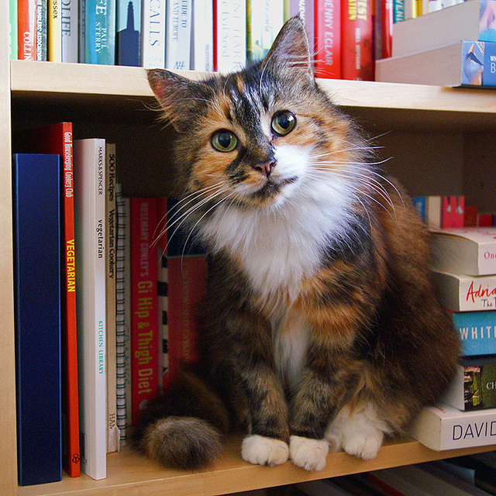
Our agenda
Provide an introduction to legal research to fulfill course assignment needs:
Gain a broad overview of the legal system in Canada
Use online legal resources to locate case law and legislation
Understand case citations
Find secondary legal literature to research your topic
“And I thought we were friends” by hehedan,
CC BY-NC 2.0

Slide 3
Court Systems
Court Systems | Description
Superior | Major civil and criminal cases heard in this court. Most case law found in our in legal databases originates from this court system.
Inferior | A high volume of cases, including criminal cases Often known as “provincial court” Typical jurisdiction: small claims, traffic offences, criminal offences, family matters
Federal | Some designated matters go to federal court: e.g., copyright, industrial design, patents, cases around the legality of federal gov’t actions
Note: superior and inferior court structures and names will vary between provinces. Check websites, e.g., Provincial Court of British Columbia
Table adapted from: Legal Research on the Web, Winter 2012 course material, iSchool Institute, Faculty of Information, University of Toronto
Notes:
Very generalized summary of court structure in Canada (excluding Quebec)
Canada has three main court systems

Slide 4
Levels of Court: Superior Court System
Level of Court | Examples
1st level: Trial Court | British Columbia Supreme Court, Court of Queen’s Bench (Alberta), Ontario Superior Court of Justice
2nd level: Appellate Court | British Columbia Court of Appeal, Alberta Court of Appeal, Ontario Court of Appeal
3rd level: Supreme Court of Canada | Supreme Court of Canada
Table adapted from: Legal Research on the Web, Winter 2012 course material, iSchool Institute, Faculty of Information, University of Toronto
Notes:
Within each of the three court systems, there are generally three levels of court, with overlap.
The third and final stage for all three court systems is the one Supreme Court of Canada
This slide shows the three levels of court for the Superior Court system, including some example names for each of the court, which vary by province

Slide 5
Court systems: Tribunals
Administrative Tribunals/Boards - Examples
BC Labour Relations Board | BC Human Rights Tribunal
Canada Industrial Labour Relations Board | Canada Human Rights Tribunal
BC Employment Standards Tribunal | British Columbia Workers' Compensation Appeal Tribunal
Administrative Tribunals are also a source of decided cases.
Tribunals have adjudicative powers
Regulate distinct areas
Tribunal Board Members have area expertise
Own rules of procedure
Decisions formerly in print → moving online
Notes:
In addition to various levels of court such as Provincial Court, BC Supreme Court, BC Court of Appeal and the Supreme Court of Canada, Additionally, many matters are dealt with via Tribunals.

Slide 6
What is legal literature?
Primary legal literature
The source of the law itself
Case law / Judgments / Reasons for Decision (common law)
Legislation – Acts / Statutes, Regulations
Notes:
Move from overview to researching these legal system via various sources. Can be thought of as two main types of legal information.
Primary legal literature consists of sources that outline the law: case law and other decisions, statutes, regulations. The sources of law.

Slide 7
Case lawCase Law
The terms Case Law, Reasons for Decisions, Judgment (*no ‘e’!) are often used interchangeably
Main content of published case law and decisions should be identical, regardless of source
Case law/judgments available through both free and subscription sources
Notes:
Case Law

Slide 8
What is legal literature?
Secondary legal literature
Writing about the law, such as:
articles from academic legal journals
case commentary
newsletters and digests by legal experts
textbooks, books
other literature written about primary legal sources
Provides an understanding of legal issues and case law in context
Notes:
Secondary legal literature is writing about the law, but not the source of the actual law itself (a few exceptions, such as some often-cited legal treatises)

Slide 9
Case law databases
Significant overlapping coverage in case law cases covered in various databases
Free sources – namely, CanLII - are easily accessible
Subscription sources often include value-added tools such as summarizing headnotes, subject classification, and research tools such as the Canadian Abridgment Digest

Slide 10
Case law databases
Three main online resources for legal research at SFU
CanLII (open access)
Westlaw Next Canada
Lexis Advance Quicklaw
Plus:
HeinOnline
SFU Library’s list of law-related databases
Notes:
DEMO: Where legal databases are.
DEMO: Open up CanLII, as we will spend most of our time looking at this free resource. It’s accessible after you graduate.

Slide 11
canlii
“CanLII is a non-profit …. [whose] goal is to make Canadian law accessible for free on the Internet. This website provides access to court judgments, tribunal decisions, statutes and regulations from all Canadian jurisdictions”.
Free & easy to use
Continually improving & expanding
One-stop shop for current cases and law (may need to go to print or subscription databases for older tribunal decisions)

Slide 12
Canlii
Use the Primary Law Databases link to search within decisions from:
Canadian Human Rights Tribunal 1979 –
Labour Arbitration Awards*
Federal Public Sector Labour Relations and Employment Board 2015 -
BC Human Rights Tribunal 2008 –
BC Labour Relations Board 2000 –
BC Labour Arbitrations Awards*
*=incomplete coverage, some years missing
Notes:
There are others as well.

Slide 13
Find a case or decision!
You will often search for a particular case in a database by either:
1) case citation, or,
2) case name
A case name is based on the abbreviated names of the parties involved in the case. Example case names:
R v Sun Glow Foodservice Ltd
Western Canada Wilderness Committee v Canada (Minister of Environment)
Moore v Bertuzzi
Notes:
Highlight what R means – Regina for Queen

Slide 14
Understanding case citations
Legal citation help: The Queen’s University Library’s Guide to Legal Citation with the 9th edition of the McGill Guide
Notes:
To locate cases by citation, we need to know how to read the citation correctly.
Case citations recall the world of print.
Style of cause – the Plaintiff vs. Defendant, Petitioner v. Respondent, Complainant v. Respondent – in italics.
Neutral citation (most courts issued after 1999). Elements: year of decision, abbreviation of the court, an ordinal number (basically a SIN number for the case).
Some cases don’t have neutral citations. In which case, you may see a citation to a court reporter. Will see these in databases as well. FYI:
Parentheses – the year the decision was made.
Next, which law reporter reported on the case. There can be several. This report can be found in the 69th volume of the Dominion Law Reports on page 433.
Traditionally judgments were (and still are) published in series of volumes called "law reports." The SFU Library in Burnaby has a large number of print law reports series such as Business Law Reports (HF 1278 B8), but our collection has migrated to online content now.
The "2nd" tells you that the DLR has been published in multiple series; the second series was 1956-68. Some law reports stop at a certain series, e.g., 100, before they reset
First page of the report
Supreme Court of BC decision. The abbreviated name of the court in which the case was tried, enclosed in round brackets, sometimes appears at the very end of the citation.
This one has a neutral citation…neutral because it the case is represented by the citation without reference to a commercial reporter (neutral = “no name” brand)

Slide 15
DEMO – finding a case in canlii
CanLII
By case name: Fibercom Systems Inc. v Rogers Cable Inc
By case citation: 2005 BCSC 419
Notes:
Two cases; useful to have case citation

Slide 16
Find a case by topic
Browse by Tribunal
CanLII – find cases that refer to sections of the Act/Code (or part thereof)
B.C. Employment Standards Act
B.C. Human Rights Code
B.C. Labour Relations Code
Canada Labour Code
Workers Compensation Act, etc.
Keyword search
Notes:
What if you don’t have a particular case in mind?
You can browse by tribunal for ideas
We’ll do exercises on all three of these methods, so just a demo for this part.

Slide 17
Finding cases by topic
Searching primary sources directly for case law by keyword is usually not recommended
Keyword = 1000s of unrelated hits
Exception: very unique terminology
Exception: search within a pre-narrowed pool of decisions
Start with secondary legal sources and/or specialized legal research tools, such as the Canadian Abridgment Digest, and the Canadian Encyclopedic Digest
Notes:
For most broad legal topics (e.g. wrongful dismissal) a general keyword search for case law will return thousands of hits. Onerous to go through.
Secondary legal literature and finding aids will help

Slide 18
Practice time!
Please see handout for database exercises

Slide 19
Where to go for help
Moninder Lalli, Liaison Librarian for Labour Studies
moninder_lalli@sfu.ca
778-782-4264
Yolanda Koscielski, Liaison Librarian
ysk6@sfu.ca
778-782-3315
Research help desk (drop-in & by appointment)
Phone: 778.782.4345
Email us at: libask@sfu.ca
AskAway (online chat)

