Slide 1
Finding data & articles efficiently ECON 900
Mark Bodnar Economics & Business Librarian mbodnar@sfu.ca
Carla Graebner Librarian for Data Services & Government Information cgraebne@sfu.ca
&

Slide 2
Goals & plans
Familiarity, not mastery
Data: issues + Statistics Canada + RDM + key data sources + beyond…
Articles: mining the interconnections
Other SFU Library services & resources: Research Commons + Sage Research Methods + ?

Slide 3
Data: realism
Every possible topic
Free
Data
collected
Affordable for
libraries
Published

Slide 4
Data: parameters
Time
Range: 10 yrs? 12 months?
Frequency: Annual? Daily?
Geography
Scope: Global? National? Local?
Granularity: Every country? All towns over 10K?
Topic
Financial data? Demographics? Economic indicators? Opinions?

Slide 5
Data: flexibility
Time
Range : shorter? older?
Frequency: quarterly instead of monthly?
Geography
Scope: reduce to selected areas?
Granularity: expand to larger areas?
Topic
Realism: what’s close enough for inferences, estimates, assumptions…?

Slide 6
Data: publishers
Governments:
local, regional, provincial, national
Intergovernmental agencies:
IMF, UN, OECD, WRI…
Academic researchers:
Data repositories
And beyond:
Polling firms, think tanks, research institutes, associations…

Slide 7
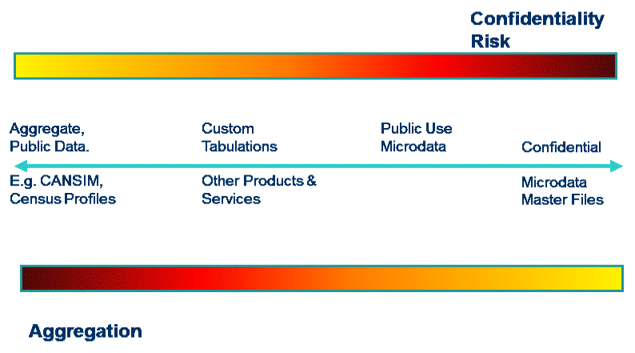
Statistics Canada
Library
Continuum of Access
Research Data Centre

Slide 8
CHASS: Computing in the Humanities and Social Sciences Data Centre
Multiple databases and search and retrieval programs maintained by Computing in the Humanities and Social Sciences (CHASS) at the University of Toronto.
Access to the Census via the Census Analyzer and PUMFs*
Access to CANSIM data tables
x
Notes:
CANSIM (CANadian Socioeconomic Information Management) comprehensive socioeconomic database with 36 million time series that cover every aspect of Canadians’ lives.

Slide 9
The Abacus Data Network is a data repository collaboration involving Libraries at Simon Fraser University (SFU), the University of British Columbia (UBC), the University of Northern British Columbia (UNBC) and the University of Victoria (UVic).
Public Use Microdata Files (PUMFs)
Postal Code Conversion File (PCCF): bring your own postal codes!
BC Assessment Data
Open Data
x

Slide 11
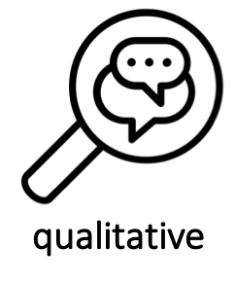
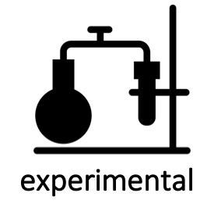
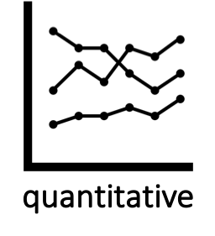
What is research data management?
Research Data: materials created, generated, or collected as part of a research project.
Research Data Management: the steps taken to ensure your data remains safe, persists, and is accessible in the long-term.
Notes:
Data access lies on a spectrum from public-use to strongly restricted-use (with Data Use Agreements, or secure data enclaves, or other controls).

Slide 12
Why is research data management important?
(an incomplete list!)
Data has research value, just as publications do.
Increase your visibility and impact: data can be cited, too!
Retention of data enables both verification of results and new insights.
Encourages collaboration.
Required by granting agencies and publishers.
Notes:
Archived datasets get assigned DOIs for example. Data papers, data notes, etc.
New data management policies coming soon from Tri-Agencies. Many journals already have lists of best practices.

Slide 13
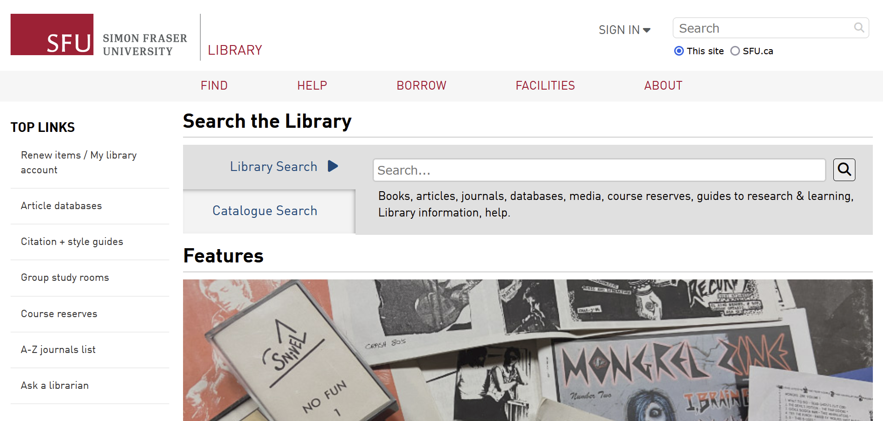
SFU Library: Data & GIS

Slide 14
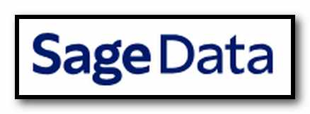
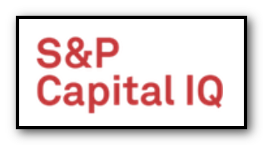
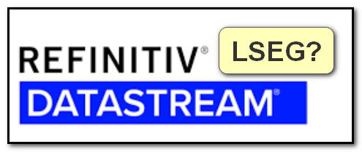
Data: sources & tips (part 2)
SFU Library
+
*Free
resources

Slide 15
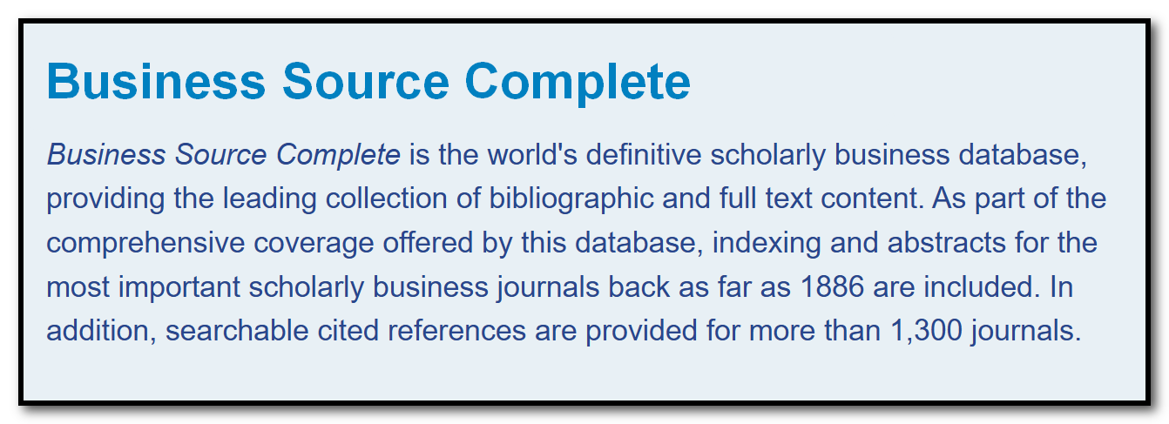
Articles: mining interconnections
References
Citations
Authors
Sources
Subjects
Terms

Slide 16
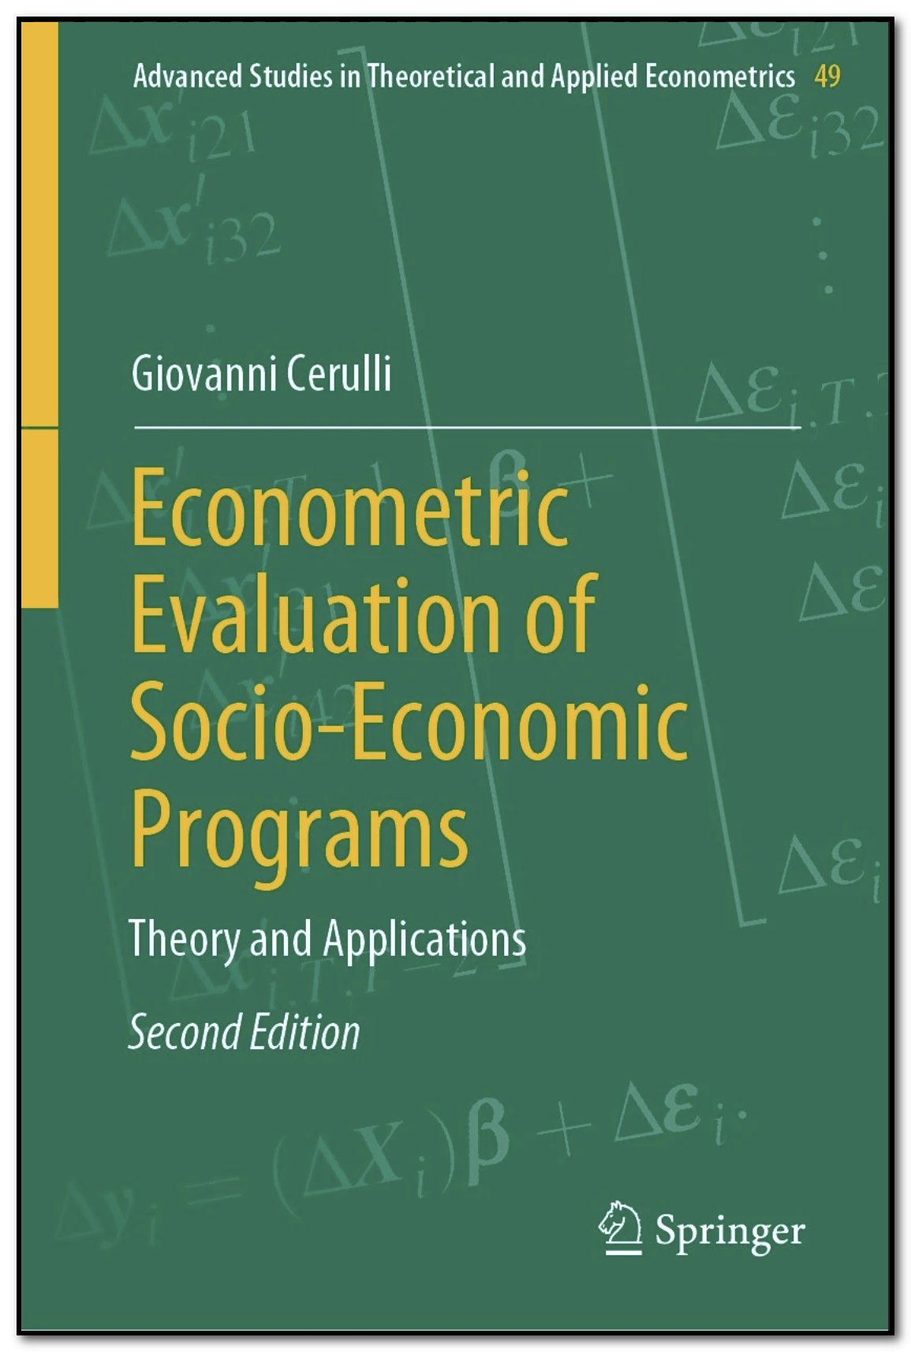
Extra if time…
Other?

