Slide 1
SFU Library Orientation
Criminology 860: Library research & Literature reviews
Yolanda Koscielski
Librarian for Criminology, Philosophy & Psychology
September 13, 2024
ysk6@sfu.ca

Slide 2
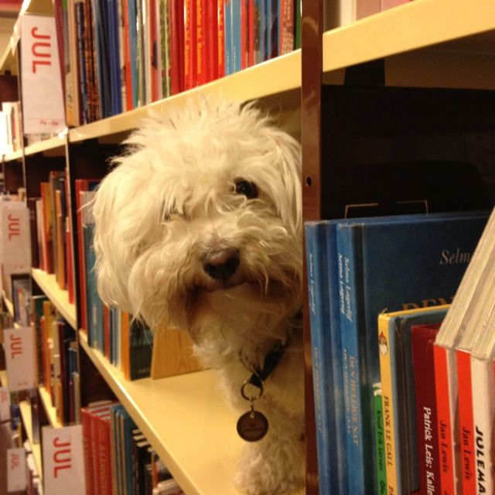
Our agenda
Icebreaker Exercise
Resources for CRIM
Search strategies
https://i.pinimg.com/originals/de/32/89/de32896d6903b303071c14c42c09e2a8.

Slide 3
Liaison Librarian for criminology
Based at Burnaby campus
Manage collections for Criminology
Provide individual and group consultations on library research
Create research web guides
Help you locate hard to find resources
Full list of Liaison Librarians

Slide 4

Activity: What is A Poor literature review?
Make a list of what you can do during the research process
to produce the worst possible literature review.
Works in pairs
  3 minutes to discuss
  Share with the group – 1 item from list

Slide 5
What is A Poor literature review?
Possible answers:
Ignore disconfirming evidence, dissenting studies
Searching only one or two sources (i.e., only Criminal Justice Abstracts)
Use one variant of search term (no synonyms)
Search without considering if your topic can be expanded/reduced
No rationale for inclusion/exclusion of search terms
Limiting to one type of information source (e.g., only journal articles)
Only old articles
Only new articles

Slide 6
What is A Poor literature review?
Possible answers:
Missing key articles by not following an argument forward in the conversation (e.g., not using Times cited in this database feature when relevant)
Not citing sources
Not understanding material, key concepts
Searching too broad a topic
Not synthesizing or integrating material; putting quotes inside as though they speak for themselves
Using ChatGPT/AI do your literature review!

Slide 7
Finding resources
Where to search
Types of information sources
Library Search / Catalogue Search
Google Scholar
Subject-Specific databases, mostly subscription: 700+ databases
NGOs and other grey literature
Legal analysis, legal cases
Maps & spatial data
Statistics, census
…
Start at the Criminology Research Guide!

Slide 8
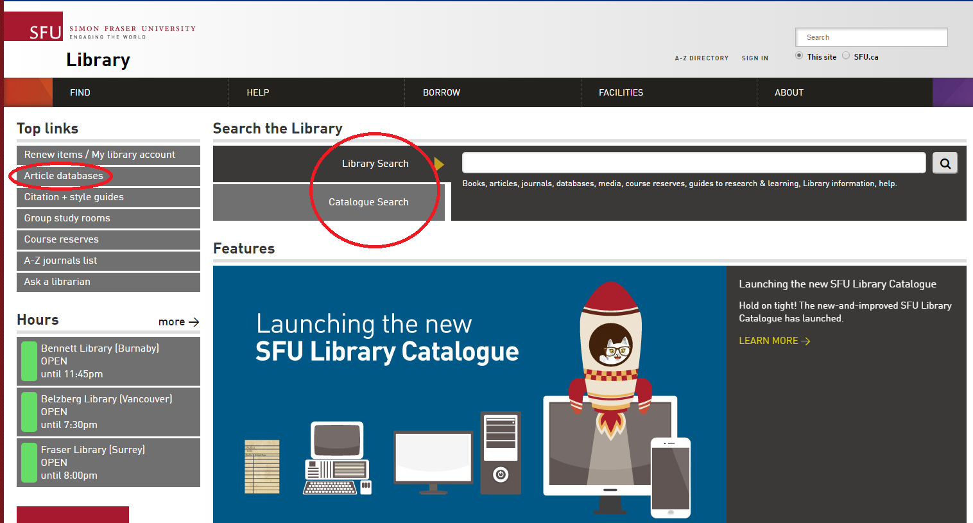
Using library vs. Catalogue search
Which search is broader (that is, searches across more sources?)
What percentage of our database content is indexed by the catalogue?

Slide 9
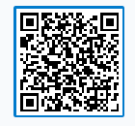
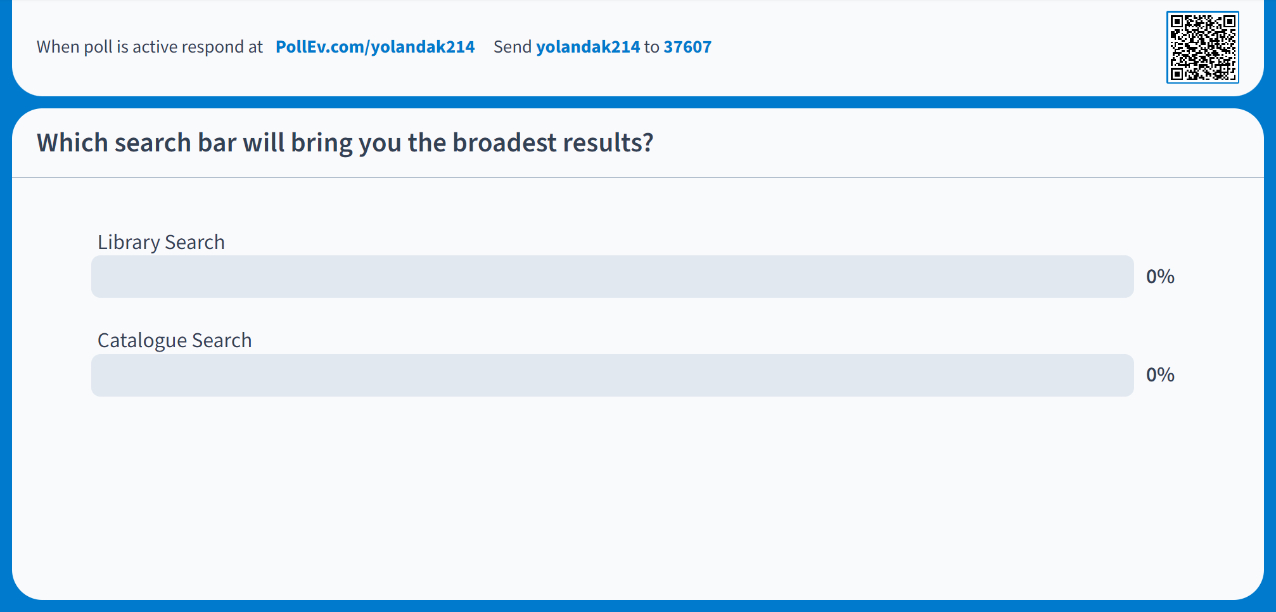
Using library vs. Catalogue search
PollEv.com/yolandak214
Send yolandak214 to 37607

Slide 10
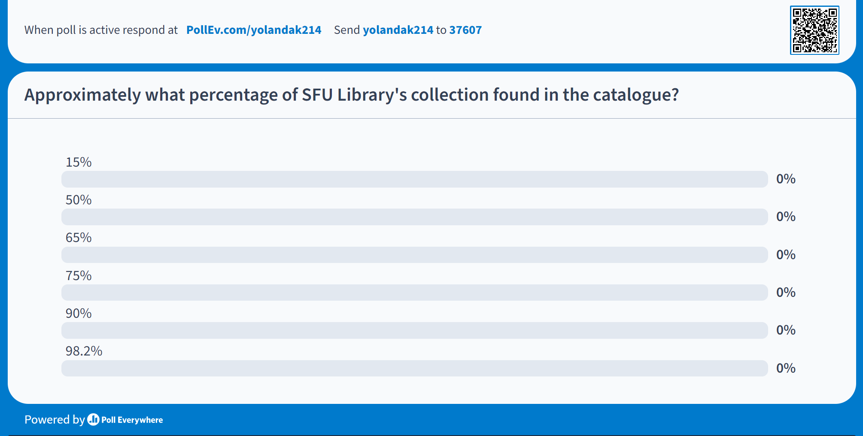
Using library vs. Catalogue search
PollEv.com/yolandak214
Send yolandak214 to 37607

Slide 11
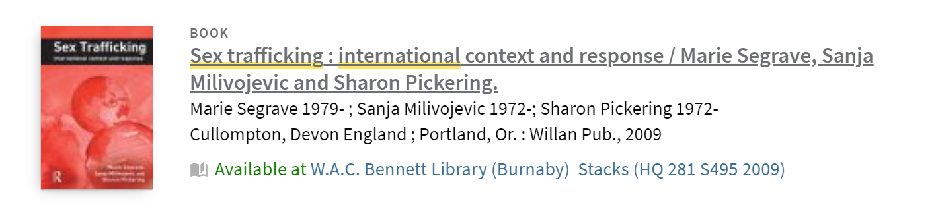
Activity: Browse by Call Number
From the library homepage, find a way to virtually browse for books by call number, as though you were in the physical library.
Note: The fifth Floor is under construction

Slide 12
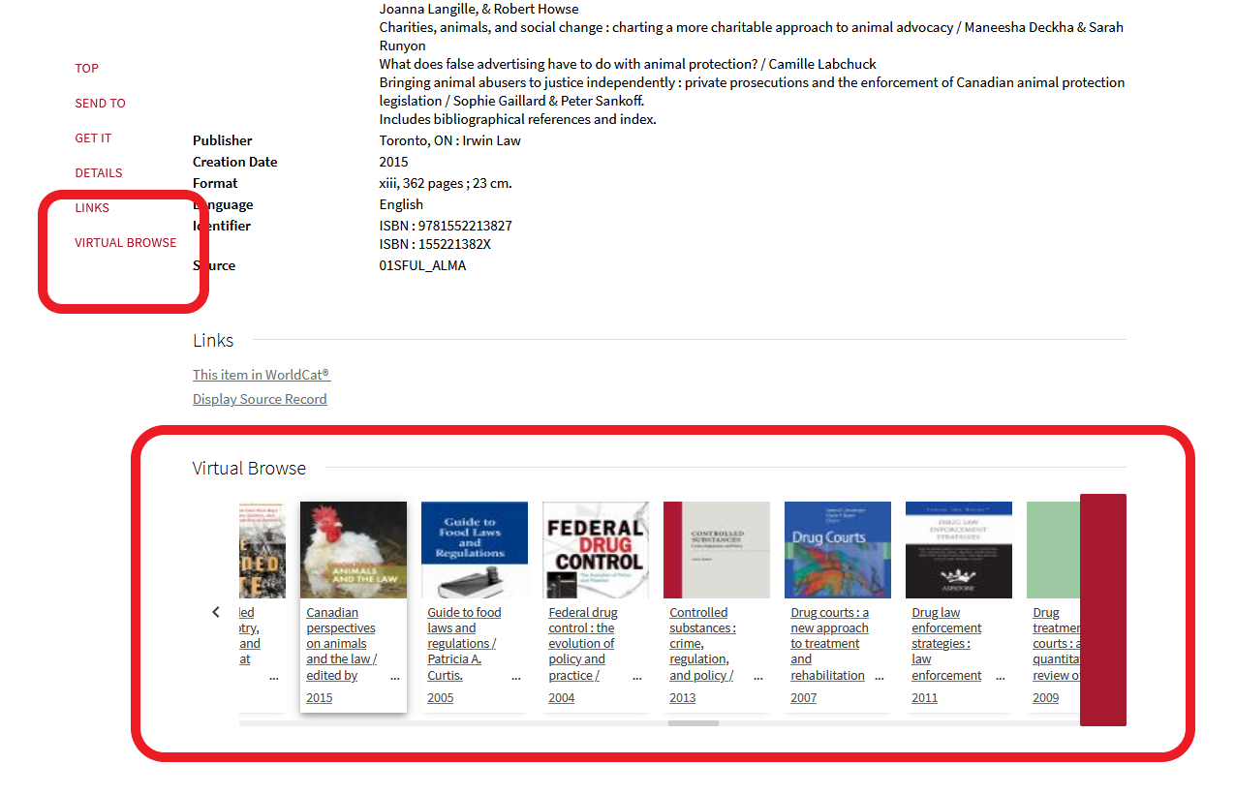
Activity: Browse by Call Number
HV = Social pathology. Social and public welfare. Criminology.

Slide 13
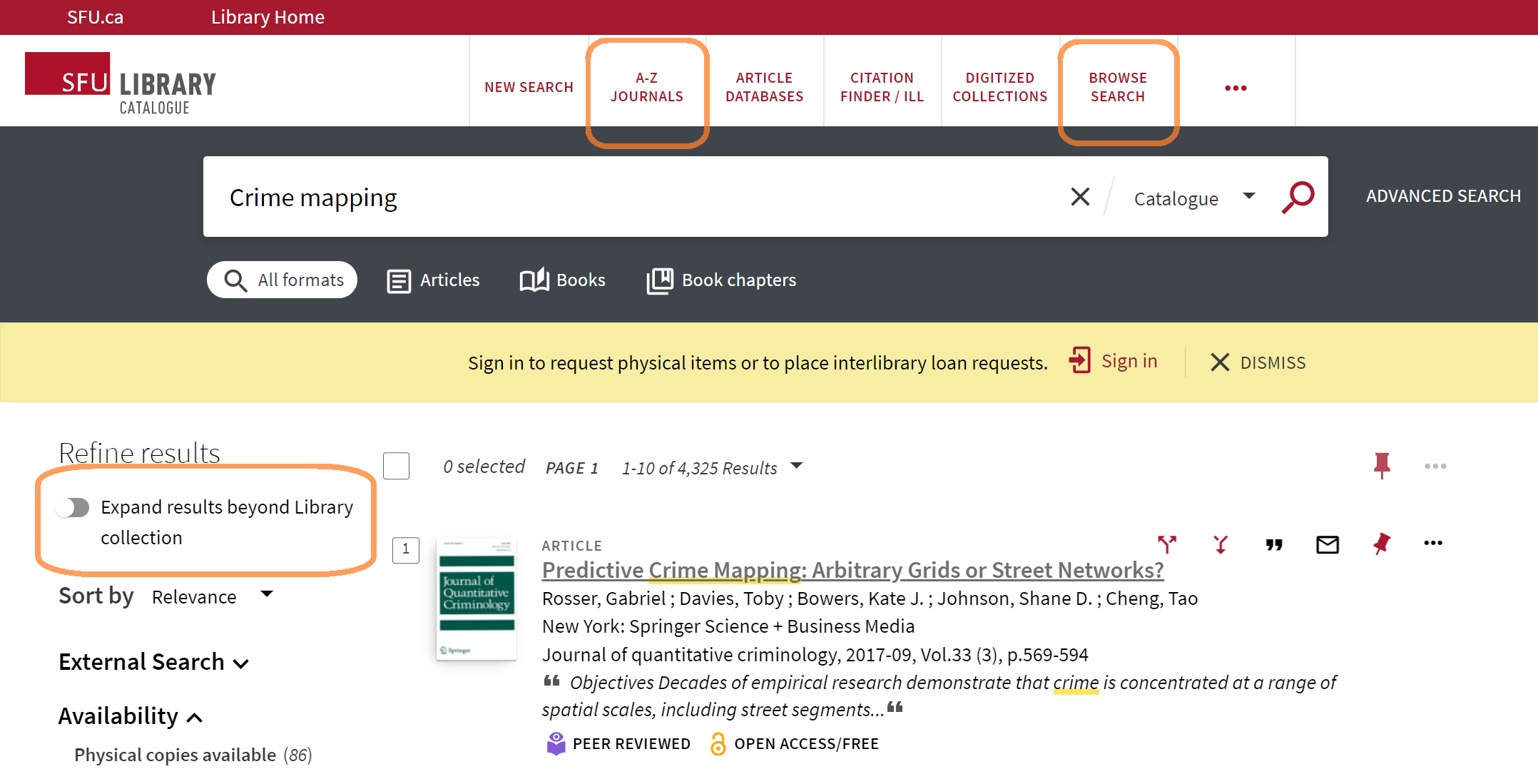
Using library/Catalogue search

Slide 14
Using google scholar
Strengths
  High volume, popular articles
  Generous algorithm
  Times cited tool
  Known-item searching, unique terminology
  Other info:
    Open Science Framework (OSF), Institutional Repositories*, US case law, grey literature
  Unusual to not check it
Weaknesses
  No specific discipline
  Loss of control
  Mysterious algorithms + unknown source coverage
  Searches are optimized
  Missing deep data
  Popularity prioritized
  Predatory / deceptive publishers included
  Payment prompted

Slide 15
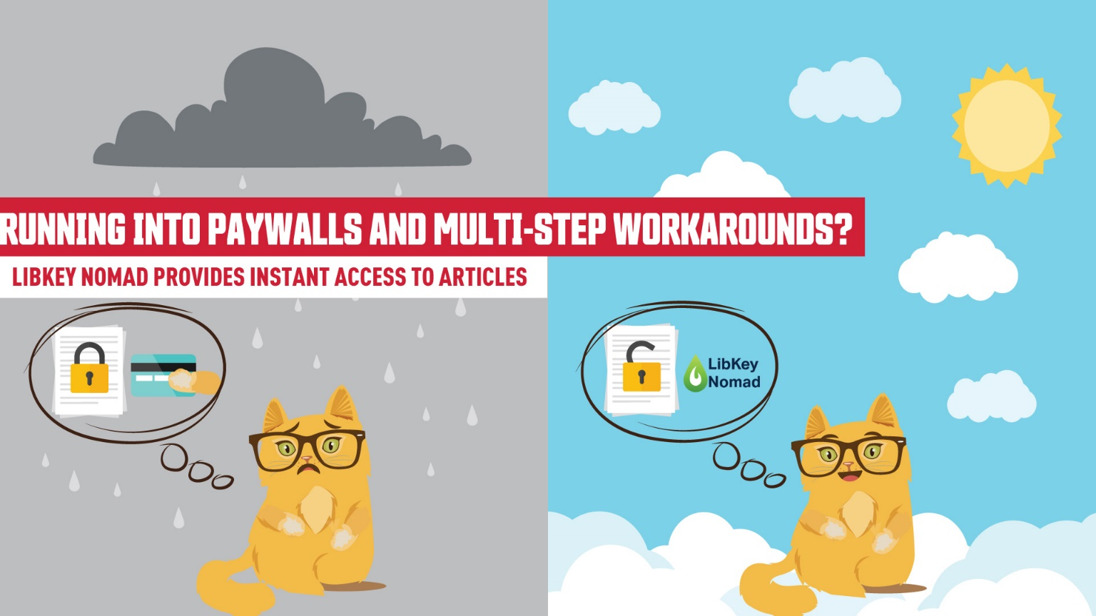

Access library resources – libkey nomad
Running into paywalls and multi-step workarounds?
LibKey Nomad provides instant access to articles.
thirdiron.com/downloadnomad
Notes:
The Libkey Nomad browser extension can now link to e-books in addition to journal articles.
Add the Libkey Nomad browser extension to your computer's internet browser (Safari, Chrome, Firefox, or Microsoft Edge) to be connected to articles and e-books from the library's holdings when navigating the internet

Slide 16



Access library resources – libkey nomad
Go to thirdiron.com/downloadnomad
Choose your browser and follow the prompts to install the LibKey Nomad browser extension
Search for and choose Simon Fraser University as your organization
You’re all set!
Look for LibKey Nomad icons on scholarly webpages.
thirdiron.com/downloadnomad
Notes:
The Libkey Nomad browser extension can now link to e-books in addition to journal articles.
Add the Libkey Nomad browser extension to your computer's internet browser (Safari, Chrome, Firefox, or Microsoft Edge) to be connected to articles and e-books from the library's holdings when navigating the internet

Slide 17
Exercise
Criminal Justice Abstracts with Full Text
PsycINFO
MEDLINE
CBCA Complete
Web of Science
WestLaw Next Canada
Annual Review of Criminology
Oxford Bibliographies Online – Criminology
Sage Research Methods Online
PsycTESTS
Canada Commons
NCJRS
Summit – SFU’s Research Repository – Criminology Theses Subcollection
FORENSICnetBASE 15. Criterion on Demand
15X
Exercise (5 - 7 mins in database)
Locate the database/resource on the SFU Library website (first task!)
Run a search for a topic of your choice, OR, animal therapy.
What kind of information does the database contain? (45 second report back to group). Feel free to add any opinion or commentary about the tool.
Notes:
--database from last term?

Slide 18
Using Subject specific databases
Tips
  Make use of high quality metadata, particularly subject headings
  Use limiters unique to discipline
  Sign in and use search history + sets to keep track of your research over time
Notes:
TIP: Where can I get this link?

Slide 19

Boolean review
Poll Everywhere
Notes:
PollEv.com​/yolandak214
*present view + instructions

Slide 20
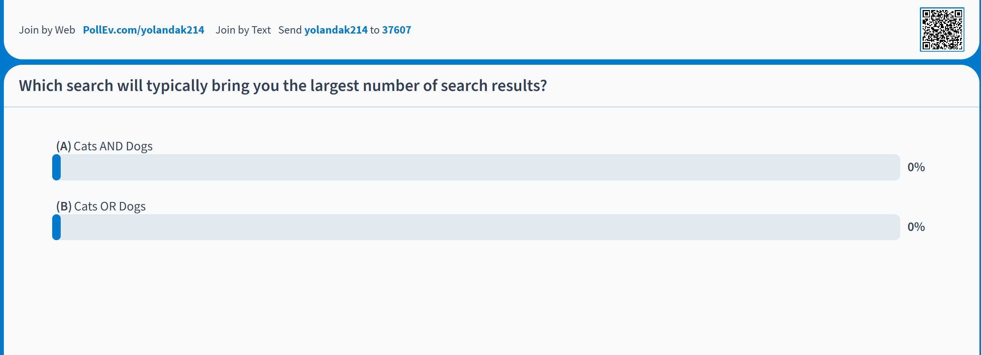
Boolean review
PollEv.com/yolandak214
Send yolandak214 to 37607
Notes:
TIP: Where can I get this link?

Slide 21
Boolean searching: and/or
A AND B
A
B
A OR B
Notes:
Search Strategies

Slide 22
Boolean searching: and/or
CATS AND DOGS
CATS
DOGS
CATS OR DOGS
Notes:
Search Strategies

Slide 23
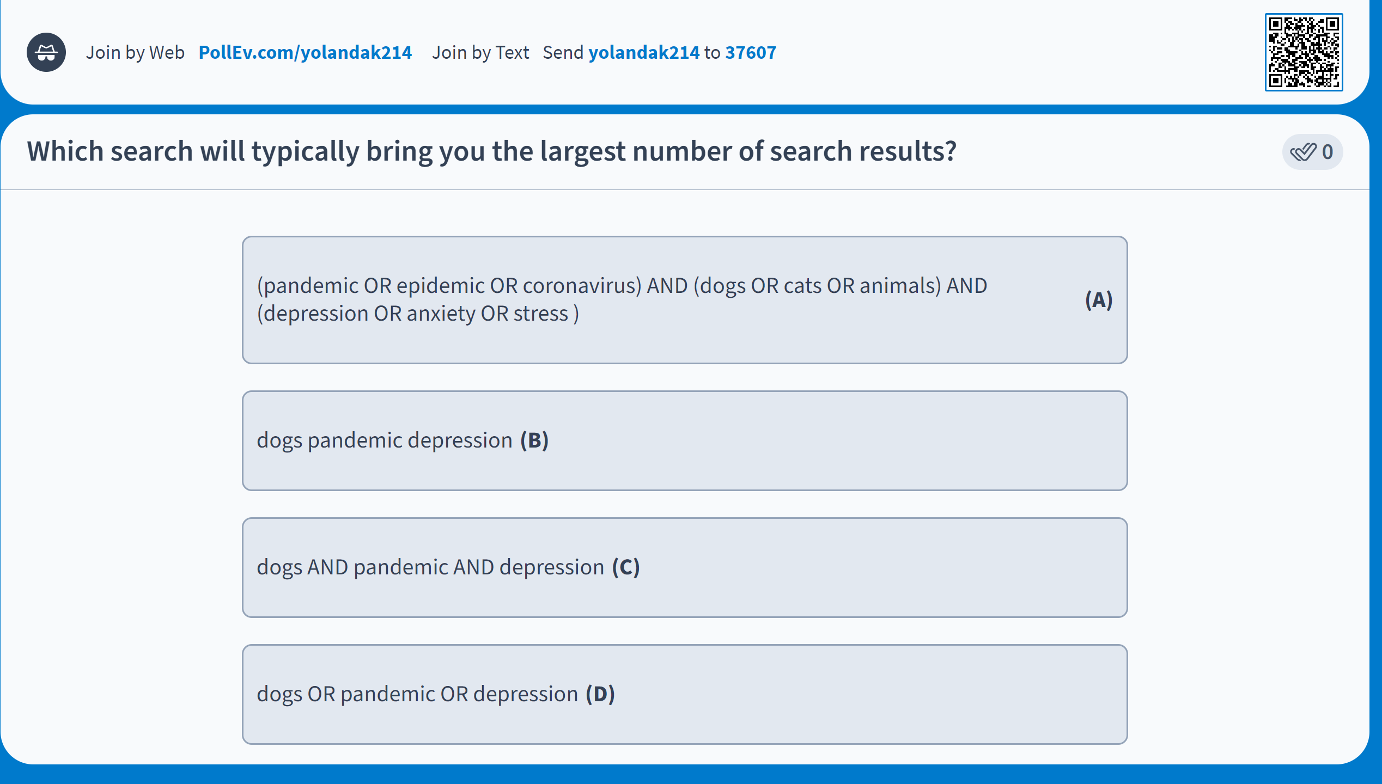
Boolean review
PollEv.com/yolandak214
Send yolandak214 to 37607

Slide 24
Boolean searching: and/or
PsycINFO
(pandemic OR epidemic OR coronavirus) AND (dogs OR cats OR animals) AND (depression OR anxiety OR stress) (147 results)
Dogs pandemic depression (312 results)
Dogs AND pandemic AND depression (7 results)
Dogs OR pandemic OR depression (403,498 results)
Notes:
In psycINFO
Dogs pandemic depression (312)
Dogs or pandemic or depression (403,498)
Dogs AND pandemic AND depression (7)
(pandemic OR epidemic OR coronavirus) AND (dogs OR cats OR animals) AND (depression OR anxiety OR stress) (147)

Slide 25
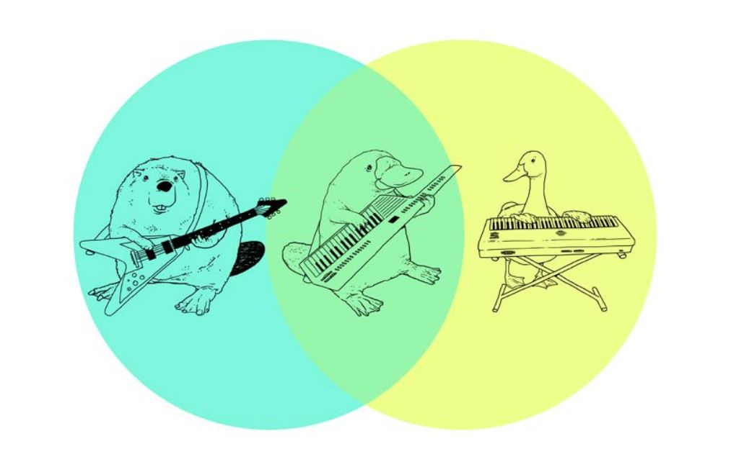
Boolean searching: and/or

Slide 26
Boolean & other Search tips
Use AND between keywords to narrow your search
1
For example: recidivism AND youth
Use OR between related keywords to broaden your search
2
For example: Aboriginal OR Indigenous OR First Nations
Use quotation marks around an exact phrase
3
For example: “young offender”
Use an asterisk (*) to find related terms
4
For example: Canad* retrieves: Canada, Canadian, etc.
“justice-involved”

Slide 27
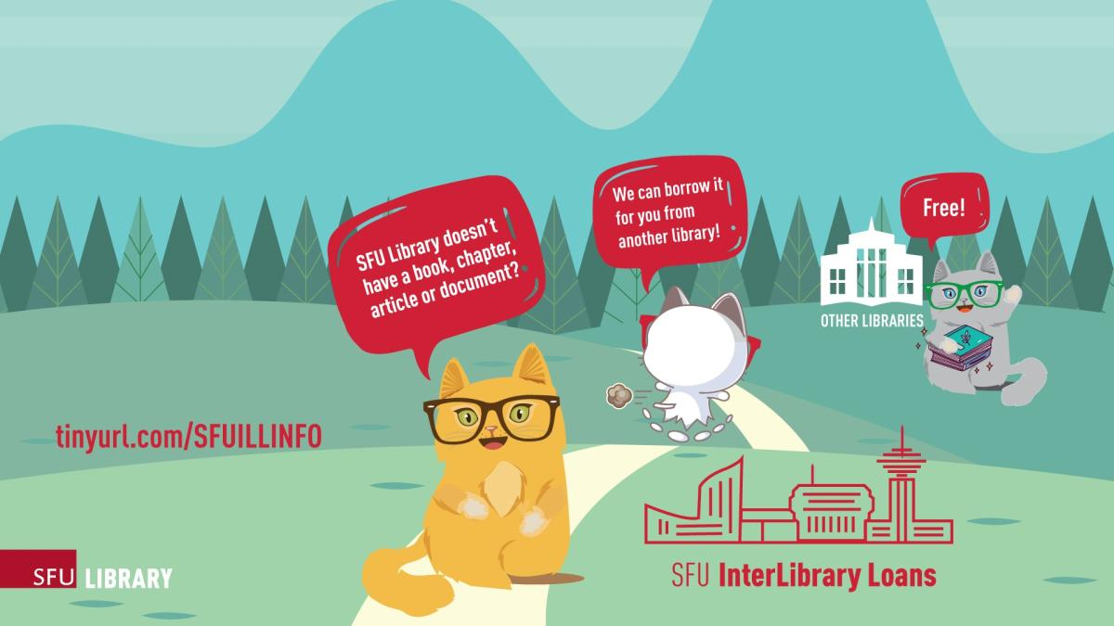

Interlibrary Loan & Book Requests

Slide 28
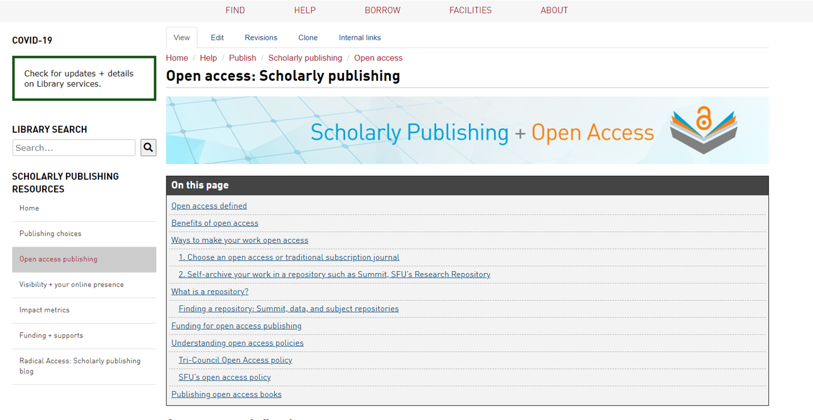
Support for open access publishing
Graduate Students are eligible to apply for open access publishing funding*
Support of up to $1250 for one article.
Also: SFU Library has memberships or direct invoicing arrangements with some of the most prominent open access publishers

Slide 29

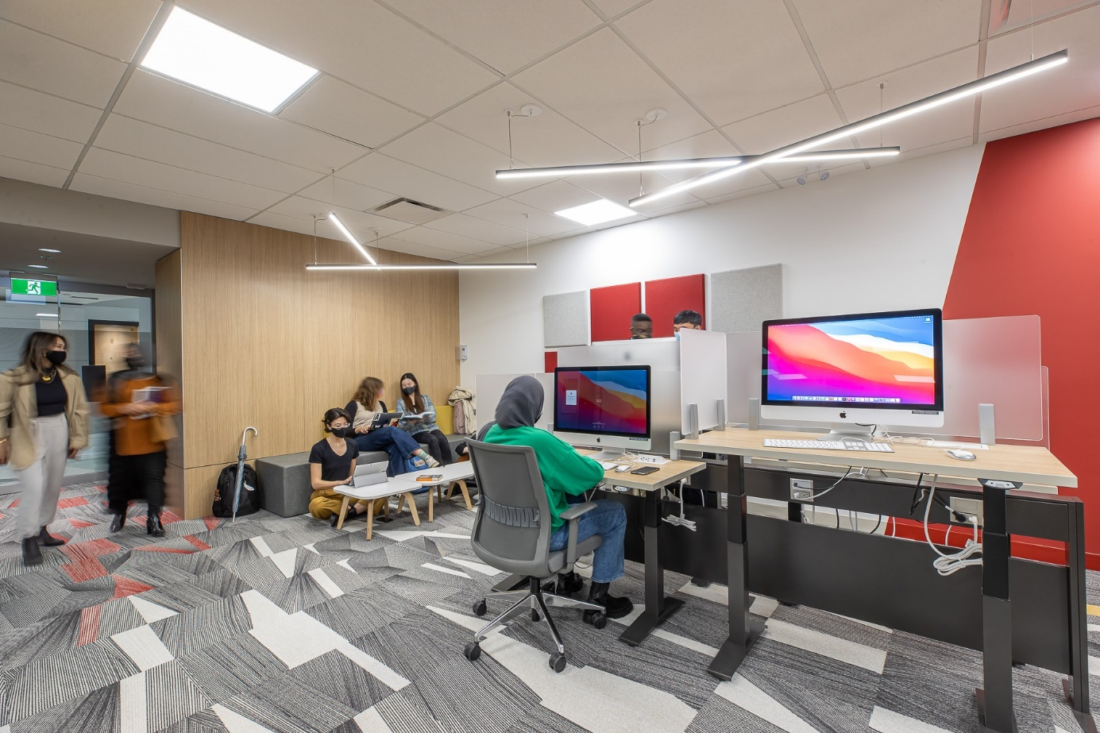

RESEARCH COMMONS
FOR GRADUATE STUDENTS
Spaces to work, including private, bookable rooms for individuals and groups
Specialized workshops
Consultations with specialists and help with research software
Graduate Writing Services
Thesis template and formatting help
Software, data, and Digital Humanities support
Learn more
Contact: research-commons@sfu.ca

Slide 30

RESEARCH COMMONS
FOR GRADUATE STUDENTS
Workshops and consultations are available in a variety of key areas, including:
Academic publishing and impact metrics
Citation management with Zotero
Research Data Management
Digital Humanities approaches and tools
Qualitative data analysis with NVivo
R & Python programming
ArcGIS & QGIS
Academic writing
Thesis template and submission help

Slide 31
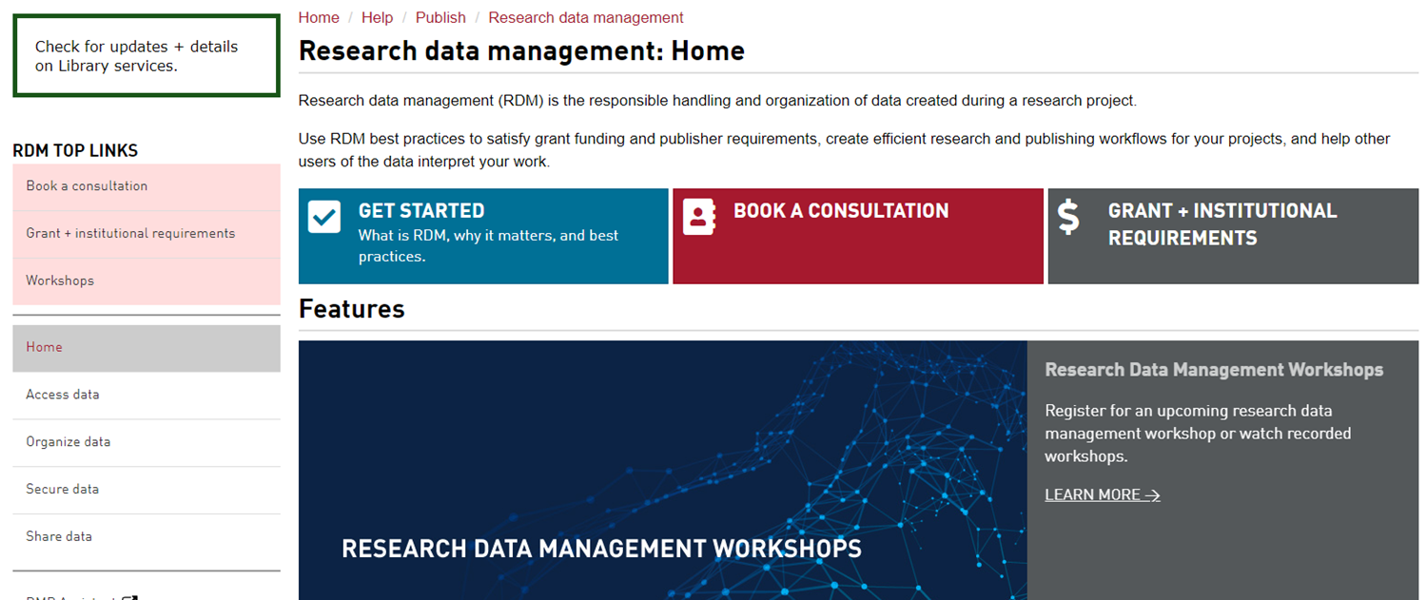
Research data management
It’s good practice to think about this early on in your research
Notes:
Area on library website dedicated to RDM

Slide 32





What is Research Data Management?
Research Data: materials created, generated, or collected as evidence in support of scholarly publications, presentations, etc.
Research Data Management: steps taken to ensure your data remains safe, persists, and is accessible in the long-term.
Notes:
Consider early on in your research
Increase your visibility and impact: data can be cited, too!
Retention of data enables both verification of results and new insights
Good practice to manage your data, especially if working with human participants
Required by granting agencies, publishers, research institutions.
Example:

Slide 33
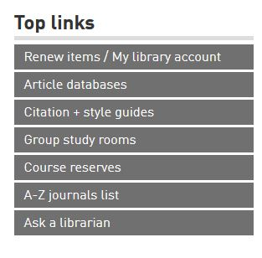

Where to go for help
  Yolanda Koscielski
  ysk6@sfu.ca
Ask a Librarian
  Research help desk (office hours & by appointment)
  Zoom consultations
  Phone: 778.782.4345
  Email: libask@sfu.ca
  AskAway (online chat)
https://i.pinimg.com/originals/de/32/89/de32896d6903b303071c14c42c09e2a8

