Slide 1
SFU Library Orientation
Criminology 860: Library research & Literature reviews
Yolanda Koscielski
Librarian for Criminology, Philosophy & Psychology
September 22, 2023
ysk6@sfu.ca

Slide 2
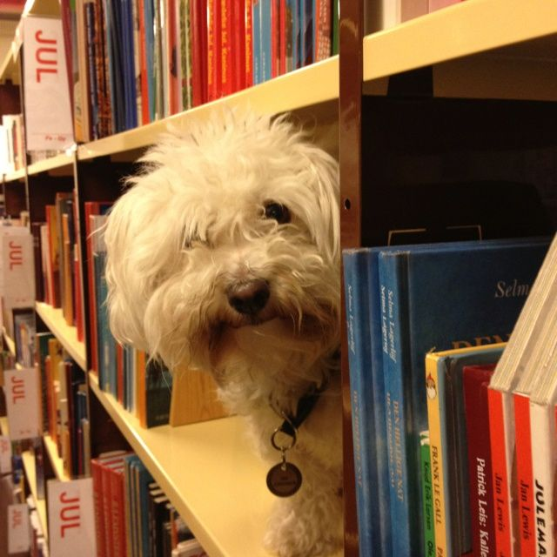
Our agenda
Icebreaker Exercise
Resources for CRIM
Search strategies
https://i.pinimg.com/originals/de/32/89/de32896d6903b303071c14c42c09e2a8.

Slide 3
Liaison Librarian for Psychology
Based at Burnaby campus
Manage print and electronic collections for Psychology
Provide individual and group consultations on library research
Author instructional web guides
Help you locate hard to find resources
Full list of Liaison Librarians

Slide 4
activity
Icebreaker
Name
MA or PhD
New to SFU or returning student
Research tip to share (e.g., favorite resource, lesson learned, etc.) OR favourite stress snack
Notes:
Library Q –

Slide 5
Finding resources
Where to search
Types of information sources
Library Search / Catalogue Search
Google Scholar
Subject-Specific databases, mostly subscription: 700+ databases
NGOs and other grey literature
Legal analysis, legal cases
Maps & spatial data
Statistics, census
…
Start at the Criminology Research Guide!

Slide 6
Using library vs. Catalogue search
Which search is broader (that is, searches across more sources?)
What percentage of our database content is indexed by the catalogue?

Slide 7
Using library vs. Catalogue search
Catalogue Search
Preliminary searches
Books, gov’t docs, movies, etc.
Library Search
SFU Library Subject Research Guides
FAQs – holds, loans, etc.
Institutional repository (past theses, dissertations)
Includes catalogue
Digitized collections such as the Northern Justice Society Native Crime Bibliography

Slide 8
Activity: Browse by Call Number
From the library homepage, find a way to virtually browse for books by call number, as though you were in the physical library.
Note: The fifth Floor is under construction

Slide 9
Activity: Browse by Call Number
HV = Social pathology. Social and public welfare. Criminology.

Slide 10
Using library/Catalogue search
Tips:
Expand results beyond Library Collection
Browse Search for known titles
A-Z journals for specific journals
Browse books by call number / topic

Slide 11
Using google scholar
Strengths
High volume, popular articles
Generous algorithm
Times cited tool
Known-item searching, unique terminology
Other info:
Open Science Framework (OSF), Institutional Repositories, US case law, grey literature
Unusual to not check it
Weaknesses
No specific discipline
Loss of control
Mysterious algorithms + unknown source coverage
Searches are optimized
Missing deep data
Popularity prioritized
Predatory publishers
Payment prompted

Slide 12
Access library resources – libkey nomad
Running into paywalls and multi-step workarounds?
LibKey Nomad provides instant access to articles.
thirdiron.com/downloadnomad
Notes:
The Libkey Nomad browser extension can now link to e-books in addition to journal articles.
Add the Libkey Nomad browser extension to your computer's internet browser (Safari, Chrome, Firefox, or Microsoft Edge) to be connected to articles and e-books from the library's holdings when navigating the internet

Slide 13
Access library resources – libkey nomad
Go to thirdiron.com/downloadnomad
Choose your browser and follow the prompts to install the LibKey Nomad browser extension
Search for and choose Simon Fraser University as your organization
You’re all set!
Look for LibKey Nomad icons on scholarly webpages.
thirdiron.com/downloadnomad
Notes:
The Libkey Nomad browser extension can now link to e-books in addition to journal articles.
Add the Libkey Nomad browser extension to your computer's internet browser (Safari, Chrome, Firefox, or Microsoft Edge) to be connected to articles and e-books from the library's holdings when navigating the internet

Slide 14
Exercise
Criminal Justice Abstracts with Full Text
PsycINFO
FORENSICnetBASE
MEDLINE
CBCA Complete
Web of Science
WestLaw Next Canada
Annual Review of Criminology
Oxford Bibliographies Online – Criminology
Sage Research Methods Online
PsycTESTS
Canada Commons
Summit – SFU’s Research Repository – Criminology Theses Subcollection
Exercise (5-7 mins)
Locate the database/resource on the SFU Library website (first task!)
Run a search for a topic of your choice, OR, animal therapy.
Briefly describe the resource’s contents. Who might this be useful for?
Notes:
--database from last term?

Slide 15
Using Subject specific databases
Tips
Make use of high quality metadata, particularly subject headings
Use limiters unique to discipline
Sign in and use search history + sets to keep track of your research over time
Notes:
TIP: Where can I get this link?

Slide 16
Boolean review
Poll Everywhere
Notes:
PollEv.com​/yolandak214
*present view + instructions

Slide 17
Boolean review

Slide 18
Boolean searching: and/or
PsycINFO
(pandemic OR epidemic OR coronavirus) AND (dogs OR cats OR animals) AND (depression OR anxiety OR stress) (147 results)
Dogs pandemic depression (312 results)
Dogs OR pandemic OR depression (403,498 results)
Dogs AND pandemic AND depression (7 results)
Notes:
In psycINFO
Dogs pandemic depression (312)
Dogs or pandemic or depression (403,498)
Dogs AND pandemic AND depression (7)
(pandemic OR epidemic OR coronavirus) AND (dogs OR cats OR animals) AND (depression OR anxiety OR stress) (147)

Slide 19
Boolean searching: and/or
A AND B
A
B
A OR B
Notes:
Search Strategies

Slide 20
Boolean searching: and/or
CATS AND DOGS
CATS
DOGS
CATS OR DOGS
Notes:
Search Strategies

Slide 21
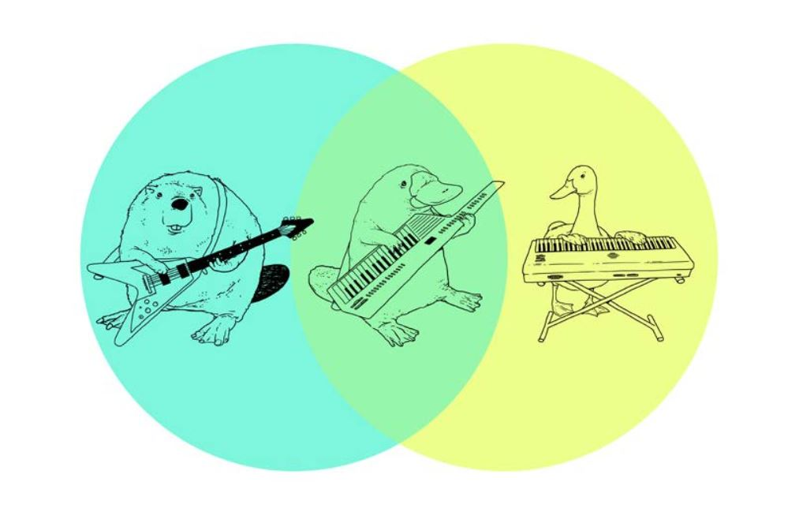
Boolean searching: and/or

Slide 22
Boolean & other Search tips
Use AND between keywords to narrow your search
1
For example: recidivism AND youth
Use OR between related keywords to broaden your search
2
For example: Aboriginal OR Indigenous OR First Nations
Use quotation marks around an exact phrase
3
For example: “young offender”
Use an asterisk (*) to find related terms
4
For example: Canad* retrieves: Canada, Canadian, etc.

Slide 23
Interlibrary Loan & Book Requests

Slide 24
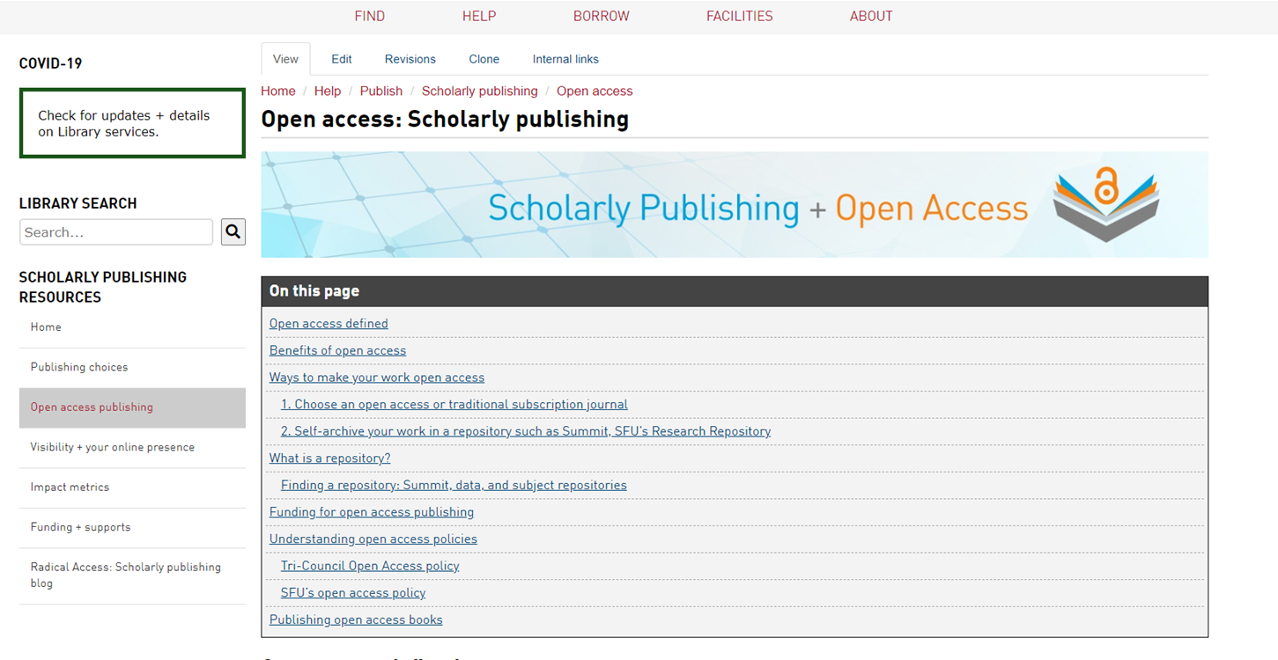
Support for open access publishing
Graduate Students are eligible to apply for open access publishing funding*
Up to $2500 per article; one article per year
Library has memberships or direct invoicing arrangements with some of the most prominent open access publishers

Slide 25
Research data management
It’s good practice to think about this early on in your research
Notes:
Area on library website dedicated to RDM
Note upcoming 3-session workshops in early November

Slide 26
What is Research Data Management?
Research Data: materials created, generated, or collected as evidence in support of scholarly publications, presentations, etc.
Research Data Management: steps taken to ensure your data remains safe, persists, and is accessible in the long-term.
Notes:
Consider early on in your research
Increase your visibility and impact: data can be cited, too!
Retention of data enables both verification of results and new insights
Good practice to manage your data, especially if working with human participants
Required by granting agencies, publishers, research institutions.

Slide 27
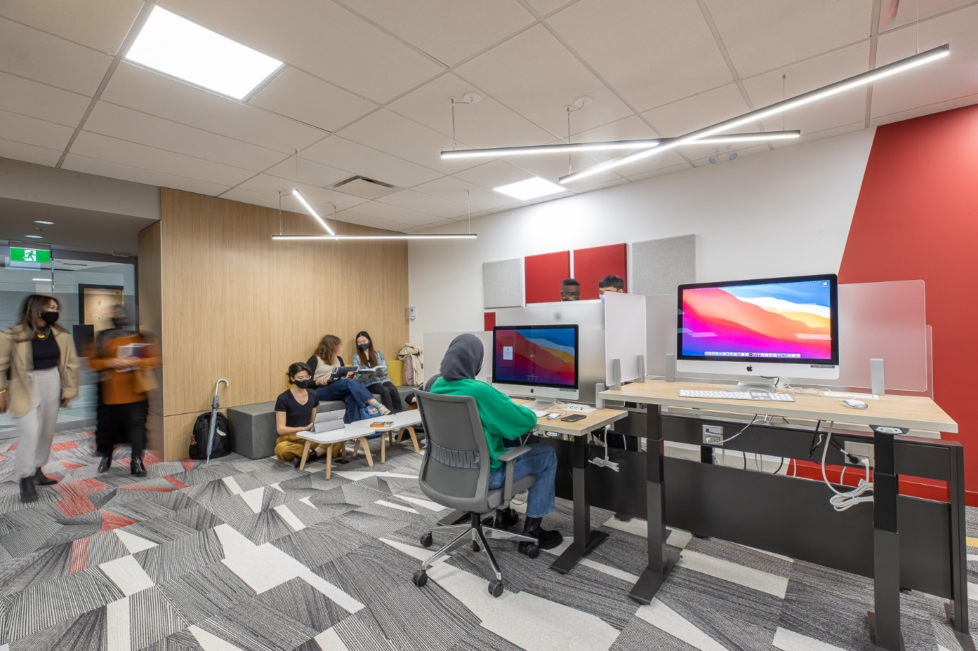
RESEARCH COMMONS
Free services for graduate students and postdocs in all disciplines.
Spaces to work, including private, bookable rooms for individuals and groups
Specialized workshops
Access to research software
Consultations with specialists
Graduate Writing Services
Thesis template and formatting help
Data services and Digital Humanities support
Learn more: https://www.lib.sfu.ca/about/branches-depts/rc
Notes:
Update slides for key services

Slide 28
RESEARCH COMMONS
Workshops and consultations are available to graduate students and postdocs in a variety of areas, including:
Academic publishing and impact metrics
Citation management with Zotero
Digital Humanities approaches and tools
Qualitative data analysis with NVivo
R & Python programming
ArcGIS & QGIS
Thesis and academic writing
Thesis template and submission help
Research Data Management

Slide 29
Where to go for help
Ask a Librarian
Research help desk (office hours & by appointment)
Zoom consultations
Phone: 778.782.4345
Email: libask@sfu.ca
AskAway (online chat)

