Slide 1
SFU Library Orientation
Criminology 860: Library research & Literature reviews
Yolanda Koscielski
Librarian for Criminology, Philosophy & Psychology
September 16, 2022
ysk6@sfu.ca

Slide 2
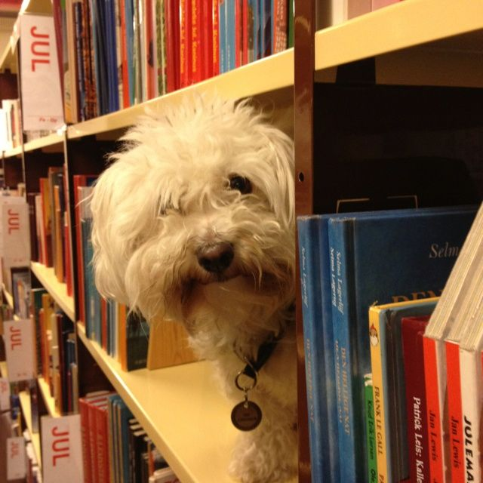
Our agenda
Icebreaker Exercise
Resources for CRIM
Search strategies
Other supports for you
https://i.pinimg.com/originals/de/32/89/de32896d6903b303071c14c42c09e2a8.

Slide 3
activity
Make a list of what you can do during the research process
to produce the worst possible literature review.
Works in pairs
3 minutes to discuss
Share with the group – 1 item from list

Slide 4
What is A Poor literature review?
Possible answers:
Ignore disconfirming evidence, dissenting studies
Searching only one or two sources (i.e., only Google)
Use one variant of search term (no synonyms)
Search without considering if your topic can be expandable/reduced
No rationale for inclusion/exclusion of search terms
Limiting to one type of information source (e.g., only journal articles)
Only old articles
Only new articles

Slide 5
What is A Poor literature review?
Possible answers:
Missing key articles by not following an argument forward in the conversation (e.g., not using Times cited this database feature when relevant)
Not citing sources
Not understanding material, key concepts
Searching too broad a topic
Not synthesizing or integrating material; putting quotes inside as though they speak for themselves

Slide 6
Finding resources
Where to search
Types of information sources
Library Search / Catalogue Search
Google Scholar
Subject-Specific databases, mostly subscription: 700+ databases
NGOs and other grey literature
Legal analysis, legal cases
Maps & spatial data
Statistics, census
…
Start at the Criminology Research Guide!
Notes:
-Switch gears to looking at various resources, and the library website
-How many new to SFU?
-Criminology Research Guide Demo

Slide 7
Using library vs. Catalogue search
Which search is broader (that is, searches across more sources?)
What percentage of our database content is indexed by the catalogue?

Slide 8
Using library vs. Catalogue search
What are reasons to use (or not use) the library catalogue?
Catalogue Search
Preliminary searches
Books, gov’t docs, movies, etc.
Library Search
SFU Library Subject Research Guides
FAQs – holds, loans, etc.
Institutional repository (past theses, dissertations)
Includes catalogue
Digitized collections such as the Northern Justice Society Native Crime Bibliography

Slide 9
Using library/Catalogue search
Strengths:
Expand results beyond our library
*The* place for print books -- and e-books
Tip: Browse Search for known titles
Books by subject headings
Do we have it? searches
Weaknesses:
Not comprehensive
No specific discipline
Too many results!!

Slide 10
Using google scholar
What are reasons to use (or not use) Google?
TIP – search through library
Notes:
TIP – search through library

Slide 11
Using google scholar
Strengths
High volume, popular articles
Generous algorithm
Times cited tool
Known-item searching, unique terminology
Other info:
Institutional Repositories, US case law, grey literature
Unusual to not check it

Slide 12
Using google scholar
Weaknesses
No specific discipline
Loss of control
Mysterious algorithms + unknown source coverage
Searches are optimized
Missing deep data
Popularity prioritized
Predatory publishers
Payment

Slide 13
Finding articles
Good reasons to use (or not use) subject-specific databases, for instance, Criminal Justice Abstracts and PsycINFO

Slide 14
Using Subject specific databases
Strengths
Mapped to a disciplinary perspective
High quality metadata, including subject headings
Limiters unique to discipline
Search history + sets
Weaknesses
Time-consuming
Particular / technical to search
Fewer results
TIP: Where can I get this link?
Notes:
TIP: Where can I get this link?

Slide 15
Exercise
Criminal Justice Abstracts with Full Text
National Criminal Justice Reference Service
PsycINFO
FORENSICnetBASE
MEDLINE
CBCA Complete
Web of Science
WestLaw Next Canada
Annual Review of Criminology
Business Source Complete
Oxford Bibliographies Online – Criminology
Sage Research Methods Online
HeinOnline
PsycTESTS
Canada Commons
Summit – SFU’s Research Repository
Exercise (5-7 mins)
Locate the database/resource on the SFU Library website (first task!)
Run a search for a topic of your choice, OR, animal therapy.
Please provide some feedback on the database, such as: How helpful are the search functions? What kind of content does the database contain (on first impression)
Notes:
What would be useful for your cohort to know? Practice using the library website.

Slide 16
Boolean review
Poll Everywhere
(“present view”)

Slide 17
Boolean searching: and/or
A AND B
A
B
A OR B
Notes:
Search Strategies

Slide 18
Boolean searching: and/or
CATS AND DOGS
CATS
DOGS
CATS OR DOGS
Notes:
Search Strategies

Slide 19
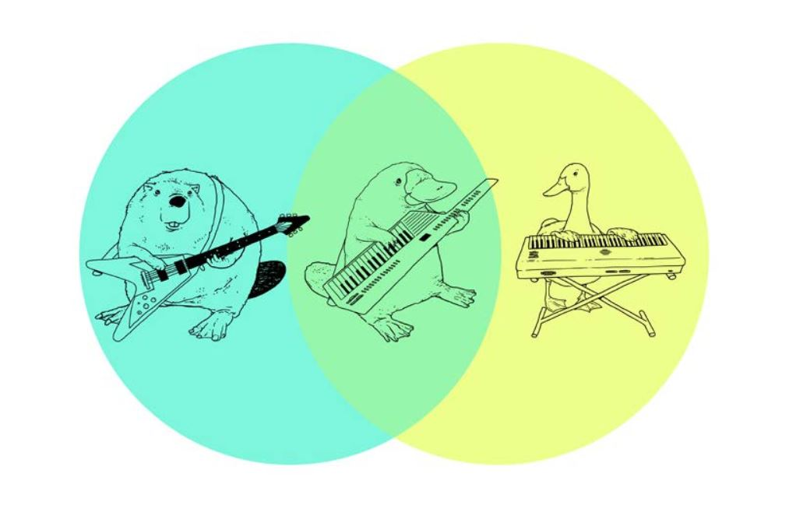
Boolean searching: and/or

Slide 20
Boolean & other Search tips
Use AND between keywords to narrow your search
For example: recidivism AND youth
Use OR between keywords to broaden your search
For example: Aboriginal OR Indigenous OR First Nations
Use quotation marks around an exact phrase
For example: “young offender”
Use an asterisk (*) to find related terms
For example: Canad* will get results for: Canada, Canadian, Canadians …

Slide 21
Search strategies
Hypothesis: Art therapy decreases recidivism
in young offenders
Art therapy AND criminal
offenders;
Criminal offenders AND
recidivism
Art therapy AND recidivism AND young offenders
Art therapy AND youth

Slide 22
Interlibrary Loan & Book Requests
Can send book requests for important titles to purchase directly to me: ysk6@sfu.ca

Slide 23
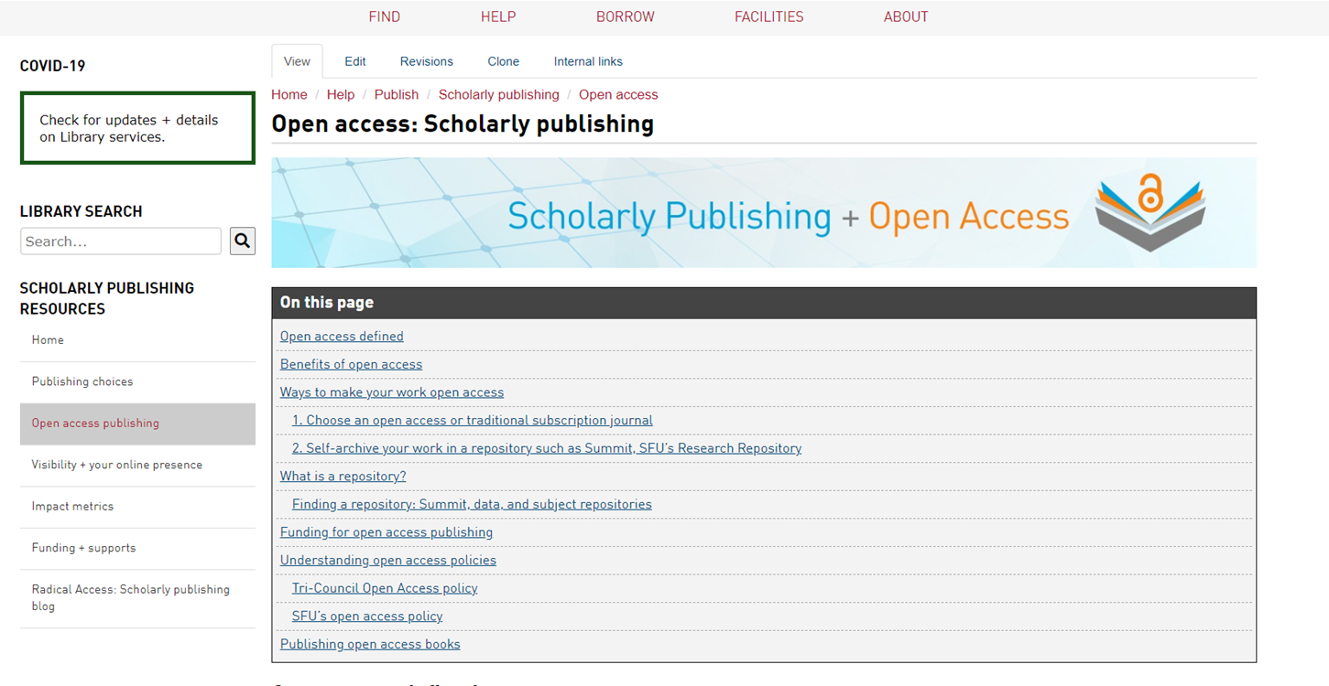
Support for open access publishing
Graduate Students are eligible to apply for open access publishing funding*
Up to $2500 per article; two articles per year
* = please review conditions to ensure eligibility

Slide 24
Research data management
It’s good practice to think about this early on in your research

Slide 25
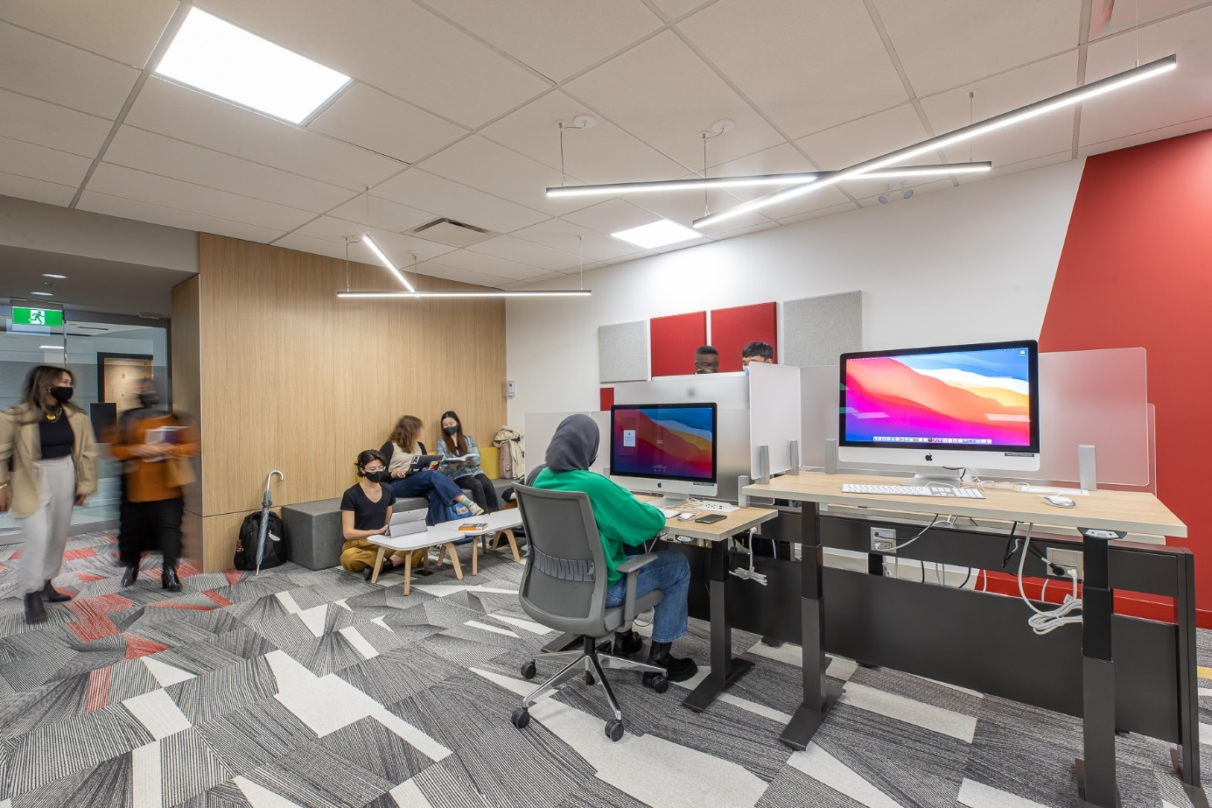
RESEARCH COMMONS
Free services, supports, software, and spaces for graduate students and postdocs in all disciplines.
Help is available for every step of the research and writing process, as are comfortable and inspiring spaces in which to work.
Email, call, or set up an online appointment—you can receive assistance from anywhere.
Learn more: https://www.lib.sfu.ca/about/branches-depts/rc Contact: research-commons@sfu.ca

Slide 26
RESEARCH COMMONS
Graduate students and postdocs are encouraged to participate in workshops and book consultations in a variety of areas, including:
academic publishing and impact metrics;
citation management with Zotero;
Digital Humanities approaches and tools;
qualitative data analysis with NVivo;
R & Python programming;
GIS using ArcGIS & QGIS;
thesis and academic writing;
thesis template and submission help;
research data management.

Slide 27
Finding books – in print!
For print books, look for the call number to find the book’s location on the shelf (eg HV 6534 A8 H65 2016)
What is a call number?
The call number represents what the book is about and acts like the book's address on the library's shelves or stacks. Because books on the shelves are arranged in call number order, you will find books on similar subjects shelved near each other.
Quiz: What order would you find these on the library shelf?
HV 650 B9 H12 2022
HV 6534 A12 2016
H 652 B9 A12 1999
HV 6534 A8 K651 2002
HV 6534 A8 H65 2016
Notes:
Next goal: PRINT or ONLINE books
--buy increasingly more ebooks (online preferred purchase), but some will still be in print, particularly the biographical texts.
--print books – jot down the call number, and library staff can help you find the information

Slide 28
Finding books
H 652 B9 A12 1999 (3)
HV 650 B9 H12 2022 (1)
HV 6534 A12 2016 (2)
HV 6534 A8 H65 2016 (5)
HV 6534 A8 K651 2002 (4)
HV = Social pathology. Social and public welfare. Criminology.
6534 = HV6251 - 6773.55 Crimes and offenses
Notes:
Next goal: PRINT or ONLINE books
--buy more and more online, but some will still be in print, particularly the biographical texts.
--print books – jot down the call number, and library staff can help you find the text

Slide 29
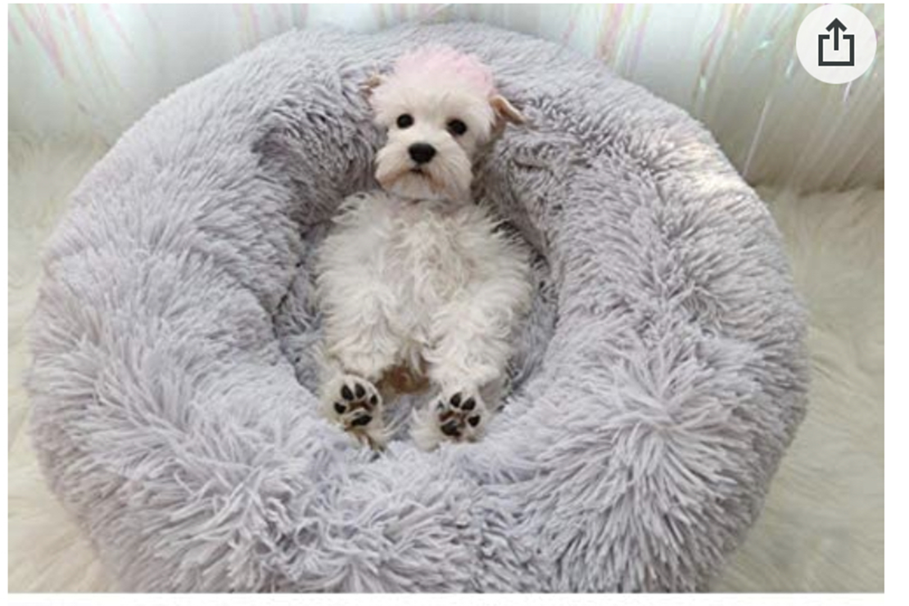
Where to go for help
SharepointHome warm dog bed, photo from Amazon.com
Yolanda Koscielski
ysk6@sfu.ca
778-872-3315
AskALibrarian
Email us at: libask@sfu.ca
AskAway (online chat)
Research Commons Website
Space, software & support for grad students & post-docs!
Contact us: research-commons@sfu.ca

