Slide 1
SFU Library workshop
Criminology 491: Library research & Literature reviews
Yolanda Koscielski
Librarian for Criminology, Philosophy & Psychology
October 2, 2024
ysk6@sfu.ca

Slide 2
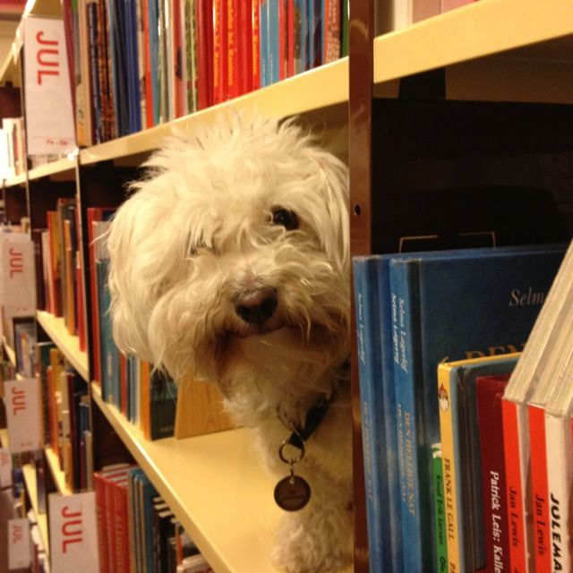
Our agenda
Icebreaker Exercise
Resources for CRIM
Search strategies
https://i.pinimg.com/originals/de/32/89/de32896d6903b303071c14c42c09e2a8.

Slide 3

Activity: What is A Poor literature review?
Make a list of what you can do during the research process
to produce the worst possible literature review.
Works in pairs
  3 minutes to discuss
  Share with the group – 1 item from list

Slide 4
Liaison Librarian for criminology
Based at Burnaby campus
Manage collections for Criminology
Provide individual and group consultations on library research*
Author research web guides
Help you locate hard to find resources
Full list of Liaison Librarians

Slide 5
What is A Poor literature review?
Possible answers:
Ignoring disconfirming evidence, dissenting studies
Searching only one or two sources (i.e., only Criminal Justice Abstracts)
Using one variant of search term (no synonyms)
Searching without considering if your topic can be expanded/reduced
No rationale for inclusion/exclusion of search terms
Limiting to one type of information source (e.g., only journal articles)
Only old articles
Only new articles

Slide 6
What is A Poor literature review?
Possible answers:
Missing key articles by not following an argument forward in the conversation (e.g., not using Times cited in this database feature when relevant)
Not citing sources
Not understanding material, key concepts
Searching too broad a topic
Not synthesizing or integrating material; putting quotes inside as though they speak for themselves
Having ChatGPT/AI do your literature review

Slide 7
Finding resources
Where to search
Types of information sources
Library Search / Catalogue Search
Google Scholar
Subject-Specific databases, mostly subscription: 700+ databases
NGOs and other grey literature
Legal analysis, legal cases
Maps & spatial data
Statistics, census
…
Start at the Criminology Research Guide!

Slide 8
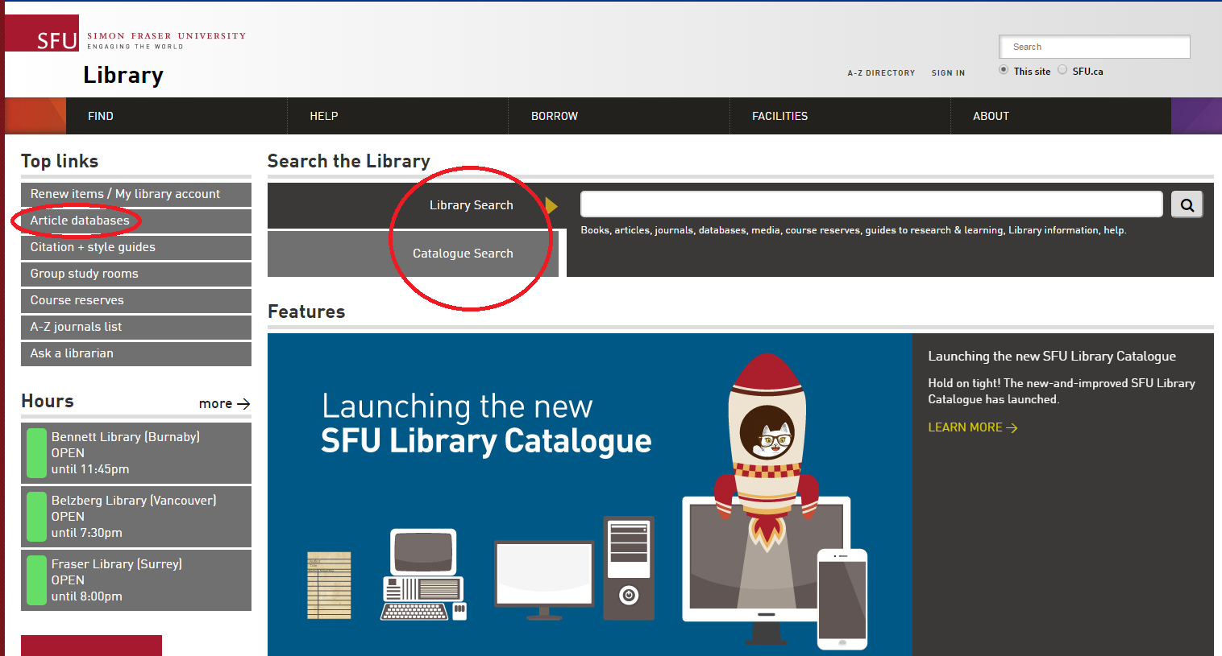
Using library vs. Catalogue search
Which search is broader (that is, searches across more sources?)
What percentage of our database content is indexed by the catalogue?

Slide 9
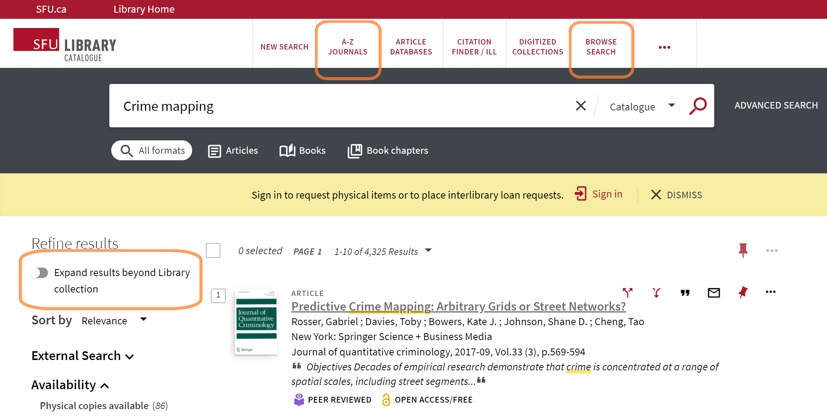
Using library/Catalogue search

Slide 10
Using google scholar
STRENGTHS
WEAKNESSES
  High volume, popular articles
  Generous algorithm
  Times cited tool
  Known-item searching, unique terminology
  Other info:
    Open Science Framework (OSF), Institutional Repositories*, US case law, grey literature
  Unusual to not check it
  No specific discipline
  Loss of control
  Mysterious algorithms + unknown source coverage
  Searches are optimized
  Missing deep data
  Popularity prioritized
  Predatory / deceptive publishers included
  Payment prompted

Slide 11
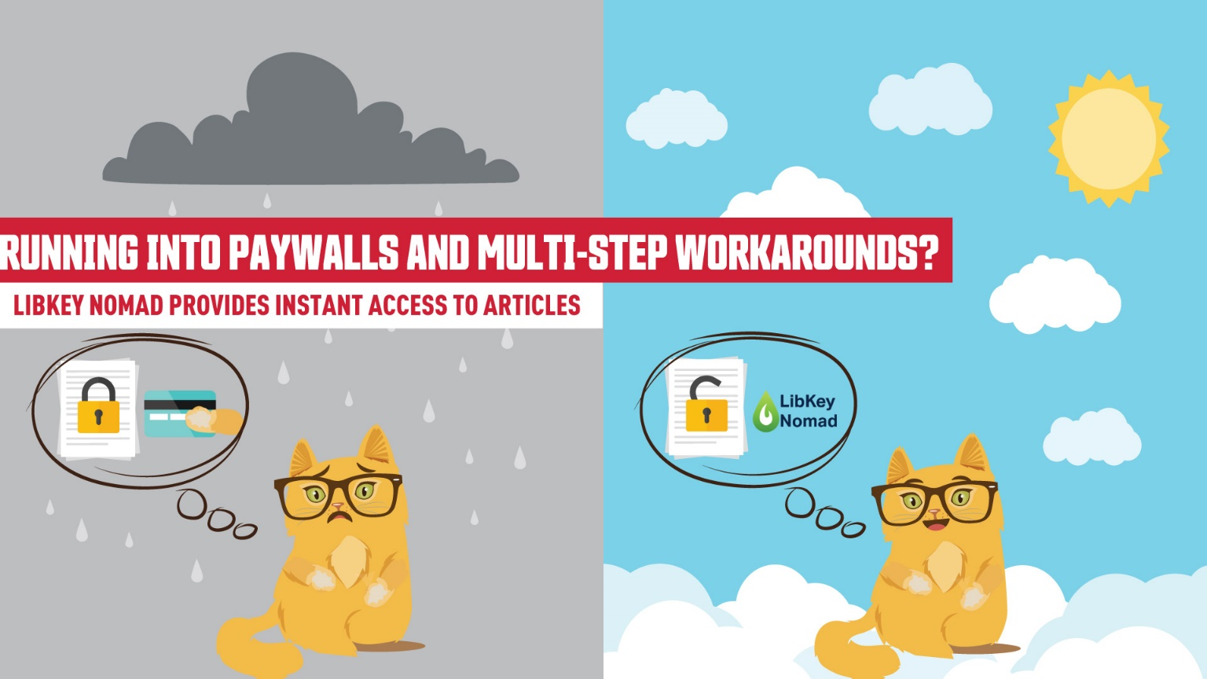

Access library resources – libkey nomad
Running into paywalls and multi-step workarounds?
LibKey Nomad provides instant access to articles.
thirdiron.com/downloadnomad
Notes:
The Libkey Nomad browser extension can now link to e-books in addition to journal articles.
Add the Libkey Nomad browser extension to your computer's internet browser (Safari, Chrome, Firefox, or Microsoft Edge) to be connected to articles and e-books from the library's holdings when navigating the internet

Slide 12



Access library resources – libkey nomad
Go to thirdiron.com/downloadnomad
Choose your browser and follow the prompts to install the LibKey Nomad browser extension
Search for and choose Simon Fraser University as your organization
You’re all set!
Look for LibKey Nomad icons on scholarly webpages.
thirdiron.com/downloadnomad
Notes:
The Libkey Nomad browser extension can now link to e-books in addition to journal articles.
Add the Libkey Nomad browser extension to your computer's internet browser (Safari, Chrome, Firefox, or Microsoft Edge) to be connected to articles and e-books from the library's holdings when navigating the internet

Slide 13
Exercise
Exercise (5-7 mins)
Locate the database/resource on the SFU Library website (first task!)
Run a search for a topic of your choice, OR, animal therapy.
A) Briefly describe the resource’s contents
B) What might you(or someone else) use the database for?
Please provide a 60-second summary for everyone.
Criminal Justice Abstracts
PsycINFO
PsycTESTS
Web of Science
CBCA Complete
WestLaw Next Canada
Annual Review of Criminology
Oxford Bibliographies Online – Criminology module
Sage Research Methods Online
Notes:
What would be useful for your cohort to know? Practice using the library website.

Slide 14
Using Subject specific databases
Tips
  Sign in and use search history + sets to keep track of your research over time

Slide 15

Boolean review
Poll Everywhere

Slide 16
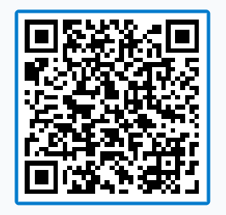
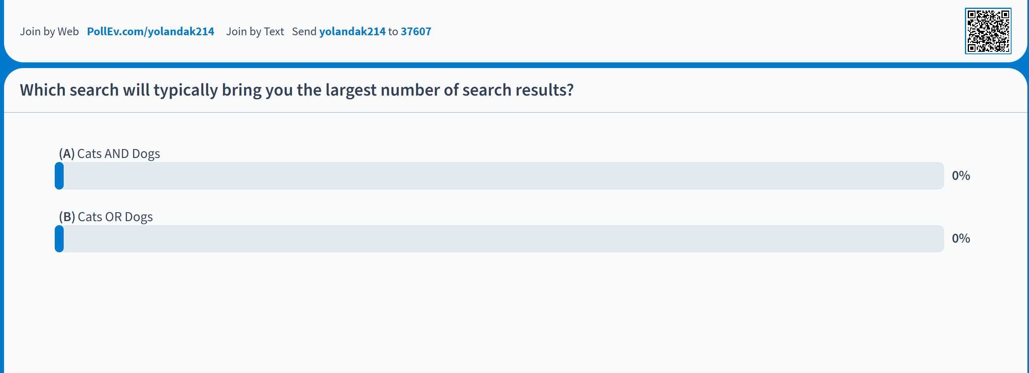
Boolean review
Notes:
TIP: Where can I get this link?

Slide 17
Boolean searching: and/or
A AND B
A
B
A OR B

Slide 18


Boolean searching: and/or
CATS AND DOGS
CATS
DOGS
CATS OR DOGS
Notes:
Search Strategies

Slide 19
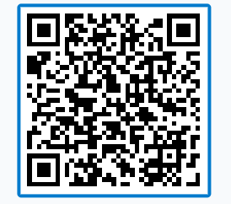
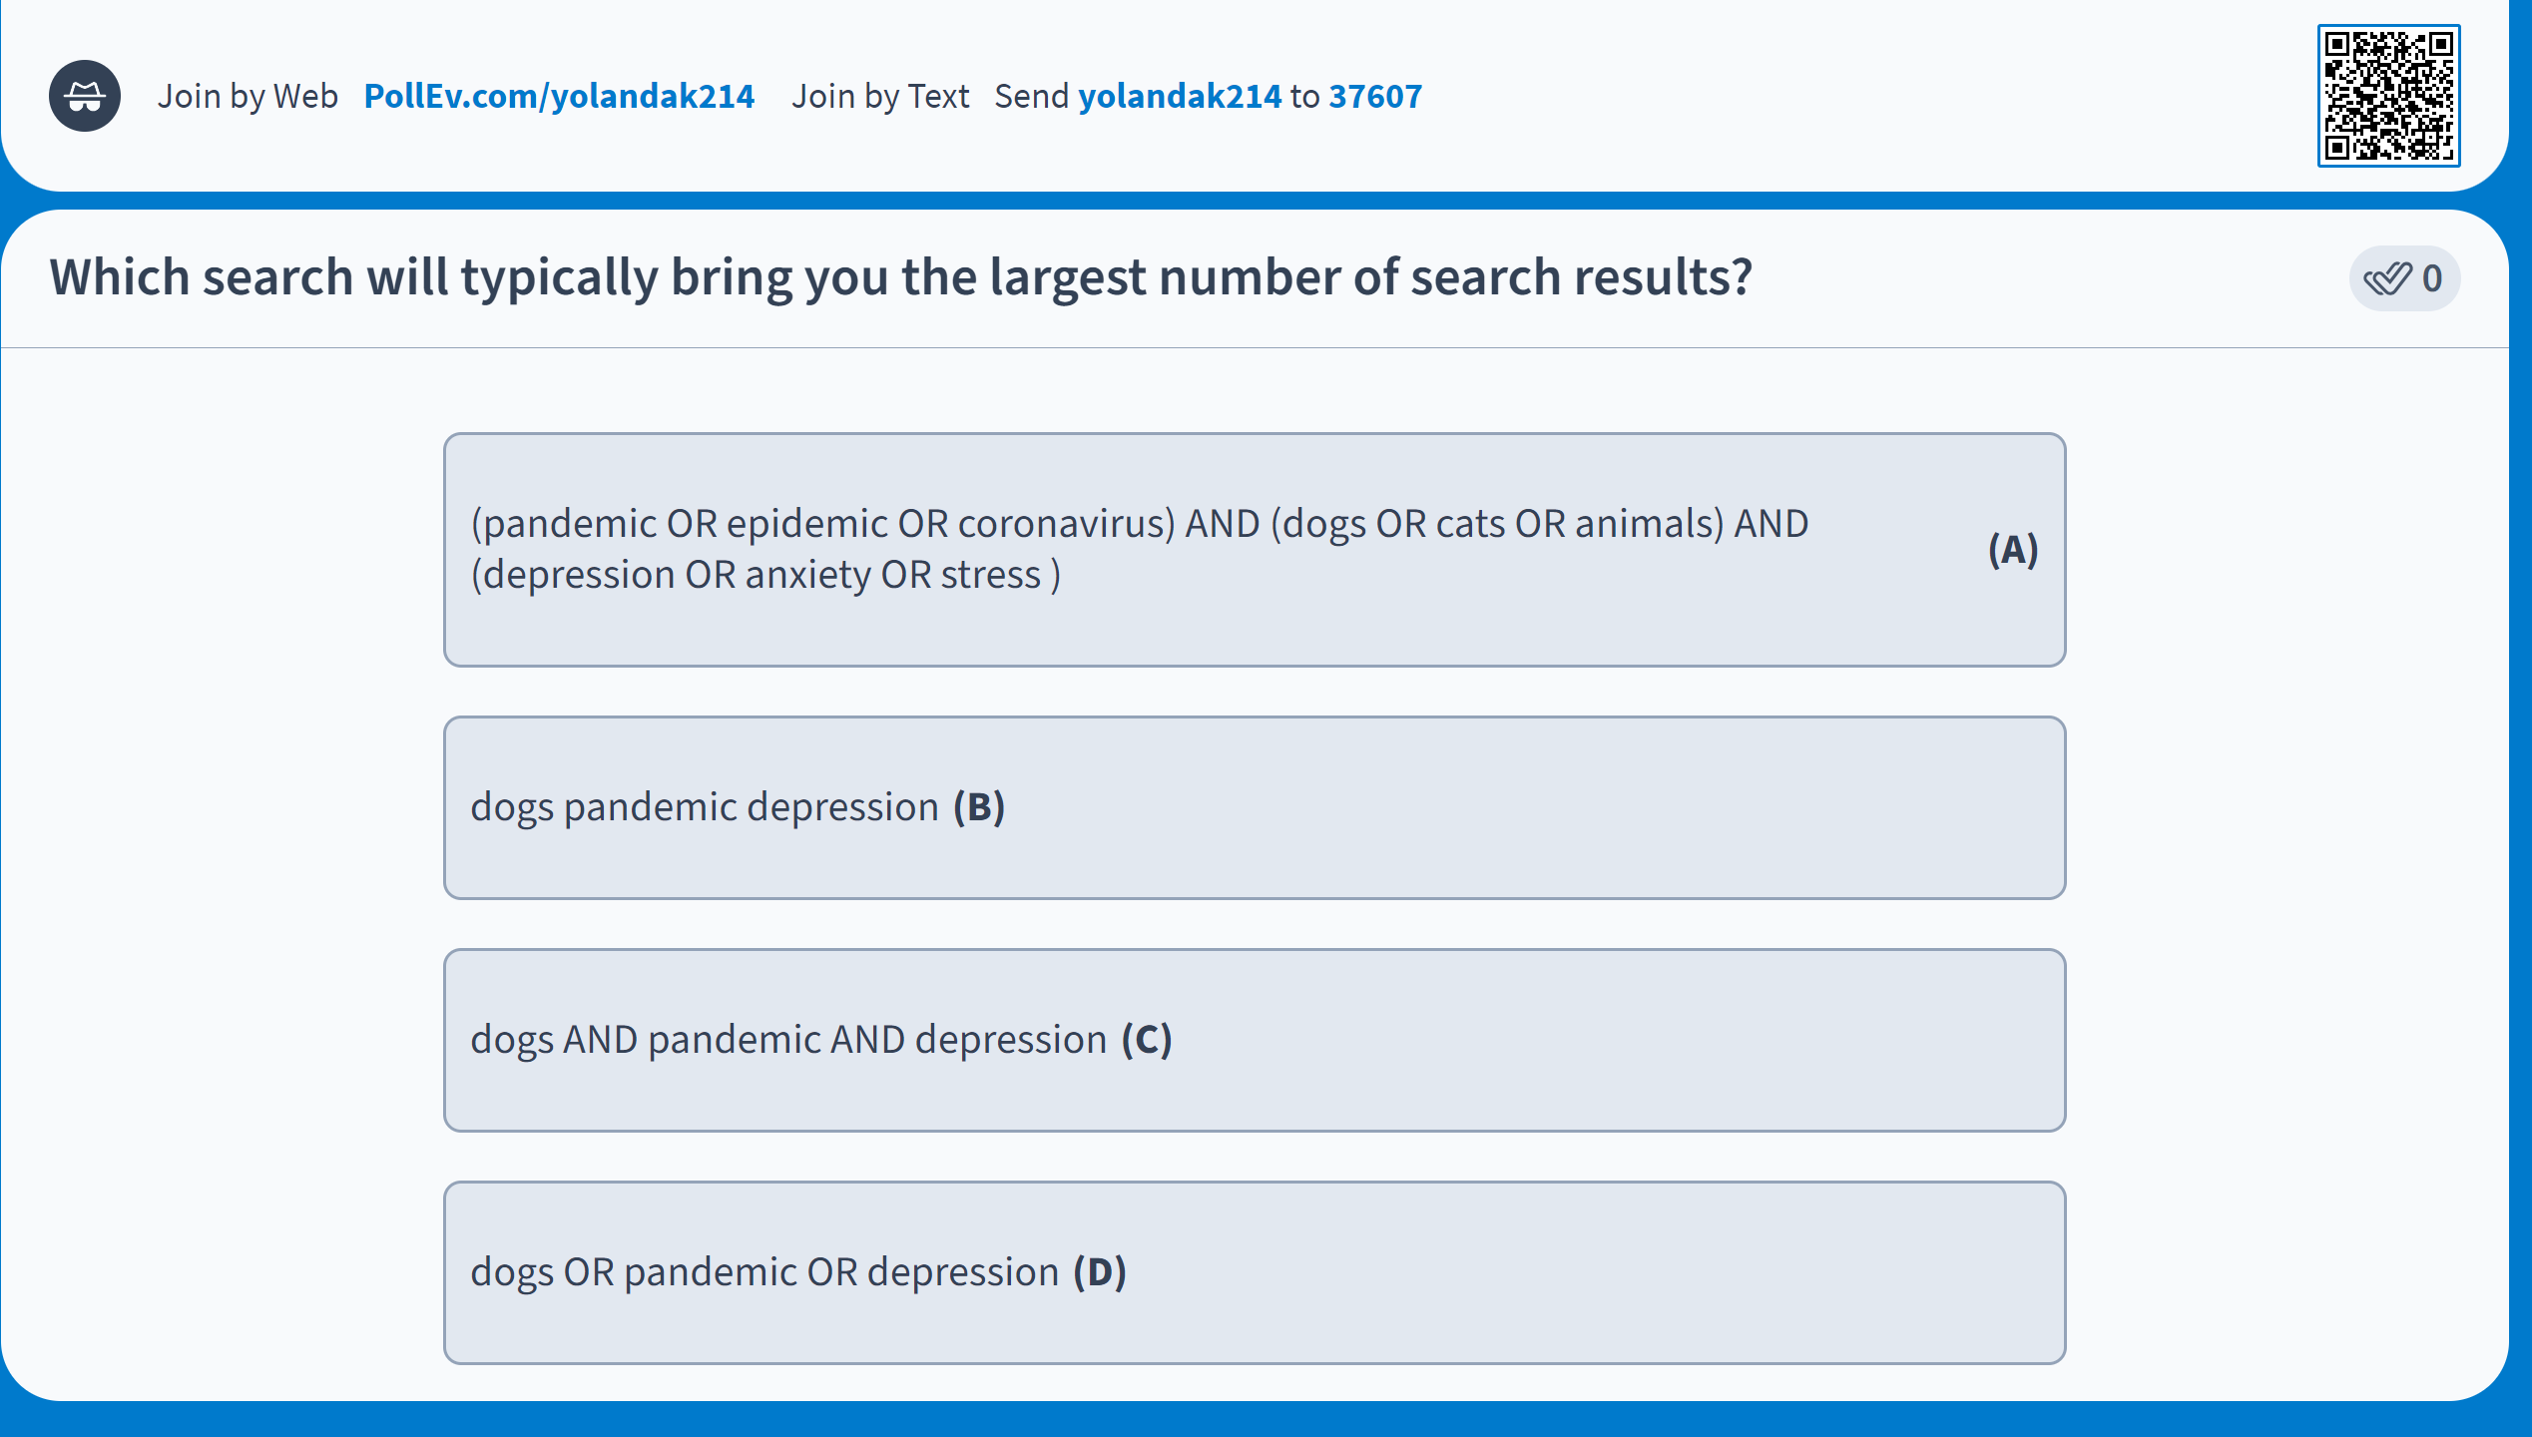
Boolean review

Slide 20
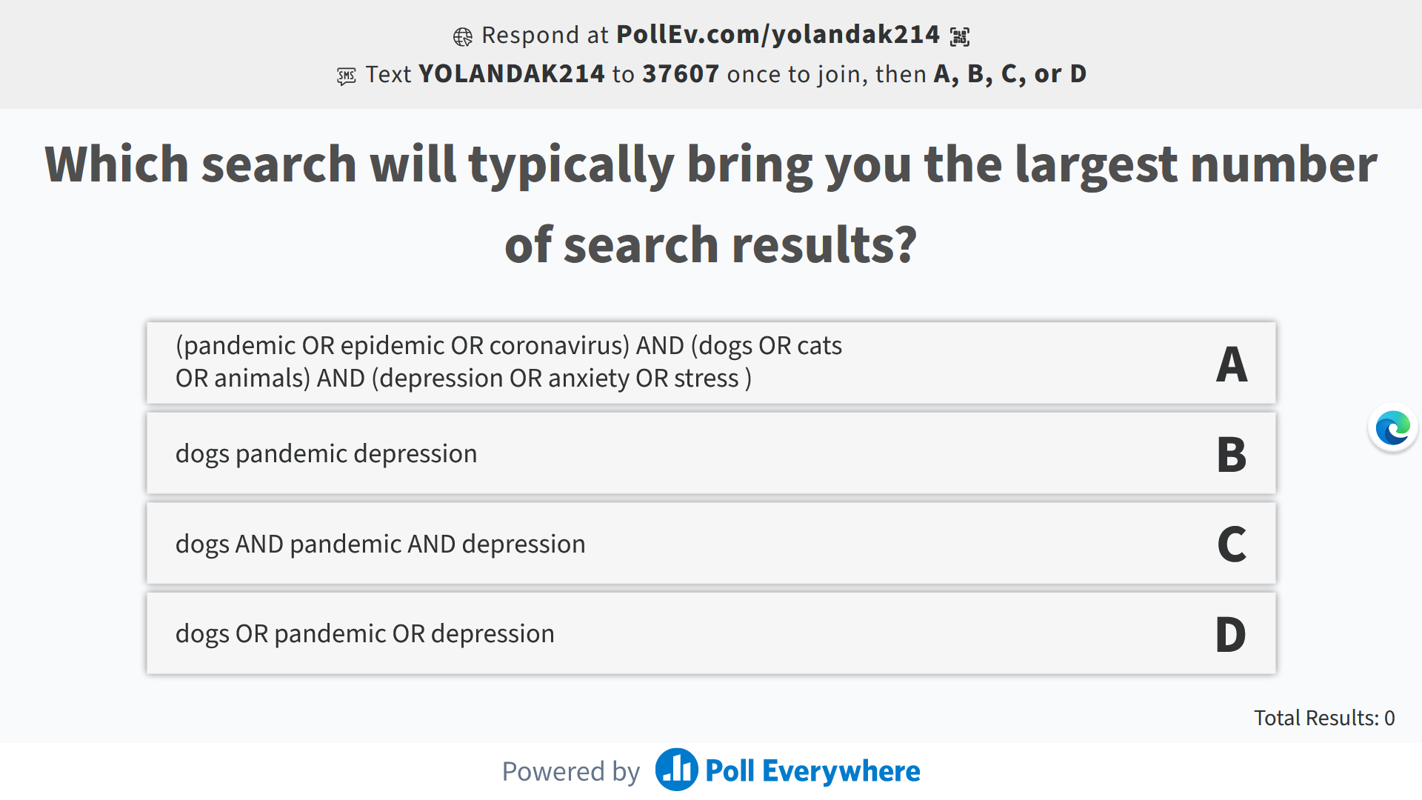
Boolean review

Slide 21
Boolean searching: and/or
PsycINFO
(pandemic OR epidemic OR coronavirus) AND (dogs OR cats OR animals) AND (depression OR anxiety OR stress) (147 results)
Dogs pandemic depression (312 results)
Dogs OR pandemic OR depression (403,498 results)
Dogs AND pandemic AND depression (7 results)
Notes:
In psycINFO
Dogs pandemic depression (312)
Dogs or pandemic or depression (403,498)
Dogs AND pandemic AND depression (7)
(pandemic OR epidemic OR coronavirus) AND (dogs OR cats OR animals) AND (depression OR anxiety OR stress) (147)

Slide 22
Boolean & other Search tips
Use AND between keywords to narrow your search
1
For example: recidivism AND youth
Use OR between keywords to broaden your search
2
For example: Indigenous OR First Nations OR Coast Salish…
Use quotation marks around an exact phrase
3
For example: “young offender”
Use an asterisk (*) to find related terms
4
For example: Canad* retrieves: Canada, Canadian, etc.

Slide 23
Search strategies
Hypothesis: Art therapy
decreases recidivism
in justice-involved youth
Art therapy AND
justice-involved people;
Justice-involved people AND
recidivism
Art therapy AND recidivism AND justice-involved youth
Art therapy AND youth

Slide 24
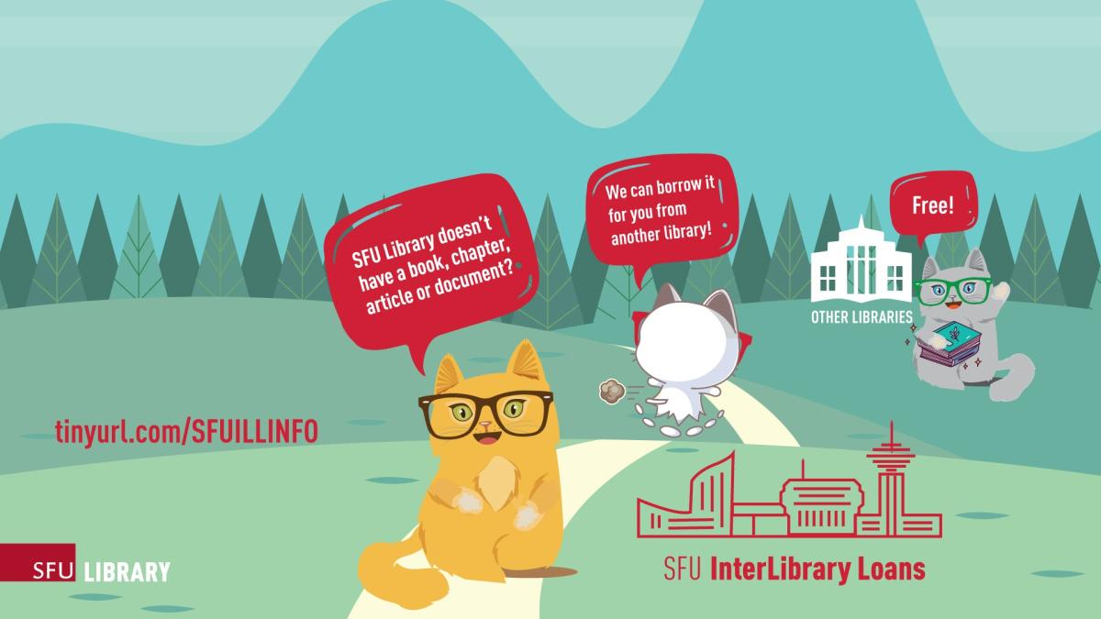

Interlibrary Loan & Book Requests

Slide 25
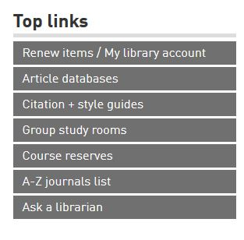

Where to go for help
  Yolanda Koscielski
  ysk6@sfu.ca
Ask a Librarian
  Research help desk (office hours & by appointment)
  Zoom consultations
  Phone: 778.782.4345
  Email: libask@sfu.ca
  AskAway (online chat)
https://i.pinimg.com/originals/de/32/89/de32896d6903b303071c14c42c09e2a8

