Slide 1
SFU Library workshop
Criminology 491: Library research & Literature reviews
Yolanda Koscielski
Librarian for Criminology, Philosophy & Psychology
October 3, 2023
ysk6@sfu.ca

Slide 2
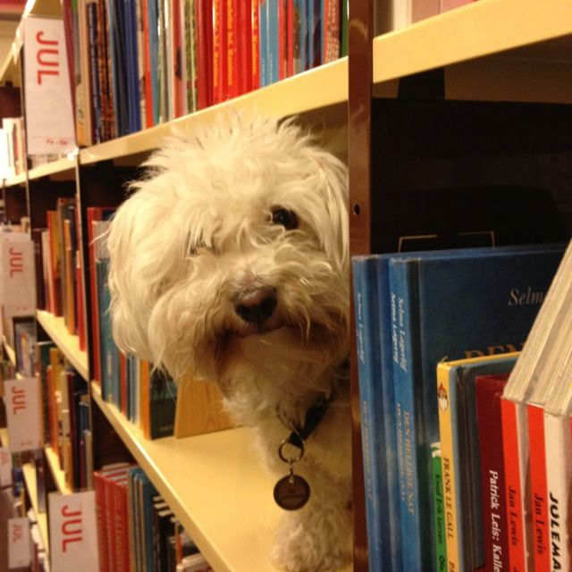
Our agenda
Icebreaker Exercise
Resources for CRIM
Search strategies
https://i.pinimg.com/originals/de/32/89/de32896d6903b303071c14c42c09e2a8.

Slide 3

Activity: What is A Poor literature review?
Make a list of what you can do during the research process
to produce the worst possible literature review.
Works in pairs
  3 minutes to discuss
  Share with the group – 1 item from list

Slide 4
What is A Poor literature review?
Possible answers:
Ignore disconfirming evidence, dissenting studies
Searching only one or two sources (i.e., only Criminal Justice Abstracts)
Use one variant of search term (no synonyms)
Search without considering if your topic can be expanded/reduced
No rationale for inclusion/exclusion of search terms
Limiting to one type of information source (e.g., only journal articles)
Only old articles
Only new articles

Slide 5
What is A Poor literature review?
Possible answers:
Missing key articles by not following an argument forward in the conversation (e.g., not using Times cited in this database feature when relevant)
Not citing sources
Not understanding material, key concepts
Searching too broad a topic
Not synthesizing or integrating material; putting quotes inside as though they speak for themselves
Having ChatGPT/AI do your literature review

Slide 6
Finding resources
Where to search
Types of information sources
Library Search / Catalogue Search
Google Scholar
Subject-Specific databases, mostly subscription: 700+ databases
NGOs and other grey literature
Legal analysis, legal cases
Maps & spatial data
Statistics, census
…
Start at the Criminology Research Guide!

Slide 7
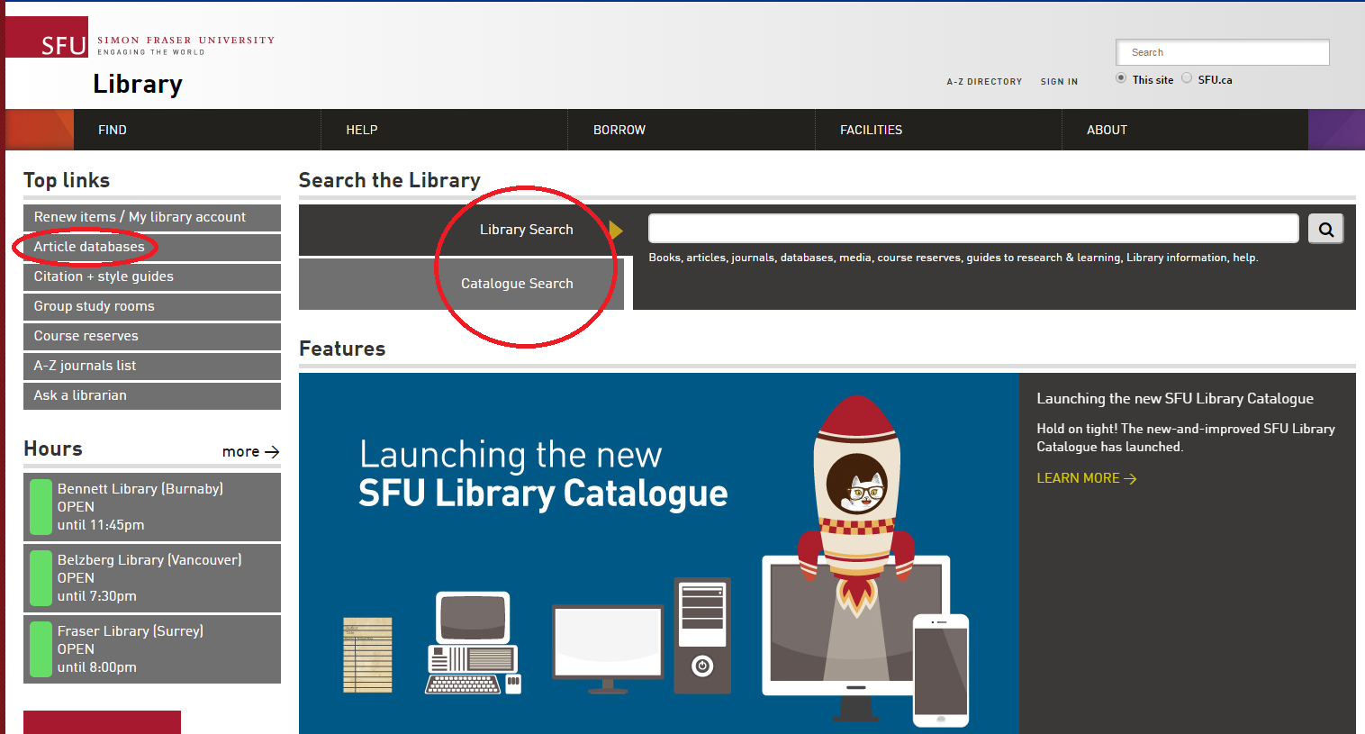
Using library vs. Catalogue search
Which search is broader (that is, searches across more sources?)

Slide 8
Using library/Catalogue search
Tips:
  Expand results beyond Library Collection
  Browse Search for known titles
  A-Z journals for specific journals
  Use LibrarySearch for FAQs, Research Guides (e.g. Media Review)

Slide 9
Using google scholar
STRENGTHS
WEAKNESSES
  High volume, popular articles
  Generous algorithm
  Times cited tool
  Known-item searching, unique terminology
  Other info:
    Open Science Framework (OSF), Institutional Repositories, US case law, grey literature
  Unusual to not check it
  No specific discipline
  Loss of control
  Mysterious algorithms + unknown source coverage
  Searches are optimized
  Missing deep data
  Popularity prioritized
  Predatory publishers
  Payment prompted

Slide 10
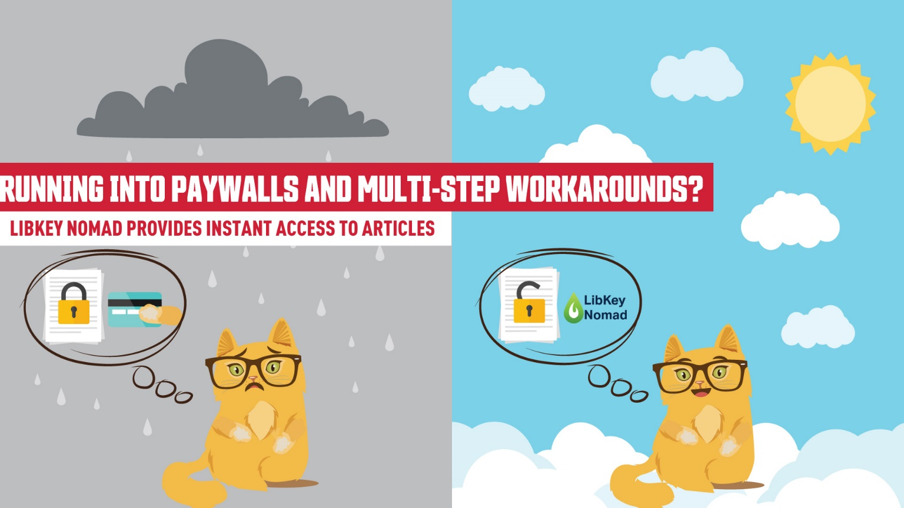

Access library resources – libkey nomad
Running into paywalls and multi-step workarounds?
LibKey Nomad provides instant access to articles.
thirdiron.com/downloadnomad
Notes:
The Libkey Nomad browser extension can now link to e-books in addition to journal articles.
Add the Libkey Nomad browser extension to your computer's internet browser (Safari, Chrome, Firefox, or Microsoft Edge) to be connected to articles and e-books from the library's holdings when navigating the internet

Slide 11



Access library resources – libkey nomad
Go to thirdiron.com/downloadnomad
Choose your browser and follow the prompts to install the LibKey Nomad browser extension
Search for and choose Simon Fraser University as your organization
You’re all set!
Look for LibKey Nomad icons on scholarly webpages.
thirdiron.com/downloadnomad
Notes:
The Libkey Nomad browser extension can now link to e-books in addition to journal articles.
Add the Libkey Nomad browser extension to your computer's internet browser (Safari, Chrome, Firefox, or Microsoft Edge) to be connected to articles and e-books from the library's holdings when navigating the internet

Slide 12
Exercise
Exercise (5-7 mins)
Locate the database/resource on the SFU Library website (first task!)
Run a search for a topic of your choice, OR, animal therapy.
Briefly describe the resource’s contents. Who might this be useful for?
PsycINFO
PsycTESTS
Web of Science
CBCA Complete
Canada Commons
Canadian Points of View Reference Centre
SFU Summit: Criminology Theses
MEDLINE
Notes:
What would be useful for your cohort to know? Practice using the library website.

Slide 13
Using Subject specific databases
Tips
  Make use of high quality metadata, particularly subject headings
  Use limiters unique to discipline
  Sign in and use search history + sets to keep track of your research over time

Slide 14

Boolean review
Poll Everywhere

Slide 15
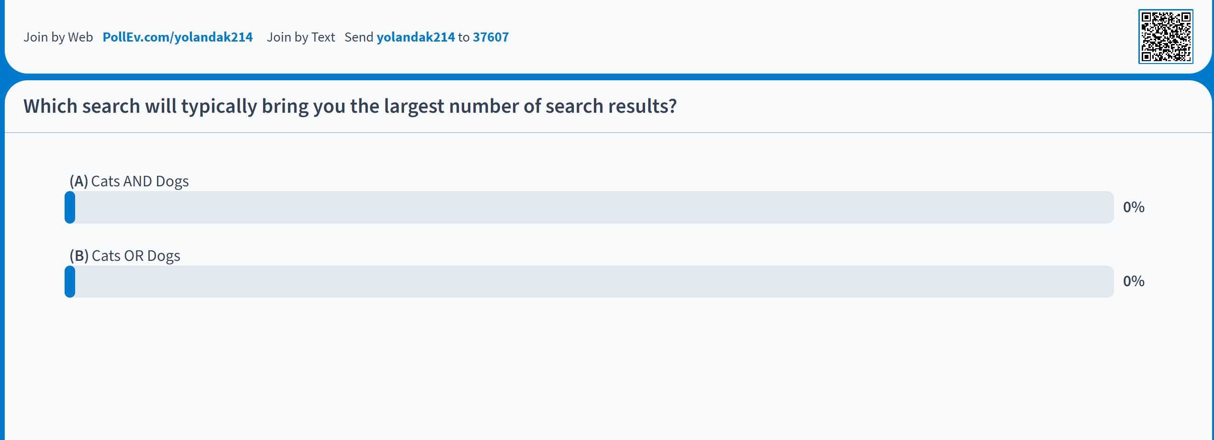
Boolean review
Notes:
TIP: Where can I get this link?

Slide 16
Boolean searching: and/or
A AND B
A
B
A OR B

Slide 17
Boolean searching: and/or
CATS AND DOGS
CATS
DOGS
CATS OR DOGS
Notes:
Search Strategies

Slide 18
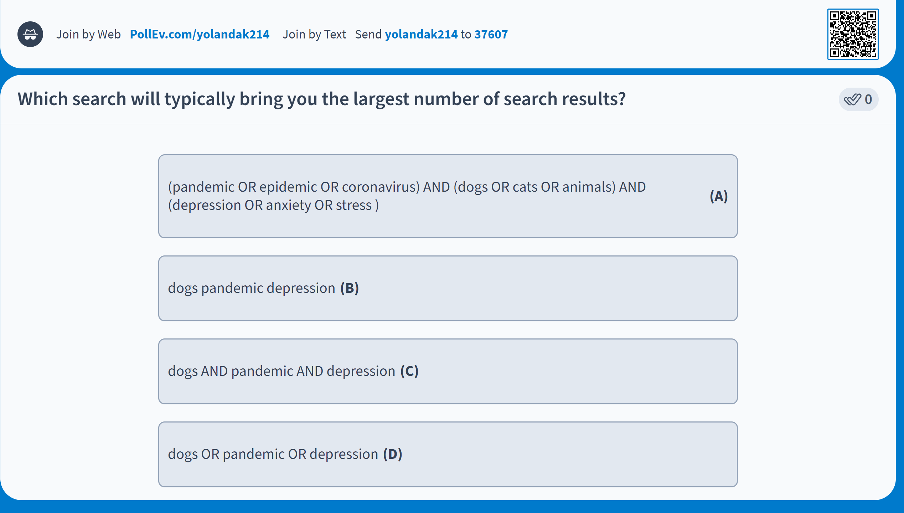
Boolean review

Slide 19
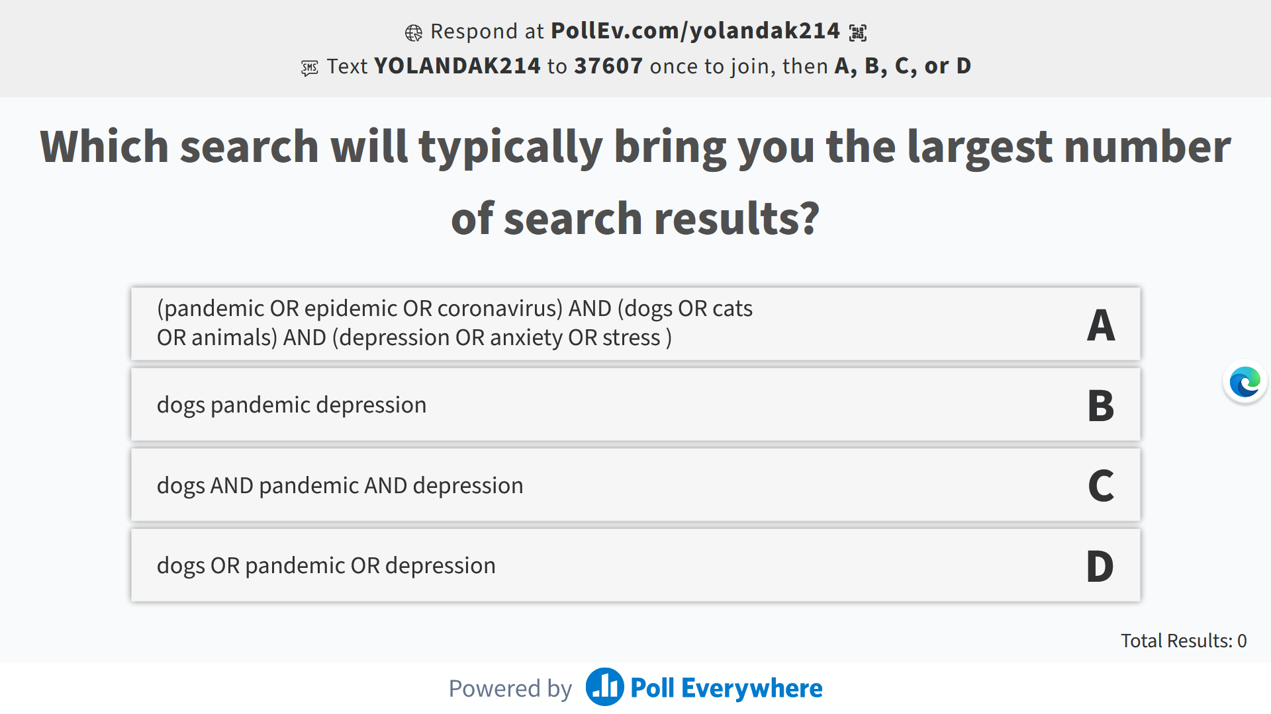
Boolean review

Slide 20
Boolean searching: and/or
PsycINFO
(pandemic OR epidemic OR coronavirus) AND (dogs OR cats OR animals) AND (depression OR anxiety OR stress) (147 results)
Dogs pandemic depression (312 results)
Dogs OR pandemic OR depression (403,498 results)
Dogs AND pandemic AND depression (7 results)
Notes:
In psycINFO
Dogs pandemic depression (312)
Dogs or pandemic or depression (403,498)
Dogs AND pandemic AND depression (7)
(pandemic OR epidemic OR coronavirus) AND (dogs OR cats OR animals) AND (depression OR anxiety OR stress) (147)

Slide 21
Boolean & other Search tips
Use AND between keywords to narrow your search
1
For example: recidivism AND youth
Use OR between keywords to broaden your search
2
For example: Aboriginal OR Indigenous OR First Nations
Use quotation marks around an exact phrase
3
For example: “young offender”
Use an asterisk (*) to find related terms
4
For example: Canad* retrieves: Canada, Canadian, etc.

Slide 22
Search strategies
Hypothesis: Art therapy
decreases recidivism
in young offenders
Art therapy AND criminal
offenders;
Criminal offenders AND
recidivism
Art therapy AND recidivism AND young offenders
Art therapy AND youth

Slide 23


Interlibrary Loan & Book Requests

Slide 24
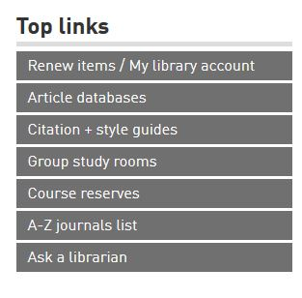

Where to go for help
  Yolanda Koscielski
  ysk6@sfu.ca
Ask a Librarian
  Research help desk (office hours & by appointment)
  Zoom consultations
  Phone: 778.782.4345
  Email: libask@sfu.ca
  AskAway (online chat)
https://i.pinimg.com/originals/de/32/89/de32896d6903b303071c14c42c09e2a8

