Slide 1
SFU Library workshop
Criminology 491: Library research & Literature reviews
Yolanda Koscielski
Librarian for Criminology, Philosophy & Psychology
October 3, 2022
ysk6@sfu.ca

Slide 2
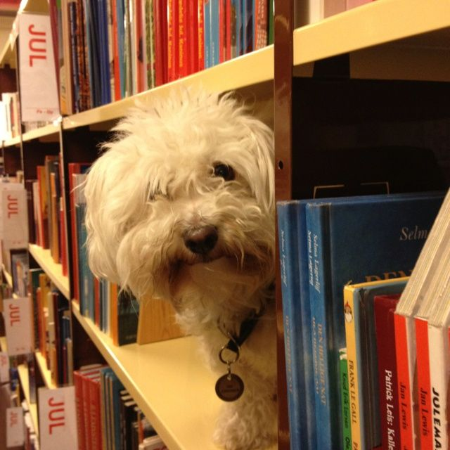
Our agenda
Icebreaker Exercise
Resources for CRIM
Search strategies
https://i.pinimg.com/originals/de/32/89/de32896d6903b303071c14c42c09e2a8.

Slide 3
Activity: What is A Poor literature review?
Make a list of what you can do during the research process
to produce the worst possible literature review.
Works in pairs
3 minutes to discuss
Share with the group – 1 item from list

Slide 4
What is A Poor literature review?
Possible answers:
Ignore disconfirming evidence, dissenting studies
Searching only one or two sources (i.e., only Criminal Justice Abstracts)
Use one variant of search term (no synonyms)
Search without considering if your topic can be expanded/reduced
No rationale for inclusion/exclusion of search terms
Limiting to one type of information source (e.g., only journal articles)
Only old articles
Only new articles

Slide 5
What is A Poor literature review?
Possible answers:
Missing key articles by not following an argument forward in the conversation (e.g., not using Times cited in this database feature when relevant)
Not citing sources
Not understanding material, key concepts
Searching too broad a topic
Not synthesizing or integrating material; putting quotes inside as though they speak for themselves

Slide 6
Finding resources
Where to search
Types of information sources
Library Search / Catalogue Search
Google Scholar
Subject-Specific databases, mostly subscription: 700+ databases
NGOs and other grey literature
Legal analysis, legal cases
Maps & spatial data
Statistics, census
…
Start at the Criminology Research Guide!
Notes:
-Switch gears to looking at various resources, and the library website
-Criminology Research Guide Demo

Slide 7
Using library vs. Catalogue search
Which search is broader (that is, searches across more sources?)

Slide 8
Using library vs. Catalogue search
Poll Everywhere

Slide 9
Using library vs. Catalogue search
Catalogue Search
Preliminary searches
Books
Gov’t docs
etc.
Library Search
SFU Library Subject Research Guides
FAQs – holds, loans, etc.

Slide 10
Catalogue vs. databases
LIBRARY CATALOGUE
SUBJECT-SPECIFIC DATABASES
Expand results beyond our library
*The* place for print books -- and e-books
Tip: Browse Search for known titles
Do we have it? searches
Mapped to a disciplinary perspective
High quality metadata, including subject headings
Limiters unique to discipline
Search history + sets
TIP: Where can I get this link?

Slide 11
Using google scholar
Search Google through the Library website to avoid being prompted for payment
Notes:
TIP – search through library

Slide 12
Using google scholar
STRENGTHS
WEAKNESSES
High volume, popular articles
Generous algorithm
Times cited tool
Known-item searching, unique terminology
Other info:
Institutional Repositories, US case law, grey literature
No specific discipline
Loss of control
Mysterious algorithms + unknown source coverage
Searches are optimized
Missing deep data
Popularity prioritized
Predatory publishers
Payment

Slide 13
Exercise
Criminal Justice Abstracts with Full Text
Business Source Complete
PsycINFO
PsycTESTS
Web of Science
FORENSICnetBASE
CBCA Complete
WestLaw Next Canada
Annual Review of Criminology
Sage Research Methods Online
NCJRS
Canada Commons
LegisINFO
Canadian Points of View Reference Centre
DSM Library
SFU Summit: Criminology Theses
MEDLINE
Primal Pictures Interactive Anatomy
Run a search for a topic of your choice, OR, animal therapy
One minute presentations on both databases (30 seconds each)
What kind of content does the database contain?
How might it be useful to your or your fellow students’ research?
Any kudos, critiques, or other reviews about the database you’d like to share?
Notes:
What would be useful for your cohort to know? Practice using the library website.

Slide 14
Boolean review
Poll Everywhere

Slide 15
Boolean review

Slide 16
Boolean searching: and/or
PsycINFO
(pandemic OR epidemic OR coronavirus) AND (dogs OR cats OR animals) AND (depression OR anxiety OR stress) (147 results)
Dogs pandemic depression (312 results)
Dogs OR pandemic OR depression (403,498 results)
Dogs AND pandemic AND depression (7 results)
Notes:
In psycINFO
Dogs pandemic depression (312)
Dogs or pandemic or depression (403,498)
Dogs AND pandemic AND depression (7)
(pandemic OR epidemic OR coronavirus) AND (dogs OR cats OR animals) AND (depression OR anxiety OR stress) (147)

Slide 17
Boolean searching: and/or
A AND B
A
B
A OR B

Slide 18
Boolean searching: and/or
CATS AND DOGS
CATS
DOGS
CATS OR DOGS
Notes:
Search Strategies

Slide 19
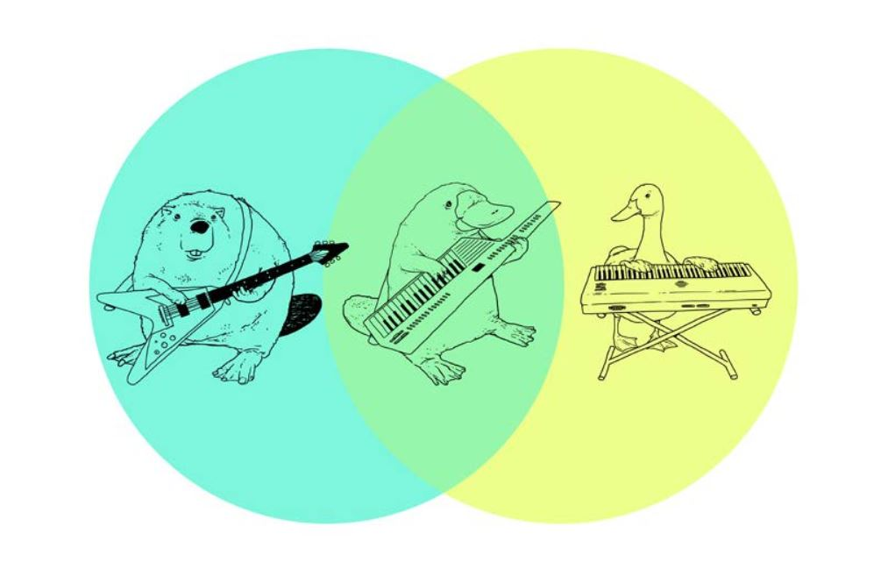
Boolean searching: and/or

Slide 20
Boolean & other Search tips
Use AND between keywords to narrow your search
1
For example: recidivism AND youth
Use OR between keywords to broaden your search
2
For example: Aboriginal OR Indigenous OR First Nations
Use quotation marks around an exact phrase
3
For example: “young offender”
Use an asterisk (*) to find related terms
4
For example: Canad* retrieves: Canada, Canadian, etc.

Slide 21
Search strategies
Hypothesis: Art therapy decreases recidivism
in young offenders
Art therapy AND criminal
offenders;
Criminal offenders AND
recidivism
Art therapy AND recidivism AND young offenders
Art therapy AND youth

Slide 22
Interlibrary Loan & Book Requests
Can send book requests for important titles to purchase directly to me: ysk6@sfu.ca

Slide 23
Finding books – in print!
For print books, look for the call number to find the book’s location on the shelf (eg HV 6534 A8 H65 2016)
What is a call number?
The call number represents what the book is about and acts like the book's address on the library's shelves or stacks. Because books on the shelves are arranged in call number order, you will find books on similar subjects shelved near each other.
Quiz: What order would you find these on the library shelf?
HV 650 B9 H12 2022
HV 6534 A12 2016
H 652 B9 A12 1999
HV 6534 A8 K651 2002
HV 6534 A8 H65 2016
Notes:
Next goal: PRINT or ONLINE books
--buy increasingly more ebooks (online preferred purchase), but some will still be in print, particularly the biographical texts, expensive texts, small presses and very large presses
--print books – jot down the call number, and library staff can help you find the information

Slide 25
Finding books
H 652 B9 A12 1999 (3)
HV 650 B9 H12 2022 (1)
HV 6534 A12 2016 (2)
HV 6534 A8 H65 2016 (5)
HV 6534 A8 K651 2002 (4)
HV = Social pathology. Social and public welfare. Criminology.
6534 = HV6251 - 6773.55 Crimes and offenses
Notes:
Next goal: PRINT or ONLINE books
--buy more and more online, but some will still be in print, particularly the biographical texts.
--print books – jot down the call number, and library staff can help you find the text

Slide 26
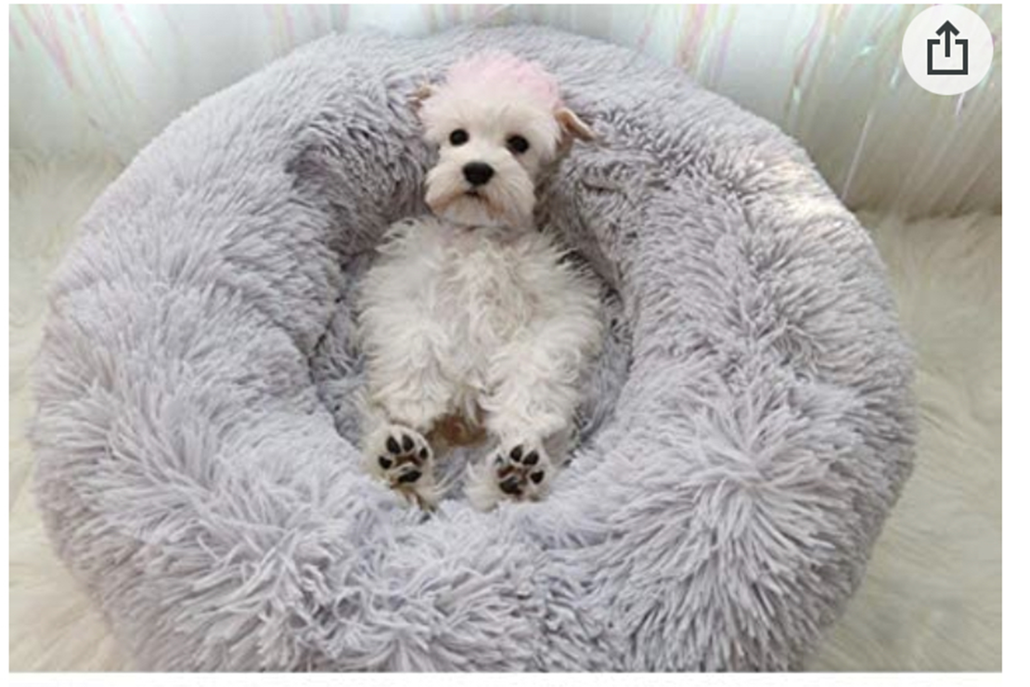
Where to go for help
SharepointHome warm dog bed, photo from Amazon.com
Yolanda Koscielski
ysk6@sfu.ca
778-872-3315
AskALibrarian
Email us at: libask@sfu.ca
AskAway (online chat)

