Slide 1
SFU Library
Criminology 330: Library research
Yolanda Koscielski
Liaison Librarian for Criminology, Philosophy & Psychology
ysk6@sfu.ca
James Bachmann
Library Learning and Instruction
October 7 & 8, 2019

Slide 2
Our agenda
Provide an introduction to legal research to help with your course assignment:
Use online legal resources to locate case law and legislation
Understand case citations
Learn some relevant terminology and definitions
“And I thought we were friends” by hehedan,
CC BY-NC 2.0

Slide 3
Our agenda
The assignment will be distributed about halfway through the tutorial.
You will have time to work independently on it
Librarians are available for questions
"Outside of a dog, a book is man's best friend. Inside of a dog it's too dark to read“ –Groucho Marx, by Brunobib CC BY-SA 2.0

Slide 4
What is legal literature?
Primary legal literature
The source of the law itself
Case law / Judgments / Reasons for Decision (common law)
Legislation – Acts / Statutes, Regulations
Notes:
Move from overview to researching these legal system via various sources. Can be thought of as two main types of legal information.
Primary legal literature consists of sources that outline the law: case law and other decisions, statutes, regulations. The sources of law.

Slide 5
What is legal literature?
Secondary legal literature
Writing about the law, such as:
articles from academic legal journals
case commentary
newsletters and digests by legal experts
textbooks, books
other literature written about primary legal sources
Provides an understanding of legal issues and case law in context
Notes:
Secondary legal literature is writing about the law, but not the source of the actual law itself (a few exceptions, such as some often-cited legal treatises)

Slide 6
Court Systems
Court Systems | Description
Superior | Major civil and criminal cases heard in this court. Most case law found in our in legal databases originates from this court system.
Inferior | A high volume of cases, including criminal cases Often known as “provincial court” Typical jurisdiction: small claims, traffic offences, criminal offences, family matters
Federal | Some designated matters go to federal court: e.g., copyright, industrial design, patents, cases around the legality of federal gov’t actions
Note: superior and inferior court structures and names will vary between provinces. Check websites, e.g., Provincial Court of British Columbia
Table adapted from: Legal Research on the Web, Winter 2012 course material, iSchool Institute, Faculty of Information, University of Toronto
Notes:
Very generalized summary of court structure in Canada (excluding Quebec)
Canada has three main court systems
The Superior court system is where you will find most cases listed in legal databases. Civil and criminal matters.
Inferior court system deals with many legal cases (225,000 cases per year)
There are different names for these courts, depending on the provinces.
Many criminal offences are heard here, (over 95% of criminal offences) unless they are major cases such as murder.
Not as many listed in legal databases because they are not legally important (i.e., precedent setting). “Provincial Court”: “You can also dispute by-law offences such as walking a dog without a leash.”
Federal court matters are determined by legislation (Federal Court Act) & (Tax Court of Canada Act) and may include copyright, industrial design, patents, cases around the legality of gov’t actions, maritime lawsuits, etc.
+ Tribunals

Slide 7
Primary literature - Case lawCase Law
The terms Case Law, Reasons for Decisions, and Judgment are often used interchangeably
Case law is available through both multiple free and subscription sources (court websites, databases, etc.)
Significant overlapping coverage of case law across various databases

Slide 8
Primary literature - Case lawCase
Main content of published case law should be identical, regardless of source
Free sources – namely, CanLII – make the law publically accessible
Subscription sources often include value-added content such as
summarizing headnotes
subject classification
research tools such as the Canadian Encyclopedic Digest

Slide 9
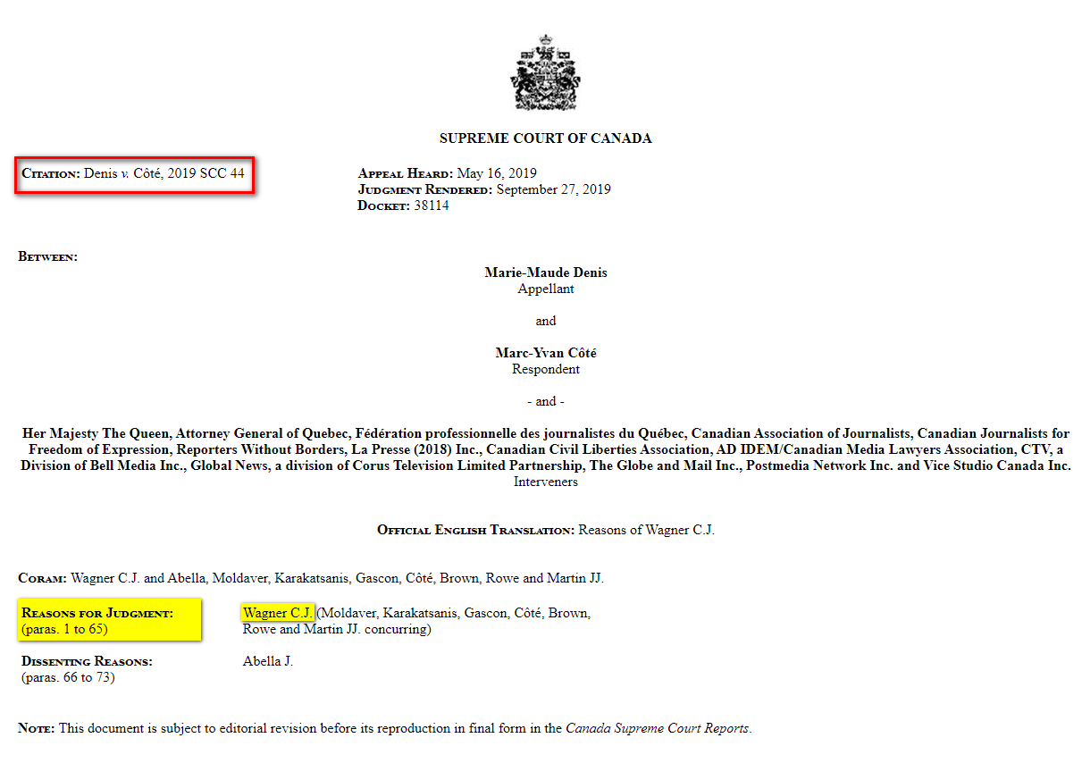
Primary literature - Case lawCaseLaw
Note: Supreme Court of Canada cases are heard by multiple judges, with one judge who writes the Reasons for Judgment for the majority of the Court.
Notes:
Take a closer look at example piece of case law.
(Image is hyperlinked to case)

Slide 10
Legal research databases
Three main online resources for legal research at SFU
CanLII (open access)
Westlaw Next Canada
Lexis Advance Quicklaw
Plus:
HeinOnline
SFU Library’s list of law-related databases
DEMO – How to access
Notes:
DEMO: Where legal databases are.
DEMO: Open up CanLII, as we will spend most of our time looking at this free resource. It’s accessible after you graduate.
You’ll go to the first three in your assignment

Slide 11
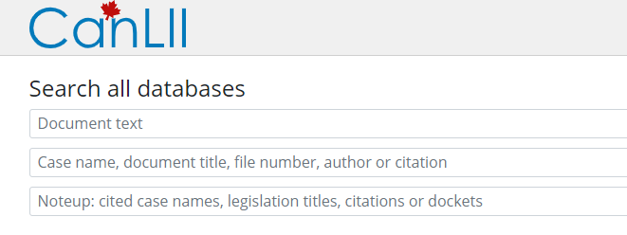
canlii
“CanLII is a non-profit …. [whose] goal is to make Canadian law accessible for free on the Internet
Find Canadian primary law in one place
court judgments
tribunal decisions
statutes and regulations
Notes:
Note the different fields for searching here – not like the three search lines of other databases, which are all the same.

Slide 12
Primary literature - legislation
As with case law, there are free sources and subscription sources for legislation
Also significant overlapping coverage in legislation covered in databases and websites
Free sources include CanLII and government websites (e.g, LegisINFO)
Make sure you are looking at the most up-to-date version; many sources provide access to historical versions of laws

Slide 13
Finding a case or decision
You will often search for a particular case in a database by either:
1) case citation, or,
2) case name
A case name is based on the abbreviated names of the parties involved in the case. Example case names:
R v Sun Glow Foodservice Ltd
Western Canada Wilderness Committee v Canada (Minister of Environment)
Moore v Bertuzzi
Notes:
Highlight what R means – Regina for Queen

Slide 14
Understanding case citations
Legal citation help: The Queen’s University Library’s Guide to Legal Citation with the 9th edition of the McGill Guide
Notes:
Case name = the parties involved in the case: the Plaintiff vs. Defendant, Petitioner v. Respondent, Complainant v. Respondent
Case citation = usually a neutral citation (most courts issued after 1999).
Neutral citation Elements: year of decision, abbreviation of the court, an ordinal number (basically a SIN number for the case).
“Neutral” because it the case is represented by the citation without reference to a commercial reporter (neutral = “no name” brand)
Some cases don’t have neutral citations. In which case, you may see a citation to a court reporter. Won’t go into detail, just note that they exist.
[Info in case there are questions:
Parentheses – the year the decision was made.
Next, which law reporter reported on the case. There can be several. This report can be found in the 69th volume of the Dominion Law Reports on page 433.
Traditionally judgments were (and still are) published in series of volumes called "law reports." The SFU Library in Burnaby has a large number of print law reports series such as Business Law Reports (HF 1278 B8), but our collection has migrated to online content now.
The "2nd" tells you that the DLR has been published in multiple series; the second series was 1956-68. Some law reports stop at a certain series, e.g., 100, before they reset
First page of the report
Supreme Court of BC decision. The abbreviated name of the court in which the case was tried, enclosed in round brackets, sometimes appears at the very end of the citation.]

Slide 15
Find a case or decision
CanLII
By case name: Fibercom Systems Inc. v Rogers Cable Inc
By case citation: 2005 BCSC 419
Notes:
In this example, we have two cases; it’s useful to also have the case citation to distinguish between the two.

Slide 16
Case citations
Notes:
Take a minute and try this out.

Slide 17
Case citations

Slide 18
NOTing up a case
Noting up a case means you are researching a case to see if it has:
1) been cited (referred to) in subsequent cases, and,
2) if the case has progressed to a higher court, ensuring you have found the most recent (i.e., legally relevant) version of a case
Future court cases may treat the cited case in different ways:
Followed, Distinguished, Explained, Mentioned, Cited…
DEMO: Noting up a case in Lexis Advance Quicklaw: R v Tran, 2010 SCC 58
Notes:
DEMO:
Enter case citation
Click “History of the Case” on the left hand side
Once in the history section:
View the section “Citing Cases” to see how many courts in other cases have followed, distinguished, explained, mentioned or cited this case. 95 cases have cited this one.
Note where to find where a case has been mentioned, followed, cited in dissenting cases, etc. (text in blue box)

Slide 19
Secondary legal literature: CED
The Canadian Encyclopedic Digest (C.E.D.) is an example of secondary legal literature found through a subscription database
It highlights key legislation and important cases by legal topic
Access it via Westlaw Next
Notes:
We’ll do exercises on all three of these methods, so just a demo for this part.

Slide 20
Westlaw Next Canada
Notes:
Flexible full-text search bar, always adjusting to search whatever is below it
Primary legal literature = Primary Sources
Secondary legal literature = Commentary
Note separate subscriptions on the left
Next – get started on assignment. Learn by doing

Slide 21
Where to go for help
Yolanda Koscielski, Liaison Librarian
ysk6@sfu.ca
Research help desk (drop-in & by appointment)
Phone: 778.782.4345
Email us at: libask@sfu.ca
AskAway (online chat)

