Slide 1
SFU Library Orientation
Criminology 103 – Spring 2024
Yolanda Koscielski
Librarian for Criminology, Philosophy & Psychology
ysk6@sfu.ca
Notes:
Plus legal research

Slide 2
Your term paper
Choice of 6 criminals
Describe the case in detail
Provide relevant background information on the individual (such as developmental/family history, schooling, employment, early signs of delinquency, etc.)
Present the appropriate psychological theory that best explains the motivations and behaviour of the offender
Convincingly apply the theory to the case

Slide 3
Your term paper - resources
A high quality paper will make use of relevant primary sources such as books and scholarly journal articles to support your view on explaining criminal behaviour.
It is recommended that you use a minimum of 5 sources for your paper. You may use general online sources to obtain information about the individual’s crime, but you may not use such sources to describe and explain theories or as supporting evidence for your arguments about why a particular theory is applicable.

Slide 4
CRIMINOLOGY 103 RESEARCH GUIDE
Notes:
Access from the main Criminology guide, or just search crim 103 on the library site. PP from today will be found there.

Slide 5
Finding online articles – 3 Main Library places
Library Search
Catalogue Search
Article databases

Slide 6
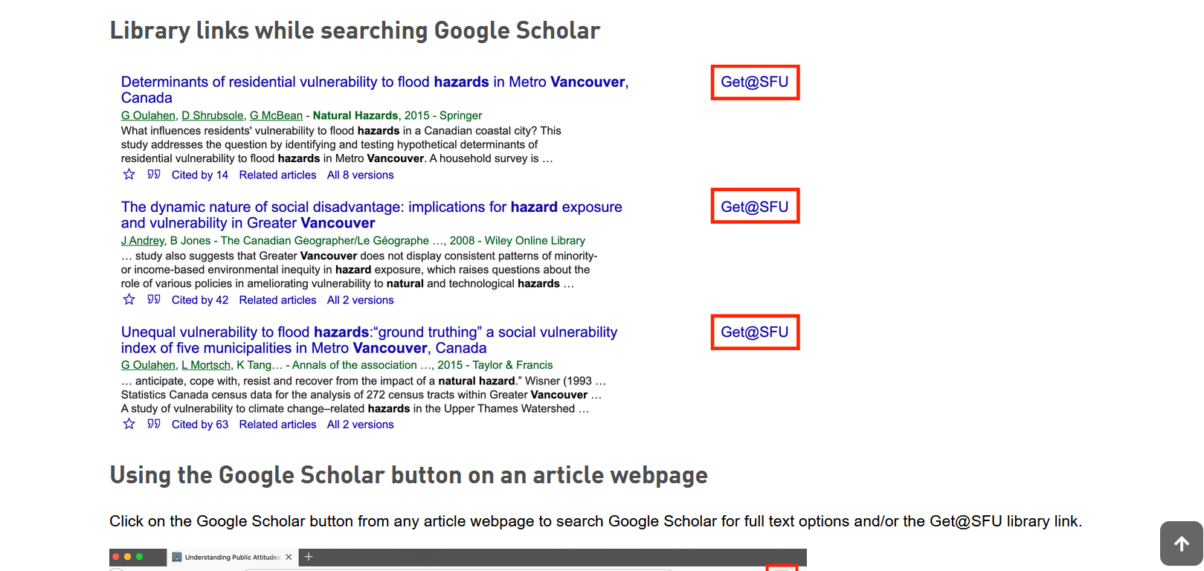
Avoid paying for research + resources
SFU library links in Google Scholar

Slide 7
Access Library Resources - LibKey Nomad
Running into paywalls and multi-step workarounds?
LibKey Nomad provides instant access to journal articles and e-books.
Add the Libkey Nomad browser extension to your computer's internet browser (Safari, Chrome, Firefox, or Microsoft Edge) to be connected to the library's holdings when navigating the internet.
thirdiron.com/downloadnomad

Slide 8
How to install LibKey Nomad
Go to thirdiron.com/downloadnomad
Choose your browser and follow the prompts to install the LibKey Nomad browser extension
Search for and choose Simon Fraser University as your organization
You’re all set!
Look for LibKey Nomad icons on scholarly webpages.
Notes:
* Google Scholar

Slide 9
Avoid paying for research + resources

Slide 10
Access Library Resources
Make use of (free!) Interlibrary Loan System for books and journal articles
Overjoyed cats.

Slide 11
Background and case information sources

Slide 12
Background and case information sources
Popular Crime literature in collection – print and online (not academic)
Book and book chapters
Encyclopedia entries
TIP: use name variants, nicknames
Example: Joseph James DeAngelo, Golden State Killer, Original Night Stalker, EARONS,…
Search by accomplice names, if applicable
Click on the catalogue’s subject heading

Slide 13
Background and case information sources
DEMO: John Allen Muhammed, John Allen Williams, D.C. Sniper, Lee Boyd Malvo (accomplice) -
Example: Sniper : inside the hunt for the killers who terrorized the nation

Slide 14
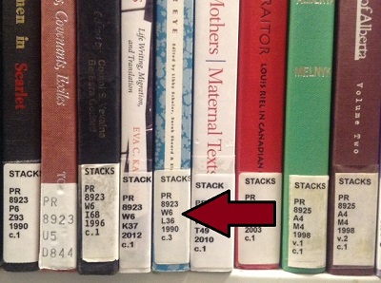
Finding books – in print!
What is a call number?
The “call number” represents what the book is about and acts like the book's address on the library's shelves or stacks. Because books on the shelves are arranged in call number order, you will find books on similar subjects shelved near each other.
HV 6115 W34 2009
Alpha - Subject
Numeric- Subject
Location
Year of Publication

Slide 15
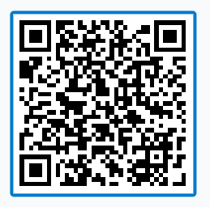
Finding books – in print!
Quiz: What order would you find these books on the library shelf?
HV 6534 A12 2016
HV 650 B88 A12 1999
H 650 B9 H12 2022
HV 6534 A8 H65 2016
PollEv.com​/yolandak214 OR Send yolandak214 to 37607

Slide 16
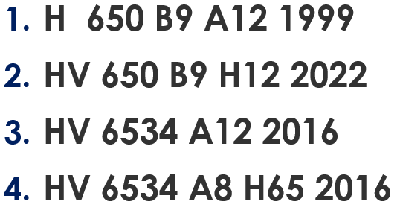
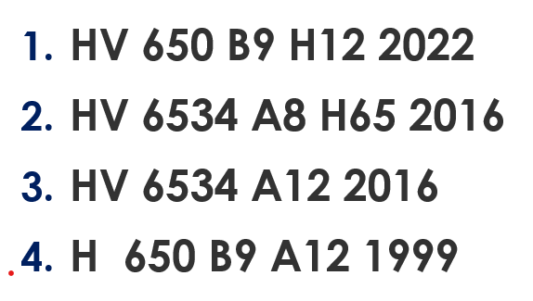
Finding books – in print!
Option A
Option B
Send A, B, or C to yolandak214 to 37607
Option C
Notes:
--buy more and more online, but some will still be in print, particularly the biographical texts.
--print books – jot down the call number, and library staff can help you find the information

Slide 17
Finding books
Answer:
H 650 B9 A12 1999
HV 650 B9 H12 2022
HV 6534 A12 2016
HV 6534 A8 H65 2016
Notes:
Next goal: PRINT or ONLINE books
--buy more and more online, but some will still be in print, particularly the biographical texts.
--print books – jot down the call number, and library staff can help you find the information

Slide 18
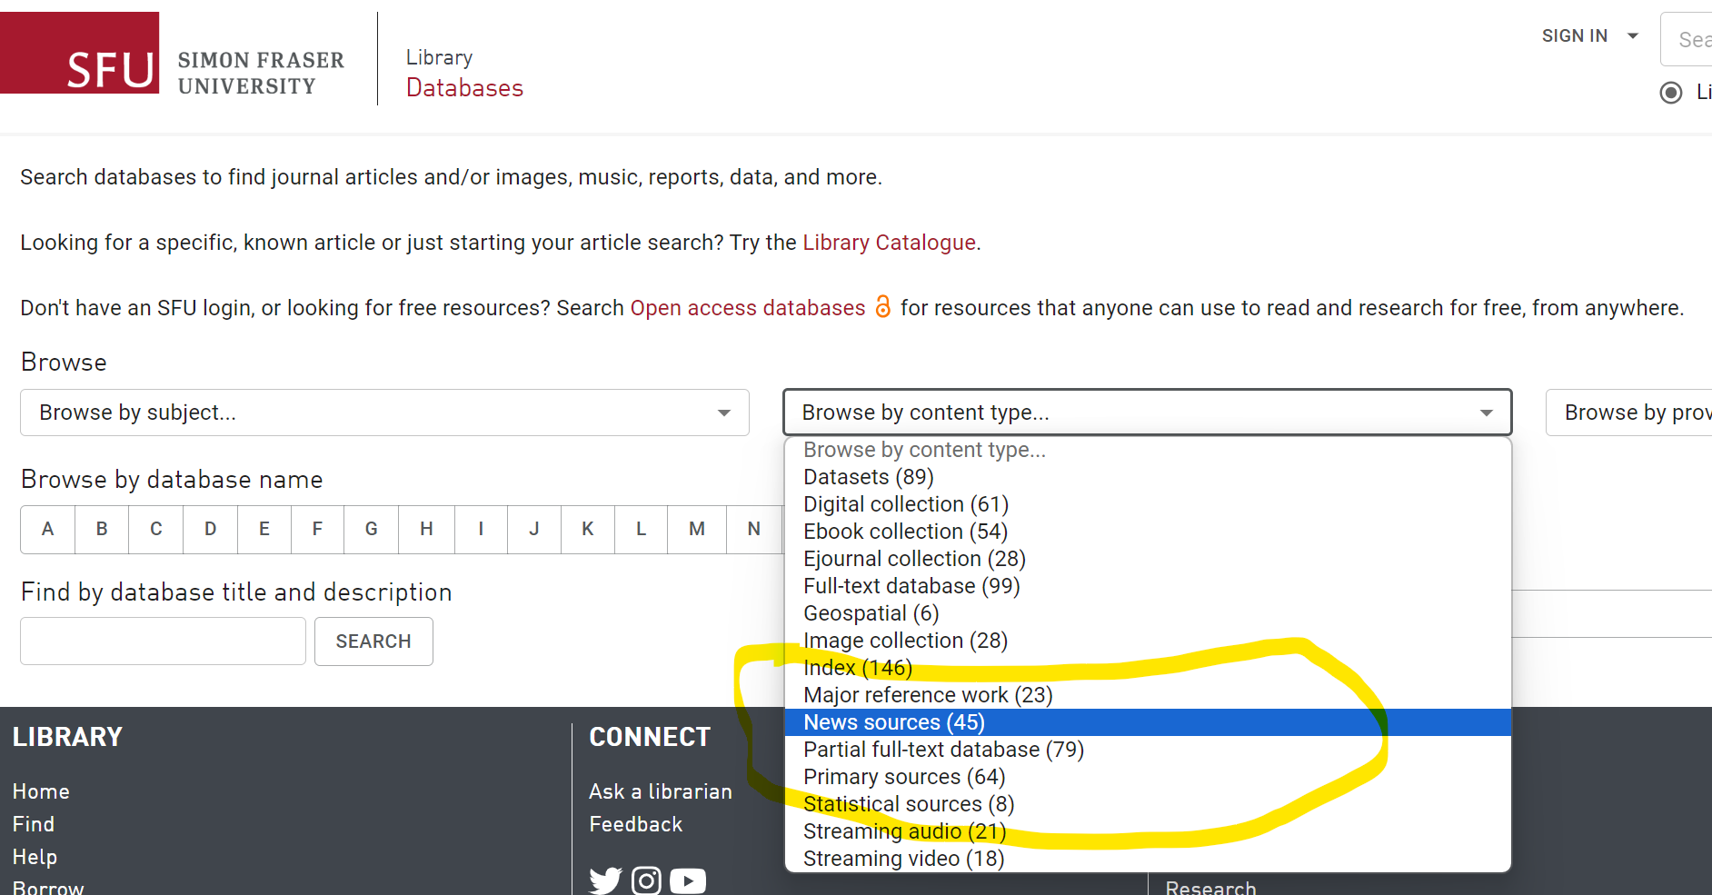
Background and case information
Newspapers + news magazines databases
News content archived* in databases. More stable and searchable than many media website.
CBCA Complete
Canadian Newsstream

Slide 19
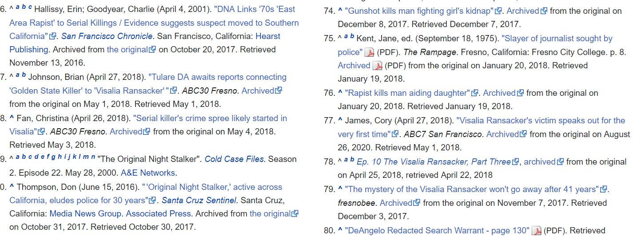
Background and case information
Wikipedia –
track down
Citations / Citation Finder

Slide 20
Highlighted Resource
DSM-V-TR (Diagnostic and Statistical Manual of Mental Disorders)*
The standard diagnostic tool used by mental health professionals worldwide, in particular, psychiatry.
Paraphilic Disorders
Disruptive, Impulse-Control, and Conduct Disorders
Pyromania, Kleptomania,etc.
Personality Disorders
Antisocial personality disorder
…..many entries

Slide 21
Highlighted Resource
A book! – print or electronic
In particular, a book chapter
Example: Biology and criminology : the biosocial synthesis

Slide 22
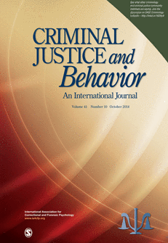
Scholarly vs popular sources
Popular magazine articles
Examples: People, Psychology Today
Scholarly journal articles
Example: Criminal Justice and Behavior: An International Journal

Slide 23
Scholarly vs popular articles
Popular magazine articles
Example: Psychology Today
Scholarly journal articles
Example: Criminal Justice and Behavior: An International Journal
Audience: general public
Colourful graphics & advertisements
Good for broad overview & popular perspective, case details
Plain language
No abstracts or citations (rare)
Audience: academics, assume some shared knowledge
Mostly text, with some tables & charts
Good for historical, current, scholarly, in-depth perspective
Subject-specific language
Includes abstracts & citations
Key criterion: peer-reviewed

Slide 24
Scholarly vs popular articles
Psychology Today “Presents scientifically accurate psychological information for the layperson”.

Slide 25
Finding online Academic articles
Article databases
More targeted
Subject-specific searches

Slide 26
RECOMMENDED article DATABASES for primary research
Criminology specific/appropriate databases:
A source for scholarly journal articles on Criminological theories
Criminal Justice Abstracts: The core database for Criminology
PsycINFO: The core database for research in Psychology, including many topics related to crime.
Sociological Abstracts: Sociological perspective on some Criminology-related topics.
Notes:
Databases linked to subject

Slide 27
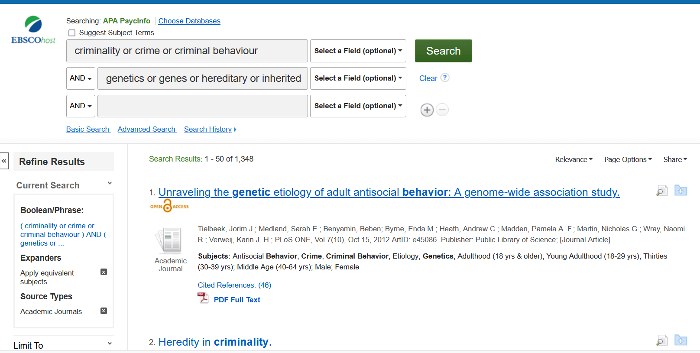
Example search in the database PsycINFO
TIP: use name variations and concept synonyms e.g., genes or genetics or hereditary or inherited…
TIP: use name variations here as well, e.g., Unabomber OR Ted Kaczynski

Slide 28
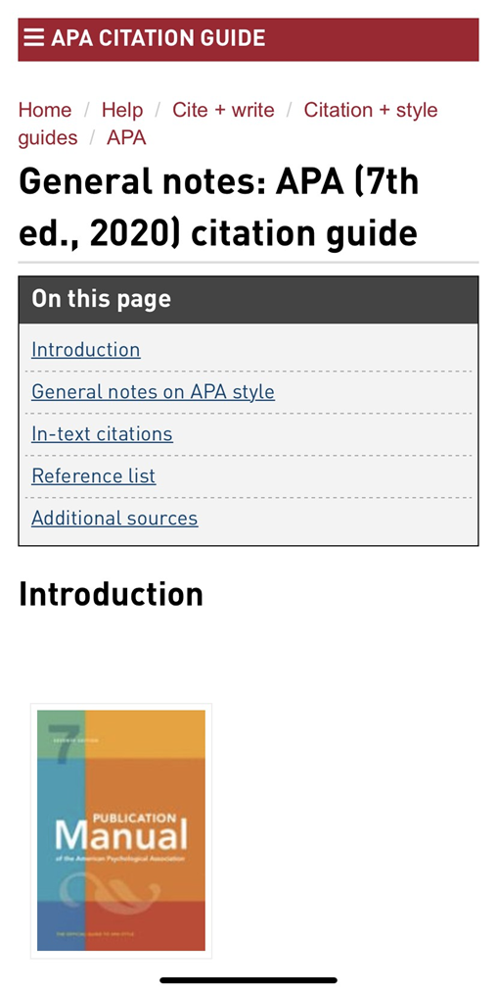
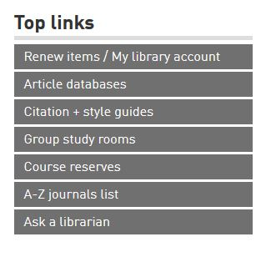
APA citation
APA Style
SFU Library’s APA (7th edition) Resource Guide offers a lot of help with this citation style and provides some useful links to extra APA-help pages.
Ask a librarian if you have any questions about how to cite!

Slide 29
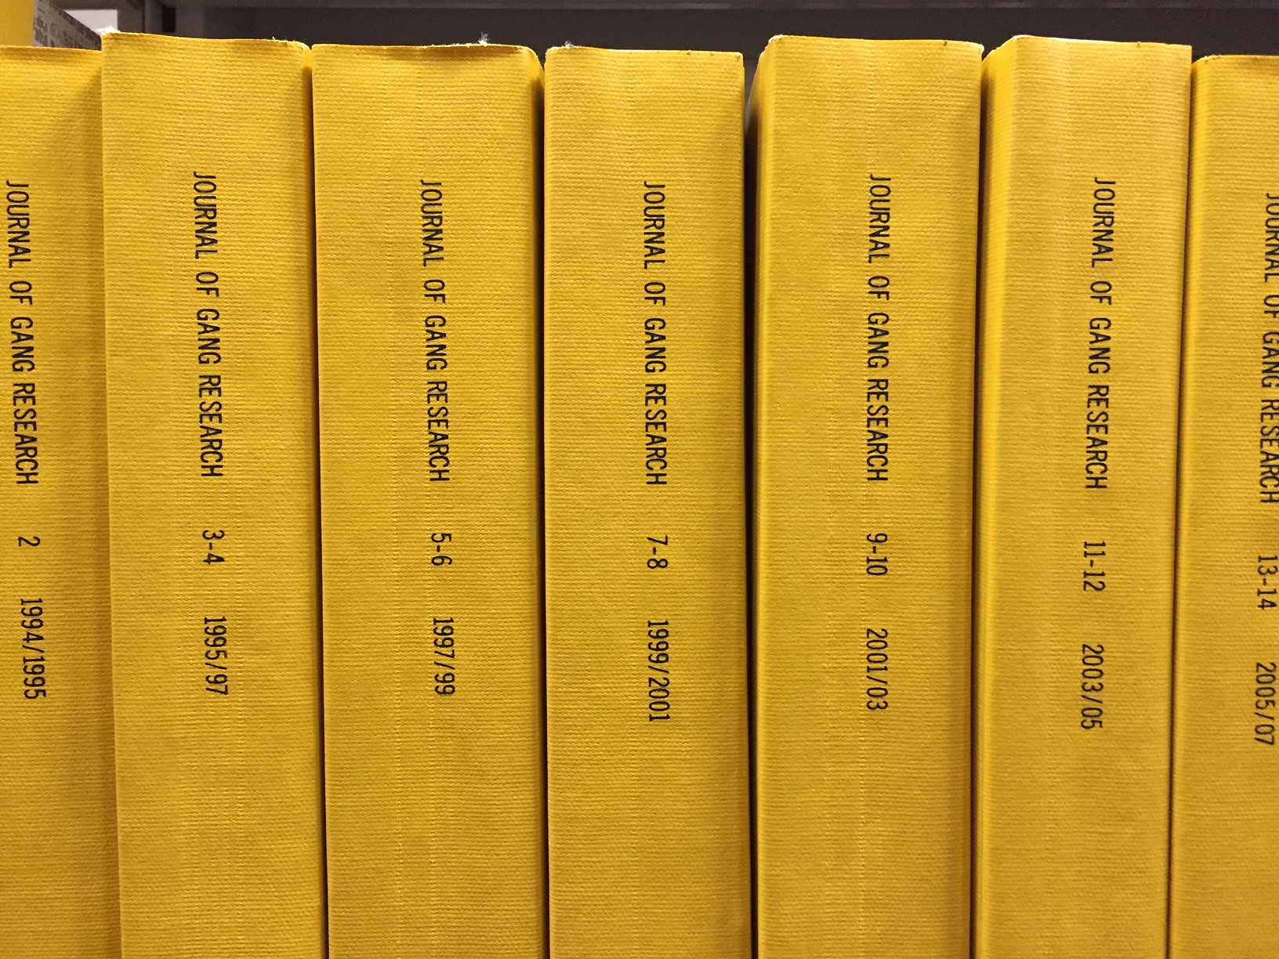
bONUS assignment!
Library research assignment for a bonus point next week.
For 1 additional bonus participation point, complete the following assignment:
Go to the W.A.C. Bennett Library and find any article printed in the Journal of Gang Research.
Photocopy the first page of the article that contains the abstract, write your name on it, and bring it to class next week.
Notes:
Sixth floor of the Bennett Library, organized by Journal name, lots of journals start with the word journals
Objectives:
PHYSICALLY go to the library,
Find a journal that’s available in hard copy only,
make a copy of the abstract.
--Step foot in the library
--Figure out how to look something up by call number, locate a volume, and find an article.
--While I realize the vast majority of journals are now available electronically, this is not always true, and is certainly not always true

Slide 30
Help!
Ask a Librarian
Research help desk (office hours or appointment)
In-person or Zoom
Phone: 778.782.4345
Email
AskAway (online chat, weekends and evenings)
Student Learning Commons
Academic writing, study skills, EAL/ESL support, Write Away
Notes:
Where to go for help

