Slide 1
SFU Library Orientation
Criminology 103 – Spring 2022
Yolanda Koscielski
Librarian for Criminology, Philosophy & Psychology
ysk6@sfu.ca
Notes:
Plus legal research

Slide 2
Our agenda
Scope of Library Service & Support
Resources for your assignment:
Background and case info
Primary research
Peer-reviewed articles
APA citation
Help
https://i.pinimg.com/originals/de/32/89/de32896d6903b303071c14c42c09e2a8

Slide 3
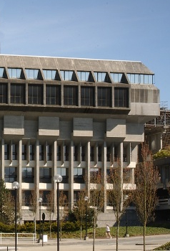
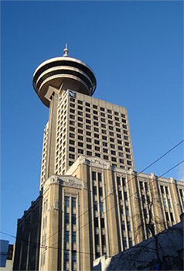
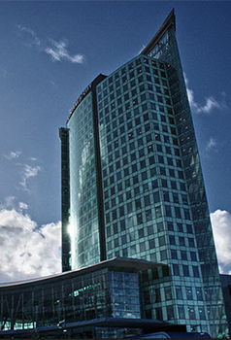
SFU Library Info
A few quick facts about us …
SFU Burnaby
SFU Vancouver
SFU Surrey
Online
three campus libraries – one system
2.5 million+ books & e-books
98,000+ subscriptions to journals, magazines & newspapers
500+ research databases
Use the library remotely and Return to Campus Updates

Slide 4
Avoid paying for research + resources
Google scholar + websites, generally – avoid paywells!
See: Accessing online resources from off-campus – subscriptions resources
LibKey Nomad or Endnote Click (formerly Kopernio) = browser extensions
SFU library links in Google Scholar
SFU Library Off-Campus Bookmarklet:
Where can I get this link? in databases
Interlibrary Loan
Print version
Materials we don’t have
Notes:
Not textbooks

Slide 5
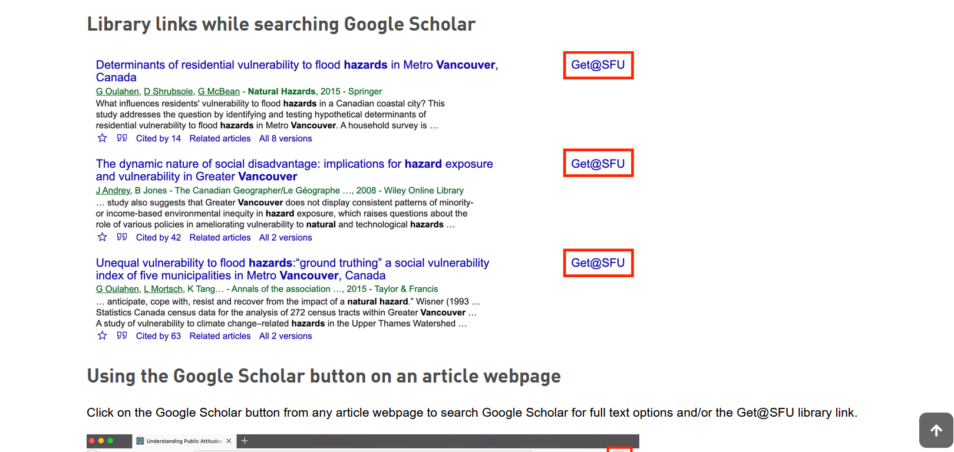
Avoid paying for research + resources
SFU library links in Google Scholar

Slide 6
Avoid paying for research + resources

Slide 7
Your term paper
Your paper should:
Choice of 6 criminals
Describe the case in detail
Provide relevant background information on the individual (such as developmental/family history, schooling, employment, early signs of delinquency, etc.)
Present the appropriate psychological theory that best explains the motivations and behaviour of the offender
Convincingly apply the theory to the case

Slide 8
Your term paper - resources
Make use of primary sources such as books and scholarly journal articles
Must use a minimum of 5 sources for your paper
You may use general online sources to obtain information about the individual’s crime, but you must not use such sources to describe and explain theories or as supporting evidence for your arguments on why a theory is applicable

Slide 9
CRIMINOLOGY 103 RESEARCH GUIDE
Notes:
Access from the main Criminology guide, or just search crim 103 on the library site.

Slide 10
Where to start…
Activity: jot down 3+ sources where you might go for information on the case or primary research on the theories explaining the crime

Slide 11
Background and case information sources
Notes:
--Popular Crime literature in collection – print and online
--book and book chapters
--not academic sources
--TIP: use name variants
--DEMO: John Allen Muhammed, John Allen Williams, D.C. Sniper, Lee Boyd Malvo (accomplice)
--Joseph James DeAngelo, Golden State Killer, Original Night Stalker, EARONS
--Example: Sniper : inside the hunt for the killers who terrorized the nation / Sari Horwitz and Michael E. Ruane ; with exclusive reporting from the metropolitan staff of The Washington Post.
--Need a book review or amazon to find it. Note the subject heading.

Slide 12
Background and case information sources
Popular Crime literature in collection – print and online (not academic)
Book and book chapters
Encyclopedia entries
TIP: use name variants
Example: Joseph James DeAngelo, Golden State Killer, Original Night Stalker, EARONS,…
Search by accomplice names, if applicable
Use Amazon to identify titles* (* with caution)
Click on the catalogue’s subject heading
DEMO: John Allen Muhammed, John Allen Williams, D.C. Sniper, Lee Boyd Malvo (accomplice) -
Example: Sniper : inside the hunt for the killers who terrorized the nation

Slide 13
Finding books – in print!
For print books, look for the call number to find the book’s location on the shelf (eg HV 6534 A8 H65 2016)
What is a call number?
The call number represents what the book is about and acts like the book's address on the library's shelves or stacks. Because books on the shelves are arranged in call number order, you will find books on similar subjects shelved near each other.
Quiz: What order would you find these on the library shelf?
HV 650 B9 H12 2022
HV 6534 A12 2016
H 652 B9 A12 1999
HV 6534 A8 K651 2002
HV 6534 A8 H65 2016
Notes:
Next goal: PRINT or ONLINE books
--buy more and more online, but some will still be in print, particularly the biographical texts.
--print books – jot down the call number, and library staff can help you find the information

Slide 14
Finding books
H 652 B9 A12 1999 (3)
HV 650 B9 H12 2022 (1)
HV 6534 A12 2016 (2)
HV 6534 A8 H65 2016 (5)
HV 6534 A8 K651 2002 (4)
HV = Social pathology. Social and public welfare. Criminology.
6534 = HV6251 - 6773.55 Crimes and offenses
Notes:
Next goal: PRINT or ONLINE books
--buy more and more online, but some will still be in print, particularly the biographical texts.
--print books – jot down the call number, and library staff can help you find the information

Slide 15
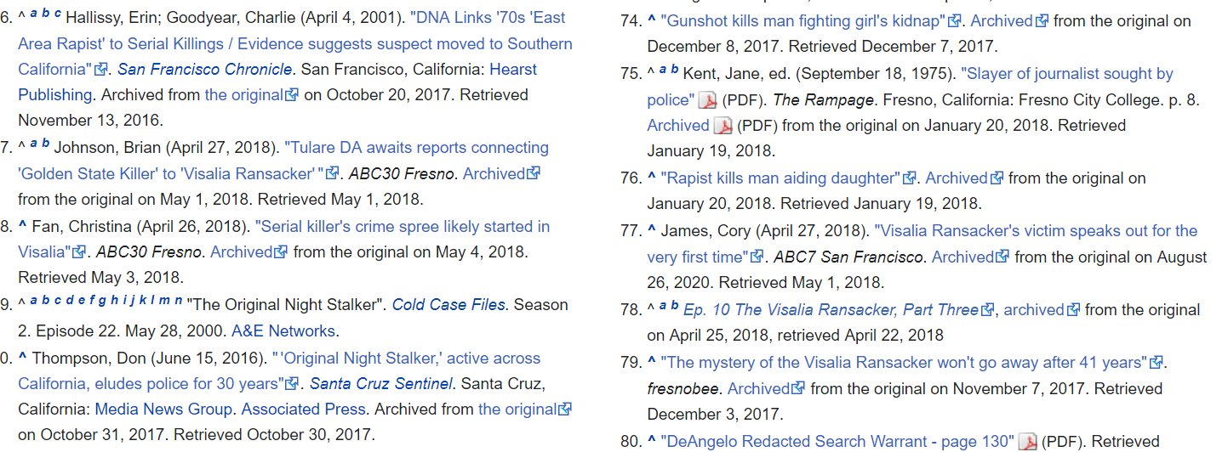
Background and case information
Newspapers + news magazines databases
More stable, searchable, and free-through-SFU-Library content
CBCA Complete
Canadian Newsstream
Wikipedia –
track down
Citations / Citation Finder
Notes:
Graduate and honours – more manipulable for larger, content-analysis studies

Slide 16
Highlighted Resource
DSM-V (Diagnostic and Statistical Manual of Mental Disorders)*
The standard diagnostic tool used by mental health professionals worldwide, in particular, psychiatry.
Paraphilic Disorders
Disruptive, Impulse-Control, and Conduct Disorders
Pyromania, Kleptomania,etc.
Personality Disorders
Antisocial personality disorder
…..many entries

Slide 17
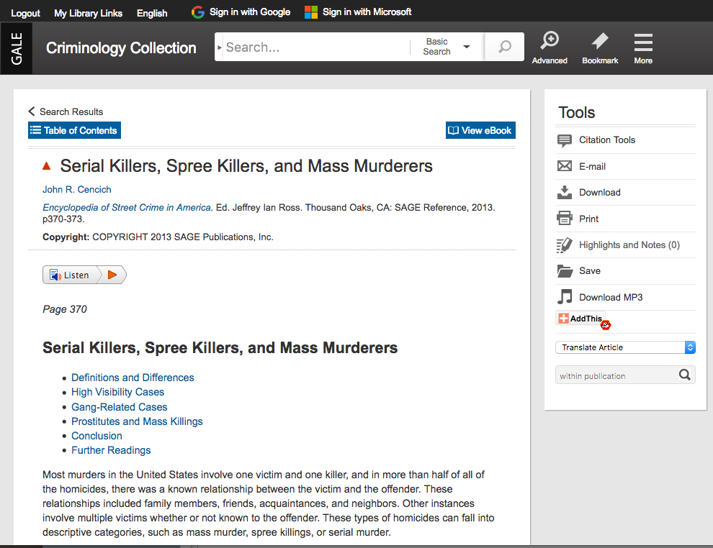
Highlighted Resource
Overview of your topic / the “big picture”
Written with the academic in mind, often by specialists in the field
Use the bibliography to identify key articles, studies, authors, etc.
Often entries are found in catalogue
Example:
Encyclopedia of Criminology and Criminal Justice
Explanations for Criminal Behaviour (volume)

Slide 18
Highlighted Resource
A book! – print or electronic
In particular, a book chapter
Example: Biology and criminology : the biosocial synthesis

Slide 19
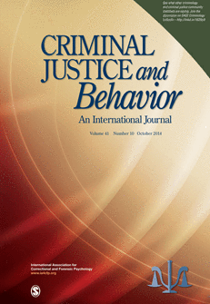
Scholarly vs popular sources
Popular magazine articles
Examples: People, Psychology Today
Scholarly journal articles
Example: Criminal Justice and Behavior: An International Journal

Slide 20
Scholarly vs popular articles
Popular magazine articles
Example: People
Scholarly journal articles
Example: Criminal Justice and Behavior: An International Journal
Audience: general public
Colourful graphics & advertisements
Good for broad overview & popular perspective, case details
Plain language
No abstracts or citations (rare)
Audience: academics, assume some shared knowledge
Mostly text, with some tables & charts
Good for historical, current, scholarly, in-depth perspective
Subject-specific language
Includes abstracts & citations
Key criterion: peer-reviewed

Slide 21
Scholarly vs popular articles
Psychology Today “Presents scientifically accurate psychological information for the layperson”.

Slide 22
Finding online articles – 3 Main places
Library Search Broad/preliminary searches
Searches many (but not all) databases + library website
Catalogue Search
Narrower than library search
Article databases
More targeted
Subject-specific searches

Slide 23
RECOMMENDED article DATABASES for primary research
Criminology specific/appropriate databases:
Criminal Justice Abstracts: Covers crime trends, crime prevention and deterrence, juvenile delinquency, juvenile justice, police, courts, punishment and sentencing.
PsycINFO: The core database for research in Psychology, including many topics related to crime and deviance.
Sociological Abstracts: Sociological perspective on topics such as law and penology, social psychology, violence, and more.
Notes:
Databases linked to subject

Slide 24
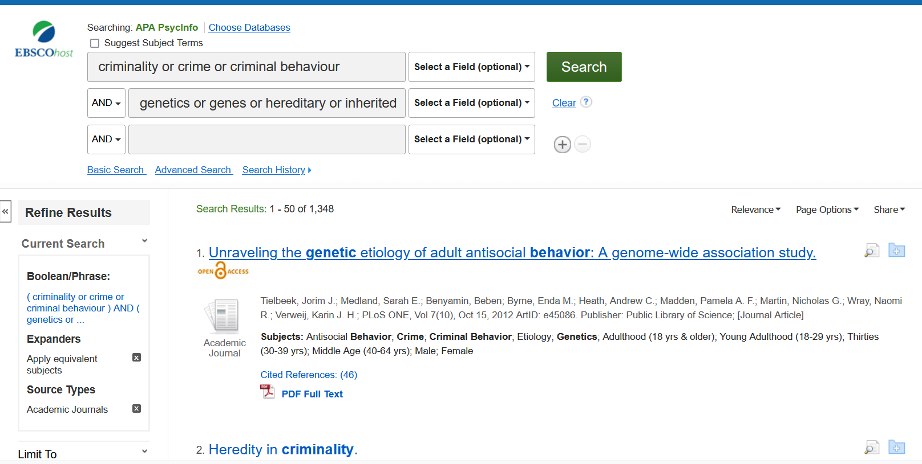
Example search in the database PsycINFO
TIP: use name variations and concept synonyms e.g., Unabomber OR Ted Kaczynski
TIP: use name variations here as well, e.g., Unabomber OR Ted Kaczynski

Slide 25
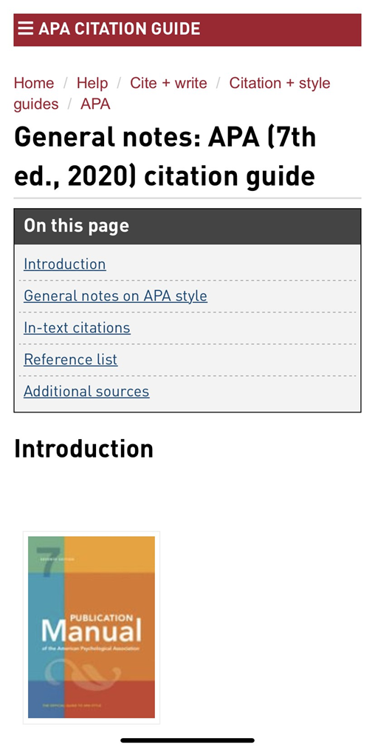
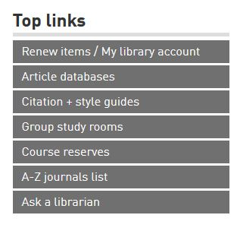
APA citation
APA Style
SFU Library’s APA (7th edition) Resource Guide offers a lot of help with this citation style and provides some useful links to extra APA-help pages.
Ask a librarian if you have any questions about how to cite!

Slide 26
Help!
Ask a Librarian
Research help desk (drop-in & by appointment)
NEW!: Zoom consultations
Phone: 778.782.4345
Email
AskAway (online chat)
Student Learning Commons
Academic writing, study skills, EAL/ESL support, Write Away
Notes:
Where to go for help

