Slide 1
SFU Library - Research skills
Criminology 101 – introduction to criminology - Spring 2023
Billy Fung
libask@sfu.ca
Notes:
Plus legal research

Slide 2
Acknowledgment
We acknowledge SFU’s three campuses are on the ancestral and unceded lands of the
xʷməθkʷəy̓əm (Musqueam),
Sḵwx̱wú7mesh (Squamish),
Səl̓ílwətaɬ (Tsleil-Waututh),
q̓íc̓əy̓ (Katzie),
kʷikʷəƛ̓əm (Kwikwetlem),
Semiahmoo,
Kwantlen,
Qayqayt, and
Tsawwassen Nations and peoples

Slide 3
Academic Background
BA (Hon.), The University of Hong Kong
MSc, School of Oriental and African Studies, University of London
MLIS (In Progress), The University of British Columbia
Fellow of Royal Asiatic Society
MLIS Co-Op Student at SFU :D
Research Experiences and Area
East Asian Politics, Civil Society, Social Movement, Identity Politics in Hong Kong
Former research assistant for EDUHK, HKU and SCMP.

Slide 4
Our agenda
Library service & support
Canadian Newsstream Database
Finding peer-reviewed journal articles
APA citation
Help
https://i.pinimg.com/originals/de/32/89/de32896d6903b303071c14c42c09e2a8

Slide 5
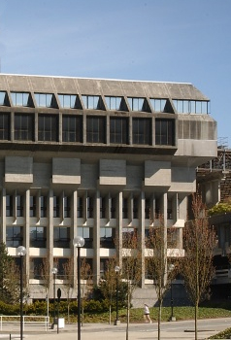
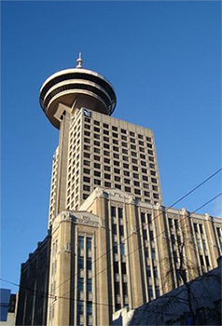
SFU Library Info
A few quick facts about us …
SFU Burnaby
SFU Vancouver
SFU Surrey
Online
three campus libraries – one system
2.5 million+ books & e-books
98,000+ subscriptions to journals, magazines & newspapers
500+ research databases
Notes:
Overview of SFU Library

Slide 6
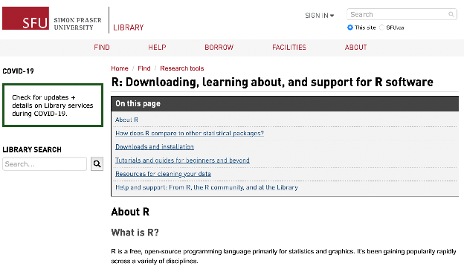
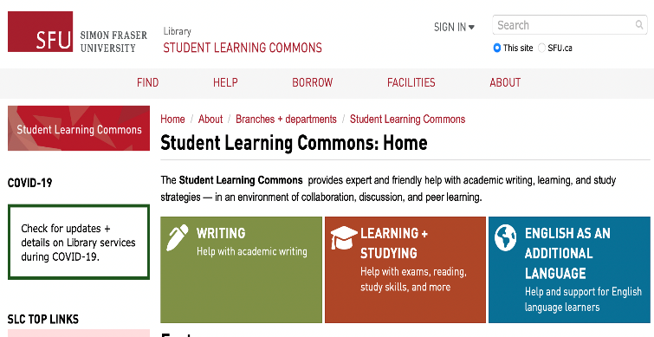
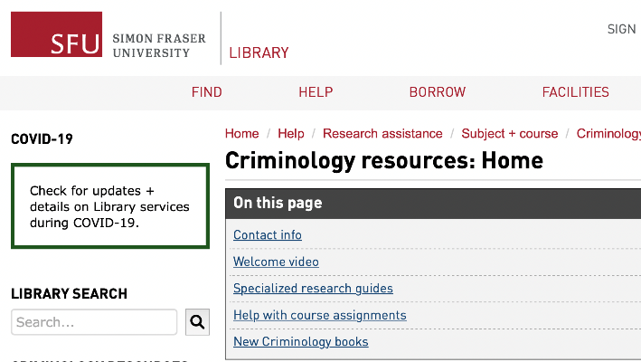
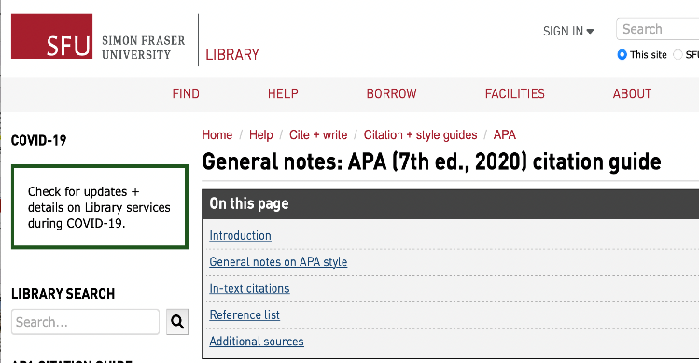
During your work: You need the Library
Finding the News that you want : Canadian Newsstream (P.8)
Reviewing Literatures: SFU Library (P.17)
Criminology Resources: Home
In the long run- Analysing Materials and Data Sets : SFU Software Guides and Workshops
Academic Writing: Student Learning Commons (P.26)
Citation: APA Guide (P.25)
Having other problems? Ask a Librarian ! (P.26)

Slide 7
Your term paper - resources
For your paper:
Use the Canadian Newsstream database to search for and select a newspaper article focussed on a crime event
The crime must be Canadian
The crime must have happened in the past year
Include 3-5 peer-reviewed journal articles, as well as the course textbook

Slide 8
Part 1: Finding Canadian Newspaper articles
Using Canadian Newsstream

Slide 9
Canadian Newsstream
Canadian Newsstream = “Full text access to major Canadian daily newspapers (such as the Globe and Mail, National Post, The Gazette (Montreal), and Vancouver Sun) as well as small market newspapers and weeklies published in Canada”.
Unlike news websites, news articles available through the Canadian Newsstream database are typically:
More stable (less likely to disappear)
More searchable (precise search tools available)
Free to access as SFU Library has already paid the subscription fees

Slide 10
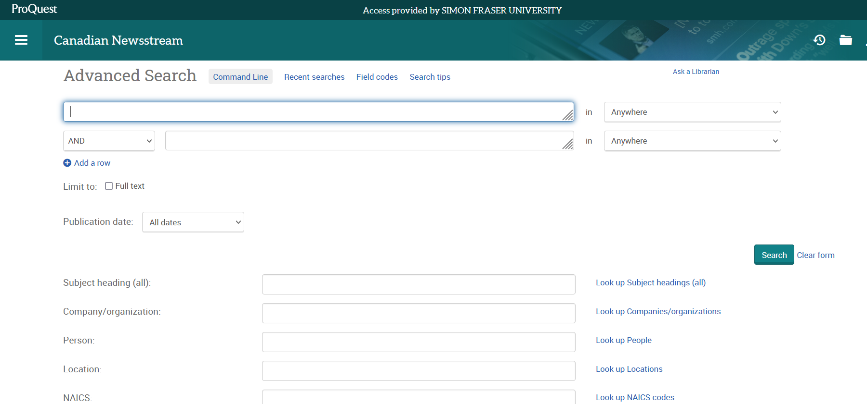
Canadian Newsstream - DEMO
Notes:
Demonstrate Navigating to the Canadian Newsstream database from library homepage
We will be searching for the recent crime of December 18th, 2022, the swarming murder of Ken Lee by seven young teenage girls in Toronto. To find newspaper articles, try starting with the keywords – swarming death teens (about 1,219 results)
Next, limit by publication date – enter one year range (Feb 2, 2022 to Feb 2, 2023)
Click on one of the full-text options

Slide 11
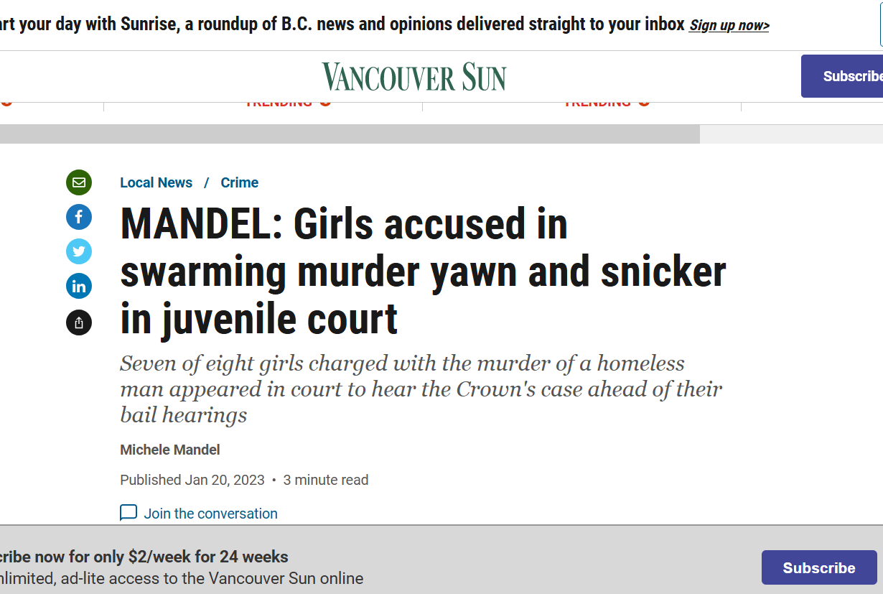
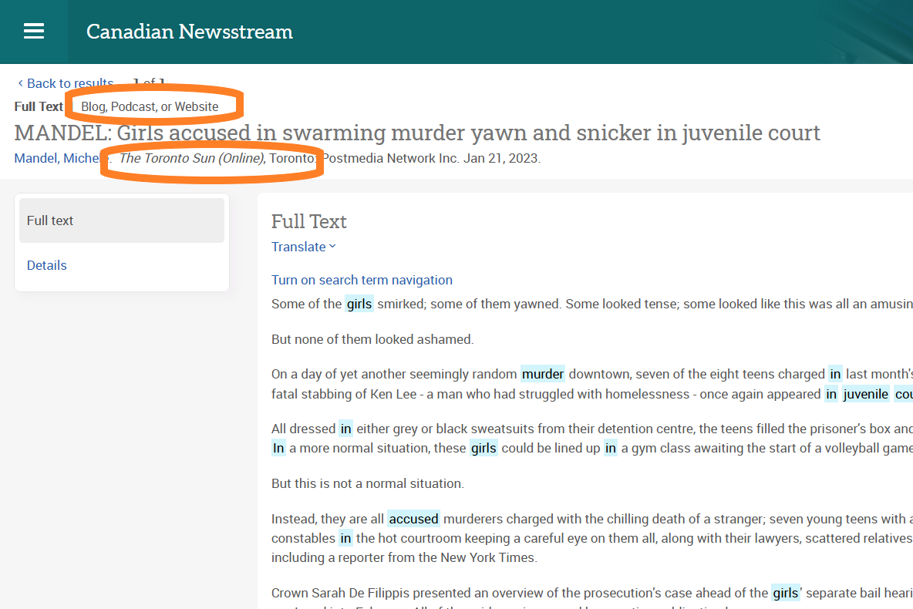
Canadian Newsstream
Note: if you’ve found an article online, e.g., VancouverSun.com, you can search for the same article in Canadian Newsstream!
Notes:
Note that often a news story will be disseminated across many Canadian newspapers at the same time. In this example, we found Michele Mandel’s article online via the Vancouversun.com, but in Canadian newsstream, we have a copy of version that was published in the online Toronto Sun. It is the same article.

Slide 12
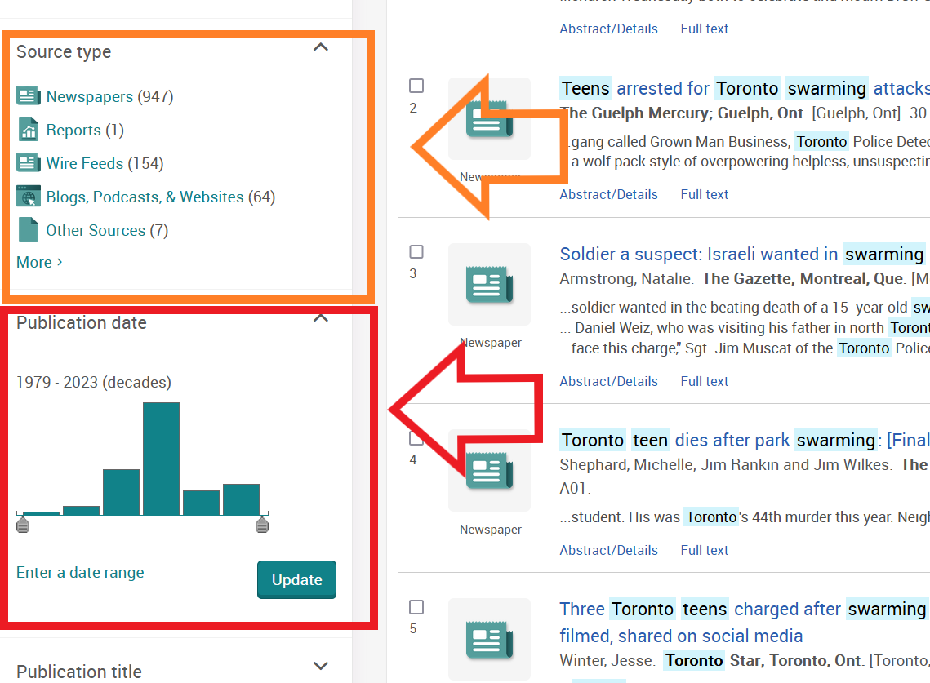
Canadian Newsstream
SEARCH TIPS:
Use Publication Date limiter → Last 12 months
Or, enter a date range
Use Source type limiter→ newspapers
Notes:
How to access

Slide 13
Part 2: Finding peer-reviewed journal articles
Using sfu library’s website

Slide 14
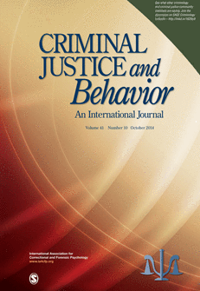
Scholarly vs popular sources
Popular magazine articles
Examples: People, Psychology Today
Scholarly journal articles
Example: Criminal Justice and Behavior: An International Journal
Notes:
First – let’s distinguish between popular and scholarly sources.

Slide 15
Scholarly vs popular articles
Popular magazine articles
Example: People
Scholarly journal articles
Example: Criminal Justice and Behavior: An International Journal
Audience: general public
Colourful graphics & advertisements
Good for broad overview & popular perspective, case details
Plain language
No abstracts or citations (rare)
Audience: academics, assume some shared knowledge
Mostly text, with some tables & charts
Good for historical, current, scholarly, in-depth perspective
Subject-specific language
Includes abstracts & citations
Key criterion: peer-reviewed

Slide 16
Scholarly vs popular articles
Psychology Today “Presents scientifically accurate psychological information for the layperson”.
More Information: What is a Scholarly (or Peer-Reviewed) Journal?
Notes:
Highlight this link for students for future reference/more details.

Slide 17
Finding online articles – 3 Main places
Library Search Broad/preliminary searches
Searches many (but not all) databases + library website
Catalogue Search
Narrower than library search
Article databases
More targeted
Subject-specific searches
Notes:
Library homepage overview.

Slide 18
Avoid paying for research + resources
Google scholar and journal websites will often prompt you for payment
Avoid these paywalls by accessing scholarly journals through the SFU Library website
See: Accessing online resources from off-campus for extra options (e.g. browser extensions, bookmarklets, etc.)
Notes:
Not textbooks

Slide 19
Full text vs. index-only
Make use of the Get@SFU link in SFU Library’s databases: full text may be available in other databases subscribed to by SFU
Notes:
Explain the Get at SFU button that shows up in databases vs. the full text in some databases

Slide 20
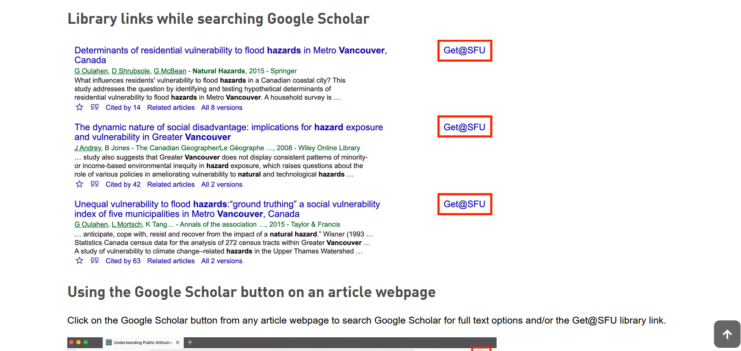
Avoid paying for research + resources
SFU library links in Google Scholar
Notes:
Screenshot of searching Google Scholar via SFU. Get@sfu works for searching Google Scholar via the library website as well.

Slide 21
RECOMMENDED article DATABASES for peer-reviewed articles
Criminology specific/appropriate databases:
Criminal Justice Abstracts: Covers crime trends, crime prevention and deterrence, juvenile delinquency, juvenile justice, police, courts, punishment and sentencing.
PsycINFO: The core database for research in Psychology, including many topics related to crime.
Sociological Abstracts: Sociological perspective on topics such as law and penology, social psychology, violence, and more.
Notes:
Databases linked to subject

Slide 22
Working with your topic
Developing Keywords
Identify key concepts.
Topic: What is the influence of genetics on criminal behaviour of young offenders?
Brainstorm keywords for each concept
Genetics | Criminal behaviour | Young offenders
genetics | crime | young offenders
genes | violence | juvenile delinquents
inherited | deviance | adolescents
hereditary | criminal behaviour | youth offenders
epigentics?... | Illegal… | Teenagers…
Notes:
How to develop keywords.
Put your research topic into a question
Identify key concepts
Brainstorm keywords for each key concept

Slide 23
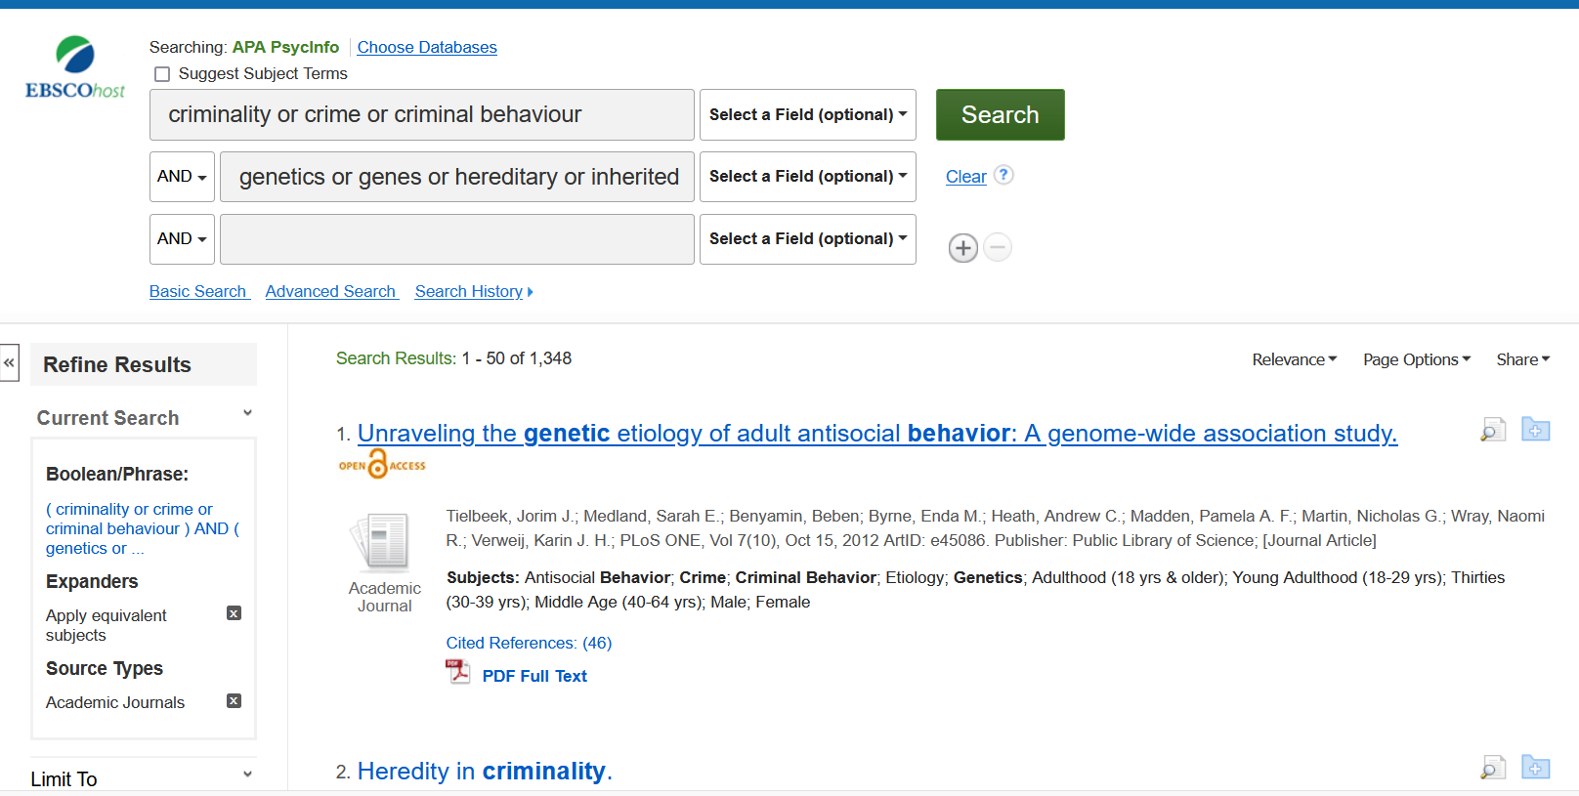
Example search in the database PsycINFO
TIP: put one concept per search line
TIP: use synonyms for each concept in every search line
TIP: use name variations here as well, e.g., Unabomber OR Ted Kaczynski

Slide 24
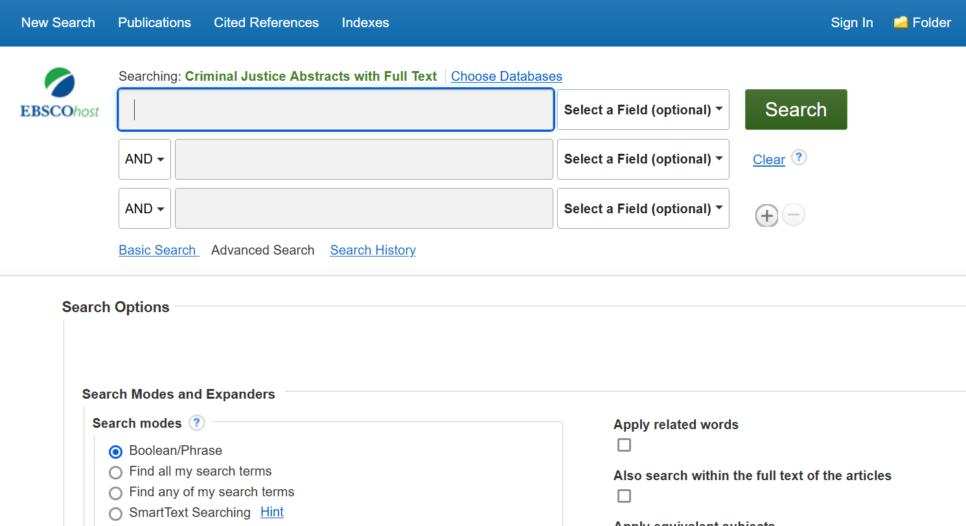
Criminal justice abstracts – DEMO
Notes:
Demonstrate Navigating to the CJA from library homepage.
Our sample topic: What is the influence of genetics on criminal behaviour of young offenders?
Search for keywords –
First line: crime or criminal or illegal or violence or deviance or criminal behaviour
Second line: young offenders or juvenile delinquents or adolescents or youth offenders
Third line: genetics or genes or hereditary or inherited
Limit by Scholarly (Peer Reviewed) Journals. (Note there are also practitioner journals in CJA, so we want to avoid including those).

Slide 25
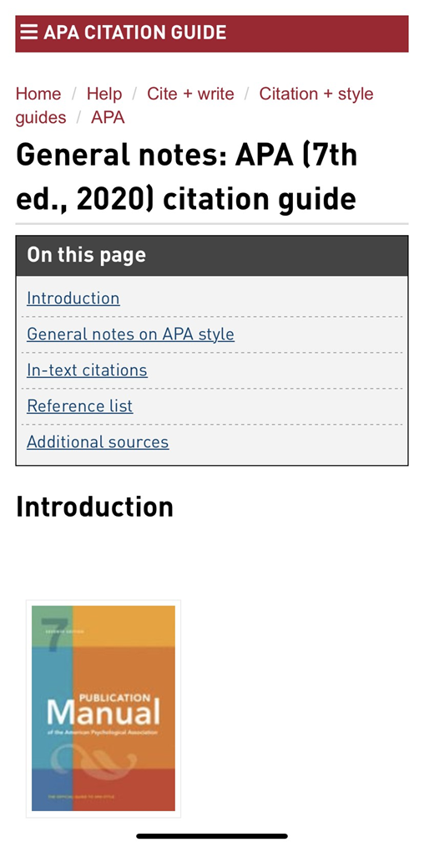
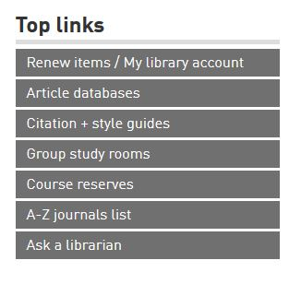
APA citation
APA Style
SFU Library’s APA (7th edition) Resource Guide offers a lot of help with this citation style and provides some useful links to extra APA-help pages.
Ask a librarian if you have any questions about how to cite!

Slide 26
Help!
Ask a Librarian
Research help desk (drop-in & by appointment)
NEW!: Zoom consultations
Phone: 778.782.4345
Email
AskAway (online chat)
Student Learning Commons
Academic writing support, study skills, EAL/ESL support, Write Away
Notes:
Where to go for help

