Slide 1
SFU Library –
Assignment Support
Criminology 321: Qualitative Research Methods in Criminology
May 9, 2024
Yolanda Koscielski
Librarian for
Criminology, Psychology and Philosophy

Slide 2

Agenda
1. Finding academic resources
2. Search terms
3. Finding research methodology info
4. Locating qualitative research
5. Help
https://i.pinimg.com/originals/de/32/89/de32896d6903b303071c14c42c09e2a8

Slide 3
Assignment
Recap
From your Annotated Bibliography Assignment:
Topic/Problem
  • Clearly identify your topic/problem in the form of a research question or research statement. The more specific your topic is, the easier it will be to find relevant and appropriate research.
Be Specific
  • It is often helpful to make a list of 5+ search terms that relate to your topic (similar to what you would see on the 1st page of a journal article)
Resources
  • Your annotated bibliography should include a minimum of 8 and a maximum of 10 academic sources. (See: what is a scholarly or peer-reviewed journal article?)
  -Grey literature may be used but do not count as one your academic sources
  -Identify the methodology of each study. You are encouraged to find as many qualitative studies as possible
  -Your sources should be current (meaning within the last 10-15 years) unless historical references are important for context
  -Most sources should be Canadian
  -Start early, this assignment is foundational for all other assignments in this course.

Slide 4
Finding academic sources

Slide 5
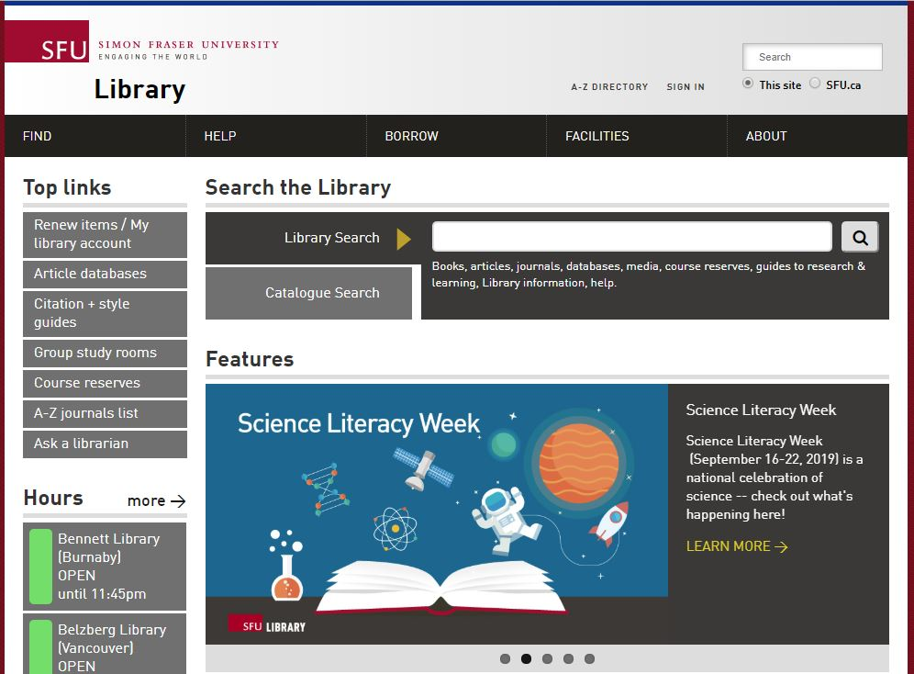
Finding
Articles
Online
Library Search
Broad/preliminary searches
Includes books, articles, databases, media, course reserves
ALSO includes research guides, learning guides, library info, help
Searches many (but not all) databases
DEMO
Notes:
There are two main options
--Library Search searches almost everything. By everything, I mean individual books, journal articles, databases, media, course reserves, journals, and the library website.
DEMO 1. Search for Annotated Bibliography
Because it includes the library website, you can also search here for an annotated bibliography
----What is an annotated bibliography? https://www.lib.sfu.ca/help/cite-write/citation-style-guides/annotated-bibliography
DEMO 2. Search for Criminology Guide – special guides
--Criminology – Criminology subject guide: Course guides, journals, specialized guides. Slide show
--general journal article search

Slide 6
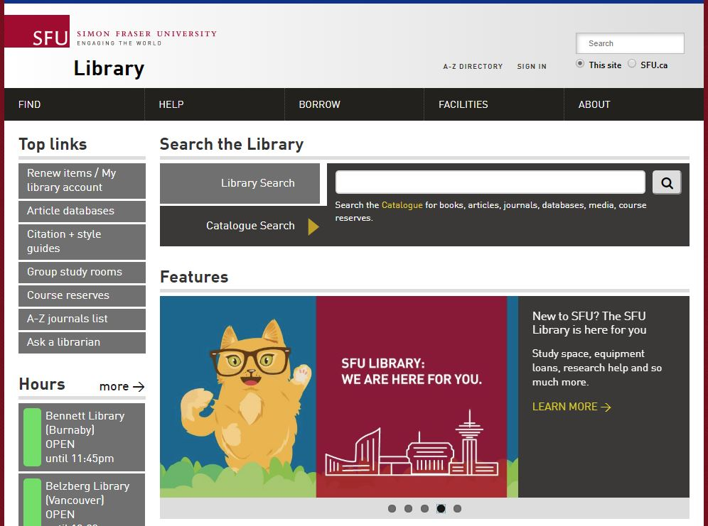
Finding
Articles
Online
Catalogue Search
Broad/preliminary searches
Includes books, articles, databases, media, course reserves
Searches many (but not all) databases

Slide 7
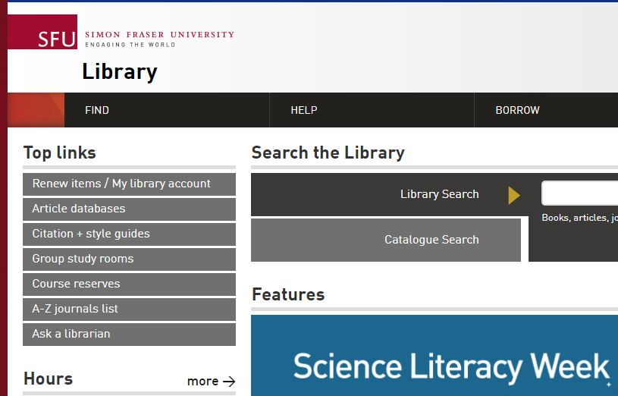
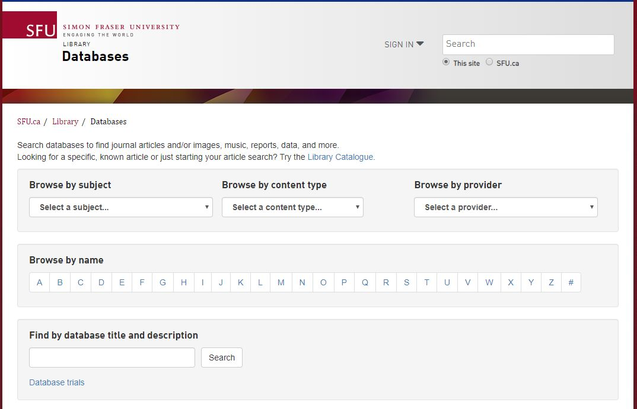
Finding
Articles
Online
Article databases
More targeted & in-depth searches
Subject-specific or multidisciplinary
Notes:
individual databases for more targeted searches
We have about 700 subject-specific and multidisciplinary databases, with 44 Crim-related databases

Slide 8
Recommended
Databases
DEMO: Databases by Subject Area
Criminology databases
  Criminal Justice Abstracts
    academic articles, magazines, dissertations, reports, books …
Other discipline-based databases
  PsycINFO
    Articles, books, & more in the field of psychology and the psychological aspects of other disciplines including Criminology and Law
  Proquest Sociology Collection
    International literature in sociology and social services, and related fields
  CBCA Complete
    Limit to scholarly journals; good for Canadian content

Slide 9
Grey Literature
  Note: For your assignment, Grey literature (for example, a government report) may be used, but it does not count as one of your
  academic sources.
  Canada Commons
  Public policy documents from Canadian institutes and research groups.
  Example: Breaking the Cycle - An update on the use of segregation and solitary confinement in Manitoba youth custody facilities (2021, 22 pages, with references)
TIP:
citation mining!
Notes:
One source for grey literature is Canada Commons, which contains public policy documents
A search for solitary confinement returns many reports with a Canadian focus.
The bibliography points me to some journal articles. Hard to find Canadian sources sometimes, so this can be useful.
This is what we call “citation mining”

Slide 10
Search Terms

Slide 11
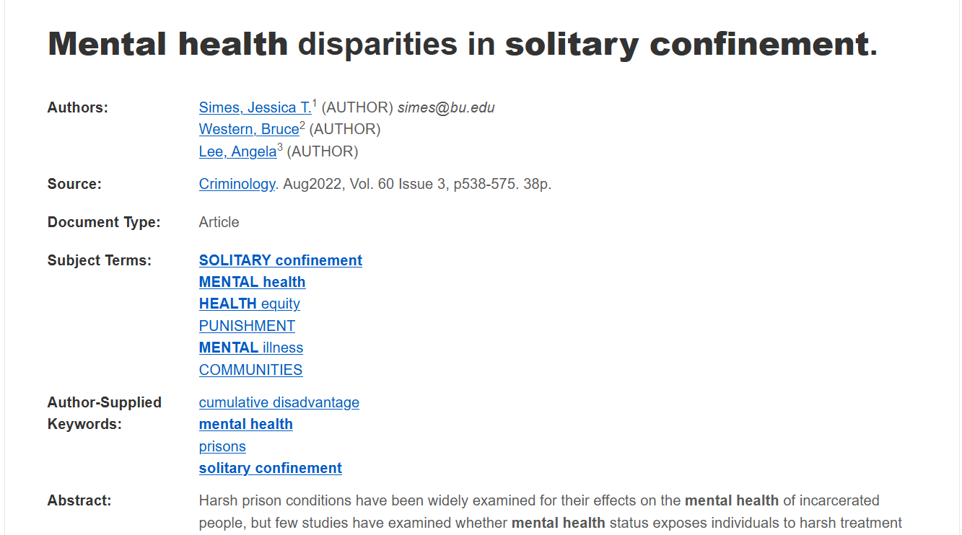
Working with your topic
“It is often helpful to make a list of 5+ search terms that relate to your topic (similar to what you would see on the 1st page of a journal article)”
Image of key terms from a database record

Slide 12
Search tips
TIP: Use the Research Concepts Worksheet
Brainstorming search terms – conceptual categories to use
Example key concept: solitary confinement
Synonyms: administrative segregation
Broader terms: prison discipline
Narrower terms: indefinite solitary confinement, secure isolation
Related terms: restraint of prisoners
Notes:
--auto-fill
A second tip I wanted to highlight is that , when you are brainstorming keywords, it helps to keep in mind certain categories which can be used for generating some terms.
So, for example, for solitary confinement, it helps to first thing of synonyms. As noted in your assignment details,
--the more contemporary “administrative segregation” can be used a synonymous search term,
You can also think of broader terms, such as prison discipline
Narrower terms are another category to consider, such as indefinite solitary confinement, or secure isolation
And there are also a related term – that is a lateral term which might still provide some important articles (cousins?)

Slide 13
Finding Research Methodology Info
Notes:
WRT resource methodologies, there are two resources to highlight these are – databases about research methodologies.

Slide 14
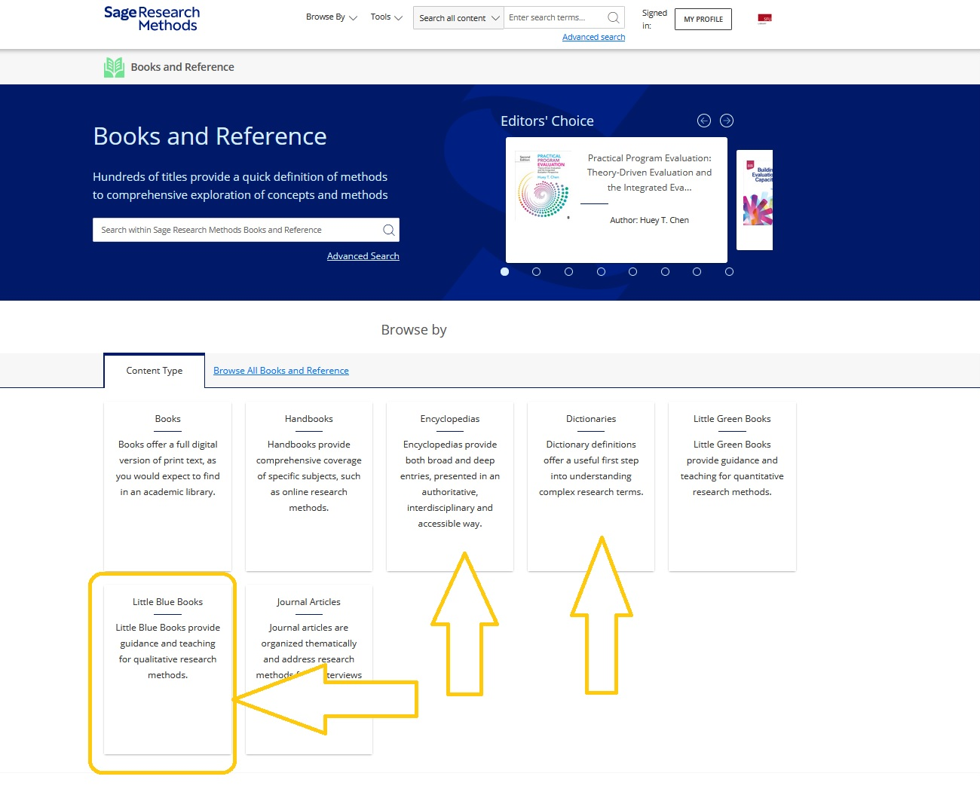
A portal about research methodology: books, dictionaries, encyclopedias, ca, etc.
Little Blue Books series focus on qualitative research
How to find…
Research Methodology info
Sage Research Methods Online (SRMO)
Notes:
Supplemental resource, which can be good for mining keywords
Used by graduate students

Slide 15
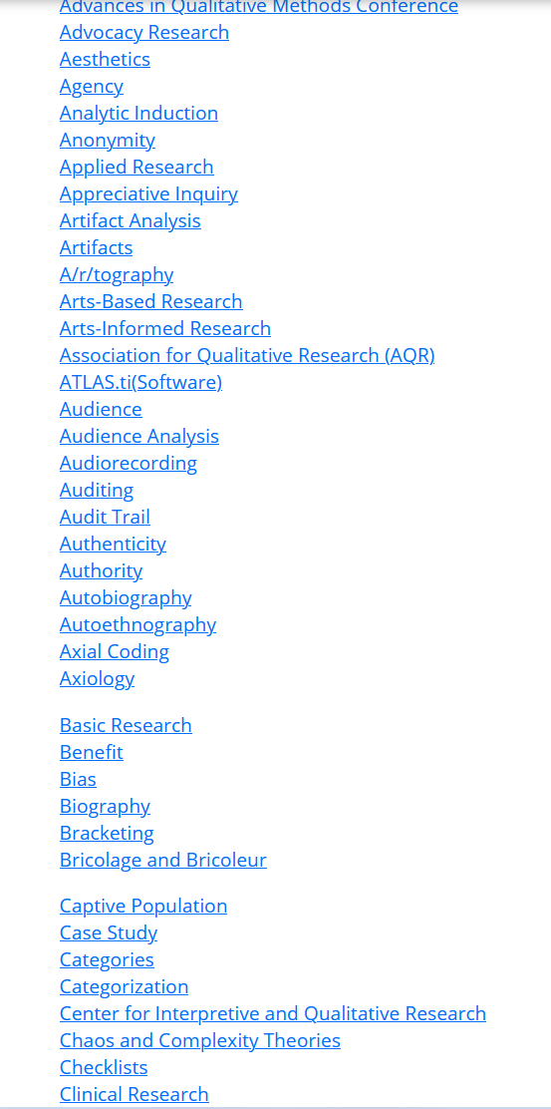
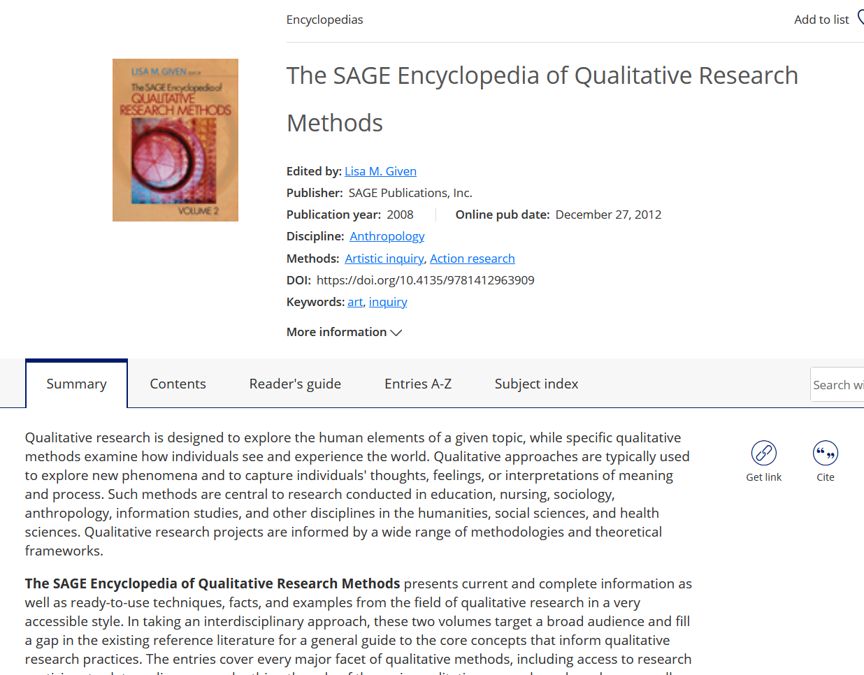
How to find…
Research Methodology info
Example resource: SAGE Encyclopedia of Qualitative Research Methods
Notes:
Within this resource, there is one source for quick definitions, for example = the Sage Encyclopedia of Qualitative Research Methods
Here you can find entries on all different research methods

Slide 16
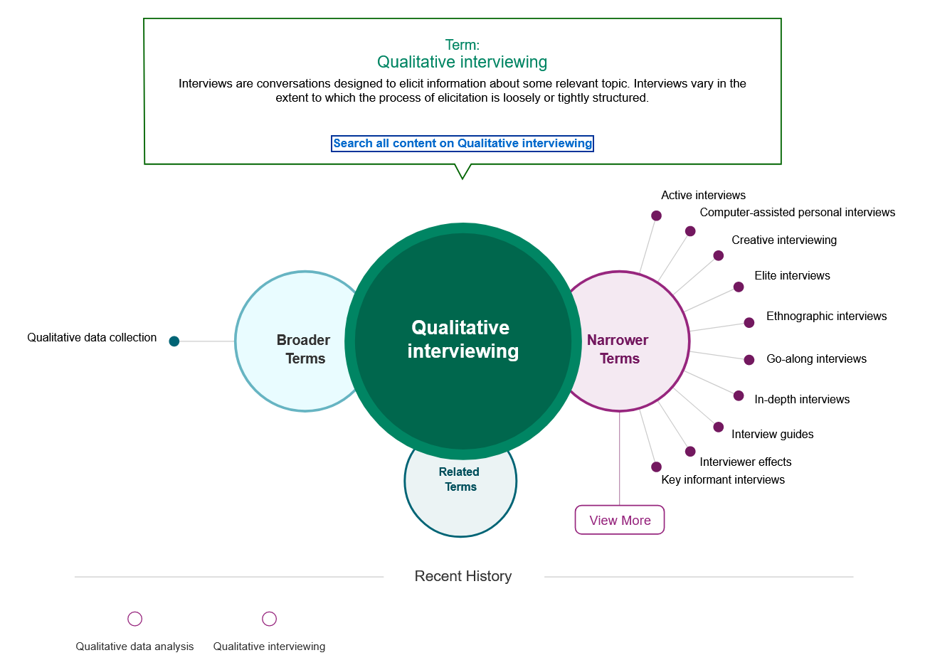
How to find…
Research Methodology info
Interactive Methods Map (Sage)
Sage Research Methods Online (SRMO)

Slide 17
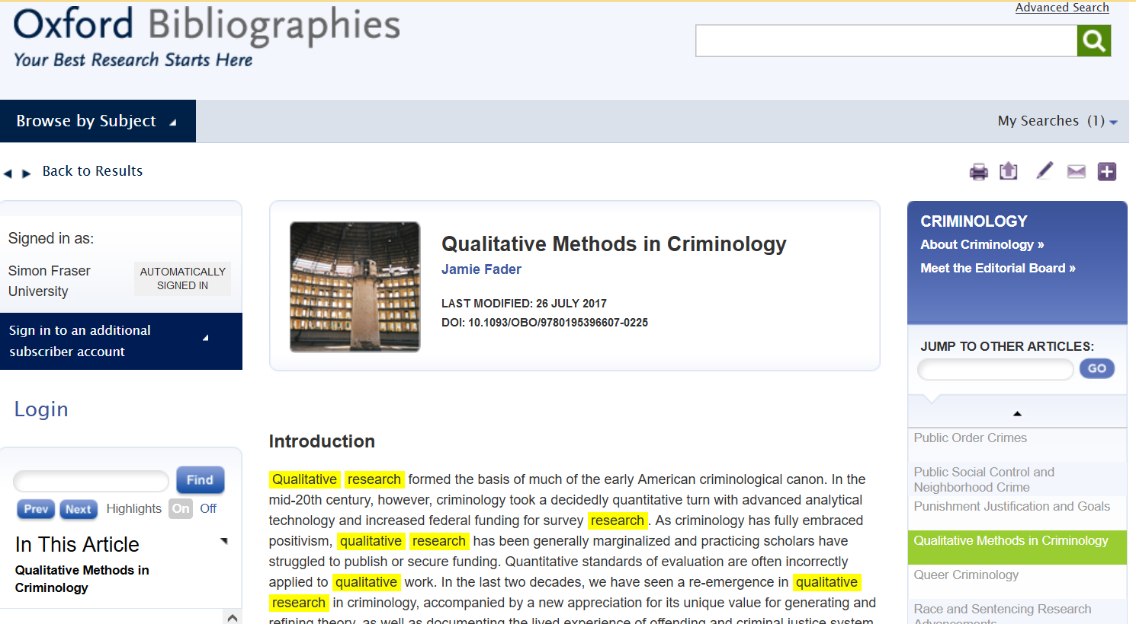
Oxford Bibliographies Online :
Qualitative Methods in Criminology
DEMO
Notes:
Another resource which I particular like is OBO. This is in fact an elaborate version of an annotated bibliography.
It is Lists key books, articles, and other sources on a wide variety of subjects via annotated bibliographies
curated by experts (ie profs) in their field.
List seminal works, so some are outside of the past 0-15 years requirement.
But, this is a good place to find definitions of QRM, and see core example studies listed (see Varieties and Exemplars of Qualitative Research).
Browse by subject – Criminology
Q – qualitative methods
Overview of Qualitative Methods in Criminology
TOC – varieties and exemplars of qualitative research
List types
Show size of article
Demo – focus groups. We are going to come back to that.
CNTR + F → copes under “current status”
And, once you look up these studies (get at SFU), you can see who has cited them in future, current articles using other databases.
Useful for generating keywords re methodology, finding core articles, seeing who has cited them

Slide 18
Oxford Bibliographies Online :
Qualitative Methods in Criminology
“Several content analyses of publications in top criminology and criminal justice journals have established the current representation of qualitative research therein. The most recent study of this type, Copes, et al. 2011, found that less than 4 percent of articles published in the fifteen top-ranked journals in the field were qualitative”
DEMO
Notes:
Interestingly, this entry notes (under current status) that…
This article is over ten years old, but this interesting to note that there is just not a lot out there

Slide 19
Finding qualitative articles

Slide 20
Two main methods
Locating Qualitative Articles
Dedicated search limiters in databases
Adding related keywords
Notes:
Direct and indirect way
The second may return less unique results

Slide 21
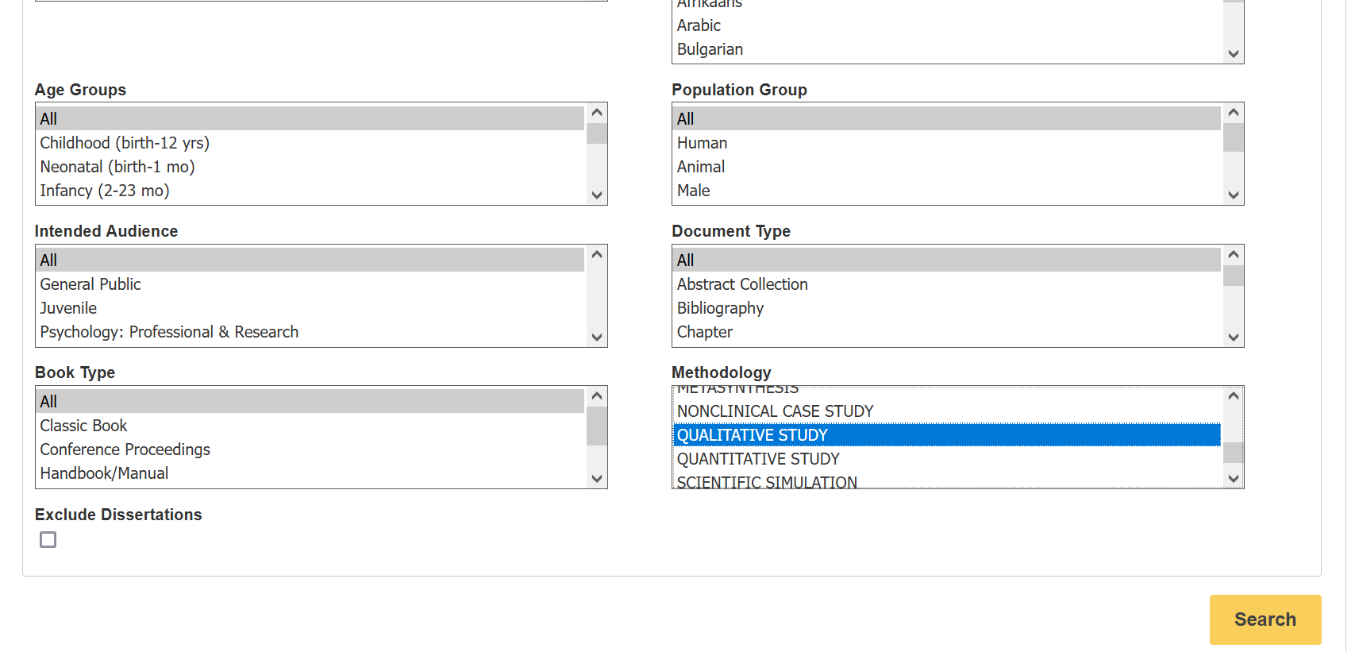
Search limiters
PsycINFO
DEMO
Qualitative Study: “A type of research methodology that produces descriptive data, with little emphasis given to numerical quantitative measures”. – EBSCO/PsycINFO description
Notes:
Some databases will let you search for these types of studies directly, which it defines as…
double-check
PsycINFO – does index a number of Criminology journals
Show limiters
DEMO search: solitary confinement and mental health
Limit to qualitative – new and unindexed studies (limit)
Double-check

Slide 22
Adding methodology keywords
Possibilities:
Qualitative
Ethnography
Interviews
Life-course
Narrative inquiry
Content analysis
Case study
Focus group
…
Useful for databases without a qualitative study limiter.
Notes:
The other way to find qualitative studies indirectly is to add keywords that may seen in articles that use a qualitative approach.
You can think of your own to add in here as well, from your course materials, lectures, and additional sources we have mentioned.
Not perfect, but better results

Slide 23
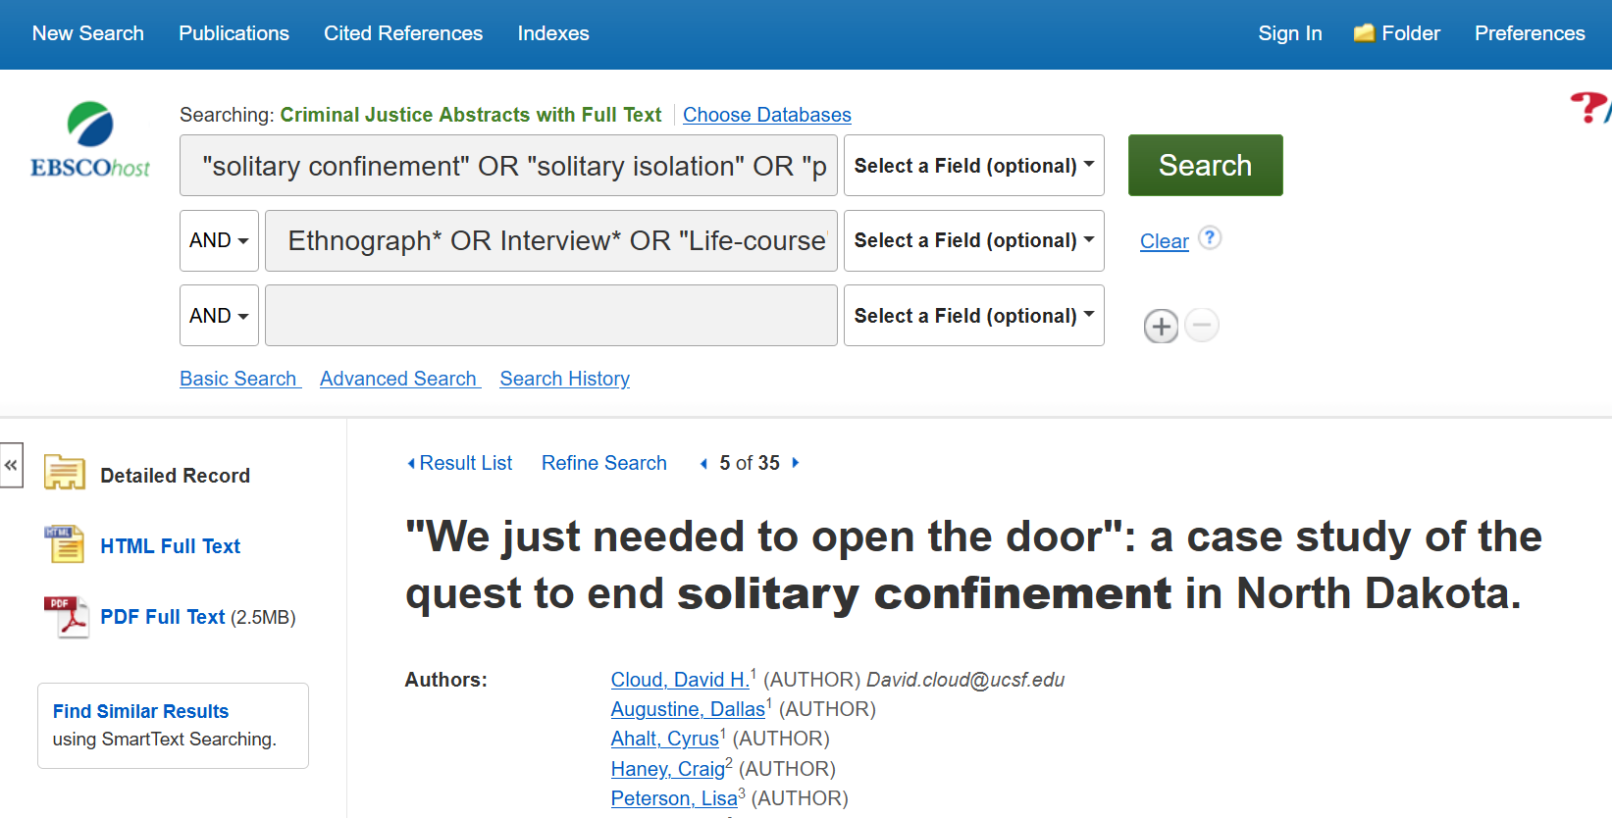
Adding methodology keywords
DEMO
Notes:
Demo in CJA
First line – our topic
Second line – these qualitative keywords
Quotation marks so it is searching terms as a phrase
First line: "solitary confinement" OR "solitary isolation" OR "prison confinement" OR "administrative segregation"
Second line: Ethnograph* OR Interview* OR "Life-course" OR "Narrative inquiry" OR "Content analysis" OR qualitative
Highlighted terms will show you why the article is coming up. Of course, some will be irrelevant. Read Abstract.
Add Canada. – structured interview.
Go to article #5- case study, may be relevant
“Methods: We conducted an embedded case study, analyzing changes in policies and procedures, administrative data, and focus groups and interviews with incarcerated persons and staff”. Mixed methods.
Times Cited – show here

Slide 24
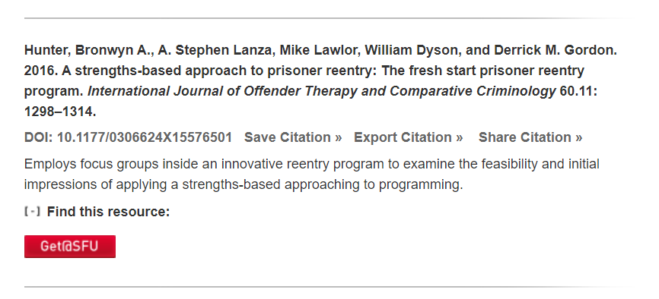
Third method
“Cited by” feature
Cited by…
Hoffman, K.A., Thompson, E., Gaeta Gazzola, M. et al. “Just fighting for my life to stay alive”: a qualitative investigation of barriers and facilitators to community re-entry among people with opioid use disorder and incarceration histories. Addict Sci Clin Pract 18, 16 (2023)
DEMO
Notes:
Third method – see who has cited this article – similar topic, other qualitative studies.
Go back to Oxford Bibliographies Online – Focus Groups.
Find full text
DEMO from CJA – times cited feature, methodologically linked
DEMO from OBO – cited 24 times

Slide 25
Almost done!

Slide 26
APA Style
Notes:
For your assignment, you will be using APA Style

Slide 27
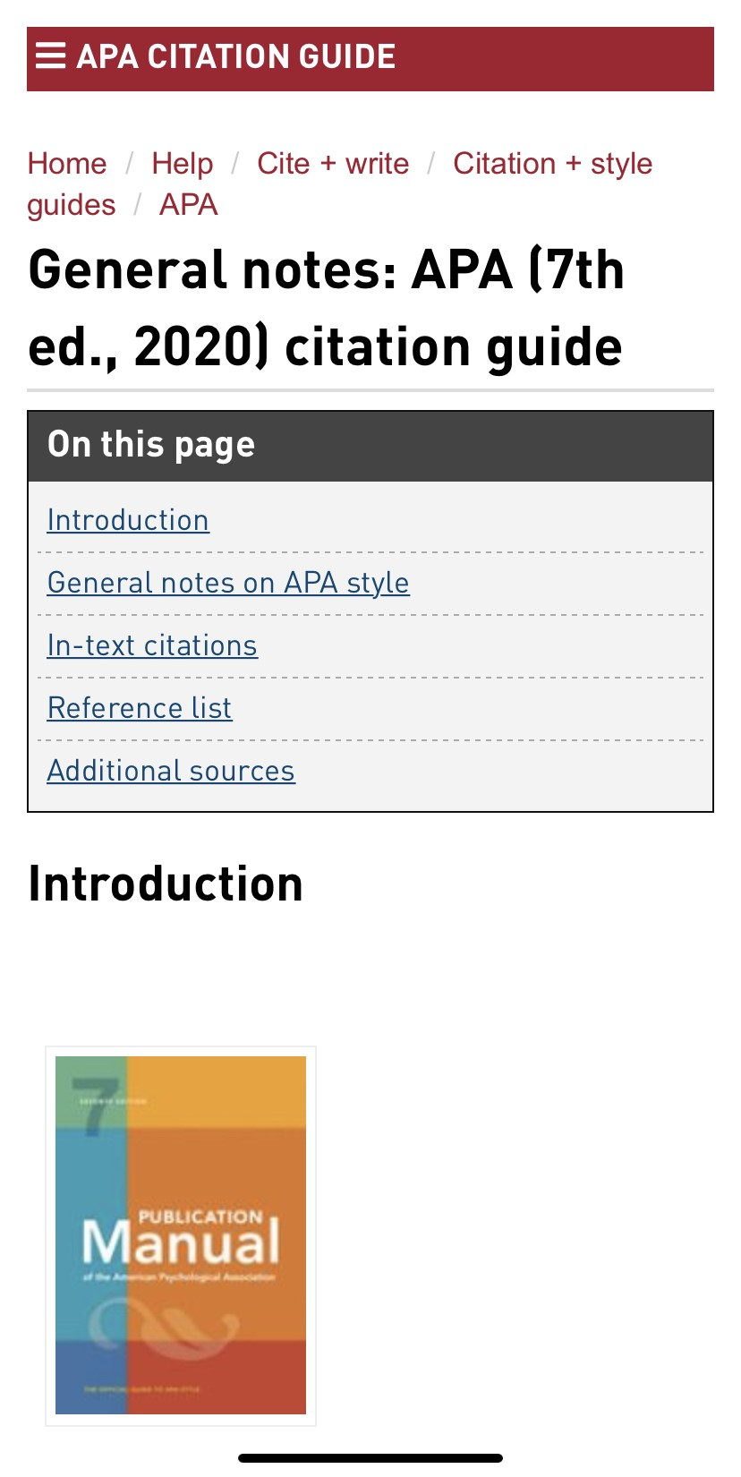
APA
Citation
Style
APA Style
SFU Library’s APA (7th edition) Resource Guide offers a lot of help with this citation style and provides some useful links to extra APA-help pages.
Notes:
-New Guide to APA style available on the SFU Library website, based on the 7th edition print book
-The menu on the left of the APA Resource Guide gives rules and examples for citing books and articles for your annotated bibliography

Slide 28
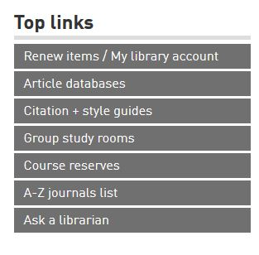
Where to go for help
Ask a Librarian
  Research help desk (office hours & by appointment)
  Zoom consultations
  Phone: 778.782.4345
  Email: libask@sfu.ca
  AskAway (online chat)
Student Learning Commons
  Academic writing, study skills, EAL/ESL support, annotated bibliographies*
  Write Away
Notes:
--We have a number of different ways you can ask for help with your assignment
----The AskaLibrarian link on this slide will provide the contacts for all of the different points

