Slide 1
SFU Library –
Assignment Support
Criminology 321: Qualitative Research Methods in Criminology
Yolanda Koscielski
Librarian for
Criminology, Psychology and Philosophy

Slide 2

Agenda
1. Finding academic resources
3. Search terms
4. Finding research methodology info
5. Locating qualitative research
6. Help
https://i.pinimg.com/originals/de/32/89/de32896d6903b303071c14c42c09e2a8

Slide 3
Assignment
Recap
From your Annotated Bibliography Assignment:
Topic/Problem
  • Clearly identify your topic/problem in the form of a research question or research statement. The more specific your topic is, the easier it will be to make sound arguments in your advocacy letter.
Be Specific
  • It is often helpful to make a list of 5+ search terms that relate to your topic (similar to what you would see on the 1st page of a journal article)
Resources
  • Your annotated bibliography should include a minimum of 10 and a maximum of 12 academic sources. (See: what is a scholarly or peer-reviewed journal article?)
  -grey literature may be used but do not count as one your academic sources
  -sources should be based on qualitative research, or mixed methods (both qualitative and quantitative)
  -ensure your sources are current to reflect up-to-date research on your topic
  -each source is cited in APA format

Slide 4
Finding academic sources

Slide 5
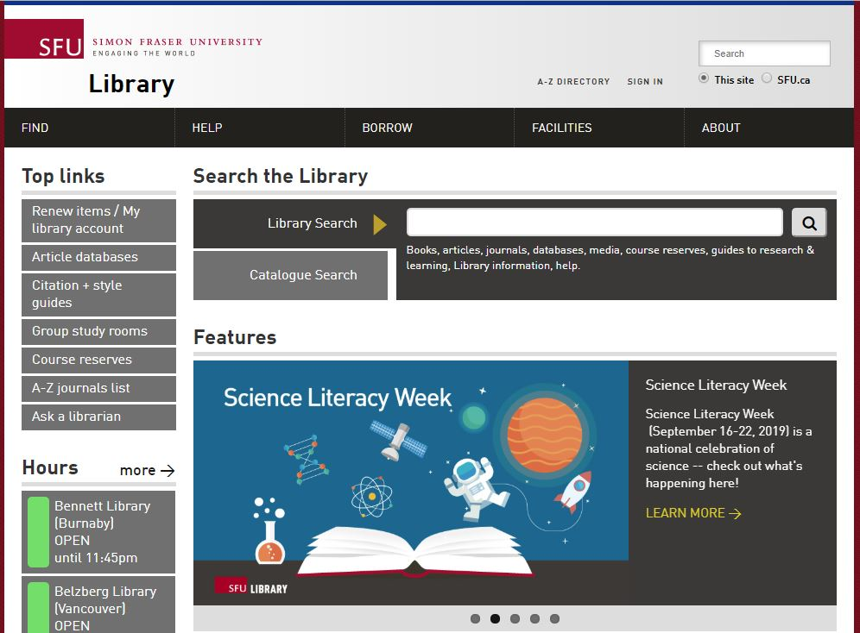
Finding
Articles
Online
Library Search
Broad/preliminary searches
Includes books, articles, databases, media, course reserves
ALSO includes research guides, learning guides, library info, help
Searches many (but not all) databases
DEMO

Slide 6
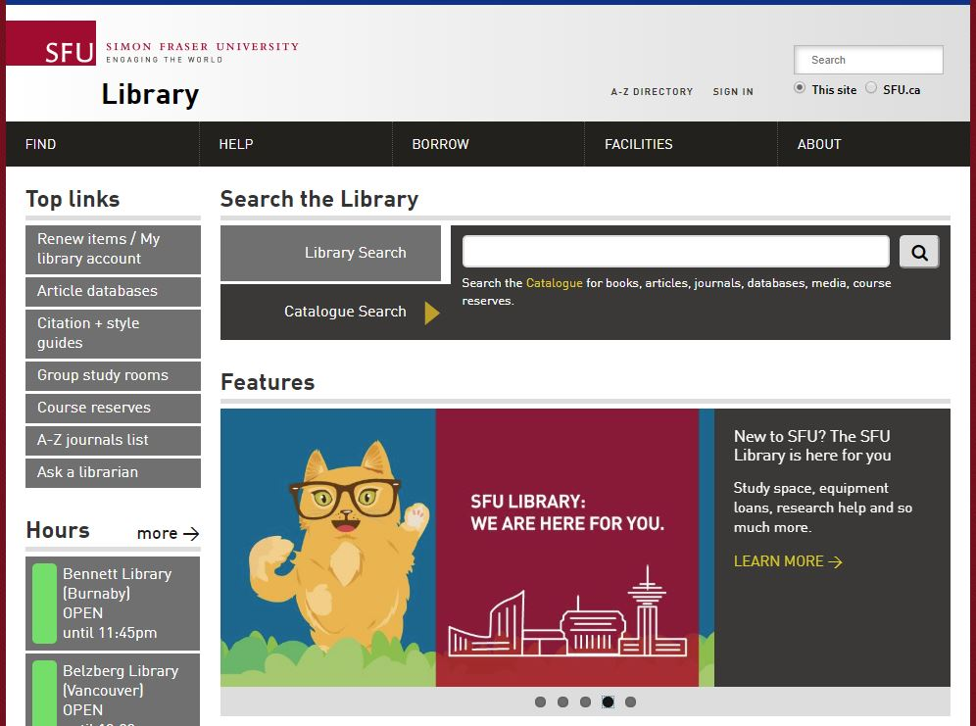
Finding
Articles
Online
Catalogue Search
Broad/preliminary searches
Includes books, articles, databases, media, course reserves
Searches many (but not all) databases

Slide 7
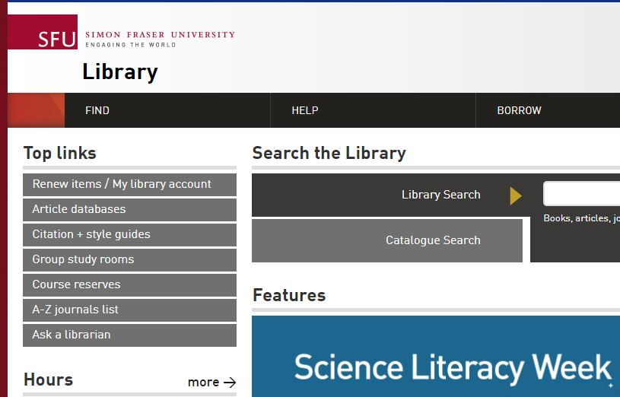
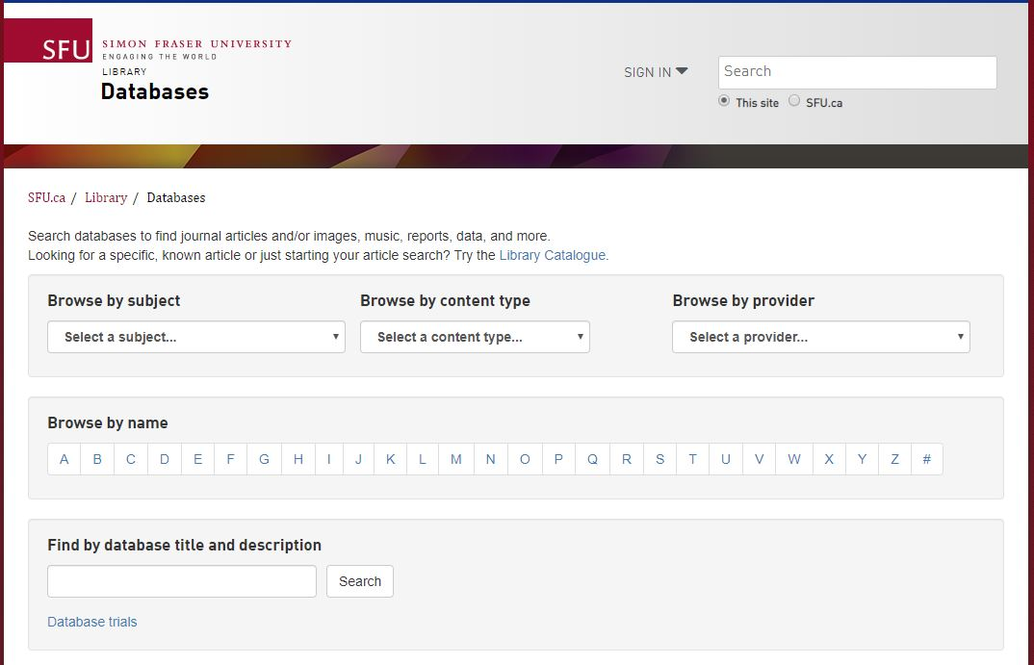
Finding
Articles
Online
Article databases
More targeted & in-depth searches
Subject-specific or multidisciplinary

Slide 8

Recommended
Databases
DEMO: Databases by Subject Area
Criminology databases
  Criminal Justice Abstracts
    academic articles, magazines, dissertations, reports, books …
Other discipline-based databases
  PsycINFO
    academic articles, books, dissertations …
  Sociological Abstracts
    academic articles, books, dissertations, association reports …

Slide 9
Grey Literature
  Note: For your assignment, Grey literature (for example, a government report) may be used, but it does not count as one of your
  academic sources.
  Canada Commons
  Public policy documents from Canadian institutes and research groups.
  Example: It's a Matter of Time: Systemic Review of Secure Isolation in Ontario Youth Justice Facilities
TIP: citation mining!

Slide 10
Search Terms

Slide 11
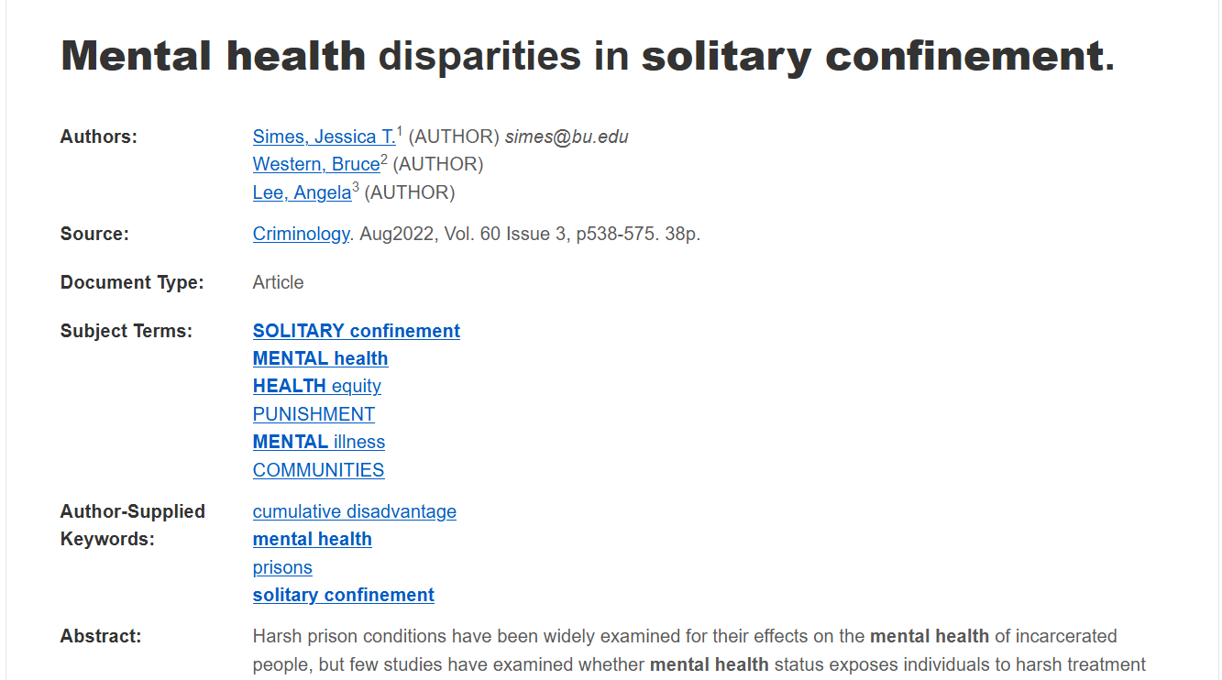
Working with your topic
“It is often helpful to make a list of 5+ search terms that relate to your topic (similar to what you would see on the 1st page of a journal article)”
Image of key terms from a database record

Slide 12
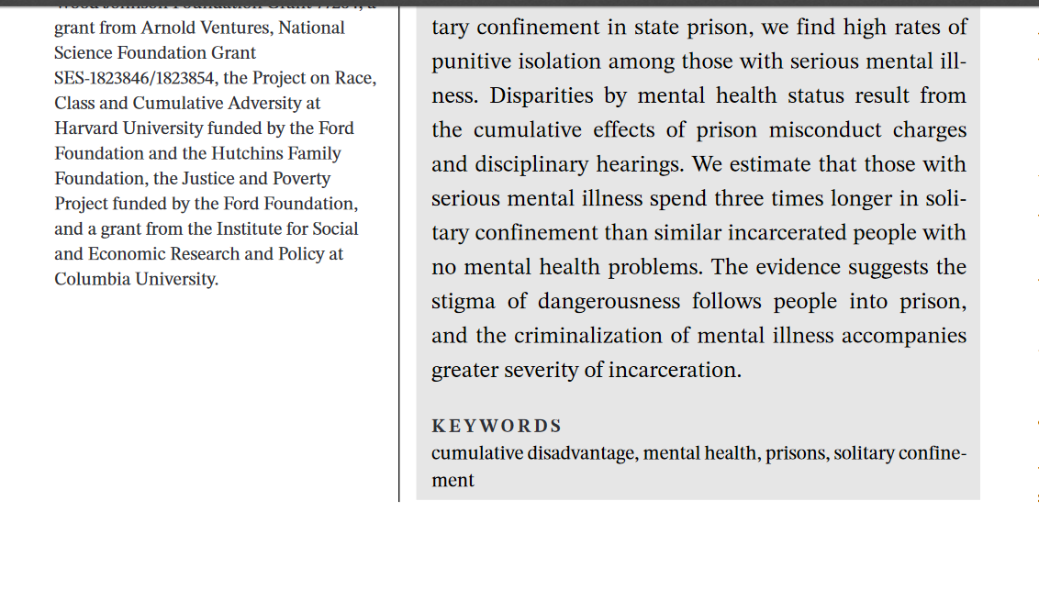
“It is often helpful to make a list of 5+ search terms that relate to your topic (similar to what you would see on the 1st page of a journal article)”

Slide 13
Search tips
TIP: Use the Research Concepts Worksheet
Brainstorming search terms – conceptual categories to use
Example key concept: solitary confinement
Synonyms: administrative segregation
Broader terms: prison discipline
Narrower terms: indefinite solitary confinement, secure isolation
Related terms: restraint of prisoners

Slide 14
Finding Research Methodology Info

Slide 15
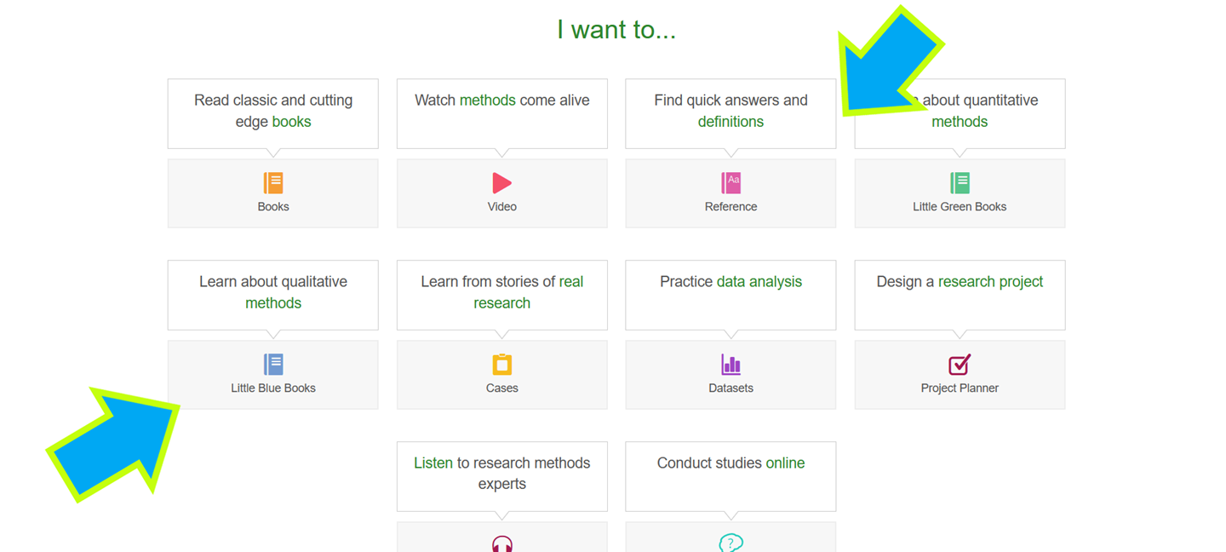
A portal about research methodology: ebooks, articles, reference sources, and videos.
Little Blue Books focus on qualitative research
Definitions
Sage Research Methods Online (SRMO)
Method: Qualitative Analysis

Slide 16
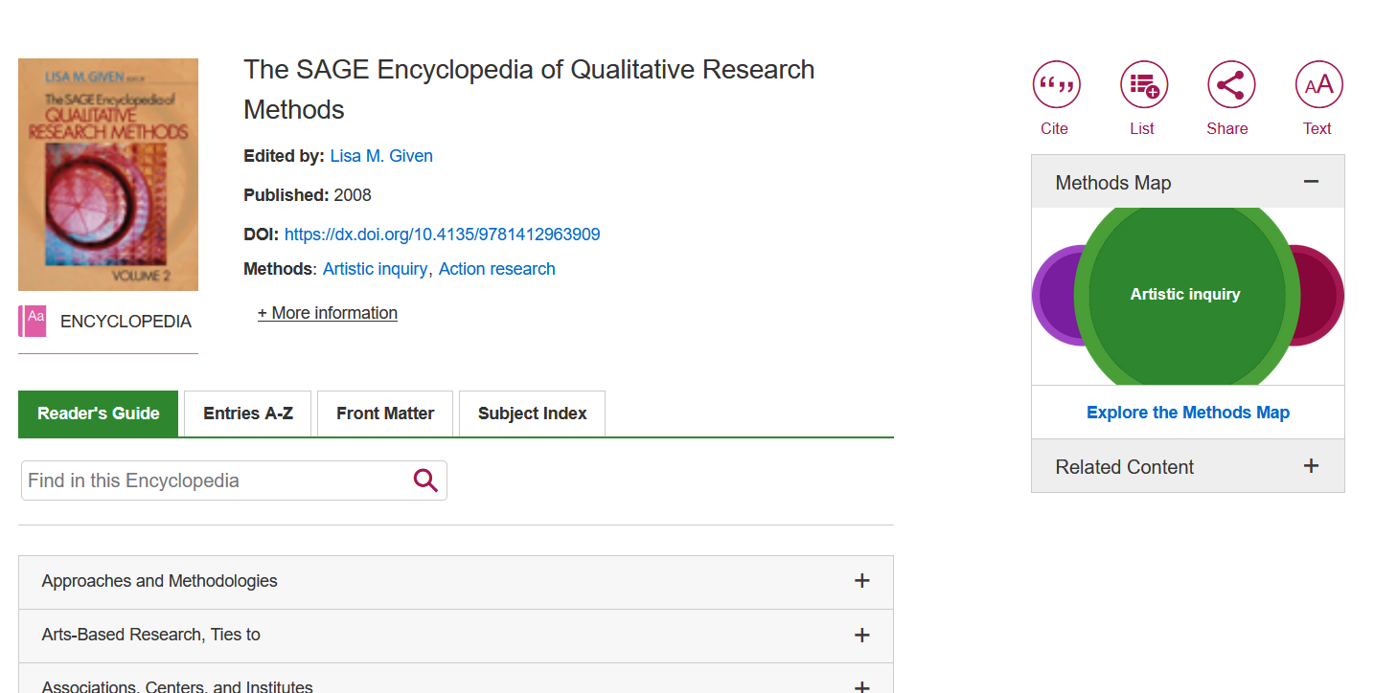
How to find…
Research Methodology info
Example resource: SAGE Encyclopedia of Qualitative Research Methods

Slide 17
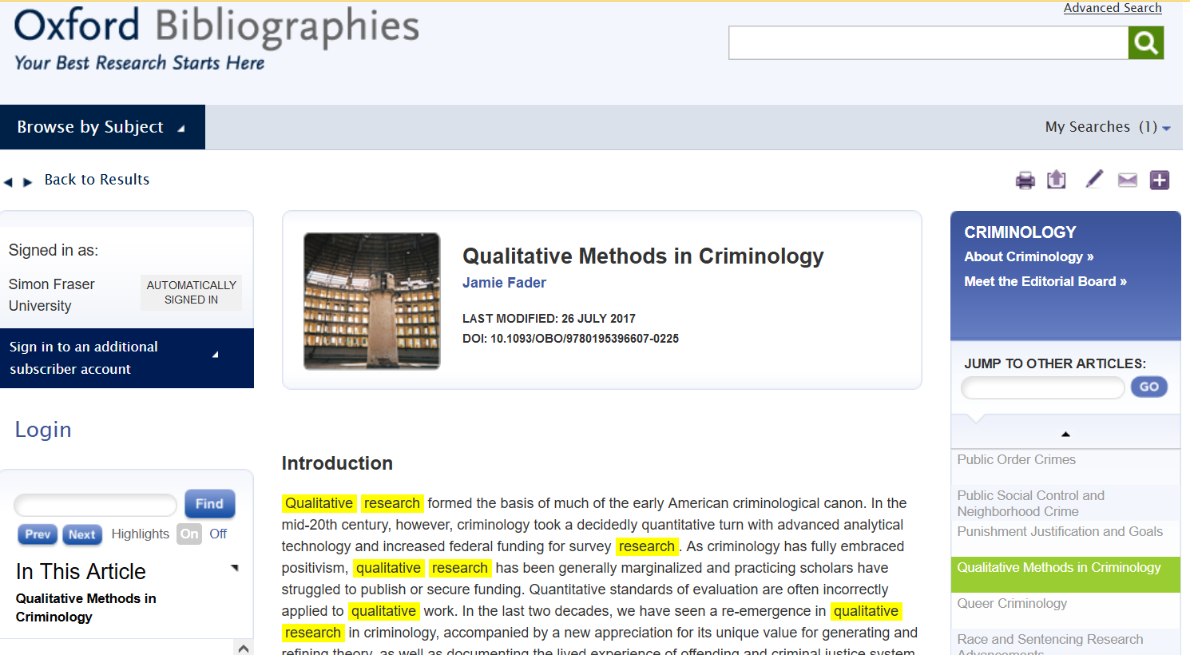
Oxford Bibliographies Online :
Qualitative Methods in Criminology
DEMO

Slide 18
“Several content analyses of publications in top criminology and criminal justice journals have established the current representation of qualitative research therein. The most recent study of this type, Copes, et al. 2011, found that less than 4 percent of articles published in the fifteen top-ranked journals in the field were qualitative”
Oxford Bibliographies Online :
Qualitative Methods in Criminology
DEMO

Slide 19
Finding qualitative articles

Slide 20
Two main methods
Locating Qualitative Articles
Dedicated search limiters in databases
Adding related keywords

Slide 21
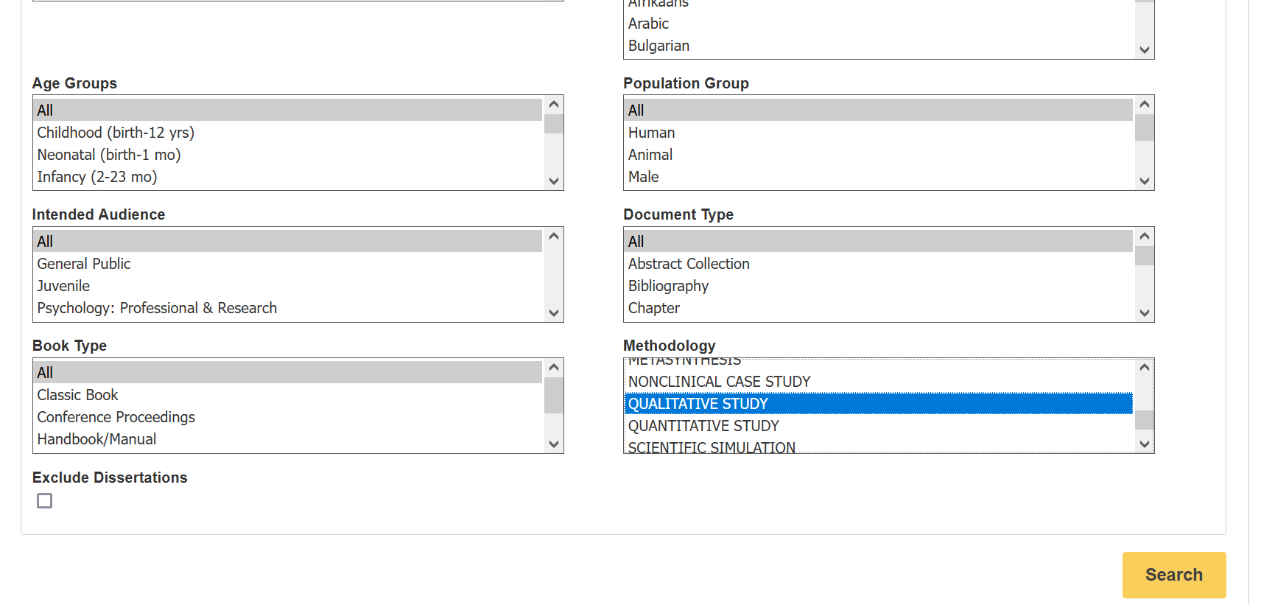
Search limiters
PsycINFO
DEMO
Qualitative Study: “A type of research methodology that produces descriptive data, with little emphasis given to numerical quantitative measures”. – EBSCO/PsycINFO description

Slide 22
Adding methodology keywords
Possibilities:
Qualitative
Ethnography
Interviews
Life-course
Narrative inquiry
Content analysis
Case study
Focus group
…
Useful for databases without a qualitative study limiter.

Slide 23
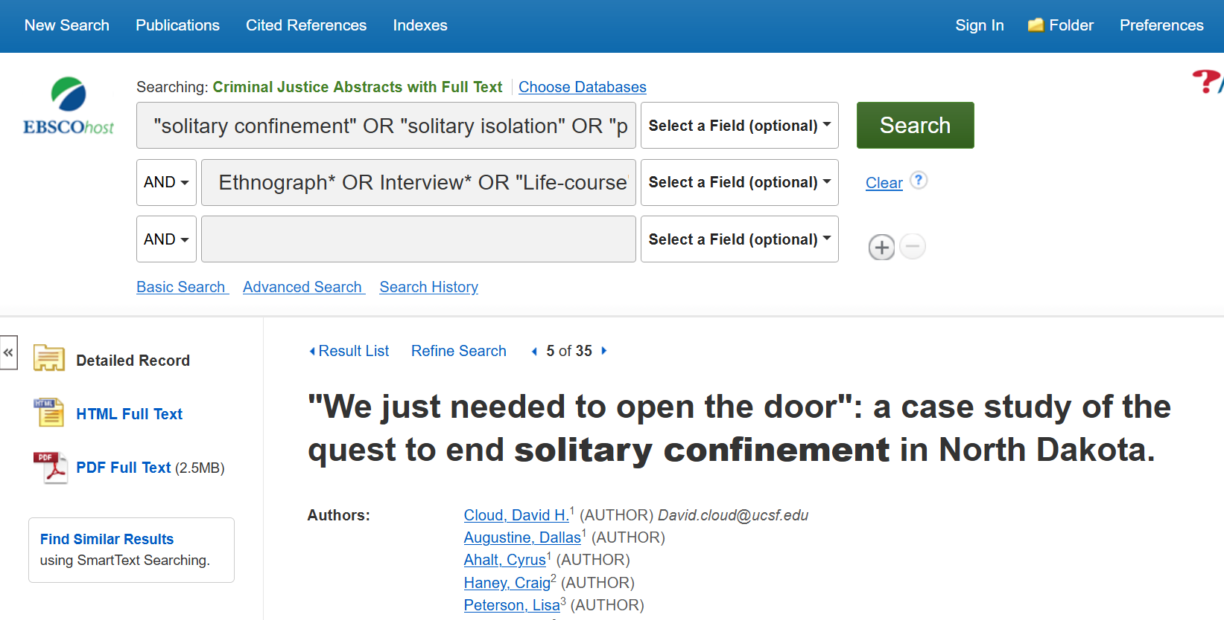
Adding methodology keywords
DEMO

Slide 24
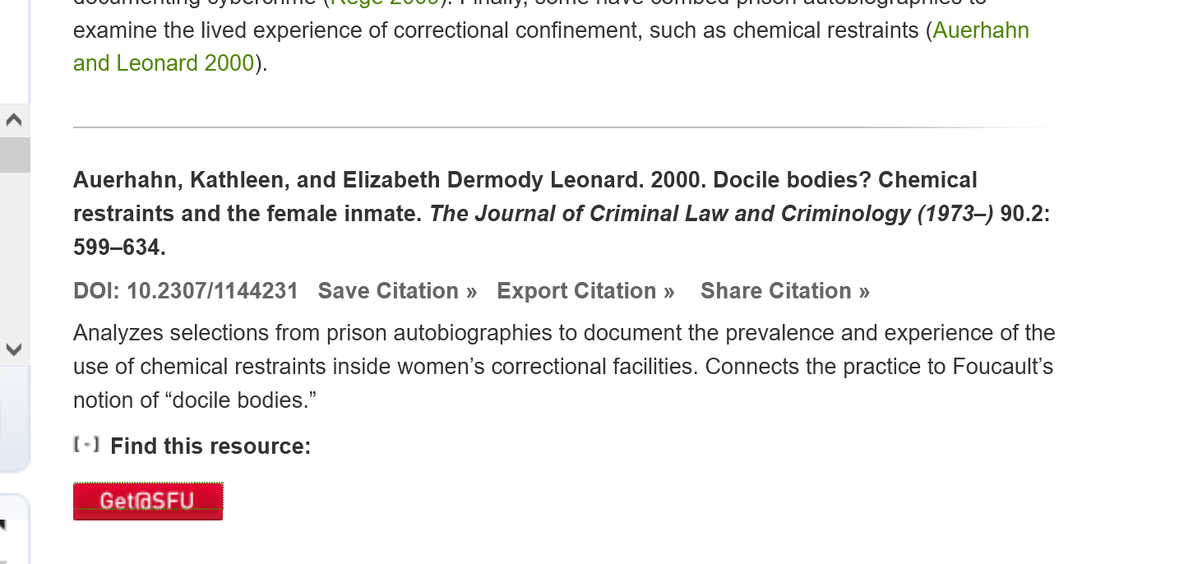
Third method
“Cited by” feature
DEMO
Cited by…Incorrigible While Incarcerated: Critically Analyzing Mainstream Canadian News Depictions of Ashley Smith

Slide 25
Almost done!

Slide 26
APA Style

Slide 27
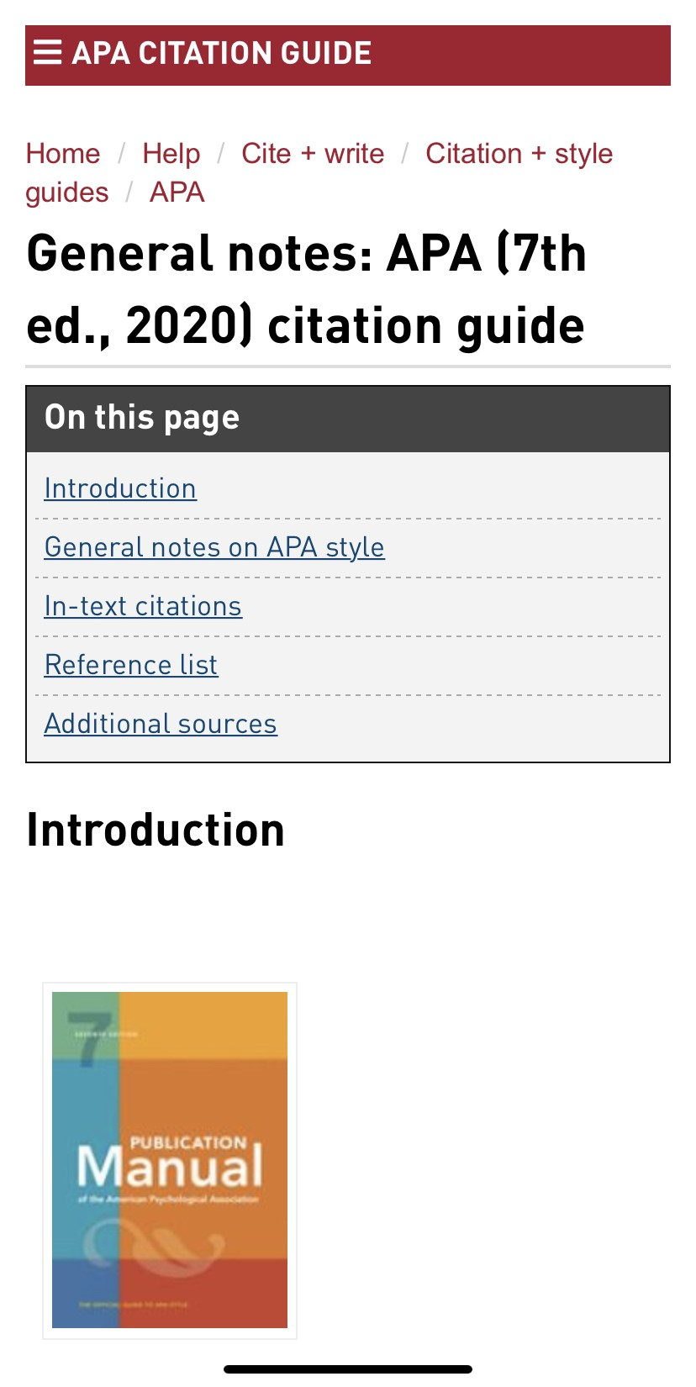
APA
Citation
Style
APA Style
SFU Library’s APA (7th edition) Resource Guide offers a lot of help with this citation style and provides some useful links to extra APA-help pages.

Slide 28
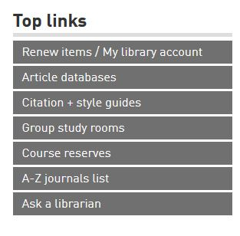
Where to go for help
Ask a Librarian
  Research help desk (drop-in & by appointment)
  NEW!: Zoom consultations
  Phone: 778.782.4345
  Email: libask@sfu.ca
  AskAway (online chat)
Student Learning Commons
  Academic writing, study skills, EAL/ESL support, annotated bibliographies*
  Write Away

