Slide 1
SFU Library – Assignment Support
Criminology 321: Qualitative Research Methods in Criminology
September 15, 2023
Yolanda Koscielski
Librarian for
Criminology, Psychology and Philosophy

Slide 2
Agenda
1. Finding academic resources
2. Search terms
3. Finding research methodology info
4. Locating qualitative research
5. Help
https://i.pinimg.com/originals/de/32/89/de32896d6903b303071c14c42c09e2a8

Slide 3
Assignment Recap
From your Annotated Bibliography Assignment:
Topic/Problem
• Clearly identify your topic/problem in the form of a research question or research statement. The more specific your topic is, the easier it will be to make sound arguments in your advocacy letter.
Be Specific
• It is often helpful to make a list of 5+ search terms that relate to your topic (similar to what you would see on the 1st page of a journal article)
Resources
• Your annotated bibliography should include a minimum of 8 and a maximum of 10 academic sources. (See: what is a scholarly or peer-reviewed journal article?)
-grey literature may be used but do not count as one your academic sources
-sources should be based on qualitative research
-ensure your sources are current to reflect up-to-date research on your topic
-each source is cited in APA format

Slide 4
Finding academic sources

Slide 5
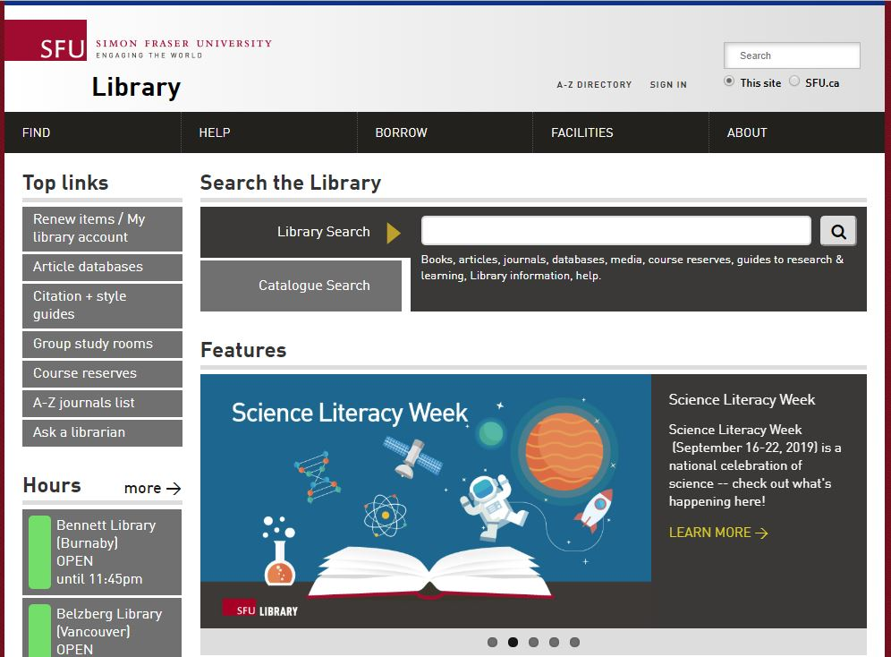
Finding Articles Online
Library Search
Broad/preliminary searches
Includes books, articles, databases, media, course reserves
ALSO includes research guides, learning guides, library info, help
Searches many (but not all) databases
DEMO

Slide 6
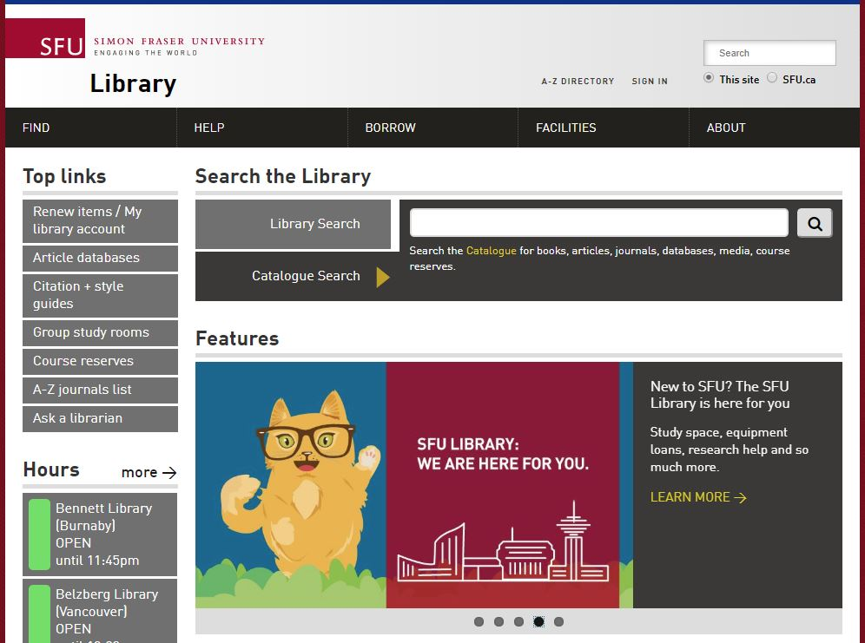
Finding Articles Online
Catalogue Search
Broad/preliminary searches
Includes books, articles, databases, media, course reserves
Searches many (but not all) databases

Slide 7
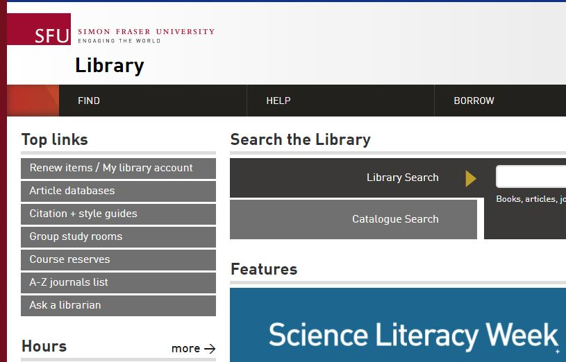
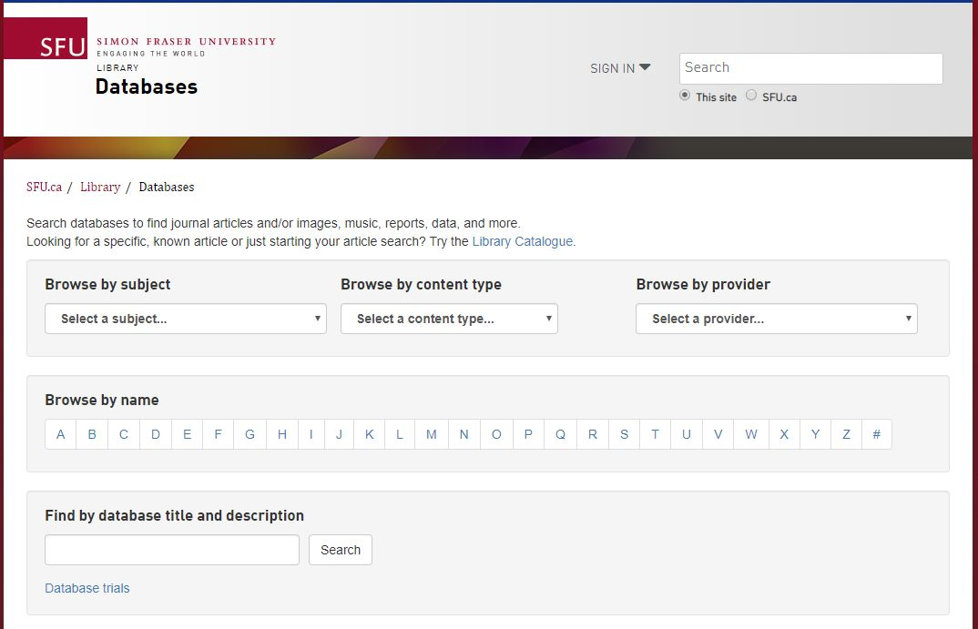
Finding Articles Online
Article databases
More targeted & in-depth searches
Subject-specific or multidisciplinary

Slide 8
Recommended Databases
DEMO: Databases by Subject Area
Criminology databases
Criminal Justice Abstracts
academic articles, magazines, dissertations, reports, books …
Other discipline-based databases
PsycINFO
Articles, books, & more in the field of psychology and the psychological aspects of other disciplines including Criminology and Law
Proquest Sociology Collection
International literature in sociology and social services, and related fields

Slide 9
Grey Literature
Note: For your assignment, Grey literature (for example, a government report) may be used, but it does not count as one of your
academic sources.
Canada Commons Public policy documents from Canadian institutes and research groups.
Example: Breaking the Cycle - An update on the use of segregation and solitary confinement in Manitoba youth custody facilities (2021, 22 pages, with references)
TIP:
citation mining!

Slide 10
Search Terms

Slide 11
Working with your topic
“It is often helpful to make a list of 5+ search terms that relate to your topic (similar to what you would see on the 1st page of a journal article)”
Image of key terms from a database record

Slide 12
“It is often helpful to make a list of 5+ search terms that relate to your topic (similar to what you would see on the 1st page of a journal article)”

Slide 13
Search tips
TIP: Use the Research Concepts Worksheet
Brainstorming search terms – conceptual categories to use
Example key concept: solitary confinement
Synonyms: administrative segregation
Broader terms: prison discipline
Narrower terms: indefinite solitary confinement, secure isolation
Related terms: restraint of prisoners

Slide 14
Finding Research Methodology Info

Slide 15
A portal about research methodology: books, dictionaries, encyclopedias, ca, etc.
Little Blue Books series focus on qualitative research
How to find… Research Methodology info
Sage Research Methods Online (SRMO)

Slide 16
How to find… Research Methodology info
Example resource: SAGE Encyclopedia of Qualitative Research Methods

Slide 17
How to find… Research Methodology info
Interactive Methods Map (Sage)

Slide 18
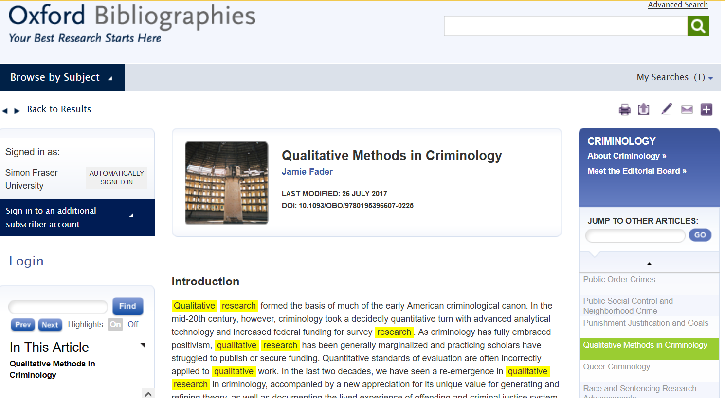
Oxford Bibliographies Online :
Qualitative Methods in Criminology
DEMO

Slide 19
Oxford Bibliographies Online :
Qualitative Methods in Criminology
“Several content analyses of publications in top criminology and criminal justice journals have established the current representation of qualitative research therein. The most recent study of this type, Copes, et al. 2011, found that less than 4 percent of articles published in the fifteen top-ranked journals in the field were qualitative”
DEMO

Slide 20
Finding qualitative articles

Slide 21
Two main methods
Locating Qualitative Articles
Dedicated search limiters in databases
Adding related keywords

Slide 22
Search limiters
PsycINFO
DEMO
Qualitative Study: “A type of research methodology that produces descriptive data, with little emphasis given to numerical quantitative measures”. – EBSCO/PsycINFO description

Slide 23
Adding methodology keywords
Possibilities:
Qualitative
Ethnography
Interviews
Life-course
Narrative inquiry
Content analysis
Case study
Focus group
…
Useful for databases without a qualitative study limiter.

Slide 24
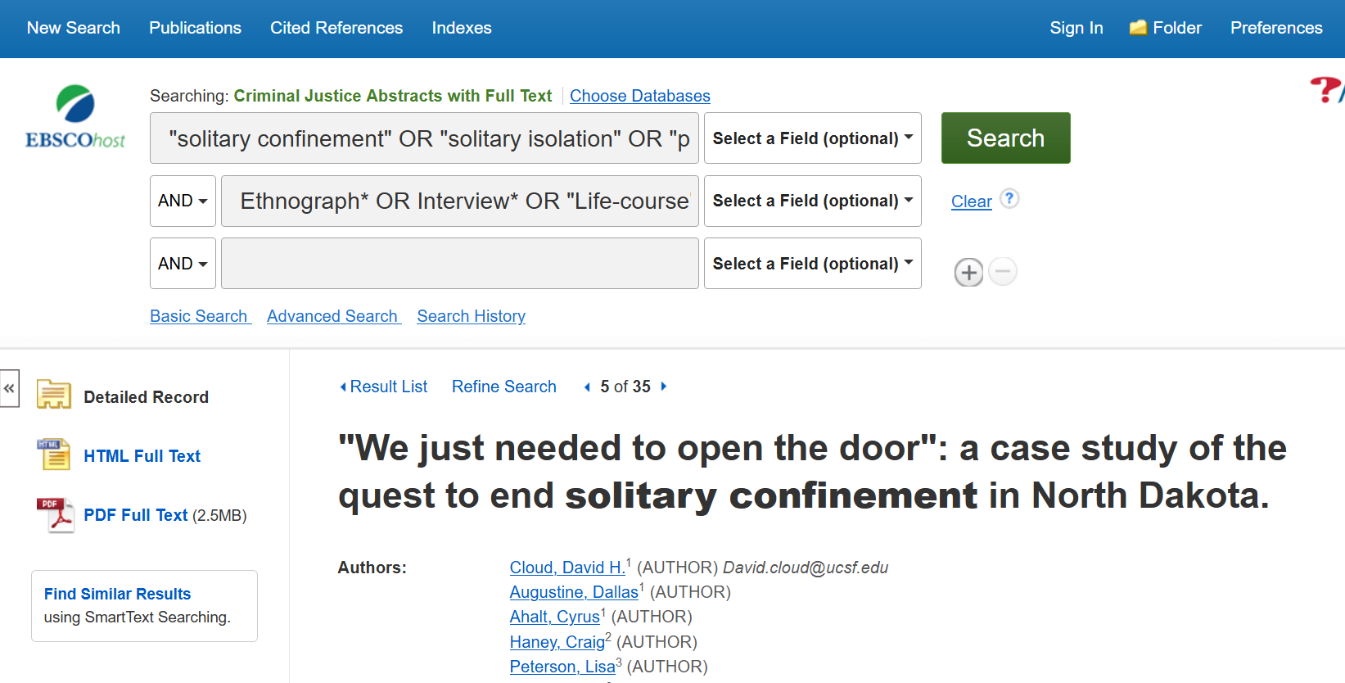
Adding methodology keywords
DEMO
Notes:
Demo in CJA
First line – our topic
Second line – these qualitative keywords
Quotation marks so it is searching terms as a phrase
First line: "solitary confinement" OR "solitary isolation" OR "prison confinement" OR "administrative segregation"
Second line: Ethnograph* OR Interview* OR "Life-course" OR "Narrative inquiry" OR "Content analysis" OR qualitative
Highlighted terms will show you why the article is coming up. Some will be irrelevant.
Go to article #5- case study, may be relevant
“Methods: We conducted an embedded case study, analyzing changes in policies and procedures, administrative data, and focus groups and interviews with incarcerated persons and staff, ”

Slide 25
Third method “Cited by” feature
Cited by…
Hoffman, K.A., Thompson, E., Gaeta Gazzola, M. et al. “Just fighting for my life to stay alive”: a qualitative investigation of barriers and facilitators to community re-entry among people with opioid use disorder and incarceration histories. Addict Sci Clin Pract 18, 16 (2023)
DEMO

Slide 26
Almost done!

Slide 27
APA Style

Slide 28
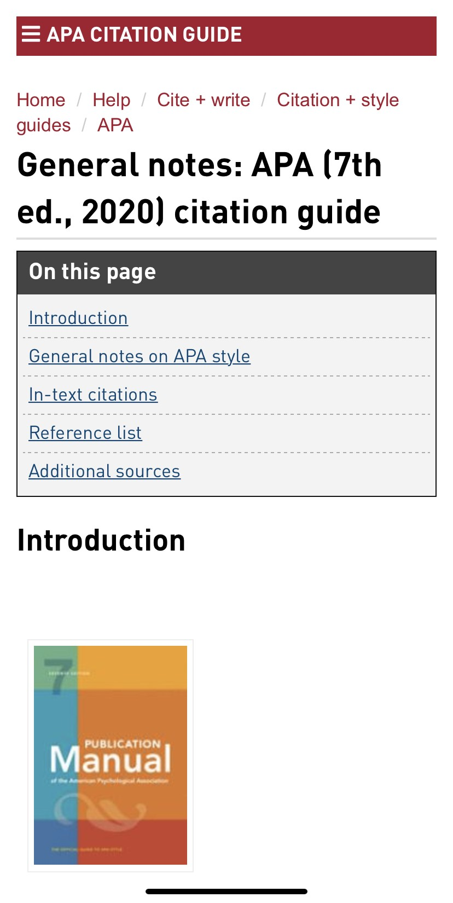
APA Citation Style
APA Style
SFU Library’s APA (7th edition) Resource Guide offers a lot of help with this citation style and provides some useful links to extra APA-help pages.

Slide 29
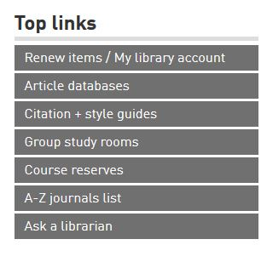
Where to go for help
Ask a Librarian
Research help desk (office hours & by appointment)
Zoom consultations
Phone: 778.782.4345
Email: libask@sfu.ca
AskAway (online chat)
Student Learning Commons
Academic writing, study skills, EAL/ESL support, annotated bibliographies*
Write Away

