Slide 1
SFU Library Orientation
Criminology 220: Research Project Help
Emma Brookman
libask@sfu.ca

Slide 2
Acknowledgment
We acknowledge SFU’s three campuses are on the ancestral and unceded lands of the
xʷməθkʷəy̓əm (Musqueam),
Sḵwx̱wú7mesh (Squamish),
Səl̓ílwətaɬ (Tsleil-Waututh),
q̓íc̓əy̓ (Katzie),
kʷikʷəƛ̓əm (Kwikwetlem),
Semiahmoo,
Kwantlen,
Qayqayt, and
Tsawwassen
Nations and peoples

Slide 3
Agenda
1. SFU Library Info
2. Assignment Recap
3. How to find:
Background info via encyclopedias
Peer-reviewed journal articles
4. Plus …
Working with your topic
Search tips
“And I thought we were friends” by hehedan,
CC BY-NC 2.0

Slide 4
SFU Library Info

Slide 5
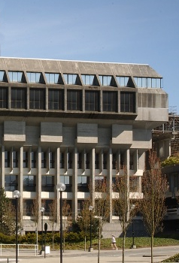
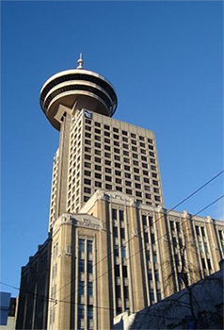
SFU Library Info
A few quick facts about us …
SFU Burnaby
SFU Vancouver
SFU Surrey
three campus libraries
+2.5 million books & e-books
+98,000 subscriptions to journals, magazines & newspapers
+500 research databases

Slide 6
Assignment Recap

Slide 7
Assignment Recap
From your Research Project Assignment:
Literature Review
a. Summarize 5 to 8 peer-reviewed studies (remember, you need to include at least 10 peer-reviewed references in the paper, but they don’t all have to be included in the Lit Review section).
Data and Methods
d. Discuss your research design (e.g., experimental, non-experimental)
e. Describe your data collection method (e.g., self-report surveys, existing data, content analysis, focus groups)
References
a. Include at least 12-15 references (10 of these must be peer-reviewed journal articles)
b. Non-peer reviewed references can come from newspaper and magazine articles, websites, documentaries, and so on
c. Use APA formatting for in-text citations and reference list
Notes:
Here’s a quick review of some of instructions for your assignment … [Read through slide]

Slide 8
What is a literature review?
A literature review…
summarizes related studies
tries to make sense of the patterns of findings
draws conclusions about what is known, what is not known, and what should be known.
(adapted from SFU Library website)
Notes:
Lit reviews are a summary of trends and patterns of results and conclusions of studies related to your topic:
you get an idea of what’s going on in the field before you start your research
people who read your research get a some BG info before they read about your research & findings

Slide 9
How to Find Background Info

Slide 10
How to find… Background info: Encyclopedias
Encyclopedias
offer an overview of your topic (the “big picture”)
are written with the academic in mind, often by specialists in the field
Identifies key articles, studies, authors, etc.
Encyclopedias and hand-books:
Gale Virtual Reference Library
Oxford Reference Online
SAGE Knowledge

Slide 11
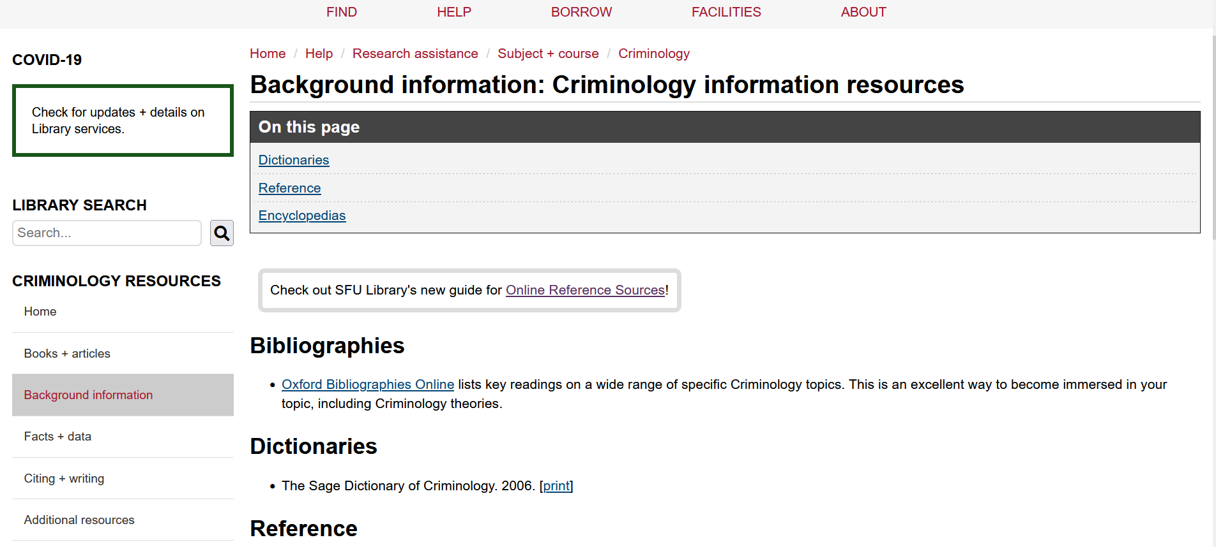
How to find… Background info: Encyclopedias
SFU Library’s Criminology Research Guide

Slide 12
Articles: Popular vs. Scholarly

Slide 13
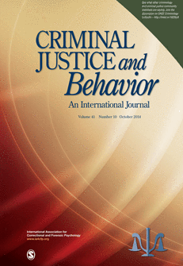
Popular vs. Scholarly
Popular Magazine
Example: The Atlantic
Scholarly Journal
Example: Criminal Justice and Behavior:
An International Journal

Slide 14
Popular vs. Scholarly
Popular Magazine articles Example: The Atlantic
Audience: general public
Writers: paid reporters, non-specialist writers
Design: colourful, graphics, advertisements
Features: no abstracts, citations, or bibliographies
Focus: on a popular topic of interest to the general public
Use: good for broad overviews and popular perspectives
Language: plain, accessible

Slide 15
Popular vs. Scholarly
Scholarly Journal articles
Example: Criminal Justice and Behavior: An International Journal
Audience: academics
Writers: unpaid scholars and researchers
Design: often visually boring with mostly text, some tables and charts
Features: abstracts, citations, bibliographies
Focus: on a specific topic of interest to specialists
Use: good for historical, current, scholarly, in-depth perspectives
Language: subject-specific, jargon-filled
Key criterion: peer-reviewed
Notes:
Peer-review = group of academics and researchers of the topic review the article and evaluate the quality of the article before publishing

Slide 16
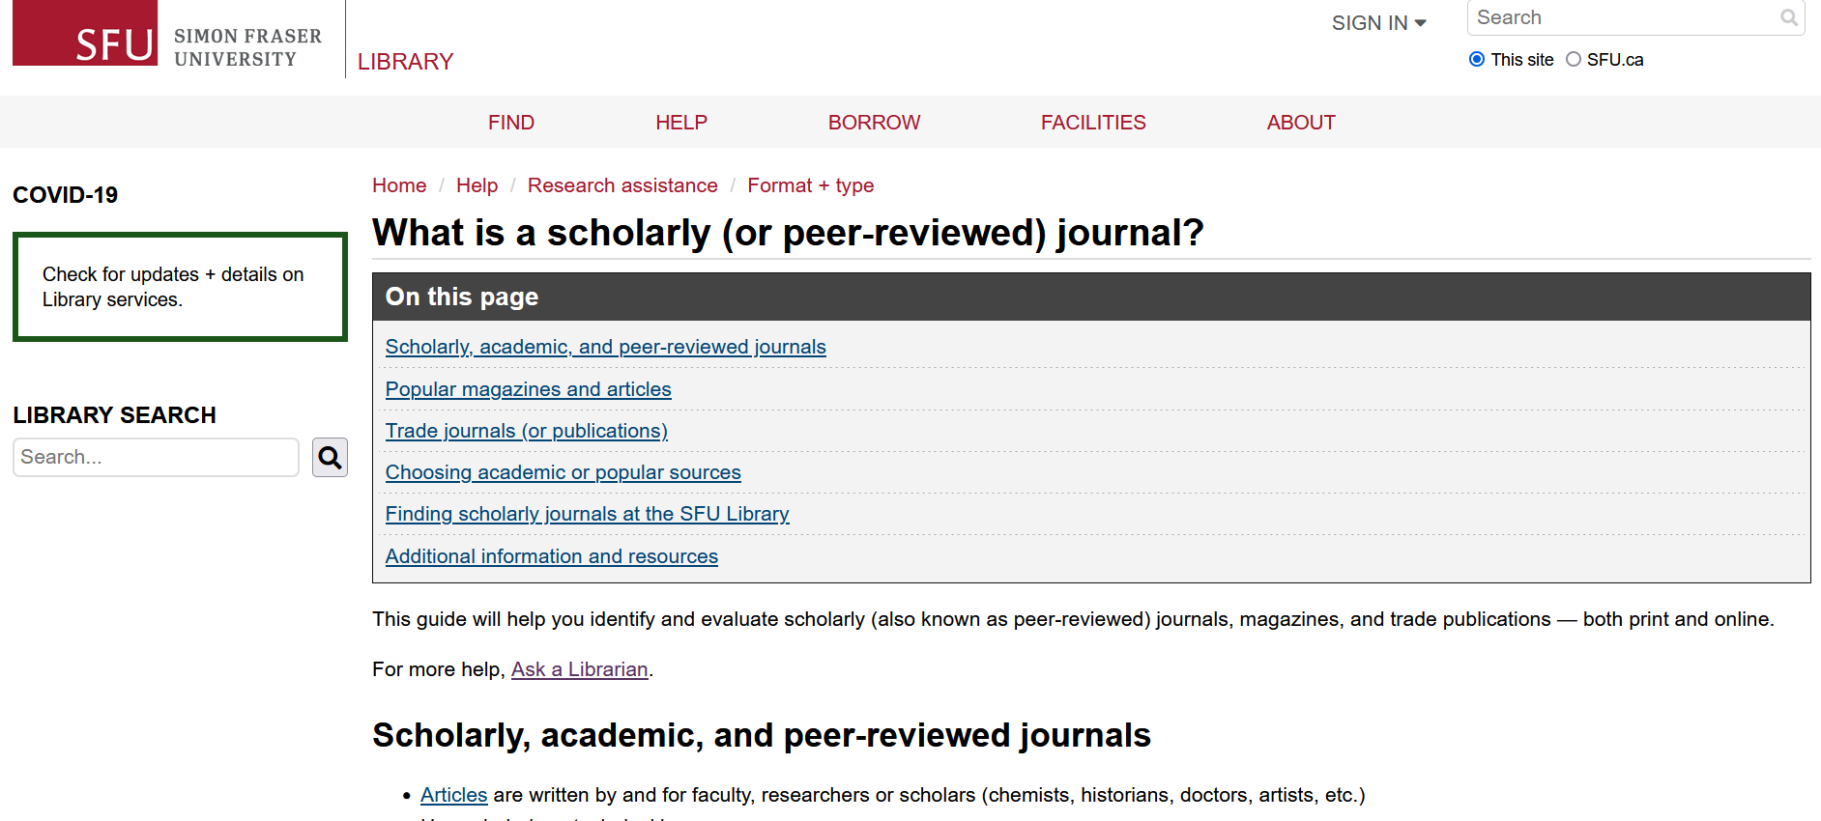
Popular vs. Scholarly
SFU Library’s Scholarly Journal Guide offers a lot more info about scholarly journals and popular magazines.
Feel free to browse through it!

Slide 17
Finding Articles Online

Slide 18
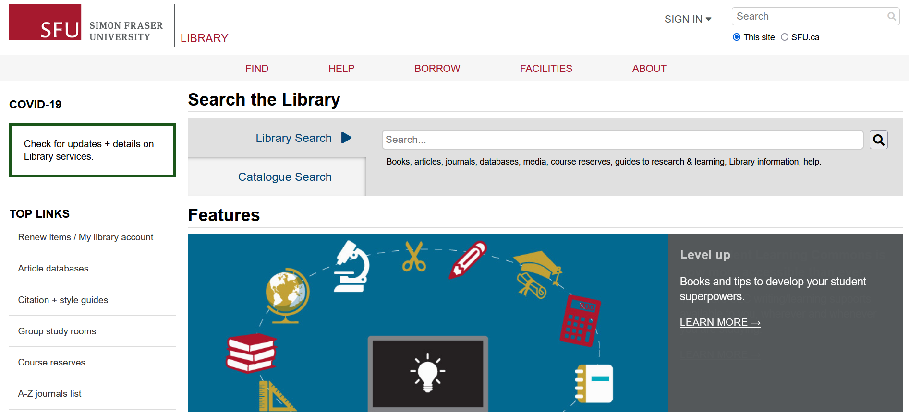
Finding Articles Online
Library Search
Broad/preliminary searches
Includes books, articles, databases, media, course reserves
ALSO includes research guides, learning guides, library info, help
Searches many (but not all) databases

Slide 19
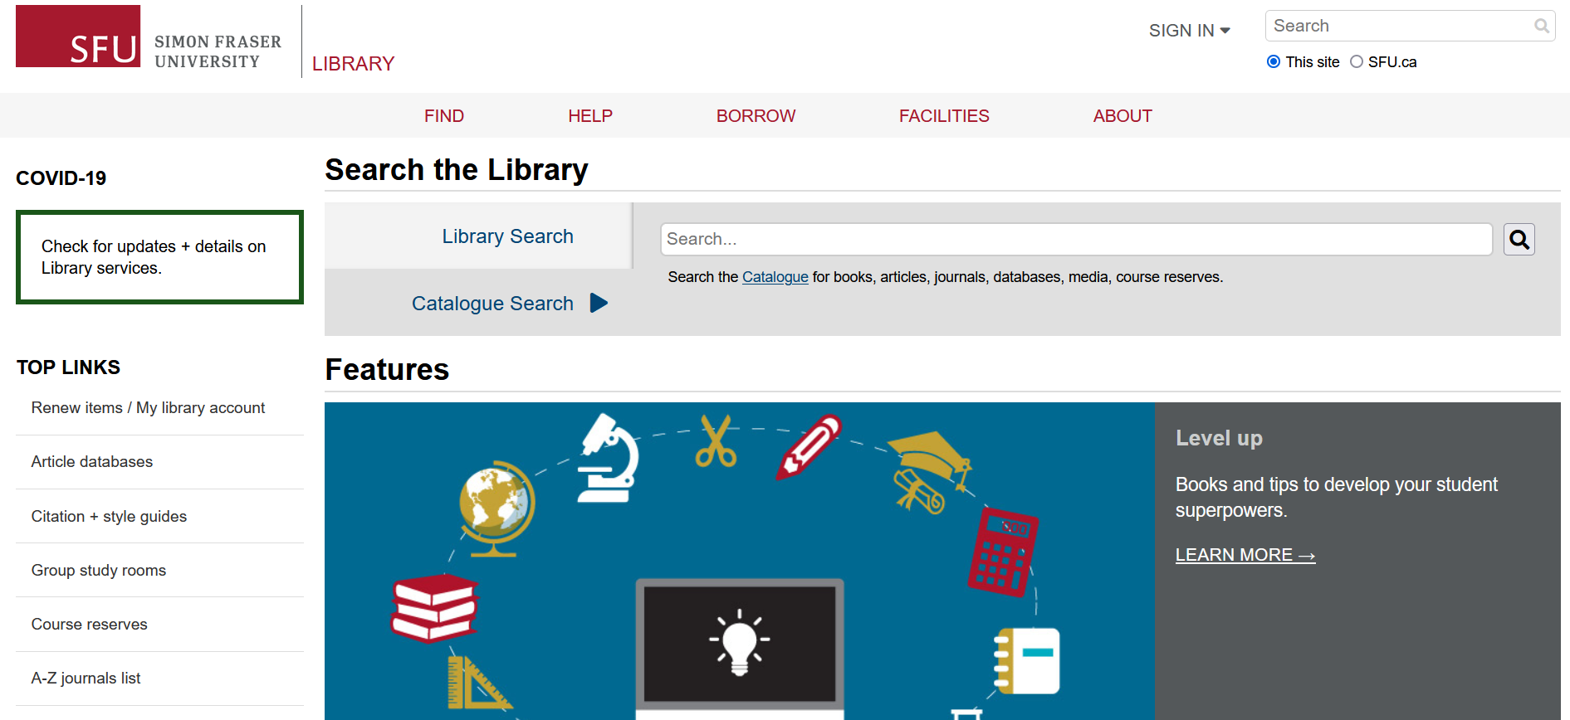
Finding Articles Online
Catalogue Search
Broad/preliminary searches
Includes books, articles, databases, media, course reserves
Searches many (but not all) databases

Slide 20
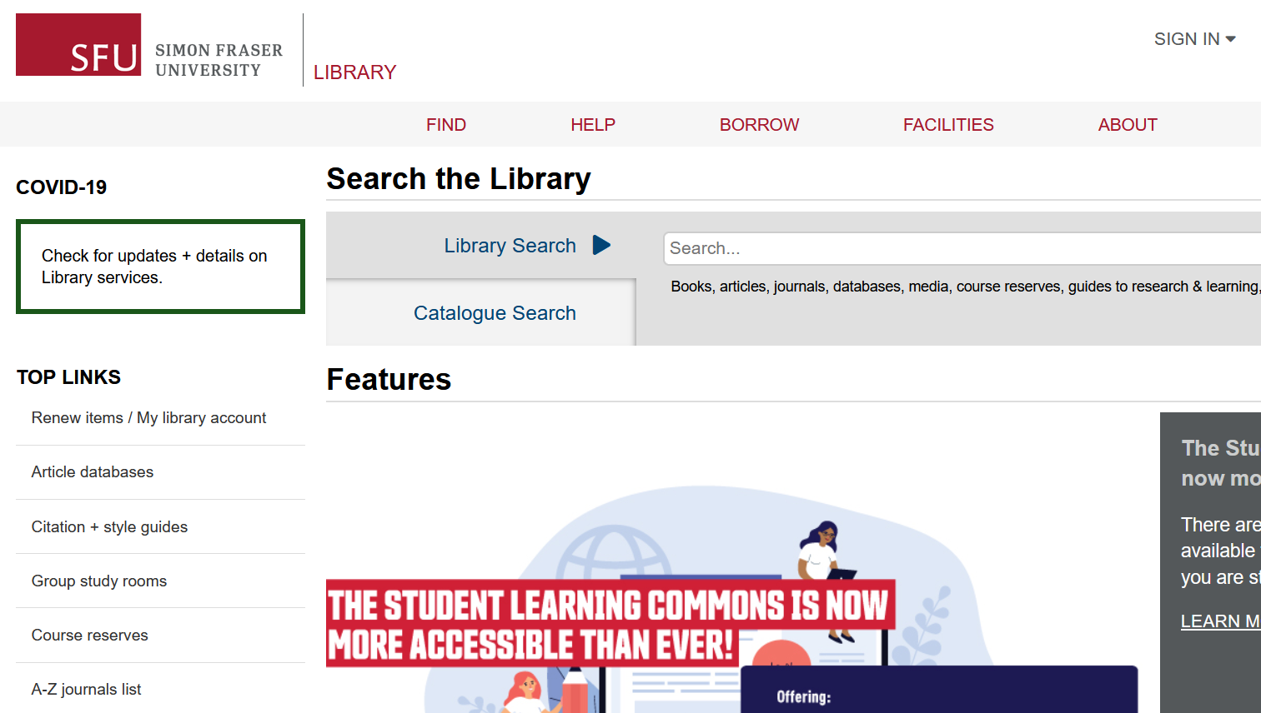
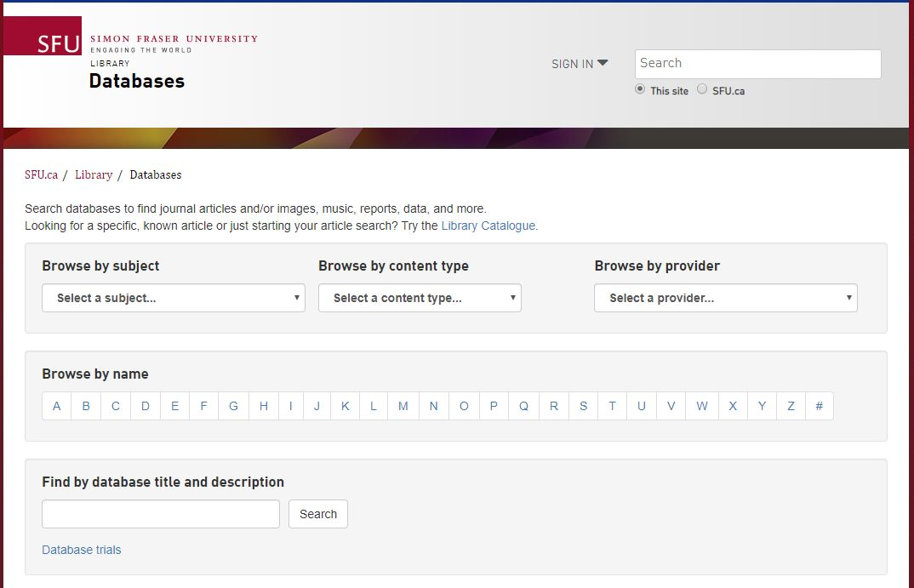
Finding Articles Online
Article databases
More targeted & in-depth searches
Subject-specific or multidisciplinary

Slide 21
Recommended Databases
Criminology databases
Criminal Justice Abstracts
academic articles, magazines, dissertations, reports, books …
National Criminal Justice Reference Service
academic articles, government reports, research reports, books …
Other discipline-based databases
PsycINFO
academic articles, books, dissertations …
Sociological Abstracts
academic articles, books, dissertations, association reports …

Slide 22
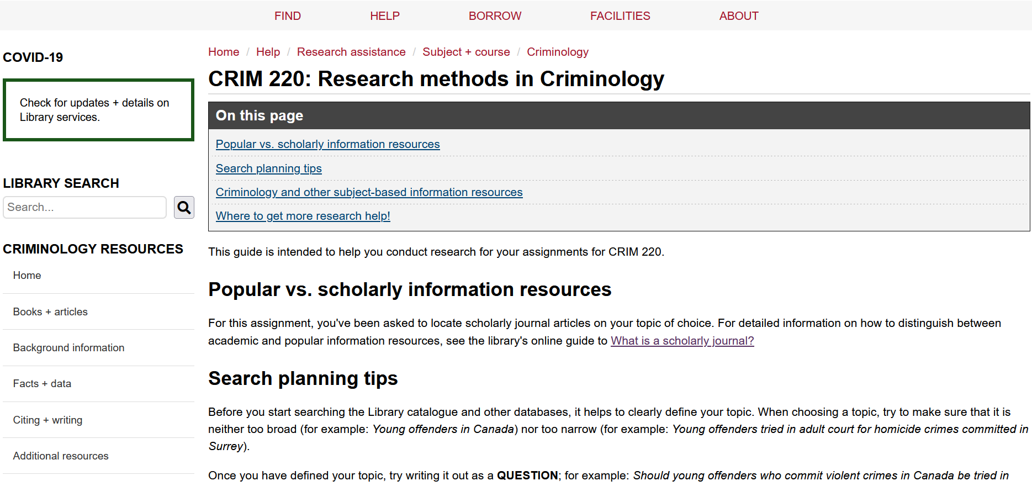
Criminology Research Guide
You can go to your course Criminology Research Guide for further resources and databases!

Slide 23
Topic & Searching

Slide 24
Working with your topic
Focusing your topic
Example topic: Arts therapy and recidivism
Ask yourself:
Who? Women, youth, Indigenous peoples …
What? Visual art, music, mental health …
When? Historical or contemporary?
Where? Vancouver, BC, Canada, North America, international …
Notes:
When choosing your research topic, you must consider a few things to help identify key concepts of your topic
Who = what group you are focusing on
What = what is the subject you’re researching? What sort of arts therapy (music therapy, visual arts?
When = timeframe?
Where = geographical location? Entirety of Canada vs. Vancouver?

Slide 25
Working with your topic
Developing keywords
Revised topic: Impact of arts therapy on recidivism in young offenders
Identify key concepts
Brainstorm keywords (search terms) for each key concept
Arts therapy | Recidivism | Young offenders
Therapy Counselling Music therapy Dance therapy | Repeat offender | Juvenile delinquents Early adolescent offenders Youth Teenagers

Slide 26
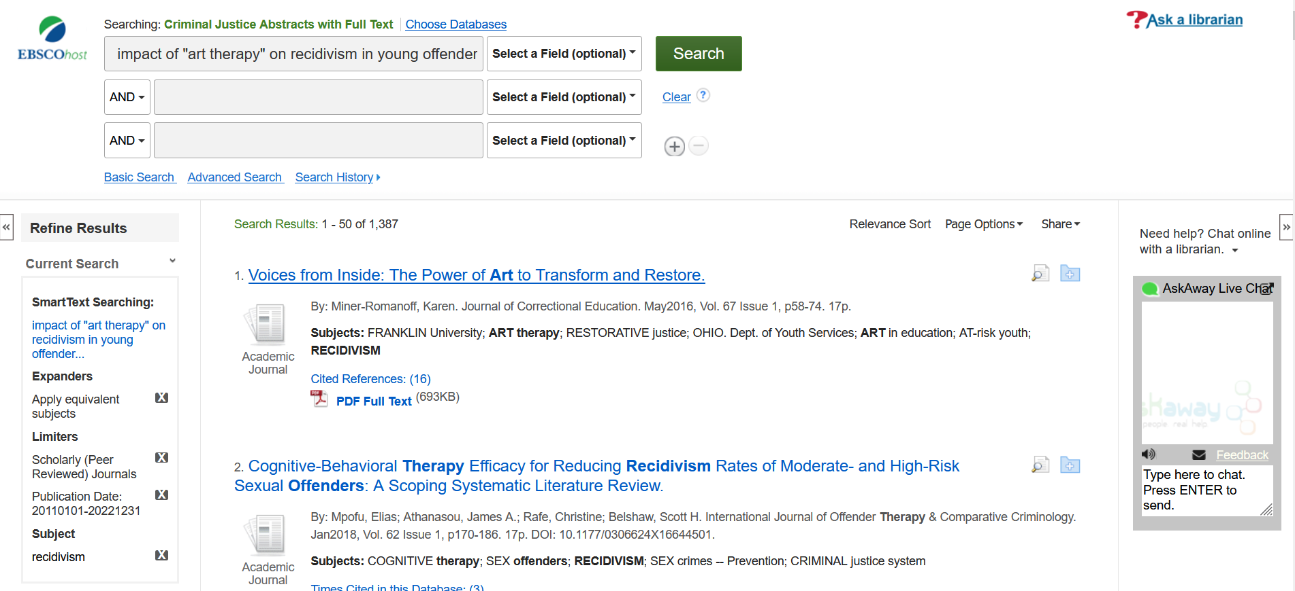
Searching through databases
`
Like searching through the library catalogue
You can go to our “How to find journal articles” guide for more tips!
Library research tutorials also go over this information (ex. Library Research Skills and Beyond the Basics)
Notes:
Ex, of search using Criminal Justice Abstracts database
Things to note:
“Phrase searching” – why is “art therapy” in quotations?
Filters → like using any database (Ex. Amazon allows you to filter your search results, so does many social media platforms)
For more in-depth search tips, see library’s “How to find journal articles” guide, or our Library research tutorials

Slide 27
APA Style

Slide 28
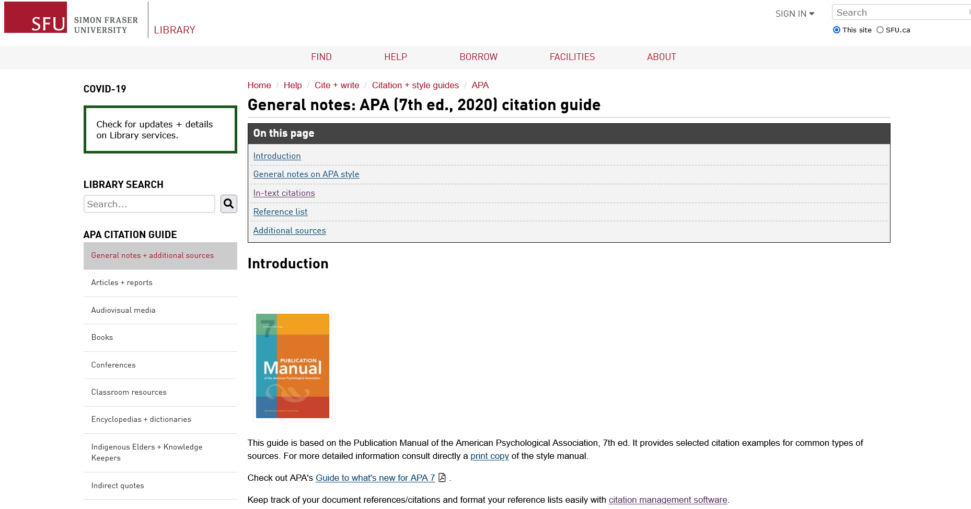
APA Citation Style
APA Style
SFU Library’s APA (7th edition) Resource Guide offers a lot of help with this citation style and provides some useful links to extra APA-help pages.

Slide 29
Almost done!

Slide 30
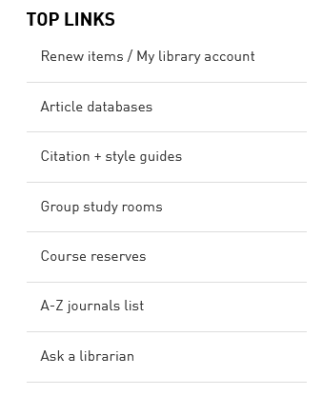
Where to go for help
Contact us:
Research help desk (drop-in & by appointment)
Phone: 778.782.4345
Email us at: libask@sfu.ca
AskAway (online chat)
Citation Guides: APA, MLA, Chicago …
Student Learning Commons
Academic writing, study skills, EAL/ESL support

