Slide 1
SFU Library Orientation
Criminology 220: Library Research
Yolanda Koscielski
Librarian for Criminology, Philosophy & Psychology
Notes:
PowerPoint will be linked from the library website.
General Library content + specific tips for this research assignment

Slide 2
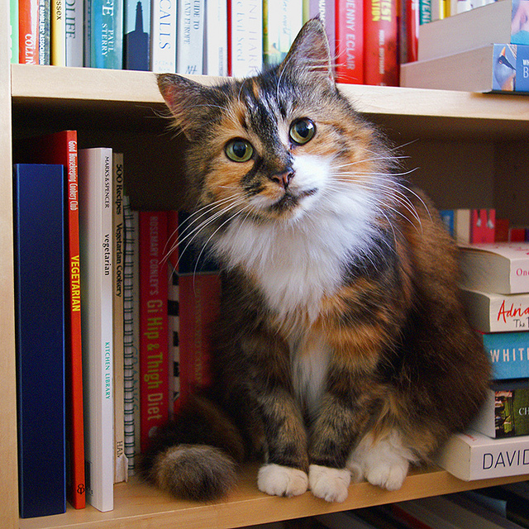
Agenda
Six things to know about research at SFU Library:
SFU Library is for you
Use the library’s free resources to avoid paying for research
Tools are available to help you identify scholarly articles
We have 700+ specialized databases
There are some useful search strategies you can deploy
Research help is available
“And I thought we were friends” by hehedan,
CC BY-NC 2.0

Slide 3
1. SFU Library is for You

Slide 4
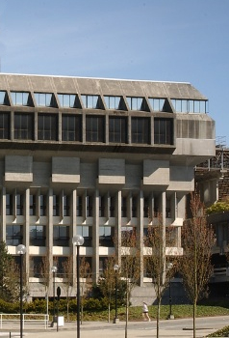
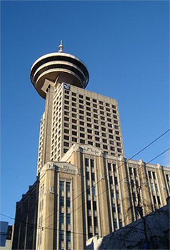
SFU Library Info
A few quick facts about us …
SFU Burnaby
SFU Vancouver
SFU Surrey
three campus libraries, one SFU Library
interbranch book requests
course reserves
+700 research databases

Slide 5
Specialized Resources at SFU Library
Examples:
Research Data Management Unit
Help with accessing microdata, etc.
MAPS/GIS Unit
Knowledge mobilization team
Scholarly publishing support
Digital Humanities Lab
A Media Makerspace
Dick Kouwenhoven Book Arts Studio (new!)
Institutional repository
Niche databases, special collections and resources
E.g. Criterion on Demand

Slide 6
2.Use the library’s free resources to avoid paying for research

Slide 7
Access library resources – libkey nomad
Running into paywalls and multi-step workarounds?
LibKey Nomad provides instant access to articles.
thirdiron.com/downloadnomad

Slide 8
How to install LibKey Nomad
Go to thirdiron.com/downloadnomad
Choose your browser and follow the prompts to install the LibKey Nomad browser extension
Search for and choose Simon Fraser University as your organization
You’re all set!
Look for LibKey Nomad icons on scholarly webpages.

Slide 9
Interlibrary Loan & Book Requests
Notes:
Criterion

Slide 10
3. Articles: Non-Scholarly vs. Scholarly

Slide 11
Popular/ vs. Scholarly
“Find at least 7 scholarly articles that relate to your chosen topic…at least 2…published after 2021”
Popular Magazine
Example: Psychology Today
Scholarly Journal
Example: Criminal Justice and Behavior:
An International Journal

Slide 12
Popular vs. Scholarly
Popular Magazine articles Example: Psychology Today
Articles are usually written by journalists or professional writers for a general audience
Use language easily understood by general readers
Rarely give full citations for sources
Are written for the general public (non-experts)
May present or adapt information originally published in scholarly journals
Do not always include information about the authors
Articles tend to be shorter and more graphically appealing than those in academic journals

Slide 13
Popular vs. Scholarly
Scholarly Journal articles
Example: Criminal Justice and Behavior: An International Journal
Articles are written by and for faculty, researchers or scholars (chemists, criminologists, doctors, artists, etc.)
Use scholarly or technical language
Articles tend to be long, detailed, and specific about research in a particular academic discipline
Include full citations for sources, abstracts
Are refereed or peer-reviewed
Include information about the authors
Are published by academic organisations
Note: book reviews and editorials are not considered scholarly articles, even when found in scholarly journals

Slide 14
Popular vs. Scholarly
Key criterion: peer-reviewed
Peer-reviewed or refereed journals have an editorial board of subject experts who review and evaluate submitted articles before accepting them for publication. A journal may be a scholarly journal but not a peer-reviewed journal.

Slide 15
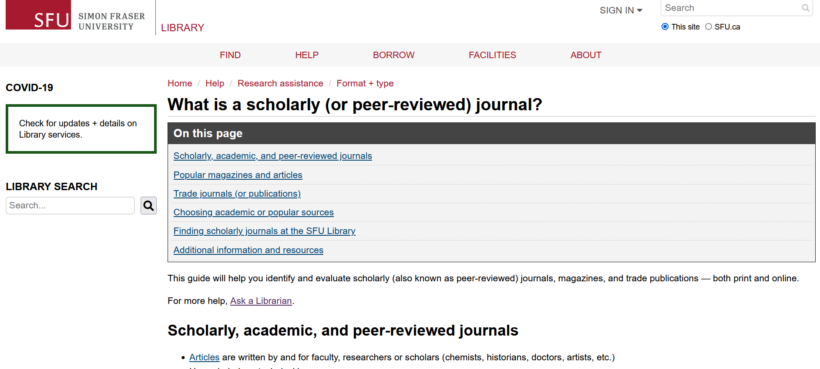
Popular vs. Scholarly
SFU Library’s Scholarly Journal Guide offers a lot more info about scholarly journals and popular magazines.
Feel free to browse through it!

Slide 16
Google Scholar
Dissertation
Journal article
Book chapter
Legal journal
Peer reviewed?

Slide 17
4. Specialized Databases

Slide 18
What is a literature review?
A literature review…
summarizes related studies
tries to make sense of the patterns of findings
draws conclusions about what is known, what is not known, and what should be known.
(adapted from SFU Library website)

Slide 19
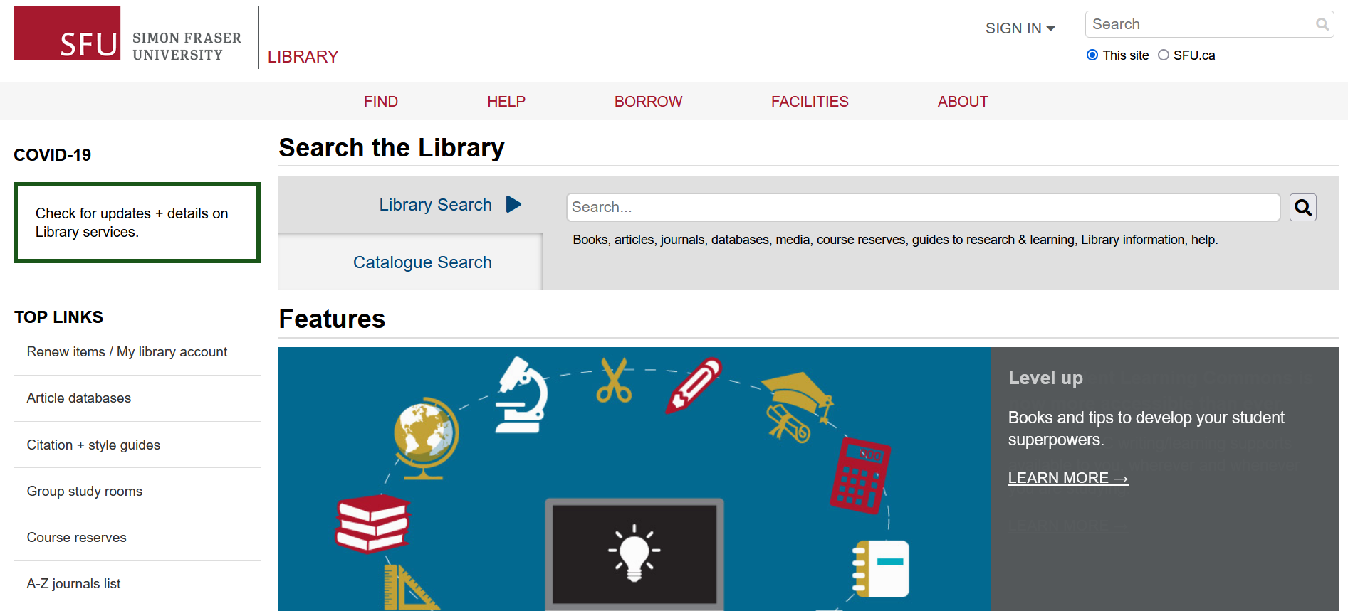
Finding Articles Online
Library Search
Searches the catalogue and the website
Includes research guides, learning guides, library info, help, databases, content of most (but not all) databases

Slide 20
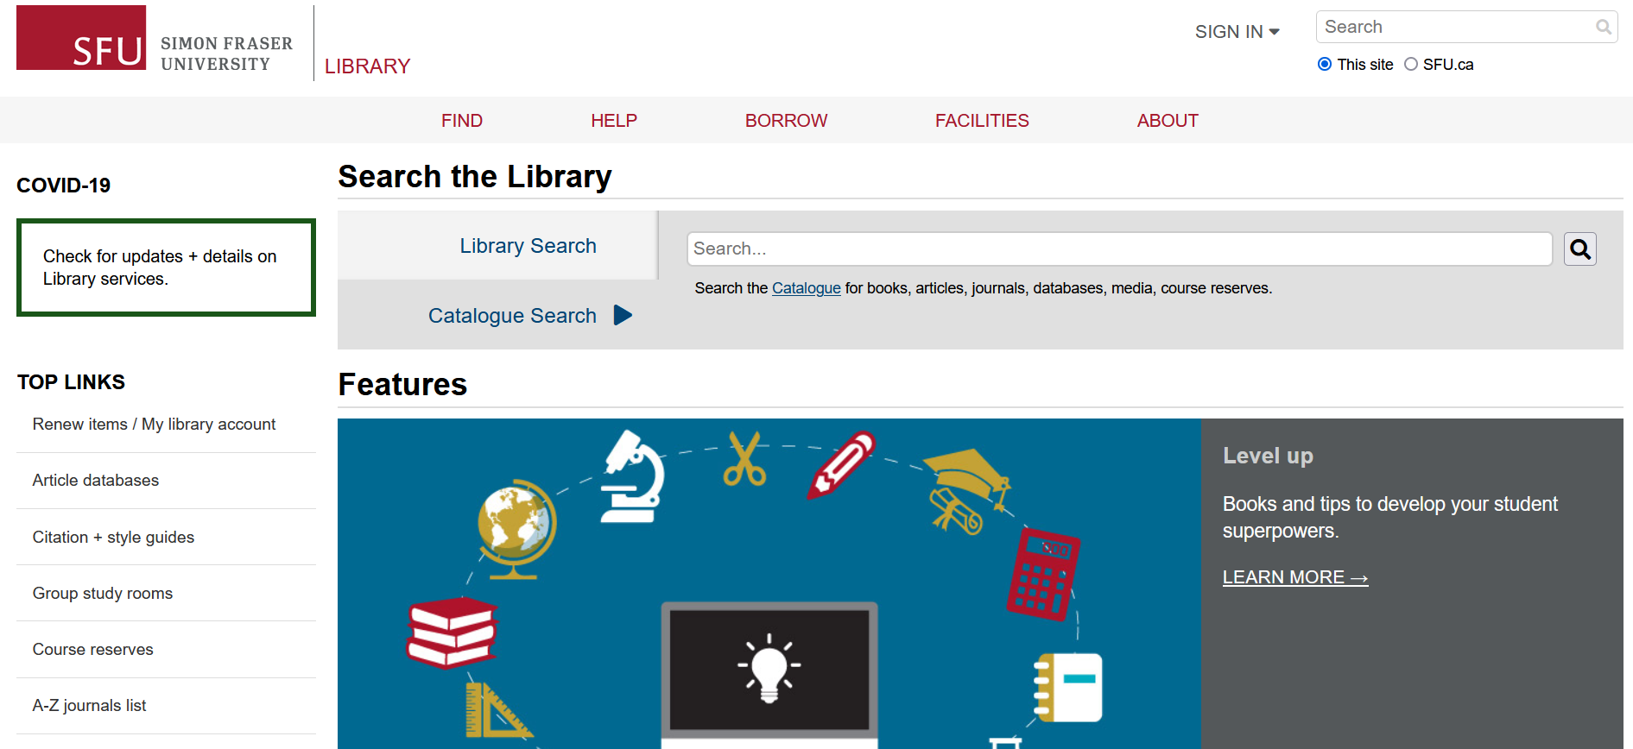
Finding Articles Online
Catalogue Search
Narrower
Includes our main collection items: books, articles, databases, media, course reserves

Slide 21
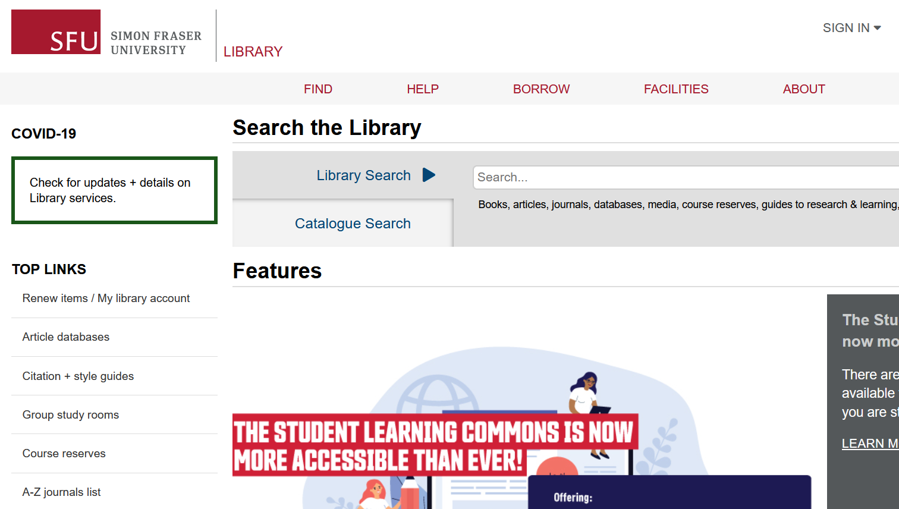
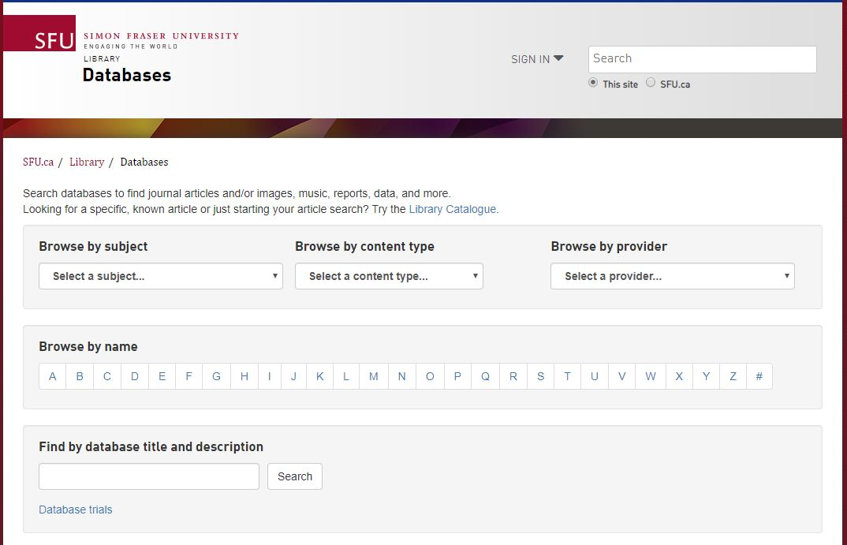
Finding Articles Online
Article databases
More targeted & in-depth searches
Subject-specific or multidisciplinary

Slide 22
Recommended Databases
Criminology databases
Criminal Justice Abstracts
academic articles, magazines, dissertations, reports, books …
Other discipline-based databases
PsycINFO
academic articles, books, dissertations …
Sociological Abstracts
academic articles, books, dissertations, association reports …(e.g. Journal of Gang Research)
CBCA Complete
Comprehensive Canadian periodical collection for reference and current events. Publications include scholarly journal articles, trade publications, dissertations, books, newspapers and magazines.

Slide 23
Recommended Databases – Search tips
Criminal Justice Abstracts
academic articles, magazines, dissertations, reports, books …
Make use of auto-fill for synonyms
One concept per line
Quotation marks for phrases

Slide 24
Searching through databases
Get@SFU
Look at Cited References and Times Cited in the Database

Slide 25
5. Topic & Search Tips

Slide 26
Working with your topic
Focusing your topic
Example topic: Therapy and recidivism
Ask yourself:
Who? Women, youth, incarcerated people…
What? Visual art therapy, cognitive behavioural therapy…
When? Historical or contemporary? Time frame (short term or long term)?
Where? Vancouver, BC, Canada, North America, international …

Slide 27
Working with your topic
Developing keywords
Revised topic: Impact of arts therapy on recidivism in young offenders
Identify key concepts
Brainstorm keywords (search terms) for each key concept
Arts therapy | Recidivism | Young offenders
Music therapy Dance therapy Bibliotherapy Equine therapy Therapy Counselling | Repeat offender | Criminals Juvenile delinquents Early adolescent offenders Youth Teenagers Justice-involved youth

Slide 28
Boolean & other Search tips
Use AND between keywords to narrow your search
1
For example: recidivism AND youth
Use OR between keywords to broaden your search
2
For example: Coast Salish OR Indigenous OR First Nations
Use quotation marks around an exact phrase
3
For example: “young offender”
Use an asterisk (*) to find related terms
4
For example: Canad* retrieves: Canada, Canadian, etc.
Notes:
Polic*

Slide 29
Search strategies
Art therapy AND criminal
offenders; or,
Criminal offenders AND
recidivism; or,
Art therapy and recidivism
Art therapy AND recidivism AND young offenders
Art therapy AND mental health

Slide 30
Research and Writing Help
Human-powered research support!

Slide 31
Where to go for help
Contact us: Ask a Librarian
Book an appointment (Zoom, in person, or phone)
Same day often available
Phone: 778.782.4351 (call back)
Email us at: libask@sfu.ca
AskAway (online chat)
Citation Guides: APA, MLA, Chicago …
Student Learning Commons
Academic writing, study skills, EAL/ESL support
WriteAway

Slide 32
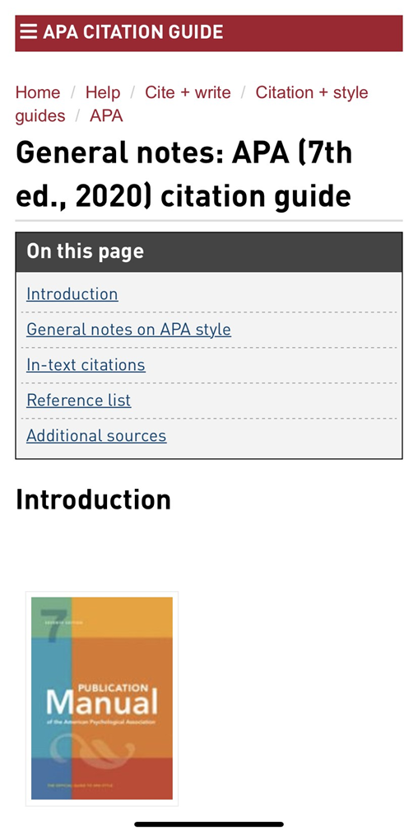
APA Citation Style
APA Blog + SFU APA Guide
“We will be very picky when grading the reference list…”

Slide 33
Thank you!

