Slide 1
SFU Library Orientation
Criminology 210: Research Paper Help
James Bachmann
Library Learning & Instructional Services

Slide 2
Agenda
1. SFU Library Info
2. Assignment Recap
3. Conducting a Literature Review or Background Research
4. How to find:
Background info
Info on research methodology
Peer-reviewed articles & non-peer reviewed sources
Citation help
5. Plus …
Working with your topic
Search tips
“And I thought we were friends” by hehedan,
CC BY-NC 2.0

Slide 3
SFU Library Info

Slide 4
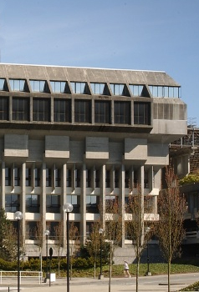
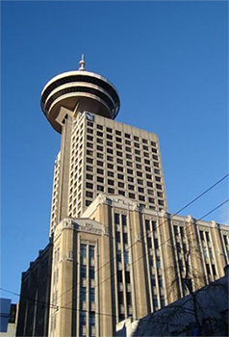
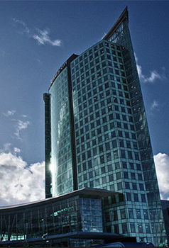
SFU Library Info
A few quick facts about us …
SFU Burnaby
SFU Vancouver
SFU Surrey
three campus libraries
2.5 million+ books & e-books
98,000+ subscriptions to journals, magazines & newspapers
500+ research databases

Slide 5
Assignment Recap

Slide 6
Assignment Recap
From your Paper Guidelines:
Critically address an issue related to young offenders or youth justice
• Issue should reflect at least one topic covered in this course
Research
• At least 10 peer-reviewed articles
Use APA style
• Use APA formatting for paper, in-text citations, and reference list
• Pay close attention to detail
Notes:
Students should see assignment for full details

Slide 7
Conducting a Literature Review or Background Research

Slide 8
What is a literature review?
A literature review…
summarizes related studies
tries to make sense of the patterns of findings
draws conclusions about what is known, what is not known, and what should be known.
(adapted from SFU Library website)
Notes:
It’s basically used for helping
you get a feel for what’s going on in the field before you start your research
people who read your research get a bit of background information before they read about your research and findings
Is different than an annotated bibliography
Background research is similar, just usually not as thorough/broad

Slide 9
Literature Review / Background Research
Denton, E. (2009). International News Coverage of Human Trafficking Arrests and Prosecutions: a Content Analysis (Master’s Thesis). Simon Fraser University, Burnaby, BC. Retrieved from http://summit.sfu.ca/item/9561
From Erin Denton’s Literature Review (20 pages)
In 1904, the first modern response to the new slave trade, the International Agreement for the Suppression of the White Slave Traffic, was created (Friman & Reich, 2007). …
History
Notes:
Sample Lit Review - Erin Denton’s Master’s thesis (an SFU student)
- we’ll use this to see things a Lit Review section of a bigger research paper does, what it looks like, etc.
History
here Denton is using resources to help teach the audience some historical facts / historical timeline

Slide 10
Literature Review / Background Research
Denton, E. (2009). International News Coverage of Human Trafficking Arrests and Prosecutions: a Content Analysis (Master’s Thesis). Simon Fraser University, Burnaby, BC. Retrieved from http://summit.sfu.ca/item/9561
From Erin Denton’s Literature Review (20 pages)
… the current, relatively accepted definition of trafficking describes a wide range of activities (Bruckert & Parent, 2002; O’Connell, Davidson & Donelan in Laczko & Gramegna, 2003). The trafficking of humans is not one single activity….
Definitions
Notes:
Definitions
here Denton is using resources to help define terms that are important in the field and will be important in the paper

Slide 11
Literature Review / Background Research
Denton, E. (2009). International News Coverage of Human Trafficking Arrests and Prosecutions: a Content Analysis (Master’s Thesis). Simon Fraser University, Burnaby, BC. Retrieved from http://summit.sfu.ca/item/9561
From Erin Denton’s Literature Review (20 pages)
While Andrees (2005) considers the use of media and secondary sources a cause for concern, others (e.g., Dottridge, 2002), see the use of media as a means to gain access to a field of study that is notoriously difficult to infiltrate….
Issues
Notes:
Issues
here Denton is using resources to point out some of the issues that researchers in the field have tackled and also points of contention among researchers
- this example shows how two researchers have opposing views on an issue

Slide 12
Literature Review / Background Research
Denton, E. (2009). International News Coverage of Human Trafficking Arrests and Prosecutions: a Content Analysis (Master’s Thesis). Simon Fraser University, Burnaby, BC. Retrieved from http://summit.sfu.ca/item/9561
From Erin Denton’s Literature Review (20 pages)
Rather than separating the forced prostitution and sexual exploitation literature from human trafficking, much of the literature muddles the two together….
Gaps
Notes:
Gaps
here Denton points out problems and gaps (i.e., missing things) she sees with research in the field
this is an important part of any Lit Review (or paper) because it’s usually in moments like these that authors show that they’re going to fill the gap
- they’ll point out the gap and then hint at or clearly explain how their research will help clear up the confusion or fill in the missing pieces

Slide 13
How to Find Background Info

Slide 14
How to find… Background info: Encyclopedias
Encyclopedias
offer an overview of your topic (the “big picture”)
are written with the academic in mind, often by specialists in the field
When reading an encyclopedia entry:
use the bibliography to identify key articles, studies, authors, etc.
Encyclopedias and hand-books:
Gale Virtual Reference Library
Oxford Reference Online
SAGE Knowledge

Slide 15
How to find… Background info: Encyclopedias
SFU Library’s Resource Guide about Encyclopedias
Check out the resource guide for more links and information about using encyclopedias
Notes:
lib.suf.ca → Find → Other Materials → Background Sources → Encyclopedias

Slide 16
How to Find Research Methodology Info

Slide 17
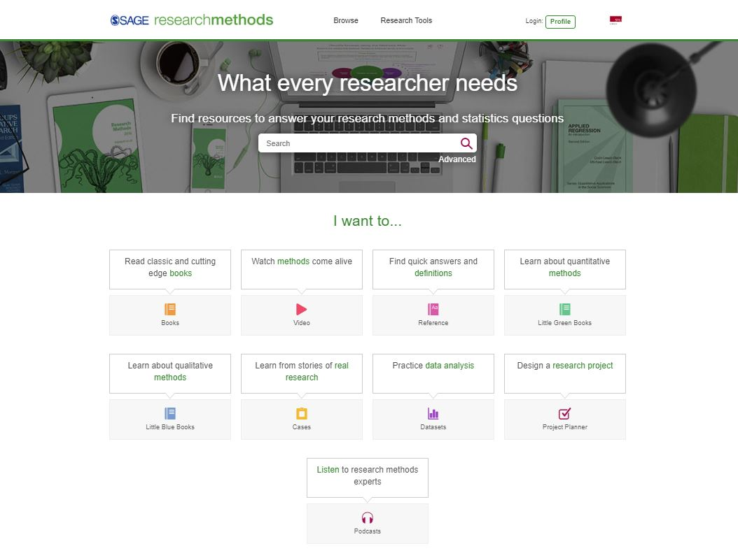
How to find… Research Methodology info
Research Methods Info
Check out Sage Research Methods Online to learn more about research methods
Notes:
Use Library Search or the Catalogue and search for “Sage Research Methods Online”

Slide 18
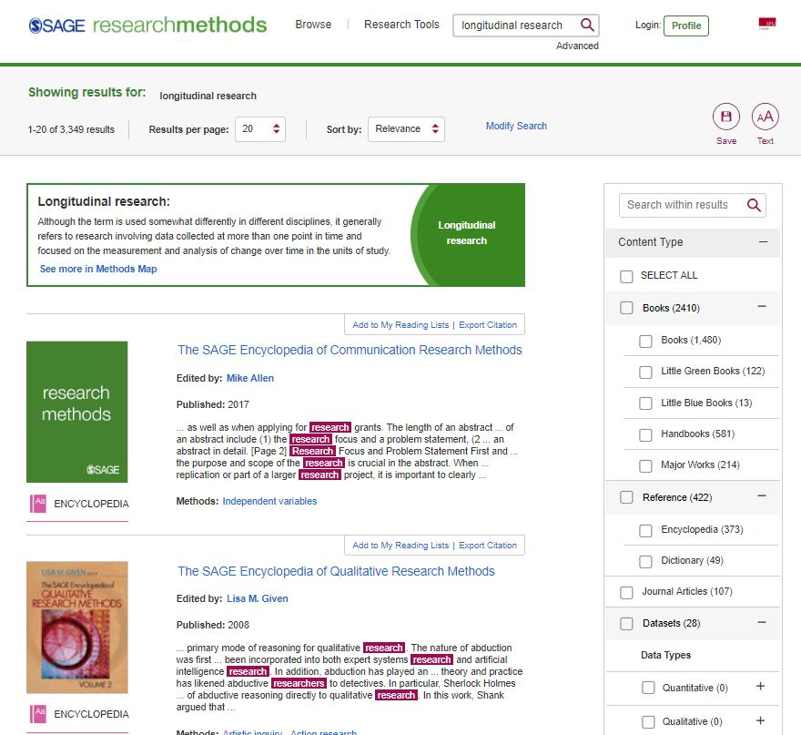
How to find… Research Methodology info
Research Methods Info
Narrow your search by type (encyclopedia entries)
Notes:
Use filters to narrow search results
For example, under Reference, can narrow results to Encyclopedias

Slide 19
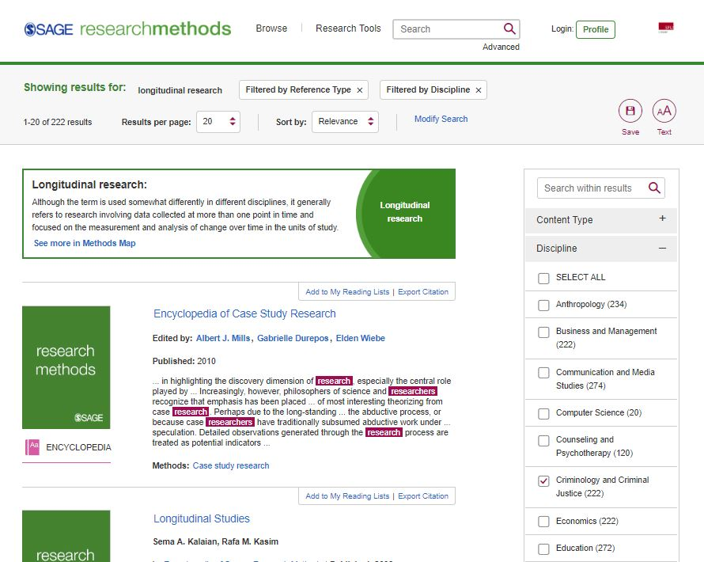
How to find… Research Methodology info
Research Methods Info
Next, narrow by discipline (criminology and criminal justice)
Notes:
Under Discipline, can narrow results to Criminology and Criminal Justice

Slide 20
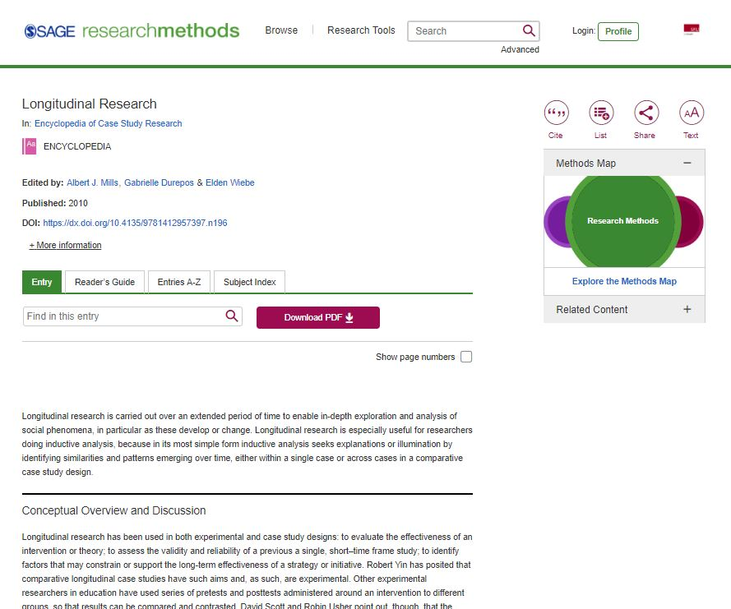
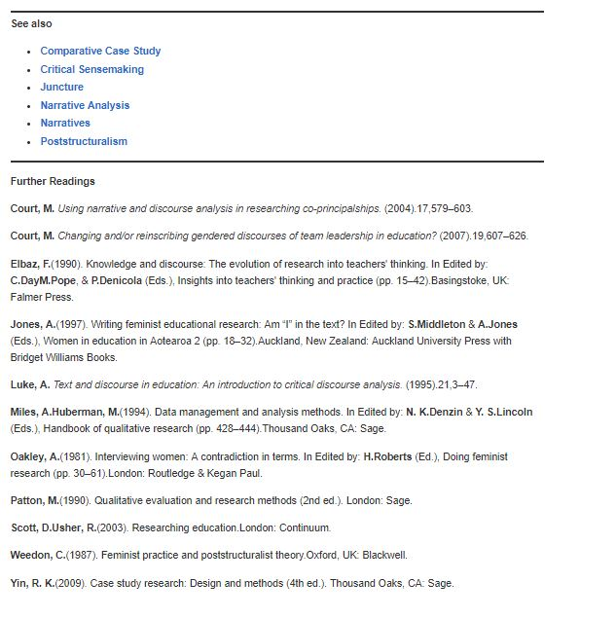
How to find… Research Methodology info
Research Methods Info
check out the Further Readings section in the articles you find for key readings and resources
Notes:
When looking at a resource, don’t miss the Further Readings section!

Slide 21
Articles: Popular vs. Scholarly
Notes:
Ask:
- What are examples of each type?
- How can we tell the difference?

Slide 22
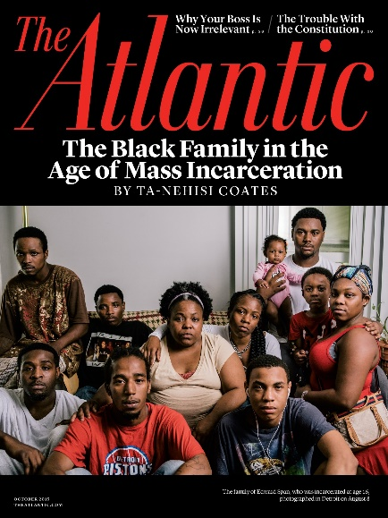
Popular vs. Scholarly
Popular Magazine
Example: The Atlantic
Scholarly Journal
Example: Criminal Justice and Behavior:
An International Journal

Slide 23
Popular vs. Scholarly
Popular Magazine articles Example: The Atlantic
Audience: general public
Writers: paid reporters, non-specialist writers
Design: colourful, graphics, advertisements
Features: no abstracts, citations, or bibliographies
Focus: on a popular topic of interest to the general public
Use: good for broad overviews and popular perspectives
Language: plain, accessible

Slide 24
Popular vs. Scholarly
Scholarly Journal articles
Example: Criminal Justice and Behavior: An International Journal
Audience: academics
Writers: unpaid scholars and researchers
Design: often visually boring with mostly text, some tables and charts
Features: abstracts, citations, bibliographies
Focus: on a specific topic of interest to specialists
Use: good for historical, current, scholarly, in-depth perspectives
Language: subject-specific, jargon-filled
Key criterion: peer-reviewed
Notes:
What does peer-reviewed mean?

Slide 25
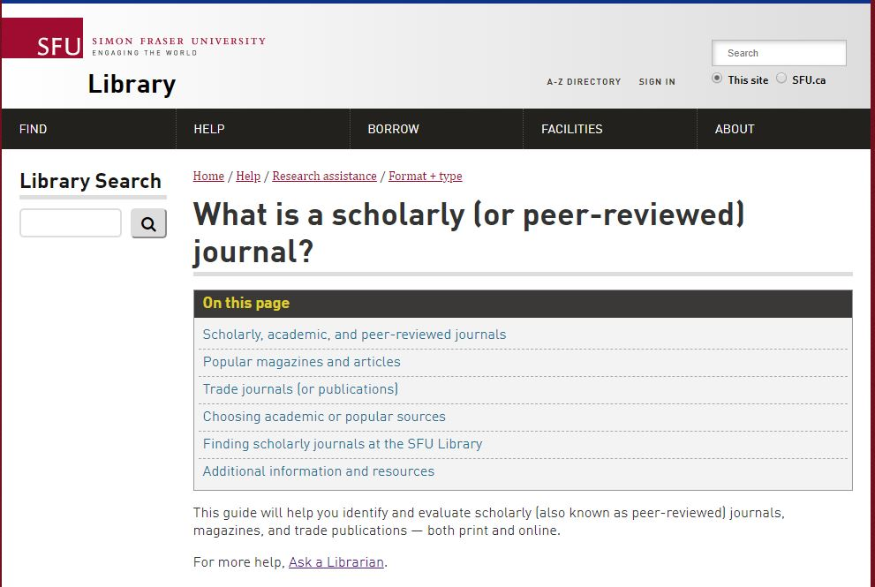
Popular vs. Scholarly
SFU Library’s Scholarly Journal Guide offers a lot more info about scholarly journals and popular magazines.
Feel free to browse through it!
Notes:
lib.suf.ca → Help → Research Assistance → Find Materials by Format + Type
then, under the section “Finding academic or scholarly journal articles, in the last paragraph click the link “What is a scholarly (or peer-reviewed) journal?”
OR
use Library Search and search for “scholarly journal” and then click on “What is a scholarly (or peer-reviewed) journal?” (in the column on the right in the search results)

Slide 26
Finding Articles Online

Slide 27
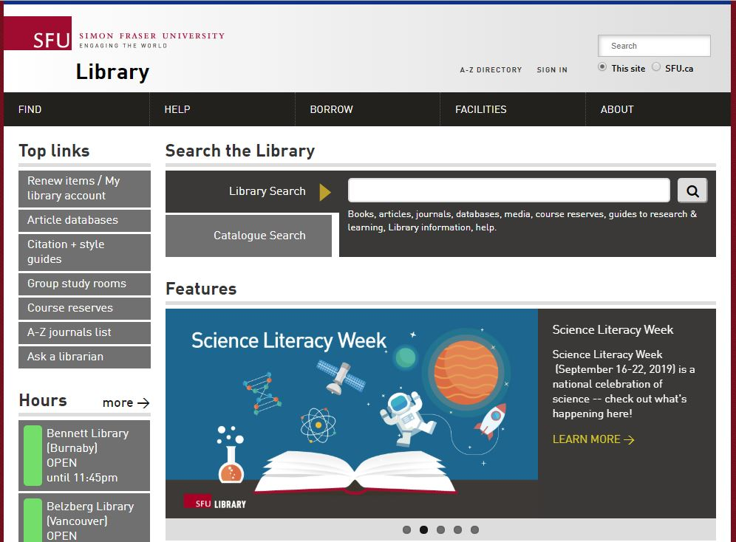
Finding Articles Online
Library Search
Broad/preliminary searches
Includes books, articles, databases, media, course reserves
ALSO includes research guides, learning guides, library info, help
Searches many (but not all) databases

Slide 28
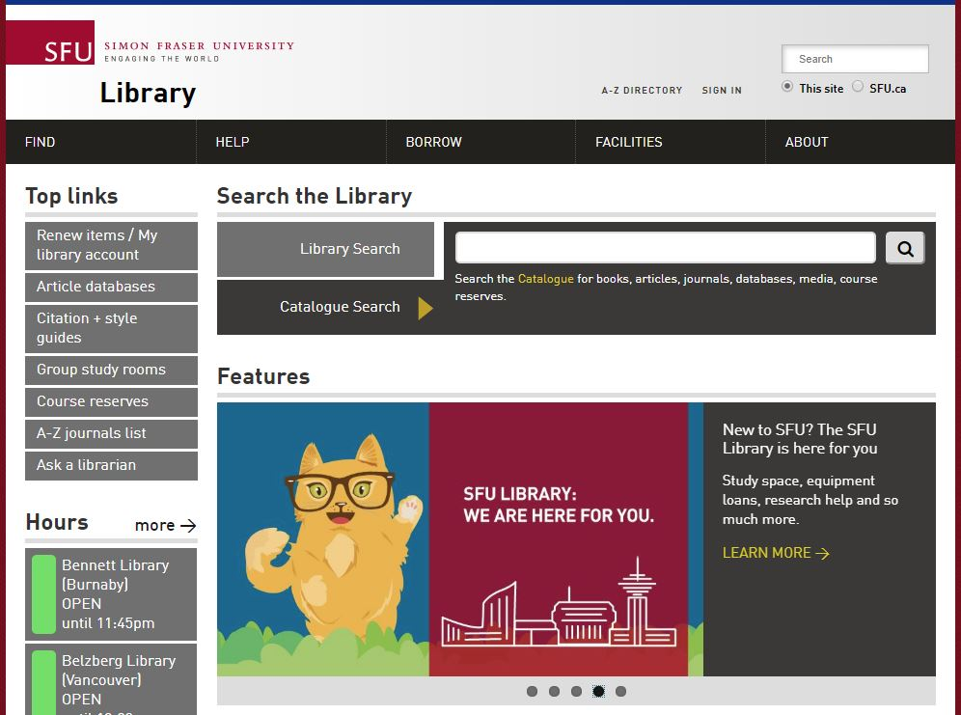
Finding Articles Online
Catalogue Search
Broad/preliminary searches
Includes books, articles, databases, media, course reserves
Searches many (but not all) databases

Slide 29
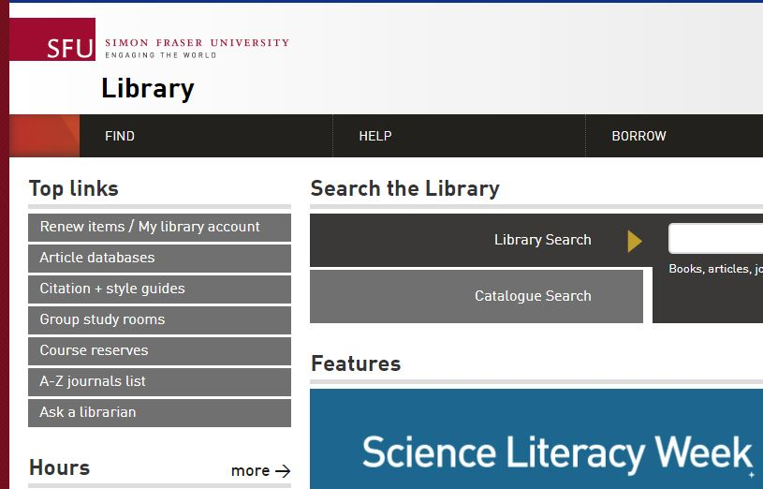
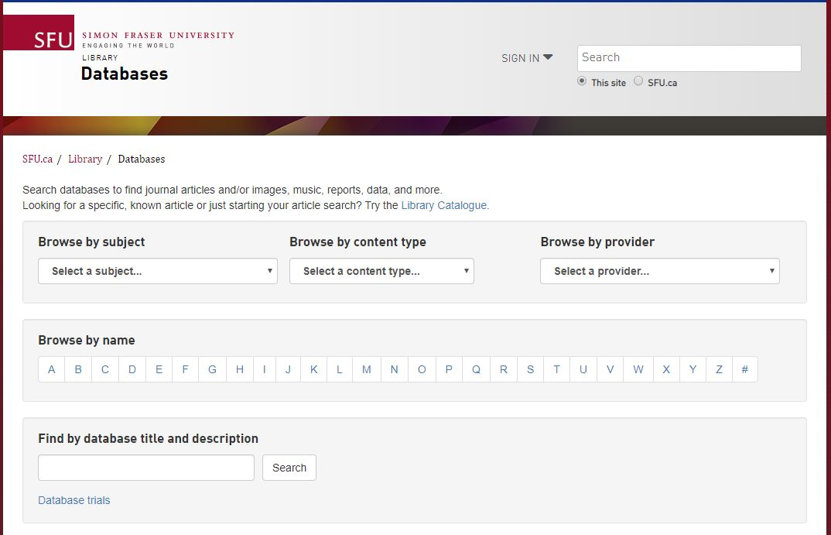
Finding Articles Online
Article databases
More targeted & in-depth searches
Subject-specific or multidisciplinary

Slide 30
Recommended Databases
Criminology databases
Criminal Justice Abstracts
academic articles, magazines, dissertations, reports, books …
National Criminal Justice Reference Service
academic articles, government reports, research reports, books …
Other discipline-based databases
PsycINFO
academic articles, books, dissertations …
Sociological Abstracts
academic articles, books, dissertations, association reports …

Slide 31
APA Style

Slide 32
APA Citation Style
APA Style
APA is a citation style developed by the American Psychological Association
It provides rules for in-text citations, the bibliography (i.e. the References page), and document formatting
Notes:
Be careful! APA Style was recently updated, so be sure to check whether the resource you’re using is for the 6th or 7th edition.

Slide 33
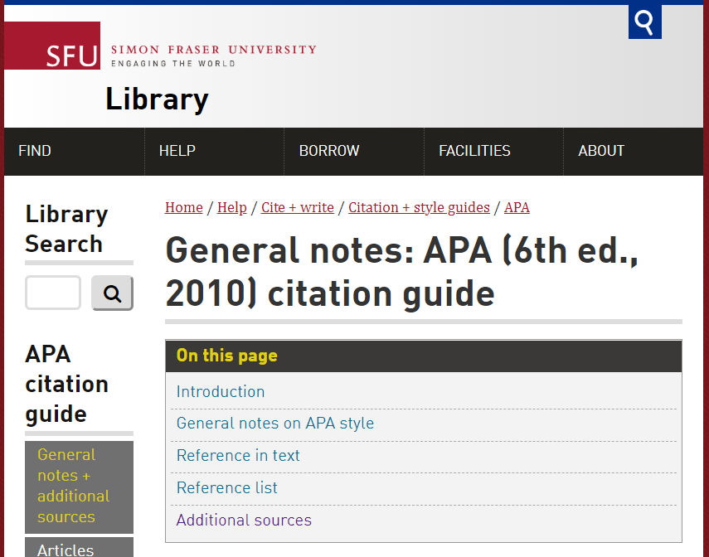
APA Citation Style
APA Style
SFU Library’s APA (6th edition) Resource Guide offers a lot of help with this citation style and provides some useful links to extra APA-help pages.

Slide 34
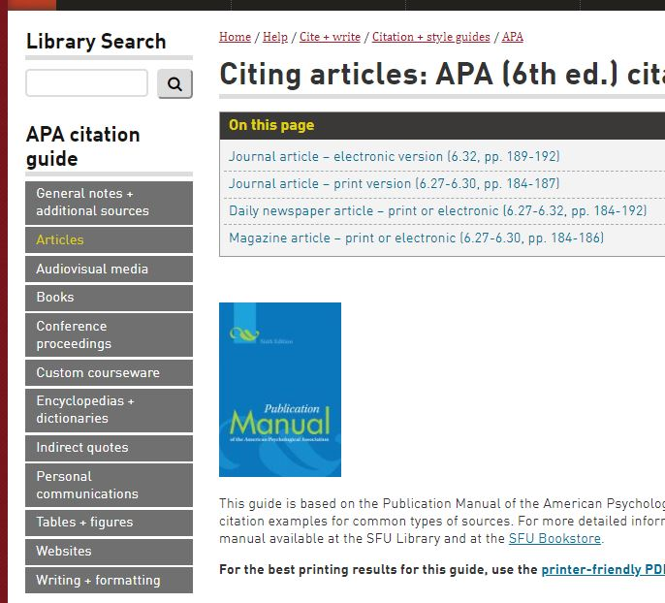
APA Citation Style
APA Style
The menu on the left of the APA Resource Guide gives rules and examples for lots of resource types (articles, AV material, books, websites, etc.)

Slide 35
Topic & Searching

Slide 36
Working with your topic
Focusing your topic
Example topic: Art therapy and recidivism
Ask yourself:
Who? Women, youth, Indigenous people …
What? Visual art, music, mental health …
When? Historical or contemporary?
Where? Vancouver, BC, Canada, North America, international …
Why? Effects, context …

Slide 37
Working with your topic
Developing keywords
Revised topic: Impact of art therapy on recidivism in young offenders.
Identify key concepts
Brainstorm keywords (search terms) for each key concept
Art therapy | Recidivism | Young offenders
Therapy Counselling Music therapy Dance therapy | Repeat offender Multiple offender | Juvenile delinquents Early adolescent offenders Youth Teenagers

Slide 38
Search tips
Use AND between keywords to narrow your search
For example: recidivism AND alcohol
Use OR between keywords to broaden your search
For example: soccer OR football
Use quotation marks around an exact phrase
For example: “art therapy”
Use an asterisk (*) to find related terms
For example: Canad* will get results for: Canada, Canadian, Canadians …
Notes:
For more search tips and details, use Library Search and search for “Boolean operators” or “search tips” and then click on “Power searching and Boolean searching: Catalogue search guide” (in the column on the right in the search results)

Slide 39
Working with your topic
Sample search of Criminal Justice Abstracts

Slide 40
Almost done!

Slide 41
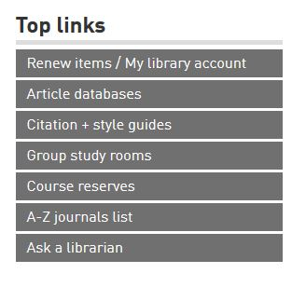
Where to go for help
Contact us:
Research help desk (drop-in & by appointment)
Phone: 778.782.4345
Email us at: libask@sfu.ca
AskAway (online chat)
Citation Guides: APA, MLA, Chicago …
Student Learning Commons
Academic writing, study skills, EAL/ESL support

