Slide 1
SFU Library Orientation
Criminology 104: Library Research
Yolanda Koscielski
Librarian for Criminology, Philosophy & Psychology
Notes:
PowerPoint will be linked from the library website.
General Library content + specific tips for this research assignment

Slide 2
Agenda
Today’s topics
SFU Library is for you – make use of it!
Avoid paying for resources
Identify scholarly articles
Use specialized databases
Learn some search strategies
Access research help
https://i.pinimg.com/originals/de/32/89/de32896d6903b303071c14c42c09e2a8.

Slide 3
1. Make use of your library

Slide 4
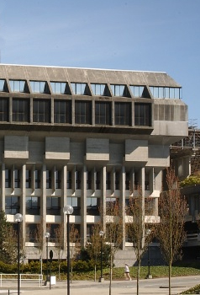
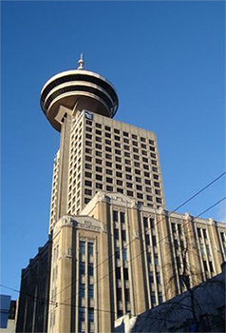
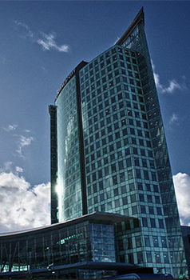
SFU Library Info
A few quick facts about us …
SFU Burnaby
SFU Vancouver
SFU Surrey
three campus libraries, one SFU Library
interbranch book requests
course reserves
+700 research databases

Slide 5
Specialized Resources at SFU Library
Examples:
NEW! fabricommons (SFU Surrey)
MAPS/GIS Unit
Scholarly publishing support
Digital Humanities Lab
SFU Library Media and Maker Commons (W.A.C. Bennett Library)
Dick Kouwenhoven Book Arts Studio (new-ish!)
Niche databases, special collections and resources
E.g. Criterion on Demand, CrimComics collection
Notes:
Labelling theory

Slide 6
2.Use the library’s free resources to avoid paying for materials

Slide 7
Access library resources – libkey nomad
Running into paywalls and multi-step workarounds?
LibKey Nomad provides instant access to articles.
thirdiron.com/downloadnomad

Slide 8
How to install LibKey Nomad
Go to thirdiron.com/downloadnomad
Choose your browser and follow the prompts to install the LibKey Nomad browser extension
Search for and choose Simon Fraser University as your organization
You’re all set!
Look for LibKey Nomad icons on scholarly webpages.

Slide 9
Interlibrary Loan & Book Requests
Notes:
Criterion

Slide 10
3. Articles: Non-Scholarly vs. Scholarly

Slide 11
Assignment Excerpts *If a discrepancy exists, your instructor’s version is the correct one!
“Apply ONE theory from our class to explain the offence/conduct of the offender (500-750 words)”.
“Actively utilize a minimum of SIX academic sources (journal articles, academic books etc.)”.
“Please note, you may not find academic sources on the McArthur case specifically, but rather on the offence, the sentence imposed, themes of the crime and surrounding circumstances etc. and your chosen theory”.

Slide 12
Popular/ vs. Scholarly
Popular Magazine
Example: Psychology Today
Scholarly Journal
Example: Criminal Justice and Behavior:
An International Journal

Slide 13
Popular vs. Scholarly
Popular Magazine articles Example: Psychology Today
Articles are usually written by journalists or professional writers for a general audience
Use language easily understood by general readers
Rarely give full citations for sources
Are written for the general public (non-experts)
May present or adapt information originally published in scholarly journals
Do not always include information about the authors
Articles tend to be shorter and more graphically appealing than those in academic journals

Slide 14
Popular vs. Scholarly
Scholarly Journal articles
Example: Criminal Justice and Behavior: An International Journal
Articles are written by and for faculty, researchers or scholars (chemists, criminologists, doctors, art historians, etc.)
Use scholarly or technical language
Articles tend to be long, detailed, and specific about research in a particular academic discipline
Include full citations for sources, abstracts
Are refereed or peer-reviewed
Include information about the authors
Are published by academic organisations
Note: book reviews and editorials are not considered scholarly articles, even when found in scholarly journals

Slide 15
Popular vs. Scholarly
Key criterion: peer-reviewed
Peer-reviewed or refereed journals have an editorial board of subject experts who review and evaluate submitted articles before accepting them for publication.
Example: editorial board for Criminal Justice and Behavior

Slide 16
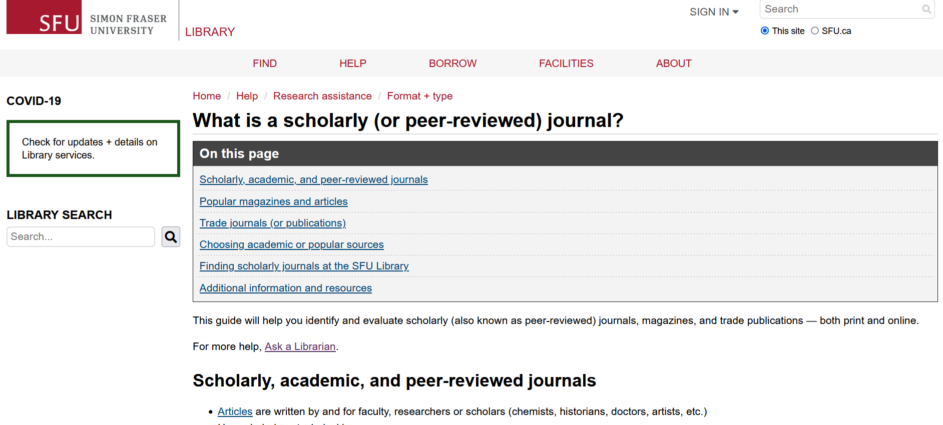
Popular vs. Scholarly
SFU Library’s Scholarly Journal Guide offers a lot more info about scholarly journals and popular magazines (and trade journals).
Feel free to browse through it!

Slide 17
4. Specialized Databases
Notes:
--Follow on phones

Slide 18
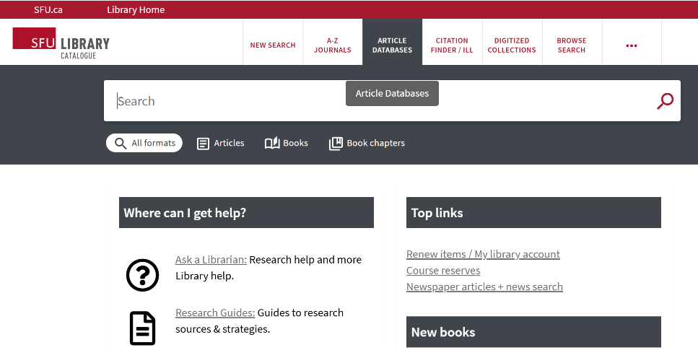
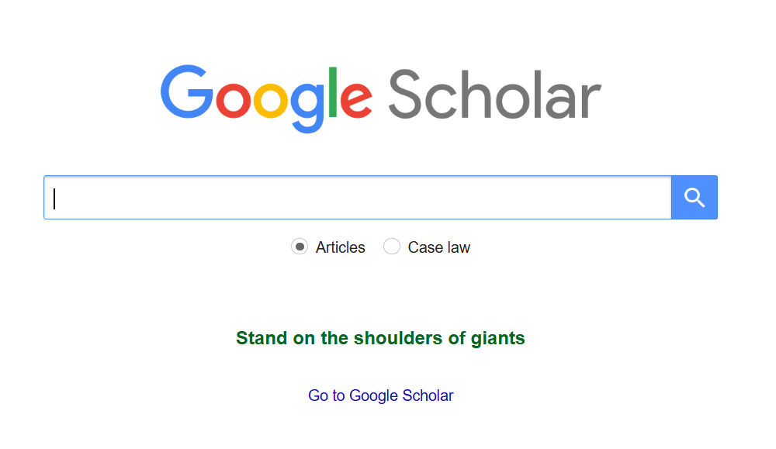
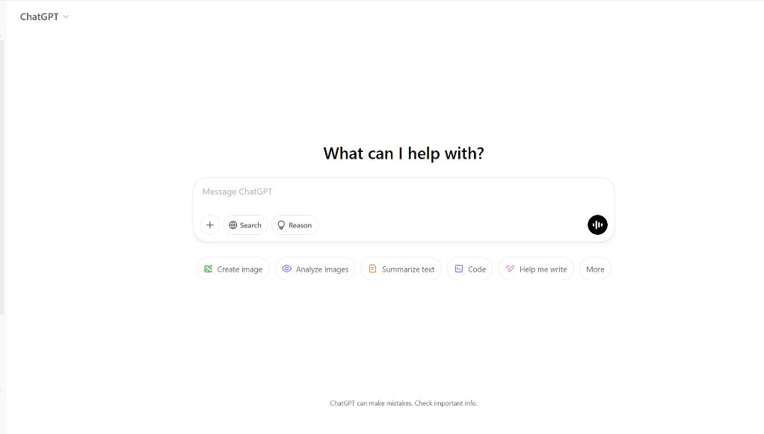
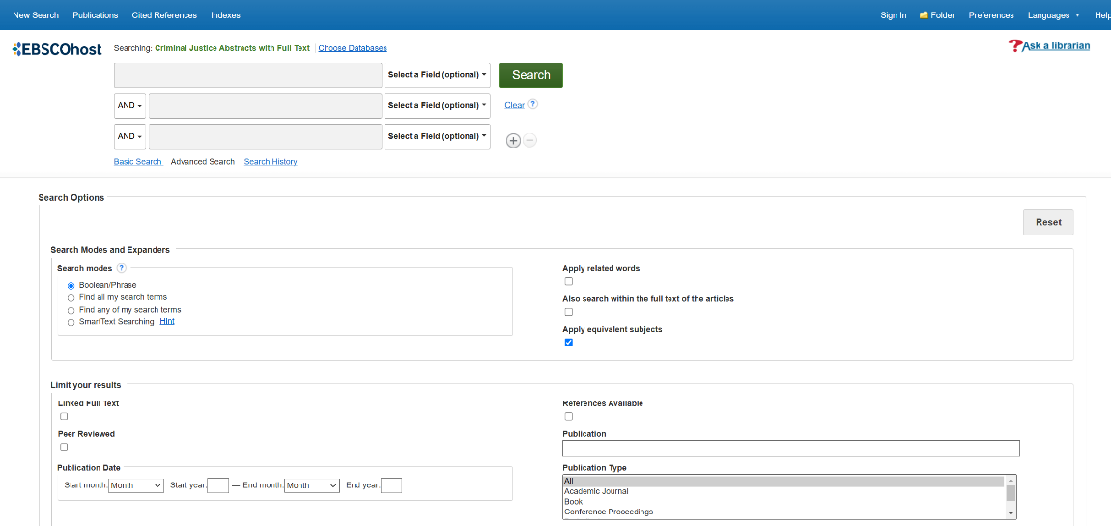
Where to get started with research?
Notes:
Depends on context

Slide 19
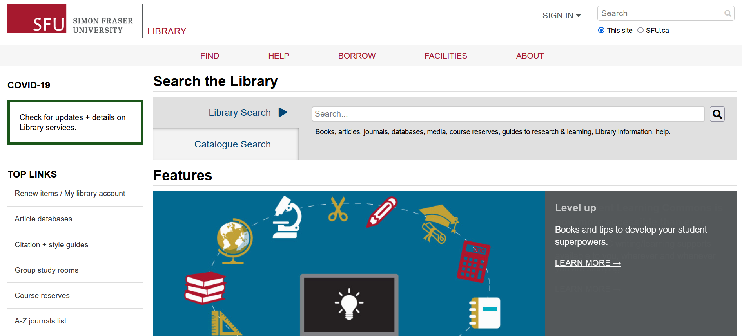
Library Search
Library Search
Searches the catalogue and the website
Includes research guides, learning guides, library info, help, databases, content of most (but not all) databases

Slide 20
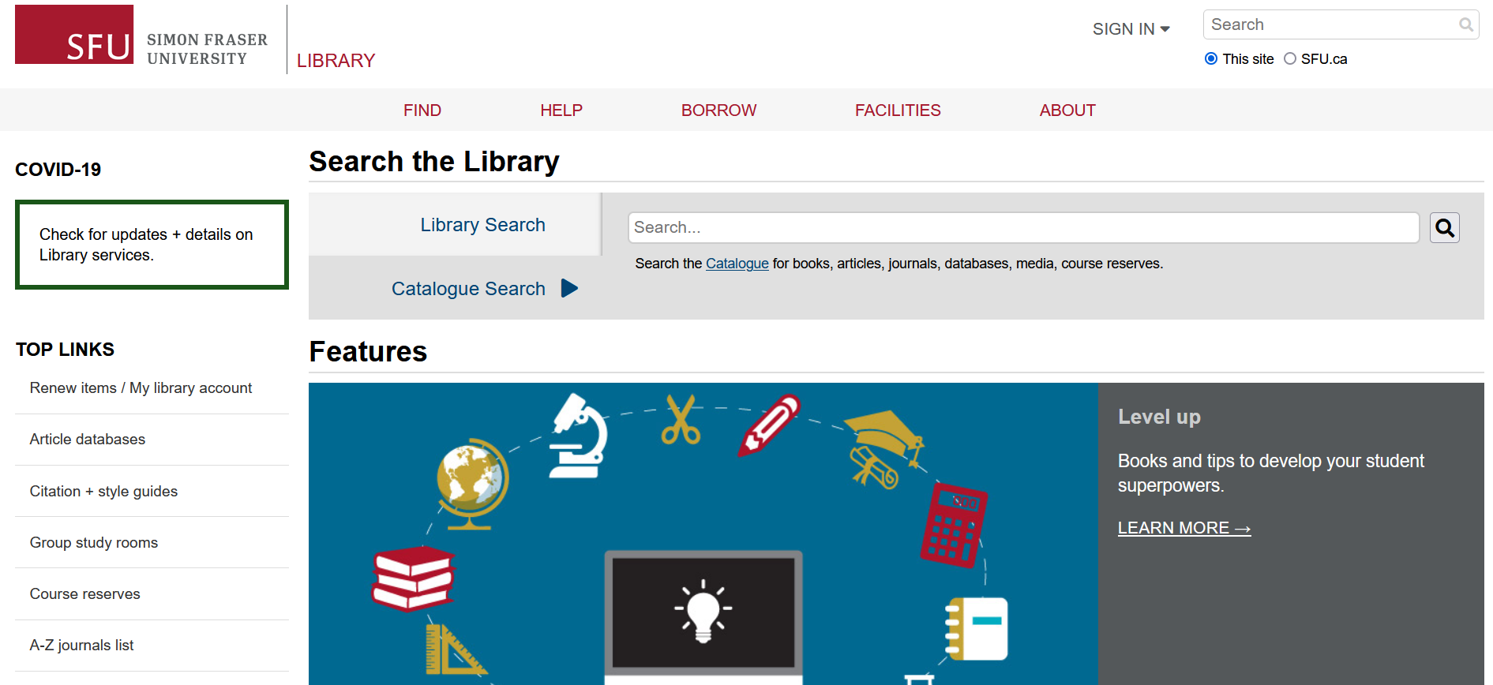
Catalogue Search
Catalogue Search
Narrower
Includes our main collection items: books, articles, databases, media, course reserves

Slide 21
Google Scholar
Journal article
Journal article
Book chapter
Legal journal
Peer reviewed?
Notes:
Known article searches

Slide 22
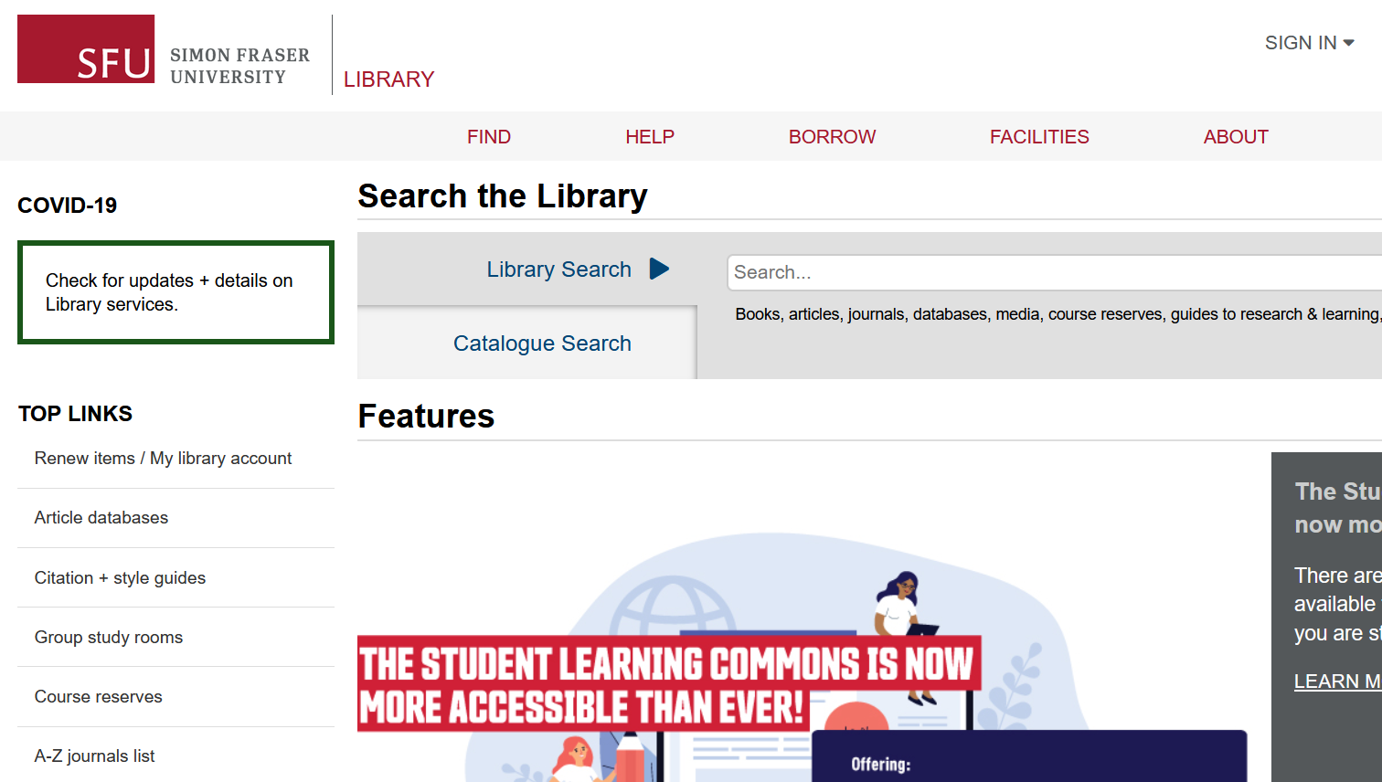
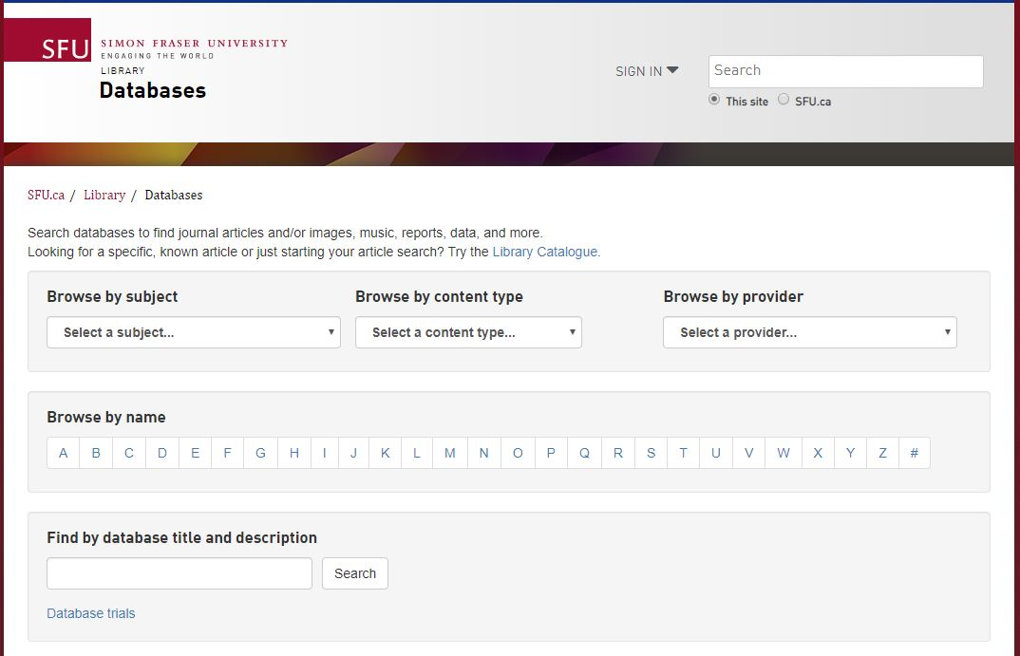
Finding Articles Online
Article databases
More targeted & in-depth searches
Subject-specific or multidisciplinary
DEMO
Notes:
DEMO

Slide 23
Recommended Databases
Criminology databases
Criminal Justice Abstracts
academic articles, magazines, dissertations, reports, books …
Other discipline-based databases
PsycINFO
academic articles, books, dissertations …
Sociological Abstracts
academic articles, books, dissertations, association reports …(e.g. Journal of Gang Research)
CBCA Complete
Comprehensive Canadian periodical collection for reference and current events. Publications include scholarly journal articles, trade publications, dissertations, books, newspapers and magazines.

Slide 24
Recommended Databases – Search tips
Criminal Justice Abstracts
academic articles, magazines, dissertations, reports, books …
Make use of auto-fill for synonyms
One concept per line
Quotation marks for phrases
Notes:
DEMO – Criminal Justice Abstracts

Slide 25
Searching through databases
Get@SFU
Look at Cited References and Times Cited in the Database

Slide 26
5. Topic & Search Tips

Slide 27
Working with your topic
Focusing your topic
Example topic: Therapy and recidivism
Ask yourself:
Who? Women, youth, incarcerated people…
What? Visual art therapy, cognitive behavioural therapy…
When? Historical or contemporary? Time frame (short term or long term)?
Where? Vancouver, BC, Canada, North America, international …

Slide 28
Working with your topic
Developing keywords
Revised topic: Impact of arts therapy on recidivism in young offenders
Identify key concepts
Brainstorm keywords (search terms) for each key concept
Arts therapy | Recidivism | Young offenders
Music therapy Dance therapy Bibliotherapy Equine therapy Therapy Counselling | Repeat offender | Criminals Juvenile delinquents Early adolescent offenders Youth Teenagers Justice-involved youth
Notes:
Maybe a new topic here for theory?

Slide 29
Working with your topic
Developing keywords
”find academic sources…on the offence, the sentence imposed, themes of the crime and surrounding circumstances etc. and your chosen theory.”
Can search sub-topics separately
Theory | Aspect of Crime
Theory synonym 1 Theory synonym 2 (Theory author) | Synonym 1 Synonym 2 Synonym 3 Synonym 4 Synonym 5

Slide 30
Boolean operators & other Search tips
Use AND between keywords to narrow your search
1
For example: recidivism AND youth
Use OR between keywords to broaden your search
2
For example: Coast Salish OR Indigenous OR First Nations
Use quotation marks around an exact phrase
3
For example: “young offender”
Use an asterisk (*) to find related terms
4
For example: Canad* retrieves: Canada, Canadian, etc.
Notes:
Polic*

Slide 31
Research and Writing Help
Human-powered research support!

Slide 32
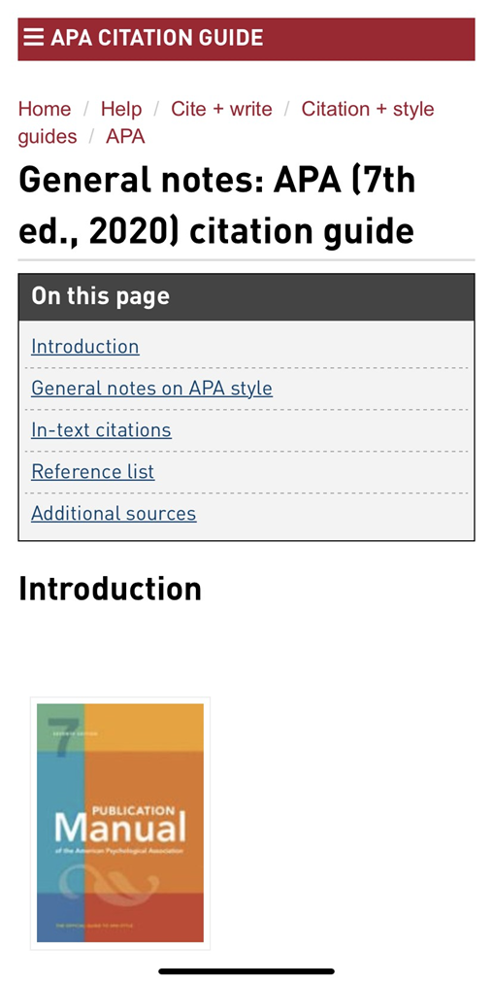
APA Citation Style
APA Blog + SFU APA Guide

Slide 33
Where to go for help
Contact us: Ask a Librarian
Book an appointment (Zoom, in person, or phone)
Same day often available
Phone: 778.782.4351 (call back)
Email us at: libask@sfu.ca
AskAway (online chat)
Citation Guides: APA, MLA, Chicago …
Student Learning Commons
Academic writing, study skills, EAL/ESL support
WriteAway

Slide 34
Thank you!

