Slide 1
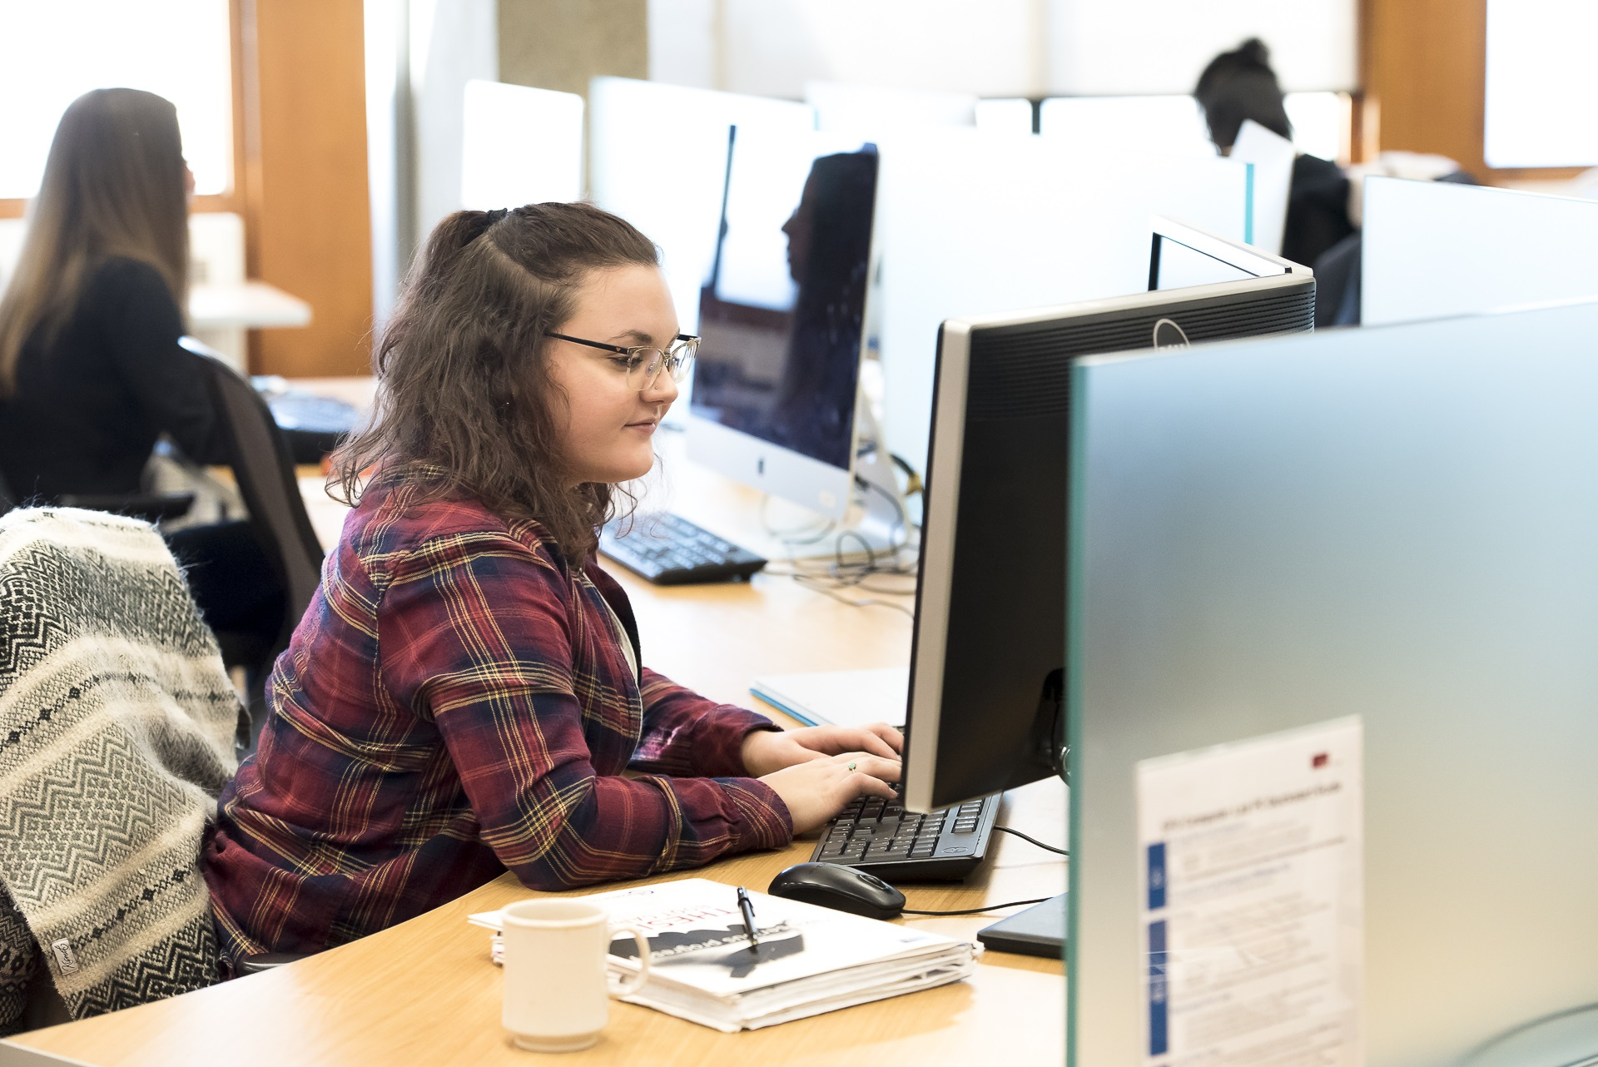
RESEARCH COMMONS
SERVICES, SPACES, & SOFTWARE
Presenter Name
Presenter Title
email@sfu.ca

Slide 2
RESEARCH HELP
FROM ANYWHERE
Contact your liaison librarian for in-depth research guidance
http://www.lib.sfu.ca/help/research-assistance/liaison-librarians
Check out our research guides
http://www.lib.sfu.ca/help/research-assistance/subject
Quick question? Chat with a librarian (Ask Away)
http://www.lib.sfu.ca/help/ask-us

Slide 3
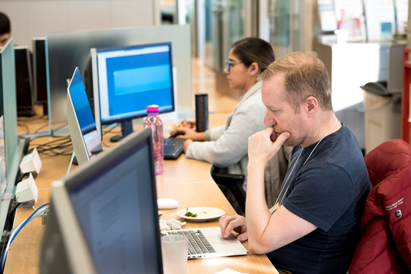
RESEARCH COMMONS FOR GRADUATE STUDENTS
Free services, software, and spaces for graduate students and postdocs in all disciplines.
Help is available for every step of the research and writing process.
Learn more: https://www.lib.sfu.ca/about/branches-depts/rc Contact us: research-commons@sfu.ca

Slide 4
RESEARCH COMMONS
FOR GRADUATE STUDENTS
Space: (Bennett Library, Burnaby and Harbour Centre, Vancouver): Quiet study space for grads and post-docs only (accessible by punch code) with dual-monitor workstations and team rooms. Our Burnaby location has lockers.
Software: Access, licenses, and training for a variety of research support software.
Services and support: hands-on workshops, and one-to-one or small group consultations with experts. Register for a workshop, book a consultations, or email research-commons@sfu.ca.

Slide 5
WRITING SUPPORT
Read Aheads & writing consultations: receive support with writing and constructive feedback on your draft written work or presentation materials, in-person or online.

Slide 6
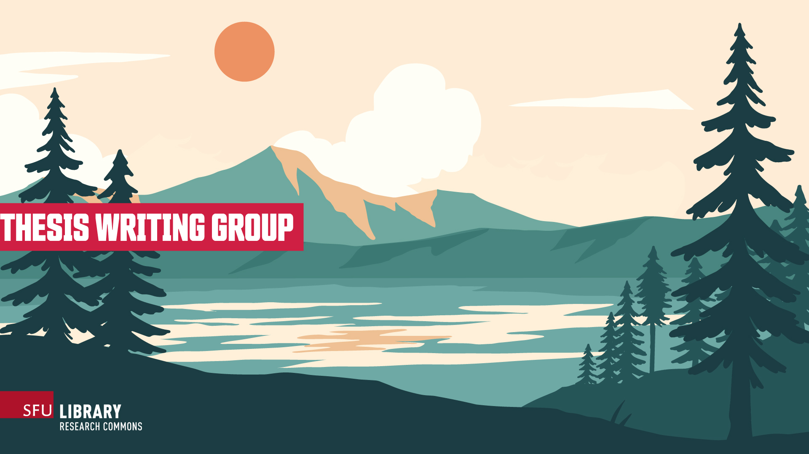
THESIS WRITING GROUP: 10 SESSIONS EACH TERM
Thesis Writing Group is a supportive community that meets online for three hours of focused writing every Friday over the course of ten weeks each term. Build a sustainable writing practice with a group of peers from across disciplines.
Facilitated by members of the Graduate Writing Team and the Research Commons Librarian.
Goal-setting, reflection, and discussion to open and close each session.
Writing and research help is available each week.
An Assistant for Theses is available for questions about using the thesis template, formatting, or the thesis submission process.

Slide 7
CITATIONS MADE EASY
WITH ZOTERO
Zotero is a citation management tool that collects, organizes, and stores your references and helps you create properly formatted in-text citations and bibliographies in almost any style—in seconds.
Zotero can also help you:
Access, manage, and share your sources online, all in one place
Quickly import references and PDFs
Annotate PDFs and create notes
Ready to get started? Download Zotero and learn more.

Slide 8
GIS SUPPORT: ArcGIS & QGIS
The GIS & Map Librarian can assist you with:
Getting started with GIS
Searching for geospatial data
Answering questions specific to your project
Demonstrating features and techniques.
Ready to get started? Download software and access training.
Questions? Request a consultation.

Slide 9
QUANTITATIVE DATA ANALYSIS: R
R is a freely available open source statistical language that is used for data manipulation, data visualization, and statistical analyses. It is powerful, platform independent, and extensible.
R can also be used to generate publication-quality graphics.
Ready to get started? Register for a workshop.
Questions? Reach out to data-services@sfu.ca for assistance over email, or to book a consultation.

Slide 10
QUALITATIVE DATA ANALYSIS: NVIVO
NVivo is a software package that helps with the organization and analysis of qualitative data.
NVivo helps you:
classify, sort, and arrange information
test theories, examine relationships, and identify trends in your data
Ready to get started? Download NVivo and access help and training.

Slide 11
RESEARCH DATA MANAGEMENT
The Data Services team offers:
Access to secondary data, including datasets, statistics, GIS, and maps from providers such as Statistics Canada.
Tools for creating a Data Management Plan (DMP), with a focus on funding agency requirements.
Advising on best practices to format datasets for long term access.
Research and reference help regarding research data.
Learn more. For assistance over email, reach out to data-services@sfu.ca

Slide 12
SCHOLARLY PUBLISHING + OPEN ACCESS
The Digital Scholarship team offers support for:
Exploring and evaluating publishing choices
Building your online research profile and increasing your research impact
Sharing your work within and beyond the academy
Funding for open access publishing through the SFU Central Open Access Fund
The SFU Open Access Policy and funder OA requirements
Learn more. Questions? Email digital-scholarship@sfu.ca

Slide 13
DIGITAL PROJECTS
Digital Humanities is the application of computational tools and methods to Humanities disciplines.
The Digital Humanities Innovation Lab can assist with:
Consultations on Digital Humanities tools, projects, and processes
Digital skill development consultations and workshops
Questions? Request a consultation or email dhil@sfu.ca

Slide 14
ENGLISH AS AN ADDITIONAL LANGUAGE
The EAL/ESL Specialist can assist with:
Academic writing: word usage, grammar, sentence structure, making connections between ideas, elaborating and expanding arguments, logical reasoning, paraphrasing techniques
Academic reading: skimming and scanning, critical reading, comprehension and analysis
Conversational and academic speaking and listening: comprehensibility, presentation techniques, pronunciation, pragmatic competence
Learn more.

Slide 15
COPYRIGHT SUPPORT
SFU Library’s Copyright Office can answer questions like:
Can I show a video clip in my tutorial?
How do I know if I am allowed to use an image in my thesis?
Am I able to include an article I previously published in my thesis?
To receive assistance over email, or to set up a consultation, email copy@sfu.ca.

Slide 16
AND MORE...
Expert formatting guidance for the thesis template
Knowledge mobilization learning and support
Data visualization with Tableau
Feedback and advice on grant and scholarship applications
Time management tips
Please visit the Research Commons website for more information, or email research-commons@sfu.ca
We love to hear from you.

