Slide 1
SFU Library Orientation
Criminology 220: Literature reviews
Chloe Riley
Librarian
chloe_riley@sfu.ca

Slide 2
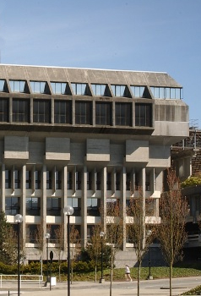
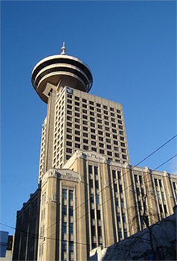
SFU Library
A few quick facts about us …
SFU Burnaby
SFU Vancouver
SFU Surrey
Over 2.5 million books & ebooks
Over 98,000 subscriptions to journals, magazines & newspapers
Over 500 research databases
Three campus libraries

Slide 3
Your assignment
From your Research Project assignment:
Literature Review
a. Summarize 7 to 10 peer-reviewed studies (remember, you need to include at least 10 peer-reviewed references in the paper, but they don’t all have to be cited in this section).
Data and Methods
d. Discuss your research design (e.g., experimental, non-experimental)
e. Describe your data collection method (e.g., self-report surveys, existing data, content analysis, focus groups)
References
a. Include at least 15 references (10 of these must be peer-reviewed journal articles)
b. Non-peer reviewed references can come from newspaper and magazine articles, websites, documentaries, and so on
c. Use APA formatting for in-text citations and reference list

Slide 4
Our agenda
How to find:
Background info
Info on research methodology
Peer-reviewed articles
Non-peer reviewed sources
APA citation help
Plus …
Narrowing your topic
“And I thought we were friends” by hehedan,
CC BY-NC 2.0

Slide 5
What is a literature review
A literature review…
Summarizes related studies and tries to makes sense of the pattern of findings. It draws conclusions about what is known, what is not, and what should be.
(adapted from SFU Library website)

Slide 6
Example literature review
Denton, E. (2009). International News Coverage of Human Trafficking Arrests and Prosecutions: a Content Analysis (Master’s Thesis). Simon Fraser University, Burnaby, BC. Retrieved from http://summit.sfu.ca/item/9561
From Erin Denton’s Literature Review (20 pages)
In 1904, the first modern response to the new slave trade, the International Agreement for the Suppression of the White Slave Traffic, was created (Friman & Reich, 2007). …
… the current, relatively accepted definition of trafficking describes a wide range of activities (Bruckert & Parent, 2002; O’Connell, Davidson & Donelan in Laczko & Gramegna, 2003). The trafficking of humans is not one single activity….
While Andrees (2005) considers the use of media and secondary sources a cause for concern, others (e.g., Dottridge, 2002), see the use of media as a means to gain access to a field of study that is notoriously difficult to infiltrate….
Rather than separating the forced prostitution and sexual exploitation literature from human trafficking, much of the literature muddles the two together….
History
Definitions
Issues
Gaps

Slide 7
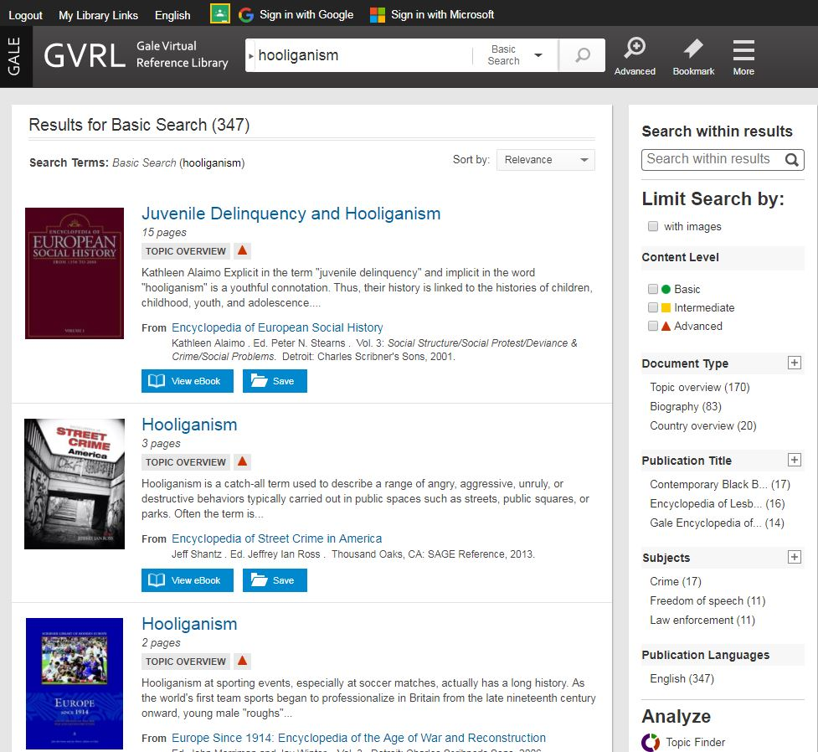
Background sources: Encyclopedias
Overview of your topic / the “big picture”
Written with the academic in mind, often by specialists in the field
Use the bibliography to identify key articles, studies, authors, etc.
Encyclopedias and handbooks:
Gale Virtual Reference Library
Oxford Reference Online
SAGE Reference

Slide 8
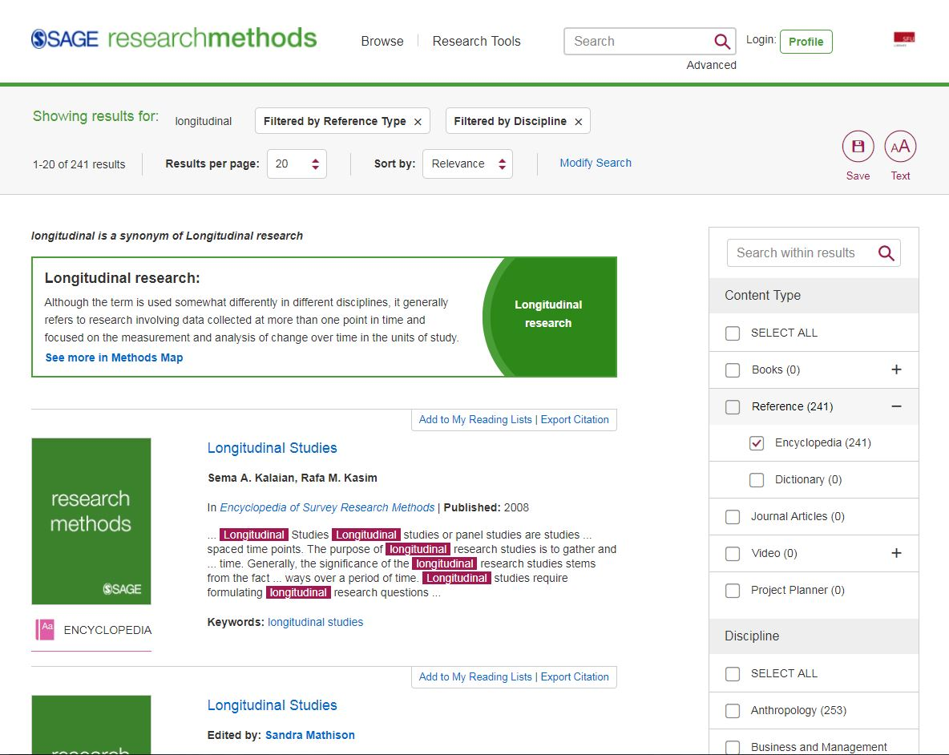
Research methodology info
Sage Research Methods Online
Start with discipline-specific encyclopedia entries for good overview of specific methodology
Once you do a search, narrow by discipline
Check out Further Readings section in the articles for key readings and resources

Slide 9
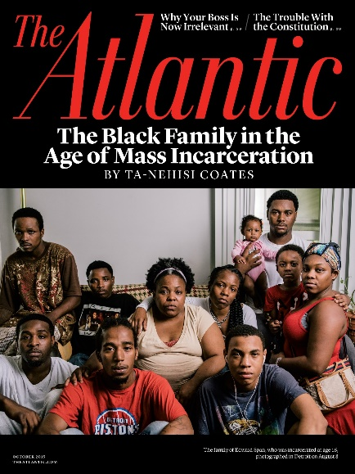
Scholarly vs popular
Popular magazine articles
Example: The Atlantic
Scholarly journal articles
Example: Criminal Justice and Behavior: An International Journal
Audience: general public
Colourful graphics & advertisements
Plain language
No abstracts or citations
Audience: academics
Mostly text, with some tables & charts
Subject-specific language
Includes abstracts & citations
Key criterion: peer-reviewed

Slide 10
Finding online articles
Catalogue Search
Broad/preliminary searches
Searches many (but not all) databases
Article databases
More targeted & in-depth searches
Subject-specific or multidisciplinary

Slide 11
RECOMMENDED DATABASES
Criminology databases:
Criminal Justice Abstracts: academic articles, magazines, dissertations, reports, books …
National Criminal Justice Reference Service: academic articles, government reports, research reports, books
Other discipline-based databases
PsycINFO: academic articles, books, dissertations …
Sociological Abstracts: academic articles, books, dissertations, association reports …
General databases:
Academic Search Complete: academic articles
Web of Science: academic articles

Slide 12
Search tips
Use AND between keywords to narrow your search
For example: hooliganism AND alcohol
Use OR between keywords to broaden your search
For example: soccer OR sports
Use quotation marks around an exact phrase
For example: “art therapy”
Use an asterisk (*) to find related terms
For example: Canad* will get results for: Canada, Canadian, Canadians …

Slide 13
Working with your topic
Focusing your topic
Developing keywords
Example topic: Art therapy and recidivism
Ask yourself:
Who? Women, youth, Indigenous people …
What? Visual art, music, dance …
When? Historical or contemporary?
Where? BC, Canada, North America, international …
Why? Effects, context …
Revised topic: Impact of art therapy on recidivism in young offenders.
Art therapy | Recidivism | Young offenders
Therapy Counselling Music therapy Dance therapy | Repeat offender | Juvenile delinquents Early adolescent offenders Criminals

Slide 14
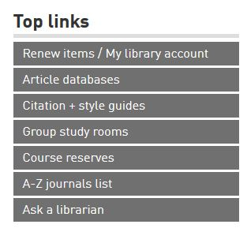
Where to go for help
Contact us:
Research help desk (drop-in & by appointment)
Phone: 778.782.4345
Email us at: libask@sfu.ca
AskAway (online chat)
Citation Guides: APA, MLA, Chicago …
Student Learning Commons
Academic writing, study skills, EAL/ESL support

