Slide 1
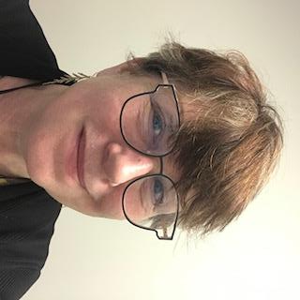
CA 821 research for historical & social context, theoretical approaches
Focus on SFU Library collections
Offer direction and coaching during your research journey through the information labyrinth
Available for one-on-one consultations for your specific research question
SYLVIA ROBERTS (she / her)
Liaison Librarian for Contemporary Arts & Communication
sroberts@sfu.ca 778-782-3681

Slide 2
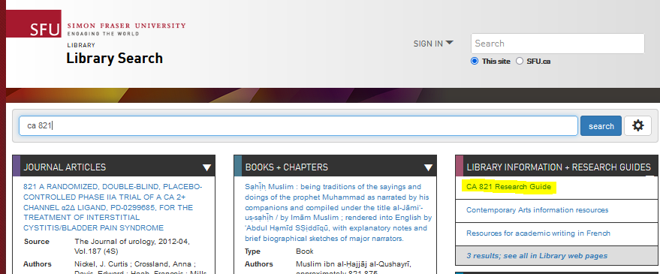
SCA research collections at SFU Library (and beyond)
Records of academic discourse through history (selective, partial, colonial, etc.)
Selected to support curriculum and research
Produced by academic and independent scholars, artists, educators, curators, journalists and other experts*
Discovery tools to find discussion, analysis, critiques, reviews and examples in…
Books & book chapters
Journal articles
Arts magazines
Media
Primary sources (news, images, personal records)
Archives & special collections
Notes:
*we’ll discuss what makes an expert

Slide 3
Your research journey will be unique
Information searching is a contextualized, complex experience that affects, and is affected by, the cognitive, affective, and social dimensions of the searcher
Searching for information is often nonlinear and iterative, requiring the evaluation of a range of information sources and the mental flexibility to pursue alternate avenues as new understanding develops
Authority is constructed & contextual
(ACRL 2015)
"Discover" by kohlmann.sascha is licensed with CC BY-SA 2.0.

Slide 4
Authority is constructed & contextual
What makes a text credible, trustworthy, authoritative?
How do you establish the authority of a text?
What forms of knowledge are important for your work?
Who are important supports for your work?
Notes:
Authoritative – expert, timely (context), who decides?
Significant – catalyst for subsequent scholarship, primary source
Influential – citations, how many and where
Elders, oral histories, culture keepers, lived experience, embodied knowledge
Practitioners, artists, curators, critics – other forms of scholarship and knowledge
DEEP DIVE into key sources rather than skimming the surface

Slide 5
Tools to help you discover key sources
Draw on others’ subject expertise
Encyclopedias, bibliographies, handbooks, e.g.
Encyclopedia of Aesthetics
Oxford Bibliographies Online
Oxford Very Short Introductions
Larger selection on the CA 821 guide
Literature reviews / introductions
Notes:
Quantitative methods such as citation counts, journal metrics and researcher specific metrics (collectively referred to as bibliometrics) provide one means of measuring research impact. Research impact can also be described qualitatively, in terms of social and cultural influence, through the use of alternative metrics.

Slide 7
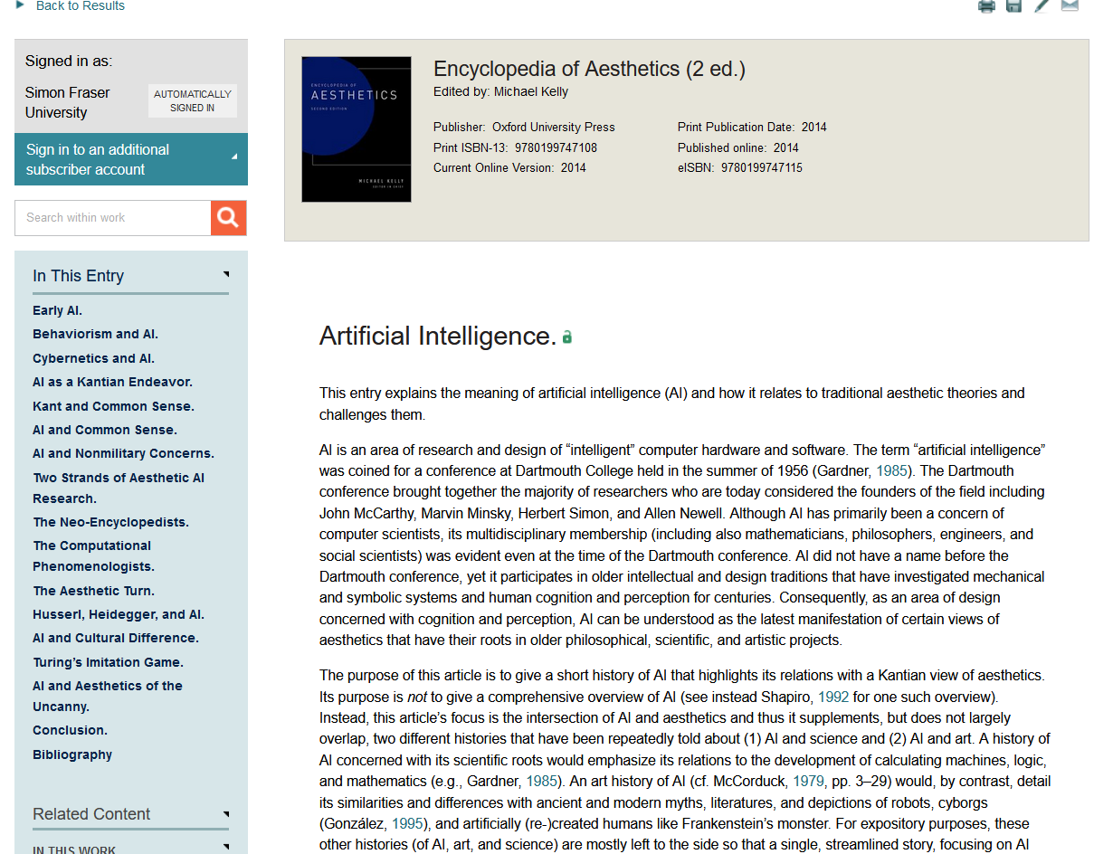

Slide 8
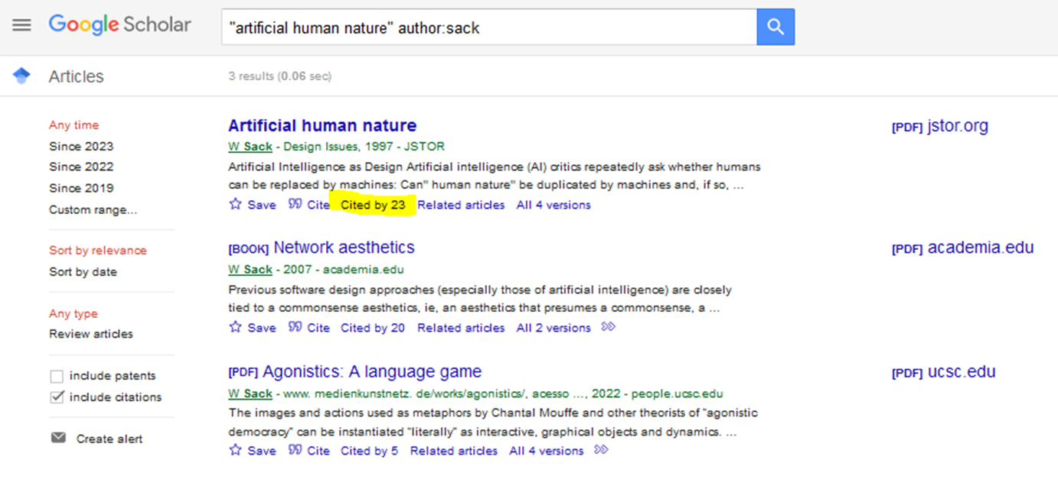
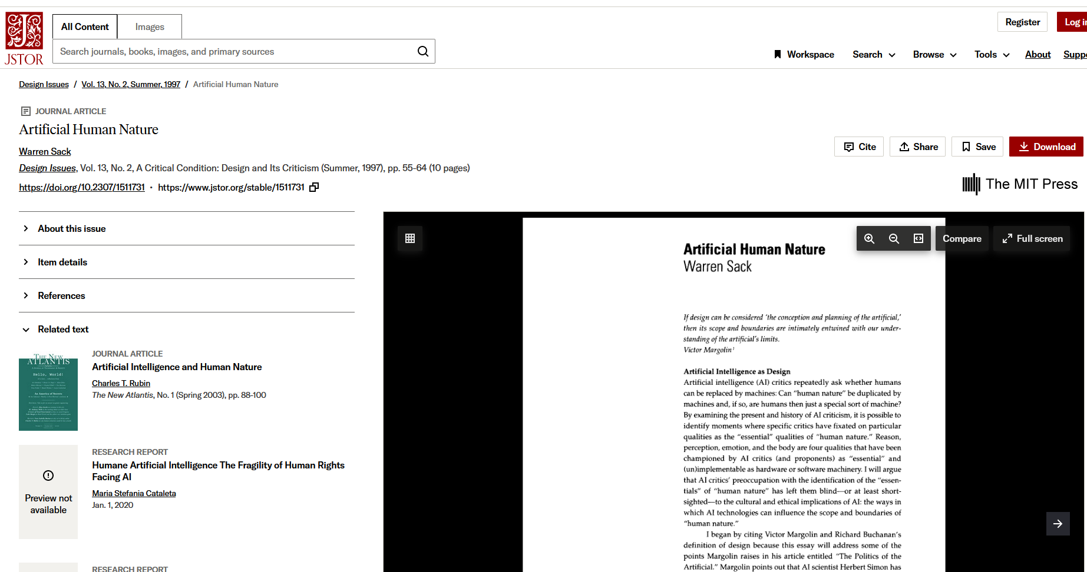

Slide 9
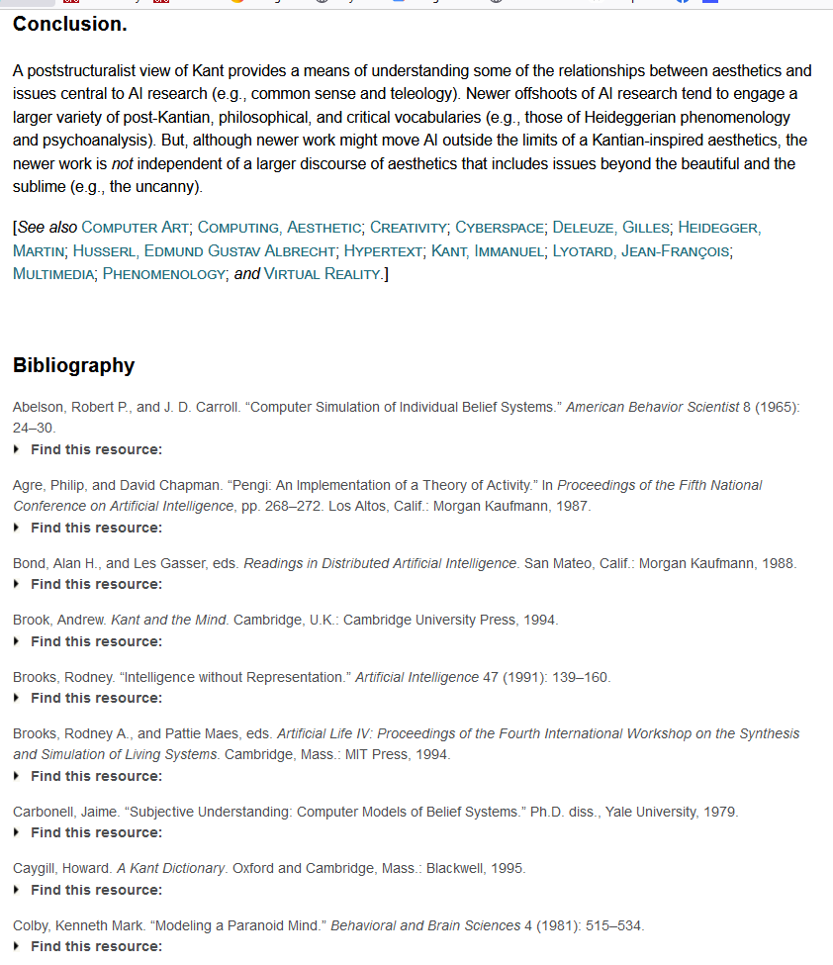

Slide 10
Notes:
exclusive, authoritative research guides across a variety of subject areas. Combining the best features of an annotated bibliography and a high-level encyclopedia, this cutting-edge resource directs researchers to the best available scholarship across a wide variety of subjects.

Slide 11
Notes:
Can pre-select “module” to find key sources in that discipline OR search and then filter by discipline

Slide 12
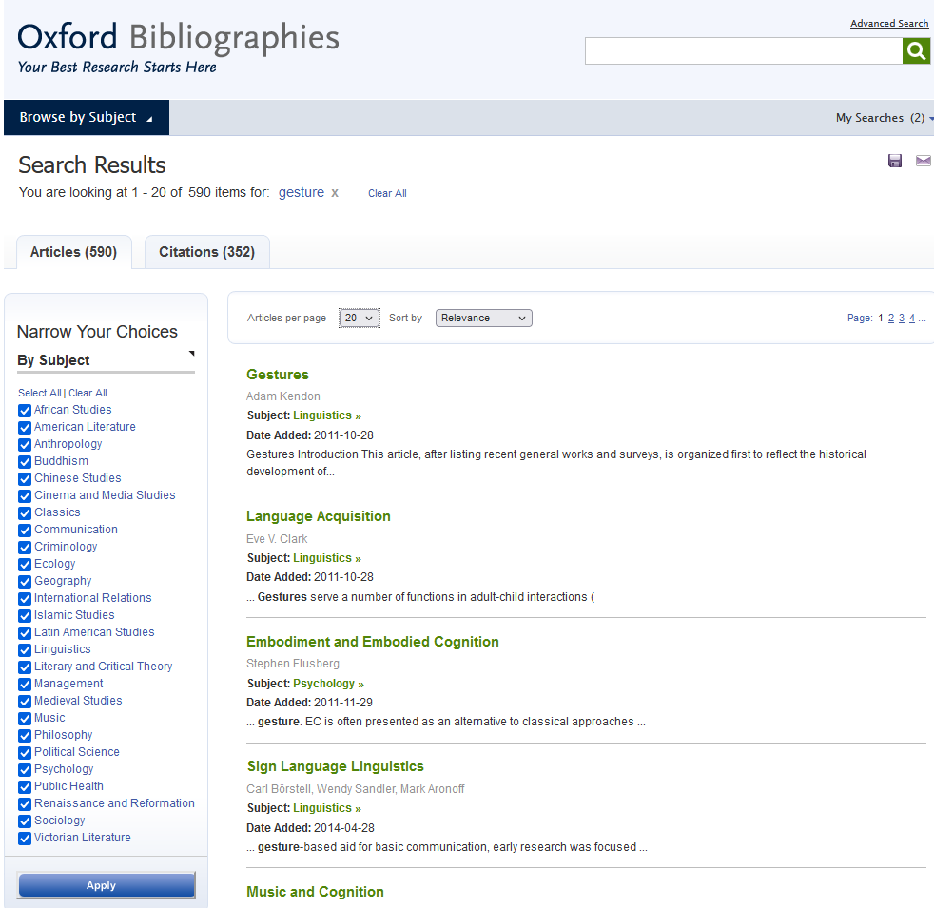
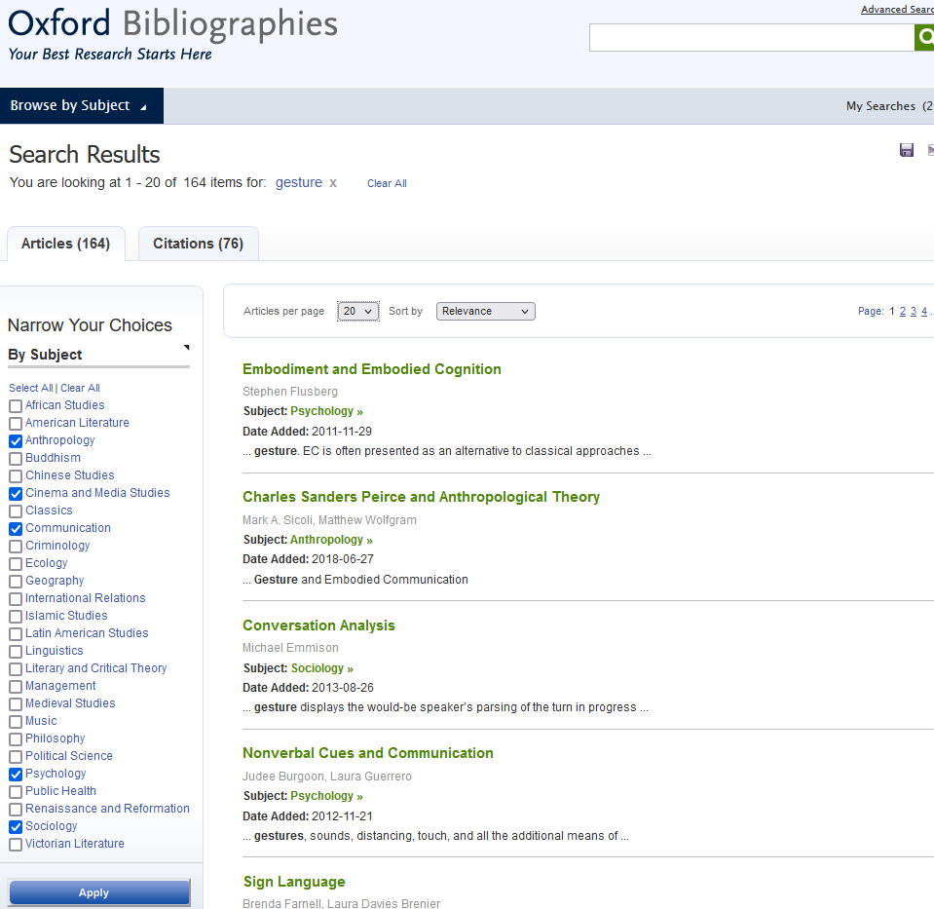

Slide 13
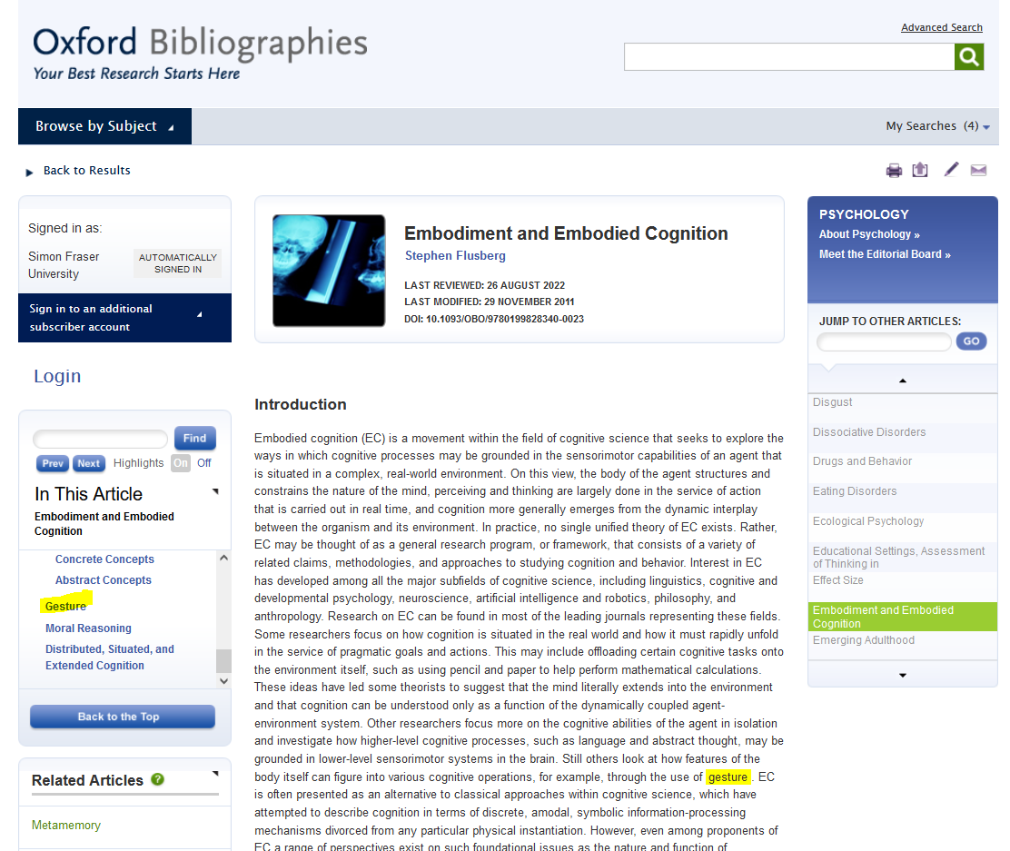
Notes:
AUTHORITY? CURRENCY? COMPREHENSIVENESS?
Welcome to the Framing, Reasoning and MEtaphor (FRaME) Lab, a cognitive science laboratory at Vassar College directed by Dr. Stephen Flusberg.
Long record of publiscations in psychology, metaphorical thinking – searched for gesture in CV and didn’t find

Slide 14
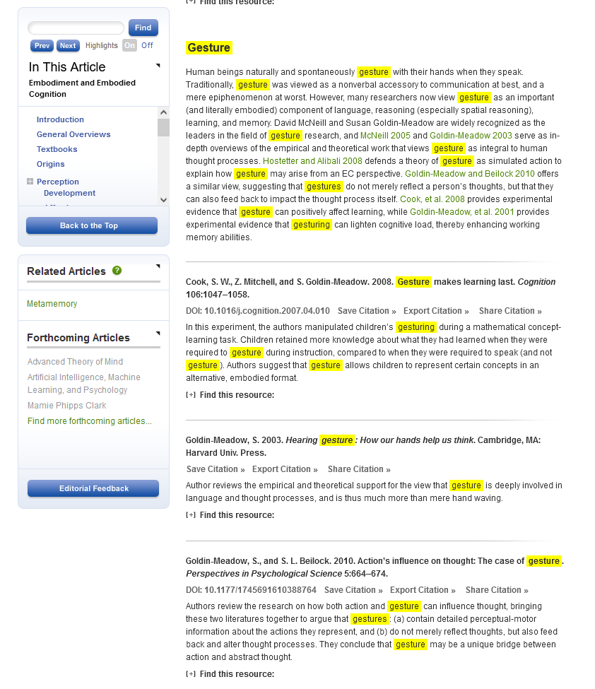
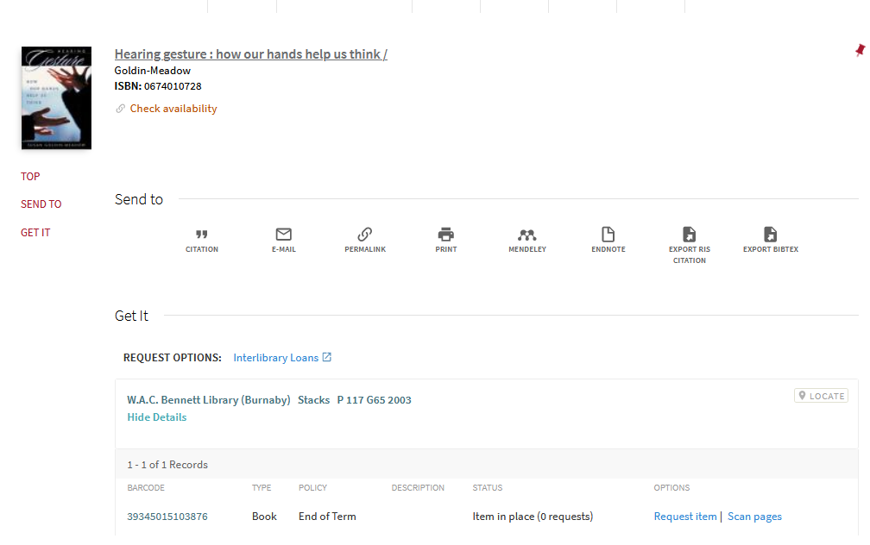

Slide 16
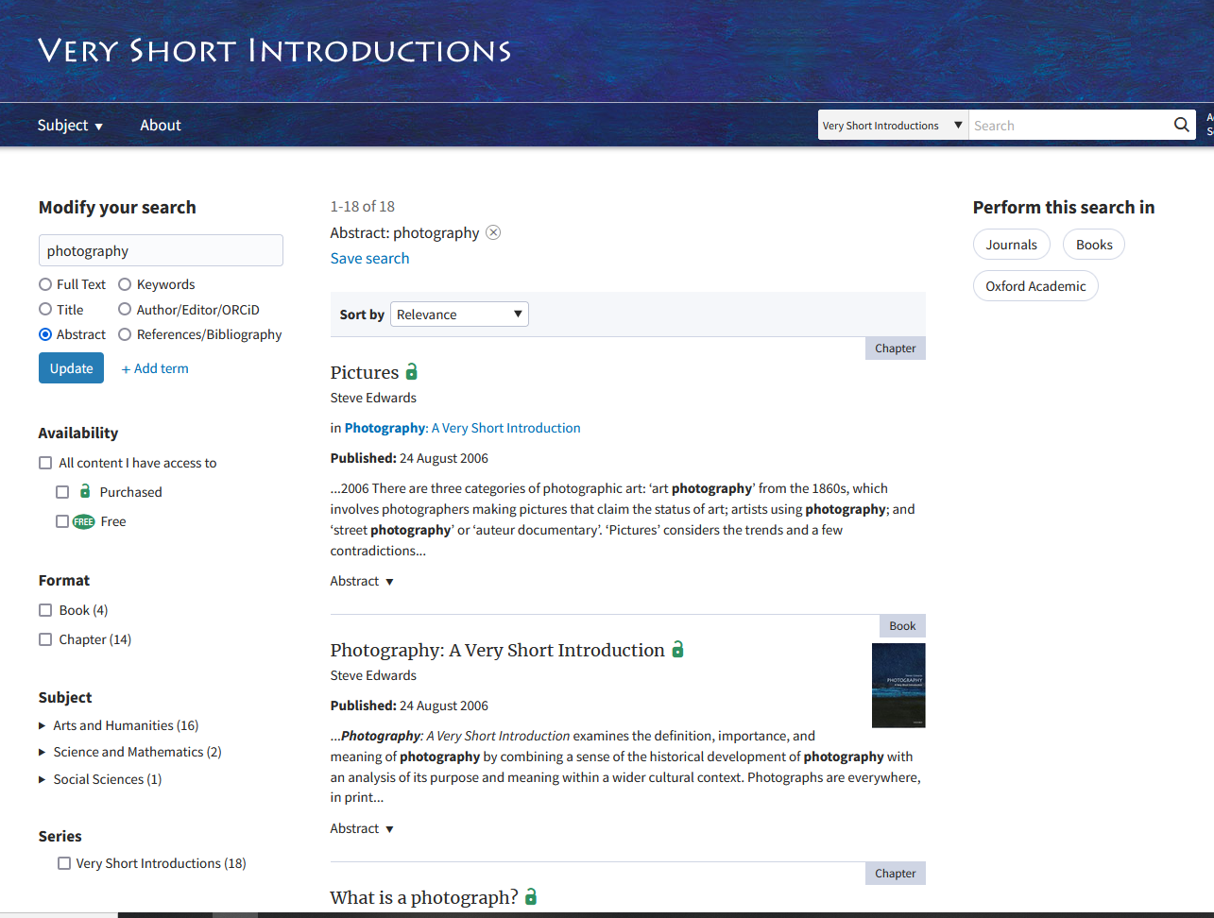

Slide 17
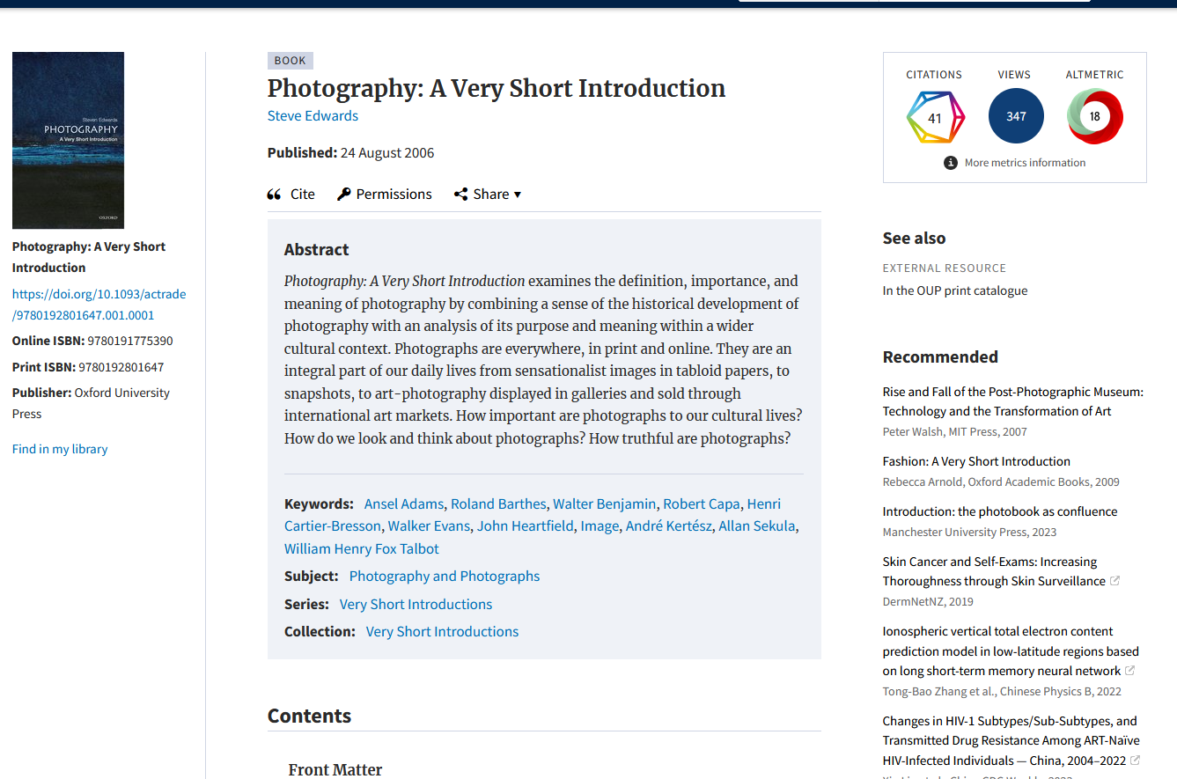

Slide 18
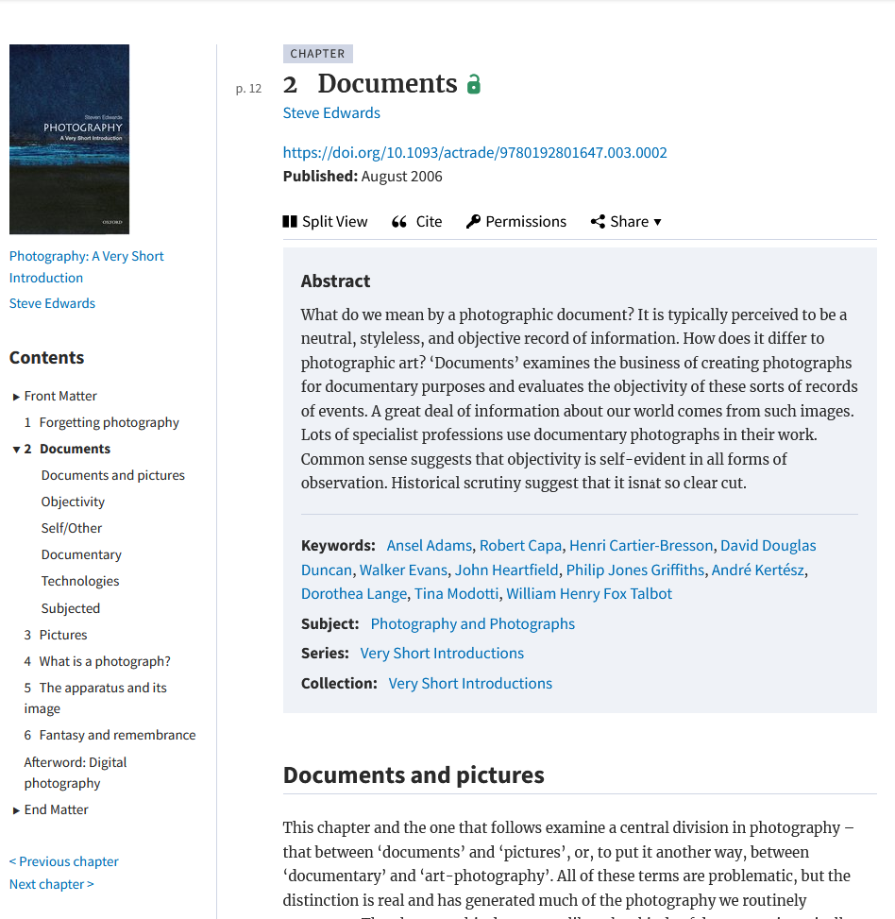
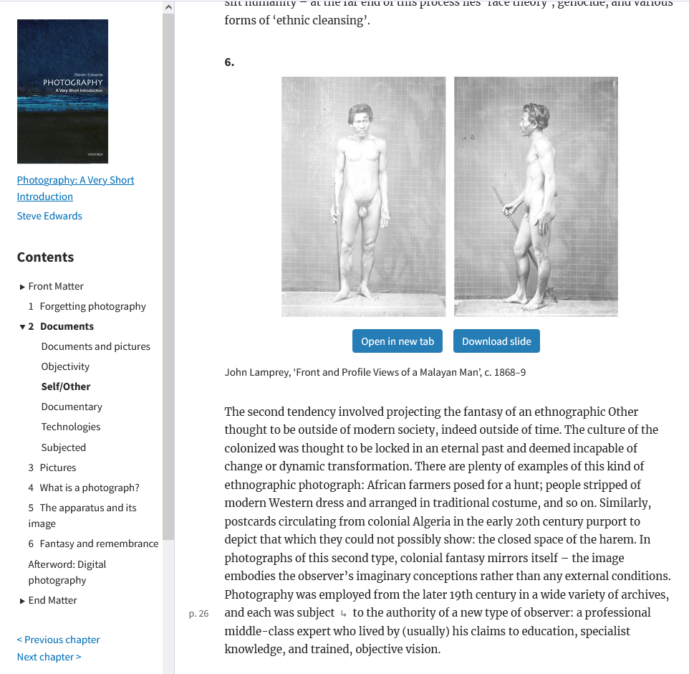

Slide 19
CA 821 research guide

Slide 20
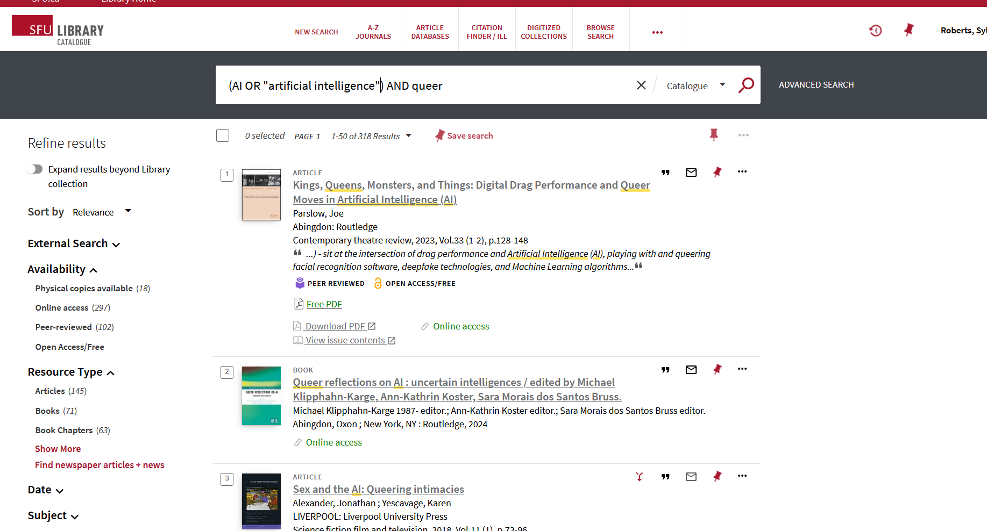

Slide 21
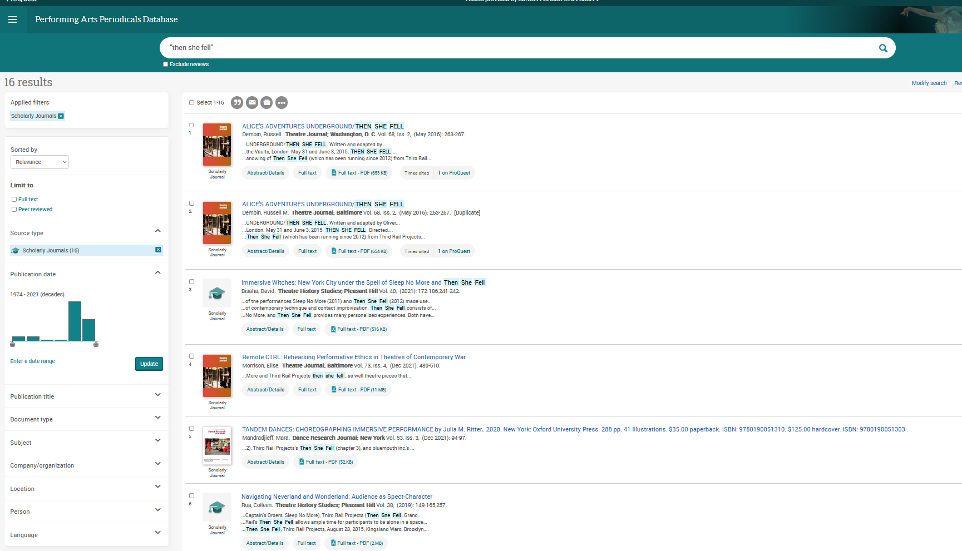

Slide 22
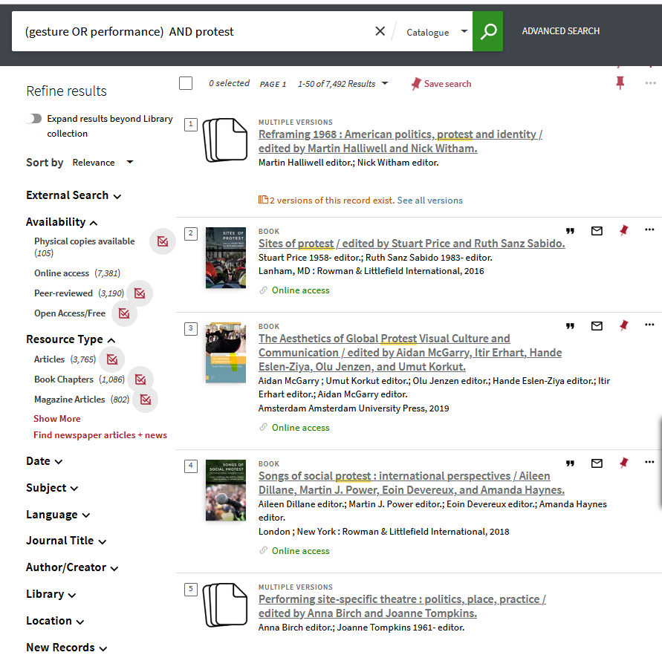
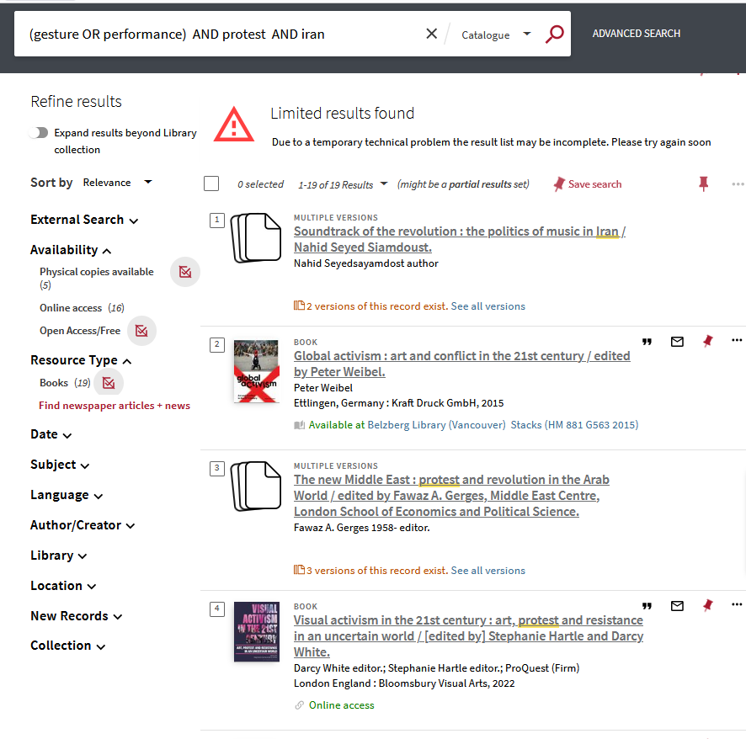

Slide 23
Using what you have (i.e. bird in hand)
How many of you have found a source that seems key to your research?
How can you use it to find related materials?
Notes:
Reference lists – authors, key sources – goes backward in time
Citation lists – who’s cited an article since it’s been published
Quantitative methods such as citation counts, journal metrics and researcher specific metrics (collectively referred to as bibliometrics) provide one means of measuring research impact.
Research impact can also be described qualitatively, in terms of social and cultural influence, through the use of alternative metrics.

Slide 24
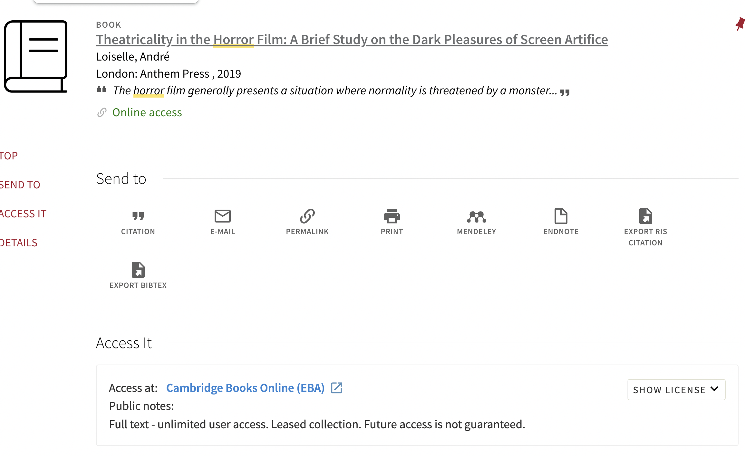
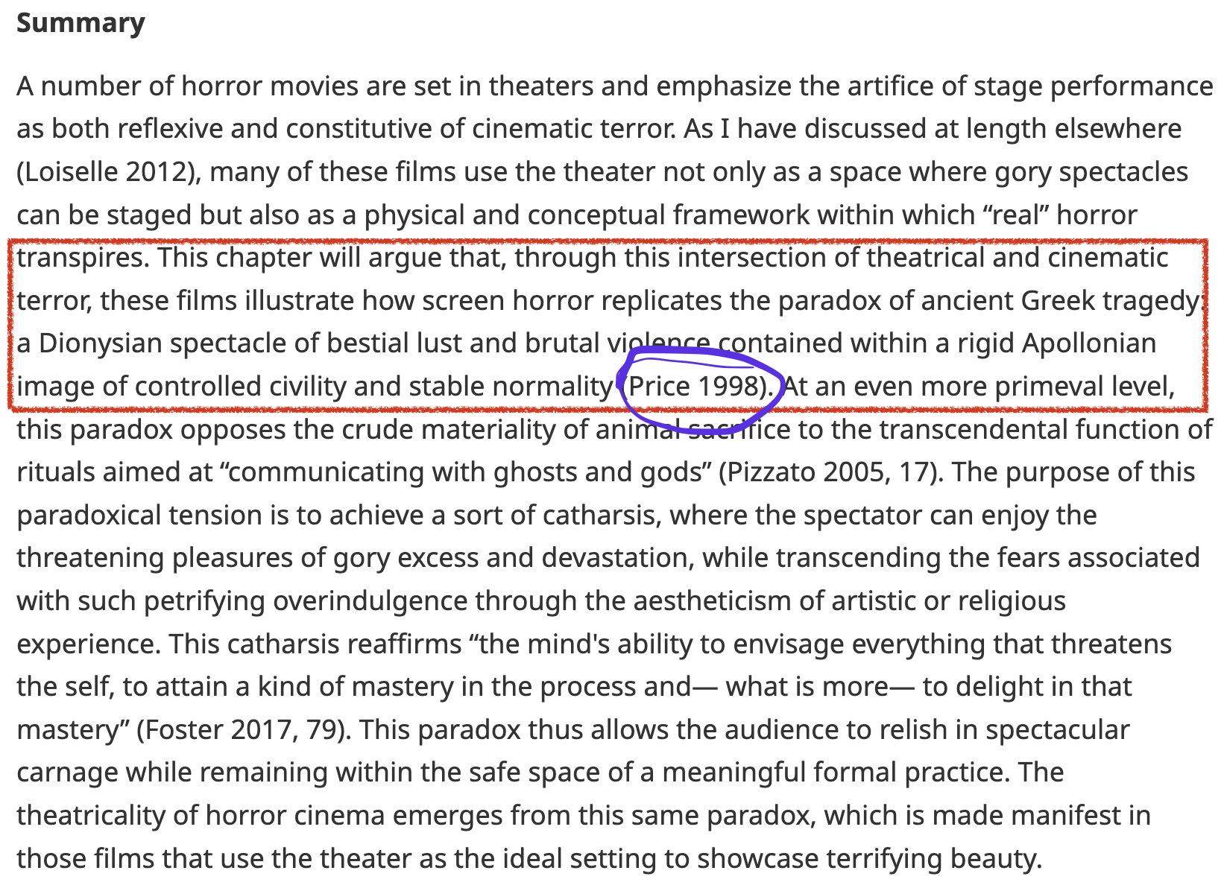
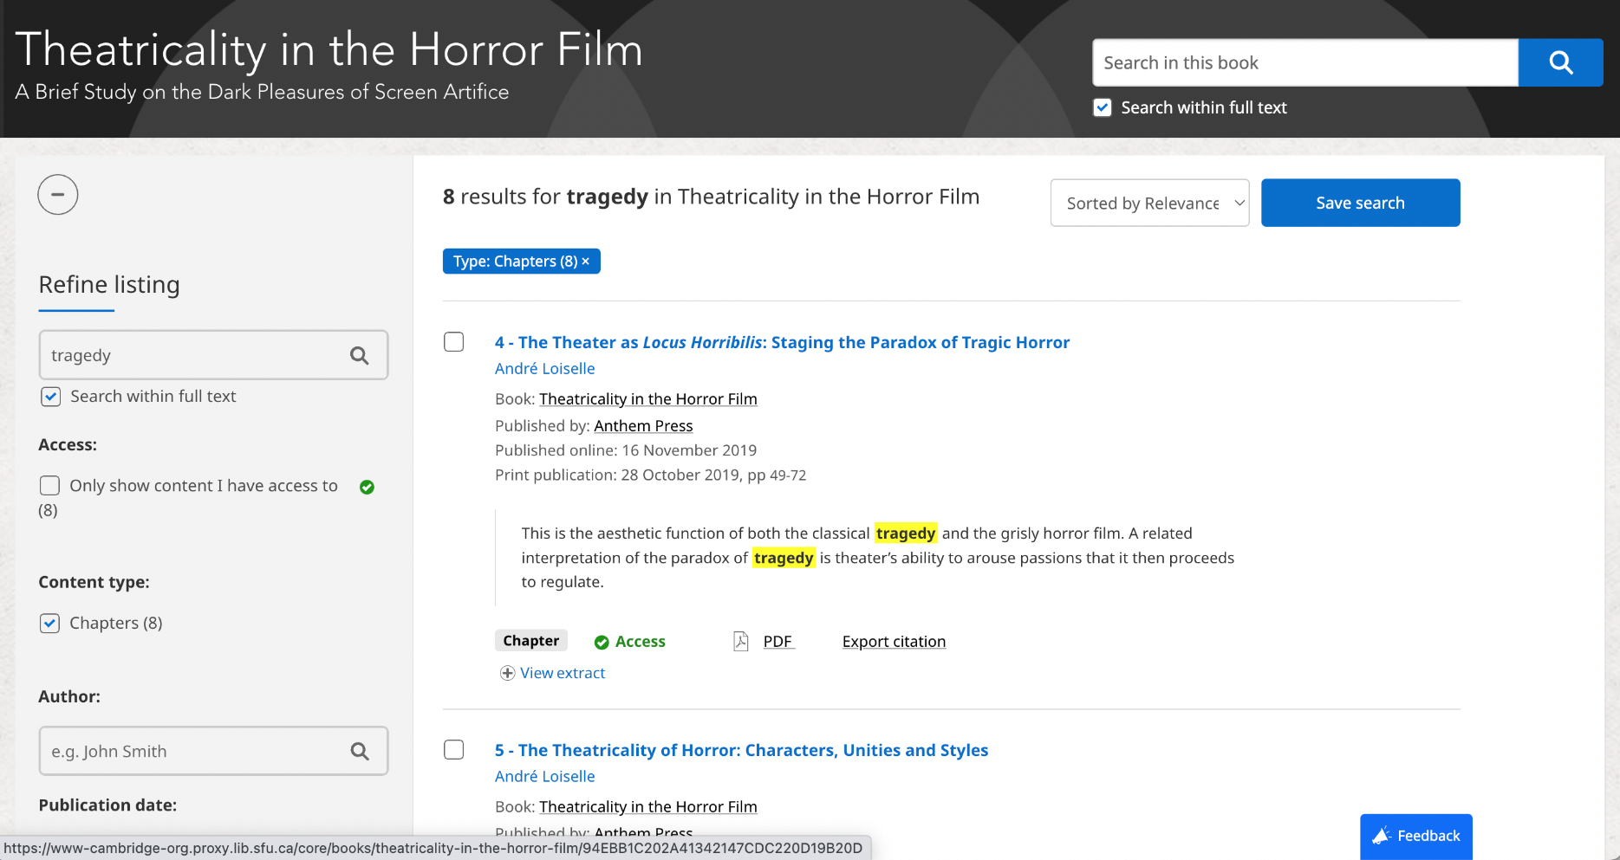

Slide 25
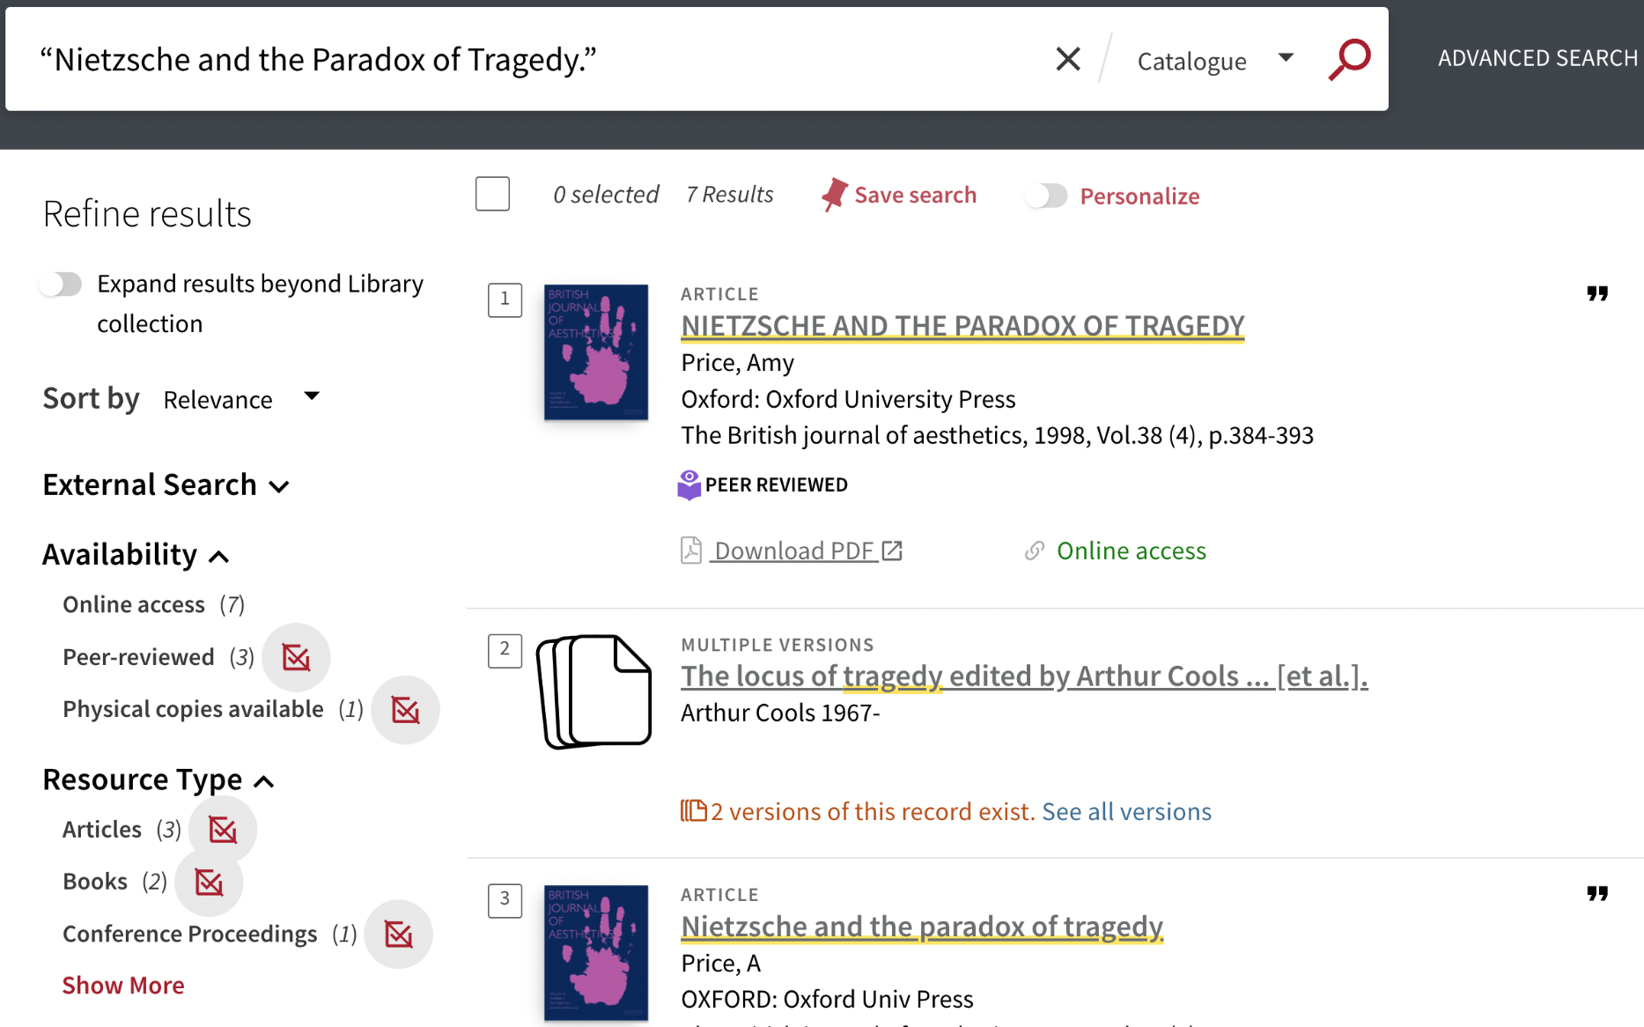

Slide 26
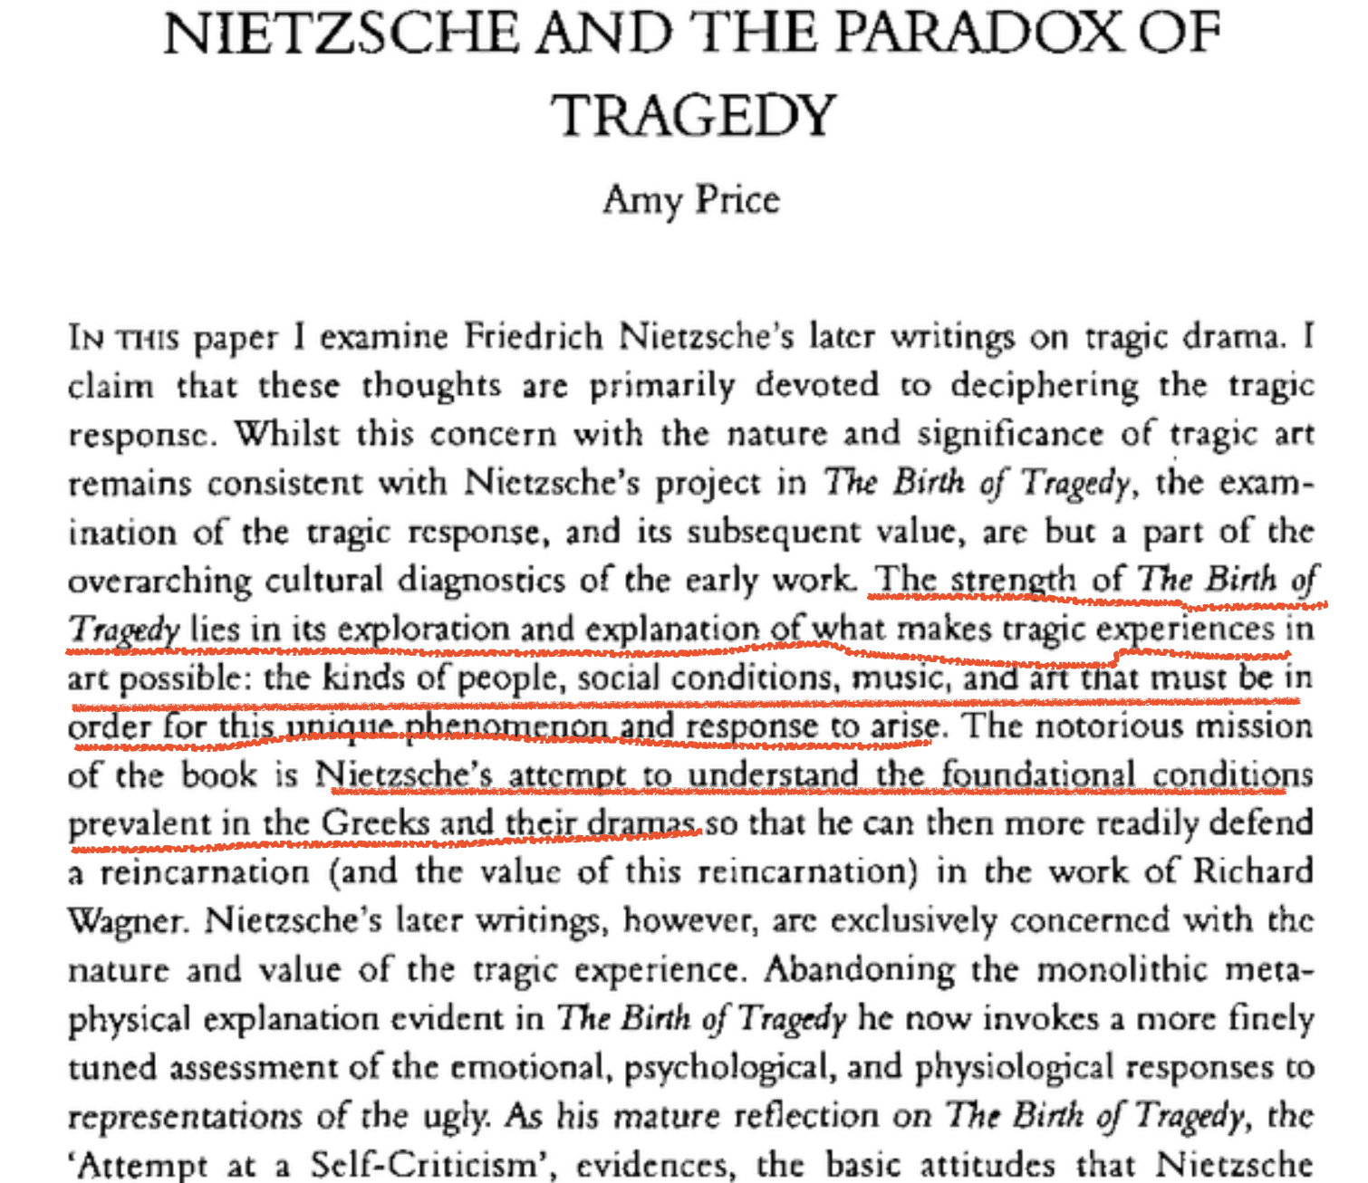

Slide 27
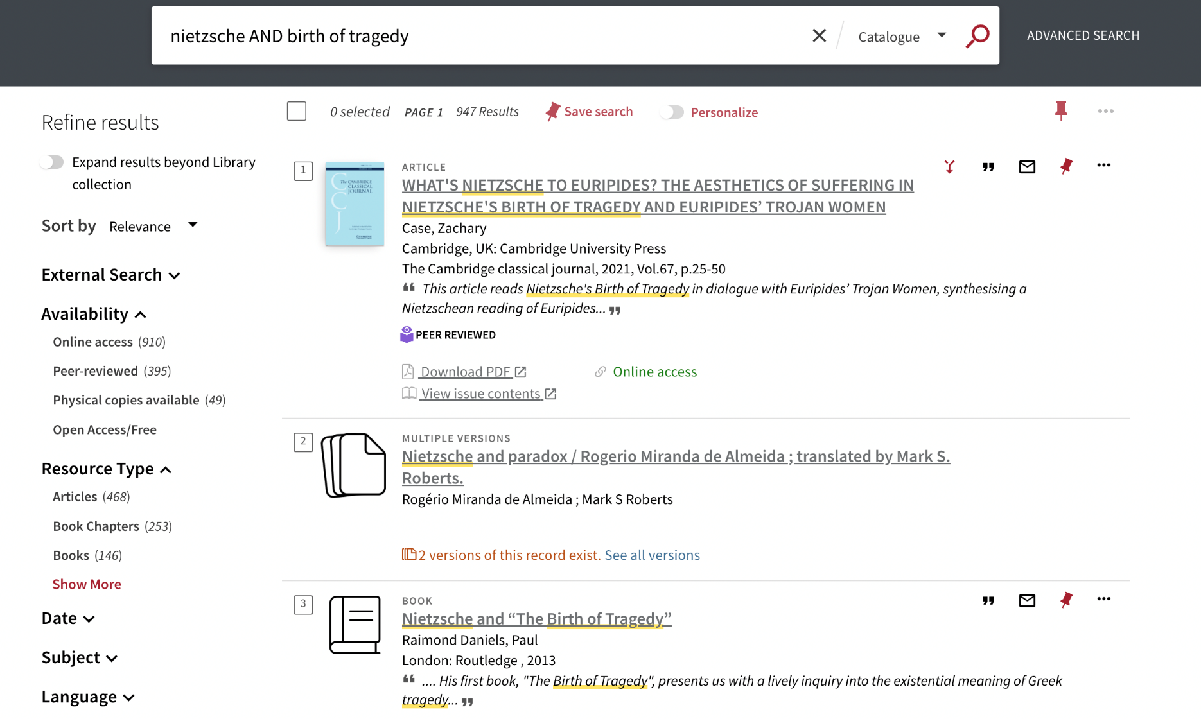
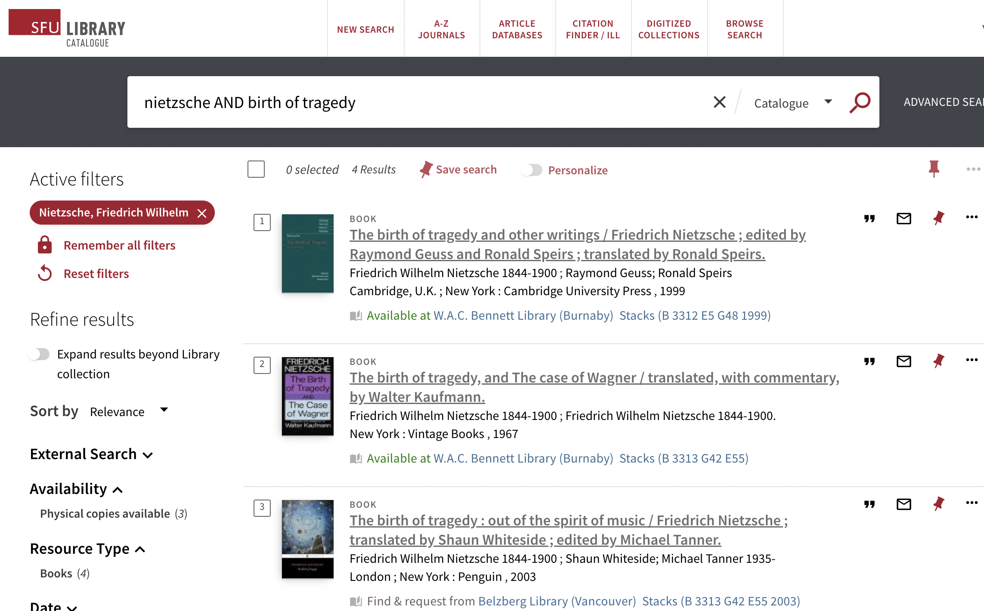
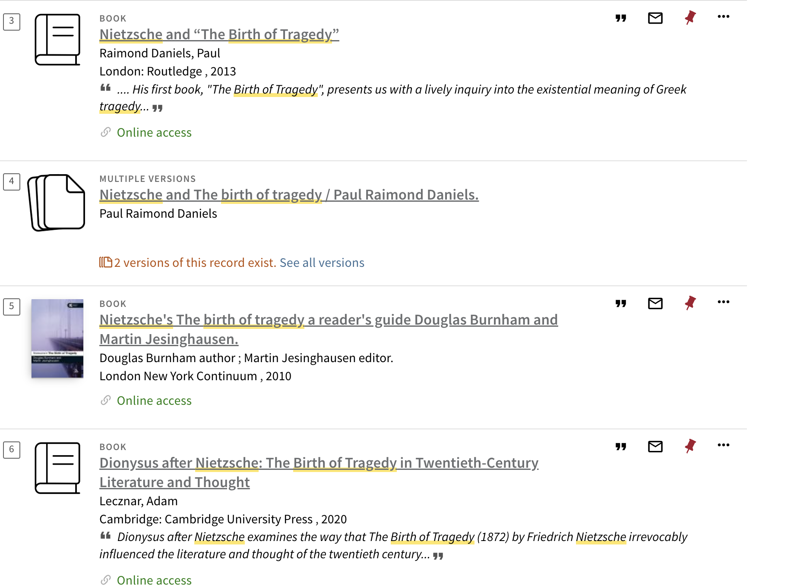

Slide 30
Current research interests
Immersive theatre: "Then She Fell"
Colonial ethnographic photography in Africa
Art versus reportage photography
AI and queer artmaking
Mirror imagery in Iranian cinema
Gesture and performance as protest in Iran
Dance performance: Assembly Hall
Multiculturalism and faith in work of Makoto Fujimura
Notes:
I want more detail about all of these topics ☺ - can apply specifics prior to searching or in response to what you find
Search “immersive theatre” “then she fell” – reviews in academic publications and newspapers – immersive theatre as topic
Search “ethnographic photography AND Africa” – what time period? By who? Which countries / peoples? Can start with a specific example and then spread – other terms “ethnohistory”? “historical anthropology”?
Wikipedia “Visual anthropology is a subfield of social anthropology that is concerned, in part, with the study and production of ethnographic photography, film and, since the mid-1990s, new media.”- Provides a historical overview and sources – OXO “Visual anthropology” has a section specifically covering “visual analysis”, “visual methodologies”, “ethnographic film”, “ethnographic photography” “Edwards, Elizabeth. 2001. Raw histories: Photographs, anthropology and museums. Oxford and New York: Berg.
Edwards is one of the foremost historians of ethnographic photography. This collection of essays contains important studies of Jenness and Haddon, among others, as well as analyses of contemporary photographers who engage with historical materials, such as Finnish photographer Jorma Puranen.” Subject for this book is “Photography in anthropology” – no geographic subdivisions but “history”
Try search in catalogue for “photography AND anthropology AND Africa”
“Empires of the Visual: Photography and Colonial Administration in Africa” in Images and empires : visuality in colonial and postcolonial Africa
Can find overviews of photography like “The public life of photographs” from the Ryerson Image Centre that discusses the role of the photograph in news and art – sometimes the notion of “documentary” photographs is relevant – interested in history of photography in art, as well as in journalism, can consider using terms like “photojournalism”, “photoconceptualism”

Slide 31
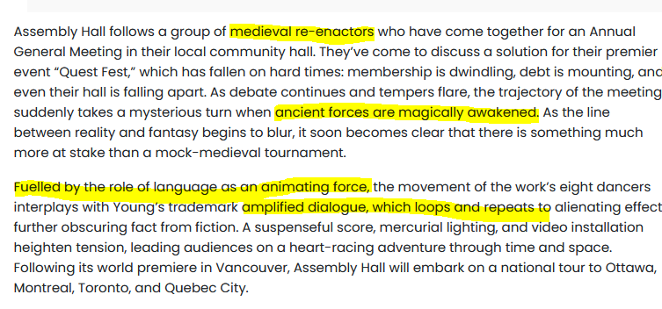

Slide 32
COMMENTS?
QUESTIONS?
THANK YOU!

